Slide 1



感恩遇见，相互成就，本课件资料仅供您个人参考、教学使用，严禁自行在网络传播，违者依知识产权法追究法律责任。
更多教学资源请关注
公众号：溯恩英语
知识产权声明

Slide 2
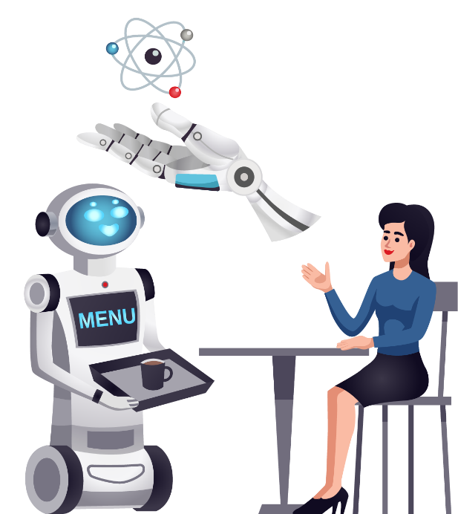

SDL模式下基于教材文本的应用文写作
202510高二强基联盟B卷应用文
投稿——AI的利弊与观点

Slide 3
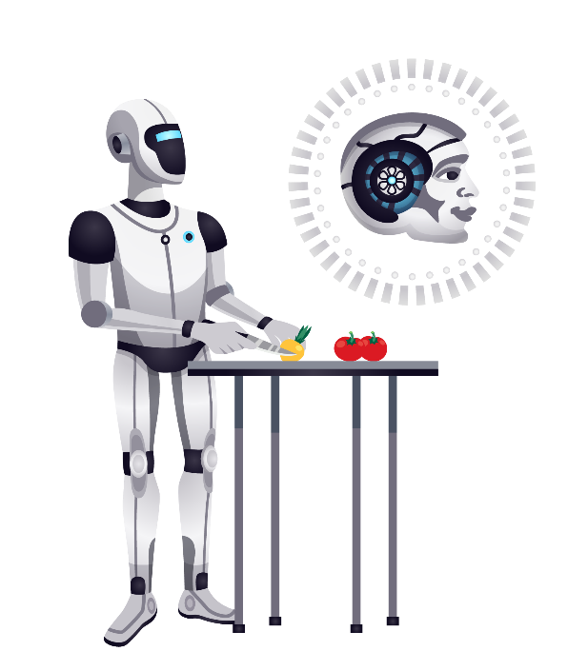

目 录
CONTNETS
1
写作存在的问题
2
SDL模式的运用
3
参考范文和下水作文
4
对接模考与高考

Slide 4
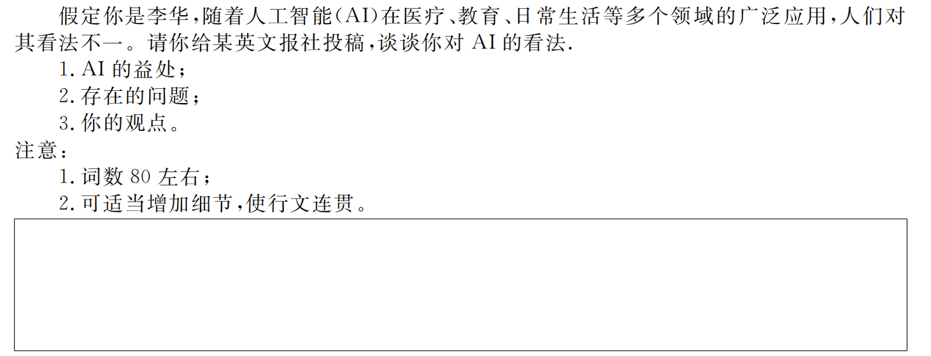

题目呈现

Slide 5
01
考场写作存在的问题

Slide 6

写作存在的问题
体裁错误
要点遗漏
部分考生写成了个人
书信或演讲稿
部分考生未写全要点，遗漏了要点2或要点3
要点比重失衡
卷面潦草
部分考生要点1和要点2比重失衡，重优势轻问题
部分考生书写潦草，卷面字迹难以辨认

Slide 7
02
SDL应用文写作模式的运用

Slide 8
第一步：仔细审题，拟定结构
体裁 | 投稿
人称 | 第一人称，第三人称
时态 | 一般现在时
结构 | Para 1: 投稿背景+投稿目的/AI的巨大影响(background information+writing purpose/the great influence of AI) Para 2:AI的利弊(advantages and disadvantages of AI) Para 3: 个人观点(personal opinion towards AI)

Slide 9
基于SDL模式的应用文写作步骤
SDL应用文写作模式流程图
仔细审题
拟定结构
(Structure)
研读要点
拓展细节(Details)
02
01
巧用策略
升级语料(Language)
结合教材
搭建语料
(Language)
04
03

Slide 10
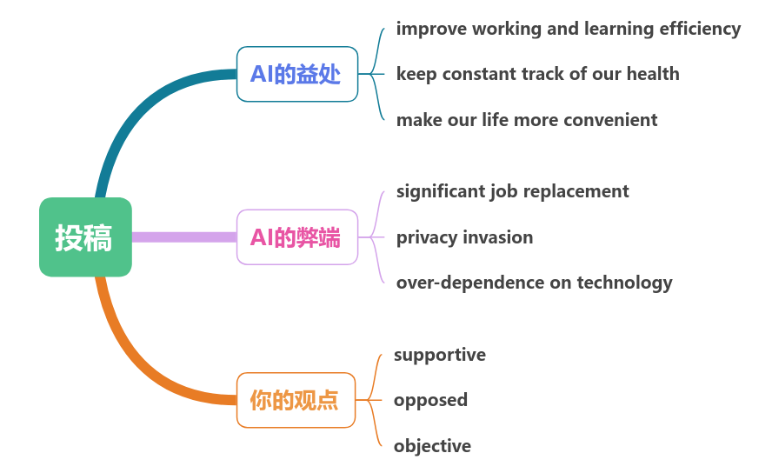

第二步：研读要点，拓展细节
What details can be added to make the passage logical and coherent?

Slide 11
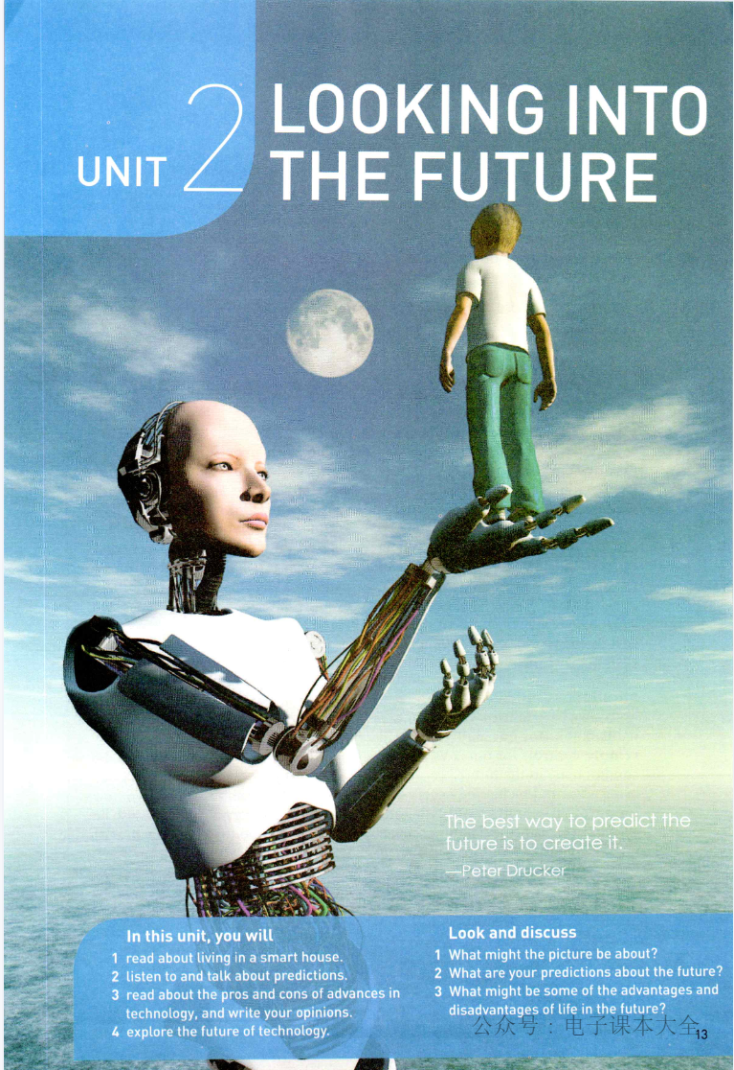

第三步：结合教材，搭建语料
What useful expressions in the textbooks can be applied?
Advantages：
monitor your health regularly
check your body weight
send a warning to your phone
give you suggestions on a healthier diet
keep constant track of your health
warn you early on if there’s something abnormal of if you have critical illness
give people warnings about potential natural disasters
keep in touch with families and friends
make larger networks of friends
provide a more comfortable environment to live in
make your home more enegry-efficient
lead us a living smater lives

Slide 12
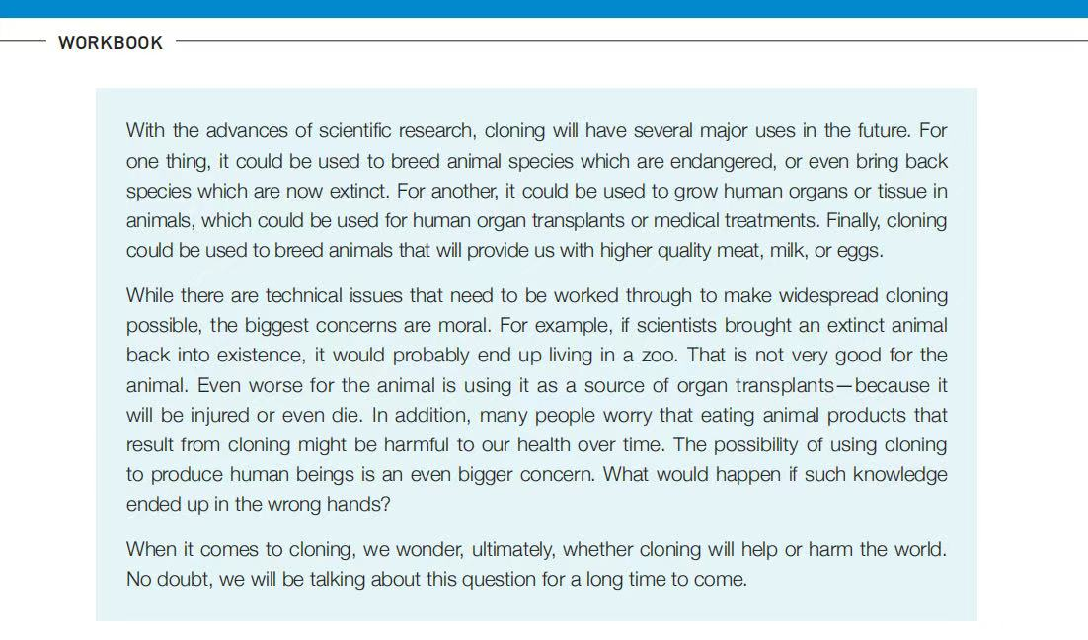

第三步：结合教材，搭建语料
What useful expressions in the textbooks can be applied?
disadvantages:
cause moral concerns
be harmful to our health over time
end up in the wrong hands
高中英语人教版X1U3workbook---reading and writing

Slide 13

第三步：结合教材，搭建语料
What useful expressions in the textbooks can be applied?
personal opinion towards AI
look on the positive side of the change
accept it rahter than resist it
talk about the question for a long time to come

Slide 14
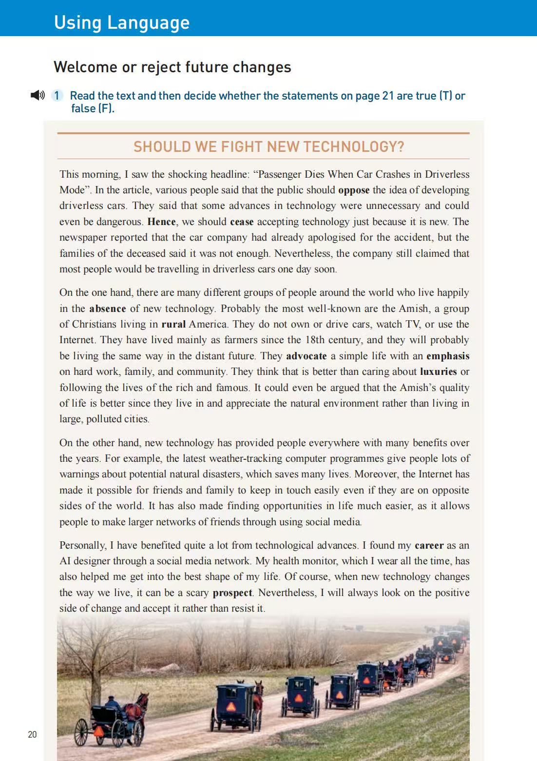
第三步：结合教材，搭建语料
Structure：
para 1：introducing the issue
para 2: disadvantages of technology
para 3: advantages of technology
para 4: personal opinion
Writing skills：
giving examples
making contrast
signposts(listing, contrast, giving example, giving opinion...)
高中英语人教版X1U3 Using language(2)

Slide 15
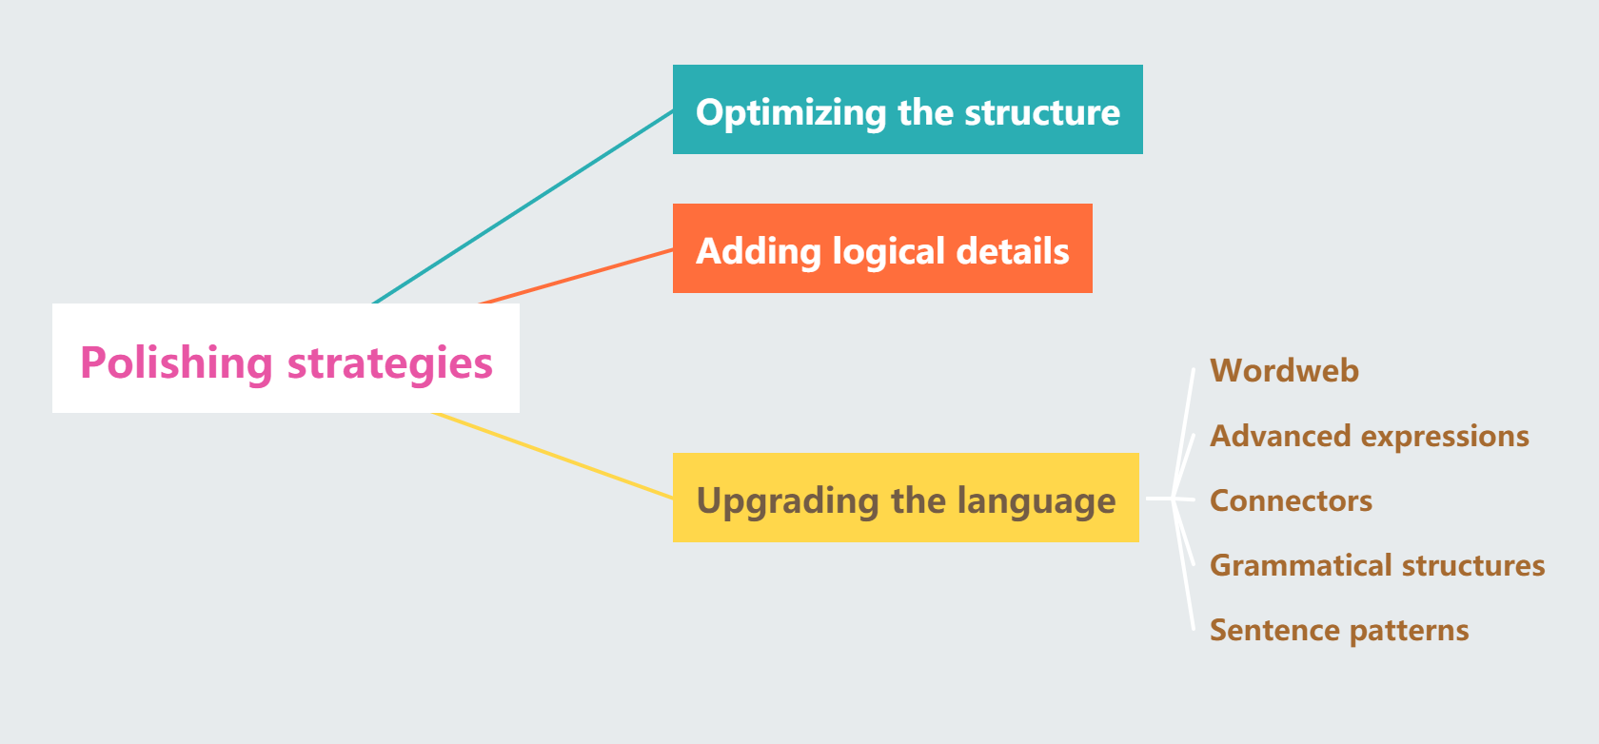
第四步：巧用策略，升级语料

Slide 16
第四步：巧用策略，升级语料
Para 1: AI is important and applied widely in our life. People have different opinions towards it.
策略1：高阶表达+非谓语动词
AI plays a crucial/vital/significant/essential part in daily life and has been applied in various aspects, ranging from education to healthcare. But people hold different opinions towards its wide application.
策略2：There is no denying that...句式
There is no denying that AI has been applied in various aspects of our daily life, including education, communication and healthcare. However, public opinion remain divided regarding its widespread existence.
策略3：定语从句+高阶表达
Artificial intelligence, which has been widely integrated in various fields of our daily life, has sparked heated discussion. People’s opnions towards it vary from person to person.

Slide 17
第四步：巧用策略，升级语料
Para 2: AI can answer students’ questions instantly and helps them learn better.
策略1：高阶表达+非谓语动词+语篇衔接词
When it comes to education, AI can give tailored feedback on students’ learning, which can effectively enhance their learning efficiency.
策略2：倒装句+高阶表达+非谓语动词
Not only does AI transform the way of learning by adapting to each student’s learning pace and style, but it can also give real-time answers to students’ questions, thus enhancing their learning efficiency.

Slide 18
第四步：巧用策略，升级语料
Para 2: In healthcare, AI can help doctors detect diseases and get immediate treatments.
策略1：高阶表达+非谓语动词
In healthcare, AI can help doctors detect potential diseases early on and give personalized diagnoses and treatment, thus saving more lives.
策略2：高阶表达+定语从句
AI-powered devices can keep constant track of people’s health and send a warning if it detects any potential illness, which makes great contributions to people’s well-being.

Slide 19
第四步：巧用策略，升级语料
Para 2: But AI may lead to some problems.
策略1：倒装句
Intelligent and convenient as AI is, it may bring about some potential problems/its problems can not be overlooked.
策略2：非谓语动词+定语从句
Despite the enormous benefits mentioned above, there’re still some concerns which we need to think about.
策略3：谚语+语篇衔接词
However, just as an old saying goes, “Every coin has two sides.” AI is not an exception. It has both advantages and disadvantages.

Slide 20
第四步：巧用策略，升级语料
Para 2: For examle, some people may lose their jobs due to the rapid development of AI. And people’s personal information may be leaked.
策略1：表语从句+非谓语动词+语篇衔接词
One major concern is that AI may replace human labor in the fields such as manufacturing(制造业), transportation and customer service, leading to job losses and social unstability. Moreover, another concern is privacy issue, as AI can collect large amounts of personal information from users.
策略2：宾语从句+非谓语动词+it作形式宾语+语篇衔接词
Many people are concerned that AI may replace their jobs in the future, thus making it hard for them to make a living. Additionally, privacy concern is another big issue, since personal information is likely to be leaked.

Slide 21
第四步：巧用策略，升级语料
Para 2: Some people may depend on AI too much and lose their own abilities.
策略1：定语从句+高阶表达
Some people may over-depend on AI in daily life such as writing essays and solving math problems, which may hinder their independent learning ability in the long term.
策略2：主语从句+表语从句+非谓语动词
What makes people concerned is that some people may over-rely on AI to accomplish daily tasks such as writing essays or working out math problems, thus grealty reducing their creativity and critical-thinking ability.

Slide 22
第四步：巧用策略，升级语料
Para 3: In my opinion, we should be cautious when we use AI in our life.
策略1：语篇衔接词+非谓语动词+倒装句
From my perspective, we, as a cosiety, should establishe relevant regulations and create a harmonious social environment for its application. Only in this way can we embrace the convenience brought by AI.
策略2：虚拟语气+省略句
As for me, while AI offers tremendous value, it is advocated that we should take a cautious attitude towards its wide application. When used thoughtfully, AI can be a powerful tool for us, not the other way aroud.

Slide 23
03
下水作文和范文
点击输入简要文字内容，文字内容需概括精炼，不用多余的文字修饰，言简意赅的说明分项内容。

Slide 24
教师下水作文
AI plays a crucial/vital/significant/essential part in daily life and has been applied in various aspects, ranging from education to healthcare. But people’s opinions towards it vary from person to person.
On the one hand, AI can bring great convenience to our life. When it comes to education, AI can give tailored feedback on students’ learning, which can effectively enhance their learning efficiency. In healthcare, AI-powered devices can keep constant track of people’s health and send a warning if it detects any potential illness, which makes great contributions to people’s well-being. Intelligent and convenient as AI is, its problems can not be overlooked. One major concern is that AI may replace human labor in the fields such as manufacturing(制造业), transportation and customer service, leading to job losses and social unstability. Moreover, another concern is privacy issue, as AI can collect large amounts of personal information from users.
As for me, while AI offers tremendous value, it is advocated that we should take a cautious attitude towards its wide application. When used thoughtfully, AI can be a powerful tool for us, not the other way aroud.

Slide 25
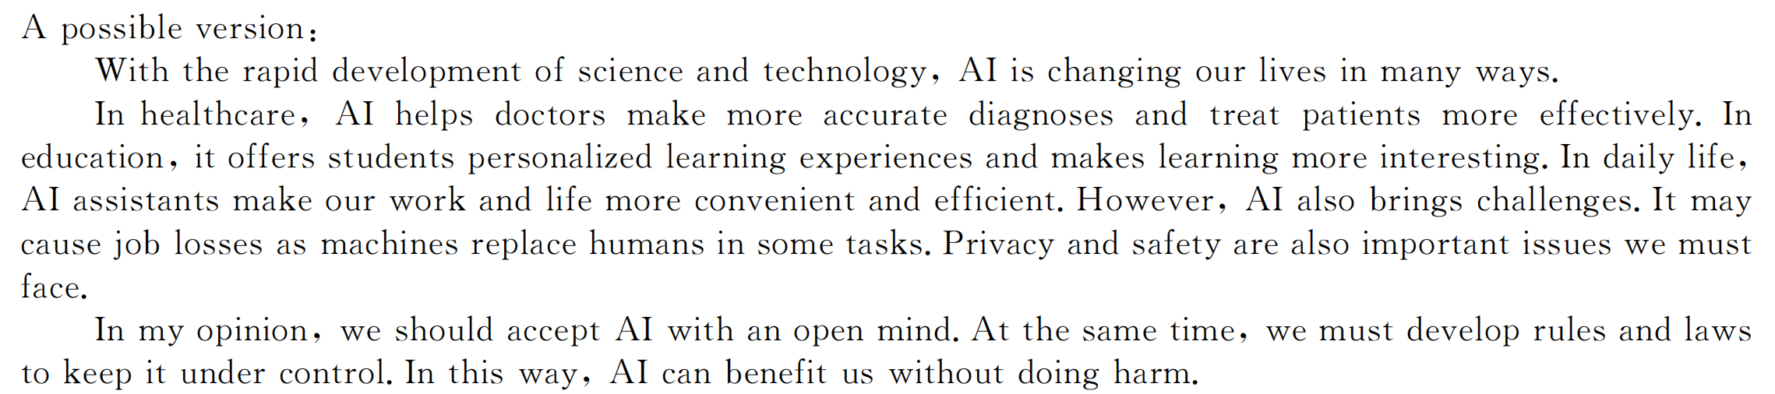
参考范文

Slide 26
04
对接模考与高考

Slide 27
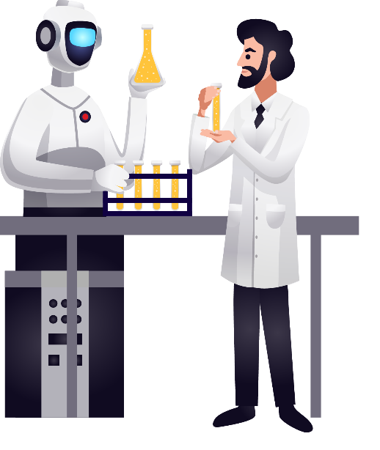
科技类话题模考与高考
2025.1浙江首考
用手机在校园里拍摄短视频
2024.11宁波一模
生活中具有重大影响的科技产品
2025.5 Z20联盟考试
学校的智慧课堂
2025.4绍兴二模
技术与个性化学习

Slide 28
2025.1浙江首考
你将参加英语课上的“一分钟演讲”活动。请你针对部分同学在校园内用手机拍摄短视频的现象写一篇演讲稿，内容包括：（1）陈述看法；（2）提出建议
注意：
（1）写作词数应为80左右；
（2）请按如下格式在答题纸的相应位置作答
My Views on Filming Short Videos on Campus
Good morning!Today,I'd like to share my views on the trend of filming short videos on our campus.
Admittedly, it is a fantastic way to unleash students’ creativity, and capture memorable moments,creating a digital archive of memories. Nevertheless, it is not without issues, including distraction for the students involved and those around, impacting their studies and potential violation of privacy without explicit consent.
To address the concern,I propose we film videos more responsibly-be mindful of when, and what we film, respecting privacy, and set specific times for video creations to avoid interference with with our academic responsibilities.When used thoughtfully and responsibly,I believe, filming short videos can be a powerful tool for education, creativity, and personal growth!Thank you!

Slide 29
学校英语俱乐部将组织关于“生活中具有重大影响的科技产品”的讨论，请你作为代表发言，内容包括：
1. 介绍一项产品及其影响
2. 对该产品的展望
注意：
（1）写作词数应为80左右；
（2）请按如下格式在答题纸的相应位置作答
2024.11宁波市一模
学校英语俱乐部将组织关于“生活中具有重大影响的科技产品”的讨论，请你作为代表发言，内容包括：
1. 介绍一项产品及其影响
2. 对该产品的展望
注意：
（1）写作词数应为80左右；
（2）请按如下格式在答题纸的相应位置作答
Good morning, everyone.
It is my honor to give a speech on behalf of the English Club. Today, I would like to discuss a technological product that has profoundly reshaped our daily lives—the smartphone.
Designed in various types and colors, smartphones have not only revolutionized communication, making it instant and convenient, but also transformed how we access information, shop, and entertain ourselves. With a single device, endless information is at our fingertips, allowing us to connect anytime and anywhere.
Looking to the future, it is anticipated that smartphones, equipped with advanced AI, will continue to evolve, becoming smarter and even more personalized. Their capabilities expanding as technology advances, smartphones will enhance productivity and transform learning and health management.
Thanks for your listening!

