Slide 1



感恩遇见，相互成就，本课件资料仅供您个人参考、教学使用，严禁自行在网络传播，违者依知识产权法追究法律责任。
更多教学资源请关注
公众号：溯恩英语
知识产权声明

Slide 2


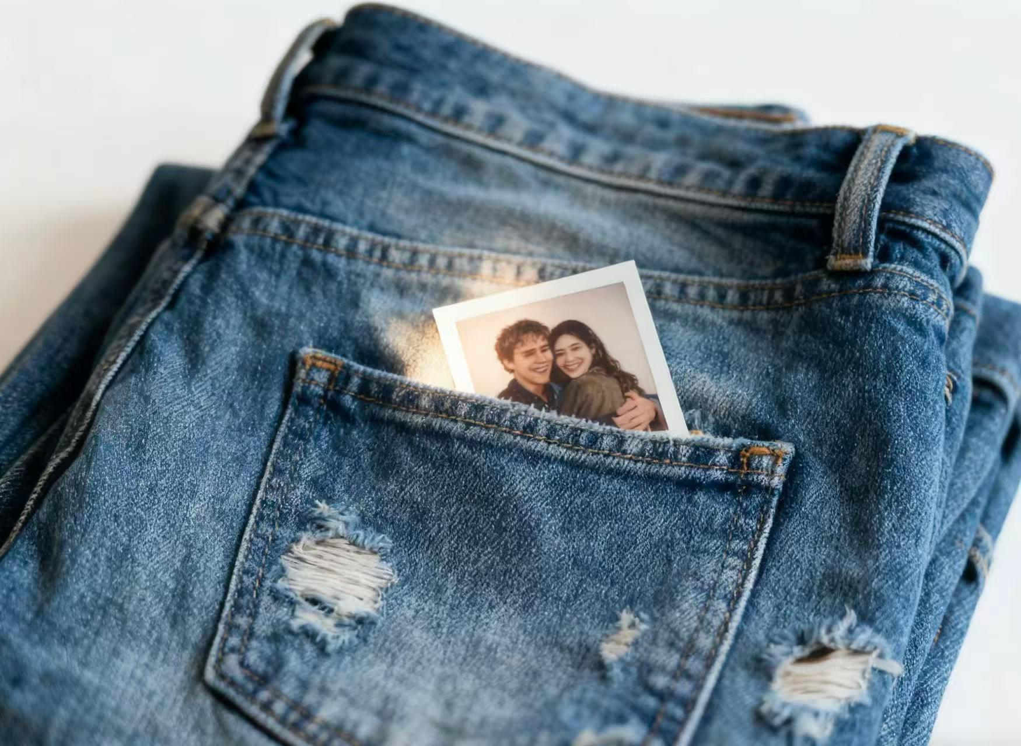

Enjoy!
Photograph
Loving can hurt. Loving can hurt sometimes
But it’s the only thing that I know
When it gets hard. You know it can get hard sometimes
It is the only thing that makes us feel alive
We keep this love in a photograph
We made these memories for ourselves
Where our eyes are never closing
Our hearts were never broken
And time’s forever frozen still
So you can keep me
Inside the pocket of your ripped (rip) jeans
Holding me close until our eyes meet
You won't ever be alone
Wait for me to come home
v

Slide 3

Non-finite Verbs
非谓语动词
姜苏娜

Slide 4


一、非谓语动词作主语(S)
1. Doing/To do + V + 其他
【区别】doing作主语：表示________、________、_______的动作；
to do作主语：表示_______、________或_______的动作。
抽象的
习惯性
经常性
具体的
一次性的
未发生
e.g. ___________(swim) is my favourite sport.
e.g. ___________(eat) by those strong animals is a natural thing.
e.g. _________(finish) this report today is my main task.
Swimming
Being eaten
To finish

Slide 5
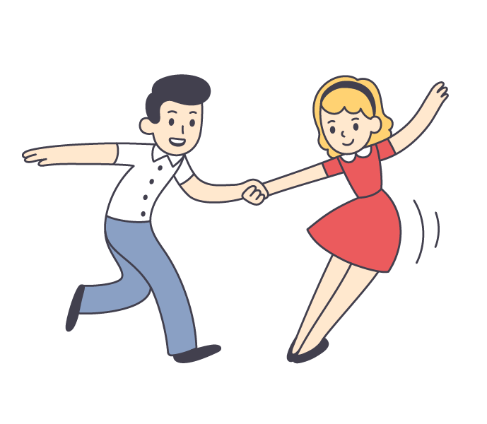
一、非谓语动词作主语(S)
2. It is/was adj. (for/of sb.) to do sth. 做某事是......的
e.g. It is easy for me _________(learn) how to dance.
e.g. It is impolite ____ him to say so.
to learn
of
3. It is no use/no good/useless/a waste of time doing sth.
e.g. It is no use ________(cry) over the spilt milk.
e.g. It’s a waste of time _______(argue) with him.
crying
arguing

Slide 6


二、非谓语动词作表语(P)
1. doing/to do作表语
【区别】doing作表语：表示________、________、_______的动作；
to do作表语：表示_______、________或_______的动作。
抽象的
习惯性
经常性
具体的
一次性的
未发生
e.g. My job is ________(teach) English.
e.g. His job this time is ________(clean) the windows.
teaching
to clean
2. 分词作表语
令人......的
感到......的
现在分词作表语: ___________ 过去分词作表语: ___________
e.g. It is ________(shock) that he cares little about his mother.
shocking
e.g. I felt __________(depress).
depressed

Slide 7
二、非谓语动词作表语(P)
1. doing/to do作表语
【区别】doing作表语：表示________、________、_______的动作；
to do作表语：表示_______、________或_______的动作。
抽象的
习惯性
经常性
具体的
一次性的
未发生
e.g. My job is ________(teach) English.
e.g. His job this time is ________(clean) the windows.
teaching
to clean
2. 分词作表语
令人......的
感到......的
现在分词作表语: ___________ 过去分词作表语: ___________
e.g. It is ________(shock) that he cares little about his mother.
shocking
e.g. I felt __________(depress).
depressed

Slide 8

三、非谓语动词作宾语(O)
advise, avoid, mind, consider, delay, postpone, (can’t) resist, practice, finish, imagine, feel like,
1. 接______作宾语的动词(短语)：__________________________________________
doing
e.g. She avoids _______(eat) junk food to stay healthy.
e.g. He couldn’t imagine _______(live) without his phone.
eating
living
2. 接_____作宾语的动词：______________________________________________
to do
afford, agree, decide, determine, choose, expect, hope
e.g. We can’t afford ______(go) on vacation this year.
e.g. I expected ________(visit) her.
to go
to visit
to do
remember, forget, regret, stop, go on, mean
3. 既可接______又可接______作宾语的动词（短语）：________________________
doing
e.g. He regrets not _______(study) harder in school.
e.g. We regret _______(inform) you that your application has been rejected.
studying
to inform

Slide 9
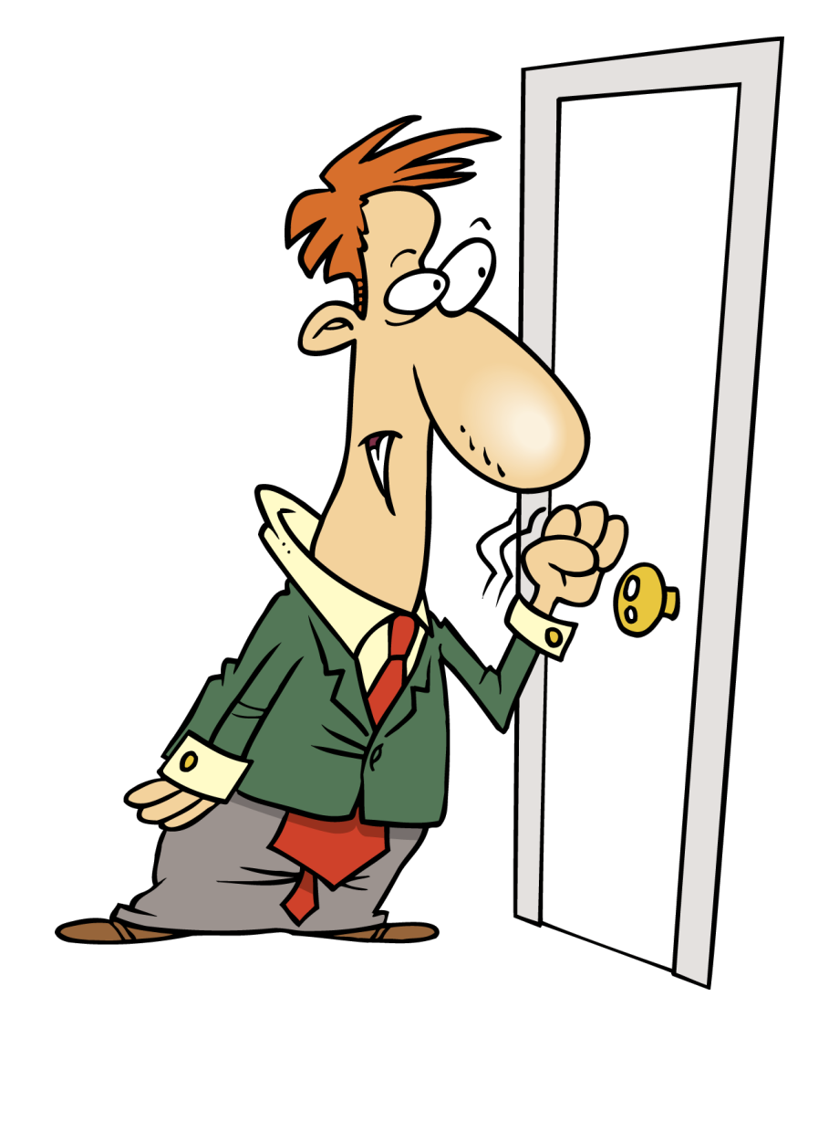
四、非谓语动词作宾语补足语(OC)
1. 接to do作宾补的动词（短语）：__________________________________________________________
advise, allow, ask, beg, encourage, expect, tell, call on, depend on
e.g. I begged her not __________(leave) .
to leave
e.g. He encouraged me __________(work) harder.
to work
2. 感官动词＋宾语＋宾补（______, ______, ______）
do doing done
see, watch, observe, notice, hear, listen to, feel
e.g. They noticed the boy _____(run) out of the room.
e.g. Listen! Do you hear someone ________(knock) at the door?
e.g. He was happy to see his mother ______(take) good care of at home.
run
knocking
taken

Slide 10
四、非谓语动词作宾语补足语(OC)
3. 使役动词＋宾语＋宾补（______, ______）
do done
have, make, let, get
e.g. Please have him _____(call) me back.
e.g. She finally got her computer ________(repair).
e.g. She got me _______(wash) the dishes.
call
repaired
to wash
特殊：get sb. to do sth. 让某人做某事
4. 发现类动词/leave/keep＋宾语＋宾补（______, ______）
doing done
find, catch
e.g. The teacher caught two students ________(cheat) in the final exam.
e.g. I found the window ______(break).
cheating
broken

Slide 11

四、非谓语动词作宾语补足语(OC)
5. with的复合结构
with+宾语+宾补（______, ______, ______）
doing done to do
e.g. The park looks lively with children _______(run) and _______(laugh).
e.g. With the problem ______(solve), everyone felt a sense of relief.
e.g. With so much work ________(finish), I can’t go out with you tonight.
running
laughing
solved
to finish

Slide 12
五、非谓语动词作定语(Attr.)
1. 现在分词作定语：表示_________。其中doing表示______,being done表示_______。
2. 过去分词作定语：表示______________。
3. 不定式作定语：表示______。其中______表示主动，__________表示被动。
正在进行
主动
被动
已完成和被动
将来
to do
to be done
e.g. The girl ________(stand) there is my sister. 正站在那的女孩是我姐姐。
e.g. The problem __________________(discuss) at the meeting is important.
会上正在讨论的这个问题很重要。
standing
being discussed
e.g. The problem __________________(discuss) at the meeting is important.
会上讨论过的这个问题很重要。
discussed
e.g. The problem __________________(discuss) at the meeting is important.
会上要讨论的这个问题很重要。
to be discussed

Slide 13
五、非谓语动词作定语(Attr.)
注意：须用to do 作定语的两种情况
①在序数词、形容词最高级、the last, the only等后或被这些词语修饰的名词或代词后面。
to enter
e.g. Liu Yang is the first Chinese woman astronaut ________(enter) the space.
e.g. He is the best _________(do) the job.
e.g. She was the last person ___________(leave) the office.
to do
to leave
②在抽象名词后，如ability, chance, plan, way等。
出国学习的机会
the chance to study abroad

Slide 14
六、非谓语动词作状语(Adv.)
1. 非谓语动词的逻辑主语必须与句子的主语一致
×
Walking in the street, a car knocked the boy down.
Walking in the street, the boy was knocked down by a car.
2. 可表示时间、原因、条件、伴随、目的、结果
3.
 | 两个动作同时或无明显时间差 | 强调动作先发生
主动 | doing | having done
被动 | done | having been done
e.g. She sat by the window _________(read) a novel.
e.g. _____________(finish) her homework, she went out to play.
e.g. _________(give) enough time, the team will complete the task.
e.g. __________________(praise) by the teacher, the boy studied harder.
reading
伴随状语
Having finished
时间状语
Given
条件状语
Having been praised
原因状语

Slide 15
六、非谓语动词作状语(Adv.)
注意：部分done 作状语不表示被动，而表示一种状态，如seated, hidden, located, dressed in, faced with,, lost/absorbed/buried in( 沉溺于)
e.g. __________(absorb) in painting, John didn’t notice evening approaching.
Absorbed
4. to do作结果状语表示出乎意料、令人不快的结果
only to do sth. 结果却做某事
5. to do可跟在表示情感、难易程度的形容词后面作原因状语
e.g. I’m happy _________(meet) you here.
to meet
6. to do可用于too...to do sth., so...as to do sth., enough...to do sth.等结构中作结果状语
7. 作状语的固定形式
Considering, generally speaking, judging from, supposing that, providing that, owing to, speaking of, given, to be honest, to tell the truth

Slide 16

Practice!
1. ______ (master) a foreign language requires consistent effort and practice. (2021年 全国甲卷)
Mastering
2. It is possible ______ (walk) or bike the entire 14 kilometers. (2021年 全国甲卷)
to walk
3. One of my dreams is ______ (travel) around the world after retirement. (2024年 天津卷)
to travel
4. His part-time job is ______ (deliver) newspapers in the neighborhood every morning. (2020年 江苏卷)
delivering

Slide 17
Practice!
5. To eat one, you have to decide whether ______ (bite) a small hole in it first... or to put the whole dumpling in your mouth... (2023年 新高考I卷)
to bite
6. As a foodie, I can't resist ______ (try) various local snacks when traveling. (2022年 北京卷)
trying
7. With the deadline approaching, we had to postpone ______ (hold) the sports meeting. (2021年 新高考I卷)
holding
8. They've chosen ______ (donate) the money to a local charity. (2020年 全国III卷)
to donate

Slide 18
Practice!
9. Nanxiang aside, the best Xiao long bao have a fine skin, allowing them ______ (lift) out of the steamer basket without tearing or spilling any of their contents. (2023年 新高考I卷)
to be lifted
10. I saw him ______ (cross) the street when the accident happened. (2021年 天津卷)
crossing
11. The teacher had us ______ (write) an essay every week to practice our writing skills. (2022年 浙江卷)
write
12. You should keep the machine ______ (run) for another ten minutes to clean it thoroughly. (2020年 北京卷)
running

Slide 19





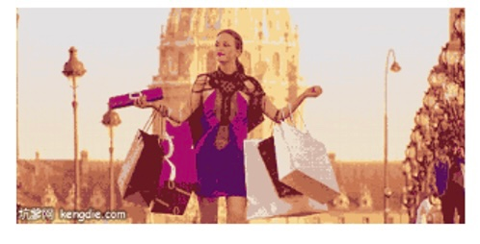
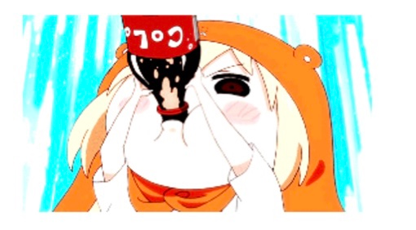

Make sentences!

Slide 20
Thank you!

