Slide 1


感恩遇见，相互成就，本课件资料仅供您个人参考、教学使用，严禁自行在网络传播，违者依知识产权法追究法律责任。
更多教学资源请关注
公众号：溯恩英语
知识产权声明

Slide 2
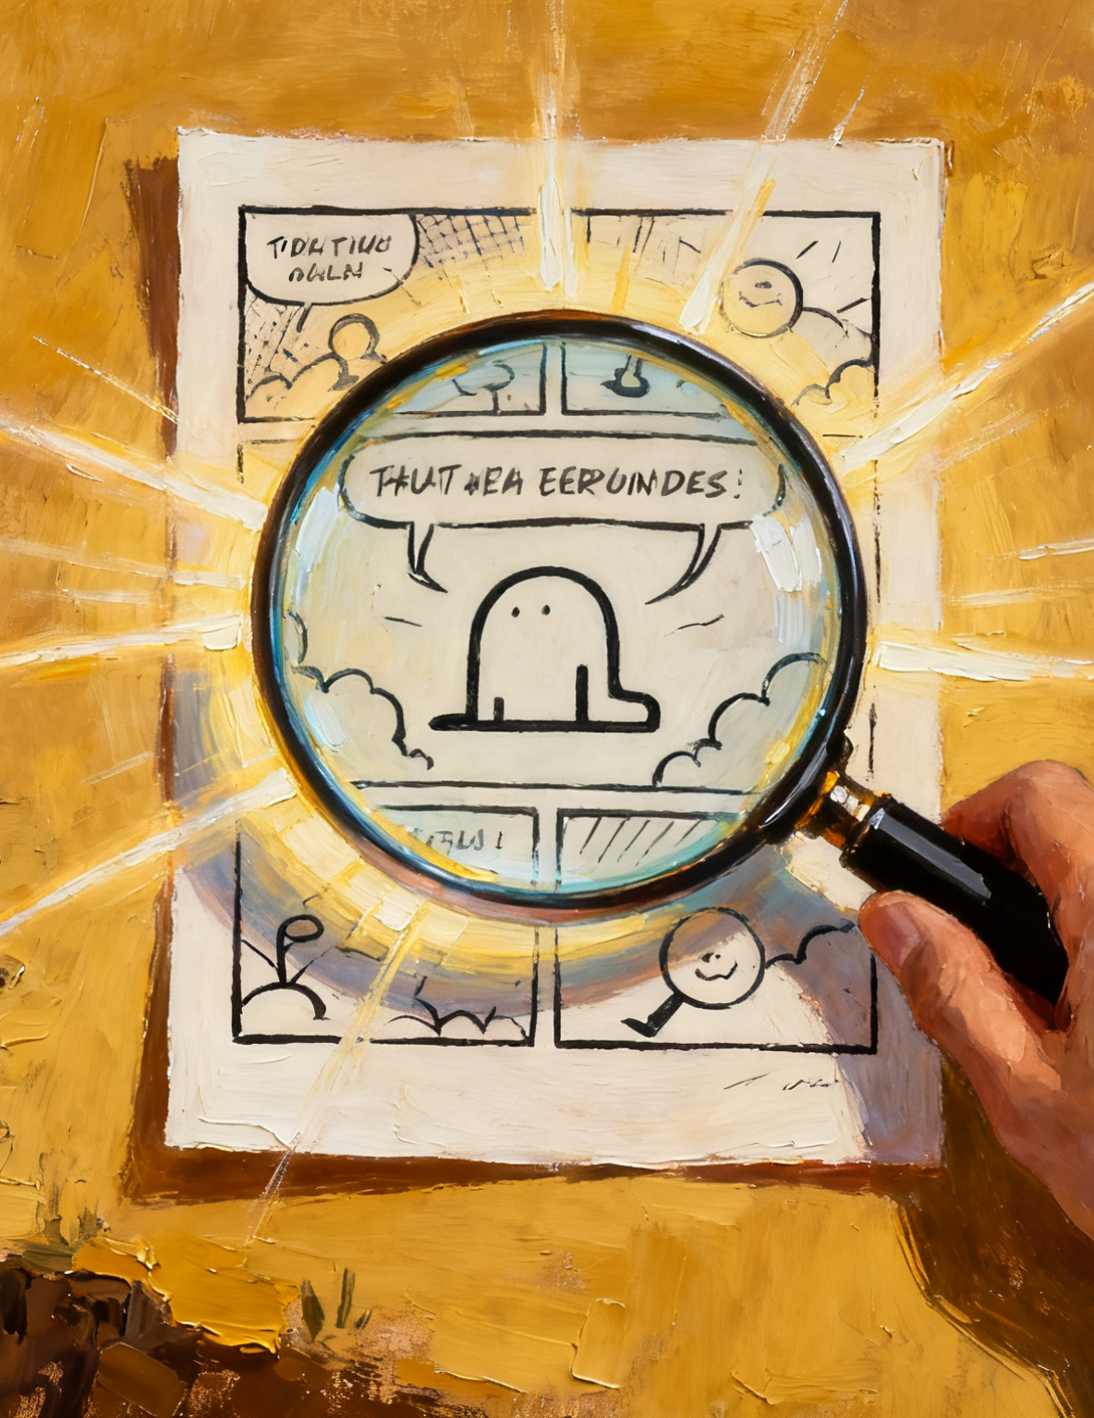
2026高考应用文思维训练：
漫画作文：
“描述 + 观点”类
抓漫画核心・拓观点深度
→抓核心（拆解漫画）
→拓深度（思维延伸）
→写精准（语言表达）
刘艳

Slide 3
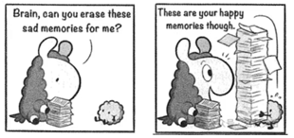
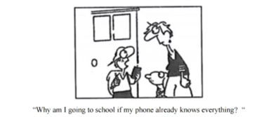
经典漫画题目梳理：思考 3 篇作文的共同要求和核心特征
1）202504 南昌二模
你校英文报在举办征文比赛。请你根据下面的漫画，以“Memories”为题，写一篇短文进行投稿。
内容包括：
1．漫画内容；2．你的看法。
2） 202403山西一模
你校英文报正在开展以 “The Understanding of Going to School!”为题的讨论。请根据图片写一篇短文投稿,内容包括:
1.简要描述图片:2.你的看法。
"Why am I going to school if my phone already knows everything?

Slide 4
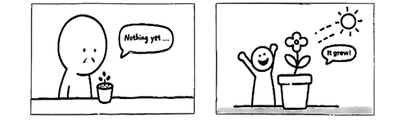
3） 2025年10月大湾区模拟考
你校英文报正在举办征文比赛，请你根据以下漫画，以“Growth”为题，写一篇短文投稿，内容包括：
（1）漫画内容： （2）你的看法。
Growth
Growth, like a flower, takes time.
核心特征：
写作结构固定：
均要求 “描述漫画内容 + 表达个人看法”。
漫画特点鲜明：
通过对话、场景或文字暗示核心观点，语言简洁、寓意深刻。
主题贴近生活：
围绕成长、记忆、学习等常见话题，观点具有普遍性。

Slide 5
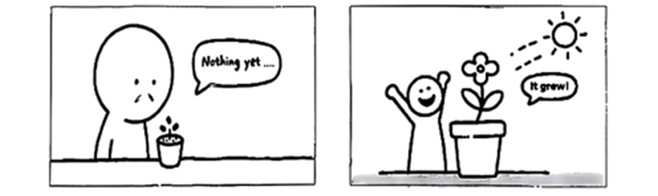
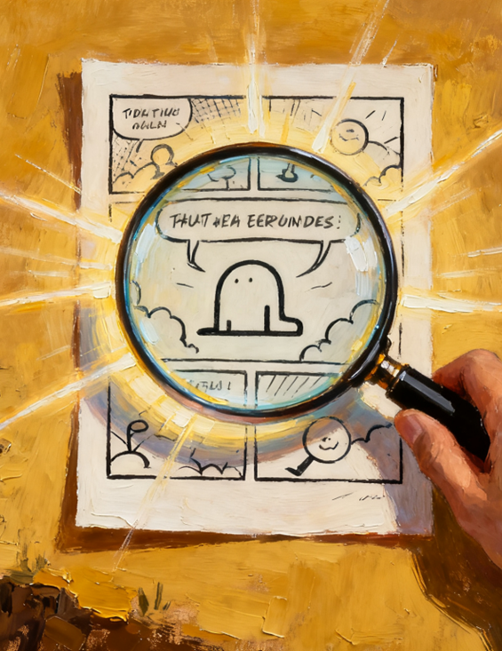
实战演练：
抓漫画核心・拓观点深度
2025年10月大湾区模拟考
你校英文报正在举办征文比赛，请你根据以下漫画，以“Growth”为题，写一篇短文投稿，内容包括：
（1）漫画内容： （2）你的看法。
Growth
Growth, like a flower, takes time.
漫画写作
1 文体：短文投稿
2 时态：一般现在时
3 主题： Growth：Growth, like a flower, takes time
4 要点分层：
P1：漫画内容
P2：看法
P3：总结
5 语气：理性，真挚

Slide 6
P1 ：漫画内容
抓核心（拆解漫画）
Thinking Method | Thinking Points
Observe Cartoon Elements | Pay attention to characters' expressions (disappointment → joy), dialogue text ("Nothing yet..." "It grew!"), and scene changes (seed → flower) to extract core visual and textual information.
Sort Out Picture Logic | Clarify the time sequence of the two pictures (first planting a seed with no change, then the seed grows into a flower) and the emotional transition (from disappointment to joy) to define the narrative logic of the cartoon.
Extract Core Words and Sentences 提取核心词句 | Mark the key expressions in the cartoon such as "Nothing yet...", "It grew!", and vocabulary describing growth like "grow", "development", etc., to prepare for subsequent viewpoint refinement.

Slide 7
描述漫画的常用句型
As is shown in the cartoon...（如图所示……）
The cartoon presents a scene where...（这幅漫画呈现了一个…… 的场景）
There are some words in the cartoon: “...”（漫画中有这样一句话：“……”）
We can see from the cartoon that...（从漫画中我们可以看到……）
1 ______（如图所示）, there are two scenes in the cartoon, which ______（分别呈现了种子不同的生长阶段）.
2 In the first scene, a person looks at a newly planted seed, ______（脸上带着失望）, and says "Nothing yet..." softly.
3 In the second scene, the seed has grown into a bright flower, and the person ______（欣喜地张开嘴）and exclaims "It grew!".
1 As is shown in the cartoon; show different growth stages of the seed respectively
2 with disappointment on his face
3 opens his mouth with joy

Slide 8
P2 ：漫画内容
拓深度（思维延伸）
Thinking Method | Thinking Points
Relate to Life Phenomena | learning accumulation (e.g., learning English from word accumulation to fluent expression) and skill cultivation (e.g., learning a musical instrument from unfamiliarity to proficiency), and find the common ground between the cartoon and reality.
Use Rhetoric to Expand | Use rhetoric such as metaphor (comparing growth to seed growth) and analogy (personal growth is like plant growth, which requires time and patience) to make the viewpoint more persuasive and appealing.
Explore Deep Meanings | Derive the life principle of "don't be eager for quick success, persistence will eventually bring gains" from "no short-term change but long-term growth" to enhance the depth of the viewpoint.

Slide 9
写精准（语言表达）
展手段（思维方法 + 文学修辞） | 中文表达 | 英文表达
思维方法：关联 “学书法” 技能学习；文学修辞：比喻（成长 = 书法练习） | 就像漫画中迟迟未发芽的种子。但只要日复一日临摹、积累，终能写出工整流畅的字迹 | Growth requires time and persistence, just like practicing calligraphy. At first, we ______（握笔不稳，笔画歪斜）, but we can make progress by ______（日复一日临摹）.
思维方法：关联 “背英语单词” 学习场景；文学修辞：类比（单词积累 = 种子生长） | 只要坚持日复一日积累、反复巩固，词汇量便会悄悄增长，如同种子默默扎根土壤。 | The seed’s growth in the cartoon is like our English word memorization: at first, we ______（总记不住单词）, but our vocabulary will ______（悄悄增长）after persistent accumulation.
hold the brush unsteadily with crooked strokes;
copying day after day
always forget the words; grow quietly

Slide 10
写精准（语言表达）
思维方法：关联 “参加比赛” 备赛经历；文学修辞：拟人（种子 = 备赛的自己） | 反复打磨技能、弥补短板，终会像种子长成花朵般，在比赛中绽放光彩 | The seed in the cartoon is just like us preparing for a competition: at first, we work hard but ______（没看到进步）, so we ______（难免感到沮丧）, but we can shine like the blooming seed if we don’t give up.
see no progress; inevitably feel frustrated

Slide 11
P3：总结
写精准（语言表达）
思维方法 | 思考要点 | 补全句子
结构衔接 + 句型多样 + 强化主题词汇 | 用总结性逻辑词衔接，运用定语从句、状语从句丰富表达，重复 “growth”“patience” 等词强化观点。 | ______（总之）, growth is like the seed’s growth in the cartoon—it requires not only ______（时间等待）but also patient care. In our lives, when we ______（面对学习或技能培养）, we should stay patient and ______（不断付出努力）. As long as we ______（坚持不放弃）, we will definitely harvest our own ______（“成长之花”）eventually.
In conclusion; time to wait
face study or skill cultivation; keep making efforts
persist and never give up; "flower of growth"

Slide 12
下水作文
开篇直接还原漫画的两个关键场景，精准提取 “播种无回应→开花获喜悦” 的核心情节，不偏离素材。
As shown in the cartoon, there are two scenes. In the first scene, a person looks at a newly planted seed with disappointment and says, "Nothing yet...". In the second scene, the same person is joyful as the seed has grown into a flower, and exclaims, "It grew!".
The seed in the cartoon is just like us preparing for a competition. At first, we put in a lot of effort but see no obvious progress, and it is inevitable to feel frustrated — just like the seed's "silence" of "Nothing yet". But the seed never stops growing, and we never give up training: we polish our skills repeatedly and make up for our shortcomings. Eventually, we will shine in the competition, just as a seed grows into a flower. This tells us that time never fails those who persist, and the rewards of growth always come after silent efforts.
In conclusion, growth is like the seed’s growth in the cartoon, requiring time and patience. In our lives, we should be patient and keep working hard, and we will definitely harvest our own "flower of growth" eventually.
采用 “引材料→析类比→明道理→做总结” 的经典结构，层层推进。
将 “种子” 与 “备战竞赛的我们” 建立类比，把 “种子沉默期” 对应 “努力却无明显进步的阶段”，“种子开花” 对应 “竞赛中发光”，比喻贴切且贯穿全文，让材料与观点无缝衔接。
不局限于 “等待” 的表面含义，而是挖掘出 “坚持 + 耐心 = 成长” 的深层道理

Slide 13
参考范文1
Growth
Growth, like a flower, takes time. Just as the cartoon shows, a boy stares at an empty flowerpot, sighing, “Nothing yet.” But with sunlight and care, a bud finally blooms, making him delighted.
This scene, simple yet profound, mirrors the very rhythm of our lives. In study, progress often hides beneath the surface; in pursuing dreams, the path may appear endless. Yet every page we turn, every effort we invest, is like an unseen root spreading underground, quietly preparing for the bloom of tomorrow . Growth whispers to us that patience is not wasted time but silent strength.
For students, growth is the transformation of persistence into progress, of unseen effort into shining achievement.

Slide 14
参考范文 2
Growth
Growth, like a flower, takes time. This truth unfolds vividly in the cartoon: a boy stares at a pot sadly, murmuring "Nothing yet" because no change can be seen. Later, he beams with delight when the seed finally blossoms into a flower under the warm sunshine.
To me, this cartoon illustrates a timeless truth: growth is invisible at first but powerful in the long run. Just like a seed, our studies, friendships, and even dreams may not seem to be growing for a while. Yet if we continue to devote patience, care, and confidence, the reward will eventually come in a surprising and beautiful form. Growth demands not only effort but also endurance.
In conclusion, growth is the silent miracle that turns persistence into blossoms.

Slide 15
漫画类应用文写作口诀
观图抓核：先观察漫画元素（场景、对话、表情），提炼核心信息与表层内容。
联实拓深：关联生活实际（学习、技能、经历），挖掘漫画深层寓意与道理。
修辞点睛：运用比喻、类比等修辞，让观点更生动，提升表达感染力。
精准成文：按 “描述 - 分析 - 总结” 结构，用核心词汇与句型，简洁准确完成写作。

