Slide 1


感恩遇见，相互成就，本课件资料仅供您个人参考、教学使用，严禁自行在网络传播，违者依知识产权法追究法律责任。
更多教学资源请关注
公众号：溯恩英语
知识产权声明

Slide 2





丽水、湖州
衢州三地市
2026届高三英语联考客观题解析
F A Y

Slide 3




语篇 | 体裁 | 话题 | 主要内容
A | 应用文（活动倡议） | “Walk for Green” 校园步行活动 | 介绍活动目的（鼓励绿色出行、健康生活）、路线设置（从 MTR 站出发，覆盖多栋楼宇）、参与方式（刷卡记录行程）、积分规则及注意事项。
B | 说明文（人物研究） | 鸟类学家 Marler 的鸟类鸣叫研究 | 讲述 Marler 观察到鸟类鸣叫的地域差异（方言），通过实验证明鸟类鸣叫是后天学习而非先天遗传，其理论逐渐被认可并影响人类语言研究
C | 议论文（社会现象） | 数字媒体快速播放功能的争议 | 介绍不同人群对媒体播放速度的偏好，平台增设该功能的原因，分析快速播放的时间优势与对理解度、艺术表达的影响
D | 议论文（人文思考） | 对AI 表达礼貌的价值 | 以人们对 AI 聊天机器人讲礼貌的现象切入，通过实验说明感恩与善意对个人的积极影响，指出对 AI 礼貌实质是强化自身优良品质
七 选 五 | 记叙文（活动介绍） | 华盛顿特区 “Book It Around D.C.” 读书俱乐部 | 介绍俱乐部将有声书与步行结合的活动形式，成员的参与体验、活动发展情况及单次活动的具体流程

Slide 4

阅读理解详解
01
Reading Comprehension Detailed Analysis

Slide 5

篇章 | 题目 | 考查重点
A | 21.Where does “Walk for Green” start? 22.What are participants required to do? 23.How many points do you get by walking from YIA Building to LWS Building? | 21.活动起点、参与要求等细节定位； 22.路线积分计算； 23. 应用文信息筛选与理解
B | 24.What did Marler find while observing chaffinches? 25.What do the underlined words “culturally transmitted” mean in paragraph 3? 26.What can we infer about Marler? 27.Why was Marler's theory significant? | 24.研究发现与实验结论提取； 25. 关键词词义猜测； 26.人物性格与研究意义推断 27.对研究意义与价值的归纳
C | 28.What can be learned about the controversy from paragraph 1? 29.Why did many platforms introduce faster playback options? 30.What is the author's purpose in mentioning Hamlet? 31.What can be a suitable title for the text? | 28.争议核心与现象解读； 29.平台行为动机分析； 30.举例论证的目的； 31.文章主旨归纳
D | 32.How does the author introduce the topic in paragraph 1? 33.What value of gratitude does the experiment in paragraph 3 show? 34.Which of the following would Maimonides most likely approve of? 35.What message does the author mainly convey in the text? | 32.话题引入方式判断； 33.实验结论提取； 34.观点态度推断； 35.文章核心主旨理解

Slide 6
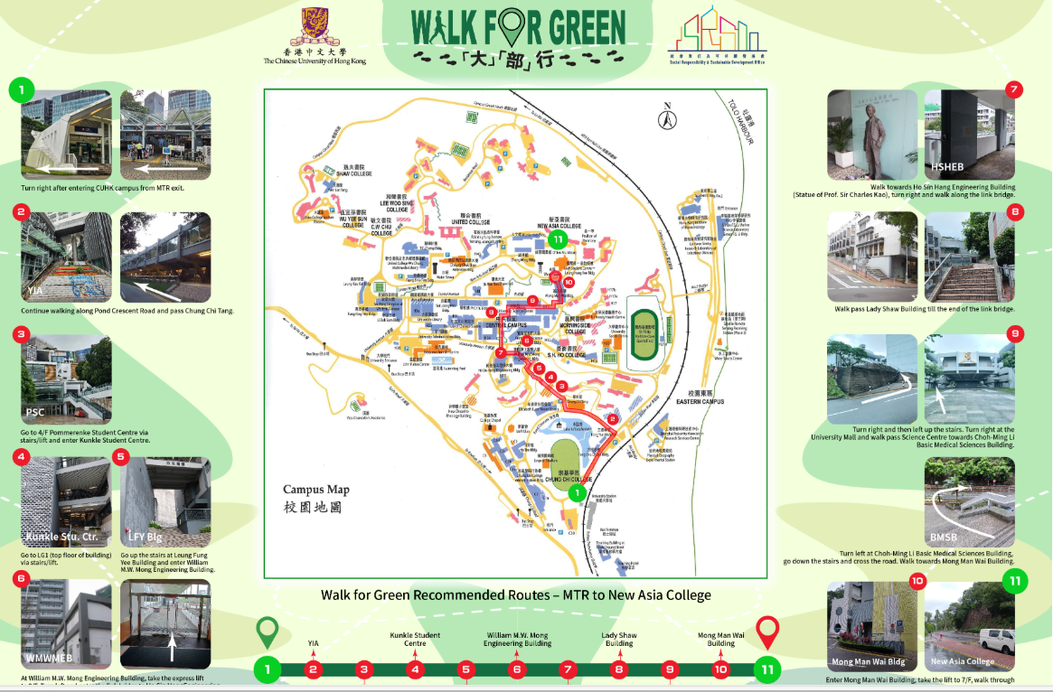

A
Walk for Green

Slide 7
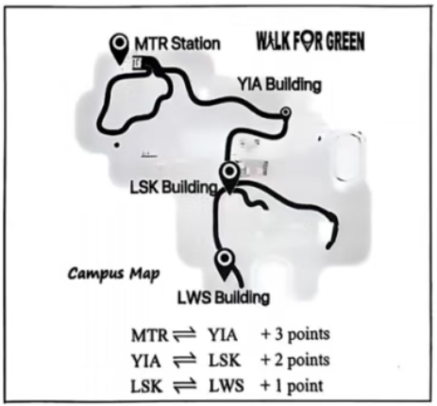
A
WALK FOR GREEN
How often do you walk around the campus instead of getting straight onto the shuttle bus? The beauties of our campus deserve to be better explored and can best be explored on foot. Walking is also a greener and healthier alternative to using vehicles. To encourage more students and staff members to walk around the campus, our school has launched a new “Walk for Green” initiative.
Programme
Setting out from the MTR Station, “Walk for Green” recommends various walking routes on campus, one of which covers the YIA Building, LSK Building and LWS Building. Card readers for different walking routes have been installed to record the number of points completed by “Walk for Green” participants. Participants who collect 60 points within 30 days will be awarded the title “Green Walker”.
Participation
To participate, students and staff members would choose a marked route, and tap their school cards at the card readers installed at both the start and end points (and also at an intermediate card reader). Name, student/staff ID, department/unit, date, time and card readers tapped will be recorded.
Walking Journey Points
MTR → YIA: +3 points
• YIA → LSK: +2 points
• LSK → LWS: +1 point
Important Notes:
1.Walkers must complete one trip (either upwards or downwards) within one hour to score points.
2.A maximum of six points will be awarded each day.
Every time you take a walk on campus, you are helping to preserve our environment and also keeping yourself healthy. Let's start from today!
21. Where does “Walk for Green” start? D
22. What are participants required to do? D
D. Choose a pre-set route.
pre-set: decided, arranged, or programmed in advance;
23. How many points do you get by walking from YIA Building to LWS Building? C

Slide 8
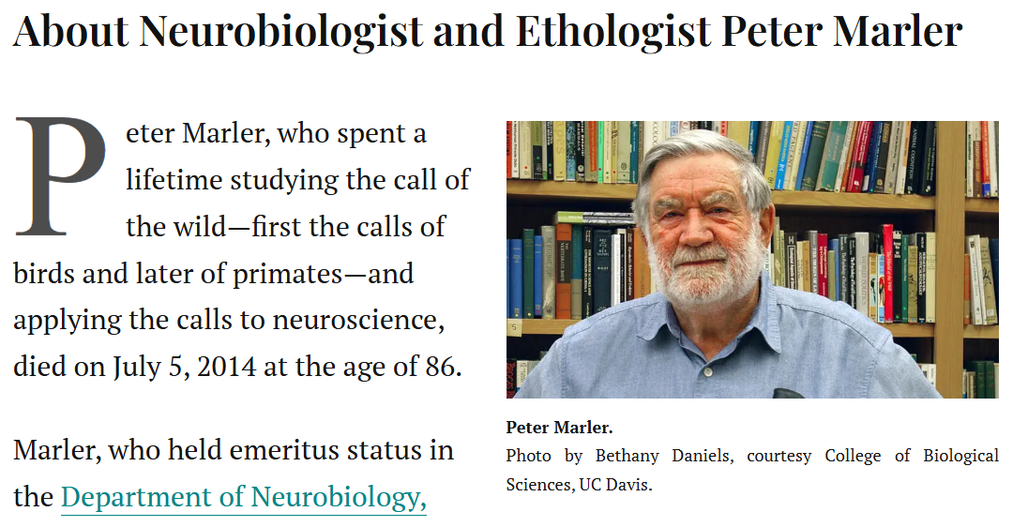
B
Peter Marler’s theory about birds’ regional "dialects“

Slide 9
B
1For a long time, scientists believed the beautiful songs of birds were purely a product of instinct. Peter Marler, a pioneering British animal behaviorist, revolutionized this view through his research into how birds actually learn to sing, earning him the title “the father of birdsong.”
2Marler's fascination began in his youth, observing chaffinches in the English countryside. He noticed slight but consistent differences in the songs of birds from different regions, much like human dialects. This curiosity defined his career. In the 1950s, he began carefully recording these songs. Using a crucial tool called a spectrogram, which visually represents sound, he was able to scientifically confirm that these regional variations, or “dialects,” were indeed real. His famous study of the white-crowned sparrow in California clearly showed distinct dialects between northern and southern populations.
3The central question remained: were these dialects inherited or learned? To solve this, Marler designed a series of experiments that would later be regarded as models of clarity. He raised young birds in complete vocal isolation from adults. These isolated birds only produced simple, natural calls, proving that the full, complex song was not automatic. However, when he played recordings of adult songs to them during a critical learning period after hatching, they successfully learned and sang the complete tune. This was decisive evidence that birdsong is a culturally transmitted behavior.
4Initially, his theory faced doubts from a scientific community that favored instinct-based explanations. The mainstream view still favored instinct, and some dismissed his work as an exception rather than a rule. Marler, however, quietly continued his careful studies. Gradually, his well-designed methods and undeniable evidence won over the community. By transforming lines of numbers into meaningful maps of sound and behavior, he gave the world new eyes to see what had always been hidden in plain hearing.
5The impact of his work extended far beyond ornithology. It provided a powerful simpler model for scientists studying the incredibly complex evolution of human language, suggesting our own speech may have roots in similar vocal learning processes.
Introduction
—Peter Marler and his view
Discovery of Birdsong Dialects
Marler’s experiments
Acceptance of Marler’s Theory
The impact

Slide 10
B
1For a long time, scientists believed the beautiful songs of birds were purely a product of instinct. Peter Marler, a pioneering British animal behaviorist, revolutionized this view through his research into how birds actually learn to sing, earning him the title “the father of birdsong.”
2Marler's fascination began in his youth, observing chaffinches in the English countryside. He noticed slight but consistent differences in the songs of birds from different regions, much like human dialects. This curiosity defined his career. In the 1950s, he began carefully recording these songs. Using a crucial tool called a spectrogram, which visually represents sound, he was able to scientifically confirm that these regional variations, or “dialects,” were indeed real. His famous study of the white-crowned sparrow in California clearly showed distinct dialects between northern and southern populations.
3The central question remained: were these dialects inherited or learned? To solve this, Marler designed a series of experiments that would later be regarded as models of clarity. He raised young birds in complete vocal isolation from adults. These isolated birds only produced simple, natural calls, proving that the full, complex song was not automatic. However, when he played recordings of adult songs to them during a critical learning period after hatching, they successfully learned and sang the complete tune. This was decisive evidence that birdsong is a culturally transmitted behavior.
4Initially, his theory faced doubts from a scientific community that favored instinct-based explanations. The mainstream view still favored instinct, and some dismissed his work as an exception rather than a rule. Marler, however, quietly continued his careful studies. Gradually, his well-designed methods and undeniable evidence won over the community. By transforming lines of numbers into meaningful maps of sound and behavior, he gave the world new eyes to see what had always been hidden in plain hearing.
5The impact of his work extended far beyond ornithology. It provided a powerful simpler model for scientists studying the incredibly complex evolution of human language, suggesting our own speech may have roots in similar vocal learning processes.
Introduction
—Peter Marler and his view
Discovery of Birdsong Dialects
Marler’s experiments
Acceptance of Marler’s Theory
The impact

Slide 11
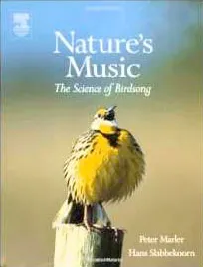
B
1For a long time, scientists believed the beautiful songs of birds were purely a product of instinct. Peter Marler, a pioneering British animal behaviorist, revolutionized this view through his research into how birds actually learn to sing, earning him the title “the father of birdsong.”
2Marler's fascination began in his youth, observing chaffinches in the English countryside. He noticed slight but consistent differences in the songs of birds from different regions, much like human dialects. This curiosity defined his career. In the 1950s, he began carefully recording these songs. Using a crucial tool called a spectrogram, which visually represents sound, he was able to scientifically confirm that these regional variations, or “dialects,” were indeed real. His famous study of the white-crowned sparrow in California clearly showed distinct dialects between northern and southern populations.
24. What did Marler find while observing chaffinches?
A. Seasonal variations in dialects
B. Regional differences in birdsong
C. Slight changes in bird population
D. Common features in bird species

Slide 12
3The central question remained: were these dialects inherited or learned? To solve this, Marler designed a series of experiments that would later be regarded as models of clarity. He raised young birds in complete vocal isolation from adults. These isolated birds only produced simple, natural calls, proving that the full, complex song was not automatic. However, when he played recordings of adult songs to them during a critical learning period after hatching, they successfully learned and sang the complete tune. This was decisive evidence that birdsong is a culturally transmitted behavior.
4Initially, his theory faced doubts from a scientific community that favored instinct-based explanations. The mainstream view still favored instinct, and some dismissed his work as an exception rather than a rule. Marler, however, quietly continued his careful studies. Gradually, his well-designed methods and undeniable evidence won over the community. By transforming lines of numbers into meaningful maps of sound and behavior, he gave the world new eyes to see what had always been hidden in plain hearing.
5The impact of his work extended far beyond ornithology. It provided a powerful simpler model for scientists studying the incredibly complex evolution of human language, suggesting our own speech may have roots in similar vocal learning processes.
25. What do the underlined words “culturally transmitted” mean in paragraph 3?
A. Found in human language
B. Spread within a single family
C. Passed down through genes
D. Learned from others in a community
26. What can we infer about Marler?
A. His findings were soon accepted
B. He truly respected others' opinion
C. He was a patient and careful scientist
D. He was the first to study bird behavior
27. Why was Marler's theory significant?
A. It supported rare bird protection
B. It proved the once-popular theory
C. It made bird research more popular
D. It promoted the study of human speech

Slide 13
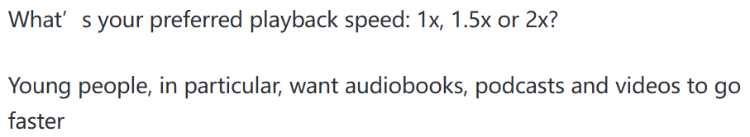
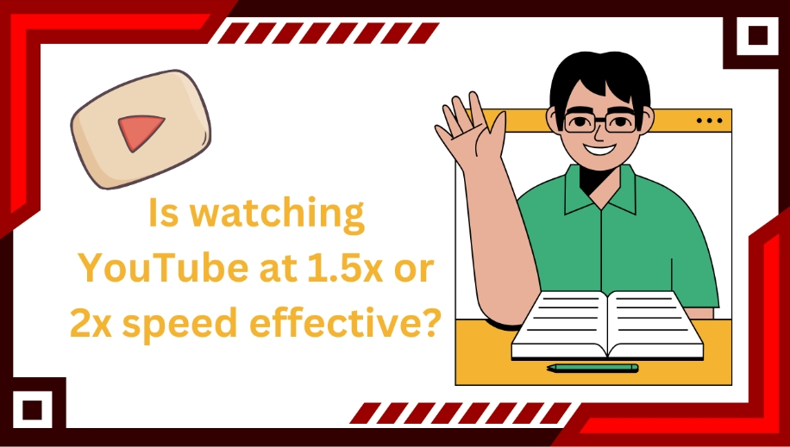
C
To speed or not to speed？

Slide 14
C
1How fast do you listen? Hollywood actor Glen Powell likes 1x listening speed, saying, “I want to hear people talk at a normal human rate,” while American comedian Bowen Yang believes 1.8x is the perfect pace. Their debate went viral earlier this year in an advertisement for a streaming platform, which was criticized for suggesting that people who listen quickly are unusual. The controversy reflects a broader change in how people consume digital media.
2Surveys support this observation. A survey showed that 31% of Americans aged 18–29 listen faster than 1x, compared with only 8% of those over 45. To meet this demand, many platforms such as Apple, Spotify, Netflix and YouTube now provide fast playback options. Some even allow speeds up to 4x for premium users.
3The appeal is easy to understand: faster playback can save a large amount of time. YouTube once reported that its viewers together saved more than 900 years per day thanks to this feature. For busy students and workers, such efficiency is attractive.
4But does speeding affect comprehension? The average person speaks at a rate of about 150 words per minute, but most brains are capable of processing information faster than that, says Marcus Pearce, a cognitive scientist at Queen Mary University of London. A recent meta-analysis led by academics at the University of Waterloo in Canada found that up to 1.5x there was not much of a difference in performance, although scores started to decrease noticeably as playback speeds approached or exceeded 2x.
5The practice has also raised different opinions. From the platforms’ perspective, faster speeds mean users consume more content, which increases advertising income. But many performers argue that something artistic is lost. Reading aloud involves pacing, tone and pause, and rushing may damage the quality of a performance. Imagine the famous monologues in Hamlet delivered at double speed — much of the meaning would disappear.
6Despite the disagreements, fast playback has become part of daily life for many people. For them, to speed or not to speed is no longer a real question.
Controversy over speed playback
introducing controversy
verifying the phenomenon
Age differences and platform adaptation
Time-saving appeal of speed playback
analyzing pros and cons
Impact of speed playback on comprehension
Different opinions on speed playback
Speed playback as part of daily life
summarizing the current situation

Slide 15
C
1How fast do you listen? Hollywood actor Glen Powell likes 1x listening speed, saying, “I want to hear people talk at a normal human rate,” while American comedian Bowen Yang believes 1.8x is the perfect pace. Their debate went viral earlier this year in an advertisement for a streaming platform, which was criticized for suggesting that people who listen quickly are unusual. The controversy reflects a broader change in how people consume digital media.
2Surveys support this observation. A survey showed that 31% of Americans aged 18–29 listen faster than 1x, compared with only 8% of those over 45. To meet this demand, many platforms such as Apple, Spotify, Netflix and YouTube now provide fast playback options. Some even allow speeds up to 4x for premium users.
28.What can be learned about the controversy from paragraph 1? A. An advertisement is well received B. People prefer different listening speeds C. Digital media is a topic of much debate D. Streaming platforms are part of daily life
29.Why did many platforms introduce faster playback options? A. To attract more elderly listeners B. To respond to the users' needs C. To help people's comprehension D. To cut content production costs
Consume digital media: it can be understood as engaging with, using, accessing or interacting with digital media content.
The honor system: A system based on trust, where people are expected to follow rules (e.g., pay, take exams fairly) without external supervision, relying on their own honesty and sense of responsibility.

Slide 16
C
3The appeal is easy to understand: faster playback can save a large amount of time. YouTube once reported that its viewers together saved more than 900 years per day thanks to this feature. For busy students and workers, such efficiency is attractive.
4But does speeding affect comprehension? The average person speaks at a rate of about 150 words per minute, but most brains are capable of processing information faster than that, says Marcus Pearce, a cognitive scientist at Queen Mary University of London. A recent meta-analysis led by academics at the University of Waterloo in Canada found that up to 1.5x there was not much of a difference in performance, although scores started to decrease noticeably as playback speeds approached or exceeded 2x.
5The practice has also raised different opinions. From the platforms’ perspective, faster speeds mean users consume more content, which increases advertising income. But many performers argue that something artistic is lost. Reading aloud involves pacing, tone and pause, and rushing may damage the quality of a performance. Imagine the famous monologues in Hamlet delivered at double speed — much of the meaning would disappear.
6Despite the disagreements, fast playback has become part of daily life for many people. For them, to speed or not to speed is no longer a real question.
30. What is the author's purpose in mentioning Hamlet?
A. To stress fast speed harms art
B. To show people favor classic works
C. To prove actors dislike fast playback
D. To suggest modern audiences lack patience
31. What can be a suitable title for the text?
A. The need for fast playback
B. The argument over an advertisement
C. Higher speed, more profit
D. Speedier streaming, less meaning

Slide 17

D
Are you polite to AI chatbots?

Slide 18
D
1I often catch myself asking my questions to AI chatbots with a “please” and a “thank you.” Apparently, I am not alone. A 2024 survey found that approximately 67% of U.S. AI users are also polite and show gratitude toward AI search engines. Some even joked about the cost: if every polite word consumes electricity, the bill must be high. OpenAI's CEO Sam Altman replied: “Tens of millions of dollars well spent — you never know.”
2In reality, of course, AI chatbots do not appreciate politeness; they lack consciousness, feelings or social needs. From a purely utilitarian standpoint, all those pleases and thank-yous are just flushing money down the toilet.
3Still, there may be value that isn't immediately measurable in showing gratitude toward AI. Psychologists Robert Emmons and Michael McCullough carried out an experiment in which they divided participants into three groups, asking the first to list things they are grateful for, while others listed daily troubles or simply kept journals. After 10 weeks, they found that the first group reported 25% higher happiness levels, stronger inner strength and even better physical health.
4What's true of gratitude is also true of kindness and generosity more generally. Experiments at UC Riverside found that performing “five small acts of kindness per week” produced steady increases in happiness. This idea isn't new. The medieval thinker Maimonides wrote that “it is better for a person to give one coin to a thousand poor people than to give a thousand coins to one poor person.” He believed that regular acts of goodness, like giving charity and expressing gratitude, make us happier in the long run by turning virtue into a habit.
5So perhaps all of our pleases and thank-yous to AI have value, even if they cost OpenAI millions of dollars annually. Showing appreciation, even toward a machine, reinforces positive habits of courtesy, patience and empathy. In our increasingly digital and automated world, preserving these human qualities may be more valuable than the cost of a few extra electricity. Ultimately, the beneficiary of our politeness isn't the AI at all, but ourselves.
introducing the phenomenon
Politeness to AI chatbots
Giving a negative view
AI lacks consciousness
Gratitude's psychological benefits (experiment)
offering positive evidence
Kindness and generosity also increase happiness
(view)
Reframing the conclusion
Politeness benefits humans, not AI

Slide 19
D
1I often catch myself asking my questions to AI chatbots with a “please” and a “thank you.” Apparently, I am not alone. A 2024 survey found that approximately 67% of U.S. AI users are also polite and show gratitude toward AI search engines. Some even joked about the cost: if every polite word consumes electricity, the bill must be high. OpenAI's CEO Sam Altman replied: “Tens of millions of dollars well spent — you never know.”
2In reality, of course, AI chatbots do not appreciate politeness; they lack consciousness, feelings or social needs. From a purely utilitarian standpoint, all those pleases and thank-yous are just flushing money down the toilet.
3Still, there may be value that isn't immediately measurable in showing gratitude toward AI. Psychologists Robert Emmons and Michael McCullough carried out an experiment in which they divided participants into three groups, asking the first to list things they are grateful for, while others listed daily troubles or simply kept journals. After 10 weeks, they found that the first group reported 25% higher happiness levels, stronger inner strength and even better physical health.
32.How does the author introduce the topic in paragraph 1? A. By quoting an expert B. By telling a story C. By presenting a phenomenon D. By defining a concept
33.What value of gratitude does the experiment in paragraph 3 show? A. It strengthens our bodies and minds B. It reduces daily stress levels C. It improves memory and creativity D. It deepens social relationship

Slide 20
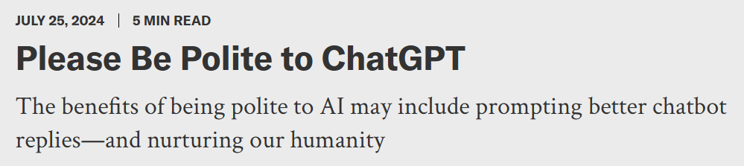
D
4What's true of gratitude is also true of kindness and generosity more generally. Experiments at UC Riverside found that performing “five small acts of kindness per week” produced steady increases in happiness. This idea isn't new. The medieval thinker Maimonides wrote that “it is better for a person to give one coin to a thousand poor people than to give a thousand coins to one poor person.” He believed that regular acts of goodness, like giving charity and expressing gratitude, make us happier in the long run by turning virtue into a habit.
5So perhaps all of our pleases and thank-yous to AI have value, even if they cost OpenAI millions of dollars annually. Showing appreciation, even toward a machine, reinforces positive habits of courtesy, patience and empathy. In our increasingly digital and automated world, preserving these human qualities may be more valuable than the cost of a few extra electricity. Ultimately, the beneficiary of our politeness isn't the AI at all, but ourselves.
34. Which of the following would Maimonides most likely approve of?
A. Giving gifts to friends on birthdays
B. Making a large donation to a charity
C. Expressing gratitude on Thanksgiving Day
D. Volunteering weekly at a community kitchen
35. What message does the author mainly convey in the text?
A. Courtesy to AI saves electricity bills
B. AI improves the quality of human life
C. Politeness benefits humans rather than AI
D. AI learns empathy from human behavior

Slide 21
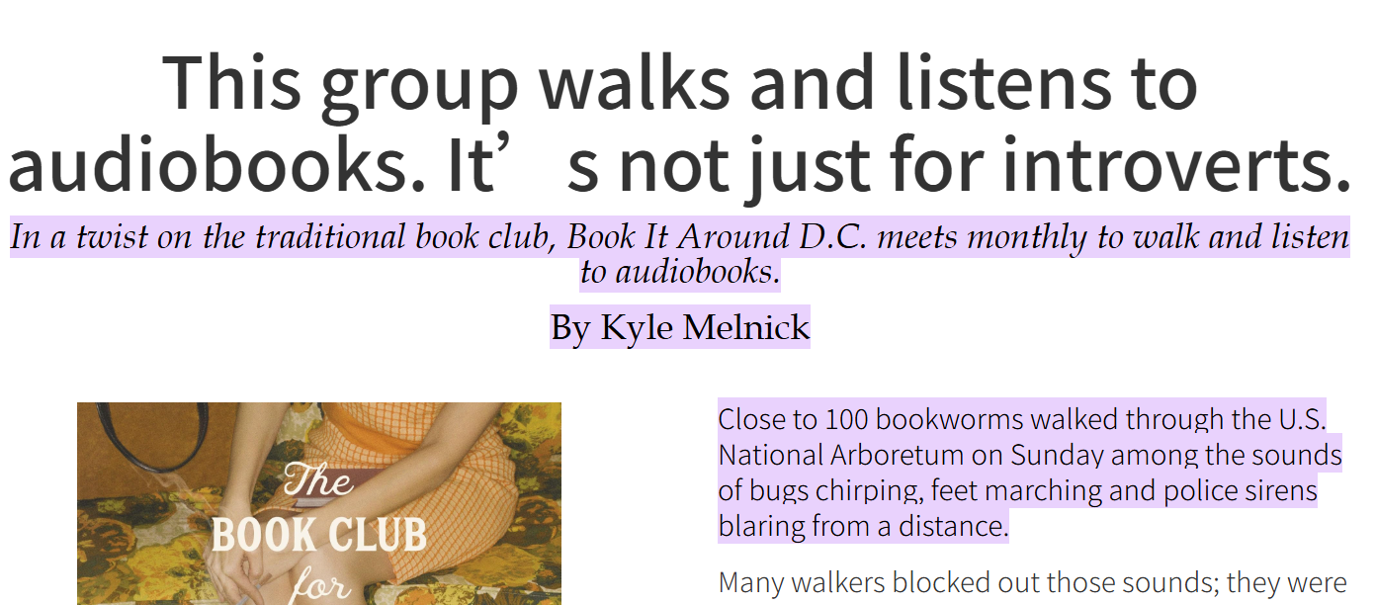
七选五
Book club combines audiobooks and exercise

Slide 22
1Nearly 100 bookworms walked through the U.S. National Arboretum on Aug. 24, among the sounds of dogs barking, feet marching and police sirens ringing out from a distance. Many walkers didn't care about those sounds. 36 This was the monthly meeting for Book It Around D.C., a new club that combines audiobooks and walking.
2Since starting in March, Book It Around D.C. has grown, bringing together audiobook listeners who said they felt happier or safer in a group. They also said it not only was a pleasure in reading but also brought them a sense of belonging — even if they didn't talk to each other. 37 “ said Bailey, who listened to The Book Club for Troublesome Women by Marie Bostwick.
3 38 This is especially true because a recent study showed that fewer Americans than before read for pleasure. In addition to audiobook clubs, silent book clubs, where people gather to read silently, have grown in popularity across the country. Many readers have found communities on social media, where some of Book It Around D.C.'s members discovered the group through Instagram.
4On the morning of Aug. 24, Kit Ballenger, a librarian who lives in Montgomery County, set up a foldable table in a parking lot in the southern part of the National Arboretum. 39 They each wrote their first name and current audiobook on a white sticker they stuck to the front of their shirts.
5The group began walking a few minutes later — some quickly; others slowly — while many walkers opened audiobook apps on their phones. Some walkers used the roughly 90-minute outing to make friends, chatting about their jobs, their favorite books and their go-to grocery stores. 40 After a quiet walk, the lawn filled with chatter.
36.承接上文didn’t care，呼应下文。G Instead, they were listening to narrators read audiobooks on their headphones
37.主题一致，逻辑连贯。（not only a pleasure but also a sense of belonging）
E. This feels like something that is beautifully both inward and outward.
38.段落结构，段落主旨。C. Bookworms say they are seeking like-minded people.
39.指代，语义。D. People of all ages carried headphones as they approached the table.
40.段落主旨，段落结构。F. The walkers passed trees, paths and gardens, many stopping to take pictures.
A. Books are just like our close friends.
B. They were trying to focus on exercise itself.
C. Bookworms say they are seeking like-minded people.
D. People of all ages carried headphones as they approached the table.
E. This feels like something that is beautifully both inward and outward.
F. The walkers passed trees, paths and gardens, many stopping to take pictures.
G. Instead, they were listening to narrators read audiobooks on their headphones.

Slide 23
完形填空详解
80 岁的詹姆斯・史密斯坚持参加超马并创纪录，以多重动力坚守热爱，展现了年龄不是极限、坚持成就可能的精神。
02

Slide 24
1James Smith has long succeeded in competition, even in snowball fights as a child. Now that he's 80, his___41___ edge has only gotten sharper. "Many have said, 'You're crazy,'" said Smith, who visits doctors every few months to check on his___42___. "But they've never told me not to___43___.
2Smith not only runs ultramarathons—races longer than 26.2 miles that often take days to___44___—he also sets records. "I've never really thought of my___45___ as an obstacle. "I kind of have the___46___ of, if somebody else can do it, you know, why can't I?"
3There are many___47___ behind his running. One of Smith's races came in November 2016, when he___48___ the challenge of a 100-mile race in southwest China, near the very region where his father, Mickey, fought Japanese soldiers while___49___ in the U.S. Army Air Corps during World War II. Once, after Smith finished an ultramarathon in California, a stranger___50___ him a note that said "Watching you struggle up that hill gave me the___51___ to fight my own illness. Thank you for showing me how to persevere." For Smith, it was proof that running could___52___ life beyond the finish line.
4After he finished Badwater Ultramarathon, one of the world's hardest footraces, Smith told his trainer Michael Johnson that it would be his___53___ ultramarathon. Smith hasn't___54___ another race—but Johnson said he would probably find one soon. "He's showing what's___55___ not just for him, but for you too, for me, for all of us," said Johnson.
A. knowledgeable B. competitive
C. creative D. influential
42.A. recovery B. progress
C. health D. memory
43.A. run B. jump
C. play D. leave
44.A. watch B. complete
C. approach D. maintain
45.A. appearance B. gender
C. personality D. age
46.A. expectation B. choice
C. attitude D. method
47.A. accidents B. stories
C. rewards D. secrets
48.A. took on B. thought about
C. put aside D. waited for
49.A. studying B. travelling
C. teaching D. serving
50.A. handed B. posted
C. bought D. promised
51.A. right B. strength
C. advice D. duty
52.A. inspire B. create
C. waste D. risk
53.A. upcoming B. favourite
C. last D. unforgettable
54.A. missed B. finished
C. won D. scheduled
55.A. real B. necessary
C. possible D. useful

Slide 25

他身披灿金色的旗帜，
宛如烈阳化作的披风。
他须眉且白发，
目光中的炬火比雷电还耀眼。
这目光，
使时间都胆怯了。
Gold flag adorns his frame,
like sun’s cloak in flame.
Brows and beard snow-white, eyes outshine thunder’s might.
This gaze, sharp and bright—
time shrinks back in fright.

Slide 26
语法填空详解
本文聚焦江苏扬州某中医医院的创新举措 —— 研发含中草药的特色面包。该面包系列由医院治未病中心研发，将烹饪创新与养生文化相结合，既满足了年轻人对健康食品的需求，又以美味易接受的形式传播中医食疗与 “治未病” 的理念，推出后广受消费者欢迎，往往短时间内售罄
核心动词：
gain fame：收获名气
combine...with...：将…… 与…… 结合
experiment with：尝试，用…… 做实验
launch：推出（产品）
be limited to：被限定于
sell out：售罄
in line with：与…… 一致
词性转换高频词
access（名词）→ accessible（形容词）
particular（形容词）→ particularly（副词）
vary（动词）→ variety（名词）→ varieties（复数）
03

Slide 27
1In Yangzhou, a city in Jiangsu Province, young people are rushing to a local traditional Chinese medicine (TCM) hospital, not for medical care, but for bread. Since early April, the hospital___56___ (gain) local fame for its special series of breads containing Chinese medicinal herbs.
2The herbal bread series, 57 (develop) by the Preventive Treatment Center of the hospital, combines culinary (烹饪的) innovation with wellness culture___58___ has attracted health-conscious youth as well as food enthusiasts. "The idea came from observing the growing demand among young people for healthier lifestyles and foods___59___can address health problems," said Chen Wei, deputy director of the center.
3"TCM dietary therapy is a vital part of preventive healthcare. By making ancient wisdom___60___(access) and delicious, we hope to encourage younger generations to embrace holistic wellness. These breads follow the rising trend of wellness-focused diets, 61 (particular) for those experiencing issues like tiredness or weak immunity. They are in line___62___ TCM's philosophy of 'preventive treatment'--solving health problems before they appear," Chen explained.
4 63 (perfect) the recipes, the team experimented with different methods, such as boiling herbs into liquid blends for dough. After months of trials, six___64___(variety) of bread were launched, priced at about 10 yuan a piece. At first, sales___65___ (limit) to a short period each afternoon. However, the subtle herbal aroma and unique flavors quickly won praise from customers. The bread often sold out within minutes.
56. has gained 动词时态 since自从
57. developed 非谓语。非谓语表被动
58. and 连词。combines 与has attracted两谓语并列
59. that/which 关系代词。先行词为 “foods”，指物，从句中缺少主语，需用关系代词 that/which 引导定语从句，修饰先行词。
60. accessible词性转换。and并列两个形容词
61. particularly词性转换。副词修饰介词短语 “for those...”，作句子状语，“particular” 的副词形式为 “particularly”（尤其，特别）
62. in line with非谓语。 “in line with”，意为 “与…… 一致，符合”，此处指面包符合中医 “治未病” 理念。
63. To perfect 主谓一致。用不定式作目的状语，表 “完善配方” 的目的是后续的实验调整，句首首字母大写。
64. varieties名词复数。基数词 “six” 修饰，需用名词复数
65. were limited 谓语。主语sales和limit为被动关系。考虑时态、语态、主谓一致。

Slide 28

THANK YOU
THANK YOU
THANK YOU
感谢
您的观看

Slide 29
试卷纯享版

Slide 30
A
WALK FOR GREEN
How often do you walk around the campus instead of getting straight onto the shuttle bus? The beauties of our campus deserve to be better explored and can best be explored on foot. Walking is also a greener and healthier alternative to using vehicles. To encourage more students and staff members to walk around the campus, our school has launched a new “Walk for Green” initiative.
Programme
Setting out from the MTR Station, “Walk for Green” recommends various walking routes on campus, one of which covers the YIA Building, LSK Building and LWS Building. Card readers for different walking routes have been installed to record the number of points completed by “Walk for Green” participants. Participants who collect 60 points within 30 days will be awarded the title “Green Walker”.
Participation
To participate, students and staff members would choose a marked route, and tap their school cards at the card readers installed at both the start and end points (and also at an intermediate card reader). Name, student/staff ID, department/unit, date, time and card readers tapped will be recorded.
Walking Journey Points
MTR → YIA: +3 points
• YIA → LSK: +2 points
• LSK → LWS: +1 point
Important Notes:
1.Walkers must complete one trip (either upwards or downwards) within one hour to score points.
2.A maximum of six points will be awarded each day.
Every time you take a walk on campus, you are helping to preserve our environment and also keeping yourself healthy. Let's start from today!

Slide 31
B
1For a long time, scientists believed the beautiful songs of birds were purely a product of instinct. Peter Marler, a pioneering British animal behaviorist, revolutionized this view through his research into how birds actually learn to sing, earning him the title “the father of birdsong.”
2Marler's fascination began in his youth, observing chaffinches in the English countryside. He noticed slight but consistent differences in the songs of birds from different regions, much like human dialects. This curiosity defined his career. In the 1950s, he began carefully recording these songs. Using a crucial tool called a spectrogram, which visually represents sound, he was able to scientifically confirm that these regional variations, or “dialects,” were indeed real. His famous study of the white-crowned sparrow in California clearly showed distinct dialects between northern and southern populations.
3The central question remained: were these dialects inherited or learned? To solve this, Marler designed a series of experiments that would later be regarded as models of clarity. He raised young birds in complete vocal isolation from adults. These isolated birds only produced simple, natural calls, proving that the full, complex song was not automatic. However, when he played recordings of adult songs to them during a critical learning period after hatching, they successfully learned and sang the complete tune. This was decisive evidence that birdsong is a culturally transmitted behavior.
4Initially, his theory faced doubts from a scientific community that favored instinct-based explanations. The mainstream view still favored instinct, and some dismissed his work as an exception rather than a rule. Marler, however, quietly continued his careful studies. Gradually, his well-designed methods and undeniable evidence won over the community. By transforming lines of numbers into meaningful maps of sound and behavior, he gave the world new eyes to see what had always been hidden in plain hearing.
5The impact of his work extended far beyond ornithology. It provided a powerful simpler model for scientists studying the incredibly complex evolution of human language, suggesting our own speech may have roots in similar vocal learning processes.

Slide 32
C
1How fast do you listen? Hollywood actor Glen Powell likes 1x listening speed, saying, “I want to hear people talk at a normal human rate,” while American comedian Bowen Yang believes 1.8x is the perfect pace. Their debate went viral earlier this year in an advertisement for a streaming platform, which was criticized for suggesting that people who listen quickly are unusual. The controversy reflects a broader change in how people consume digital media.
2Surveys support this observation. A survey showed that 31% of Americans aged 18–29 listen faster than 1x, compared with only 8% of those over 45. To meet this demand, many platforms such as Apple, Spotify, Netflix and YouTube now provide fast playback options. Some even allow speeds up to 4x for premium users.
3The appeal is easy to understand: faster playback can save a large amount of time. YouTube once reported that its viewers together saved more than 900 years per day thanks to this feature. For busy students and workers, such efficiency is attractive.
4But does speeding affect comprehension? The average person speaks at a rate of about 150 words per minute, but most brains are capable of processing information faster than that, says Marcus Pearce, a cognitive scientist at Queen Mary University of London. A recent meta-analysis led by academics at the University of Waterloo in Canada found that up to 1.5x there was not much of a difference in performance, although scores started to decrease noticeably as playback speeds approached or exceeded 2x.
5The practice has also raised different opinions. From the platforms’ perspective, faster speeds mean users consume more content, which increases advertising income. But many performers argue that something artistic is lost. Reading aloud involves pacing, tone and pause, and rushing may damage the quality of a performance. Imagine the famous monologues in Hamlet delivered at double speed — much of the meaning would disappear.
6Despite the disagreements, fast playback has become part of daily life for many people. For them, to speed or not to speed is no longer a real question.

Slide 33
D
1I often catch myself asking my questions to AI chatbots with a “please” and a “thank you.” Apparently, I am not alone. A 2024 survey found that approximately 67% of U.S. AI users are also polite and show gratitude toward AI search engines. Some even joked about the cost: if every polite word consumes electricity, the bill must be high. OpenAI's CEO Sam Altman replied: “Tens of millions of dollars well spent — you never know.”
2In reality, of course, AI chatbots do not appreciate politeness; they lack consciousness, feelings or social needs. From a purely utilitarian standpoint, all those pleases and thank-yous are just flushing money down the toilet.
3Still, there may be value that isn't immediately measurable in showing gratitude toward AI. Psychologists Robert Emmons and Michael McCullough carried out an experiment in which they divided participants into three groups, asking the first to list things they are grateful for, while others listed daily troubles or simply kept journals. After 10 weeks, they found that the first group reported 25% higher happiness levels, stronger inner strength and even better physical health.
4What's true of gratitude is also true of kindness and generosity more generally. Experiments at UC Riverside found that performing “five small acts of kindness per week” produced steady increases in happiness. This idea isn't new. The medieval thinker Maimonides wrote that “it is better for a person to give one coin to a thousand poor people than to give a thousand coins to one poor person.” He believed that regular acts of goodness, like giving charity and expressing gratitude, make us happier in the long run by turning virtue into a habit.
5So perhaps all of our pleases and thank-yous to AI have value, even if they cost OpenAI millions of dollars annually. Showing appreciation, even toward a machine, reinforces positive habits of courtesy, patience and empathy. In our increasingly digital and automated world, preserving these human qualities may be more valuable than the cost of a few extra electricity. Ultimately, the beneficiary of our politeness isn't the AI at all, but ourselves.

Slide 34
1Need a quick answer or just a smart assistant in your pocket? The AI Companion offers exactly that— and much more.
2Alex Chen, the lead AI developer behind this project, wears his signature hoodie(连帽衫) and glasses as he adjusts the system daily. His goal? 36 The AI processes requests in milliseconds, responding with clear, well-structured answers. When users engage with it, a friendly “How can I assist you today?” sets the tone——a small but meaningful touch that makes the exchange feel personal. Even during peak hours, when thousands of requests flood in all at once, the AI remains reliable, never sacrificing speed or accuracy.
3Chen's day begins at 5:30 a. m., reviewing user feedback and working on the Al's learning models. 37 “I want this technology to feel effortless—— like chatting with a knowledgeable friend,” he explains. His passion for AI arises from years of studying machine learning, but what truly drives him is making complex tech accessible to everyone.
4 38 Lisa Park, a university student majoring in computer science, relies on the AI daily. “It's not just about getting answers—— it's how the AI explains things. Even difficult concepts become easy to grasp,” she says. For her, the AI isn't just a tool. 39 Another user, Mark Reynolds, a freelance writer, adds, “It helps me brainstorm ideas faster than I could alone. The suggestions are creative and actually useful.”
5“I can't imagine working on anything else,” Chen admits. 40 His team is already testing new features, like voice interaction and real-time language translation, to expand its capabilities.
A. Books are just like our close friends.
B. They were trying to focus on exercise itself.
C. Bookworms say they are seeking like-minded people.
D. People of all ages carried headphones as they approached the table.
E. This feels like something that is beautifully both inward and outward.
F. The walkers passed trees, paths and gardens, many stopping to take pictures.
G. Instead, they were listening to narrators read audiobooks on their headphones.
七选五

Slide 35
1James Smith has long succeeded in competition, even in snowball fights as a child. Now that he's 80, his___41___ edge has only gotten sharper. "Many have said, 'You're crazy,'" said Smith, who visits doctors every few months to check on his___42___. "But they've never told me not to___43___.
2Smith not only runs ultramarathons—races longer than 26.2 miles that often take days to___44___—he also sets records. "I've never really thought of my___45___ as an obstacle. "I kind of have the___46___ of, if somebody else can do it, you know, why can't I?"
3There are many___47___ behind his running. One of Smith's races came in November 2016, when he___48___ the challenge of a 100-mile race in southwest China, near the very region where his father, Mickey, fought Japanese soldiers while___49___ in the U.S. Army Air Corps during World War II. Once, after Smith finished an ultramarathon in California, a stranger___50___ him a note that said "Watching you struggle up that hill gave me the___51___ to fight my own illness. Thank you for showing me how to persevere." For Smith, it was proof that running could___52___ life beyond the finish line.
4After he finished Badwater Ultramarathon, one of the world's hardest footraces, Smith told his trainer Michael Johnson that it would be his___53___ ultramarathon. Smith hasn't___54___ another race—but Johnson said he would probably find one soon. "He's showing what's___55___ not just for him, but for you too, for me, for all of us," said Johnson.
A. knowledgeable B. competitive
C. creative D. influential
42.A. recovery B. progress
C. health D. memory
43.A. run B. jump
C. play D. leave
44.A. watch B. complete
C. approach D. maintain
45.A. appearance B. gender
C. personality D. age
46.A. expectation B. choice
C. attitude D. method
47.A. accidents B. stories
C. rewards D. secrets
48.A. took on B. thought about
C. put aside D. waited for
49.A. studying B. travelling
C. teaching D. serving
50.A. handed B. posted
C. bought D. promised
51.A. right B. strength
C. advice D. duty
52.A. inspire B. create
C. waste D. risk
53.A. upcoming B. favourite
C. last D. unforgettable
54.A. missed B. finished
C. won D. scheduled
55.A. real B. necessary
C. possible D. useful
完形

Slide 36
1In Yangzhou, a city in Jiangsu Province, young people are rushing to a local traditional Chinese medicine (TCM) hospital, not for medical care, but for bread. Since early April, the hospital___56___ (gain) local fame for its special series of breads containing Chinese medicinal herbs.
2The herbal bread series, 57 (develop) by the Preventive Treatment Center of the hospital, combines culinary (烹饪的) innovation with wellness culture___58___ has attracted health-conscious youth as well as food enthusiasts. "The idea came from observing the growing demand among young people for healthier lifestyles and foods___59___can address health problems," said Chen Wei, deputy director of the center.
3"TCM dietary therapy is a vital part of preventive healthcare. By making ancient wisdom___60___(access) and delicious, we hope to encourage younger generations to embrace holistic wellness. These breads follow the rising trend of wellness-focused diets, 61 (particular) for those experiencing issues like tiredness or weak immunity. They are in line___62___ TCM's philosophy of 'preventive treatment'--solving health problems before they appear," Chen explained.
4 63 (perfect) the recipes, the team experimented with different methods, such as boiling herbs into liquid blends for dough. After months of trials, six___64___(variety) of bread were launched, priced at about 10 yuan a piece. At first, sales___65___ (limit) to a short period each afternoon. However, the subtle herbal aroma and unique flavors quickly won praise from customers. The bread often sold out within minutes.
语法填空

Slide 37
The girls sat under their sign in the park, which read “Decorate Your Bike Here!" Park managers had set up a Bike Parade. Bella and Mia planned to earn money by decorating kids' bikes for the event. Mia's dad, an inventor, had given them a basket of bells, whistles, gadgets (小配件) and spare parts. Bella, who loves painting, brought paints, brushes, stickers, feathers and other decorations. They had already decorated a few bikes, but Bella felt frustrated.
"Your mechanical things are better," Bella grumbled to Mia, watching her friend easily assemble the parts of a fancy bell. She held up her own works -- colorful flags and a dragon-painted horn -- and sighed, wishing they had more use. “The horn sounds like an annoying goose, not a dragon!" she complained. Mia laughed out loud, truly delighted by the funny sound, and confidently told Bella the customer would find it charming.
Just then, Bella looked at the bike bell she‘d been trying to assemble. “See? Every mechanical thing I try fails!” she murmured. Mia leaned over to offer suggestions. Bella tried again, but the pieces still wouldn't work. Her frustration grew. “I don't know what I'm doing!" she cried, throwing the bell onto the grass and siting back beside it, defeated. “Try again, Bella! You can do this," Mia encouraged gently. Bella kept her eyes shut, hoping no customers would come and pretending she wasn't a total failure.
But soon a shadow blocked her sun. Her brother Leo and his friend Izzy stood there. "Your bikes need decorating!" Mia announced before Bella could speak. “That's why we're here!” Izzy smiled. Bella's mouth fell open in surprise, but she quickly closed it, afraid to look silly.
After discussing ideas, Mia sent the boys away. She grabbed Bella's arm and said, "We’ll make these the coolest bikes. You do Izzy's, and I'll do Leo's. Come on!”
Paragraph 1: "I can’t!" Bella frowned, her heart sinking.
Paragraph 2: When Leo and Izzy returned, their eyes widened.
读后续写

