Slide 1



感恩遇见，相互成就，本课件资料仅供您个人参考、教学使用，严禁自行在网络传播，违者依知识产权法追究法律责任。
更多教学资源请关注
公众号：溯恩英语
知识产权声明

Slide 2

宁波一模应用文分析
图表类：投稿+建议信组合
Ciel

Slide 3
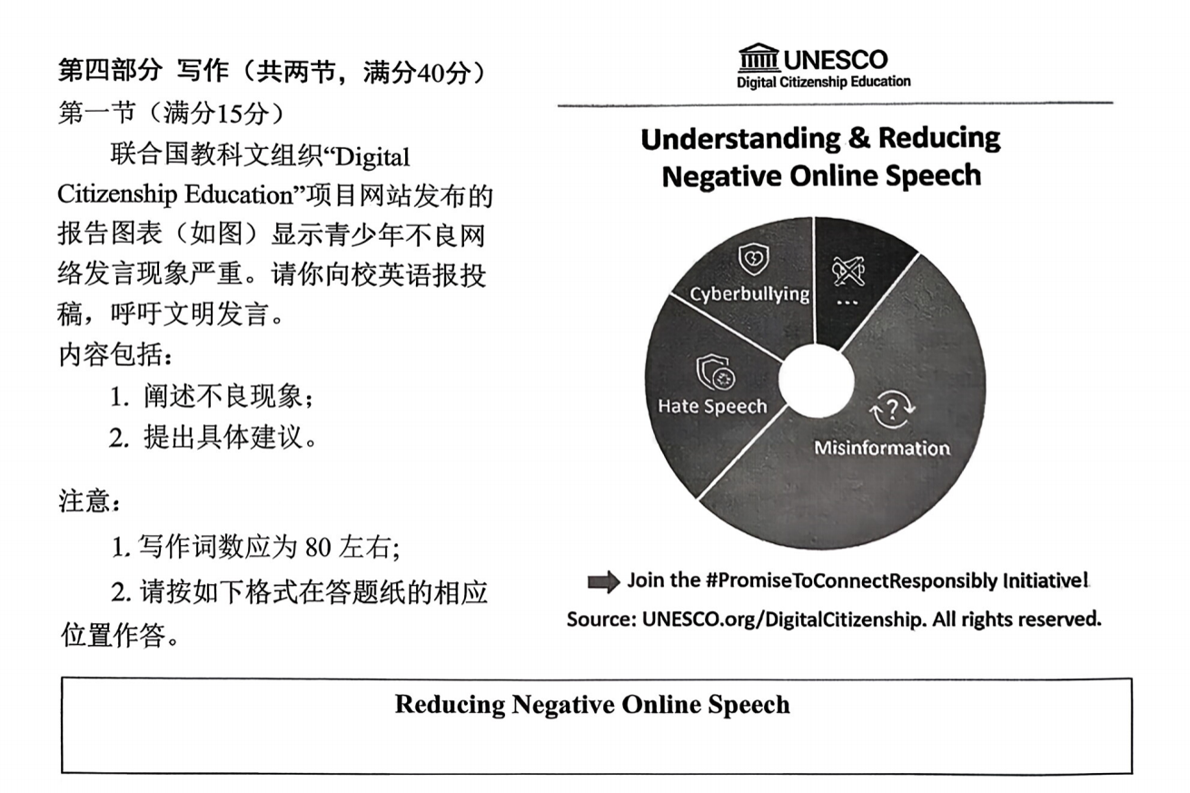
审题
Language：新人教B2U3 The Internet

Slide 4
Diverse opening techniques
① Direct Statement of the Issue
Recent reports have shown a growing concern over inappropriate online behavior among teenagers, which is not only damaging to individuals but also harmful to the entire online community.

Slide 5
Diverse opening techniques
② Citing Statistics or Reports
According to a recent report from UNESCO's “Digital Citizenship Education” project, there has been a significant rise in harmful online behaviors among youth, which demands urgent attention.

Slide 6
Diverse opening techniques
③ Asking a Question
Have you ever considered how your words online might affect others? Recent studies reveal that many teenagers are engaging in harmful online speech, which can have long-lasting impacts.

Slide 7
Diverse opening techniques
④ Personal or Societal Perspective
As more young people spend time online, it becomes evident that many are not using the Internet responsibly. From cyberbullying to spreading misinformation, the consequences of negative online behaviors are undeniable.

Slide 8
Diverse opening techniques
⑤ Quoting an Authority or Institution
UNESCO's recent report stresses the importance of “Digital Citizenship Education” to address the growing problem of negative online behaviors among teenagers.

Slide 9
These different openings serve to either directly present the problem, engage the reader, or establish authority, depending on the tone you wish to set for your piece.

Slide 10



What makes a logically coherent body and an appealing ending?
段落1：描述现象，给出具体例子或数据。
段落2：分析问题产生的原因/提出具体的解决方案。
段落3：总结，呼吁大家行动。

Slide 11
The prevalence of social media
No.1
Causes
No.3
No.2
Anonymous protection
The inadequacy of media literacy education

Slide 12

The root causes of these undesirable online behaviors often lie in three key aspects. First, the widespread popularity of social media has made it easier for teenagers to access various online platforms, expanding the scope and frequency of their interactions—and thus creating more opportunities for harmful behaviors like cyberbullying or spreading rumors.

Slide 13
Additionally, many schools fail to provide adequate media literacy education, leaving students ignorant of the real-world harm their online actions can cause.
Second, the anonymity provided by the Internet allows many young people to act without facing immediate real-world consequences, which emboldens（助长） them to engage in uncivil or harmful actions. Lastly, the lack of systematic media literacy education in many schools leaves students unaware of the potential impact of their online words and behaviors, as well as how to behave appropriately in digital environments.

Slide 14
To combat these issues, we must first implement better education programs in schools. Students should be taught about digital citizenship, which includes understanding the consequences of their online actions and how to engage respectfully. Social media platforms also have a role to play.

Slide 15
They can improve moderation systems and create features that allow users to easily report bullying or harmful content. Furthermore, it is important for parents to engage in conversations with their children about responsible online behavior and set clear guidelines for Internet use.

Slide 16
In conclusion, addressing the issue of inappropriate online behavior requires the combined efforts of schools, parents, social media companies, and the teenagers themselves. Everyone must play their part in ensuring the Internet remains a positive space. By educating young people, improving digital platforms, and fostering a culture of respect, we can create a safer and more supportive online environment.

Slide 17
In today’s digital age, the Internet has become an essential part of our lives. Many teenagers are spending a lot of time online. However, with the rise of social media platforms, bad behavior among teenagers, like cyberbullying and spreading false information, has become a serious problem. To deal with these issues, there are a few measures that we can take.
First, teenagers should learn how to distinguish between true and false information and avoid spreading rumors.

Slide 18
7-9分
Secondly, schools should focus more on teaching students about online etiquette and the importance of responsible behavior. In addition, parents need to keep an eye on their children's Internet use to prevent them from being influenced by harmful content.
In conclusion, teenagers need to be responsible when using the Internet. Only by working together can we prevent bad online behavior from spreading.

Slide 19
Lack of Specific Examples（abstract）；
Shallow Analysis:（no reasons behind why teenagers engage in bad online behavior);
Vague Solutions: The suggested solutions are general, such as "learn to distinguish information" and "monitor Internet use" ,but they lack specific, actionable details on how to implement them effectively. For instance, how can schools teach online etiquette? What strategies can parents use to monitor Internet use without being invasive?

Slide 20
The Internet plays an essential role in teenagers' lives, offering valuable opportunities for learning and socializing. However, it also poses significant challenges, such as cyberbullying and the spread of misinformation.
Around 20% of teenagers report being victims of cyberbullying, which can cause lasting emotional harm. Misinformation also spreads quickly on social media, creating confusion and fear among the public. To address these problems, schools should focus on teaching digital literacy and online ethics. Social media platforms must enhance content moderation systems to quickly identify harmful content. Parents should also play an active role in guiding their children’s online behavior and encouraging critical thinking.
In conclusion, solving online behavior issues requires collaboration among schools, parents, and social media companies to create a safer, more responsible online environment.

Slide 21
According to a report from UNESCO’s “Digital Citizenship Education” program, one of the most concerning online behaviors of Chinese teenagers is cyberbullying. This refers to young people harassing, shaming, or threatening others via platforms such as WeChat Moments and Sina Weibo. For instance, a study indicated that just over 1/6 of Chinese students have encountered some type of online bullying. Another disturbing problem is the dissemination of false information or rumors: some Chinese teenagers, usually to gain attention or for amusement, share unsubstantiated news, which may trigger unnecessary panic or cause harm.

Slide 22



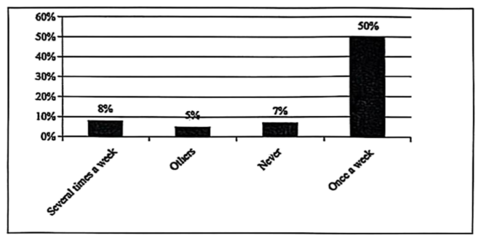
2026届福建省福州市高三上学期第一次质量检测
假定你是李华，你校英语报健康专栏对学生不吃早餐的现象进行调查，请根据以下调查统计图写一份书面报告，内容包括：
1．描述统计图（bar chart）；
2．给出建议。
How Often Breakfast Is Skipped
注意：(1)写作词数应为80个左右；
(2)请按如下格式在答题卡的相应位置作答。
Recently, our English newspaper had a survey about how often breakfast is skipped.

Slide 23

Recently, our school conducted a survey on the frequency of students skipping breakfast. According to the bar chart, 50% of students skip breakfast once a week, which is the highest proportion. Additionally, 8% skip breakfast several times a week, while 5% fall into the "Others" category. This data indicates that skipping breakfast is a widespread issue among students.

Slide 24

To address this problem, students should consider setting earlier alarms and developing a habit of going to bed earlier to ensure they have time for breakfast. Schools can also offer more appealing and nutritious breakfast options to encourage students to eat in the morning. A good breakfast is crucial, providing the necessary energy to support both academic performance and overall health.

Slide 25

Possible 考题
评论 (Commentary)
题目： 关于学生压力水平的评论
广泛关注+压力来源+减压措施
从图表中可以看到，45%的学生表示因学业压力而感到非常有压力，紧随其后的是30%的学生表示由于社交压力而感到困扰，只有15%的学生表示几乎没有压力。这些结果表明，压力已成为许多学生面临的主要问题，尤其是学业压力。

Slide 26

演讲稿 (Speech)
题目： 早餐对学业成功的重要性
令人担忧+重要性+花时间吃早餐
根据学校最近进行的一项调查，50%的同学每周至少有一次会跳过早餐。图表显示，跳过早餐会导致能量水平低下，且在课堂上难以集中注意力。
调查结果显示，定期吃早餐的学生在学业表现上更好，全天的精力也更充沛。事实上，跳过早餐的学生在课堂上更容易感到疲倦，集中注意力的能力降低，比例高达30%。

