Slide 1


感恩遇见，相互成就，本课件资料仅供您个人参考、教学使用，严禁自行在网络传播，违者依知识产权法追究法律责任。
更多教学资源请关注
公众号：溯恩英语
知识产权声明

Slide 2
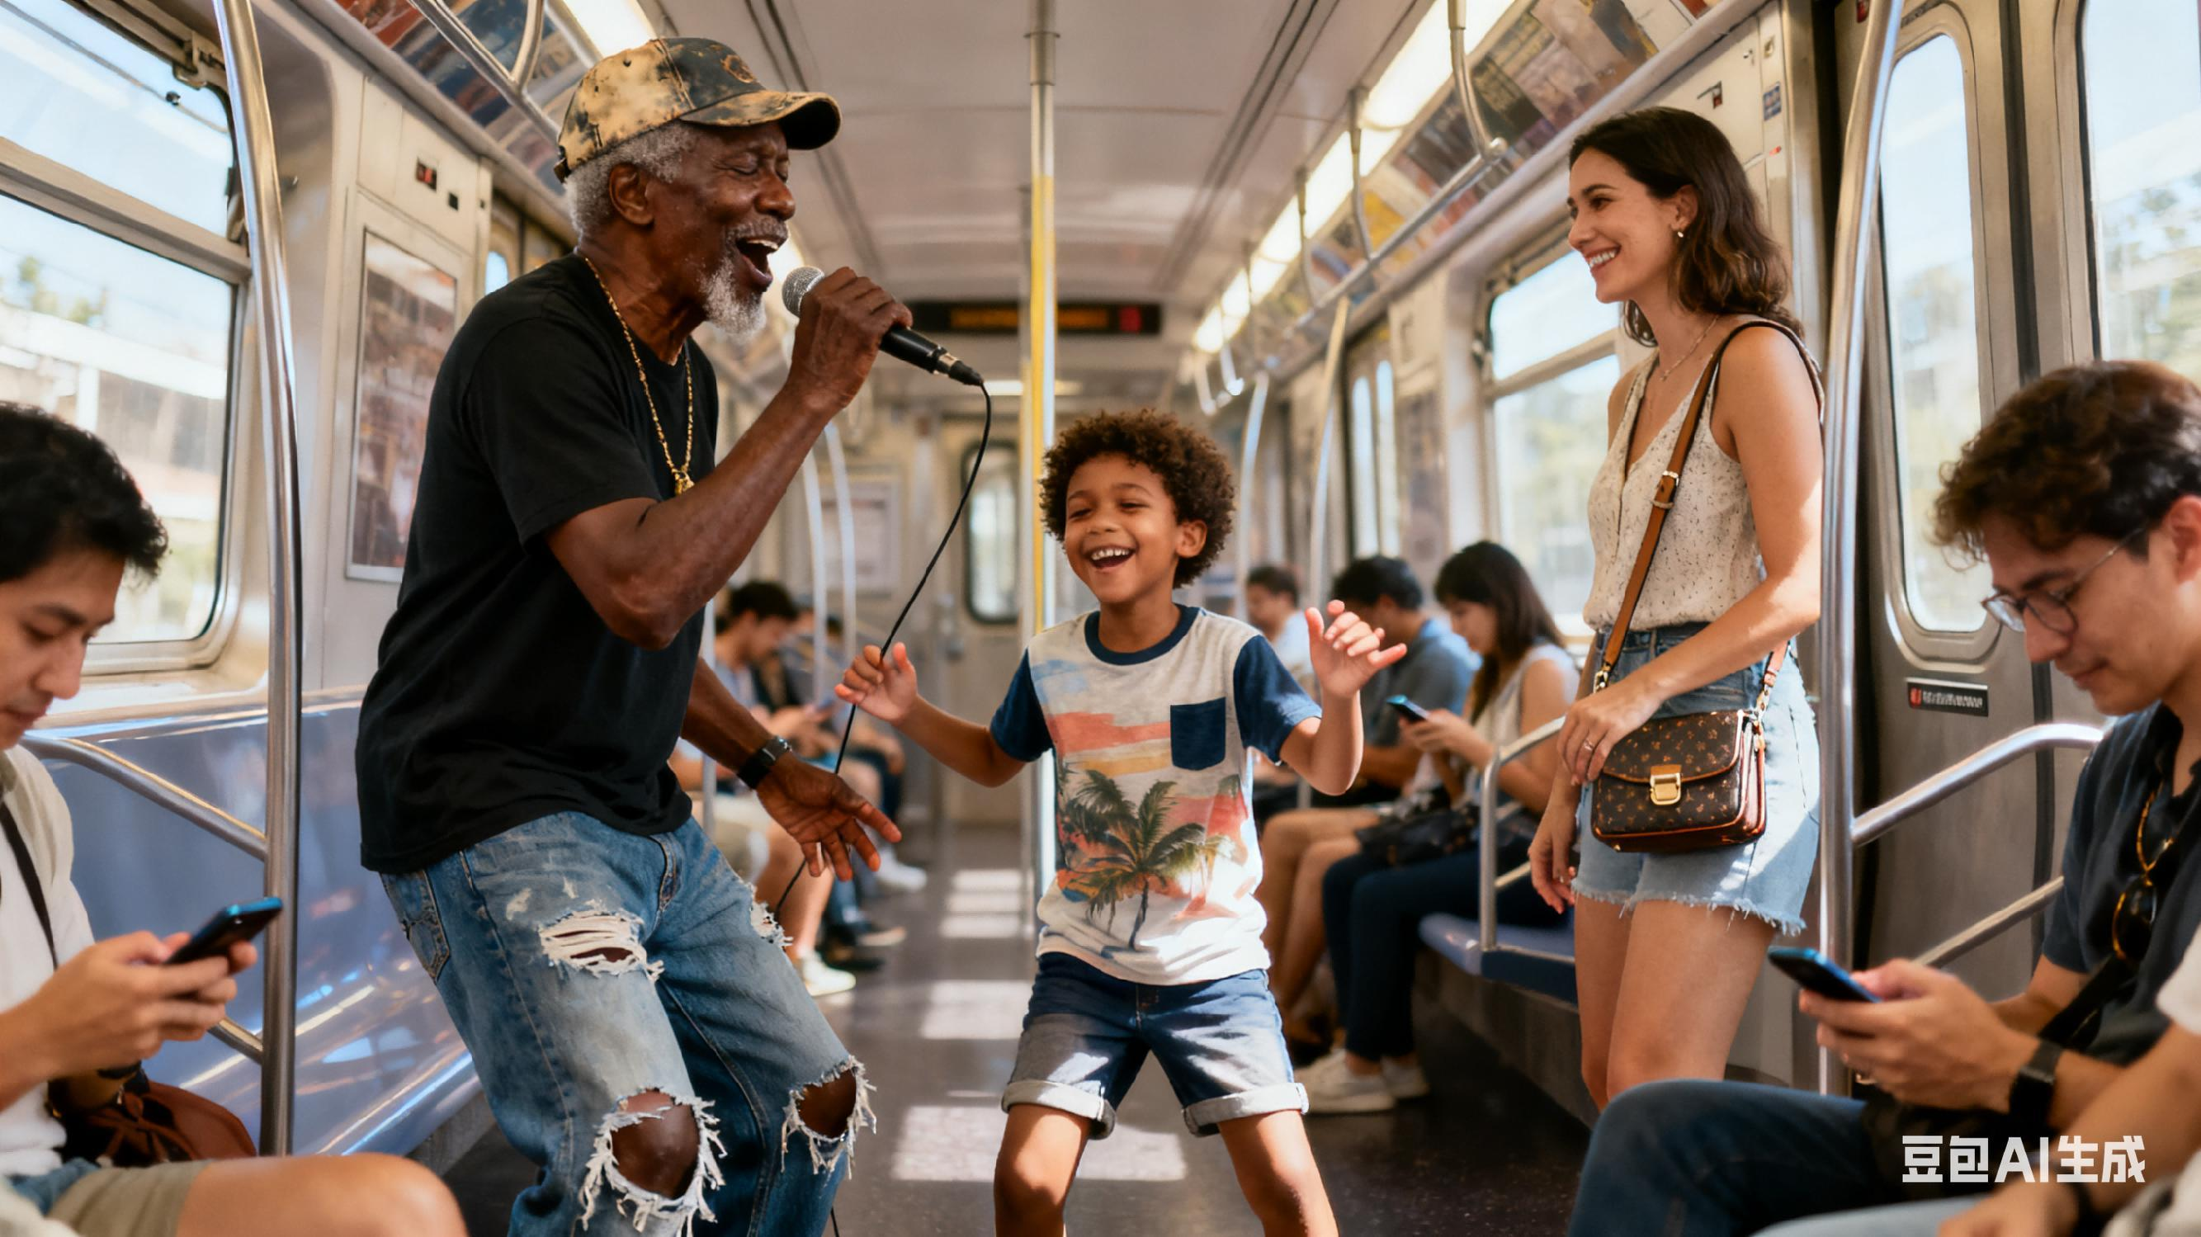
被忽略的歌声，被接住的温柔
2025年11月杭州一模读后续写
杭州二中树兰高级中学 郭合英

Slide 3
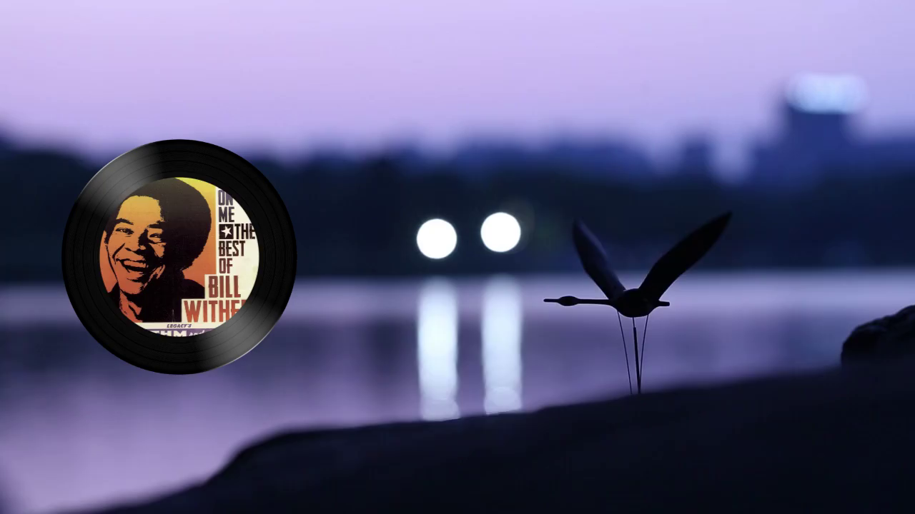
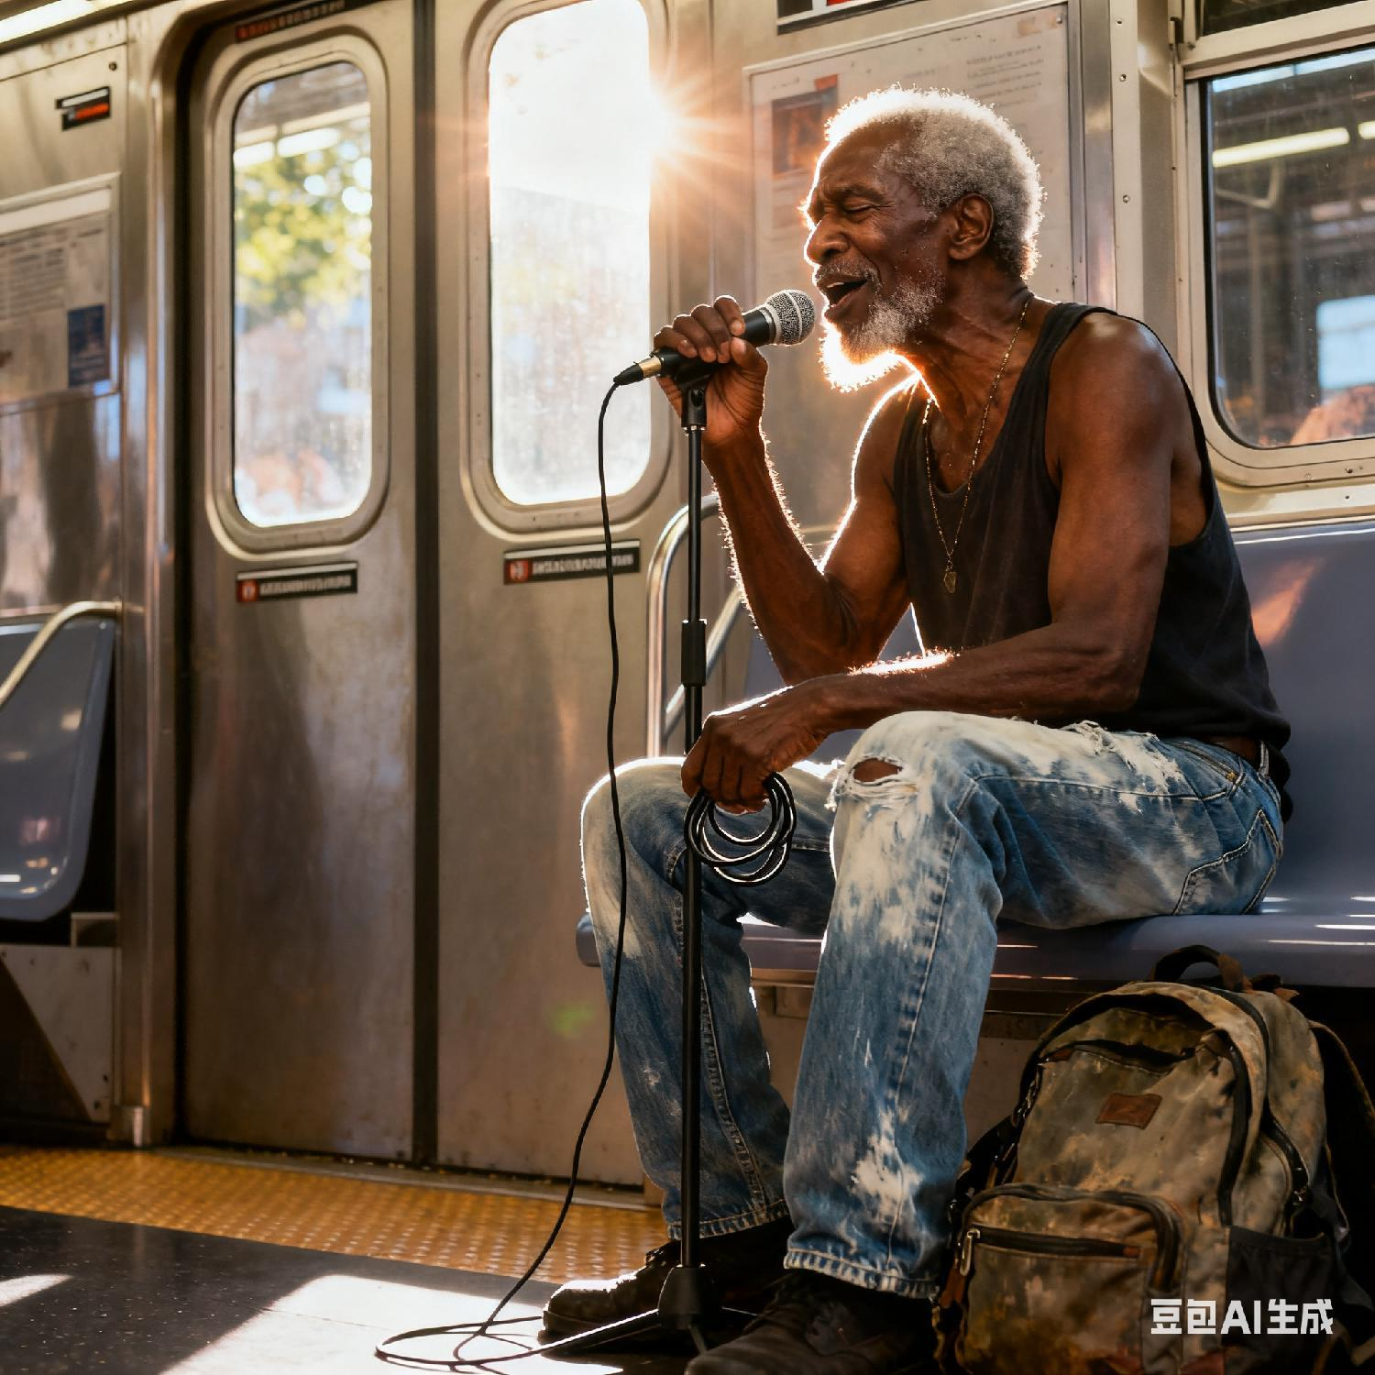
Lean on me
盛夏的纽约地铁，像个密不透风的铁盒，装着人们的疲惫与漠然—有人低头刷着手机，有人对陌生人的问候视若无睹，连空气都透着几分疏离。直到那道沙哑却温暖的歌声响起，像一缕意外闯入的风，轻轻掀动了沉寂的氛围。有人依旧沉浸在自己的世界里，但总有一份善意，会在某个瞬间与这歌声轻轻相撞，让冰冷的车厢，悄悄漾起一丝温柔的涟漪。

Slide 4

故事梳理
Learning objectives
文本分析
语言产出
作品欣赏

Slide 5
阅读下面材料，根据其内容和所给段落开头语续写两段，使之构成一篇完整的短文。
It was a hot day in New York City. I had brunch with a friend and picked up my new glasses. All done and headed back on the train. I wanted to yell at a couple of people for their rude behavior, but wisely just sat quietly.
An old black gentleman entered the far end of the train car. In worn but neat clothes, he tipped his faded cap and greeted everyone with a warm “Good afternoon, folks.” Most ignored him, with cold blank faces. Then, he started to sing. I didn’t turn my head, but I felt a smile in my soul. Many people ask for money on the train, but I always feel happy when someone offers music instead. It feels like a gift.
I let the notes settle in for a second before my eyes wandered. A young boy across from me, maybe ten, watched him, swaying (摇摆) to the rhythm, his mother too distracted by her phone to notice.
tip (为表示礼貌或打招呼)轻触（帽檐等）致意
在我内心深处
（指感觉、声音、想法等）逐渐渗透；慢慢融入（心里）
随着节奏摇摆
(to 意为 随着；按照)

Slide 6
He started his second song and my heart did a happy dance. “Lean on me, when you’re not strong. I’ll be your friend...” I love that song! Without thinking, I softly sang a little harmony with him. Right away, I decided he could have the $5 bill in my purse.
He looked tall and thin, but he had a strong voice and kind energy. Life had clearly been hard for him, but he still stood tall and carried himself with quiet dignity.
I rolled the bill tightly and waited for him to make his way to me. He held the overhead bar to steady himself as he inched down the car, pausing briefly beside each seat like he was waiting for a sign — though no one glanced up. No one was making any moves to give him coins or reach for their wallet.
和某人一起唱和声
朝……方向走
前往……地方
沿着……缓慢移动；
一点点地沿着……挪动
抓住头顶的扶手
稳住（自身 / 物体）
快速/不经意地
抬头瞥一眼
伸手去够
伸手去拿
Somehow, he noticed me singing along.
It was still hot and sticky inside the car, but something had changed.

Slide 7
通过语法填空，了解故事概要
It was a hot day in New York City. After brunch with a friend and fetching my new pair of 1 (glass), I took the train back. I felt annoyed by some people’s 2 (rude) but chose to sit quietly.
Soon, 3 elderly Black gentleman entered the train. Dressed in 4 (wear) yet neat clothes, he tipped his faded cap and greeted everyone warmly, “Good afternoon, folks.” Most ignored him, their faces cold and blank. Then he started singing. I didn’t look up, but a smile rose in my heart. Unlike those 5 beg for money, his music felt like a precious gift.
Across from me, a 10-year-old boy rocked 6 the rhythm, while his mother stayed glued to her phone. When he sang “Lean on me,” my favorite song, I 7 (conscious) joined in softly. I immediately resolved 8 (give) him the $5 in my purse.
He looked thin but had a strong voice and kind energy. Clearly, life 9 (be) tough, yet he stood tall with dignity. I rolled the bill tightly and waited. As he slowly moved down the car, 10 (hold) the bar for balance, he paused by each seat—no one looked up or reached for their wallet. …
glasses
rudeness
an
worn
who
to
unconsciously
to give
had been
holding

Slide 8
记叙文的5W1H
基本 要素 | who
 | when
 | where
核心 要素 | what
扩展 要素 | why
 | how
Core: “I”, an elderly Black gentleman; Secondary: a 10-year-old boy, the boy’s mother, other subway passengers
It was a hot day in New York City. I had brunch with a friend and picked up my new glasses.
Inside a subway car in New York City
An elderly Black gentleman greeted passengers politely and sang on the train (including “Lean on me”)
I was moved by the song, deciding to give him $5 while most passengers ignored him coldly.
Somehow, he noticed me singing along. …
It was still hot and sticky inside the car, but something had changed.…

Slide 9
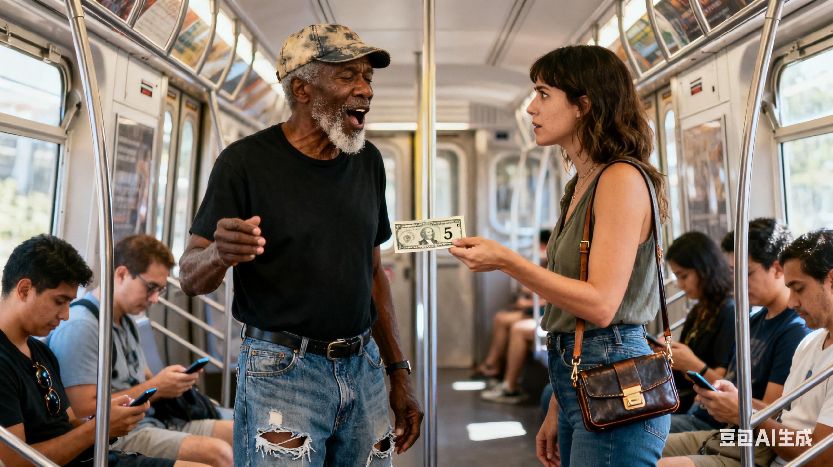
根据文章内容，推测人物性格
“I”
A young boy across from me, maybe ten, watched him, swaying (摇摆) to the rhythm, his mother too distracted by her phone to notice.
All done and headed back on the train. I wanted to yell at a couple of people for their rude behavior, but wisely just sat quietly.
克制与理性
敏锐的观察力
Most ignored him, with cold blank faces. Then, he started to sing. I didn’t turn my head, but I felt a smile in my soul. Many people ask for money on the train, but I always feel happy when someone offers music instead. It feels like a gift.
He looked tall and thin, but he had a strong voice and kind energy. Life had clearly been hard for him, but he still stood tall and carried himself with quiet dignity.
尊重与欣赏
“我”(叙述者)：共情力强、克制且懂得尊重

Slide 10
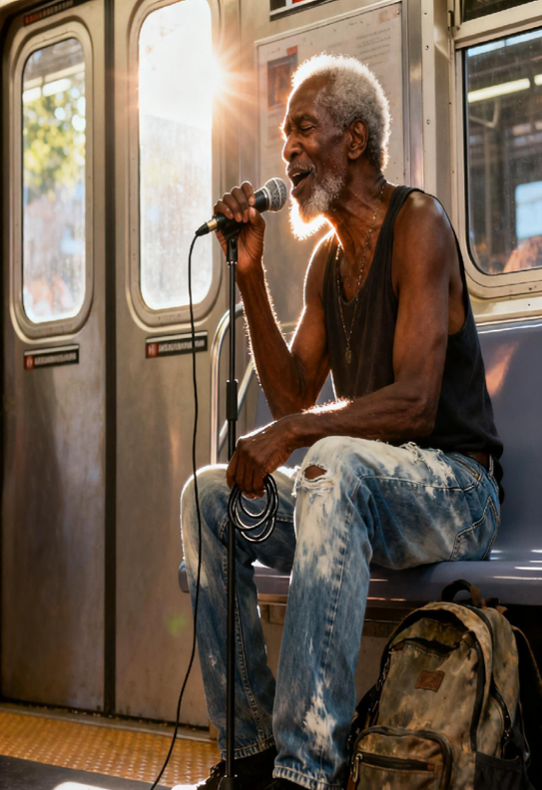
根据文章内容，推测人物性格
the old black gentleman
An old black gentleman entered the far end of the train car. In worn but neat clothes, he tipped his faded cap and greeted everyone with a warm “Good afternoon, folks.”
Somehow, he noticed me singing along.
乐观、友善且传递快乐
敏锐的观察力
(能注意到“我”跟唱，说明他并非只顾唱歌，体现出友善的互动意识)
He looked tall and thin, but he had a strong voice and kind energy. Life had clearly been hard for him, but he still stood tall and carried himself with quiet dignity.
自尊且有尊严
老黑人绅士：自尊、乐观且传递善意

Slide 11
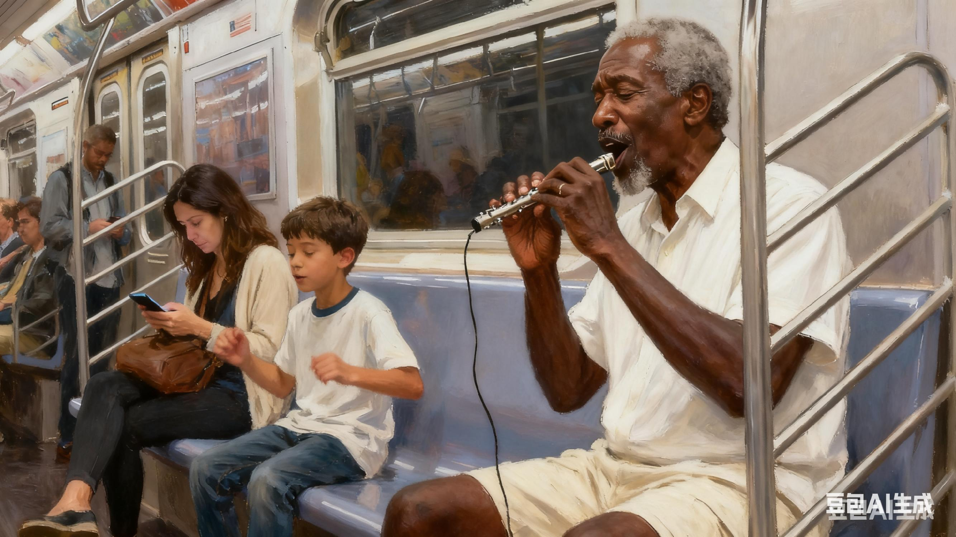
根据文章内容，推测人物性格
the little boy
纯真且真实
(不像成人那样“冷漠地无视”，而是本能地“跟着节奏摇摆”，直接表现出对音乐的喜爱和对老人的关注,未被周围的冷漠氛围同化)
A young boy across from me, maybe ten, watched him, swaying (摇摆) to the rhythm, his mother too distracted by her phone to notice.
小男孩：纯真、共情且不受环境影响

Slide 12
根据文章厘清故事脉络
The cause (起因)：场景铺垫与人物登场
Background
Events
It was a hot day in New York City. I had brunch with a friend and picked up my new glasses. All done and headed back on the train. I wanted to yell at a couple of people for their rude behavior, but wisely just sat quietly.
An old black gentleman entered the far end of the train car. In worn but neat clothes, he tipped his faded cap and greeted everyone with a warm “Good afternoon, folks.” Most ignored him, with cold blank faces.
Then, he started to sing. I didn’t turn my head, but I felt a smile in my soul. Many people ask for money on the train, but I always feel happy when someone offers music instead. It feels like a gift.
“warm”与“cold”的反差，成为故事的核心起点
在粗鲁面前，“我”选择了安静忍耐，为后续“善意”的举动做了情绪铺垫
多数乞丐以“乞讨”为生，而老人用“音乐”替代“乞讨”，引发“我”的好感，为后续的“善意”做进一步的铺垫

Slide 13

根据契诃夫法则，厘清故事脉络
Events (发展)：情感递进与细节升温
情感层面
人物互动补充
老人动作
he started to sing… but I felt a smile in my soul.
内心生喜
A young boy across from me, maybe ten, watched him, swaying (摇摆) to the rhythm
He held the overhead bar to steady himself as he inched down the car, pausing briefly beside each seat like he was waiting for a sign
孩童世界的纯粹
Without thinking, I softly sang a little harmony with him.
认可
体现老人的谨慎—不强迫他人，也为后续矛盾埋下伏笔
主动帮助
his (the boy’s) mother too distracted by her phone to notice.
Right away, I decided he could have the $5 bill in my purse.
成人世界的冷漠

Slide 14
根据文章厘清故事脉络
The conflict (矛盾): 热意与冷脸
善意的传递
集体的冷漠
（The old man）greeted everyone with a warm “Good afternoon”
Most ignored him, with cold blank faces.
核心矛盾：善意的传递与集体的冷漠
no one glanced up.
冷脸+冷漠
问候+唱歌
No one was making any moves to give him coins or reach for their wallet.
Then, he started to sing.
次要矛盾：“集体冷漠的表现”与“个体善意的酝酿”形成
“我”的反应
I decided he could have the $5 bill in my purse.
尚未完成
善意的传递
I rolled the bill tightly and waited for him to make his way to me.

Slide 15
根据首局提示，合理构思情节
Somehow, he noticed me singing along.
核心互动：落地 “我与老人的善意衔接”。
The interaction between me and the elderly man .
辅助激活：让男孩成为 “第二善意支点”。
The interaction between the little boy and the elderly man .
根据第二段给出句“something had changed”反推第一段情节：聚焦“个体破冰”，筑牢善意起点。
。
情节接口：保留 “善意延续的通道”。
The elderly man regained his passion and continued singing his songs as a gift. His voice touched everyone around.
It was still hot and sticky inside the car, but something had changed.
这种扩散不可能凭空发生，必须在第一段先出现第一个打破冷漠的“善意支点”。从文中可知，“我”是唯一有善意酝酿的角色(I decided he could have the $5 bill in my purse.)，再结合第一段给出句“he noticed me singing along.”因此，第一段需优先落地“我与老人互动”的情节。
第二段若要从“单人善意”升级为“集体善意”，第一段不能只写“我”一个破冰者，需激活文中另一隐性线索—“A young boy across from me, maybe ten, watched him, swaying (摇摆) to the rhythm”，让第一段出现两个打破冷漠的个体，为第二段“更多人跟进”铺垫
“我和男孩的回应”让老人重拾热情，既呼应前文，又为第二段 “老人再唱、带动更多人互动” 埋下直接线索。

Slide 16
根据首局提示，合理推动情节发展
It was still hot and sticky inside the car, but something had changed.
第一层扩散：家庭内部的态度松动。
以第一段中男孩 与老人的互动为契机，让男孩母亲 “looked up from her phone”，呼应原文 “mother too distracted by her phone to notice” 的细节，完成 “分心→关注” 的合理转变。
第二段核心思路围绕“change”展开，延续“环境未变但人心变暖”的鲜明对比，以“乘客态度转变”为隐性线索，串联老人的体面回应、关键人物的递进式互动，最终落点于“善意传递的余韵”。
第二层扩散：其他乘客的主动参与。
可设计 “穿白衬衫的男士递硬币” 的情节，作为 “群体善意” 的代表，让善意从 “我 和男孩” 延伸到其他乘客，体现 “扩散” 的核心。
氛围升华：从 “个体互动” 到 “群体共鸣”。
可通过 “对比描写” 与 “细节描写” 的结合实现互动升级。对比描写让 “something had changed” 更具象；细节描写让善意传递有细节支撑，最终推动互动从 “我与老人的个体呼应” 自然延伸至 “全车人的群体共鸣”。
主题收尾：呼应核心意象，延续情感余韵

Slide 17

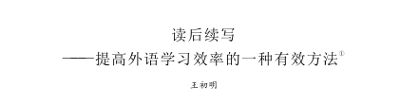
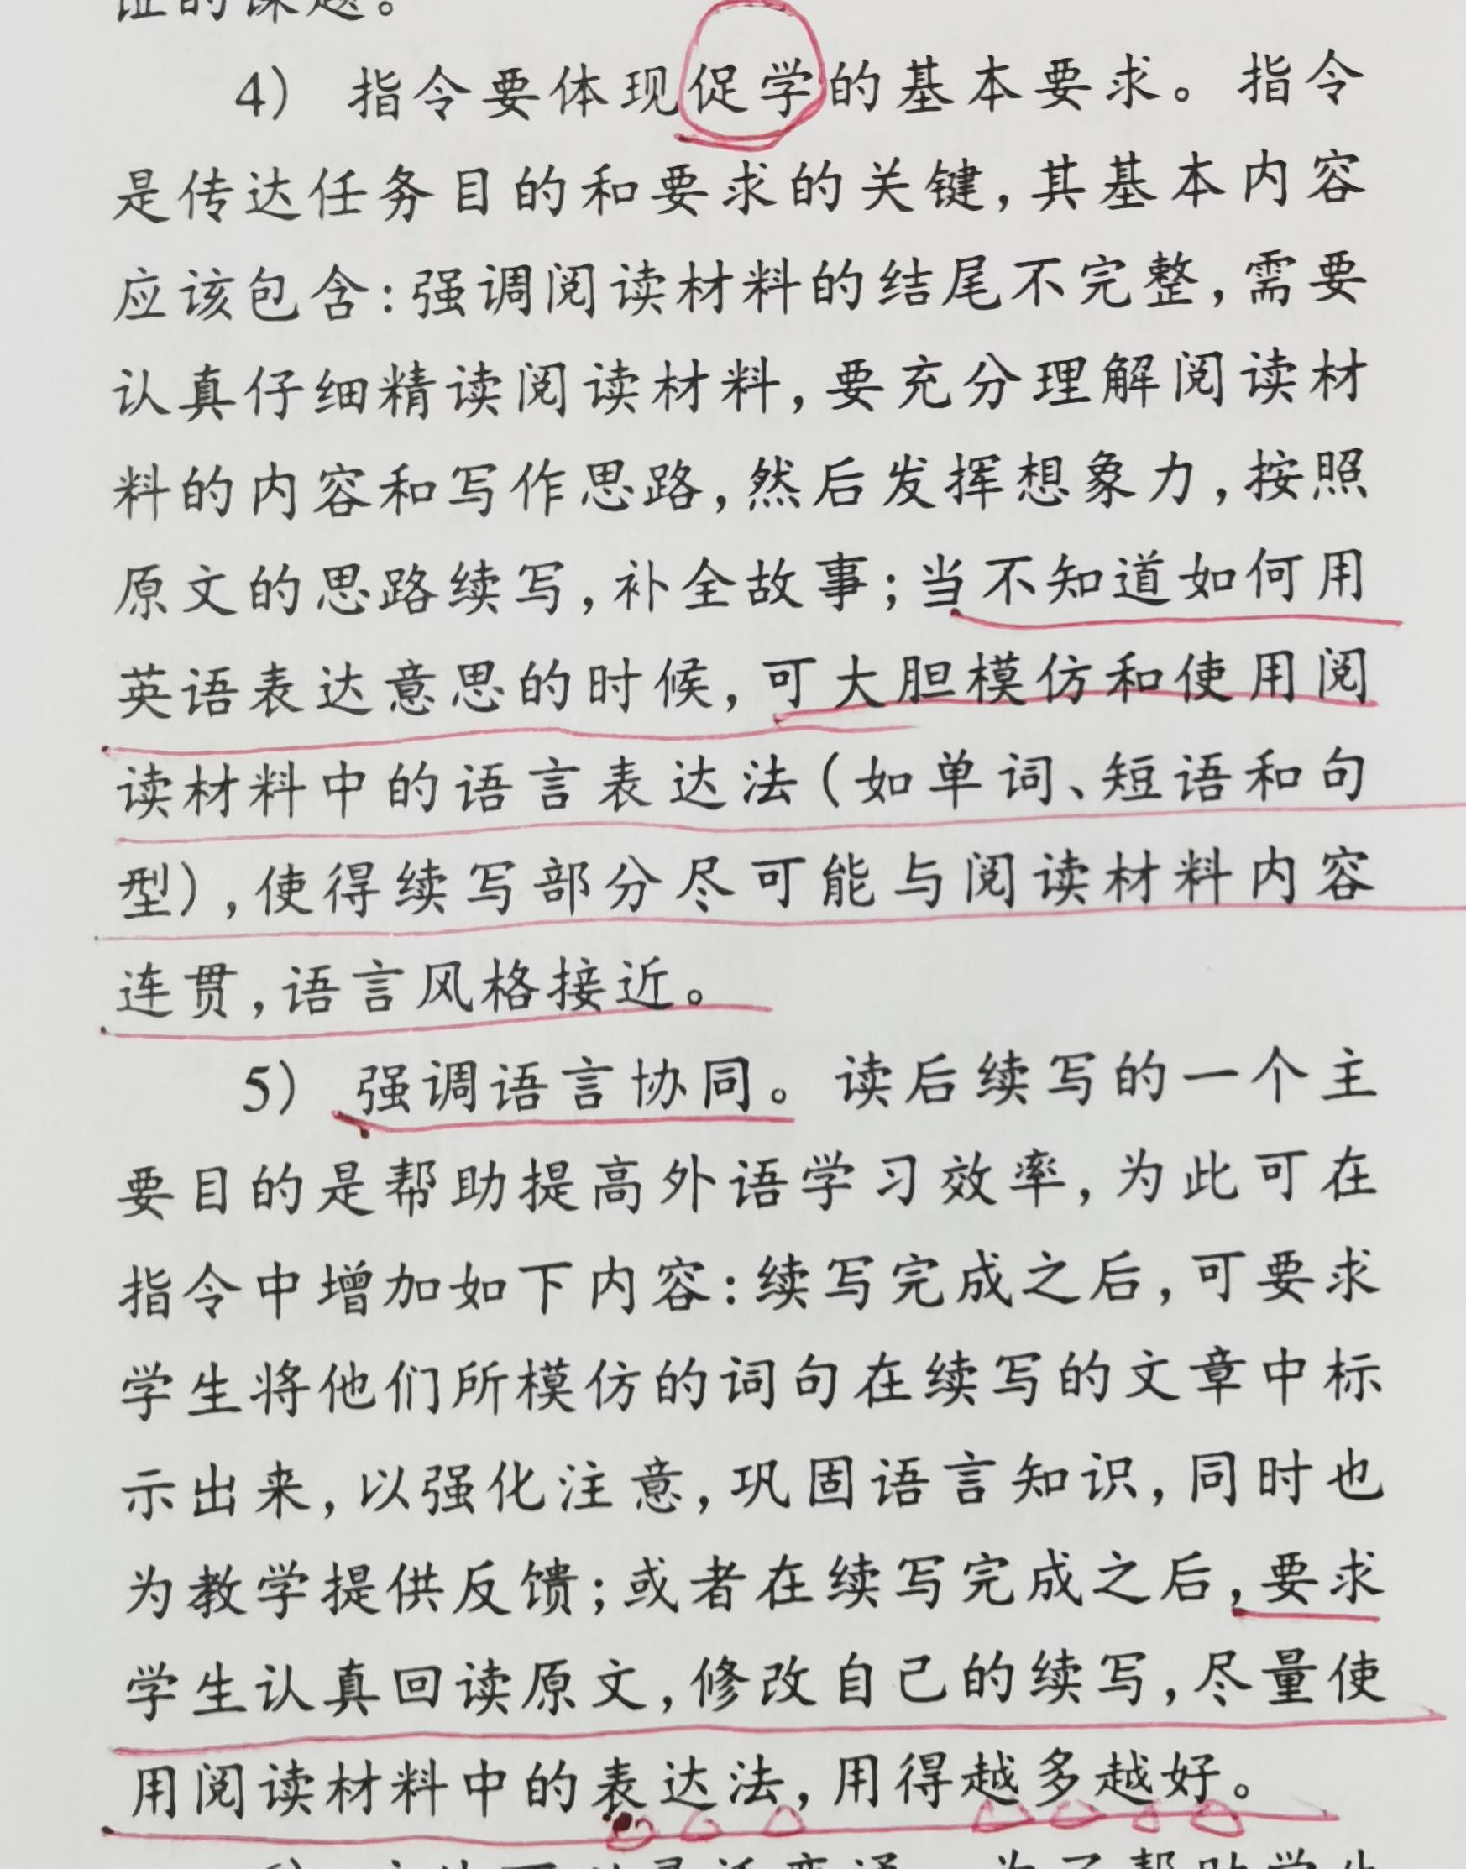
分析原文特色，铺垫续文协同
当你不知道如何用英语表达意思的时候，可大胆模仿和使用阅读材料中的语言表达法（如单词、短语和句型），使得续写部分尽可能与阅读材料内容连贯，语言风格接近。
王初明
……要求学生认真回读原文，修改自己的续写，尽量使用阅读材料中的表达法，用的越多越好。

Slide 18
分析原文特色，铺垫续文协同
叙事视角：
第一人称增强代入感,使故事更具真实感与亲和力
I had brunch with a friend and picked up my new glasses. All done and headed back on the train. I wanted to yell at a couple of people for their rude behavior, but wisely just sat quietly.
In worn but neat clothes, he tipped his faded cap
体现老人生活拮据却注重整洁
人物塑造：
细节勾勒人物，立体形象
…greeted everyone with a warm “Good afternoon, folks.”
凸显其礼貌温和
He looked tall and thin, but he had a strong voice and kind energy. Life had clearly been hard for him, but he still stood tall and carried himself with quiet dignity.
刻画了老人虽生活艰辛，却依旧保持尊严

Slide 19
分析原文特色，铺垫续文协同
情感表达：
隐性传递,避免刻意煽情
I felt a smile in my soul.
my heart did a happy dance.
All done and headed back on the train.
多使用短句与简单句式
语言风格：
句式简洁,用词质朴，鲜有长难句
He started his second song and my heart did a happy dance.
“brunch”, “new glasses”, “wallet”
“train car”, kind energy
用词质朴，无高大上词汇

Slide 20
分析原文特色，铺垫续文协同
I decided he could have the $5 bill in my purse.
因此，续文创作需在人物塑造、情感表达、语言风格、结构呼应等方面与原文高度协同，打造高质量作品，而非生硬植入“高大上”词汇的拼凑堆砌。
I rolled the bill tightly and waited for him to make his way to me.
结构铺垫：
伏笔与反差为续写蓄力
均为情节伏笔
A young boy across from me, maybe ten, watched him, swaying (摇摆) to the rhythm…
warm “Good afternoon
cold blank faces
Life had clearly been hard for him
he still stood tall and carried himself with quiet dignity
反差对比，形成矛盾冲突

Slide 21
协同下的语言积累
Paragraph 1:
Somehow, he noticed me singing along.
我们目光相遇时，他那张饱经风霜的脸柔和了下来，眼角皱起，漾出一抹温柔的笑。
与给出句自然衔接
呼应文中“Life had clearly been hard for him”
His weathered face softened when our eyes met, and the corners of his eyes wrinkled into a soft smile.
情感表达含蓄
他没有匆匆走过—相反，他放慢了脚步，一只手仍抓着头顶的扶手以保持平衡，又抬了抬那顶褪色的帽子，这次是专门朝我轻轻点了点头。
呼应原文老人“held the overhead bar to steady himself”的动作细节
He didn’t hurry past—instead, he slowed, one hand on the overhead bar for balance, and tipped his faded cap again, nodding quietly just to me.
承接原文老人 “tipped his faded cap” 的礼貌特质

Slide 22
协同下的语言积累
以 “粗糙手指” 细节强化老人 “生活艰辛却保持体面” 的形象，贴合原文 “life had clearly been hard for him, but he still... carried quiet dignity”。
我递出那卷起来的5美元纸币，他接过时，布满老茧的手指轻轻擦过我的手，仿佛不愿打乱这一刻的节奏。
呼应原文 “rolled the bill tightly” 的伏笔
I held out the rolled $5 bill, and his rough-skinned fingers brushed my hand gently as he took it, like he didn’t want to rush the moment.
“没有什么比一起唱歌更惬意的了，”他说道，声音低沉却温暖。“这对我来说意义非凡。
呼应文中“greeted everyone with a warm “Good afternoon,”的温和语调
“Nothing nicer than singing together,” he said, his voice low but warm. “This means more than you know.”

Slide 23
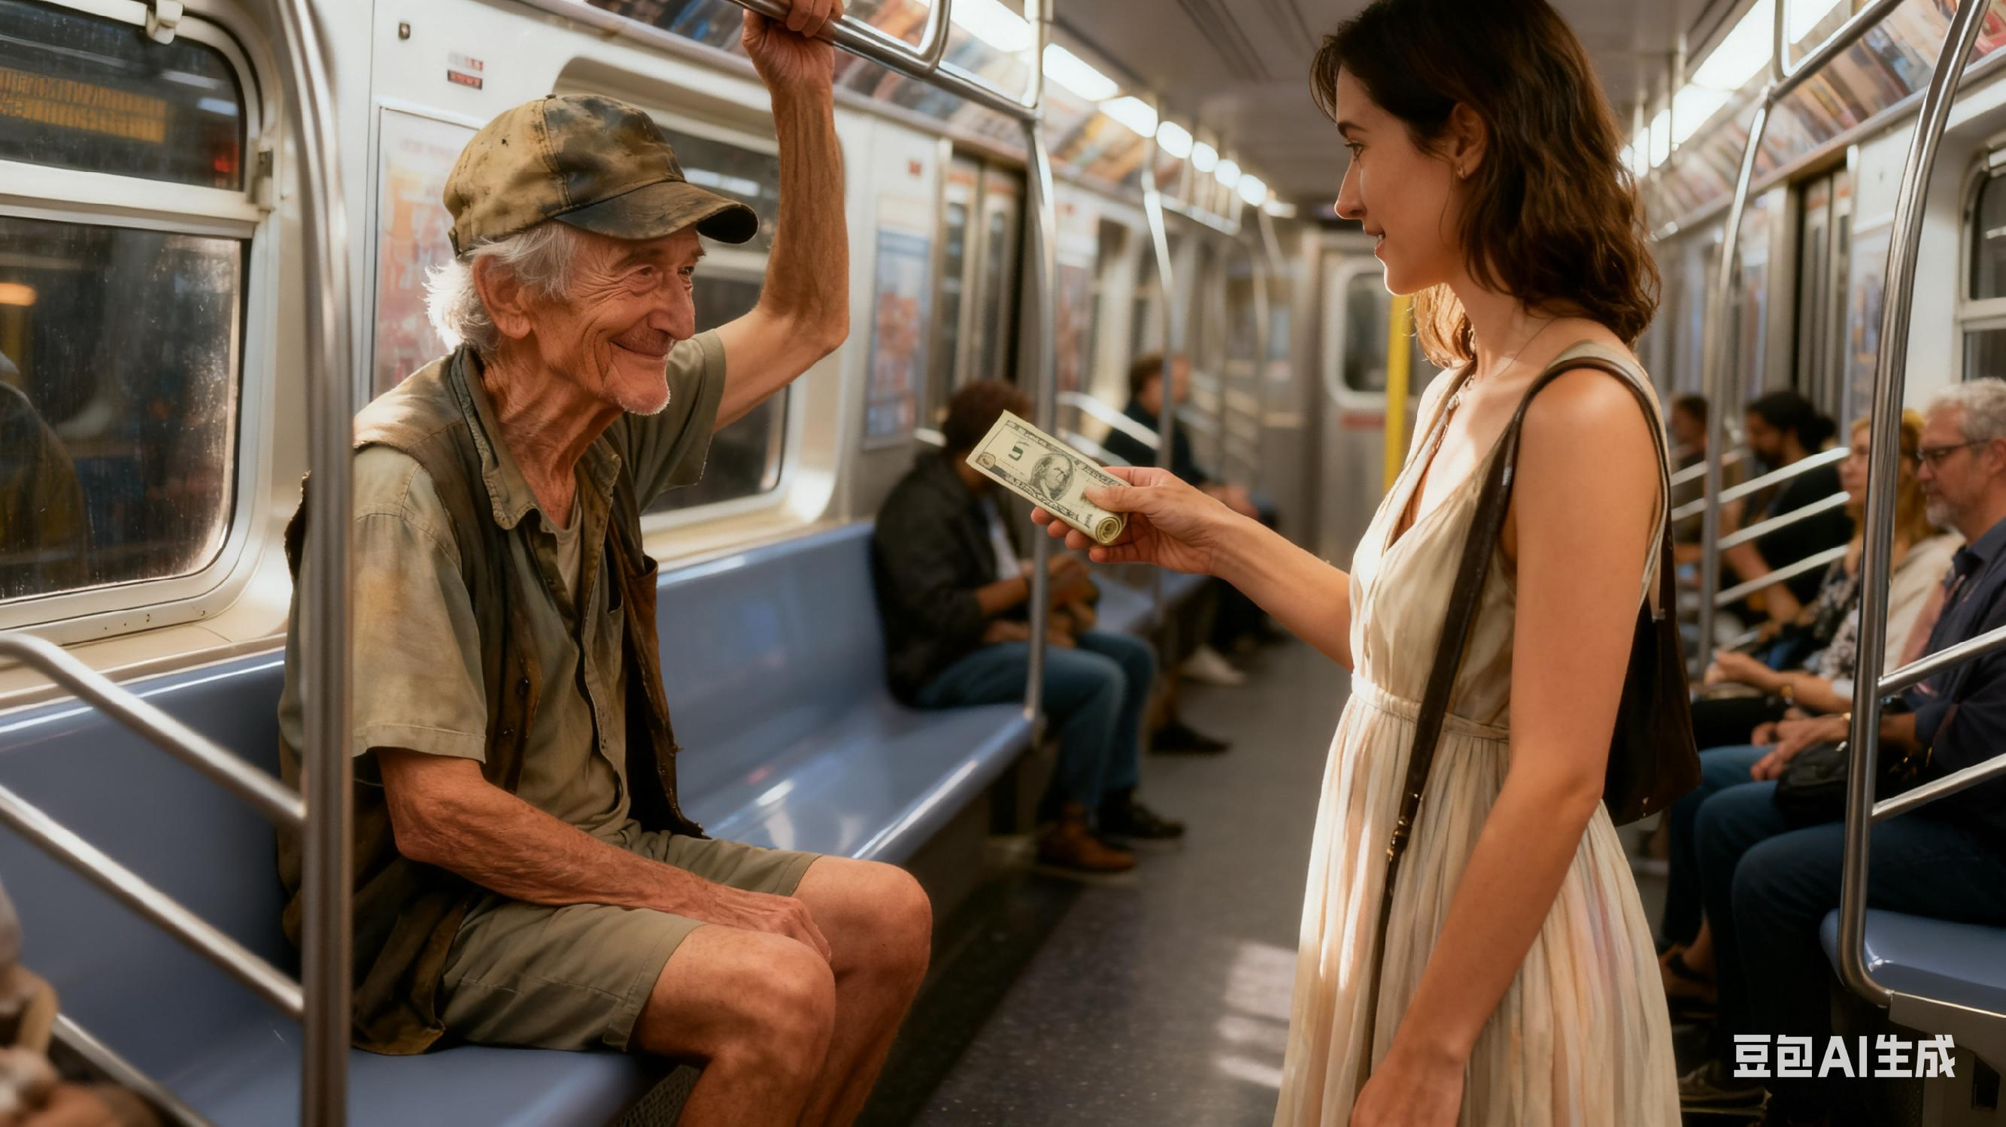
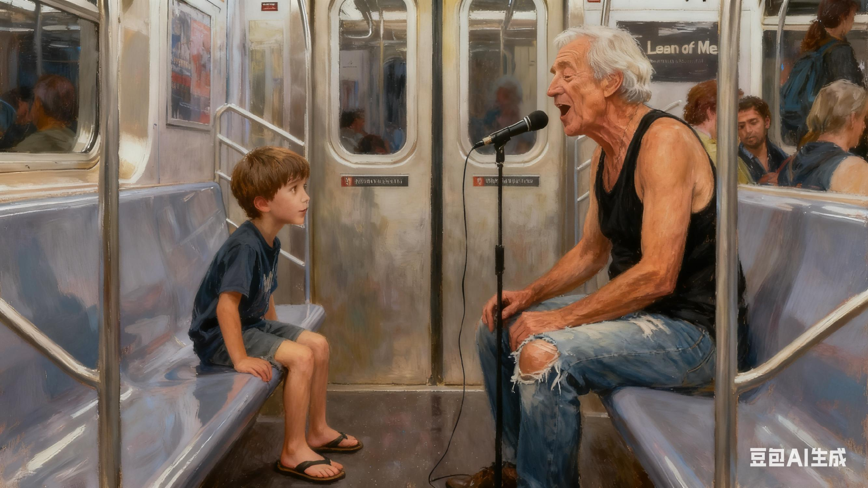
“the boy across from me” 直接呼应原文第三段第二句 “A young boy across from me”，完美契合原文 “细腻细节描写” 的风格。它也是衔接细节、推动情节的关键 —— 既承接前文 “heard a soft movement”，明确 “轻微动静” 的发出者，解答了 “谁在动” 的疑问；又为后文 “母亲看到儿子的 tapping” 埋下伏笔，让母亲的 “关注” 更具逻辑合理性，确保全文情节连贯自然。
协同下的语言积累
当他唱起“Lean on Me” 的下一句时，我听到一阵轻微的动静：对面的小男孩动了动身子，小小的脚跟着节奏轻轻拍打着地板，仿佛生怕打破这一刻的氛围。
When he started the next line of “Lean on Me,” I heard a soft movement: the boy across from me shifted, his small feet tapping along softly, as if afraid to break the moment.
“the next line of ‘Lean on Me’” 既是对前文 “ He started his second song…Lean on me” 的直接呼应，更是全文的核心衔接点 —— 既承接了 “我与老人和声互动” 的已有场景，触发了后文男孩跟拍、母亲关注、乘客共鸣的连锁温暖反应，更将 “温暖善意” 的核心主题从个人互动升华为群体共鸣，让歌曲寓意与情节深度契合。

Slide 24
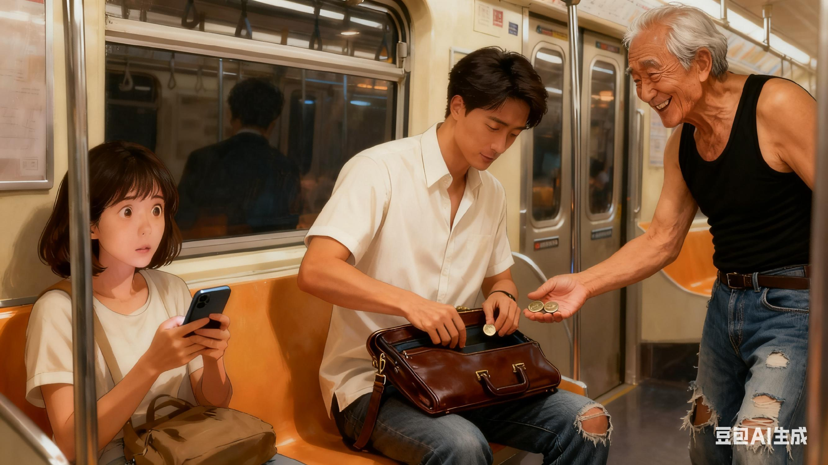
协同下的语言积累
Para 2
It was still hot and sticky inside the car, but something had changed.
那位母亲终于从手机上抬起头来，看到儿子在跟着打节拍，眼睛微微睁大了些。
承接原文 “mother too distracted by her phone to notice” 的细节，形成 “分心→关注” 的转变。
呼应第一段的结尾“ the boy across from me shifted, his small feet tapping along softly”，符合原文 “细腻细节描写” 的风格。
The mother looked up from her phone, her eyes widening slightly at her son’s tapping.
呼应原文老人 “strong voice” 的特质，同时体现善意带来的状态变化, 不堆砌复杂修饰。
一位穿着白色衬衣的男士挪了挪公文包，从口袋里摸出几枚硬币递了过去。老人依旧带着那抹笑容向他道谢，声音也轻快了些。
A man in a white shirt shifted his briefcase, fished out a few coins, and held them out. The old gentleman thanked him with that same smile, his voice a little brighter.

Slide 25
协同下的语言积累
我看着眼前的一切，心底的笑意变得更暖了。再也看不到那些冷漠麻木的脸庞了— 乘客们有的轻轻点头，有的跟着一起小声哼唱，甚至在老人唱到高音时，小男孩还发出了一声浅浅的笑。
“Gone were cold blank faces” 核心作用是 与原文形成强烈反差，同时承担承上启下、升华氛围的关键功能，让 “善意扩散” 的情节与主题更鲜明。
呼应原文 “felt a smile in my soul” 的含蓄情感表达，延续第一人称的心理视角。
Watching, I felt the smile in my soul warm more. Gone were cold blank faces—passengers nodded and sang together softly, and the boy laughed quietly when he hit a high note.
以平实的表达结尾，贴合原文 “music feels like a gift” 的核心，避免刻意升华，保持日常感。
那一刻，这列火车不再只是一个拥挤的铁盒子—而是一小片温暖的角落，宛如一份礼物，即便你下了车，这份暖意也依旧延续。
For a minute, the train wasn’t just a crowded metal box—it was a little spot of warmth that felt like a gift, lasting even when you stepped off.

Slide 26
如何呼应原文，深化主旨
主题升华不必依赖 “高大上” 词汇。抓住原文具体物体，借细节承接情节、呼应前文，既能实现语言与内容的协同，又能让核心主题落地，与文章的日常场景、质朴风格完全相融。
借“物品符号”深化“尊严与善意的双向尊重”
He unfolded the $5 bill softly, smoothing its wrinkles with rough fingers, then slid it carefully into his worn jacket pocket. It wasn’t a hurried stuff into a corner, but a quiet act that honored the kindness and his own dignity.
他轻轻展开那 5 美元纸币，用粗糙的手指抚平褶皱，随后小心翼翼地塞进自己那件旧夹克的口袋里。这不是仓促往角落一塞的举动，而是一种沉静的行为 —— 既尊重了这份善意，也守护了自己的尊严。

Slide 27
如何呼应原文，深化主旨
用“角色对比”放大“冷漠与温暖的碰撞”
The man paused briefly before handing over some coins; the mother, in turn, took out a banknote and gave it. Their small acts proved that coldness never stays forever—it always melts away. And kindness is precisely the force that makes this happen.
男士稍作停顿后递了硬币；母亲则换成纸币递出。他们的微小举动证明，冷漠不会一直停留—它总会消融。而善意，正是促成这一切的力量。

Slide 28
如何呼应原文，深化主旨
扣“歌词意象”让主旨与情节深度绑定
“Lean on me” isn’t just a song—it’s a thread that ties us: his song wrapped us in warmth, and our little responses told him his kindness didn’t fade. This small, real support turned the cold train into something unforgettable—warm, and woven together.
《Lean on me》不止是一首歌 —它是一根牵系着我们的线：他的歌声用温暖将我们萦绕，而我们细微的回应，也让他知道自己的善意未曾消散。这份微小却真切的支撑，把冰冷的列车变成了难忘的存在 —温暖, 且被紧紧编织在一起。

Slide 29
如何呼应原文，深化主旨
以“环境与心境的反差”强化主旨的感染力
The train was still hot, but no one complained anymore. The heat even seemed like a gentle wind—showing that kindness fights outer discomfort and inner cold—and warms everyone.
车厢里依旧闷热，却没人再抱怨。热气甚至仿佛变成了一缕柔风—这说明，善意能驱散外在的不适与内心的冷漠，还能温暖所有人。

Slide 30
如何呼应原文，深化主旨
加“微小余韵”让主旨穿透场景、延伸至日常
That train’s warmth—it feels like a gift. Not just for the moment, but a reminder: small kindnesses light up our daily lives.
For a minute, the train wasn’t just a crowded metal box—it was a little spot of warmth that lasted even when you stepped off.
那节车厢里的温暖 — 就像一份礼物。它不只是为了当下，更是一种提醒：微小的善意，能点亮我们的日常生活。
那一刻，这列火车不再只是拥挤的铁皮车厢 —— 它成了一小片温暖的角落，即便你下了车，这份暖意也依然留存。

Slide 31
An original work
Somehow, he noticed me singing along. His weathered face softened as our eyes met, the corners of his eyes wrinkling into a soft smile. He didn’t hurry past—instead, he slowed, one hand on the overhead bar for balance, and tipped his faded cap again, nodding quietly just to me. I held out the rolled $5 bill, and his rough-skinned fingers brushed my hand gently as he took it, like he didn’t want to rush the moment. “Nothing nicer than singing together,” he said, his voice low but warm. “This means more than you know.” When he started the next line of “Lean on Me,” I heard a soft movement: the boy across from me shifted, his small feet tapping along softly, as if afraid to break the moment.
It was still hot and sticky inside the car, but something had changed. The mother looked up from her phone, her eyes widening slightly at her son’s tapping. A man in a white shirt shifted his briefcase, fished out a few coins, and held them out. The old gentleman thanked him with that same smile, his voice a little brighter. Watching, I felt the smile in my soul warm more. Gone were cold blank faces—passengers nodded and sang together softly, and the boy laughed quietly when he hit a high note. For a minute, the train wasn’t just a crowded metal box—it was a little spot of warmth that lasted even when you stepped off.

Slide 32
A possible answer
Somehow, he noticed me singing along. He looked up and slowly walked toward me, his eyes shining with surprise and warmth. I slipped the rolled bill into his rough hand, and he gave me a grateful nod. Then, leaning closer, he whispered, “Sing with me, sister.” Without hesitation, I joined him. Our voices blended, his strong and soulful, mine soft but steady. For a moment, the crowded train car felt like a tiny concert hall, filled not with heat and impatience, but with harmony.
It was still hot and sticky inside the car, but something had changed. One by one, passengers lifted their heads, listening. The young boy’s swaying turned into clapping, his laughter breaking through the dull silence. A few others began humming along, and even his mother put down her phone. When the song ended, coins and bills appeared in the man’s cap from every direction. He stood taller, pride glowing in his smile, and I felt a quiet joy—proof that even in a weary city, music could open hearts and bring strangers together.

Slide 33


