Slide 1



感恩遇见，相互成就，本课件资料仅供您个人参考、教学使用，严禁自行在网络传播，违者依知识产权法追究法律责任。
更多教学资源请关注
公众号：溯恩英语
知识产权声明

Slide 2
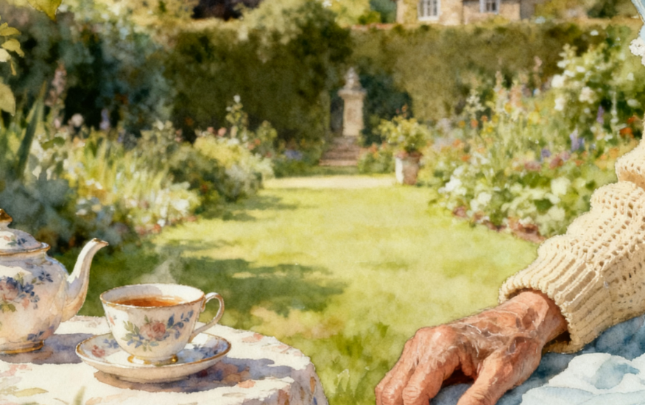
产出导向下的读后续写教学语篇解构、衔接建构与技能生成
2025年11月高三绍兴模考读后续写
海亮实验中学 陈虹

Slide 3
（2025年11月绍模）Susan had been in Banbury, England, at her grandparents' house for two weeks. The day after she had arrived from New Jersey, she'd written letters to Katie, Sasha, and Matthew. "No reply by now. But it's the summer," she thought, "They're busy hanging out at Katie's pool…or watching Outer Banks ...or posting selfies. ”
At that moment she saw her grandpa approaching the garden with a tray (托盘). “Sorry, Love. No post for you." His sad eyes reminded her of their family dog, Astro, who would arrive next week when she and her parents moved into their new house. "I've brought you some tea and sympathy, as they say," Grandpa said. She gazed at him, trying to understand what “tea and sympathy” meant.
Grandpa lowered the tray to the grass, and set the strainer (过滤器) on a light blue china cup. The teapot hummed softly as golden tea poured into the cup, its fragrance rising like morning mist. He lifted the strainer, set it on the second cup, and repeated his movements. She leaned forward, attracted by her grandpa's quiet ritual, and amazed at how skillful his hands were. She couldn't help but allow a hint of a smile.
Grandpa dropped two sugar cubes in the cup closest to her. A delicate plate scraped on the tray as he shifted it closer to her. "Perhaps a few biscuits will make you right as rain."
Susan shrugged."Couldn't hurt." Her smile grew.
“Now then," Grandpa began, "What's this about your friends not writing …”
“I guess they're busy. I'm lonely and I need a letter from them.”
It was Grandpa's turn to shrug. “No offense, but they're teenagers. They probably don't know.” “What are you telling me?” She asked. “Actually, I'm not sure.” His eyebrows rose slightly. “Take this tea, for instance," Grandpa said, "It's a symbol of hospitality (盛情). Welcome to England, my love.” He lifted his cup, "Cheers to you. For being brave like these black tea leaves."
注意：
1. 续写词数应为150左右；
2. 请按如下格式在答题卡的相应位置作答。
Susan lifted her cup and whispered," But I don't feel brave.". ________________________________
Alone now, she gazed at the tray and whispered, “Welcome to England. ”______________________
Susan lifted her cup and whispered," But I don't feel brave.". ____________________________________________ __________________________________________________________________________________________________________________________________________________________________________________________________ Alone now, she gazed at the tray and whispered, “Welcome to England. ”__________________________________ __________________________________________________________________________________________________________________________________________________________________________________________________

Slide 4
01
语篇分析 —— 人物、情节、主题

Slide 5
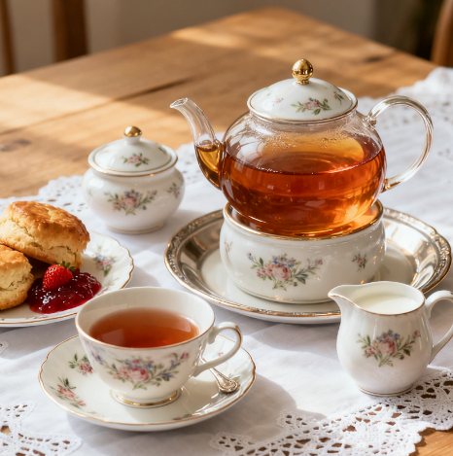
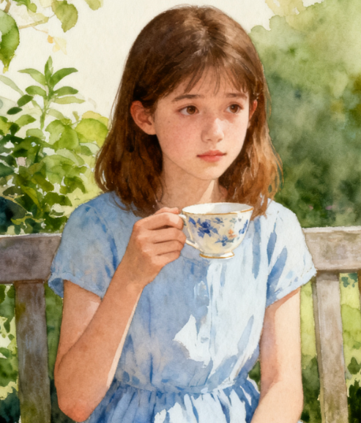
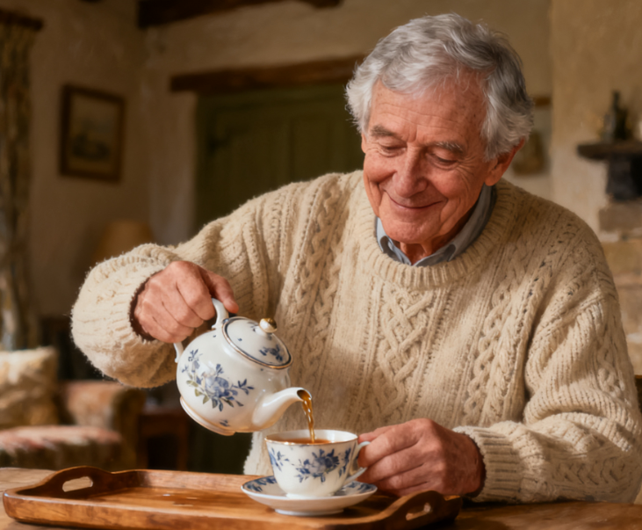

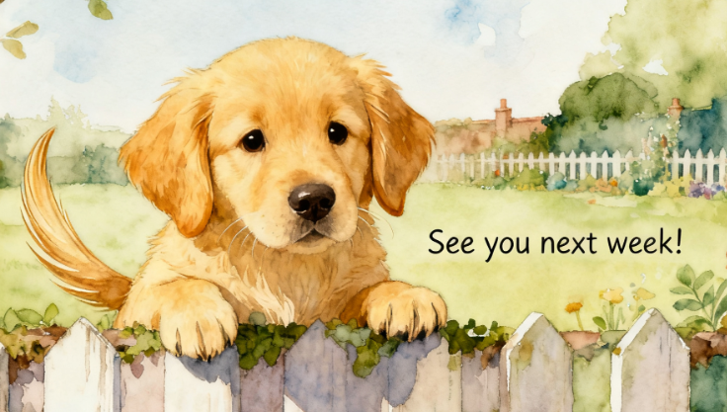
Character Analysis
Susan:17 岁美国少女，因赴英探望祖父母感到孤独，性格从迷茫到逐渐接纳，是情感与行动核心
Grandpa:英国本土亲人，温和睿智（以茶道传递善意与包容），是文化与情感载体
Katie, Sasha, Matthew：Susan 的美式旧友，代表过去的热闹社交，是孤独感的诱因，反衬新环境连接的重要性
Astro：即将到来的伴侣犬，象征陪伴与希望，与红茶共同缓解 Susan 的孤独
红茶的叙事功能具有双重属性：既是推动情节发展的道具，又是承载主题思想的象征载体。

Slide 6
Plot Development
Stage | Plot | Emotional Change
Beginning | USA to UK. Lonely, facing unfamiliar black tea. | Loneliness ↓
Development | Grandfather's tea ceremony. Black tea melts her defenses. | Weakened Defenses ↓
Climax | Actively prepares/drinks tea or builds connections through tea. (To be continued) | Personal Growth ↓
Outcome | Understands the symbolic meaning of tea,overcomes loneliness, and builds new connections. (To be continued) | Self-Acceptance & Connection

Slide 7
Theme Analysis
核心主题
人与自我：孤独与接纳、陌生环境的适应
情感主线
从迷茫孤独到平静接纳
托物言志载体
Black tea
Symbolizes: British composure, silent companionship, and emotional warmth in a new environment.

Slide 8
02
续写构思 ——“四点衔接 + 红茶线索” 框架

Slide 9
四点衔接 + 红茶贯穿
衔接点 | 核心任务 | “红茶”线索的哲学升华 | 情感与主题推进
① 第一段开头 （衔接原文结尾）
② 第一段结尾 （衔接第二段首句）
③ 第二段开头 （呼应自身段首句）
④ 第二段结尾 （升华核心主题）
承接对话，展现引导
"Courage" is "changing the environment": Grandfather uses tea as a metaphor, pointing out that the bravery of tea leaves lies in turning tasteless water into fragrant tea.
Gives a new definition to "adaptation"：not passive endurance, but active integration and creation.。
完成离场，留下空间
Leaves the image of "fusion": Grandfather leaves, the sight of tea leaves continuously unfurling in the pot becomes a living metaphor for her contemplation.
Shifts from listening to teachings to observation and internalization; the dynamic tea brewing process mirrors her inner activity.
解释独白，揭示觉醒
Realization is "becoming the tea leaf": She realizes she should not be the "water" waiting to be changed, but the "tea leaf" that actively releases its aroma.
自我认知的根本转变：from a passive object of the environment to an active creator of life.
点明主旨，托物言志
Growth is "mutual achievement": She understands that true growth is like tea leaves and water—integrating into the environment and sublimating together with it, creating one's own fragrance.
主题终极升华：adaptation is a two-way process that makes the world around you richer and more mellow

Slide 10
Detailed Outline
Para 1:Susan lifted her cup and whispered," But I don't feel brave.".
开头 (衔接原文 + 红茶)
Grandpa's Guidance (Black Tea Philosophy): Grandpa gently swirled his own cup. "Bravery, my love," he said, his voice as warm as the steam rising between them, "isn't about fearing nothing. It's about being like these tea leaves." He pointed to the pot where the dark leaves were unfurling. "They don't fight the water. They embrace it, change it, and give it new character. That's how you find your strength—by blending in and creating your own flavor here."
发展 (红茶线索推进)
Guided by his words, Susan looked more closely at the amber color of her tea and took another sip, consciously noting the transition from initial bitterness to a subtle sweetness. When she mentioned her longing for Astro, her grandfather smiled, steering the conversation back. "You see? You're already looking forward to something new. That's you beginning to unfurl, like a tea leaf in hot water." This dialogue, anchored by the shared ritual of tea, slowly began to dissolve the fog of her loneliness.
结尾 (衔接第二段首句 + 红茶铺垫)
Grandpa glanced at the fading light and stood up, giving her shoulder a gentle squeeze. "Think about it, love." He left her with the half-full, still-warm teapot and the quiet garden. Susan remained, watching him go before looking down into her empty cup. A strange sense of peace, much like the lingering tea scent, started to diffuse within her.

Slide 11
Detailed Outline
Para 2:Alone now, she gazed at the tray and whispered, “Welcome to England. ”
开头 (呼应给定首句 + 红茶衔接)
This time, the words were not filled with distance, but with a resolute solemnity. She reached out and ran her finger along the smooth rim of the bone china cup, which still held the residual warmth of the tea.
发展 (红茶 + 内心成长)
She began to clear the tray, her movements slow and deliberate, mirroring her grandfather's earlier ritual. As she carried it toward the kitchen, she felt no heaviness in her heart. She realized that just as the tea leaves ultimately became one with the water, she, too, could find her place here—not as a guest, but as part of the fabric of this life.
结尾 (衔接第二段首句 + 红茶铺垫)
Susan finally understood. that first unfamiliar cup of black tea carried far more than the ritual of English life. It was like her grandfather's silent wisdom: True acceptance isn't about waiting for the environment to become warm; it's about having the courage, like a tea leaf, to unfurl and release your own warmth and flavor into it. Loneliness was the initial bitterness, but bravely "steeping" herself—connecting and creating—was the beginning of life's sweet aftertaste. She was no longer just a welcomed guest; she had become an active creator of the new flavor of her own life here.

Slide 12
03
写作指导 —— 微技能运用与仿写训练

Slide 13
核心微技能清单
多维度描写：动作、心理、神态、环境、语言（结合红茶的视觉、嗅觉、味觉、触觉）。
写作技巧：连续动词、修辞运用（比喻/拟人）、时间衔接词、托物言志（以红茶喻情感）。
目标：从单一描写升级为 “多技能融合 + 线索贯穿” 的表达。

Slide 14
观察 - 分析 - 仿写（示例1）
原文句子:“Grandpa lowered the tray to the grass, and set the strainer on a light blue china cup. The teapot hummed softly as golden tea poured into the cup, its fragrance rising like morning mist.He lifted the strainer, set it on the second cup, and repeated his movements."
分析写作技巧 ：
动作描写：lowered, set, poured, lifted, set, repeated (一系列连续、精准的动词，生动描绘了祖父泡茶的完整仪式感)。
感官描写：hummed softly (听觉)，golden tea (视觉)，fragrance rising like morning mist (嗅觉，通感)。
修辞运用：its fragrance rising like morning mist (明喻，将茶香比作晨雾，赋予其轻盈、清新、弥漫的诗意)。
细节刻画：light blue china cup (颜色和材质细节)，repeated his movements (表现动作的熟练与专注)。
仿写：
仿写主题：续写第一段中，Susan在祖父引导下，自己尝试端起茶杯并品味时的细微动作与感受。
技巧要求：连续动词 + 感官描写 + 比喻 + 托物言志
"Susan lifted the light blue cup, its warmth seeping into her palms. She watched the golden liquid swirl as she brought it to her lips. The rich aroma, now a familiar comfort, filled her senses as she took her first conscious sip—the journey from initial bitterness to a gentle sweetness, she realized, was not just in the tea, but in her own heart."

Slide 15
观察 - 分析 - 仿写（示例2）
原文句子:"Grandpa dropped two sugar cubes in the cup closest to her. A delicate plate scraped on the tray as he shifted it closer to her."
分析写作技巧 ：
动作描写：dropped, scraped, shifted (连续动词，精准刻画了祖父体贴入微的关怀动作)。
感官描写：scraped (听觉)，closest to her (空间感)，delicate plate (视觉与质感)。
细节刻画：two sugar cubes (具体数量)，closest to her (方位细节)，delicate plate (器物特征)，这些细节共同营造出场景的真实感与画面的精确性。
情感暗示：通过将茶杯和点心“推近她”的动作细节，含蓄而有力地传达了祖父对Susan的默默关爱。
仿写：
仿写主题：续写第一段中，Susan在感受到祖父的关怀后，主动参与或回应的一个动作瞬间。
技巧要求：连续动词 + 感官描写 + 细节刻画 + 情感暗示
Following his lead, Susan picked up the tiny silver tongs, carefully selected a sugar cube, and let it drop into her grandfather's cup. A soft clink echoed hers as it dissolved, a small sound that seemed to sweeten the quiet air between them.

Slide 16
观察 - 分析 - 仿写（示例3）
原文句子:"She leaned forward, attracted by her grandpa's quiet ritual, and amazed at how skillful his hands were."
分析写作技巧 ：
动作与心理结合：leaned forward (外部动作) 清晰地展示了 attracted 和 amazed (内部心理) 的状态。
抽象名词与形容词：quiet ritual (安静的仪式) 这个词组非常有力量，它将祖父泡茶的普通动作提升到一种庄严、宁静的氛围。skillful hands (灵巧的双手) 是直接而真诚的赞美。
细节刻画：通过描写她的身体前倾和内心的感受，生动地刻画出一个从冷漠到被深深吸引的观察者形象。
仿写：
仿写主题：续写第一段中，Susan在祖父话语的启发下，再次观察茶杯或茶叶时的专注神态与内心感悟。
技巧要求：动作与心理结合 + 细节刻画 + 托物言志
She leaned closer, her eyes fixed on the tea leaves slowly unfolding at the bottom of her cup. A quiet understanding began to grow within her, as delicate yet certain as the rich color spreading in the water.

Slide 17
03
范文

Slide 18
Possible version 1
Paragraph 1: Susan lifed her cup and whispered, “But I don't feel brave," Grandpa's eyes crinkled as he leaned in, his voice softening like steam from the teapot. “You've flown across an occan. You're living in an entirely different country now. You'll make new friends. See new things. Not brave? That's brave.” He lifted his cup，tipped the last of the tea into his mouth, and set his cup down. “Now then, I must be off, Should 1 leave the tray for you?" She nodded. “Once again, welcome to England." She could hear Grandpa shuffling back to the house, his words settling deeper in her heart than the tea lcaves at the bottom of her cup.
Paragraph 2: Alone now, she gazed at the tray and whispered, “Welcome to England." The warm words of encouragement drifted around her like a gentle breeze, and in its quiet embrace her heart unclenched. Letters from across the sea suddenly seemed less urgent, the blank pages of tomorrow beckoned instead. She stretched out on the grass, and imagined how she'd walk Astro with her parents near their new house and meet new friends whoselaughter would one day feel familiar. She poured herself another cup and took a sip. The sweetness lingered home wasn't just a place you left behind, but the seeds you carried in your pockets, ready to plant wherever youlanded.

Slide 19
Possible version 2
Para1: Susan lifted her cup and whispered, "But I don't feel brave."Her grandfather smiled. "Bravery isn't about being fearless," he said gently. "It's about being like these tea leaves. They don't know what will happen in the hot water, but they choose to open up and change it, making it something new and beautiful." Susan looked into her cup, thinking about his words. She took another sip, and this time, she paid attention. The bitterness was still there, but behind it, she found a warmth and sweetness that comforted her. When her grandfather stood up and left, the garden felt different, quieter but not so lonely.
Para 2:Alone now, she gazed at the tray and whispered, “Welcome to England.”This time, the words were for her. She wasn't just a visitor anymore; she was ready to be part of this new place, just like the tea leaves were part of the water. She knew it wouldn't always be easy, and she might still feel lonely sometimes. But she also knew that bravery was a choice, a small step every day, like trying a new tea or waiting for a new friend. And in that quiet moment, with the memory of tea and her grandfather's kindness in her heart, that felt like enough.

Slide 20
Thank you

