Slide 1



感恩遇见，相互成就，本课件资料仅供您个人参考、教学使用，严禁自行在网络传播，违者依知识产权法追究法律责任。
更多教学资源请关注
公众号：溯恩英语
知识产权声明

Slide 2






溯恩英语高考专题复习
高三一轮复习 -----阅读理解备考策略
新疆·阿克苏地区第二中学 柴洋

Slide 3

【学习目标】
1. 明确高考阅读命题规律与“素养立意”导向
2. 掌握“读懂逻辑”的宏观解题思维，提升核心素养
3. 解构题型与选项特征，形成“细节服务主旨”意识

Slide 4

目录
contents
01
备考核心导向：
从“文字解读”到“逻辑建构”
02
宏观解题思维：
高维度突破阅读瓶颈
03

Slide 5


01
备考核心导向：
从“文字解读”到“逻辑建构”
PART 01

Slide 6
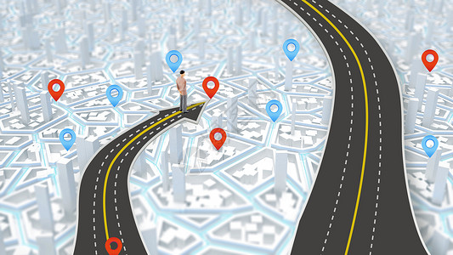
与传统答题模式的核心区别 从“读懂文字” 转向“读懂逻辑”
“定位 - 匹配”的基础技能
“读懂逻辑--建构意义”的思维素养
知识立意----能力立意----素养立意

Slide 7
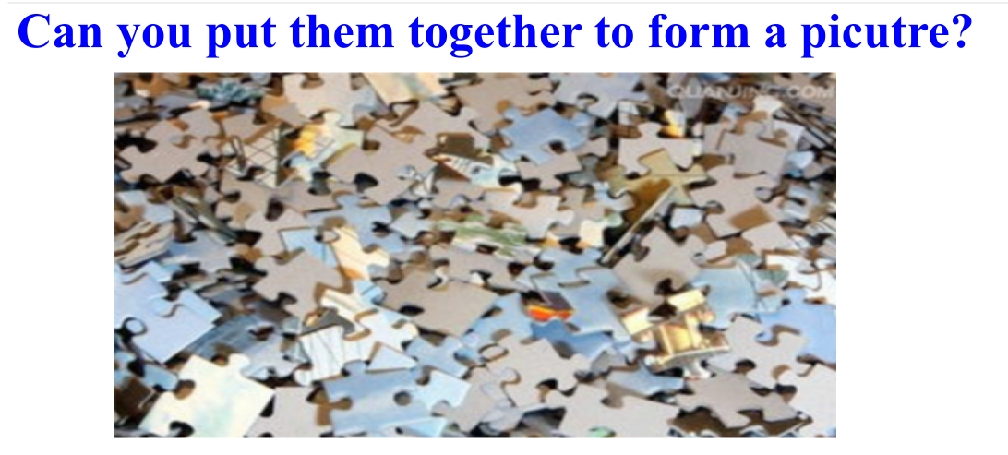
No clue.
对信息快速筛选、逻辑推理等核心素养的区分度要求更高
给学生 clue

Slide 8
2026年高考阅读备考策略
宏观解题思路
面向文章的能力
面向题目的能力

Slide 9
02
宏观解题思维：
高维度突破阅读瓶颈
PART 02

Slide 10
一、关注文章的写作对象
文章就必然有受众，而作为读者的我们就应该主动的把自己带入到文章之中受众的位置，去更好的去理解或者领会作者的意图。
进入文章的语境之中

Slide 11
例 A-3：The writer mentions the benefits in the last paragraph in order to .
A. make teens feel much better about themselves
B. encourage teens to care about their own needs
C. help parents reason teens into volunteering
D. get parents to do more community service
细节的目的：服务于主旨
第一段：Getting your teen to think beyond his own immediate needs can be more difficult than cracking a nut with a plastic fork. But don't worry. It's not impossible. There are many ways to encourage your teen to care about those outside his immediate circle of friends. As he begins to have responsibility towards others, he will realize he feels even better about himself. 北京市第四十三中学高一下学期期中考试英语试题

Slide 12
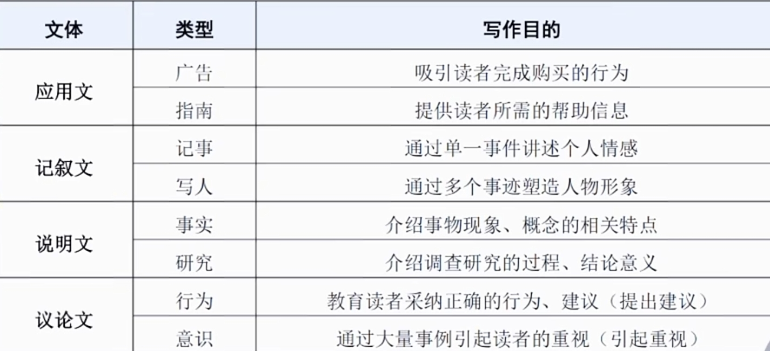
二、关注文章的文体和写作目的
写作目的是文章最核心的部分，对于解答主旨题有直接的作用。同时，细节题也要确保正确选项与文章主旨密切相关。

Slide 13
应用文会出现各种如项目符号、小标题或表格之类的特殊格式
记叙文则有明确的重点人物和事件的前因后果
说明文以客观介绍事物特点、性质为主， 不会掺杂作者个人的主观态度
议论文则是作者在某个有冲突、有矛盾的问题上表达个人观点，主观态度非常明确。

Slide 14
例B-7:2024届北京市清华大学中学生标准学术能力诊断性测试
Why did the author write the passge?
A. To warn criminals to respect and not to destroy the painting.
B. To supply advice on how to prevent future crimes of art theft
C. To share awareness of art theft and the need for good security.
D. To remind museums to equip with more updated security systems.

Slide 15
第一段
Willie Sutton, a once celebrated American criminal, was partly famous for saying he robbed banks because"that's where the money is". Actually, museums are where the money is. In a single gallery there can be paintings worth more, taken together, than a whole fleet of jets. And while banks can hide their money in basements, museums have to put their valuables in plain sight.

Slide 16
最后一段:
Thieves sometimes try using artworks as collateral for other underworld deals. The masterminds of the 1986 robbery of Russborough House near Dublin, who stole 18 paintings,tried in vain to trade them for Irish Republican Army members held in British jails. Others demand a ransom from the museum that owns the pictures. Ten years ago, thieves in Frankfurt.Germany, made off with two major works by J. M.W Turner from the Tate Gallery in London. The paintings, worth more than $80 million, were recovered in 2002 after the Tate paid more than $5 million to people having "information" about their paintings. Though ransom is illegal in Britain, money for looking into a case is not, provided that police agree the source of the information unconnected to the crime. All the same, where information money ends and ranso begins is often a gray area(充斥大写字母的人名,地名,各种数字的金额和年份，是典型的具体事例）

Slide 17
例B-7:Why did the author write the passge?
A. To warn criminals to respect and not to destroy the painting.
B. To supply advice on how to prevent future crimes of art theft
C. To share awareness of art theft and the need for good security.
D. To remind museums to equip with more updated security systems.
“宏观系统性、更高的角度”的解题思路
解题步骤
1. 这是一道主旨题
2. 用写作对象排除不合理选项
3.这篇文章是议论文。
4.议论文写作目的如何判断
如果是作者自身能够解决的问题----给读者提出建议。
如果是作者自身解决不了的问题----引起读者的共鸣。

Slide 18
例C-9:江西省赣州中学2025-2026学年高三上学期开学英语试题
What does Alexandros Savvaidis intend to show in paragraph 3?
A．The ways to reduce losses in earthquakes.
B．The importance of preparing for earthquakes.
C．The significance of developing the AI prediction.
D．The restrictions of AI-based methods in earthquake prediction.

Slide 19
para3:The project marks a substantial breakthrough in the exploration of AI for anticipating seismic (地震) events. According to Alexandros Savvaidis, a senior researcher heading the Texas Seismological Network, “Seismic occurrences strike without warning, often in the blink of an eye. Your readiness is all you can influence. Achieving a 70% prediction rate is a considerable achievement that could significantly restrict the impact of earthquakes, reducing both the financial burden and loss of life, and the potential to remarkably improve earthquake preparation worldwide.”
正确选项和文章的重要信息密切相关。
两个选项无从判断---跳出细节、高角度审视

Slide 20
What does Alexandros Savvaidis intend to show in paragraph 3?
A．The ways to reduce losses in earthquakes.
B．The importance of preparing for earthquakes.
C．The significance of developing the AI prediction.
D．The restrictions of AI-based methods in earthquake prediction.
干扰项B与主题“AI预测地震”无关

Slide 21
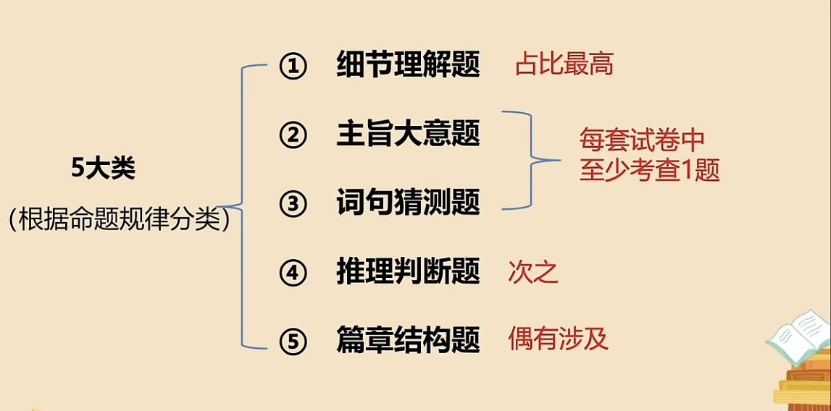
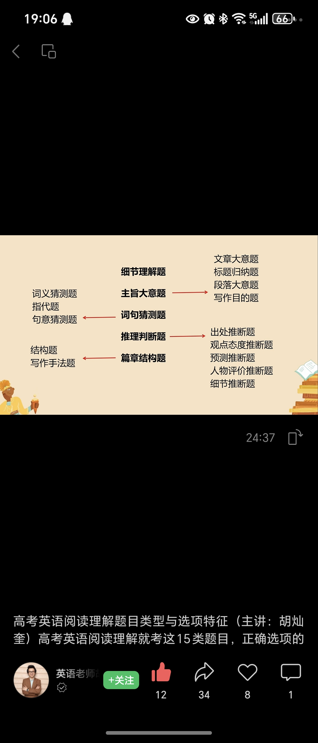
三、区分文章的题型

Slide 22
所有阅读理解的题目，都可以大致归结为两类:
细节题和主旨题
主旨题的提问方式通常是:
1.提问文章标题；
2.提问作者态度；
3.提问写作目的或主旨；
4.提问作者或读者身份；
5.提问文章出处；
6.提问细节信息在文章里的作用。
主旨题的解题思路非常明确
1.了解文章的写作对象，文体，写作目的
2.重点关注文章的标题，还有开头和结尾

Slide 23
例D-12: What is the function of paragraph 1?
A．To explain the cause of her mother’s cancer.
B．To show her concerns over medical inequalities.
C．To indicate the side effects of genetic testing.
D．To emphasize the progress in the medical field.
细节的目的：服务于主旨
Para1: My mother died of breast cancer when she was merely 50 in 1970. Afterwards, the comment repeated most often was: “You’ll need to be careful for the rest of your life because it may have been passed to you.” In 1994, the first ever breast cancer gene testing arrived. I jumped right to it and tested negative. I’m thankful for the science that has given me this preventive screening (筛查). Good for me, but is it good for everyone?
2024届湖北省武汉市部分学校高三下学期五月模拟训练题英语试卷

Slide 24
例D-16: Why did the author share her experience in college?
A．To show her care for her family.
B．To convey her love for writing letters.
C．To express her feelings attached to letters.
D．To prove her consistency in writing letters.
干扰项与主旨无关
I was the only kid in college with a reason to go to the mail box, because my mother never believed in email, in Facebook, in texting or cell phones. I was literally waiting by the mailbox to get a letter with a warmest comfort from her.
So when I moved to New York and got depressed, I did the only thing I could think of. I wrote those same kinds of letters like my mother for strangers, ......
黑龙江省哈尔滨师范大学附属中学2024年高一下学期期中考试卷

Slide 25
四、区分重要信息和次要信息
忽略文章中的次要信息是我们提高阅读速度的一个关键
重要段落----次要段落
重要语句----次要语句

Slide 26
重要位置----文章首尾段、段落首尾句、主句或句子主干
转折词后
长难句=主干+修饰
“四朵金花修饰”(介词短语、从句、 非谓语结构、形容词短语)
括号法去修饰

Slide 27
2024 年 C 篇（巴比伦微型农场）：
We all know fresh is best when it comes to food. However, most produce at the store went through weeks of travel and covered hundreds of miles before reaching the table. （While farmer’s markets are a solid choice to reduce the journey, ）Babylon Micro-Farm (BMF) shortens it even more.
快速抓取重要信息

Slide 28
宏观解题思路
细节服务于主旨
两个选项无从判断--- 跳出细节、高角度审视

Slide 29
“得阅读者得天下”
--日常阅读教学中的方法应用
词汇知识分类笔记
句子能力长难句分析
逻辑思维规律总结
知识立意----能力立意----素养立意

Slide 30



THANKS

