Slide 1


感恩遇见，相互成就，本课件资料仅供您个人参考、教学使用，严禁自行在网络传播，违者依知识产权法追究法律责任。
更多教学资源请关注
公众号：溯恩英语
知识产权声明

Slide 2
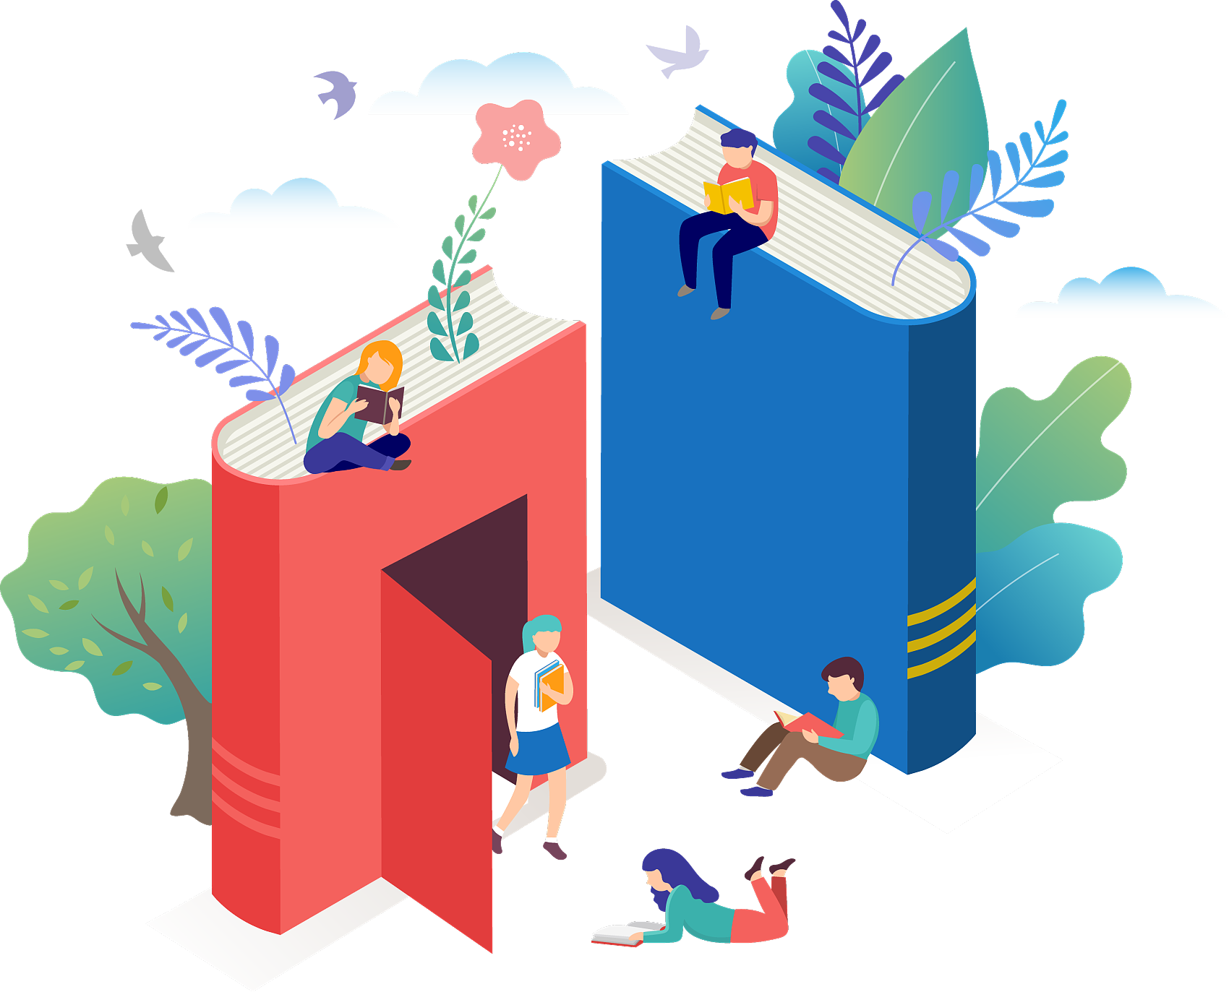
A Contribution About My Reading Habit
—— 金丽衢十二校12月联考应用文分析

Slide 3

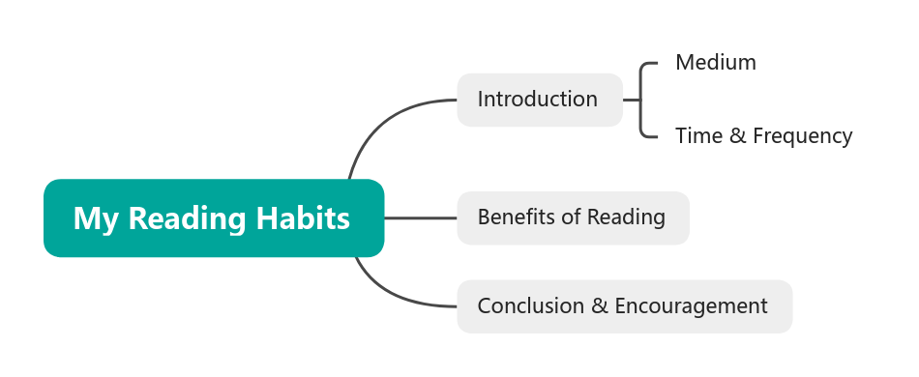
你校英文报的“Youth Voice”栏目正在举办关于“中学生课外阅读习惯”的讨论，请你写一篇短文投稿，内容包括:
1. 介绍你的阅读习惯（如阅读媒介、时间、频率等）；
2. 谈谈课外阅读给你带来的好处。
注意：1. 词数100左右；2. 请在答题卡的相应位置作答。

Slide 4
1. How can we describe our reading habits in the first paragraph, effectively combining reading medium, frequency, and time in an orderly way? How to make it stand out?

Slide 5
Which one do you prefer? Why?
①As a bookworm, my reading routine centers on a mix of print and digital books. Every evening,I immerse myself in a book for about thirty minutes before sleep.
②While I appreciate the convenience of my e-reader, my true love is the faint smell of paper and ink when leafing through a book for about thirty minutes before sleep, with all my worries vanish into thin air.
①
②
common points
highlights
Cover key points
Clear logical flow
Opening with Identity
Clear & Concise Structure
Sensory & Emotional Depth(sense: smell, touch)
Advanced sentences and phrases

Slide 6
2.What are the benefits brought by our reading habits? How to make our writing stand out?

Slide 7
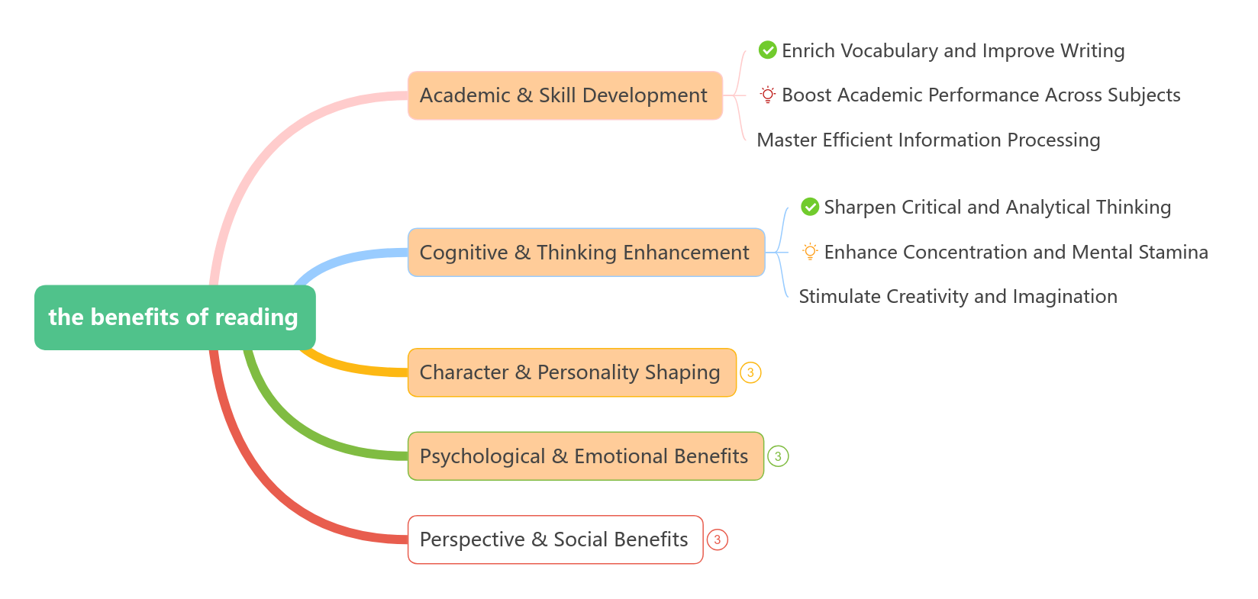

Slide 8
Which structure do you prefer? Why?
②state one core benefit
a specific book
explain in detail how this book brought you that benefit
①list three benefits from different aspects of reading benefits
①
②
common points
Strength /Potential drawback
Clarity and comprehensiveness
Efficiency and reliability
superficial/clichés
Cover key points
Clear logical flow
Depth and uniqueness
Strong persuasiveness

Slide 9
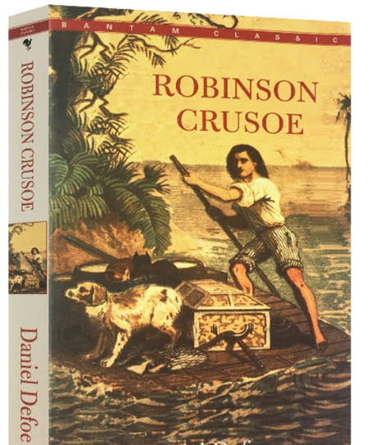
Reading shapes my resilience, and Robinson Crusoe is perhaps its most vivid testament.The twenty-eight-year struggle of Robinson Crusoe on a deserted island is not merely a fictional adventure, but rather a record of extraordinary willpower. Whenever I encounter seemingly insurmountable problems in my studies or lose heart, Crusoe's soliloquy in the face of despair—"I am resolved to survive by all possible means"—echoes in my mind.
one core benefit
introduce a book
the content/main character of the book
relate it to my own experience

Slide 10
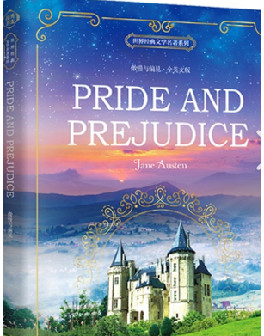
Reading cultivates my judgment, and Jane Austen's Pride and Prejudice stands as its most elegant testament. Elizabeth Bennet's journey of overcoming first impressions is not merely a romantic comedy of manners, but rather a class in emotional and social intelligence. What true judgment requires is humility and the courage to do self-reflection. Whenever I find myself forming a hasty opinion about a new classmate or situation, Elizabeth's self-revelation echoes in my mind.
阅读培养我的判断力，而简·奥斯汀的《傲慢与偏见》正是这一点最优雅的证明。伊丽莎白·班纳特克服第一印象的旅程，不仅是一部浪漫的风俗喜剧，更是一堂关于情感与社会智慧的课程。真正的判断力需要谦逊和自省的勇气。每当我发现自己对一位新同学或新情况仓促下定论时，伊丽莎白的自我觉醒时刻总会在我心中引起共鸣。

Slide 11
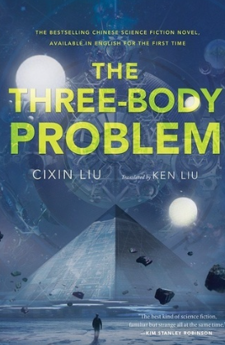
Reading expands the boundaries of my imagination, and Liu Cixin's The Three-Body Problem stands as a most vivid testament. The novel’s famous “Dark Forest” theory is more than a plot, which makes me reconsider humanity’s place in the universe. Whenever I feel stuck in my own thinking, this book reminds me to look beyond what I already know. It shows that true learning begins with the courage to question and imagine.
阅读拓展了我想象的边界，而刘慈欣的《三体》正是最生动的证明。书中著名的“黑暗森林”理论不仅是一个情节设定，它更促使我重新思考人类在宇宙中的位置。每当我感到思维陷入困境，这本书都会提醒我去探索已知之外的领域。它表明，真正的学习始于质疑与想象的勇气。

Slide 12
3.How to conclude this article in the third paragraph? How to make it stand out?

Slide 13
Encouragement/Call to Action
Therefore, my reading habit is far more than a pastime; it is my source of inspiration and motivation. I sincerely urge every fellow student to embark on your reading journey .And then you are bound to be surprised by the world and the self you discover within the pages.
In essence, reading guides our thoughts and strengthens our spirit. Let’s embrace this habit, and turn the page together. So, what will your next book be? The answer might just shape who you become.

Slide 14

Sample Writing
How Reading Shapes Me
While I appreciate the convenience of my e-reader, my true love is the faint smell of paper and ink when leafing through a book for about thirty minutes before sleep, with all my worries vanish into thin air.
Reading shapes my resilience, and Robinson Crusoe is perhaps its most vivid testament.The twenty-eight-year struggle of Robinson Crusoe on a deserted island is not merely a fictional adventure, but rather a record of extraordinary willpower. Whenever I encounter seemingly insurmountable problems in my studies or lose heart, Crusoe's soliloquy in the face of despair—"I am resolved to survive by all possible means"—echoes in my mind.
Therefore, my reading habit is far more than a pastime; it is my source of inspiration and motivation. I sincerely urge every fellow student to embark on your reading journey .And then you are bound to be surprised by the world and the self you discover within the pages.
阅读塑造了我
虽然我欣赏电子阅读器的便捷，但我真正的挚爱是每晚睡前翻阅书页时那淡淡的纸墨香，当沉浸其中约三十分钟，所有的烦忧都会烟消云散。
阅读塑造了我的韧性，而《鲁滨逊漂流记》或许是这一点最生动的证明。鲁滨逊在荒岛上二十八年的挣扎，并非仅仅是一个虚构的冒险故事，而是一份非凡意志力的实录。每当我在学习中遇到看似无法克服的难题或感到气馁时，鲁滨逊面对绝境的那句独白——“我决心尽一切可能活下去”——就会在我脑海中回响。
因此，我的阅读习惯远不止是一种消遣；它是我灵感和动力的源泉。我诚挚地呼吁每一位同学，开启你的阅读之旅吧。你必定会为在书页中发现的那个世界和那个自我而感到惊喜。

Slide 15
Useful Expressions
the benefits of reading
enrich vocabulary and improve writing
boost academic performance across subjects
master efficient information processing
sharpen critical and analytical thinking
enhance concentration and mental stamina
stimulate creativity and imagination
cultivate empathy and understanding
build perseverance and a growth mindset
shape values and moral judgment
reduce stress and achieve mental escape
increase self-awareness and emotional iq
find solace and inner peace
broaden horizons and cultural insight
spark curiosity and a lifelong love of learning
provide common ground for social connection
丰富词汇与提升写作
促进全科学业成绩
掌握高效信息处理
磨砺批判性与分析性思维
增强专注力与思维耐力
激发创造力与想象力
培育同理心与理解力
锻造毅力与成长型思维
塑造价值观与道德判断力
减轻压力与实现精神逃离
提升自我认知与情商
寻求慰藉与内心平静
拓宽视野与文化洞察
激发好奇心与终身学习热情
提供社交连接的共同话题

Slide 16
Useful Sentence Patterns
As..., my reading routine centers on.... Every evening,I immerse myself in a book for about ...minutes before sleep.
While I appreciate the convenience of my e-reader, my true love is...
Reading shapes/cultivates/enhances my ..., and <书名> is perhaps its most vivid testament....<书的内容>is not merely a fictional/fanciful..., but rather a.... Whenever I encounter seemingly insurmountable problems in my studies or lose heart,the courage of<书中人物>in the face of despair—echoes in my mind.
Therefore, my reading habit is far more than a pastime; it is my source of inspiration and motivation. I sincerely urge every fellow student to embark on your reading journey. And then you are bound to be surprised by the world and the self you discover within the pages.
Let’s embrace this habit, and turn the page together. So, what will your next book be? The answer might just shape who you become.

Slide 17
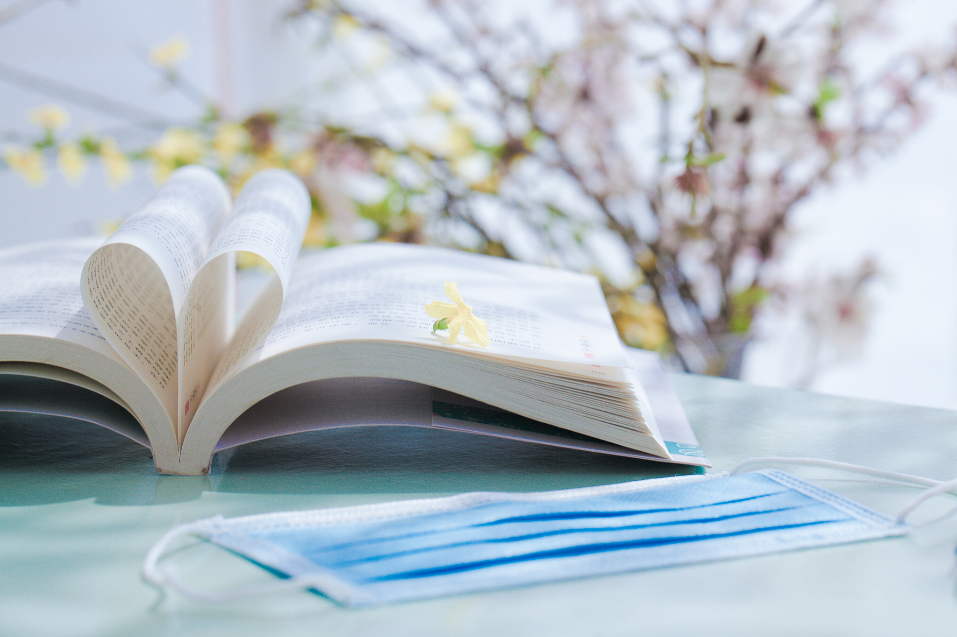
Official Sample Writing One
The Unique Value of Paper Reading
As a regular reader, I have a strong preference for paper reading. I enjoy the tactile pleasure of holding a book and the focus it brings, and I dedicate at least 30 minutes to it every day.
This habit has proven immensely beneficial. Firstly, reading physical books significantly enhances my concentration and memory retention, which directly improves my academic performance, especially in literature. Moreover, by immersing myself in various literary worlds, I have broadened my horizons and developed critical thinking skills. For instance, after reading To Kill a Mockingbird, I reflected deeply on social justice.
In conclusion, paper reading is far more than a hobby; it is a vital practice that continuously enriches my mind and soul.
纸质阅读的独特价值
作为一名阅读者，我十分偏爱纸质阅读。我喜欢手持书本的触感以及它带来的专注力，每天都会为此投入至少30分钟。
这一习惯已被证明使我受益匪浅。首先，阅读纸质书极大地增强了我的专注力与记忆力，这直接提升了我的学业成绩，尤其在文学方面。此外，沉浸于多样的文学世界使我拓宽了视野，并培养了批判性思维能力。例如，读完《杀死一只知更鸟》后，我对社会公正进行了深刻的反思。
总之，纸质阅读远不止是一种爱好；它是一项至关重要的实践，持续地丰富着我的思想与心灵。

Slide 18
Official Sample Writing Two
The Efficiency of Digital Reading
As a modern student, I primarily adopt digital reading. Using a lightweight e-reader, I can access a vast library anytime, anywhere. This allows me to make use of bits of time efficiently, such as during my daily commute.
The advantages are remarkable. The most significant one is the instant access to diverse and up-to-date resources, which keeps me well-informed. Furthermore, features like the built-in dictionary allow me to look up new words instantly, greatly boosting my vocabulary learning efficiency and reading fluency. This method has made me a more independent learner.
All in all, digital reading serves as a powerful key, unlocking a world of knowledge conveniently and effectively.
数字阅读的高效性
作为一名现代学生，我主要采用数字阅读方式。凭借轻便的电子阅读器，我能够随时随地访问海量的图书资源。这使我得以高效利用碎片时间，比如在日常通勤途中。
这种方式的优势十分显著。最重要的一点是能够即时获取多样且最新的资源，让我随时掌握前沿信息。此外，内置词典等功能使我能够即时查询生词，极大地提升了词汇学习效率和阅读流畅度。这种方法使我成为一名更自主的学习者。
总而言之，数字阅读如同一把强大的钥匙，便捷而高效地打开了知识世界的大门。

Slide 19
Official Sample Writing Three
My Balanced Reading Strategy
To maximize benefits, I smartly combine paper and digital reading. I choose paper books for deep, immersive reading at home, while using my e-reader for its convenience on the go.
This hybrid approach offers me the best of both worlds. Paper books enhance my focus and comprehension, whereas digital reading provides timely information and saves space. Consequently, this strategy has not only broadened my knowledge across various fields but also sharpened my language skills flexibly and effectively.
In conclusion, by choosing the right medium for the right situation, I have made reading a sustainable and highly rewarding part of my life.
我的平衡阅读策略
为了最大化收益，我巧妙地将纸质与数字阅读结合起来。在家中进行深入、沉浸式的阅读时，我选择纸质书；而在外出时则利用电子阅读器的便利。
这种混合方式让我兼收两者之长。纸质书提升了我的专注力和理解力，而数字阅读则提供了及时的信息并节省了空间。因此，这一策略不仅拓宽了我各个领域的知识，也灵活高效地提升了我的语言能力。
总而言之，通过在不同的情境下选择合适的阅读媒介，我让阅读成为生活中可持续且回报丰厚的一部分。

Slide 20
范文表达语料积累
纸质书特质
have a strong preference for paper reading
the tactile pleasure of holding a book
for deep, immersive reading at home
dedicate at least 30 minutes to it every day
电子书特质
primarily adopt digital reading
a lightweight e-reader
access a vast library anytime, anywhere
instant access to diverse and up-to-date resources
for its convenience on the go
make use of bits of time efficiently
during my daily commute
混合策略与选择方法
smartly combine paper and digital reading
choosing the right medium for the right situation
offer me the best of both worlds
纸质书特质
强烈偏爱纸质阅读
手持书本的触感愉悦
用于在家深度沉浸式阅读
每天至少投入30分钟
电子书特质
主要采用数字阅读
轻便的电子阅读器
随时随地访问海量图书馆
即时获取多样且最新的资源
因其在外出时的便利性
高效利用碎片时间
在我日常通勤期间
混合策略与选择方法
巧妙结合纸质与数字阅读
为不同情境选择合适的媒介
让我两者兼得

Slide 21
阅读带来的好处
认知与学业
significantly enhance my concentration and memory retention
directly improve my academic performance
greatly boost my vocabulary learning efficiency and reading fluency
sharpen my language skills flexibly and effectively
enhance my focus and comprehension
思维与品格
develope critical thinking skills
reflect deeply on social justice
make me a more independent learner
broaden my horizons
keep me well-informed
broadenmy knowledge across various fields
provide timely information and saves space
认知与学业
显著增强我的专注力和记忆力
直接提升我的学业成绩
极大提升了我的词汇学习效率和阅读流畅度
灵活高效地提升了我的语言能力
提升了我的专注力和理解力
思维与品格
培养了批判性思维能力
对社会正义进行了深刻反思
使我成为一名更独立的学习者
拓宽了我的视野
使我信息灵通
拓宽了我各个领域的知识
提供及时信息并节省空间

Slide 22

对阅读的总述与评价
far more than a hobby; it is a vital practice
a sustainable and highly rewarding part of my life
continuously enriches my mind and soul
serves as a powerful key, unlocking a world of knowledge
远不止是一种爱好；它是一项至关重要的实践
生活中一个可持续且回报丰厚的一部分
持续地丰富我的思想与心灵
作为一把强大的钥匙，打开了知识世界

Slide 23
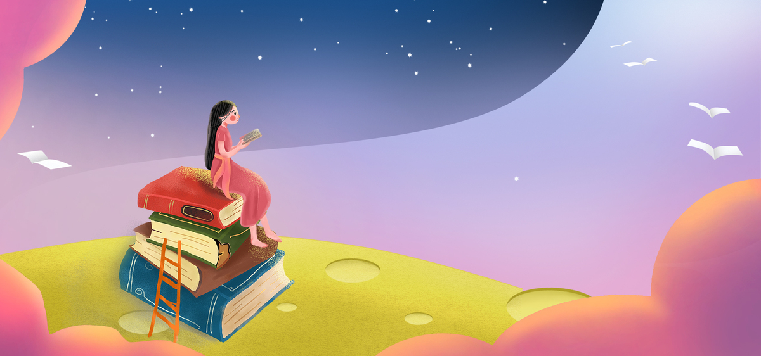
Thank you!

