Slide 1



感恩遇见，相互成就，本课件资料仅供您个人参考、教学使用，严禁自行在网络传播，违者依知识产权法追究法律责任。
更多教学资源请关注
公众号：溯恩英语
知识产权声明

Slide 2


2025年12月七校联考读后续写——
小猪凯文护送记
---聚焦协同主题的情节构建与续写技巧
杭州二中树兰高级中学 郭合英

Slide 3

文本解读
解析协同主题
Learning objectives
协同主题建构情节
作品欣赏

Slide 4
阅读下面材料，根据其内容和所给段落开头语续写两段，使之构成一篇完整的短文。
I was lounging on the sofa, enjoying a cozy TV session with the kids, when my wife Lindsey burst into the room. “Jake, there’s a pig on our driveway!” she exclaimed. Our driveway was on the opposite side of the house, so we’d installed a security camera for just such occasions. Sure enough, it revealed a massive, four-legged creature wandering around. Moments later, we caught sight of it gently touching the window with his snout (口鼻部) and grunting softly.
“He’s adorable!” my 10-year-old daughter, Ella, squealed, “I’m going to say hello!” I cautioned her that we didn’t know if the pig was friendly, but before I could stop her, she was already out the door. To our relief, the colossal pig seemed perfectly content to be petted and fawned over (讨好). Ella pleaded to keep him, but I gently explained that we didn’t have enough space.
Disappointed though Ella was, Lindsey and I decided to send the pig back. I called a local farmer to see if the pig belonged to him. When I described the animal’s size and distinctive markings, he chuckled, confirming it was definitely Kevin Bacon, who was probably just out looking for some company. The Hollywood actor’s name gave us all a good laugh. The farmer also told us Kevin enjoyed playing with kids.
We learned that the farmer was away on business and wouldn’t be able to return until the next day. He asked if we could walk Kevin home. “I’m not sure we’ll be able to get him to move,” I replied. “You could try luring (引诱) him with food,” the farmer suggested. He then mentioned that Kevin had a soft spot for Oreos (奥利奥饼干). Fortunately, we had some Oreos in the biscuit tin. I hoped it would be enough. Then Lindsey managed to fit Kevin with a dog leash (狗绳).
Paragraph 1: After checking the route to the farm, we set off with a bag of treats.
Paragraph 2: Suddenly, we realized there was only one Oreo left and it was impossible to find more food.

Slide 5



文本解读

Slide 6
扫除词汇障碍
阅读下面材料，根据其内容和所给段落开头语续写两段，使之构成一篇完整的短文。
I was lounging on the sofa, enjoying a cozy TV session with the kids, when my wife Lindsey burst into the room. “Jake, there’s a pig on our driveway!” she exclaimed. Our driveway was on the opposite side of the house, so we’d installed a security camera for just such occasions. Sure enough, it revealed a massive, four-legged creature wandering around. Moments later, we caught sight of it gently touching the window with his snout (口鼻部) and grunting softly.
“He’s adorable!” my 10-year-old daughter, Ella, squealed, “I’m going to say hello!” I cautioned her that we didn’t know if the pig was friendly, but before I could stop her, she was already out the door. To our relief, the colossal pig seemed perfectly content to be petted and fawned over (讨好). Ella pleaded to keep him, but I gently explained that we didn’t have enough space.
红色为非课标词汇，黄色为固定搭配
lounge: 懒洋洋地躺/靠
cozy: 温暖舒适的；惬意的
exclaim: 大声说；呼喊；惊叫
install: 安装；设置
果然；不出所料
grunt:（猪等动物）发出呼噜声
squeal: 尖叫；尖声说
colossal: 巨大的；庞大的
plead to do sth : 恳求做某事
fawn on/over sb: 讨好某人

Slide 7
Disappointed though Ella was, Lindsey and I decided to send the pig back. I called a local farmer to see if the pig belonged to him. When I described the animal’s size and distinctive markings, he chuckled, confirming it was definitely Kevin Bacon, who was probably just out looking for some company. The Hollywood actor’s name gave us all a good laugh. The farmer also told us Kevin enjoyed playing with kids.
We learned that the farmer was away on business and wouldn’t be able to return until the next day. He asked if we could walk Kevin home. “I’m not sure we’ll be able to get him to move,” I replied. “You could try luring (引诱) him with food,” the farmer suggested. He then mentioned that Kevin had a soft spot for Oreos (奥利奥饼干). Fortunately, we had some Oreos in the biscuit tin. I hoped it would be enough. Then Lindsey managed to fit Kevin with a dog leash.
Para 1: After checking the route to the farm, we set off with a bag of treats.
Para2: Suddenly, we realized there was only one Oreo left and it was
impossible to find more food.
chuckle: 轻声笑；咯咯笑
偏爱；特别喜欢
tin: (装食品等的)金属罐
“给……装上/套上……
leash: 牵引绳；皮带

Slide 8
原文核心情节回顾
人物
Jack
Lindsey
Ella
Kevin
The Farmer
身份
作用预测
“I”
(the writer)
Take the lead in returning
the lost pig and drives the plot forward
Assist with pig-related matters
(e.g., fitting the pig with a leash)
Jack’s wife
Jack’s
10-year-old daughter
Form a close bond with the pig, showing affection and reluctance to part with it
a lost
farm pig
The core subject of the event,
connecting the family and the farmer
the owner
of the pig
Provide remote guidance
on returning the pig

Slide 9
Core Events
原文核心情节回顾
Decide to send it back to the farm.
Ella establishes a close bond with the pig.
Confirm the situation by the security camera.
A pig suddenly appears in the driveway of the house.
We set off with “enough” Oreos.
It has a soft spot for
Oreos and likes children.
Prepare Oreos, put a dog rope on it
The farmer is on a business trip and entrusts us to send it back.
Contact the farmer and learn about the pig’s habits.
是送猪回农场的核心诱惑

Slide 10



续写触发点 + 核心矛盾
续写触发点 + 核心矛盾
续写触发点 | 核心矛盾
Paragraph 1: After checking the route to the farm, we set off with a bag of treats. Paragraph 2: Suddenly, we realized there was only one Oreo left and it was impossible to find more food.
We set off with “enough” Oreos.
如何用仅剩的一块奥利奥护送贪吃的小猪凯文到农场？

Slide 11
思路点拨
段落 | 思路
After checking the route to the farm, we set off with a bag of treats.
Suddenly, we realized there was only one Oreo left and it was impossible to find more food.
根据续写第一段提示语和文中“凯文特别爱吃奥利奥、喜欢和孩子玩、已套上狗绳”及“用食物引诱可让凯文移动”可知，奥利奥引诱+艾拉与凯文的互动是核心切入点。由此可推知，续写需详细描写凯文看到奥利奥后的反应，如摇短尾、鼻尖不停嗅闻等；艾拉分次喂食的温柔动作，如轻声安抚，可穿插小插曲，搭配路人好奇的微笑烘托趣味氛围，通过顺畅的前行过程呼应前文“食物引诱有效”的设定，凸显护送初期的温馨顺利。
根据续写第二段提示语和文中“农场主告知凯文喜欢和孩子玩”可知，奥利奥耗尽的危机+用亲子游戏替代食物引导是核心切入点。由此可推知，续写需具体描写众人的焦急状态，如我皱眉查看剩余路程，琳赛试图拉扯狗绳却无果，艾拉突发奇想的互动方式，如拍手喊凯文赛跑、扔奥利奥包装纸让它捡拾，凯文兴奋配合的模样，如迈着小短腿狂奔、哼哧哼哧跑在前头，最终顺利抵达农场的圆满结局，通过游戏互动呼应凯文爱与孩子玩耍的特点，展现护送过程中的意外趣味与温暖情谊。

Slide 12
解析协同主题

Slide 13
什么是“协同”主题续写
“协同”主题续写是指在续写过程中，续写部分与原文在多个方面保持一致和呼应，以达到主题、情节、人物、冲突、语言和特定物等方面的和谐统一，使整个文本连贯、合理且具有深度。
协同”主题续写的主要原则
主题的协同
冲突的协同
在续写部分应解决原文出现的冲突或问题。
续写时应围绕原文提炼出的主题，结尾时呼应该主题或进行升华点题。
通过这些协同原则，续写部分能够与原文形成一个有机整体，使文章主题鲜明、情节合理、情感连贯，从而在考试或写作中获得更高的评价。
分析原文语言风格，关注用词、长短句的使用，修辞手法的应用和对细节的描写，续写段落中结合创造与模仿，力争与原文高度融洽
情节发展和情感变化的协同
语言的协同
续写部分的情节应与原文情节的发展逻辑一致，恰当呼应原文的暗示，使续写更合理。
人/物设的协同
特定物的协同
续写中应与原文中表现人物性格特征的细节描写灵活呼应。
如原文中出现的特定物品或象征物，应在续写中予以呼应，以增强主题的表达。

Slide 14
“协同”维度与续写呼应要点
协同维度 | 原文对应内容 | 续写需呼应的核心要点
主题协同
情节发展和情 感变化的协同
人/物设协同
冲突协同
语言协同
特定物的协同
结尾需升华“善意传递温暖”“协作解决问题”“陪伴的意义”，呼应原文中对小猪的友善、家人间的配合。
善意与陪伴的温暖
情节逻辑：发现小猪→确认身份→受农场主委托送回→用奥利奥引诱+套狗绳出发
情感变化：意外（发现小猪）→喜爱（艾拉想留下）→责任（决定送回）→期待（用奥利奥尝试引导）
原文暗示：小猪喜欢孩子、贪吃奥利奥、体型庞大可能不易引导。
情节需围绕“护送小猪”展开，经历引导中的小波折（如小猪停留、被吸引）。
呼应“小猪喜欢孩子”“贪吃奥利奥”的暗示，让情节更合理。
情感变化可延续“期待→焦急→巧妙解决→欣慰”，贴合家人协作的氛围。
杰克（“我”）：谨慎（提醒艾拉猪可能不友善）、理性（解释没空间留猪）、负责（同意送小猪回家）
小猪凯文：温顺（接受抚摸）、贪吃（偏爱奥利奥）、渴望陪伴（出来找同伴）
凯文延续温顺 + 贪吃的特点，推动情节（如因奥利奥跟随、因无奥利奥停留）
艾拉：天真可爱、喜爱小动物（主动打招呼、恳求留猪）
琳赛：干练（设法给小猪套狗绳）、配合（支持送小猪）
杰克继续体现稳重，主导路线和解决问题。
琳赛协助管控小猪，保持干练。
艾拉用童真互动引导小猪。
原文核心冲突：如何在奥利奥有限的情况下，成功将体型庞大的小猪凯文送回农场。
续写需解决“奥利奥耗尽”的危机，利用小猪特性（喜欢孩子）找到替代方案，最终成功送回小猪。
1.用词风格：口语化、生活化。
2.句式特点：长短句结合，细节描写生动。3.修辞手法：无复杂修辞。
续文需与原文风格保持一致，且尽可能用原文里的词，短语，句式模仿等与原文风格一致。
原文特定物：奥利奥饼干（引导小猪的关键）、狗绳（管控小猪的工具）、农场（目的地）
1.奥利奥贯穿续写，作为推动情节的核心（从剩余到耗尽，引发冲突）2.狗绳延续“管控”功能，3.农场作为目的地，呼应“送小猪回家”的任务。

Slide 15
协同主题建构情节

Slide 16
三大协同维度作品赏析
亲子协同：“我”+琳赛+艾拉
父亲:主导引导，牵绳、把控路线。
女儿艾拉:情感安抚，持零食吸引、唱歌安抚。
母亲琳赛:保障安全，清障、疏导交通。
协同
主体
分工明确，互补配合：用“持零食吸引”、“牵绳引导”、
“清障护行”等具象动作体现分工；
用“眼神示意”、“轻声鼓励”等细节体现互动。
协同
方式
协同
意义
不仅成功完成护送小猪的任务，更强化了家庭凝聚力，让亲子关系在共同解决问题的过程中升温。

Slide 17
作品赏析

Slide 18
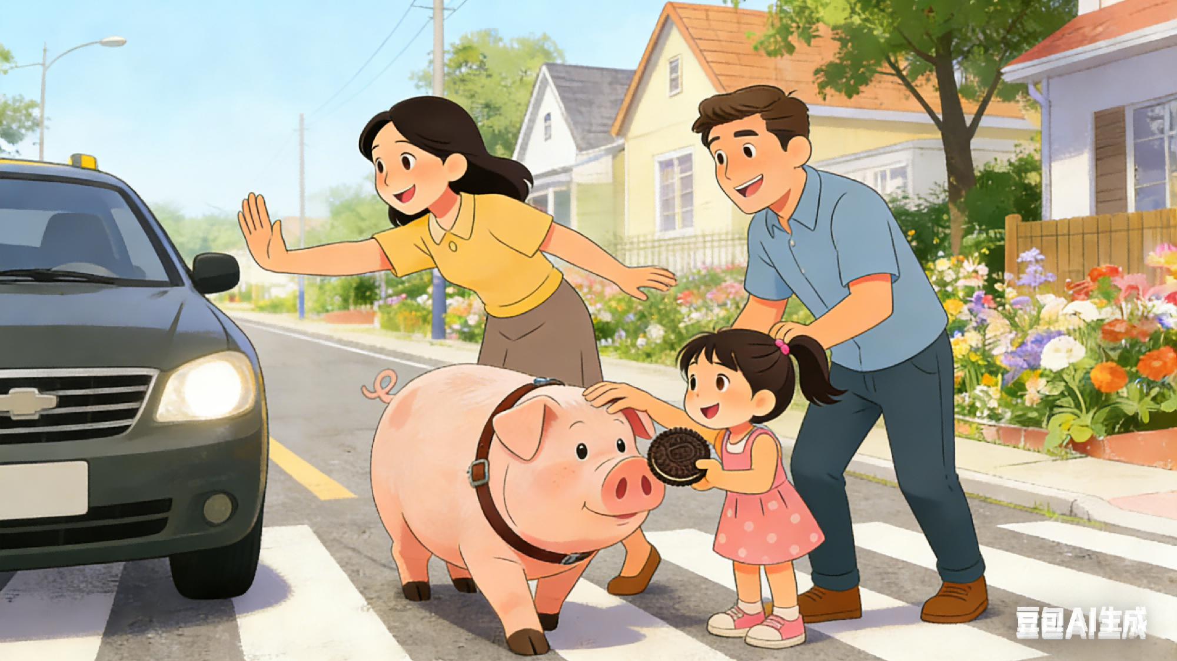
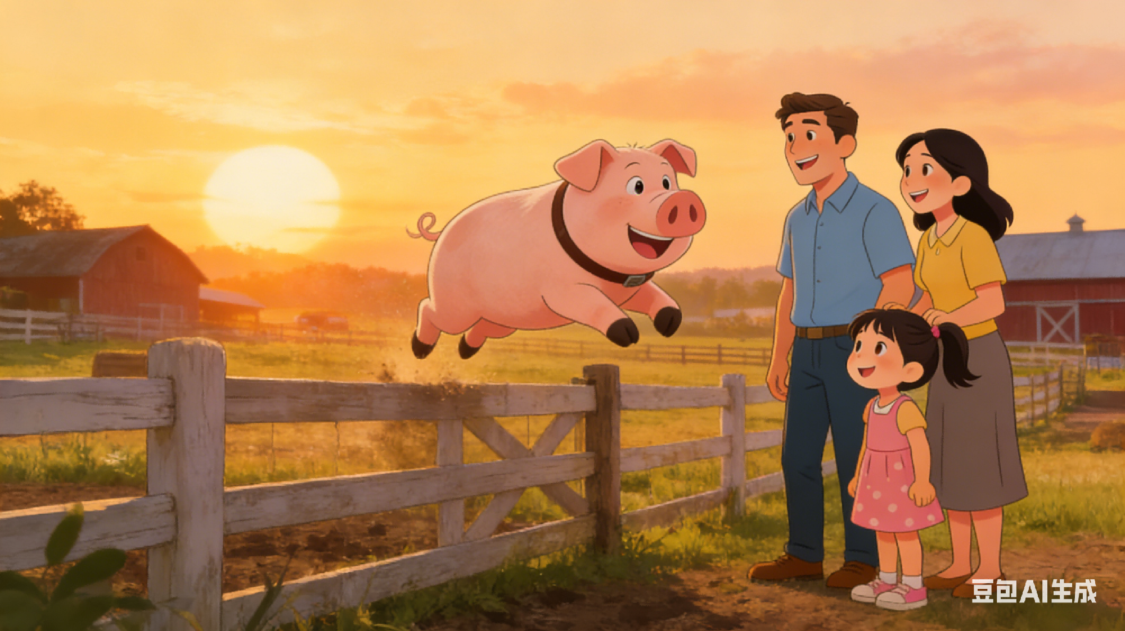
蓝色横线代表分工
亲子协同：“我”+琳赛+艾拉
红色横线代表合作
After checking the route to the farm, we set off with a bag of treats. Ella held the Oreos while I guided Kevin with the leash, and Lindsey walked ahead to guide the way. Kevin followed her closely, stopping only when she held up a cookie—he’d touch her hand gently before wolfing it down. When we crossed a busy street, Lindsey signaled cars to stop, and I knelt to comfort Kevin as Ella petted his head. “Good boy,” she whispered, slipping him another Oreo. We made it halfway smoothly. However, so focused had we been on guiding him that we hadn’t kept track of the cookies. Ella naturally reached into the Oreo bag, only to pull out one wrinkled cookie. She stared at it in surprise, then looked up at us with a worried downcast face.
Suddenly, we realized there was only one Oreo left and it was impossible to find more food. Kevin dropped down on the grass, refusing to move, and Ella’s eyes filled with worry. I exchanged a quick look with Lindsey, who nodded—we needed to work together. I waved a small stick from the ground to draw Kevin’s attention, while Ella sang the gentle song for her stuffed animals. To our surprise, Kevin brightened up, rubbed her shoulder and brushed against her hand softly. Ella held out the last Oreo; he took it gently, then walked quickly forward. As the sun set, we reached the farm, and Kevin bounded into his pen—our teamwork had saved the day.
从协同角度的亮点分析
前期分工为后期协同打基础：出发时“Ella 持 Oreo 、我牵绳、Lindsey带路”，过马路时“Lindsey 拦车、我安抚、Ella 摸头”，明确的分工让三人形成默契，为后续应对“只剩1块Oreo”的危机铺垫了“无需多言的协作基础”，协同不突兀。
协同精准适配角色特质：危机时“我用树枝吸引注意力（成人行动力）、Ella唱歌安抚（孩子的温柔共情）”，分工贴合各自身份，没有强行分配不符合角色的任务，让协同更真实可信。
人与动物的双向协同升华主题：三人的协同不仅是“解决问题的配合”，还带动了Kevin的回应——从“拒绝移动”到“被吸引后主动前进”，形成“人协同→动物呼应”的双向闭环，让“协同”不局限于人类之间,更凸显了信任带来的合力。
协同有情绪共鸣支撑：Ella担忧时，“我与Lindsey眼神交汇即达成共识”，协同中融入情绪默契，不是冰冷的任务分配，而是带着共情的配合，让协同更有温度。

Slide 19
协同主题建构情节

Slide 20
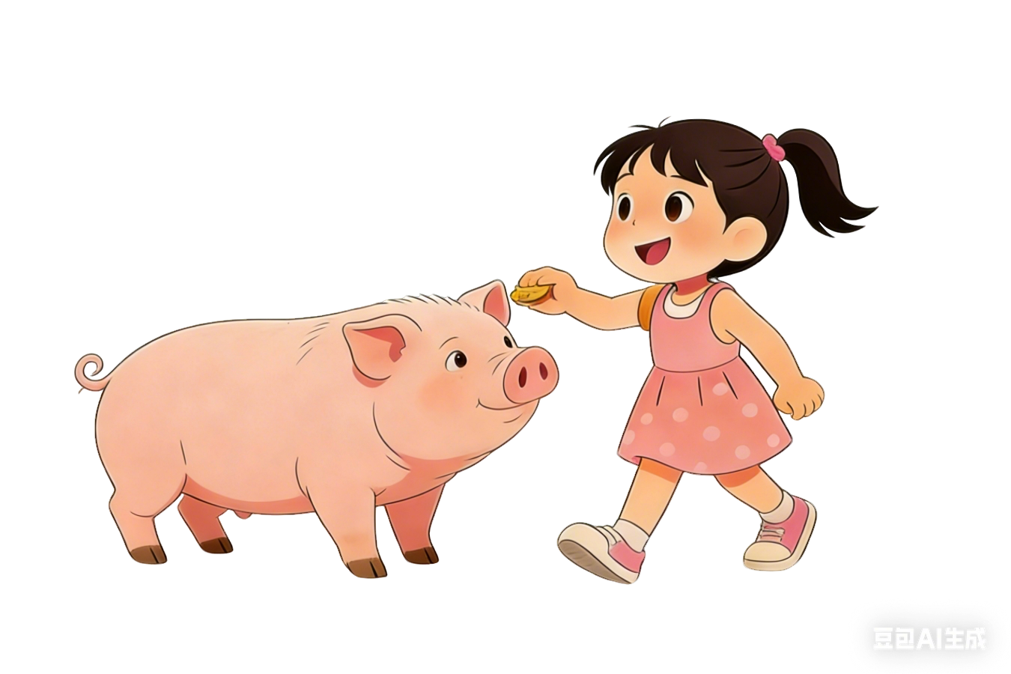
人与动物协同：艾拉+凯文
协同
主体
艾拉: 主动付出情感、建立信任。
凯文: 被动接受并回应信任。
以“情感联结”为核心，双向互动——艾拉通过“不停聊天”、“拥抱安抚”、“轻声鼓励”传递善意；凯文通过“主动跟随”、“轻柔取食”、“推回饼干”、“主动进圈”回应信任。
协同
方式
协同
意义
凸显跨物种之间的信任与理解，让“协同”主题更温暖、更有温度，也契合原文艾拉对小猪的喜爱之情。

Slide 21
作品赏析

Slide 22
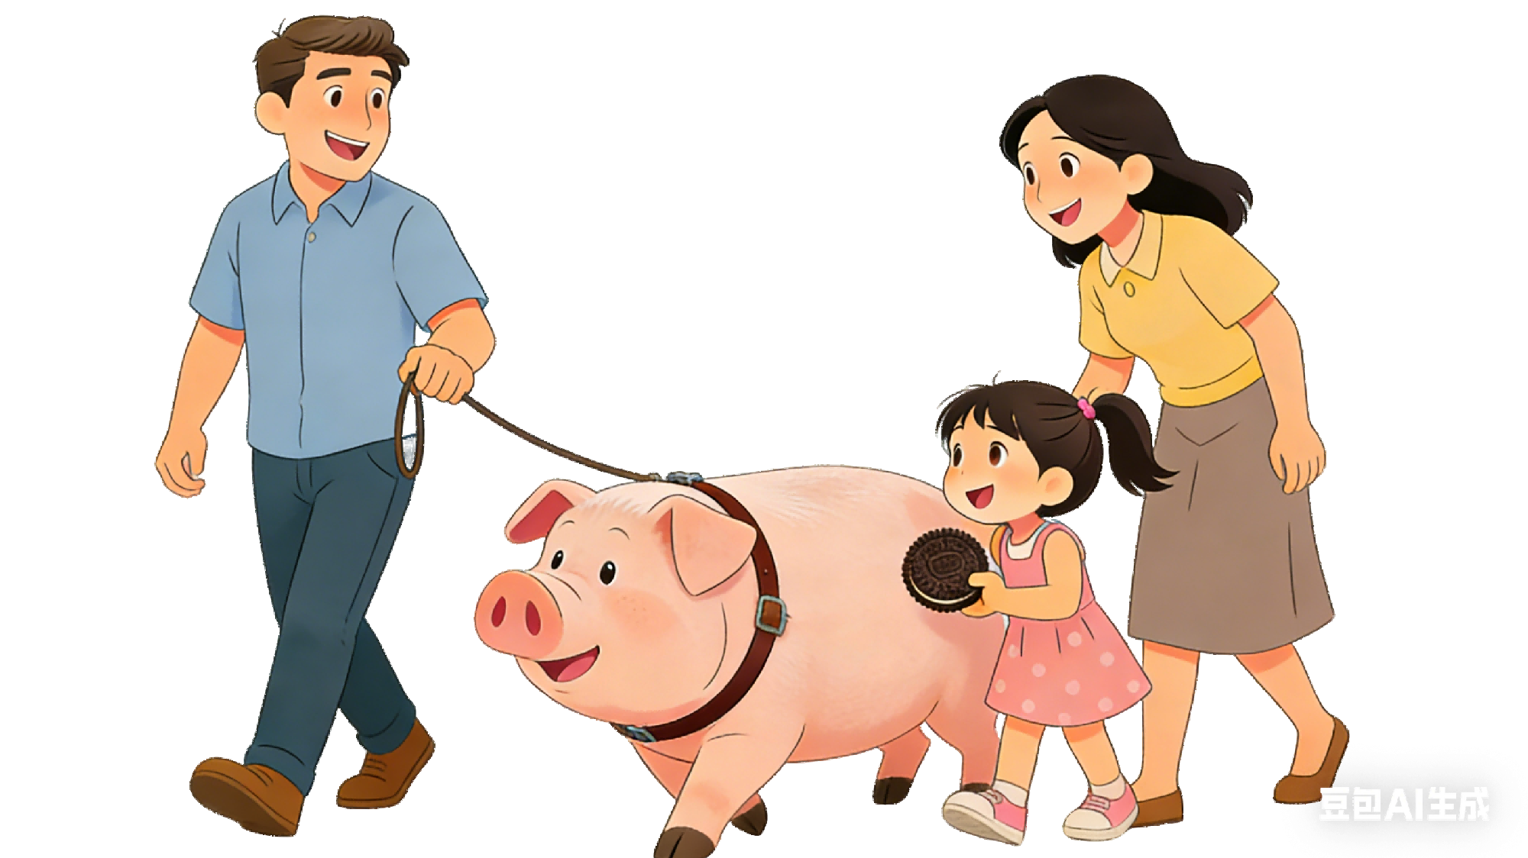
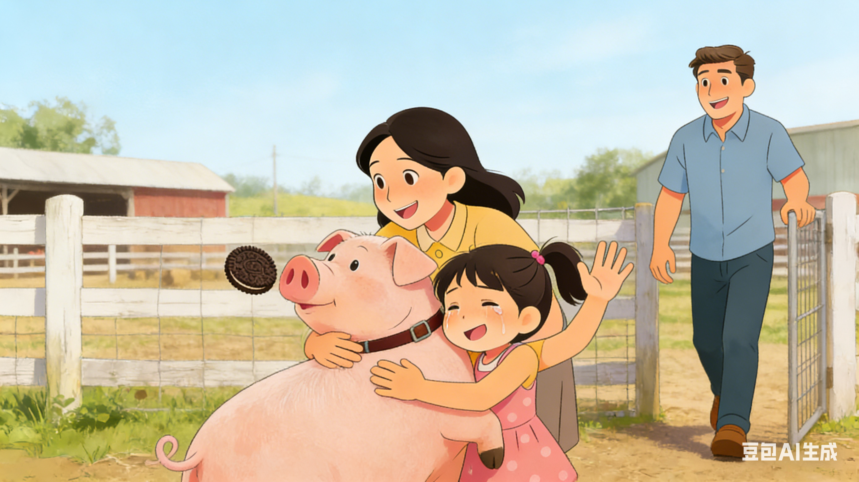
红色艾拉的情感互动
人与动物协同：艾拉+凯文
绿色凯文的回应
After checking the route to the farm, we set off with a bag of treats. Ella walked as close to Kevin as she could, talking to him nonstop. Kevin seemed to listen carefully, his ears moving slightly now and then at her voice, and he only stopped when Ella offered an Oreo. He’d take it carefully with his mouth, as if afraid to hurt her fingers, then follow her steps like a trusty company. When we crossed a small stream on the way, Kevin hesitated, but Ella knelt beside him and poured water playfully—he breathed out softly, then stepped into the stream, following her steadily to the other side. Soon, the farm came into view ahead, Ella smiled, reaching into the bag to reward him with another Oreo, but her hand froze halfway—she glanced at us with a worried expression.
Suddenly, we realized there was only one Oreo left and it was impossible to find more food. Kevin stopped at the farm’s gate, his tail hanging down, and Ella’s lower lip trembled. “Don’t worry, Kevin,” she whispered softly, hugging his neck gently. “We’ll get you home safely.” She held out the last Oreo, but instead of eating it right away, Kevin pushed it gently back to her with his nose—then turned and walked slowly into the pen. We stared in shock: he’d clearly understood her words, and his trust in her had pushed him forward. Tears of joy rolling down her cheeks, Ella waved warmly as Kevin settled into his bed in the pen.
从协同角度的亮点分析
前期互动铺垫“信任协同”基础：Ella主动贴近聊天、温柔投喂，Kevin谨慎接Oreo、紧跟步伐，形成“Ella主动共情→Kevin被动回应”的初步协同，让后续危机中的默契不突兀，是情感层面的铺垫。
关键场景的“即时协同”超自然：过小溪时，Kevin犹豫（传递需求）→Ella玩水引导（精准回应）→Kevin稳步跟进（积极配合），无需语言，仅靠动作和神态就能完成双向适配，协同效率高且真实。
危机中“情感协同”升华主题：只剩1块 Oreo时，Ella的拥抱、轻声安慰（情感输出）与Kevin推回Oreo、主动进围栏（情感回应）形成闭环，协同不仅是“解决问题”，更是“互相理解与成全”，让协同有温度。
协同角色适配: Ella的“温柔”与Kevin的“温顺”互补，人类不主导、动物不被动，这种平等的双向协同，让人与动物之间的情感更真挚，也让协同的内涵更丰富。

Slide 23
协同主题建构情节

Slide 24
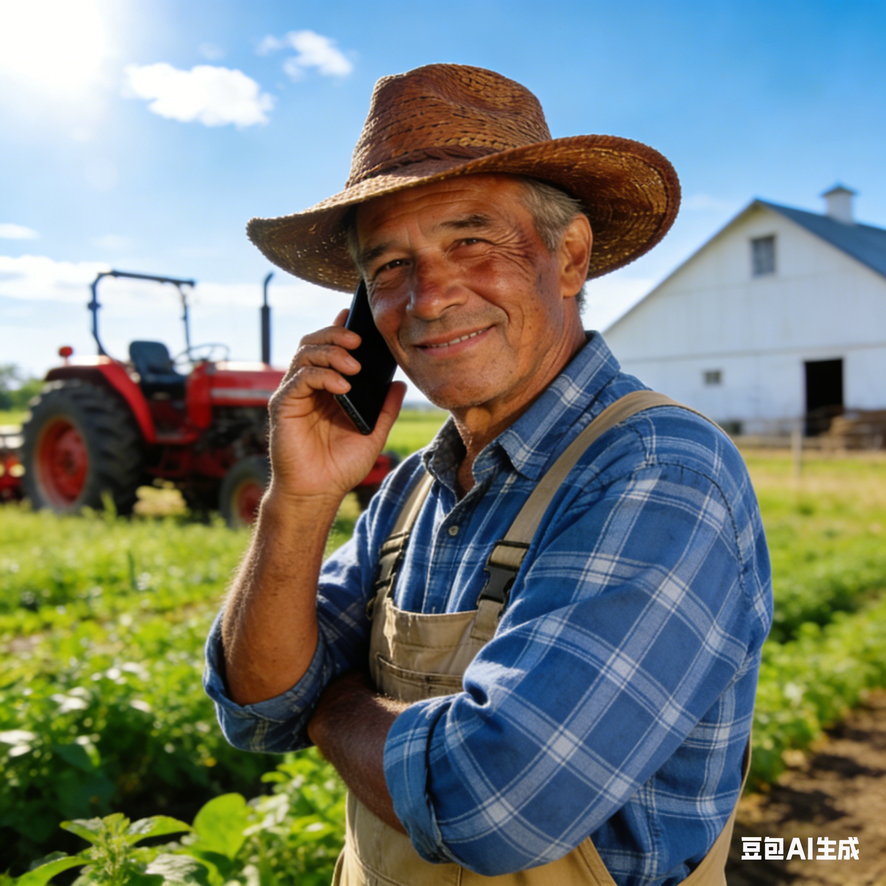
远程协助：“我”一家+农场主
“我”一家:现场执行方，负责实际护送。
农场主:远程指导方，提供关键信息与解
决方案。
协同
主体
以“电话沟通”为桥梁，实现“远程指导+现场落地”的闭环——前期：农场主指导“让艾拉聊天安抚”，现场执行“艾拉不停聊天”；后期：零食短缺时，农场主支招“用追逐游戏引导”，现场执行“艾拉游戏引导”。
协同
方式
体现远程配合的价值，说明“协同”不一定需要面对面。及时、精准的信息传递与高效执行，同样能完成目标，凸显沟通与信任的重要性。
协同
意义

Slide 25
作品赏析

Slide 26
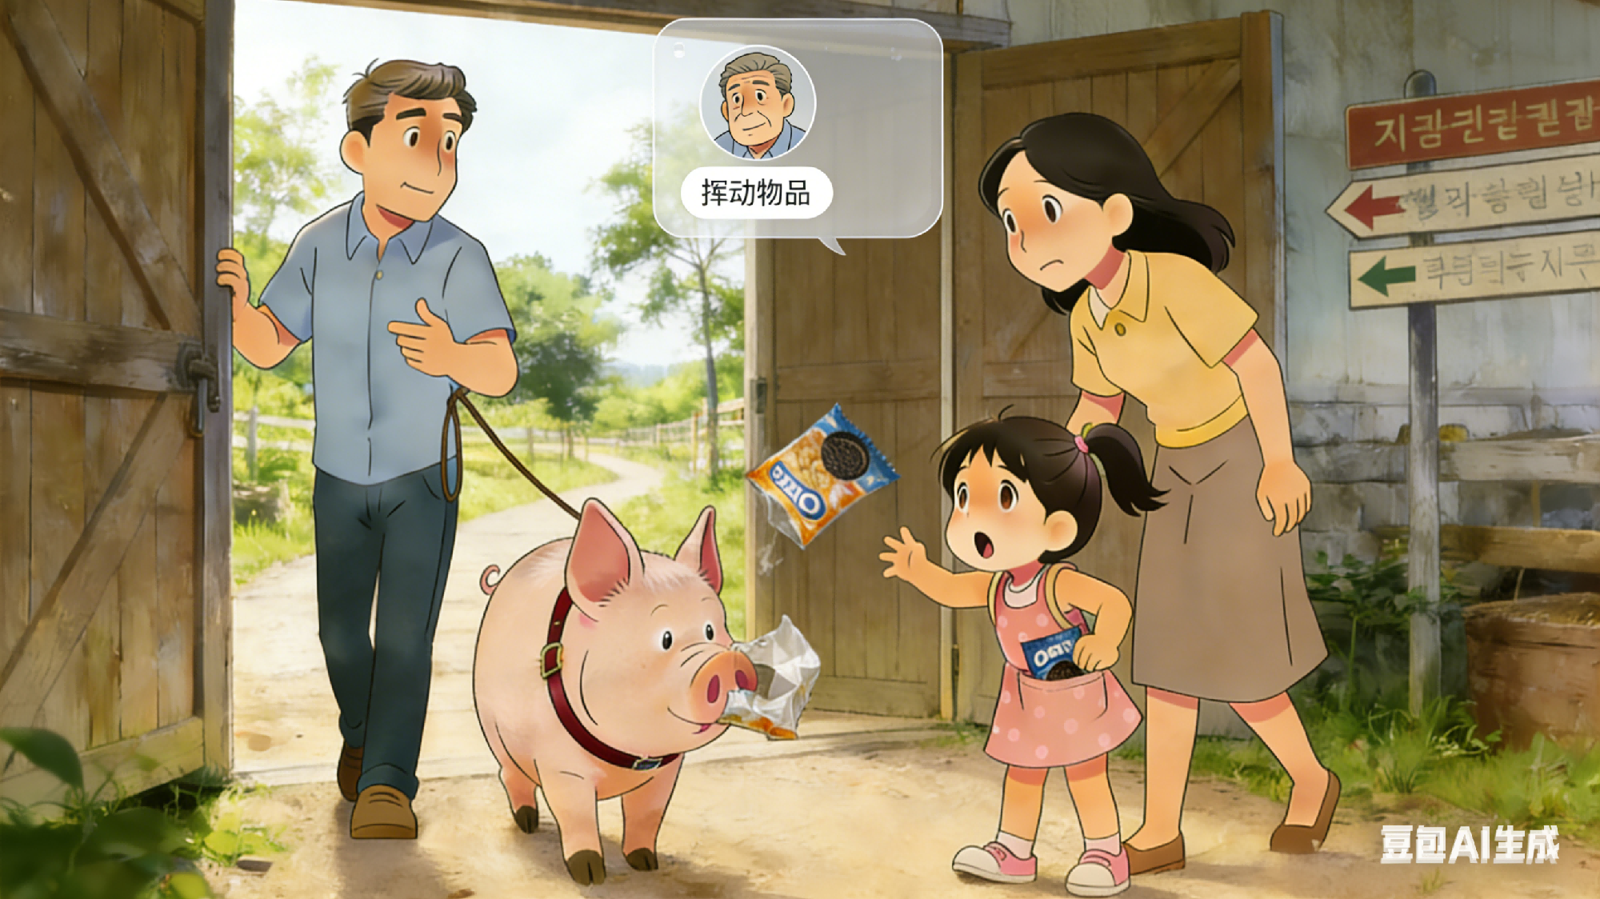
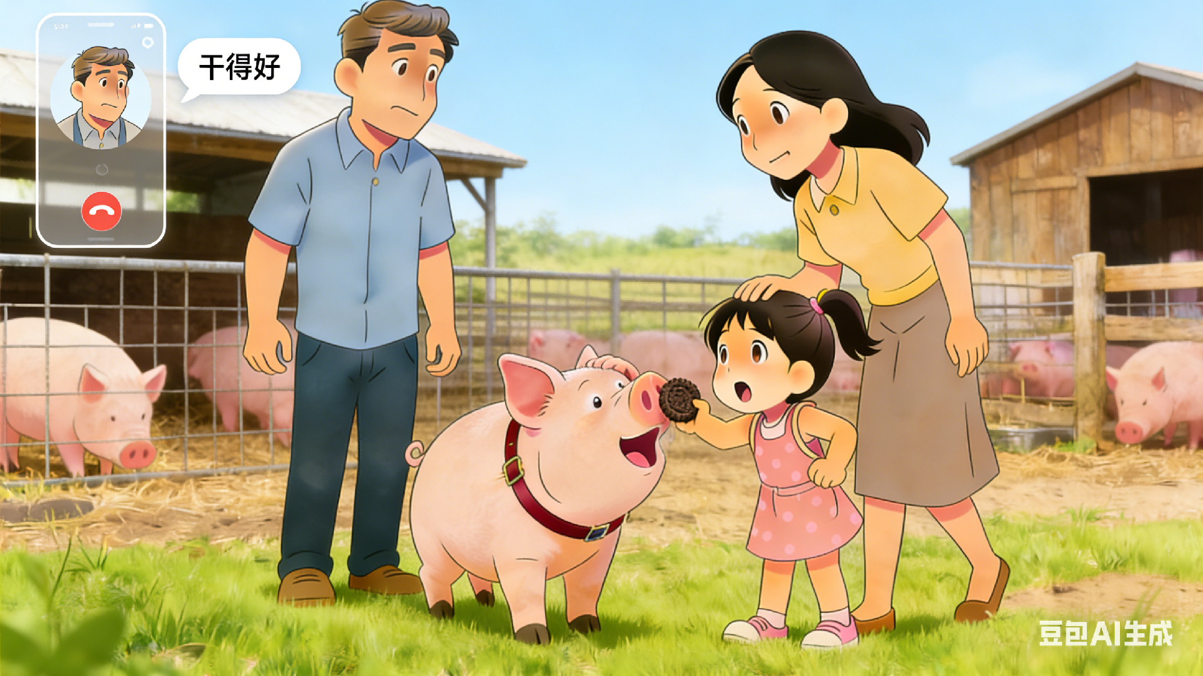
红色为“我”求助
蓝色为农场主支招
绿色为执行动作
远程协助：我们一家+农场主
After checking the route to the farm, we set off with a bag of treats. I called the farmer to confirm the final turn, and he laughed, “Kevin loves kids’ chatter—keep Ella talking, and he’ll follow!” Ella took his advice, chattering nonstop about a variety of interesting things. Kevin seemed fully absorbed, and his ears stood upright, as if hanging on her every word. Whenever he slowed, Ella handed him an Oreo, which he wolfed up quickly. Before we knew it, the farm gate came into view. To reward Kevin for walking so well, Ella reached into the bag for a cookie—only to find the bag surprisingly light. She shook it and looked inside, and we all finally caught sight of the single Oreo lying at the bottom.
Suddenly, we realized there was only one Oreo left and it was impossible to find more food. Sensing the shortage, Kevin nosed the bag with a confused noise, refusing to move. We exchanged worried glances—Lindsey tried touching him softly, but he just rooted around it. I called the farmer, who chuckled, “Kevin loves chasing! Wave something small, and he’ll follow.” Hearing this, Ella pulled an Oreo wrapper from her pocket , waving it gently at him. The familiar smell grabbed his attention—he came alive, nosing curiously. Ella threw it toward the gate, and Kevin rushed after it. At the pen, Ella held out the last Oreo. He wolfed it down, nosed her gratefully, then walked inside. We sighed with relief—thanks to the farmer’s tip and our teamwork, we’d safely brought the sweet pig home.
从协同角度的亮点分析
三级协同闭环高效破局: 以两次远程互动为核心，形成“我求助→农场主支招→Ella执行”的完美闭环，既验证了协同有效性，也成为推动情节的核心动力。
跨空间与内部分工无缝融合：农场主远程支招，与现场“我对接资源、Lindsey尝试安抚、Ella核心执行”的分工形成互补，让外部专业经验有效落地，协同层次感强。
跨物种协同升级为精准共情: 基于Kevin的习性，实现“专业经验+物种习性+个体分工适配”的三重结合，带动Kevin从拒绝到主动配合，形成人与动物的双向协同闭环。
协同递进升华情感内核：前期协同（聊天引导、投喂）更偏向“工具性”，目的是顺利赶路；而后期协同（用包装纸引导、最后投喂）则融入了情感：让协同突破任务层面，升华人与动物的信任联结，增强主题感染力。

Slide 27
参考范文

Slide 28
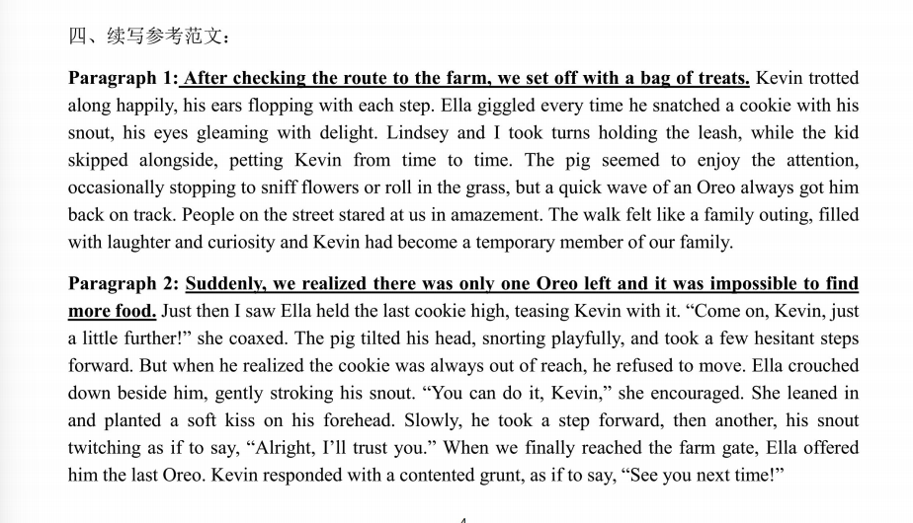
参考范文

Slide 29


