Slide 1



感恩遇见，相互成就，本课件资料仅供您个人参考、教学使用，严禁自行在网络传播，违者依知识产权法追究法律责任。
更多教学资源请关注
公众号：溯恩英语
知识产权声明

Slide 2




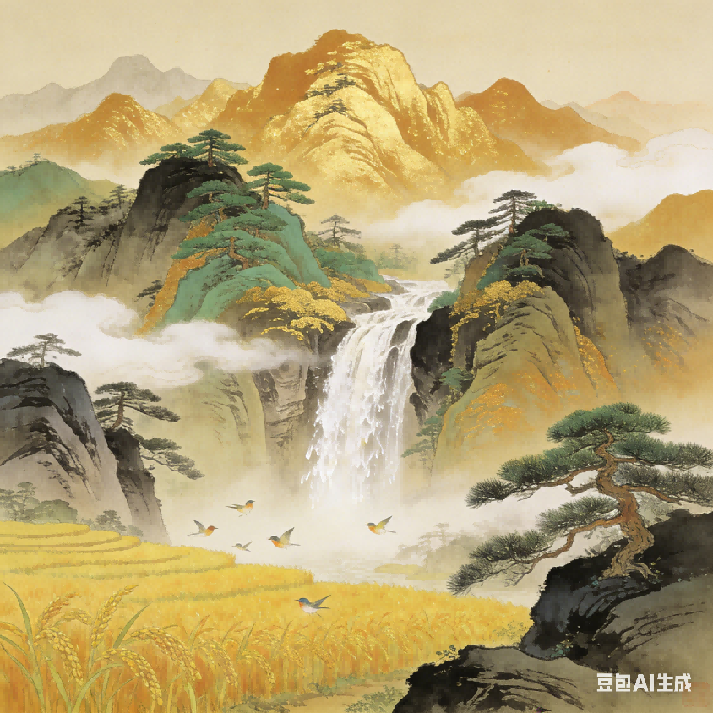
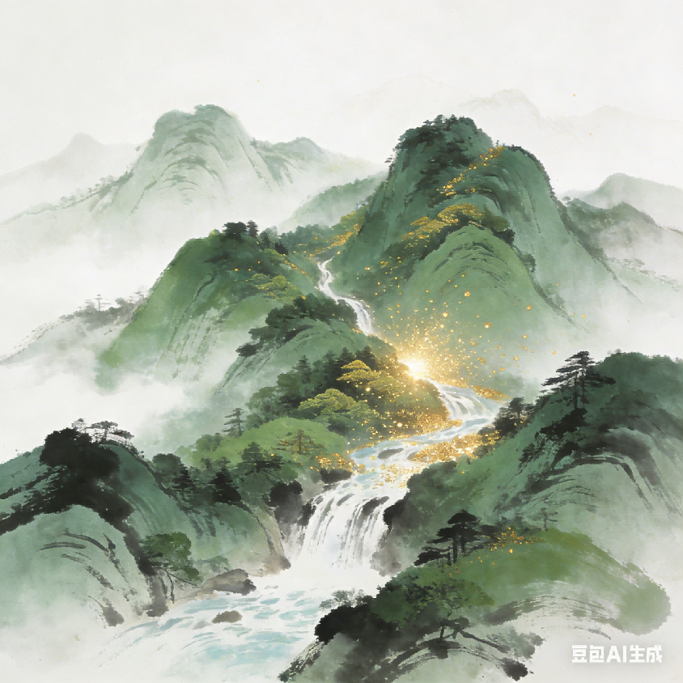
Lucid Waters & Lush Mountains = Invaluable Assets
（绿水青山就是金山银山）
---2025年12月广州市高三年级调研测试
杭州二中树兰高级中学 郭合英

Slide 3

1
理念背景介绍
2
审题
目
录
3
结构框架
4
作品赏析

Slide 4
1
理念背景介绍
目
录

Slide 5
1
理念背景介绍
2
审题
目
录

Slide 6
1
理念背景介绍
2
审题
目
录
3
结构框架

Slide 7
1
理念背景介绍
2
审题
目
录
3
结构框架
4
作品赏析

Slide 8
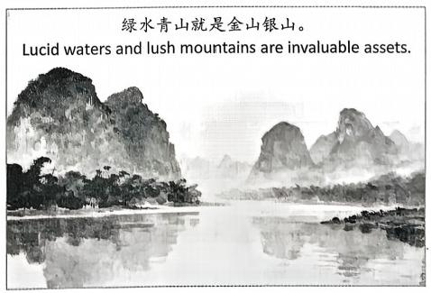
2025年12月广州市高三年级调研测试
假定你是李华，你校交换生Chris看到以下图片，对“绿水青山就是金山银山”这句话 很感兴趣，发邮 件向你进一步了解。请你给他回复邮件，内容包括：
1. 解释含义；
2. 举例说明。
注意：
1. 写作词数应为80左右；
2. 请按如下格式在答题卡的相应位置作答。
Dear Chris, Yours sincerely, Li Hua

Slide 9

1
理念背景介绍
中国生态发展核心理念，源于可持续发展实践

Slide 10
背景介绍
2005年8月15 日，时任浙江省委书记的习近平在安吉县余村调研时首次提出该理念。当时余村面临 “矿山经济” 带来的生态破坏与发展转型的两难，该理念为其指明了 “关停矿山、发展生态旅游” 的绿色转型之路；9天后，习近平以笔名 “哲欣“ 在《浙江日报》“之江新语” 栏目发表《绿水青山也是金山银山》，系统阐述这一理念的逻辑与路径。这一理念的提出，既是对浙江 “八八战略”中 “绿色浙江” 建设的深化，也是对全国发展中生态与经济关系的前瞻性回应，旨在破解“先污染后治理”的传统发展困局。

Slide 11
理念的提出
On August 15, 2005, Xi Jinping, then Party chief of Zhejiang, first put forward this concept during his research tour in Yucun Village, Anji County. At that time, Yucun was trapped in a dilemma between ecological decline caused by the “mining-driven economy” and the urgency of development transformation. This concept pointed out a green transition path for the village: namely, to “shut down mines and develop eco-tourism”. Nine days later, under the pen name “Zhexin”, Xi Jinping published an article titled “Lucid Waters and Lush Mountains Are Also Invaluable Assets” in the “Zhejiang New Talk” column of Zhejiang Daily, systematically setting forth the logic and approaches of this concept.
The proposal of this concept not only represents an in-depth development of the “Green Zhejiang” initiative under Zhejiang’s “Eight-Eight Strategy” but also serves as a forward-looking response to the relationship between ecological protection and economic development in the development of the whole country. It aims to break the traditional development dilemma of “first polluting and then treating”.

Slide 12
专业词汇积累
序号 | 汉语 | 英语
1
2
3
4
5
6
7
8
9
绿水青山就是
金山银山
Lucid Waters and Lush Mountains Are Also Invaluable Assets
八八战略
Eight-Eight Strategy
绿色浙江
Green Zhejiang
矿业驱动型经济
mining-driven economy
生态转型
green transition
生态旅游
eco-tourism
生态保护
ecological protection
生态发展
economic development
先污染后治理
first polluting and then treating

Slide 13
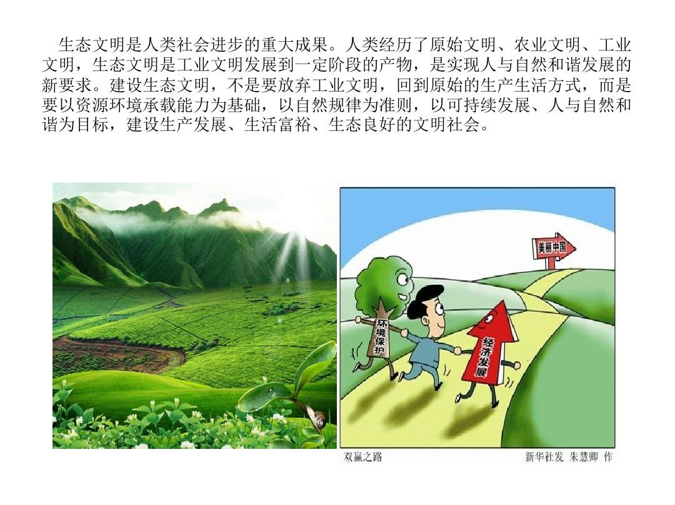
思考：如何理解这个理念？
生态文明是人类社会进步的重大成果。人类经历了原始文明、农业文明、工业文明，生态文明是工业文明发展到一定阶段的产物，是实现人与自然和谐发展的新要求。建设生态文明，不是要放弃工业文明，回到原始的生产生活方式，而是要以资源环境承载能力为基础，以自然规律为准则，以可持续发展、人与自然和谐为目标，建设生产发展、生活富裕、生态良好的文明社会。
双赢之路
环境保护
经济发展

Slide 14

2
审题
精准扣题，不跑方向
思路清晰，详略得当
明确场景，语气得体

Slide 15
假定你是李华，你校交换生Chris看到以下图片，对“绿水青山就是金山银山”这句话很感兴趣，发邮件向你进一步了解。请你给他回复邮件，内容包括：
1. 解释含义；
2. 举例说明。
明确邮件回复的核心要求
李华（学生）→ 收件人 Chris（交换生），两人是熟人，语气需友好、通俗，避免过于学术化的表达。
身份定位
必写点：1：解释含义；2：举例说明。
两个要点缺一不可，否则会导致内容不完整，失分严重。
向Chris解释“绿水青山就是金山银山”的含义，并举例说明，满足其“感兴趣、想进一步了解”的需求。
写作目的
格式要求
严格遵循给定邮件格式，无需额外添加标题或落款信息。

Slide 16

3
结构框架

Slide 17
结构框架
解释含义时，必须紧扣“生态保护与经济发展相辅相成”的核心，不可误解为“只重视生态”或“只追求经济”，需体现“绿水青山”(生态)能转化为“金山银山”(经济价值)的逻辑。
例子需具体、贴近生活，避免抽象，比如乡村生态旅游、城市绿色发展等简单易理解的案例。最好选择“中外通用”的场景，像中国安吉县余村，通过发展生态旅游替代矿产开采，既守护了洁净的生态环境，又实现了经济增收，避免使用Chris 不熟悉的小众案例。
回应关切
+引出主题
解释含义
1
2
安吉县的案例并非小众—— 它是全球可持续发展领域的典型案例（“绿水青山就是金山银山”理念发源地，相关模式被联合国推广），对国际受众（如 Chris）具备认知基础。
Beginning
Body
举例说明
礼貌收尾 +邀请互动
3
Ending

Slide 18
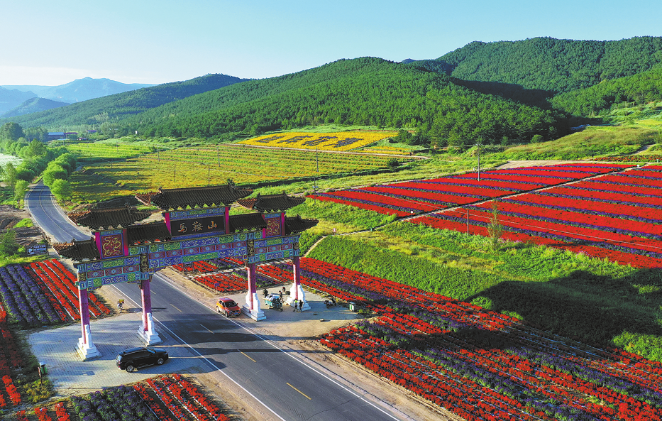
Beginning
核心功能：礼貌回复邮件，呼应 Chris 的兴趣点，自然引出 “绿水青山就是金山银山” 的核心话题，简洁明了。
翻译句子 1.很高兴你对“绿水青山就是金山银山”这句话感兴趣。这是中国发展的核心理念，我很乐意和你分享它的含义及相关事例。
I’m glad you’re interested in the saying “Lucid waters and lush mountains are invaluable assets”. It’s a core idea of China’s development, and I’d love to share its meaning and examples with you.

Slide 19
翻译句子 2 收到你询问“绿水青山就是金山银山”这句话的邮件，我非常开心。这是指导中国发展的重要理念，我很乐意解释它的含义，并和你分享一个相关事例。
Thanks for your email—great to know you’re curious about “Lucid waters and lush mountains are invaluable assets”! This is a key idea guiding China’s development, so let me break down its meaning and give you a real-life case.
翻译句子 3 你对“绿水青山就是金山银山”这句话感兴趣，我特别激动。它对中国的发展有着深远意义，我想和你分享它的内涵以及一个相关事例。
I’m thrilled that you’re interested in the phrase “Lucid waters and lush mountains are invaluable assets”. It carries profound the significance for China’s progress, and I’d like to share what it means and a related example with you.

Slide 20
Body
核心功能 1：解释含义
翻译句子 1 它凸显了生态与经济的共生关系 —— 保护自然并非发展的阻碍，而是经济可持续增长的根基。
It reflects the harmonious coexistence of ecology and economy — protecting nature isn’t a barrier to development, but the basis for sustainable growth.
翻译句子 2 它将绿水青山视作无价资产，强调良好的生态系统等同于珍贵的社会与经济财富。
It regards lucid waters and lush mountains as priceless assets, emphasizing that a sound ecosystem equals precious social and economic wealth.

Slide 21
核心功能 1：解释含义
翻译句子 3 它倡导平衡当下需求与长远利益，反对以破坏环境为代价的短视发展模式。
It advocates balancing current needs with long-term benefits, rejecting the short-sighted development that damages the environment.
翻译句子 4 它体现了人与自然的和谐共生，表明环境保护与繁荣发展能够并行不悖。
It reflects the harmony between humans and nature, showing that environmental protection and prosperity can go hand in hand.

Slide 22
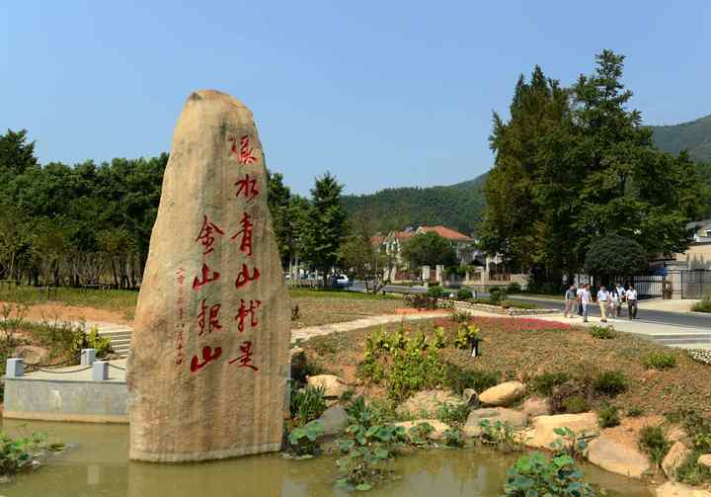
核心功能 2：举例说明
翻译句子 1 浙江安吉余村就是一个典型例子。这个村曾经依赖采矿产业，破坏了当地环境，后来转而修复山林、发展生态旅游。游客们沉醉于这里的青山绿水，当地居民则通过民宿经营和竹制品销售增收。这充分证明，良好的生态环境能带来真正的繁荣。
A classic example is Yucun Village in Anji, Zhejiang. Once dependent on mining that ruined the environment, it later restored forests and developed eco-tourism. Visitors enjoy the green mountains and clear waters, while locals earn from homestays and bamboo products. This proves greenery brings real prosperity.

Slide 23
4
作品赏析
Dear Chris,
I’m glad you’re interested in the saying “Lucid waters and lush mountains are invaluable assets”. It’s a core idea of China’s development, and I’d love to share its meaning and examples with you.
It regards lucid waters and lush mountains as priceless assets, emphasizing that a sound ecosystem equals precious social and economic wealth. A classic example is Yucun Village in Anji, Zhejiang. Once dependent on mining that ruined the environment, it later restored forests and developed eco-tourism. Visitors enjoy the green mountains and clear waters, while locals earn from homestays and bamboo products. This proves greenery brings real prosperity.
Hope this helps! Feel free to ask if you want to know more.
Yours sincerely,
Li Hua

Slide 24
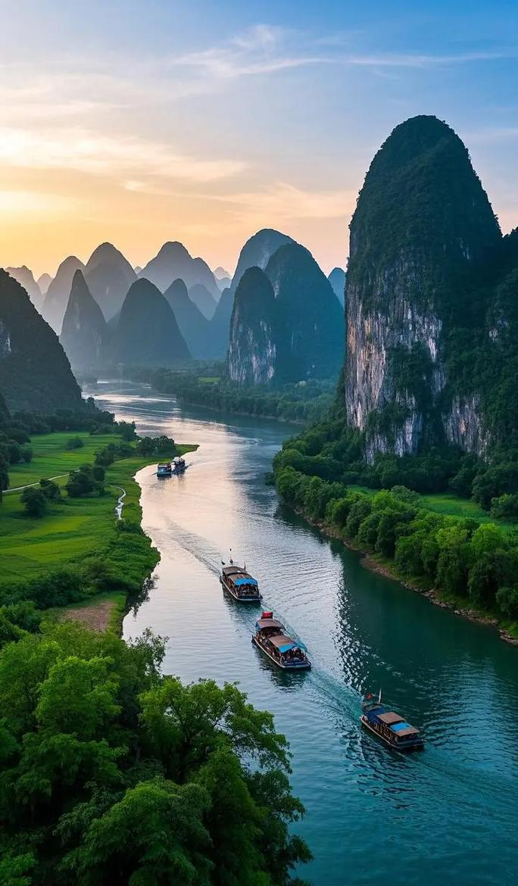
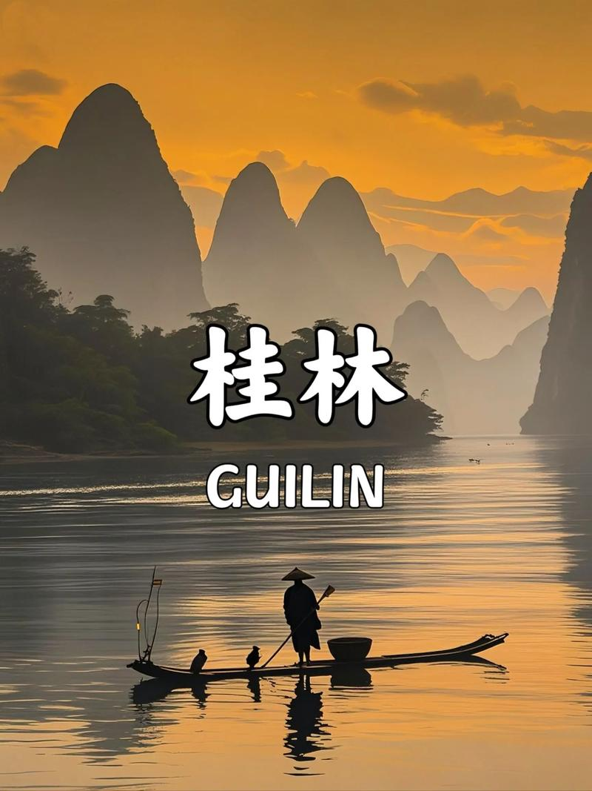
核心功能 2：举例说明
翻译句子 2 广西桂林就是绝佳例证。这座城市以喀斯特地貌的群山和清澈的漓江闻名，始终严格守护着自身的自然之美。来自世界各地的游客慕名而来欣赏美景，为当地居民带来了酒店经营、游船服务和小吃售卖等稳定收入。这充分说明，良好的生态就是真正的财富。
Guilin in Guangxi is a perfect example. Famous for its karst mountains and clear Li River, it has guarded its natural beauty strictly. Tourists from all over the world come to enjoy the scenery, bringing locals steady income from hotels, boats and snacks. This shows greenery is true wealth.

Slide 25
4
作品赏析
Dear Chris,
Thanks for your email—great to know you’re curious about “Lucid waters and lush mountains are invaluable assets”! This is a key idea guiding China’s development, so let me break down its meaning and give you a
real-life case.
It means protecting the natural environment is the key to long-term prosperity, not a barrier to development. Guilin in Guangxi is a perfect example. Famous for its karst mountains and clear Li River, it has guarded its natural beauty strictly. Tourists from all over the world come to enjoy the scenery, bringing locals steady income from hotels, boats and snacks. This shows greenery is true wealth.
Hope this helps! Feel free to ask more questions.
Yours sincerely,
Li Hua

Slide 26
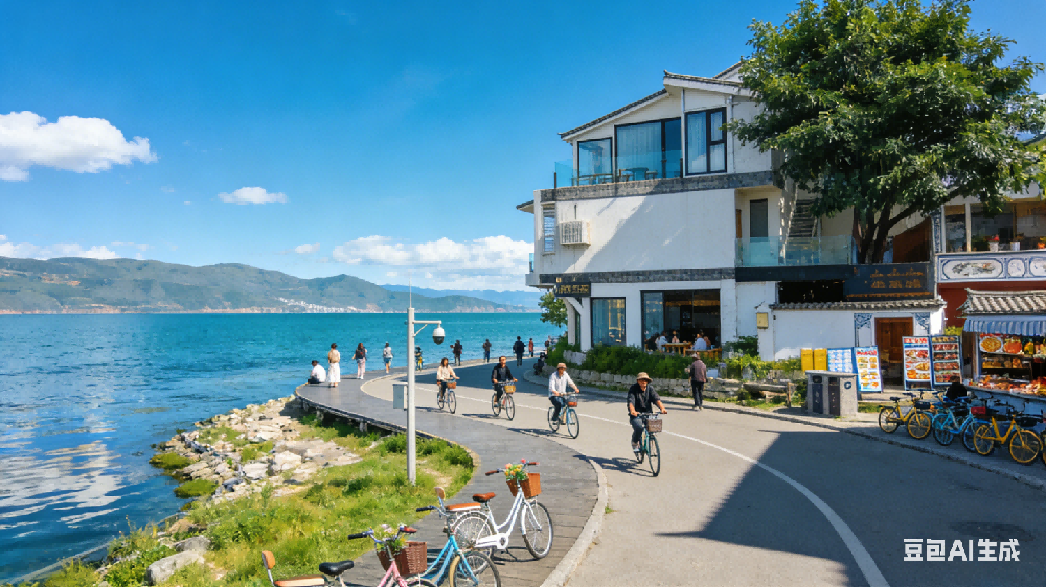
翻译句子 3 云南大理就是一个很好的例子。当地严格保护洱海，制止周边村庄的污染行为。如今，来自世界各地的游客前来欣赏洱海及周边山峦的美景，为当地人带来了客栈经营、自行车租赁和特色小吃售卖等收入。这证明，洁净的环境就是真正的繁荣。
Dali, Yunnan, is a great example. It strictly protects Erhai Lake, stopping pollution from nearby villages. Now, tourists worldwide come to enjoy the lake and surrounding mountains, bringing locals income from homestays, bike rentals and local snacks. This proves a clean environment is real prosperity.

Slide 27
4
作品赏析
Dear Chris,
I’m thrilled that you’re interested in the phrase “Lucid waters and lush mountains are invaluable assets”. It carries profound significance for China’s progress, and I’d like to share what it means and a related example with you.
It means protecting nature brings long-term wealth, not just short-term gains. Take Dali, Yunnan for an example. It strictly protects Erhai Lake, stopping pollution from nearby villages. Now, tourists worldwide come to enjoy the lake and surrounding mountains, bringing locals income from inns, bike rentals and local snacks. This proves a clean environment is real prosperity.
Hope this helps! Feel free to ask more.
Yours sincerely,
Li Hua

Slide 28
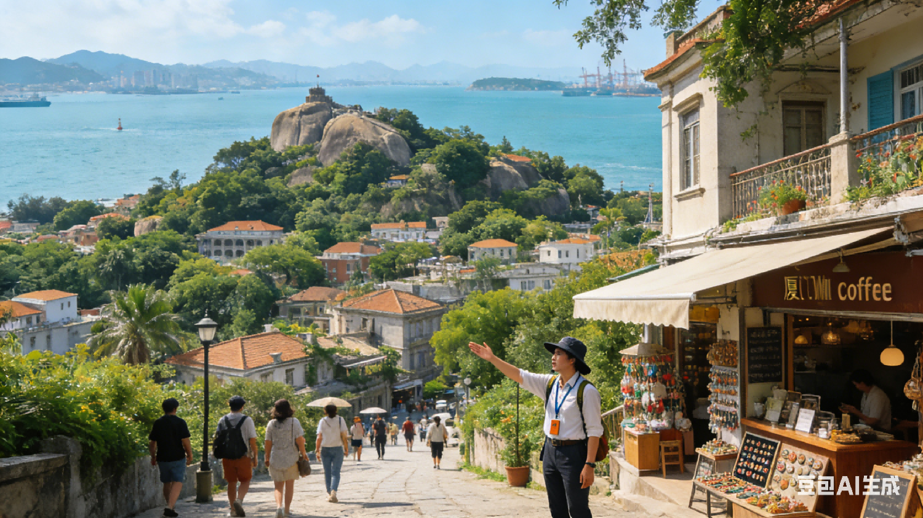
翻译句子 4 厦门鼓浪屿就是典型案例。岛上在控制游客数量的同时，修复了绿地、保护了历史建筑。游客享受着岛上的清新空气和海岸风光，当地人则从咖啡馆经营、手工艺品店和导游服务中获益。这说明，良好的生态与特色文化能带来实实在在的收入。
Xiamen’s Gulangyu Island is a typical case. It has restored green spaces and protected historical buildings while controlling tourist numbers. Visitors enjoy the island’s fresh air and coastal views, and locals benefit from cafes, handicraft shops and guided tours. This shows greenery and culture bring real income.

Slide 29
4
作品赏析
Dear Chris,
It’s nice to know you want to learn about “Lucid waters and lush mountains are invaluable assets”. Let me break down its core meaning first and then share a vivid example to make it clearer.
It emphasizes that ecological protection and development can go hand in hand. Xiamen’s Gulangyu Island is a typical case. It has restored green spaces and protected historical buildings while controlling tourist numbers. Visitors enjoy the island’s fresh air and coastal views, and locals benefit from cafes, handicraft shops and guided tours. This shows greenery and culture bring real income.
Feel free to ask if you need more details!
Yours sincerely,
Li Hua

Slide 30


