Slide 1


感恩遇见，相互成就，本课件资料仅供您个人参考、教学使用，严禁自行在网络传播，违者依知识产权法追究法律责任。
更多教学资源请关注
公众号：溯恩英语
知识产权声明

Slide 2

2025学年杭州市高一第一学期期末统考
客观题讲评

Slide 3

Passage A
语篇类型：说明文
主题语境：人与社会
话题：本文介绍了 2026 年一种新的旅行趋势 ——“有意图的旅行”（travel with intention）。

Slide 4
Tired of feeling worn out after a trip? You’re not alone. A quiet travel change is on the way for2026, where rest, choice, and real connection matter more than busy plans—known as “travel with intention”.
Comfort in What You Know
Long trips often make known things more attractive than new ones. A 2025 study by the Global Travel Association shows that almost 48% of travelers now like to cook their own meals during holidays, not just to save money, but to keep a normal and comforting daily life. Because of this, a new idea, “hushpitality”—mixing “hush” and “hospitality”—is becoming popular. Hotels now say that peace and quiet are their main attraction.
The Need for Control
The return of the road trip shows another strong wish—control. A study by Travel Insights found that 62% of young people like trips they plan themselves more than ready-made tours, valuing the freedom to decide when to stop or where to eat. Today’s travelers see themselves more as active planners and creators of their trips, not just tourists following a guide.
Connection Without Pressure
Wanting control does not mean being alone. More and more families are purposefully looking for good time together in places like quiet beach houses or national parks, staying away from phones and computers on purpose. This thoughtful way, often called a “whycation”, means the goal of the trip decides the place. In the same way, connection can also mean finding time for yourself through quiet and personal space.
In short, the perfect holiday for 2026 is slow and helps you feel better. Choosing known hotels or relaxing by the pool isn’t boring, but a move toward more meaningful travel.
P1: Lead in the topic—travel with intention
P1: Comfort in What You Know (subtitle)
P2: The Need for Control (subtitle)
P3: Connection Without Pressure (subtitle)
P5: Conclusion (In short, ……)

Slide 5


Comfort in What You Know
Long trips often make known things more attractive than new ones. A 2025 study by the Global Travel Association shows that almost 48% of travelers now like to cook their own meals during holidays, not just to save money, but to keep a normal and comforting daily life. Because of this, a new idea, “hushpitality”—mixing “hush” and “hospitality”—is becoming popular. Hotels now say that peace and quiet are their main attraction.
21. What is “hushpitality” mainly about?
A. It promotes peace and quiet.
B. It reduces travel costs.
C. It provides home-cooked meals.
D. It requires guests to stay silent.
B项文中提到自己做饭是为了省钱，并非hushpitality内容，偷换概念
×
×

Slide 6
The Need for Control
The return of the road trip shows another strong wish—control. A study by Travel Insights found that 62% of young people like trips they plan themselves more than ready-made tours, valuing the freedom to decide when to stop or where to eat. Today’s travelers see themselves more as active planners and creators of their trips, not just tourists following a guide.
22. Which type of trip would best suit someone who travels with intention?
A. A guided city tour.
B. A ready-made boat trip.
C. A self-planned road trip.
D. A planned package tour.
×
×
×

Slide 7
(P1)Tired of feeling worn out after a trip? You’re not alone. A quiet travel change is on the way for2026, where rest, choice, and real connection matter more than busy plans—known as “travel with intention”.
……
(P5)In short, the perfect holiday for 2026 is slow and helps you feel better. Choosing known hotels or relaxing by the pool isn’t boring, but a move toward more meaningful travel.
23. What is the main purpose of the passage?
A. To introduce modern hotel services.
B. To show a change in travel preferences.
C. To discuss the changes in modern life.
D. To explain the drop in traditional travel.

Slide 8
重要词汇
travel with intention
ready-made tours
purposefully
tendency
hospitality
real connection
self-planned road trip
package tour
personal space
a move toward
1.有意图的旅行
2.现成跟团游
3.刻意地；有目的地
4.趋势；倾向
5.好客；殷勤款待
6.真实联结
7.自主规划的公路旅行
8.包价旅游
9.私人空间
10.向…的转变

Slide 9
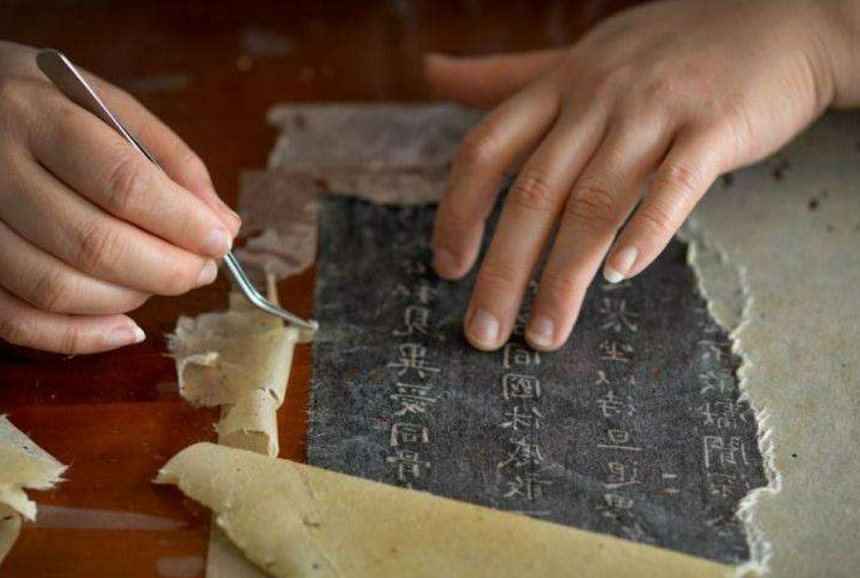
Passage B
语篇类型：记叙文
主题语境：人与社会
话题：本文讲述了荆州博物馆文物修复专家方北松，三十多年来致力于简牍修复的故事，通过具体事例展现了他的专业精神和简牍保护的艰辛与价值。

Slide 10
(P1)For more than 30 years, Fang Beisong, an expert at repairing old objects at Jingzhou Museum,has worked to make ancient words on bamboo and wooden pieces readable again. These pieces are called jiandu.
(P2)One special moment came in 2015. While cleaning a bamboo piece from the Warring StatesPeriod, he found the words for “hold your hand and grow old with you”, a line from The Book of Songs. “I felt the light and warmth of our history and culture,” Fang recalled.
(P3)After finishing his studies in chemistry in 1988, Fang began working at the museum, using science for his love of history. He focuses on jiandu—things people wrote on before paper was used. In 2002,he faced a huge task—over 92,000 pieces from the Qin Dynasty were found in Hunan. He stayed in Changsha for nine years, working 12 hours a day to sort out and protect them.
(P4)Preserving jiandu is extremely difficult. They are made of natural materials and break down easily. Once unearthed, they quickly turn black in the air, making the writing unreadable. Fang’srepair work involves over 20 steps, with decoloring and dewatering being the most important. Decoloring brings back the original color and keeps the words clear, while dewatering helps them leave the wet condition and stay steady for keeping. After years of trying, he found a good two-step way and won a national technology prize in 2019.
(P5)Each case is different. In 2020, his team worked on Han Dynasty bamboo pieces from a robbed tomb in Dingzhou. The pieces broke easily. They tried over 70 times to keep them together. Even though the writing was almost impossible to see, a special camera using infrared light showed the words clearly.
(P6)So far, Fang and his team have fixed over 100,000 pieces. “For things like these, once they are dug up, there’s only a short time to save them. I cannot stop—the faster I work, the more of our history I can save,” said Fang.
P1: Introduction (the main character/his professional identity/his core mission
P2:A specific event (finding The Book of Songs verses on Warring States bamboo slips)
P3:A major challenge (restoring and protecting 92,000 Qin Dynasty bamboo slips in Changsha)
P4：Technical difficulties and core techniques (decoloring & dewatering)
P5：Examples of diverse restoration cases
P6: Conclusion (devotion & urgency)

Slide 11
(P2)One special moment came in 2015. While cleaning a bamboo piece from the Warring StatesPeriod, he found the words for “hold your hand and grow old with you”, a line from The Book of Songs. “I felt the light and warmth of our history and culture,” Fang recalled.
24. How did Fang feel when he saw the line from The Book of Songs?
A. Moved. B. Bored. C. Shocked. D. Confused.
(P3)After finishing his studies in chemistry in 1988, Fang began working at the museum, using science for his love of history. He focuses on jiandu—things people wrote on before paper was used. In 2002,he faced a huge task—over 92,000 pieces from the Qin Dynasty were found in Hunan. He stayed in Changsha for nine years, working 12 hours a day to sort out and protect them.
25. What do we know about Fang’s work in Changsha after 2002?
A. He got a national award right after. B. He solved all preservation issues there.
C. He worked long hours to preserve jiandu. D. He went there to study Qin Dynasty history.
×
×
×

Slide 12
(P4)Preserving jiandu is extremely difficult. They are made of natural materials and break down easily. Once unearthed, they quickly turn black in the air, making the writing unreadable. Fang’srepair work involves over 20 steps, with decoloring and dewatering being the most important. Decoloring brings back the original color and keeps the words clear, while dewatering helps them leave the wet condition and stay steady for keeping. After years of trying, he found a good two-step way and won a national technology prize in 2019.
26. What does the underlined word “decoloring” in paragraph 4 mean?
A. Washing the surface to remove dirt.
B. Changing the color of jiandu.
C. Preventing jiandu from turning black.
D. Recovering the true color.

Slide 13
(P1)For more than 30 years, Fang Beisong, an expert at repairing old objects at Jingzhou Museum, has worked to make ancient words on bamboo and wooden pieces readable again. These pieces are called jiandu.
(P4)Preserving jiandu is extremely difficult. ……After years of trying, he found a good two-step way and won a national technology prize in 2019.
(P5)Each case is different. ……
(P6) So far, Fang and his team have fixed over 100,000 pieces. “For things like these, once they are dug up, there’s only a short time to save them. I cannot stop—the faster I work, the more of our history I can save,” said Fang.
(P1)For more than 30 years, Fang Beisong, an expert at repairing old objects at Jingzhou Museum, has worked to make ancient words on bamboo and wooden pieces readable again. These pieces are called jiandu.
(P4)Preserving jiandu is extremely difficult. ……After years of trying, he found a good two-step way and won a national technology prize in 2019.
(P5)Each case is different. ……
(P6) So far, Fang and his team have fixed over 100,000 pieces. “For things like these, once they are dug up, there’s only a short time to save them. I cannot stop—the faster I work, the more of our history I can save,” said Fang.
27. What lesson can we learn from Fang’s story?
A. More haste, less speed.
B. Time and tide wait for no man.
C. Actions speak louder than words.
D. Where there’s a will, there’s a way.
欲速则不达
时不我待—强调时间的紧迫性
行胜于言—强调行动的重要性
有志者事竟成—强调坚持和意志

Slide 14
重要词汇
可辨认的；能看清的
整理；分类（文物/资料）
（物体）破损；自然分解
包含；涉及
原始的；最初的
稳定的
竹木简牍
恢复；使重现
从事；致力于（专项工作）
科技奖
天然材料
保持稳定
致力于做……
readable
sort out
break down
involve
original
steady
bamboo and wooden pieces
bring back
work on
technology prize
natural materials
stay steady
work to do

Slide 15

Passage C
语篇类型：说明文（研究发现类）
主题语境：人与社会
内容：本文围绕一次性塑料袋管控政策的研究结果展开，表明塑料袋禁令 / 征税能缓解污染，但并非根治方案；治理塑料污染需从源头管控生产。

Slide 16
(P1)Plastic pollution is a global threat, but new research shows that certain rules can help. By studying information from hundreds of local bag rules in the U.S. and over 45,000 beach clean-ups,researchers discovered that in areas with bans on single-use plastic bags, these bags made up a much smaller part of the litter collected.
(P2)“It was surprising to see that these rules worked,” said co-author Kimberly Oremus, an environmental economist. In addition to their primary finding that these bans work, the researchers further found that complete bans and bag taxes are more effective than partial bans, where some types of heavier plastic bags are still allowed. Bans at the state level also help more than bans in just one city. Finally, areas that had a lot of plastic waste to begin with saw the biggest improvement from the bans.
(P3)To confirm the findings, the researchers did more work. They checked for “spillover effects,”where bans in one area might increase litter in neighboring areas without bans, but found no clear evidence of this. They also found that bag waste did not come back after a few years.
(P4)However, the study also had a surprising result. Over the seven-year study period, plastic bag litter increased across most sites, with or without bans. The difference was that in places with bans or fees, this increase was much slower and smaller. “Compared to having no rules, it’s clear that bag bans are better,” Oremus said, “but rules that only ask shoppers to change may not be enough to stop plastic pollution.”
(P5)This points to a possible future solution. In 2022, 175 countries began working on a global treaty to end plastic pollution, which may limit the production of single-use plastics. As another co-author Anna Papp said, “Cutting the problem off at the source is more likely to work than rules that only focus on shoppers.”
P1: Introduction(certain rules can help fight plastic pollution)
P2: Evidence(Policies like plastic bag bans effectively reduce litter)
P3: To confirm the findings, the researchers did more work
P4：Limitation(a suprising result: Policies only targeting shoppers are not enough.
P5 Future solution (A global treaty to cut plastic production at the source)

Slide 17
(P2)“It was surprising to see that these rules worked,” said co-author Kimberly Oremus, an environmental economist. In addition to their primary finding that these bans work, the researchers further found that complete bans and bag taxes are more effective than partial bans, where some types of heavier plastic bags are still allowed. Bans at the state level also help more than bans in just one city. Finally, areas that had a lot of plastic waste to begin with saw the biggest improvement from the bans.
(P3)To confirm the findings, the researchers did more work. They checked for “spillover effects,”where bans in one area might increase litter in neighboring areas without bans, but found no clear evidence of this. They also found that bag waste did not come back after a few years.
28. What did the study find about plastic bag rules?
A. They removed bag litter completely.
B. Bans helped least where litter was worst.
C. Complete state bans beat partial city ones.
D. They made more bag litter in nearby places.
×
×
×

Slide 18
(P4)However, the study also had a surprising result. Over the seven-year study period, plastic bag litter increased across most sites, with or without bans. The difference was that in places with bans or fees, this increase was much slower and smaller. “Compared to having no rules, it’s clear that bag bans are better,” Oremus said, “but rules that only ask shoppers to change may not be enough to stop plastic pollution.”
(P4)①However, the study also had a surprising result. ②Over the seven-year study period, plastic bag litter increased across most sites, with or without bans. ③The difference was that in places with bans or fees, this increase was much slower and smaller. ④“Compared to having no rules, it’s clear that bag bans are better,” Oremus said, “but rules that only ask shoppers to change may not be enough to stop plastic pollution.”
→句①：topic sentence
→句②：具体阐述surprising result内容
→句③：对句②的补充
→句④：用专家引言来总结复述
29. What does paragraph 4 mainly talk about?
A. Solutions go beyond bag bans.
B. Bag bans are far from effective.
C. Plastic litter still rises despite bans.
D. Bag bans end plastic pollution forever.

Slide 19
(P5)This points to a possible future solution. In 2022, 175 countries began working on a global treaty to end plastic pollution, which may limit the production of single-use plastics. As another co-author Anna Papp said, “Cutting the problem off at the source is more likely to work than rules that only focus on shoppers.”
主语
系动词
表语
长难句分析：“Cutting the problem off at the source is more likely to work than rules that only focus on shoppers.”
比较状语
修饰“rules”的定语从句
30. What is Anna Papp’s view on plastic pollution control?
A. Stricter city rules on plastic bags.
B. More effort into global clean-ups.
C. Focusing on controlling production.
D. Identifying the source of plastic litter.
×

Slide 20
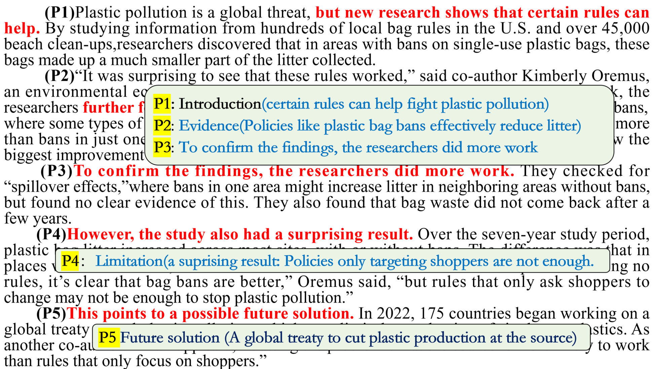
肯定效果
↓
指出局限
↓
提出更优解
31. Which of the following is the best title for the text?
A. Plastic Bags: A Lasting Problem.
B. Bag Bans: A Step, Not the Answer.
C. Plastic Pollution: An Ongoing Challenge.
D. Beyond Bans: Calling for a Global Treaty.
×
不是介绍塑料袋污染，而是分析塑料袋禁令
×
不是介绍塑料袋污染，而是分析塑料袋禁令
以偏概全(全球公约只在最后一段)

Slide 21
重要短语
全球威胁
一次性塑料袋
占（比例）
环境经济学家
主要研究发现
塑料袋税
部分禁令
州层面
溢出效应
确凿证据
研究周期
塑料袋垃圾
全球条约
从源头遏制
证实；确认
生产；制造
global threat
single-use plastic bags
make up
environmental economist
primary finding
bag taxes
partial bans
state level
spillover effects
clear evidence
study period
plastic bag litter
global treaty
cut off at the source
confirm
production

Slide 22
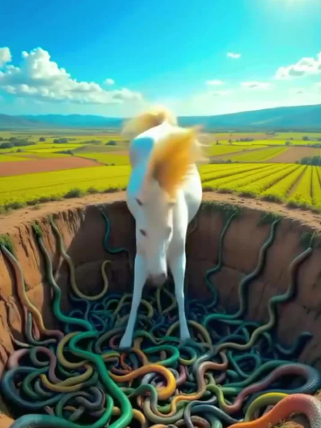
Passage D
语篇类型：说明文
主题语境：人与自然
话题：本文指出AI 生成的虚假动物视频广泛传播，会误导大众、危害野生动物保护；文章分析其危害、识别方法，并提出教育等应对方向。

Slide 23
(P1)Have you ever seen an animal video online that made you stop and wonder? Videos showing a wolf taking care of a rabbit, or a lion walking calmly through a small town are now spreading widely.This is possible because of AI technology. However, scientists warn such popular videos may hurt realwildlife protection and spread wrong ideas about nature.
(P2)A study in Conservation Biology points out that AI-generated animal videos create an untrue world, leading to wrong ideas about animal behavior and widening the gap between people and nature.Co-author José Guerrero-Casado stresses the danger of false information. For example,videos showing birds killing “bad” snakes might make people less willing to protect snakes, and create false ideas about animals that are already in danger.
(P3)The effect on children is especially worrying. These videos can give them wrong ideas about how people and animals really get along. When children discover that real-world animals do not act as they do in these made-up videos, it can have the opposite result, finally making them feel less connected to nature. This risk grows as young people increasingly turn to social media for information.
(P4)So, how can one recognize these videos? Experts suggest looking for a few signs: unnatural animal movements that appear too smooth or seem impossible in real life; light and shadows that do not look quite right; and small details like fur or feathers that appear unclear or repeat in an unusual way.
(P5)To deal with these risks, the research team suggests putting more effort into education, like teaching media literacy in schools. As another co-author Francisco Sánchez says, the goal is to make sure “children learn early that there are no lions living here.” While they think this is important,the researchers also say that school lessons alone cannot stop the spread of false information made by AI. This leads to an important question about who else in society needs to help solve this problem, if school education is not enough.
(P1)Have you ever seen an animal video online that made you stop and wonder? Videos showing a wolf taking care of a rabbit, or a lion walking calmly through a small town are now spreading widely.This is possible because of AI technology. However, scientists warn such popular videos may hurt realwildlife protection and spread wrong ideas about nature.
(P2)A study in Conservation Biology points out that AI-generated animal videos create an untrue world, leading to wrong ideas about animal behavior and widening the gap between people and nature.Co-author José Guerrero-Casado stresses the danger of false information. For example,videos showing birds killing “bad” snakes might make people less willing to protect snakes, and create false ideas about animals that are already in danger.
(P3)The effect on children is especially worrying. These videos can give them wrong ideas about how people and animals really get along. When children discover that real-world animals do not act as they do in these made-up videos, it can have the opposite result, finally making them feel less connected to nature. This risk grows as young people increasingly turn to social media for information.
(P4)So, how can one recognize these videos? Experts suggest looking for a few signs: unnatural animal movements that appear too smooth or seem impossible in real life; light and shadows that do not look quite right; and small details like fur or feathers that appear unclear or repeat in an unusual way.
(P5)To deal with these risks, the research team suggests putting more effort into education, like teaching media literacy in schools. As another co-author Francisco Sánchez says, the goal is to make sure “children learn early that there are no lions living here.” While they think this is important,the researchers also say that school lessons alone cannot stop the spread of false information made by AI. This leads to an important question about who else in society needs to help solve this problem, if school education is not enough.
P1: scientists warn such popular videos may hurt realwildlife protection and spread wrong ideas about nature.
P2：The effect of AI-generated animal videos on people
P3：The effect of AI-generated animal videos on children
P4：How to recognize these videos
P5：Suggestions for dealing with these risks

Slide 24
(P1)Have you ever seen an animal video online that made you stop and wonder? Videos showing a wolf taking care of a rabbit, or a lion walking calmly through a small town are now spreading widely.This is possible because of AI technology. However, scientists warn such popular videos may hurt realwildlife protection and spread wrong ideas about nature.
32. How does the author present the issue in the first paragraph?
A. By giving examples.
B. By making a comparison.
C. By quoting an expert.
D. By sharing an experience.

Slide 25
(P2)A study in Conservation Biology points out that AI-generated animal videos create an untrue world, leading to wrong ideas about animal behavior and widening the gap between people and nature.Co-author José Guerrero-Casado stresses the danger of false information. For example,videos showing birds killing “bad” snakes might make people less willing to protect snakes, and create false ideas about animals that are already in danger.
(P3)The effect on children is especially worrying. These videos can give them wrong ideas about how people and animals really get along. When children discover that real-world animals do not act as they do in these made-up videos, it can have the opposite result, finally making them feel less connected to nature. This risk grows as young people increasingly turn to social media for information.
×文中只是举例
×偷换概念
33. What can be inferred about AI-generated animal videos?
A. They make children love animals less.
B. They mainly focus on species in danger.
C. They may make animals seem dangerous.
D. They create a false understanding of nature.
×
×

Slide 26
(P4)So, how can one recognize these videos? Experts suggest looking for a few signs: unnatural animal movements that appear too smooth or seem impossible in real life; light and shadows that do not look quite right; and small details like fur or feathers that appear unclear or repeat in an unusual way.
→迹象1
→迹象2
→迹象3
34. According to paragraph 4, which is most probably an AI-generated video?
A. A parrot with clear feathers.
B. A cat with natural shadows.
C. A dog with unusual marks.
D. A frog with extremely smooth jumps.
一只身上有奇特斑纹的狗

Slide 27
(P5)To deal with these risks, the research team suggests putting more effort into education, like teaching media literacy in schools. As another co-author Francisco Sánchez says, the goal is to make sure “children learn early that there are no lions living here.” While they think this is important,the researchers also say that school lessons alone cannot stop the spread of false information made by AI. This leads to an important question about who else in society needs to help solve this problem, if school education is not enough.
35. What will the author most probably discuss next?
A. The media literacy lessons.
B. The duties of social media.
C. The popularity of such videos.
D. The threats to wildlife protection.

Slide 28
重要短语
AI-generated animal videos
false information
widen the gap
made-up
deal with risks
stop the spread of…
generate /ˈdʒenəreɪt/
stress
unnatural /ʌnˈnætʃrəl/
literacy /ˈlɪtərəsi/
put effort into
AI 生成的动物视频
虚假信息
扩大隔阂/差距
虚构的；编造的
应对风险
阻止… 的传播
v. 产生；生成
v. 强调；着重指出
adj. 不自然的
n. 素养；读写能力
致力于；努力做

Slide 29
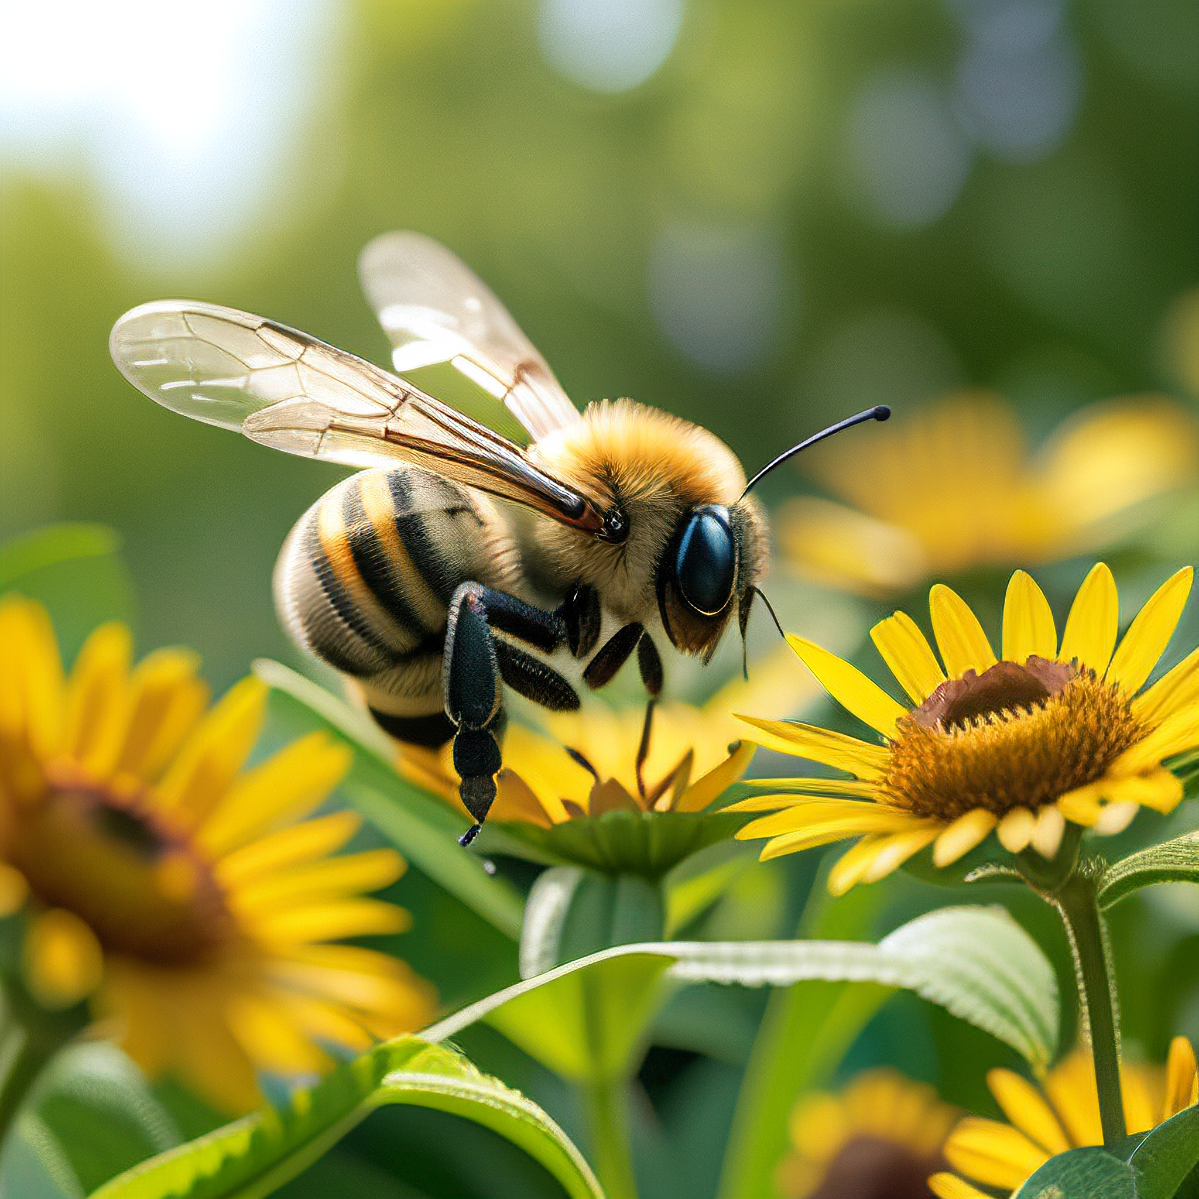
七选五
语篇类型：说明文
主题语境：人与自然
话题：本文介绍世界蜜蜂日的由来、蜜蜂的社会分工、蜇人特性、人类对蜜蜂的利用与蜜蜂的迁徙栖息特点。

Slide 30
(P1)Happy World Bee Day! May 20 was chosen because it’s also the birthday of the pioneer of modern beekeeping, Anton Jansa of 18th-century Slovenia. 36 They pollinate 35% of the world’s food crops, including 75% of the fruits, vegetables and nuts grown in the U.S.
(P2)The queen bee doesn’t rule the hive as you might think. 37 Without their constant care, the queen would die. And when her time does eventually come, the worker bees raisea new queen, which stings the old queen to death before taking over.
(P3)You may have heard that if a bee stings you, it dies. This is true only for honeybees. Other bees,including bumblebees and carpenter bees, can sting multiple times. In 1962, in what had to be one of the worst days of his life, a man in Zimbabwe survived getting stung more than 2,000 times! Roughly,500 bee species have no stingers at all. 38
(P4)Fewer than 8% of Americans are allergic to bee stings, but it’s still a common fear. 39Researchers in Africa use beehives, as well as “buzz boxes” that send out the sound of bees, to prevent animals from destroying crops and living areas.
(P5)Bees aren’t just limited to outdoor spaces like farms or gardens—they can also happen in unexpected public areas, sometimes causing unusual situations. Last May, a swarm of bees landed on the wing of a Delta Air Lines plane parked in Houston, putting off its departure for hours. 40They fly about a mile at a time, stopping to rest in open spaces like airports, many of which now use pollinator-friendly practices to protect bees and their staff.
P1 Introduction(The origin of World Bee Day and bees' critical role in pollination)
P2：Social structure of bees
P3：Stinging facts of bees
分
P3：Fear of bee stings & applications
P5 ：Habitat & behavior

Slide 31
标记表示逻辑关系的副词及连词
标记代词
标记核心主题词汇
A. To defend themselves, they bite.
B. Bees are well worth celebrating.
C. Even elephants are terrified of bees.
D. Today in the U.S., there are about 125,000 beekeepers.
E. Her job is to lay eggs while worker bees clean and feed her.
F. In spring, growing groups of bees fly together to search for larger homes.
G. They will try to drive them away and won’t go near trees with beehives in them.

Slide 32

①Happy World Bee Day! May 20 was chosen because it’s also the birthday of the pioneer of modern beekeeping, Anton Jansa of 18th-century Slovenia. ② 36 ③They pollinate 35% of the world’s food crops, including 75% of the fruits, vegetables and nuts grown in the U.S.
句①：介绍“庆祝蜜蜂日”
句②：肯定出现句③“它们”的指代(bees)，且关于蜜蜂的价值
句③：它们的作用
A. To defend themselves, they bite.
B. Bees are well worth celebrating.
C. Even elephants are terrified of bees.
D. Today in the U.S., there are about 125,000 beekeepers.
E. Her job is to lay eggs while worker bees clean and feed her.
F. In spring, growing groups of bees fly together to search for larger homes.
G. They will try to drive them away and won’t go near trees with beehives in them.

Slide 33
①The queen bee doesn’t rule the hive as you might think. ② 37 ③Without their constant care, the queen would die. ④And when her time does eventually come, the worker bees raise a new queen, which stings the old queen to death before taking over.
句①：蜂后并不统治…
句②：肯定出现句③“它们”的对应指代(worker bees)，且关于蜂王和工蜂的分工(段落主题)
句③：没有“它们”的…，蜂后将会……
A. To defend themselves, they bite.
B. Bees are well worth celebrating.
C. Even elephants are terrified of bees.
D. Today in the U.S., there are about 125,000 beekeepers.
E. Her job is to lay eggs while worker bees clean and feed her.
F. In spring, growing groups of bees fly together to search for larger homes.
G. They will try to drive them away and won’t go near trees with beehives in them.

Slide 34
①You may have heard that if a bee stings you, it dies. ②This is true only for honeybees. ③Other bees,including bumblebees and carpenter bees, can sting multiple times. ④In 1962, in what had to be one of the worst days of his life, a man in Zimbabwe survived getting stung more than 2,000 times! ⑤Roughly,500 bee species have no stingers at all. ⑥38
P3：本段核心话题：蜜蜂的蜇刺/自卫特性
句⑤：有500种蜜蜂没有刺针
句⑥：衔接无刺时的自卫方式
A. To defend themselves, they bite.
B. Bees are well worth celebrating.
C. Even elephants are terrified of bees.
D. Today in the U.S., there are about 125,000 beekeepers.
E. Her job is to lay eggs while worker bees clean and feed her.
F. In spring, growing groups of bees fly together to search for larger homes.
G. They will try to drive them away and won’t go near trees with beehives in them.

Slide 35
①Fewer than 8% of Americans are allergic to bee stings, but it’s still a common fear. ②39 ③Researchers in Africa use beehives, as well as “buzz boxes” that send out the sound of bees, to prevent animals from destroying crops and living areas.
句①：讲人类怕蜂蜇
句②：仍旧围绕生物惧怕蜂蜇，引申到句③利用蜜蜂防护农作物的应用
句③：非洲用蜜蜂声音/蜂巢防动物破坏庄稼
A. To defend themselves, they bite.
B. Bees are well worth celebrating.
C. Even elephants are terrified of bees.
D. Today in the U.S., there are about 125,000 beekeepers.
E. Her job is to lay eggs while worker bees clean and feed her.
F. In spring, growing groups of bees fly together to search for larger homes.
G. They will try to drive them away and won’t go near trees with beehives in them.
递进

Slide 36
①Bees aren’t just limited to outdoor spaces like farms or gardens—they can also happen in unexpected public areas, sometimes causing unusual situations. ②Last May, a swarm of bees landed on the wing of a Delta Air Lines plane parked in Houston, putting off its departure for hours. ③40 ④They fly about a mile at a time, stopping to rest in open spaces like airports, many of which now use pollinator-friendly practices to protect bees and their staff.
句②：蜂群出现在公共区域的意外事件
句③：肯定出现句④“它们”的对应指代(bees)，且关于蜂群移动/迁徙(段落主题)
句④：“它们”飞……
A. To defend themselves, they bite.
B. Bees are well worth celebrating.
C. Even elephants are terrified of bees.
D. Today in the U.S., there are about 125,000 beekeepers.
E. Her job is to lay eggs while worker bees clean and feed her.
F. In spring, growing groups of bees fly together to search for larger homes.
G. They will try to drive them away and won’t go near trees with beehives in them.

Slide 37
重要词汇
现代养蜂先驱
为粮食作物授粉
工蜂
蜂后
对…过敏
一大群蜜蜂
延误起飞 / 出发
寻找更大的巢穴
益虫友好型保护措施
adj. 多个的；多次的
v. 防御；保卫
v. 使恐惧；使害怕
adv. 最终；终于
n. （昆虫的）刺，蜇针
pioneer of modern beekeeping
pollinate food crops
worker bees
queen bee
be allergic to…
a swarm of bees
put off departure
search for larger homes
pollinator-friendly practices
multiple /ˈmʌltɪpl/
defend /dɪˈfend/
terrify /ˈterɪfaɪ/
eventually /ɪˈventʃuəli/
stinger /ˈstɪŋə(r)/

Slide 38

完形
语篇类型：记叙文
主题语境：人与自我
话题：J.K. 罗琳历经经济困境、抑郁等多重逆境，坚持创作《哈利・波特》，最终获得全球成功，印证 “逆境考验自我与情感力量” 的人生感悟。

Slide 39
“You will never truly know yourself, or the strength of your relationships, until both have been tested by adversity.” These are the words of J K Rowling, who 41 adversity in its many forms, having lived through and learned from it herself. A great storyteller, Rowling has experienced personal troubles, from economic 42 to depression, on her road to literary success.
罗琳深谙/理解各种形式的逆境（因自身亲历），understand adversity契合“从经历中领悟道理”的名言逻辑。
41. A. understands B. faces C. overcomes D. remembers
42. A. efforts B. struggles C. reasons D. strikes
from economic 42 to depression: 42是前面_______________的具体内容，与to后面的depression呈______关系
personal troubles
并列
economic struggles: (固定搭配)经济困顿、经济上的挣扎

Slide 40
However, it was in this helpless space that Rowling 43 writing her first novel. It struck Rowling that the magical story of Harry Potter could be 44 while she was on a train journey.With the story growing, Rowling had a dream—to 45 this story with readers, both young and old. With great 46, Rowling spent hours in nearby cafes enthusiastically 47 her story—her daughter in her baby carriage nearby.
43 A. delayed B. taught C. began D. finished
44 A. created B. designed C. discovered D. invented
45 A. share B. provide C. equip D. present
46 A. concentration B. determination C. contribution D. description
47 A. talking about B. giving in C. working out D. turning to
create a story为文学创作常用搭配
share with sb.
work out: (固定搭配)此处
表示构思、创作、打磨故事

Slide 41
Once the first three chapters were completed, Rowling sent it to several 48 . Twelve 49 it while the thirteenth gave her the 50 up. In 1997, Harry Potter and the Philosopher’s Stone hit the shelves and became a 51 success, marking the beginning of the “Potter Era”. The seven-book 52 had sold 450 million copies in 78 languages worldwide. Within a decade,Rowling made a multi-million dollar fortune and 53 herself as the most successful literary author.
表对比
开始出售
48A. librarians B. printers C. friends D. publishers
49A. revised B. recommended C. recognized D. refused
50A. thumbs B. hands C. fingers D. arms
51A. global B. social C. limited D. formal
52A. products B. projects C. works D. series
53A. established B. regarded C. presented D. saw
出版商
give sb. the thumb up: (固定搭配)认可、赞许、通过
获得全球成功
seven-book series :(固定表达)七本系列丛书
establish oneself as…: (固定搭配)确立某人…的地位/身份

Slide 42
It took many years of determination and hard work for Rowling’s creative talent to 54 . But when the story was published, her life was changed from the ordinary to the 55 .
talent shines：罗琳的创作才华历经多年终于绽放、闪耀
54A. recover B. appear C. shine D. develop
55A. helpless B. imaginative C. hopeless D. magical
from ordinary to 55: 55应与ordinary呈___________关系
相对/相反

Slide 43
重要词块
live through
test sb. in adversity
work out a story
send sth. to publishers
give sb. the thumbs up
establish oneself as…
hit the shelves
economic struggle
in adversity
depression
a seven-book series
creative talent shines
from the ordinary to the magical
经历（艰难、逆境）
在逆境中考验某人
构思 / 打磨故事
向出版商投稿
赞成；认可；通过
确立某人…… 的地位
（书籍）上市，上架发行
经济困境；经济挣扎
在逆境中
n. 抑郁；消沉
v. 七本一套的系列丛书
创作才华闪耀/展露
从平凡到神奇

Slide 44
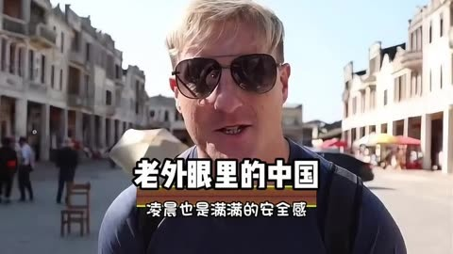
语法填空
语篇类型：记叙文
主题语境：人与社会
话题：通过与邻居的对话和比利时专家的经历，展现中国的快速发展与国际认知的变化，印证 “眼见为实” 的道理，鼓励人们超越刻板印象去理解真实的中国。

Slide 45
My neighbor, Claire, is a friendly lady, likely in her late 70s. We often chat and I am glad to offerher a 56 (help) hand, such as carrying her groceries upstairs. One day she asked me if China isstill like what it was in the old comic The Adventures of Tintin, 57 describes China in the 1930s.Of course not. China is changing so fast that I myself have found 58 hard to keep updated. TakeYinchuan for example: a city in Ningxia once 59 (consider) “remote” now feels more modernthan many European cities.
A Belgian potato expert I interviewed 60 (visit) China dozens of times in the past threedecades and has 61 balanced understanding of the country. He has taken many of his students toChina, some of whom have said the trips 62 (complete) changed their view of the Asian nation,unlike what they heard in the Western media.
Fortunately, more Europeans can take advantage of 63 (China) visa-free policy to discoverthe country and to see for themselves both the good and bad things there. The good news is thatreservations for travel to China are 64 the rise lately in several European countries.
Seeing is believing. 65 (understand) today’s China, one must look beyond old comics andbroken news.
56. helping “offer a helping hand” 是固定表达，意为“伸出援手”
57. which 关系代词引导非限制性定语从句”，先行词是 the old comic The Adventures of Tintin
58. it 常见句型find it+adj.+to do sth.”
59. considered 非谓语动词（过去分词 considered 作后置定语）
60. has visited 动词时态(现在完成时),时间状语in the past three decades
61. a 冠词用法。have a balanced understanding of…:对…有一个全面的理解
62. completely 副词修饰动词changed
63. China's 名词所有格, 表示所属关系
64. on 介词固定搭配。on the rise: 固定短语，意为“在上升，在增加”
65. To understand 非谓语动词（不定式作目的状语）

Slide 46
重要词块
offer a helping hand
groceries n.
keep updated
remote adj.
take advantage of
visa-free policy
on the rise
Seeing is believing
look beyond
broken adj.
伸出援手
食品杂货
了解最新情况
偏远的
利用
免签政策
在上升
眼见为实
超越
片面的

