Slide 1



感恩遇见，相互成就，本课件资料仅供您个人参考、教学使用，严禁自行在网络传播，违者依知识产权法追究法律责任。
更多教学资源请关注
公众号：溯恩英语
知识产权声明

Slide 2
2026年1月浙江首考 英语
完形填空&语法填空 分析
北师大嘉兴附中 吴晨华

Slide 3
完形填空 分析

Slide 4
Par1 试题评析

Slide 5
41. A. stories B. needs C. habits D. dreams
42. A. career B. degree C. hobby D. project
43. A. practical B. important
C. difficult D. dangerous
44. A. invite B. notice C. hire D. cover
45. A. issue B. idea C. truth D. founder
46. A. gain ground B. take root
C. work wonders D. raise concerns
47. A. proposed B. adapted
C. preferred D. proved
48. A. apologized B. refused
C. panicked D. regretted
49. A. pretended B. returned
C. promised D. managed
50. A. Supposedly B. Admittedly
C. Similarly D. Consequently
51. A. occupations B. solutions
C. institutions D. destinations
52. A. let alone B. except for
C. such as D. regardless of
53. A. miss B. leave C. seize D. tour
54. A. demand B. support
C. appreciation D. excuse
55. A. deal B. part
C. compete D. reconnect
01 原题呈现
Ursula has always called the beautiful small town of Beaverton her home. Although she’d had childhood 41. _____ of exploring the world and studied international business with a desire to pursue a 42. _____ in Toronto, finding a job proved more 43. _____ than she’d expected.
“I decided that if nobody was going to 44. _____ me, I would just create a job for myself,” says Ursula. She was born and raised on a large family farm, so the 45. _____ of an agriculture tourism business came naturally to her and began to 46. _____.
“I 47. _____ the plan to my family, and asked if they could rent me a small 10 acre （英亩）. They 48. _____ at first, unwilling to take a risk, but I finally 49. _____ to get the green light,” she says.
Four years later, those beautiful 10 acres of fields had turned into 20 acres filled with over 400,000 sunflowers. “50. _____, I had little confidence in the beginning,” says Ursula, “but the Sunflower Farm rose to fame and has become one of the most sought- after 51. _____in the province.”
While many visitors have never been to a farm at all, 52. _____ a sunflower farm, the unique setting allows them to 53. _____ the city for a while, breathe in the fresh air, gain a newfound 54. _____ for agriculture, and maybe even 55. _____ with their farming roots and what they may have taken for granted for too long.

Slide 6
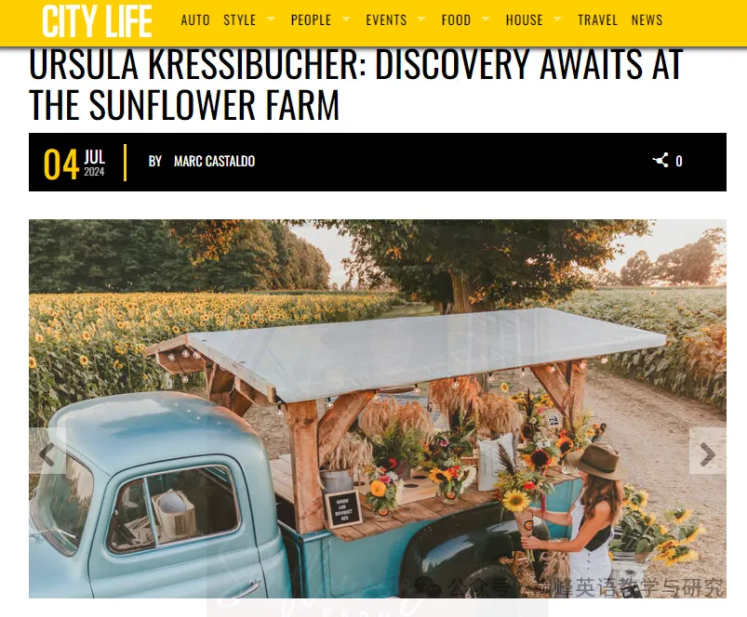
Experience a glorious day on a stunning 20-acre sunflower farm, where self-reflection and a connection to nature can flourish.
Ursula Kressibucher has always called the charming small town of Beaverton, Ont., her home. Although she’d had childhood dreams of exploring the world the first chance she got and studied international development and business with professional aspirations to take on the corporate world in Toronto or the global development industry, finding a job proved harder than she’d expected.
“Nobody would hire me, and I decided that if nobody’s going to hire me, then I’m just going to create a job and hire myself,” says Kressibucher.
Kressibucher had been born and raised on a family farm, so the idea of an agriculture tourism business came naturally to her and began to take root.
“I proposed the business plan to my family, [who were] running a large crop farm, and asked if they could rent me a small 10 acres. At first, they were a bit reluctant, but then I got the green light!” she says.
Four years later, those beautiful 10 acres of fields had turned into 20 acres filled with over 400,000 sunflowers. Admittedly, Kressibucher says, the Sunflower Farm was a gamble in 2020, the first year of the pandemic. But the farm took off right out of the gate and has become one of the most sought-after destinations in the province, known for having Canada’s first sunflower- shaped trail.
When Kressibucher reflects on what laid the foundation for her success and entrepreneurial passion, she proudly credits her strong-minded and resilient Swiss grandmother. Unfortunately, this beloved grandmother passed away just weeks before The Sunflower Farm’s opening. But her grandmother’s teachings of trying everything and never giving up no matter what remained in Kressibucher’s heart.
“Since I started, I have been overwhelmed with visitors and such positive feedback from the public,” says Kressibucher. Visitors of all ages and backgrounds immerse themselves in the events, educational farming workshops and the sunflower-shaped trail cut through the serene blooming fields.
While many visitors have never been to a farm at all, let alone a sunflower farm, the unique setting allows visitors to leave the hustle and bustle of the city for a while, breathe in the fresh air, embrace a newfound appreciation for agriculture, and maybe even reconnect with their farming roots and what they may have taken for granted for too long. But Kressibucher’s primary aim from the outset was to build The Sunflower Farm into one of several successful businesses in her hometown.
“Beaverton is such a town and a lot of people pass through it on their way to somewhere else,” says Kressibucher. “So the goal has always been to bring our visitors and show them that Beaverton itself is a beautiful road-trip destination.”
If you decide to explore the beauty of The Sunflower Farm, its opening date is July 30th. You can usually find Kressibucher standing in the sunflower fields — she might be sporting overalls or a sunflower T-shirt, or a wild, messy hairdo — but you’ll always be able to identify her by her glowing smile.
02 题源分析
https://mycitylife.ca/tag/sunflower-farm/

Slide 7
03 试题分析
本试题以“立德树人”为根本任务，将价值观教育隐性融入语篇与设题之中，关注劳动教育，传递“劳动创造价值、平凡生活亦有乐趣”的理念。
本试题文体为夹叙夹议，其主题为“青年扎根农场实现个人价值”，具体内容以Ursula放弃多伦多职业梦想、返乡创办向日葵农场的故事为线索，分为创业背景、行动实施、创业价值三个核心部分，传递“坚守家乡、自主创业、实现价值”的正能量，贴近“人与自我”的情感体验与人生价值，为学生提供了生涯规划与价值取向的范例。
本试题考查 “dream(梦想)”、 “career(职业)”、 “managed(设法做到)” 、“reconnect(重新联结)” 等词汇的语境适配能力，学生在作答时须依托语篇逻辑与情感脉络推导。

Slide 8
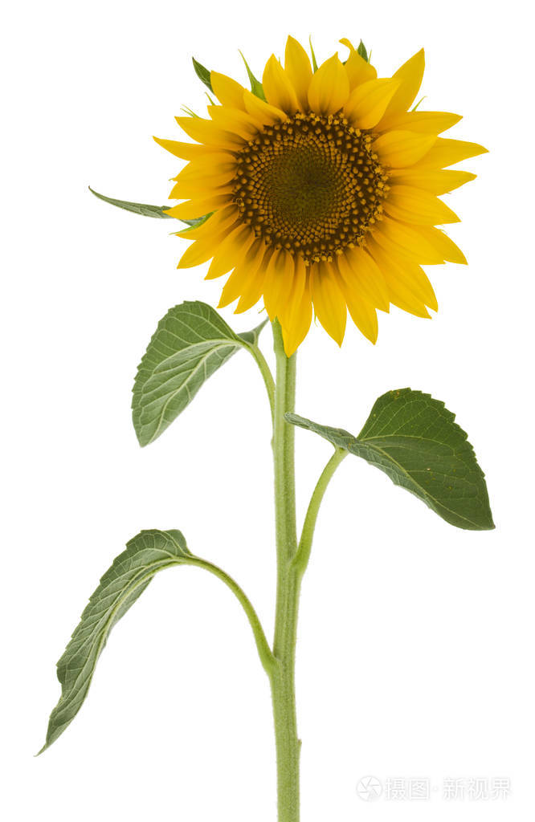
04 考点分析
考点 | 题目 | 总计
动词 | 44, 47, 48, 49, 53, 55 | 6
名词 | 41, 42, 45, 51, 54 | 5
形容词 | 43 | 1
副词 | 50 | 1
短语 | 46, 52 | 2
语境词汇 | 41, 42, 44, 45, 51, 54, 55 | 7
逻辑衔接 | 43, 48, 50, 52 | 4
文本难度适中偏易
关键词：dream, career
重点词汇：take root, proposed, managed, admittedly, let alone, appreciation, reconnect

Slide 9
Par2 解题思路

Slide 10
Step1 透内涵：首尾初读，了解文脉走向与内涵
The experience of Ursula returning to her hometown to start an agriculture business
background
Ursula has always called the beautiful small town of Beaverton her home. Although she’d had childhood 41. _____ of exploring the world and studied international business with a desire to pursue a 42. _____ in Toronto, finding a job proved more 43. _____ than she’d expected.
“I decided that if nobody was going to 44. _____ me, I would just create a job for myself,” says Ursula. She was born and raised on a large family farm, so the 45. _____ of an agriculture tourism business came naturally to her and began to 46. _____.
“I 47. _____ the plan to my family, and asked if they could rent me a small 10 acre （英亩）. They 48. _____ at first, unwilling to take a risk, but I finally 49. _____ to get the green light,” she says.
Four years later, those beautiful 10 acres of fields had turned into 20 acres filled with over 400,000 sunflowers. “50. _____, I had little confidence in the beginning,” says Ursula, “but the Sunflower Farm rose to fame and has become one of the most sought- after 51. _____in the province.”
While many visitors have never been to a farm at all, 52. _____ a sunflower farm, the unique setting allows them to 53. _____ the city for a while, breathe in the fresh air, gain a newfound 54. _____ for agriculture, and maybe even 55. _____ with their farming roots and what they may have taken for granted for too long.
process
value

Slide 11
Step2 明线索：全文细读，明晰文本内在线索
The experience of Ursula returning to her hometown to start an agriculture business
Ursula has always called the beautiful small town of Beaverton her home. Although she’d had childhood 41. _____ of exploring the world and studied international business with a desire to pursue a 42. _____ in Toronto, finding a job proved more 43. _____ than she’d expected.
“I decided that if nobody was going to 44. _____ me, I would just create a job for myself,” says Ursula. She was born and raised on a large family farm, so the 45. _____ of an agriculture tourism business came naturally to her and began to 46. _____.
“I 47. _____ the plan to my family, and asked if they could rent me a small 10 acre （英亩）. They 48. _____ at first, unwilling to take a risk, but I finally 49. _____ to get the green light,” she says.
Four years later, those beautiful 10 acres of fields had turned into 20 acres filled with over 400,000 sunflowers. “50. _____, I had little confidence in the beginning,” says Ursula, “but the Sunflower Farm rose to fame and has become one of the most sought- after 51. _____in the province.”
While many visitors have never been to a farm at all, 52. _____ a sunflower farm, the unique setting allows them to 53. _____ the city for a while, breathe in the fresh air, gain a newfound 54. _____ for agriculture, and maybe even 55. _____ with their farming roots and what they may have taken for granted for too long.
dream
career
difficult
hire
idea
take root
proposed
refused
managed
destinations
leave
appreciation
reconnect

Slide 12
Step3 通逻辑：难点精读，辨析段间句间关系
Ursula has always called the beautiful small town of Beaverton her home. Although she’d had childhood 41. _____ of exploring the world and studied international business with a desire to pursue a 42. _____ in Toronto, finding a job proved more 43. _____ than she’d expected.
“I decided that if nobody was going to 44. _____ me, I would just create a job for myself,” says Ursula. She was born and raised on a large family farm, so the 45. _____ of an agriculture tourism business came naturally to her and began to 46. _____.
“I 47. _____ the plan to my family, and asked if they could rent me a small 10 acre （英亩）. They 48. _____ at first, unwilling to take a risk, but I finally 49. _____ to get the green light,” she says.
Four years later, those beautiful 10 acres of fields had turned into 20 acres filled with over 400,000 sunflowers. “50. _____, I had little confidence in the beginning,” says Ursula, “but the Sunflower Farm rose to fame and has become one of the most sought- after 51. _____in the province.”
While many visitors have never been to a farm at all, 52. _____ a sunflower farm, the unique setting allows them to 53. _____ the city for a while, breathe in the fresh air, gain a newfound 54. _____ for agriculture, and maybe even 55. _____ with their farming roots and what they may have taken for granted for too long.
difficult
转折关系
idea
take root
因果关系
refused
managed
转折关系
Admittedly
转折关系
let alone
递进关系

Slide 13
Step4 定选项：选项回读，关注三类词汇复现
原词复现 同根词复现 语义关联复现
Ursula has always called the beautiful small town of Beaverton her home. Although she’d had childhood 41. dreams of exploring the world and studied international business with a desire to pursue a 42. career in Toronto, finding a job proved more 43. difficult than she’d expected.
“I decided that if nobody was going to 44. hire me, I would just create a job for myself,” says Ursula. She was born and raised on a large family farm, so the 45. idea of an agriculture tourism business came naturally to her and began to 46. take root.
“I 47. proposed the plan to my family, and asked if they could rent me a small 10 acre （英亩）. They 48. refused at first, unwilling to take a risk, but I finally 49. managed to get the green light,” she says.
Four years later, those beautiful 10 acres of fields had turned into 20 acres filled with over 400,000 sunflowers. “50. Admittedly I had little confidence in the beginning,” says Ursula, “but the Sunflower Farm rose to fame and has become one of the most sought- after 51. destinations in the province.”
While many visitors have never been to a farm at all, 52. let alone a sunflower farm, the unique setting allows them to 53. leave the city for a while, breathe in the fresh air, gain a newfound 54. appreciation for agriculture, and maybe even 55. reconnect with their farming roots and what they may have taken for granted for too long.

Slide 14
Par3 备考启发

Slide 15
01备考建议
这篇完形填空以 Ursula 返乡创业、打造向日葵农场的故事为载体，重点考查了词汇复现、语境逻辑、语篇理解等核心能力，非常贴合高考完形 “重语篇、轻孤立” 的命题趋势。结合其考点，备考建议如下：
一、聚焦词汇复现，夯实核心考点
原词复现、同根词复现、语义关联复现是高考完形的高频考点。备考时将真题中出现的复现词对、复现句进行分类整理。训练时，有意识地圈画文中的复现线索。
二、强化语境逻辑，突破解题关键
训练时，关注逻辑连接词，重点分析逻辑连接词前后的语义关系，培养 “逻辑先行” 的思维。
三、精做真题，总结命题规律
优先使用近年高考全国卷和新高考卷的完形真题，精做精读。建立错题档案，按 “词汇不熟、逻辑判断失误、语境理解偏差” 等类型整理错题。 定期复盘，针对薄弱点进行专项训练。
四、拓展语料，提升语篇敏感度
选择关于个人成长、创业故事、乡村振兴等主题的记叙文和夹叙夹议文，熟悉这类文章的叙事结构和情感表达。积累如take root、green light、rose to fame等在语境中具有特殊含义的短语，提升对地道表达的敏感度。

Slide 16
02语言积累
1. pursue a career 追求事业 / 从事职业
2. take root 生根；深入人心；开始发展
3. get the green light 获得许可 / 得到批准
4. rise to fame 声名鹊起 / 一举成名
5. sought-after 受欢迎的；广受欢迎的；抢手的
6. let alone 更不用说；更别提
7. reconnect with one’s roots 重新与自己的根 / 本源建立联系
8. 对比强调句: 虽然许多游客根本从未去过农场，更不用说向日葵农场了，但这个独特的环境让他们可以暂时离开城市，在清新的空气中呼吸，对农业产生新的欣赏，甚至可能重新与他们的农耕根源以及那些他们可能认为理所当然太久的东西建立联系。
While many visitors have never been to a farm at all, let alone a sunflower farm, the unique setting allows them to leave the city for a while, breathe in the fresh air, gain a new-found appreciation for agriculture, and maybe even reconnect with their farming roots and what they may have taken for granted for too long.

Slide 17
语法填空 分析

Slide 18
Par1 试题评析

Slide 19

01 原题呈现
There are few people who could find joy in waiting for a microwave（微波炉）56._________ (finish) heating, but my mum did it. One of my earliest memories is being held 57. _________ her arms, counting down the flashing green 58. _________ (number) together. Mum is small, but I remember feeling so high up there. She would dance us left and right around the kitchen, our eyes 59. _________ (watch) the microwave like it was a space rocket countdown, 60. _________ (excite) and tension building to that final moment: BEEP! The microwave had a loud alarm, but we overshadowed that noise with our own performance, tipping our heads back and shouting into the air - a scream 61. _________ always ended in laughter.
My mum would find fun even when completing the most boring of tasks. I remember 62. _________ (push) in a supermarket trolley（手推车）over 63. _________ uneven car park ground like riding a rollercoaster. She would speed up, the wind blowing our hair back 64. _________ my tiny voice singing out, “Weeee-eee-eee!”
I realise now that Mum didn’t find the joy in these tasks: she created it. Who cares if neighbours can hear you singing along to a microwave? Life is full of so many 65. _________ (seeming) uneventful moments, but we can turn any of them into a celebration.

Slide 20
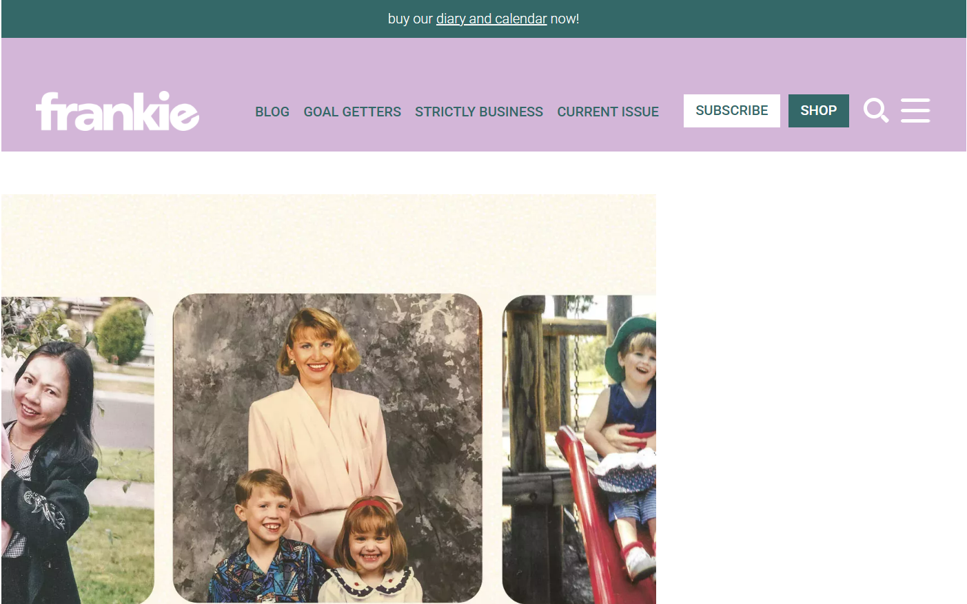
02 题源分析
DEIRDRE FIDGE There are few people who could find joy in waiting for a microwave to finish heating, but somehow, my mum did it. One of my earliest memories is being held in her arms, counting down the flashing green numbers together. Mum is petite, and I now stand a good head taller than her, but I remember feeling so high up there. She’d dance us left and right around the kitchen, our eyes watching the appliance like it was a space shuttle countdown on television, excitement and tension building to that final moment: BEEEEEP! This was a 1980s microwave, and hoo-boy, did it have a shrill alarm. But don’t worry, we overshadowed that noise with our own performance, heads tipping back after the 3, 2, 1; wailing into the air as the alarm dinged – a hooty squeal that always ended in laughter.
The self-consciousness I carry as an adult did not come from my mum, who finds fun even when completing the most mundane of tasks. As a kid, being pushed in a supermarket trolley on the bumpy car park gravel became a rollercoaster ride. She’d speed up, the wind pushing our hair back, my tiny voice singing out, “Weeee-eee-eee!” and jolting with every bump.
I realise now that Mum didn’t find the joy in these tasks: she created it. Who cares if neighbours can hear you singing along to a microwave? Life is full of so many seemingly uneventful moments, but we can turn any of them into a celebration.
https://www.frankie.com.au/article/an-ode-to-our-mums-563160

Slide 21
03 试题分析
本试题是一篇温暖的回忆性散文，该语篇首尾呼应，以“find joy”为核心，讲述了母亲如何将平凡琐事转化为欢乐时刻。最终，作者领悟到，母亲并非是“find joy”而是“create joy”，以此来表达对童年时光的怀念、对母亲乐观生活智慧的感激与领悟。
情境是落实考查内容和考查要求的载体。本试题情境紧密联系学生的生活实际，具有真实交际意义。（引自浙江省教育考试院）
语法填空考点覆盖从句、冠词、动词、名词、非谓语动词、词性转换等基础语法，同时渗透对语境逻辑的理解。

Slide 22
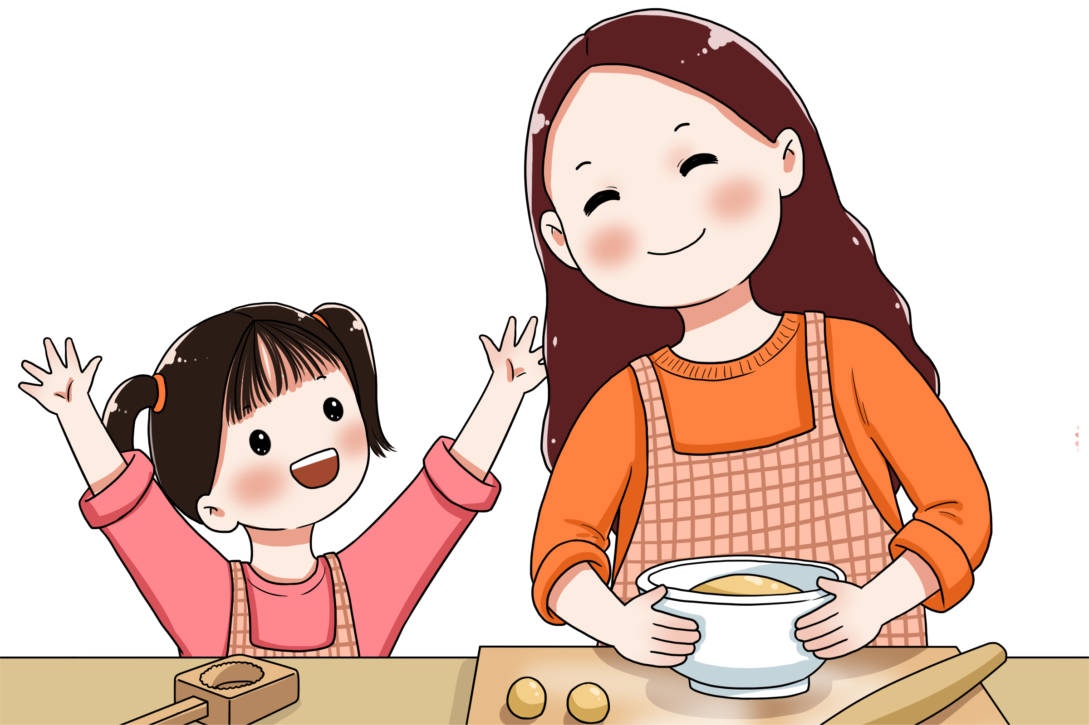
04 考点分析
考点 | 考察点 | 题目
动词 | 非谓语：不定式、doing、done | 56、59、62
名词 | 单复数 | 58
 | 词性转换 | 60
形容词 | 词性转换 | 65
连词 | 并列连词：and | 64
 | 从属连词：限制性定语从句 | 61
介词 | 固定搭配 | 57
冠词 | 定冠词：特指 | 63
试题难度阶梯设计科学合理：
考点覆盖课标核心语法点
强调在语篇语境中精准运用语言知识
实现“文化传承与价值引领”的有机统一

Slide 23
Par2 解题思路

Slide 24
解题步骤①寻找主干
句子主干
从句、状语、非谓语
并列关系
There are few people who could find joy in waiting for a microwave（微波炉）56._________ (finish) heating, but my mum did it. One of my earliest memories is being held 57. _________ her arms, counting down the flashing green 58. _________ (number) together. Mum is small, but I remember feeling so high up there. She would dance us left and right around the kitchen, our eyes 59. _________ (watch) the microwave like it was a space rocket countdown, 60. _________ (excite) and tension building to that final moment: BEEP! The microwave had a loud alarm, but we overshadowed that noise with our own performance, tipping our heads back and shouting into the air –a scream 61. _________ always ended in laughter.
My mum would find fun even when completing the most boring of tasks. I remember 62. _________ (push) in a supermarket trolley（手推车）over 63. _________ uneven car park ground like riding a rollercoaster. She would speed up, the wind blowing our hair back 64. _________ my tiny voice singing out, “Weeee-eee-eee!”
I realise now that Mum didn’t find the joy in these tasks: she created it. Who cares if neighbours can hear you singing along to a microwave? Life is full of so many 65. _________ (seeming) uneventful moments, but we can turn any of them into a celebration.

Slide 25
There are few people who could find joy in waiting for a microwave（微波炉）56._________ (finish) heating, but my mum did it. One of my earliest memories is being held 57. _________ her arms, counting down the flashing green 58. _________ (number) together. Mum is small, but I remember feeling so high up there. She would dance us left and right around the kitchen, our eyes 59. _________(watch) the microwave like it was a space rocket countdown, 60. _________ (excite) and tension building to that final moment: BEEP! The microwave had a loud alarm, but we overshadowed that noise with our own performance, tipping our heads back and shouting into the air –a scream 61. _________ always ended in laughter.
My mum would find fun even when completing the most boring of tasks. I remember 62. _________ (push) in a supermarket trolley（手推车）over 63. _________ uneven car park ground like riding a rollercoaster. She would speed up, the wind blowing our hair back 64. _________ my tiny voice singing out, “Weeee-eee-eee!”
I realise now that Mum didn’t find the joy in these tasks: she created it. Who cares if neighbours can hear you singing along to a microwave? Life is full of so many 65. _________ (seeming) uneventful moments, but we can turn any of them into a celebration.
解题步骤②逐题分析
56. to finish
动词不定式作后置定语
57. in
固定搭配，in one’s arms
58. numbers
名词，复数
59. watching
独立主格结构，主动关系
60. excitement
与 tension 并列作介词 to 的宾语
61. which/that
定语从句修饰 scream
62. being pushed
动名词，表示“记得做过某事”
63. the
特指，定冠词 the
64. and
并列连词
65. seemingly
副词，修饰形容词

Slide 26
解题步骤③重点突破
长难句1
She would dance us left and right around the kitchen, our eyes 59. _________ (watch) the microwave like it was a space rocket countdown, 60. _________ (excite) and tension building to that final moment: BEEP!
分析
该句涉及2个考点，这2个均位于独立主格之中。其中59题考查独立主格结构中的动词形式，60题考查独立主格中的名词并列关系。
破解：考生需要判断watch在句中为谓语或非谓语，再分析动词watch与主语our eyes之间的关系，可以得到答案watching。
考生需要关注and的并列关系，根据tension这一名词，判断此处应为与之并列的名词，从而得到答案excitement。
根据originate用法——originate in sp., 及根据句意——“game”与“originate”搭配，可判定此处缺从属连词，为非限制定语从句的关系代词，故填which。
启发：分析句子结构，判断逻辑关系
类似拓展：
She would speed up, the wind blowing our hair back 64. _________ my tiny voice singing out, “Weeee-eee-eee!”
该句所设空为独立主格结构中，即，前后两个独立主格结构为并列关系，故答案为and

Slide 27
解题步骤③重点突破
长难句2
The microwave had a loud alarm, but we overshadowed that noise with our own performance, tipping our heads back and shouting into the air –a scream 61. _________ always ended in laughter.
分析
该句存在用but连接的两个主谓关系，以及非谓语结构、定语从句。
破解：考生需要判断a scream在从句中所作的成分，即为作从句主语，进而判断其为定语从句的关系代词，故答案为that/which
启发：分析句子结构，判断逻辑关系

Slide 28
解题步骤③重点突破
长难句3
I remember 62. _________ (push) in a supermarket trolley（手推车）over 63. _________ uneven car park ground like riding a rollercoaster.
分析
该句设有两个考点。其中，62题考查学生对remember to do和remember doing两个表达的理解；63题考查冠词的准确判断。
破解：考生需要判断句中表达的为“我记得做过某事”，另“I”和“push”为被动关系，故答案为being pushed;
考生根据语境，发现uneven car park ground虽前文未提及，但是可依据生活经验、情境共识和叙事视角发现，这一对象本身是可以被识别的，符合定冠词the强调的是“在特定语境中可以被识别的对象”这一内涵，故答案为the。
启发：分析句子所在的情景和语境，而非单纯依据所学语法规则。

Slide 29
Par3 备考启发

Slide 30
01历年考点分析
三年浙江首考卷语法填空考点对比分析
 | 2024浙江首考 |  | 2025浙江首考 |  | 2026浙江首考
题号 | 答案 | 考点 | 答案 | 考点 | 答案 | 考点
56 | to benefit | 不定式 | a | 不定冠词 | to finish | 不定式
57 | or | either…or | times | 名词（复数） | in | 介词（固定搭配）
58 | that/which | 从属连词（定语从句） | on | 介词（固定搭配） | numbers | 名词（复数）
59 | what | 从属连词（表语从句） | and | 并列连词 | watching | 独立主格
60 | criticism | 词性转换v.→n. | to rent | 不定式 | excitement | 词性转换v.→n.
61 | be offered | 谓语（被动语态） | solution | 词性转换v.→n. | which/that | 从属连词（定语从句）
62 | have started | 谓语（时态、语态、主谓一致） | is | 谓语（时态、语态、主谓一致） | being pushed | 非谓语 （doing）
63 | designed | 非谓语（done） | which | 从属连词（定语从句） | the | 定冠词
64 | the | 定冠词 | people’s | 名词（所属关系） | and | 并列连词
65 | ones | 代词（复数） | returning | 非谓语（doing） | seemingly | 词性转换adj.→adv.

Slide 31
02备考建议
启发一 避免“语法规则单纯记忆” ，考查学生“在意义理解中分析结构”的能力
如59题考查“独立主格表伴随动作”的功能，而非单纯的“非谓语形式记忆”
64题考查“并列结构的逻辑衔接”，而非孤立的“连词选择”
启发二 避免“固定短语机械背诵” ，考查学生 “在语义场景中活用句式” 的能力
如 57 题 “held in her arms” 并非单纯考查介词搭配，而是结合 “被抱着” 的场景语义来判断；
62 题 “remember doing” 也不是孤立的短语记忆，而是通过 “回忆童年场景” 的语境来确认用法
启发三 避免“冠词规则死记硬背” ，考查学生 “在语境指代中判断特指对象” 的能力
如 63 题 “the uneven car park ground” 并非单纯考查 “特指某一处不平整的停车场地面” 的规则，而是结合 “在超市停车场推手推车” 的场景，判断出此处是特指当时所在的、具体的那片不平整地面；
文中 “the microwave”, “the kitchen” 等用法，也不是孤立的 “独一无二事物用 the” 的记忆，而是通过叙事场景明确指代特定的事物

Slide 32
03语法再填空
There are few people who could find joy in waiting for a microwave（微波炉）to finish heating, _____ my mum did it. One of my earliest memories is being held in her arms, __________ down the flashing green numbers together. Mum is small, but I remember feeling so high up there. She would dance us left and right around the kitchen, our eyes watching the microwave like it was _____ space rocket countdown, excitement and tension building to that final moment: BEEP! The microwave had a loud alarm, but we ____________(overshadow) that noise with our own performance, tipping our heads back and shouting into the air –a scream that always ended in laughter.
My mum would find fun even when completing the most boring of ________(task). I remember being pushed in a supermarket trolley（手推车）over the uneven car park ground like riding a rollercoaster. She would speed up, the wind __________(blow) our hair back and my tiny voice singing out, “Weeee-eee-eee!”
I realise now that Mum didn’t find the joy in these tasks: she created ____. Who cares if neighbours can hear you singing along to a microwave? Life is full of so many seemingly uneventful moments, but we can turn any of them into a ___________(celebrate).

Slide 33


