Slide 1


感恩遇见，相互成就，本课件资料仅供您个人参考、教学使用，严禁自行在网络传播，违者依知识产权法追究法律责任。
更多教学资源请关注
公众号：溯恩英语
知识产权声明

Slide 2
活用教材词汇，靶向高考写作
B3U4 单词拓展
Space Exploration

Slide 3


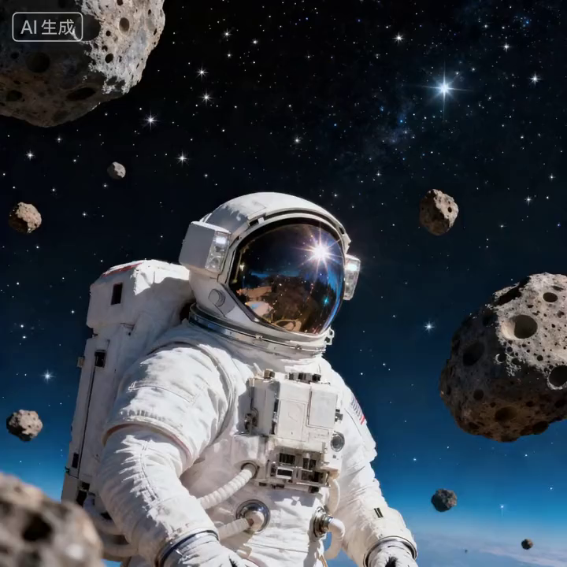
活用词汇
astronaut /ˈæstrənɔ:t/ n.宇航员;太空人
1. 正是宇航员，这些闯入未知的人，体现了人类最无畏的精神。(应用文)
It is the astronaut, who ventures into the unknown, that embodies the most daring spirit of mankind.
2. 这位名字已成为家喻户晓传奇的宇航员，激励了一代人去仰望星空。(应用文)
The astronaut, whose name is now a household legend, inspired a generation to look up at the stars.
3. 成为一名宇航员不仅需要健康的体魄，还需要一个在危机中保持冷静的头脑。(应用文)
To be an astronaut requires not only a sound body but also a mind that remains calm in crisis.

Slide 4

活用词汇
procedure /prəˈsi:dʒə(r)/ n.程序;步骤;手续
1. 只有当你严格遵守程序时，你才能确保实验的安全与成功。(应用文)
Only when you strictly follow the procedure can you ensure the safety and success of the experiment.
2. 我在邮件中详述的申请程序至关重要。(应用文)
The procedure for applying, which I have detailed in the email, is of great importance.
3. 直到他完成所有步骤，他才意识到团队合作的重要性。(续写)
Not until he had completed all the procedures did he realize the significance of teamwork.

Slide 5

活用词汇
mental /ˈmentl/ adj.精神的;思想的
1. 她当时已经是精疲力竭。(续写)
She was suffering from physical and mental exhaustion.
2. 这孩子脑子很机灵。(续写)
The baby is very mentally alert.
3. 我们担心他的精神状况。(续写)
We're worried about his mental state.
4. 正是定期锻炼有助于释放精神压力，使我们更加专注。(应用文)
It is regular exercise that helps to release mental stress, making us more focused.

Slide 6
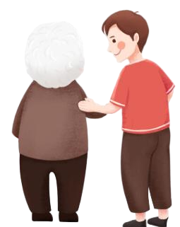
活用词汇
intelligent /ɪnˈtelɪdʒənt/ adj.有智慧的;聪明的
1. 使他出色的不仅是他聪明的头脑，还有他乐于助人的意愿。(续写)
What makes him outstanding is not only his intelligent mind but also his willingness to help others.
2. 他是一个很有才智的人。(续写)
He's a highly intelligent man.
3. 她聪明绝顶。(续写)
She's formidably intelligent.
4. 我从未遇到过像她一样聪明又谦逊的人。(续写)
Never have I encountered a person as intelligent and humble as her.

Slide 7

活用词汇
rocket /ˈrɒkɪt/ n.火箭;火箭弹
1. 正是不懈的创新，使我们的火箭技术以前所未有的速度发展。(应用文)
It is the relentless innovation that has enabled our rocket technology to advance at an unprecedented pace.
2. 这种思想立即风靡一时。(续写)
The idea took off like a rocket
(= it immediately became popular) .
3. 汽车从一条叉路上嗖的一下开了出来。(续写)
The car rocketed out of a side street.
4. 总数从376猛增到532。(应用文)
The total has rocketed from 376 to 532.

Slide 8

活用词汇
gravity /ˈgrævəti/ n.重力;引力
1.正是重力，不仅将我们的双脚牢牢固定在地面，还支配着天体的运动。(应用文)
It is gravity that not only keeps our feet firmly on the ground but also governs the motion of celestial bodies.
2. 形势如此严峻，以至于全球专家都在呼吁紧急解决这一危机。(应用文)
So grave is the situation that experts worldwide are calling for an urgent solution to this crisis.
6. 意识到自己错误的严重性后，他决心无论如何都要弥补。(续写)
Having realized the gravity of his mistake, he was determined to make amends, no matter how hard it would be.

Slide 9

活用词汇
frontier /ˈfrʌntɪə(r)/ n.边境;国界;边远地区
1. 站在技术创新的前沿，这些科学家正在为我们难以想象的未来铺平道路。(应用文)
Standing on the frontier of technological innovation, these scientists are paving the way for a future we can barely imagine.
2. 科学进步不仅拓展了我们的前沿，也重新定义了人类的可能性。(应用文)
Not only does scientific progress expand our frontiers, but it also redefines what is possible for mankind.
3. 驱使我们跨越一个又一个前沿的探索精神，深植于人性之中。(应用文)
The spirit of exploration, which drives us to cross one frontier after another, is deeply rooted in human nature.

Slide 10
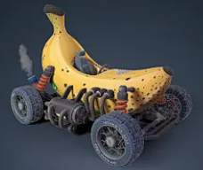
活x词汇
vehicle /ˈvi:əkl/ n.交通工具;车辆
1. 语言是文化的强大载体，承载着一个民族跨越时空的价值与传统。(应用文)
Language serves as a powerful vehicle for culture, carrying the values and traditions of a people across time and space.
2.正是通过教育，知识找到了代代相传的最有效媒介。(应用文)
It is through education that knowledge finds its most effective vehicle to pass from one generation to the next.
3.看到他们自制的车辆终于动了起来，学生们欢呼起来，他们数月的辛勤工作在那一刻得到了回报。(续写)
Seeing their homemade vehicle finally move, the students cheered, their months of hard work having paid off at that very moment.

Slide 11

活用词汇
universe /ˈju:nɪvɜ:s/ n.宇宙;天地万物
1.当我翻阅书页时，我意识到自己不只是在旁观一个故事；我已然成为那个神奇世界的积极参与者。(续写)
As I delved into its pages, I realized I wasn't merely observing a story; I was an active participant in that enchanted universe.
2.直到我们理解了自身在宇宙中的位置，我们才能开始领会存在的真谛。(应用文)
Not until we understand our place in the universe can we begin to grasp the true meaning of our existence.
3.宇宙是如此无边无际，以至于我们的整个世界不过是悬浮在阳光中的一颗淡蓝色斑点。(应用文)
So boundless is the universe that our entire world is but a pale blue dot suspended in a sunbeam.

Slide 12

活用词汇
determined /dɪˈtɜ:mɪnd/ adj.有决心的;意志坚定的
determine /dɪˈtɜ:mɪn/ vt.查明;确定;决定
1. 她坚决地摇摇头。(续写)
She shook her head, determinedly.
2. 他勇敢顽强地与疾病作斗争。(续写)
He fought the illness with courage and determination.
3.我赞赏她非把事情弄清楚的决心。(续写)
I admire her determination to get it right.
4. 他们全凭坚强的决心幸存下来。(续写)
They had survived by sheer determination.
5. 迈克决心要超过他，他在肌肉中找到了向前游泳的力量，当他的手碰到泳池边缘时，比赛结束了。(续写)
Feeling determined to pass him, Mike found the power in his muscles he needed to swim ahead, and as his hand touched the edge of the pool, the race was over.

Slide 13
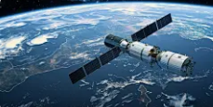
活用词汇
satellite /ˈsætəlaɪt/ n.人造卫星;卫星
1. 卫星不仅实现了全球即时通信，还在国家安全方面扮演着至关重要的角色。(应用文)
Not only do satellites enable instant communication across the globe, but they also play a vital role in national security.
2.这颗由一支年轻工程师团队设计和建造的卫星，象征着我国蓬勃发展的技术实力。(应用文)
The satellite, which was designed and built by a team of young engineers, symbolizes our country's booming technological prowess.

Slide 14

活用词汇
launch /lɔ:ntʃ vt.&n.发射;发起;上市
1. 我对你计划开设的信息素养课程非常感兴趣。(续写)
I’m deeply interested in the course in information literacy that you're planning to launch.
2. 他突然向我猛扑过来。(续写)
Without warning he launched himself at me.
3. 我建议为上海的这些建筑工人推出一项新年采购计划，让他们在这些超市购买食品时享受特别折扣。(应用文)
I suggest launching a New Year Purchasing Program for these builders of Shanghai, allowing them a special discount on the food in these supermarkets.

Slide 15
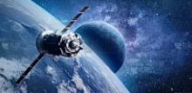
活用词汇
orbit /ˈɔ:bɪt/ n.轨道 vt.&vi.沿轨道运行
1. 正是地球围绕太阳的稳定轨道，创造了我们每年经历的四季更替。(应用文)
It is Earth's stable orbit around the sun that creates the seasonal changes we experience every year.
2.轨道计算如此精确，以至于科学家可以提前几十年预测卫星的位置。(续写)
So precise is the calculation of the orbit that scientists can predict the satellite's position decades in advance.

Slide 16

活用词汇
giant /ˈdʒaɪənt/ adj.巨大的;伟大的 n.巨人
1. 我能听到姐姐的笑声和杰森压低声音说要把那个巨大的东西切开。(续写)
I could hear my sister’s laughter and Jason’s muffled voice talking about cutting the giant thing open.
2. 他看上去可怕，实际却是个性格温和的巨人。(续写)
He looks scary but he's really a gentle giant.
3. 其中一位是位年轻女士，她伸出戴着手套的手，我的丢失的钥匙就挂在这只手指上，而她的脸上则洋溢着灿烂的笑容。(续写)
One of them, a young lady, held out her gloved hand, with my lost keys hanging from her finger and a giant smile on her face.
4. 然后我看到了自己的名字，旁边还有巨大的金色“冠军”字样。(续写)
Then I saw my name, decorated with giant, golden words—champion.

Slide 17

活用词汇
leap /li:p/ n.跳跃;剧增 vi.&vt.跳过
1. 海豚跃出水面。(续写)
A dolphin leapt out of the water.
2. 我们跳过了那条小溪。(续写)
We leapt over the stream.
3. 她突然翻身下了床。(续写)
She leapt out of bed.
4. 他们立即断然采取了行动。(续写)
They leapt into action immediately.
5. 他冲过房间去开门。(续写)
He leapt across the room to answer the door.
6. 我赶紧站了起来。(续写)
I leapt to my feet (= stood up quickly) .

Slide 18

活用词汇
leap /li:p/ n.跳跃;剧增 vi.&vt.跳过
7. 她马上挺身而出为我辩护。(续写)
She was quick to leap to my defence (= speak in support of me) .
8. 那张照片跃然纸上，引人注目。(续写)
The photo seemed to leap off the page (= it got your attention immediately) .
9. 他的名字一下引起了我的注意。(续写)
His name leapt out at me (= I saw it immediately) .
10. 他涨红了脸，心脏怦怦直跳，跳起来，扯着嗓门喊。(续写)
Blood rushing to his face and heart palpitating fiercely, he leapt to his feet and yelled at the top of his voice.

Slide 19

活用词汇
mankind /mænˈkaɪnd/ n.人类
1. 尽管我们有困难，但在此时此刻，它表明人类是好的。(应用文)
Even though we have difficulties, at this moment it shows that mankind is good.
2. 面对全球性挑战，人类必须展现出前所未有的智慧与团结。(应用文)
Confronted with global challenges, mankind must demonstrate wisdom and unity like never before.
3. 人类的未来取决于我们今天的选择，正处于微妙的平衡之中。(应用文)
The future of mankind, which depends on the choices we make today, hangs in a delicate balance.

Slide 20
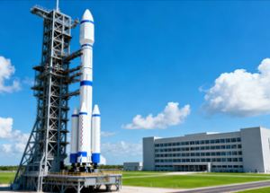
活用词汇
agency /ˈeɪdʒənsi/ n.(政府)专门机构;服务机构
没有让旅行社安排我们的住宿，我们自己在网上订了火车票和宾馆。(续写)
Instead of having a travel agency arrange our accommodations, we booked the train tickets and hotel rooms on the Internet by ourselves.
2. 联系了相关机构后，我们很快得到了专业指导，这让我们松了一口气。(续写)
Having contacted the relevant agency, we were relieved to receive professional guidance promptly.
3. 这家航天机构不仅负责发射任务，还在公众科学教育方面发挥着关键作用。(应用文)
Not only does the space agency handle launch missions, but it also plays a key role in educating the public about science.

Slide 21
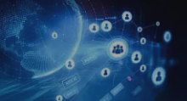
活用词汇
transmit /trænsˈmɪt/ vt.&vi.传输;发送
1. 如果使用得当，互联网可以传播知识和思想，赋予个人和社区力量。(应用文)
Used responsibly, the internet can transmit knowledge and ideas, empowering individuals and communities alike.
2. 代代相传的价值观构成了我们文化认同的基石。(应用文)
The values transmitted from generation to generation form the very foundation of our cultural identity.

Slide 22

活用词汇
data /ˈdeɪtə n.[pl.]资料;数据
1. 这些经过十年精心收集的数据，为长期气候模式提供了宝贵的见解。(应用文)
The data, which has been meticulously collected over a decade, provides invaluable insights into long-term climate patterns.
2. 我全力以赴地付出了努力，认真收集数据并详细记录结果，以此来弥补我在学业上的不足。(续写)
I spared no effort to do my bit, collecting data and recording results carefully, so as to make up for my academic disadvantage.

Slide 23
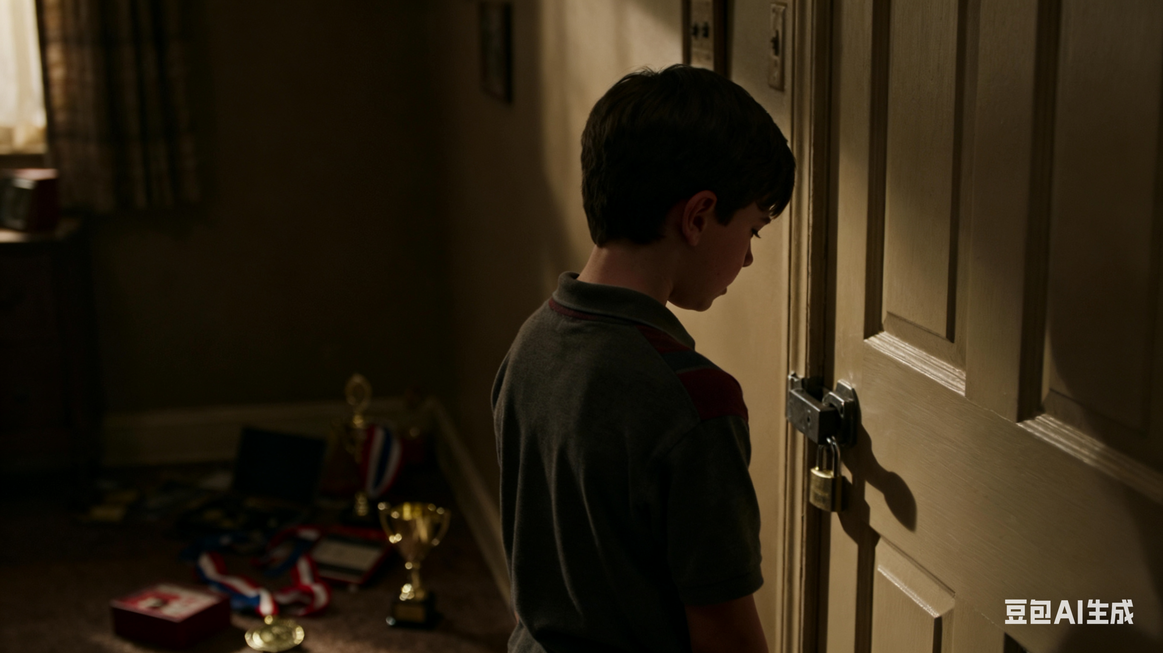
活用词汇
disappointed /ˌdɪsəˈpɔɪntɪd/ adj.失望的;沮丧的
1. 他们对比赛结果极为失望。(续写)
They were bitterly disappointed at the result of the game.
2. 看到她没来参加晚会，他感到很失望。(续写)
He was disappointed to see she wasn't at the party.
3. 他因未能获奖而失望得把自己锁在房间里。(续写)
Disappointed at his failing to win a prize, he locked himself in his room.
4. 他的脸上掠过失望的神情。(续写)
A look of disappointment flashed across/spread over his face.
5.她没有来，他感到很难掩饰自己内心的沮丧。(续写)
He found it difficult to hide his disappointment when she didn't arrive.

Slide 24
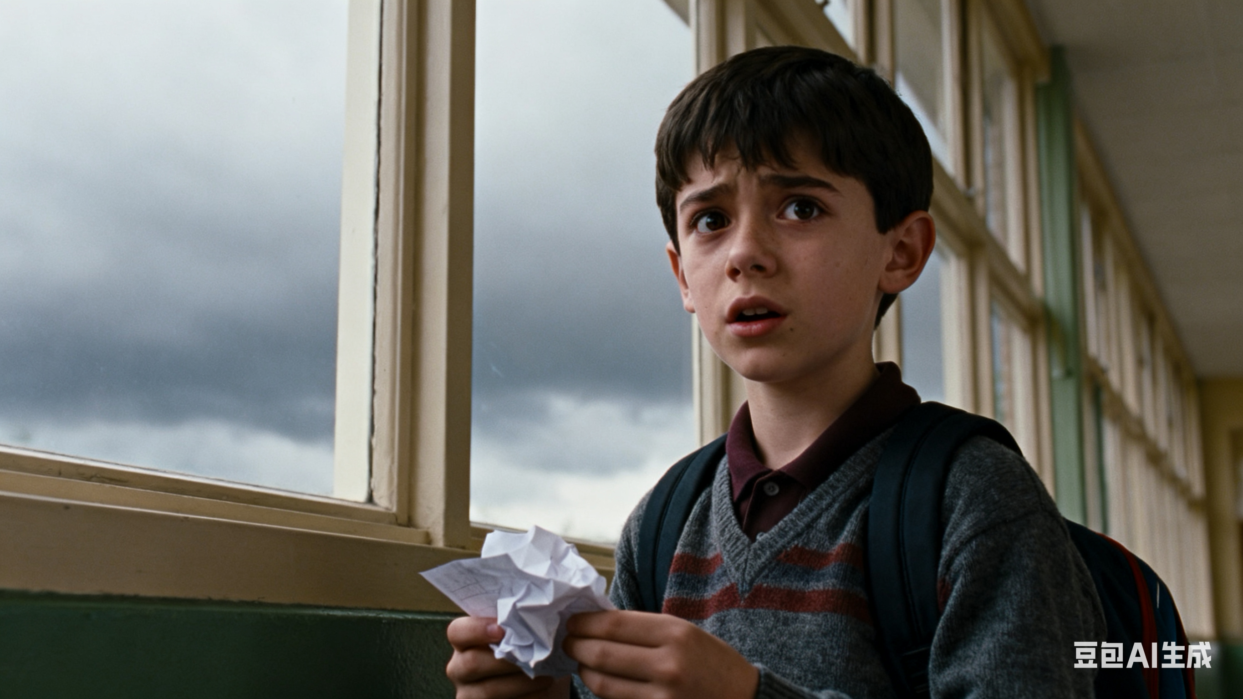
活用词汇
disappointed /ˌdɪsəˈpɔɪntɪd/ adj.失望的;沮丧的
6. 我们搭帐篷没遇到什么麻烦，但发现妈妈忘了装枕头，这让我们很失望。(续写)
We had no trouble setting up our tent, but we were disappointed to find that Mom forgot to pack up pillows.
7. 看到分数的那一刻，一种无法掩饰的失望神情从他脸上掠过。(续写)
A look of disappointment that could not be concealed flashed across his face the moment he saw the score.

Slide 25

活用词汇
desire /dɪˈzaɪə(r)/ n.渴望;欲望 vt.渴望
1. 她感到想回家的愿望难以遏制。(续写)
She felt an overwhelming desire to return home.
2. 我不想再谈此事。(续写)
I have no desire (= I do not want) to discuss the matter further.
3. 得知你很想学好汉语, 我想给你一些建议。(续写)
Knowing you have a strong desire to learn Chinese well, I’d like to offer you some suggestions.
4. 首先，我的决定是基于这样的预期：这两部分的结合能够帮助我达到预期的效果。(应用文)
To begin with, I’ve based my decision on the expectation that the combination of the two sections can lead me to my desired results.

Slide 26

活用词汇
desire /dɪˈzaɪə(r)/ n.渴望;欲望 vt.渴望
5. 其次，尽管我们的祖父母年龄越来越大，但他们仍渴望了解我们每一个人。频繁的交流会给他们带来极大的快乐。(应用文)
Secondly, although our grandparents become older and older, they still desire to learn about all of us, the frequent sharing will bring them great happiness.
6. 他内心涌起了强烈的成功欲望。(续写)
A strong desire to succeed rose up in him.

Slide 27

活用词汇
carry on /ˈkæri ɒn/ 继续做,坚持干
1. 通过这次经历，我不仅深刻认识到珍惜与家人共度时光的重要性，以及与亲人保持紧密联系的价值，而且也让我意识到自己有责任在未来传承这一传统，并为自己的家庭营造一个温馨、友好的环境。(应用文)
Through it, not only has I appreciated the significance of cherishing family time and the value of maintaining strong connections with my loved ones, but it has also instilled in me a sense of duty to carry on this tradition in the future and create a warm and welcoming environment for my own family.
2. 他的一个朋友停下来去修理自行车了，但他们鼓励麦克继续前行，并且很快就能追上他了。(续写)
One of his friends had stopped to make a bicycle repair, but they had encouraged Mac to carry on, and they would catch up with him soon.

Slide 28

活用词汇
ongoing /ˈɒngəʊɪŋ adj.持续存在的;仍在进行的
1. 接下来我们便发起了一项筹款活动，向游客募集资金，并将其用于项目的持续维护工作。(应用文)
What followed was that we launched a fundraising campaign to raise money from visitors and donate it to the ongoing maintenance.
2. 这场关于人工智能的持续辩论，涉及伦理学家和科技巨头，凸显了其对社会深远的影响。(应用文)
The ongoing debate about artificial intelligence, which involves ethicists and tech giants alike, highlights its profound impact on society.

Slide 29
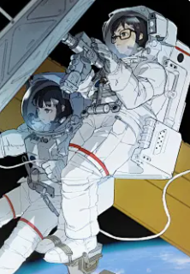
活用词汇
on board /ɒn bɔ:d/ 在宇宙飞船上;在船上
1. 如果列车脱轨，而车上有易爆气体的话，那将会是一场灾难。(续写)
With explosive gas on board, it would be disastrous if the train came off the track.
2. 一进入国际空间站，宇航员们就开始了一系列旨在研究零重力效应的实验。(续写)
Once on board the international space station, the astronauts began a series of experiments designed to study the effects of zero gravity.
3. 这个团队非常热情，让我从第一天起就觉得已经加入并成为这个家庭的一份子。(应用文)
So welcoming was the team that I felt like I was on board and part of the family from the very first day.

Slide 30
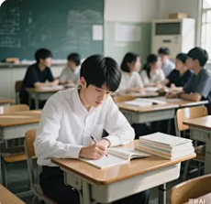
活用词汇
independently /ˌɪndɪ'pendəntlɪ adv.独立地;自立地
1.我认为自己能胜任这项工作，因为我性格好，生活独立，并且精通英语。(应用文)
I think I am qualified for the job, because I have a good character, being independent in life and having a good knowledge of English.
2. 她是个很有主见的年轻女子。(续写)
She's a very independent-minded young woman.
3.正是通过学会独立思考，学生们才能培养出创新所必需的批判性思维。(应用文)
It is by learning to think independently that students develop the critical mindset essential for innovation.

Slide 31
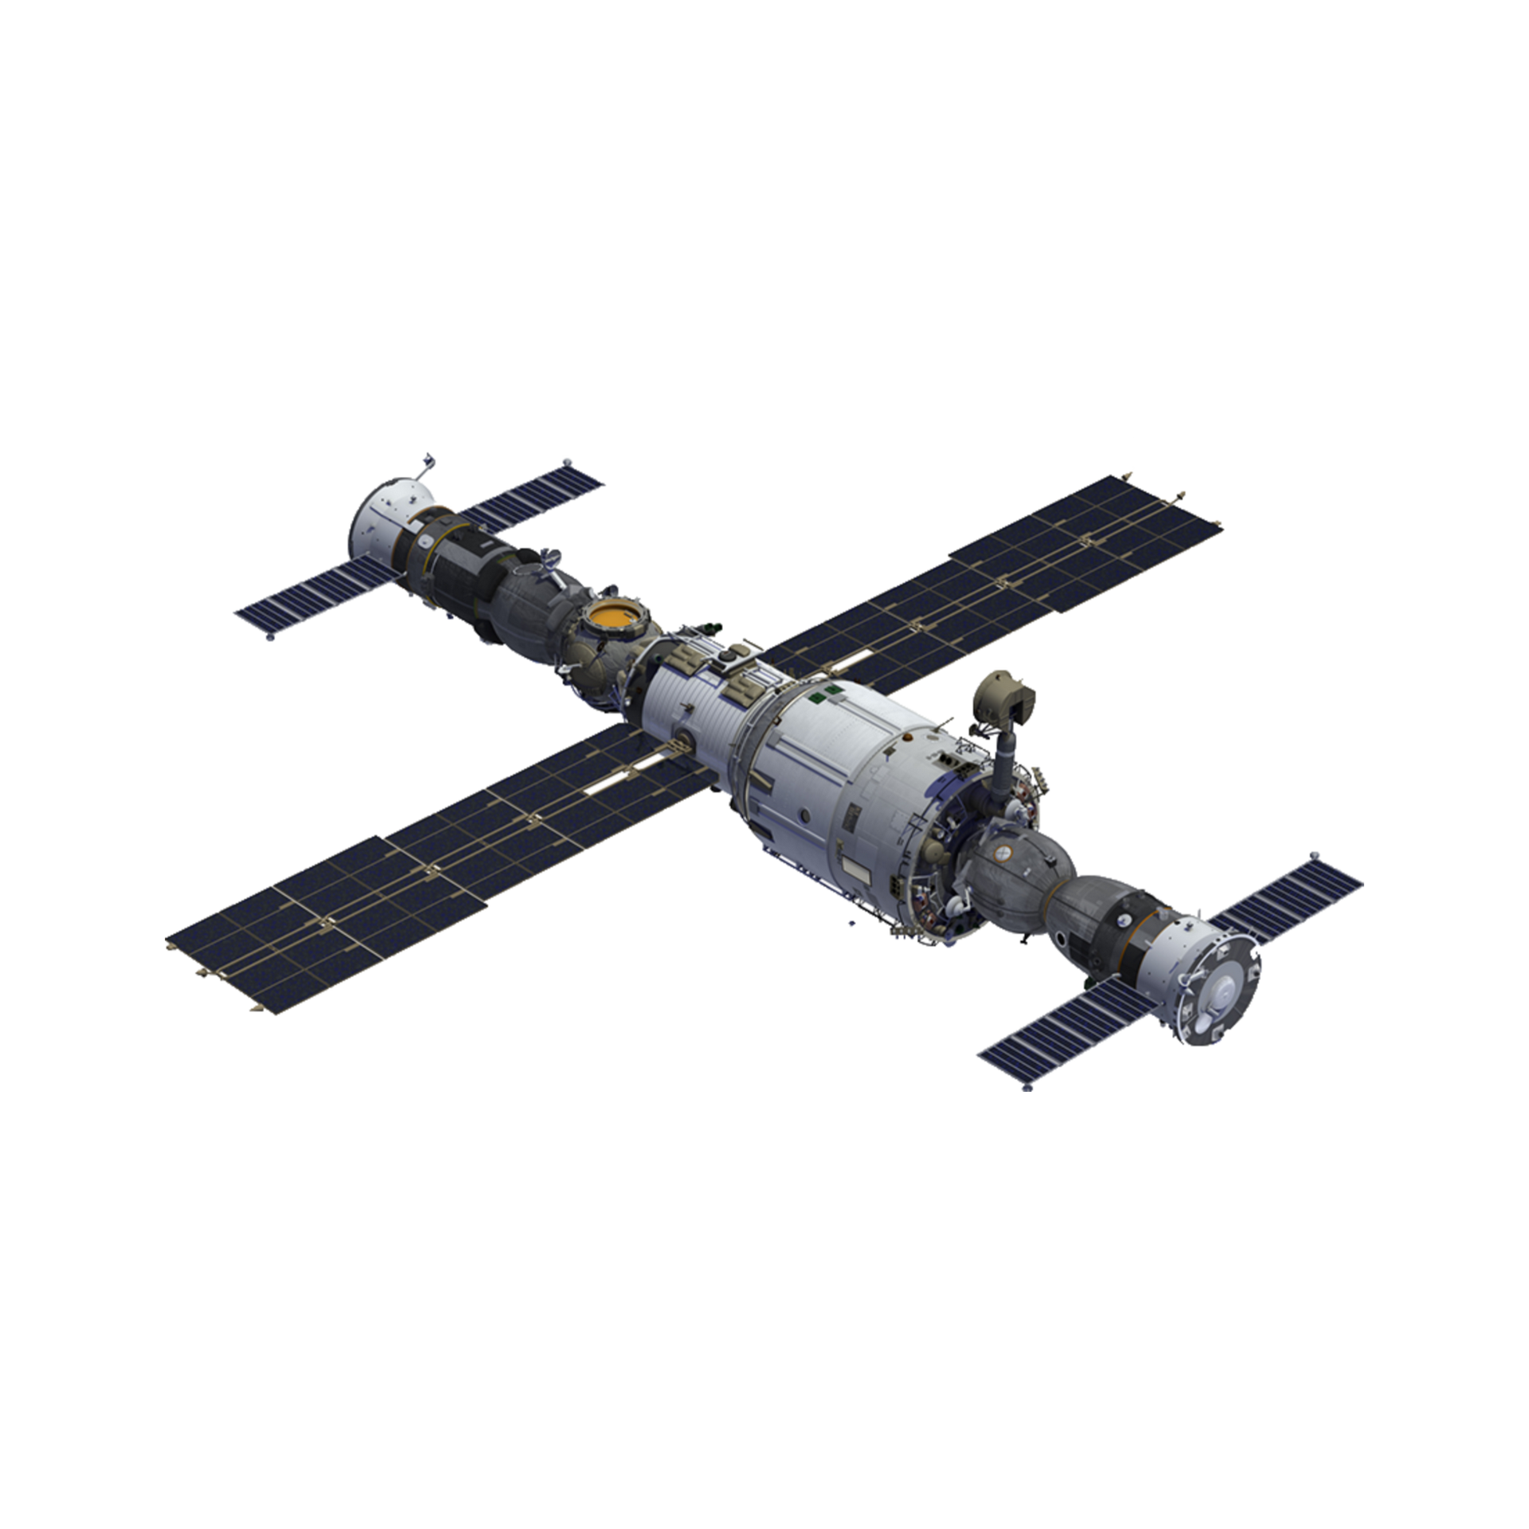
活用词汇
spacecraft /ˈspeɪskrɑ:ft/ n.航天器;宇宙飞船
1. 正是代表着人类工程学顶峰的精密航天器，使我们得以探索宇宙。(应用文)
It is the sophisticated spacecraft, representing the pinnacle of human engineering, that enables us to explore the cosmos.
2.直到航天器成功进入轨道，控制中心才爆发出如释重负和胜利的欢呼。(应用文)
Not until the spacecraft successfully entered orbit did the control center erupt in cheers of relief and triumph.

Slide 32
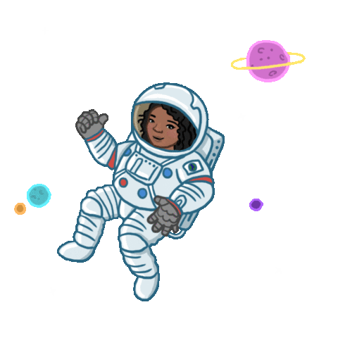
活用词汇
spacewalk /ˈspeɪswɔ:k/ n.太空行走;太空行走时间
1. 执行太空行走是对宇航员最具挑战性和最危险的任务之一，需要极大的勇气和技巧。(应用文)
Performing a spacewalk is one of the most challenging and dangerous tasks for an astronaut,requiring immense courage and skill.
2. 这次向全球直播的历史性太空行走，捕捉住了整整一代人的敬畏与想象。(应用文)
The historic spacewalk, which was broadcast live worldwide, captured the awe and imagination of an entire generation.

Slide 33
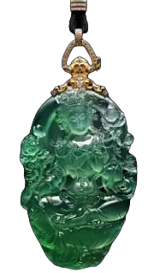
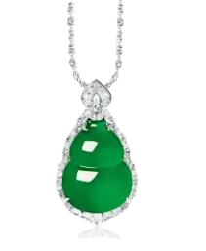
活用词汇
jade /dʒeɪd/ n.玉;翡翠;玉器
1. 在中国文化中，玉不仅仅是一种宝石，它还是美德和正直的象征。(续写)
In Chinese culture, jade is more than a precious stone; it is a symbol of virtue and moral integrity.
2.这件世代相传的玉质传家宝，承载着无数的故事和祝福。(续写)
Passed down through generations, the family heirloom of jade carried with it countless stories and blessings.
3. 她戴的玉坠是祖母送给她的礼物，是她最珍贵的财产。(续写)
The jade pendant she wore, which was a gift from her grandmother, was her most treasured possession.

Slide 34
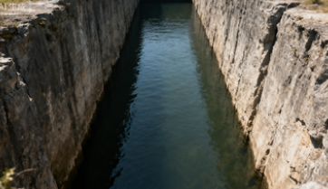

活用词汇
dock /dɒk/ v.(航天器)对接;使…进港
1. 河水在河壁底部以下足足有八英尺深，而且眼前既没有梯子也没有码头，所以根本无法从这条河中脱身。(续写)
With the water flowing a good eight feet below the lip of the wall and no ladder or dock in sight, there was no way out of the river.
2. 她坐在码头边，让脚悬空在水面上方，享受着凉爽的微风。(续写)
Sitting on the edge of the dock, she let her feet dangle over the water, enjoying the cool breeze.
3.看到船安全停靠在港口，所有等待的人都集体松了一口气。(续写)
Seeing the ship dock safely at the port, everyone who had been waiting breathed a collective sigh of relief.

Slide 35

活用词汇
signal /ˈsɪgnəl/ v.标志着;发信号 n.信号
1. 收到约定的信号后，他们离开了房间。(续写)
At an agreed signal they left the room.
2. 警报器一响，就是要所有人离开大楼。(续写)
The siren was a signal for everyone to leave the building.
3. 我一发信号，你就跑！(续写)
When I give the signal , run!
4. 正月十五是元宵节,标志着春节庆祝活动的结束。(应用文)
The Lantern Festival falls on the fifteenth day of the first lunar month, signalling the end of the Spring Festival celebrations.

Slide 36
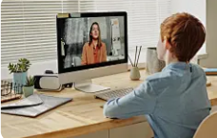
活用词汇
in the hope of doing sth. /ɪn ðə həʊp əv ˈdu:ɪŋ ˈsʌmθɪŋ/ 抱着…的希望
1. 我读了那封信，希望能找到钱包的主人。(应用文)
I read the letter in the hope of finding out who owned the wallet.
2. 我很早就打了个电话，希望在她上班之前找到她。(续写)
I called early in the hope of catching her before she went to work.
3. 简而言之，为了提高我的信息素养水平，我期望从您的课程中更多地了解信息世界以及如何轻松、安全地在其中畅行无阻。(应用文)
In a nutshell, in the hope of improving my information literacy level, I expect to learn more from your course about the information world and the ways in which to safely navigate through it with ease.

Slide 37

活用词汇
so as to do sth. /səʊ əz tə du ˈsʌmθɪŋ 为了;以便
1. 一些人花钱为自己的产品或服务购买好评以增加销量，这种做法已屡见不鲜。(应用文)
It has become a common practice for some to pay for good ratings on their products or services so as to increase their sales.
2. 我们的团队将为新成员组织一系列活动，活动难度从最简单的到最难的都有，旨在让新成员尽快熟悉乒乓球的基本玩法。(应用文)
Our team will organize quite a number of activities for the newcomers, ranging from the easiest to the hardest so as to get the new quickly aware of the basic knowledge of playing table tennis.
3. 我们应该保护环境，以便为子孙后代留下更美好的世界。(应用文)
We should protect the environment so as to leave a better world for future generations.

Slide 38
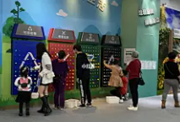
活用词汇
recycle /ˌri:ˈsaɪkl/ vt.回收利用;再利用
1. 回收利用废弃物是每个人的责任，以此来保护我们的环境。(应用文)
It's everyone's responsibility to recycle waste so as to protect our environment.
2. 通过回收旧教科书，我们不仅能节约资源，还能帮助低收入家庭的学生。(应用文)
By recycling used textbooks, we can not only save resources but also help students from low-income families
3. 如果我们不学会回收利用，垃圾量将继续增加并污染我们的生存空间。(应用文)
If we don't learn to recycle, the amount of waste will continue to increase and pollute our living space.

Slide 39

活用词汇
muscle /ˈmʌsl/ n.肌肉;实力;影响力
1. 她的肌肉变得更强壮了，他们的进展也变得明显起来，这让她产生了新的希望和乐观的情绪。(续写)
Her muscles grew stronger and their progress became evident, instilling a newfound sense of hope and optimism.
2. 他的脸是愤怒的面具，下巴的肌肉绷得如此紧，似乎快要断裂。(续写)
His face was a mask of fury, the muscles in his jaw clenched so tightly they seemed ready to snap.
3. 他一动不动地站着。(续写)
He didn't move a muscle (= stood completely still) .
4. 她害怕得一动不动，连一块肌肉都动弹不得。(续写)
She was frozen with fear, unable to move a muscle.

Slide 40
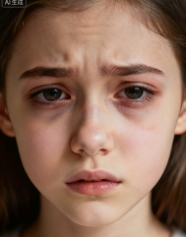
活用词汇
lack /læk/ n.缺乏;短缺 vt.没有;缺乏
1. 然而，一些缺乏自律能力的学生可能会发现，当面对屏幕时，他们的思绪会不由自主地飘走，而不是专注于老师的面容。(应用文)
However, some students who lack self-discipline may find their minds wandering when facing a screen rather than the faces of their teachers.
2. 我们这个班级最明显的问题就是缺乏交流和团队合作。(应用文)
The most obvious problem with our class is lack of interaction or teamwork.
3. 她的眼睛因睡眠不足而隐隐作痛。(续写)
Her eyes ached from lack of sleep.
4. 她深受缺乏自信心之苦。(续写)
She suffers from a lack of confidence.
5. 他缺乏自尊。(续写)
He suffers from a lack of self-regard.

Slide 41

活用词汇
lack /læk/ n.缺乏;短缺 vt.没有;缺乏
6. 缺乏足够的练习可能会导致你考试不及格。(应用文)
The lack of enough practice may lead to your failure in the exam.
7. 由于缺乏自信和经验,简完全不知道该如何应付这可怕的情况。(续写)
Lacking/For lack of/Lacking in confidence and experience, Jane was quite at a loss as to how to deal with the terrible situation.

Slide 42

活用词汇
float /fləʊt/ vi.浮动;漂流 vt.使浮动
1. 我用颤抖的双手拿起它，然后将弓在琴弦上拉动，悠扬而甜美的声音在空中回荡：“真美啊。”(续写)
I took it with trembling hands and pulled the bow across the strings, mellow and sweet sound floating in the air "It's beautiful."
2. 一群天鹅缓缓游过。(续写)
A group of swans floated by.
3. 厨房里飘出新鲜面包的香味。(续写)
The smell of new bread floated up from the kitchen.
4. 美妙的乐声从窗口传出。(续写)
Beautiful music came floating out of the window.
5. 我脑海里突然浮现出一个想法。(续写)
An idea suddenly floated into my mind.

Slide 43

活用词汇
float /fləʊt/ vi.浮动;漂流 vt.使浮动
6. 一个塑料袋在水中漂浮。(续写)
A plastic bag was floating in the water.
7. 她轻盈地下楼来迎接我们。(续写)
She floated down the steps to greet us.
8.因连续失败而气馁，她感觉自己就像一艘被抛弃的船，漂浮在绝望的海洋，努力寻找希望。(续写)
Discouraged by the news that her role as the princess in the play was replaced, she felt like an abandoned boat floating in a sea of despair, struggling to find hope.

Slide 44

活用词汇
otherwise /ˈʌðəwaɪz/ adv.否则;要不然
1. 一个符号就能表达出一种原本需要用整句话来解释的情感。(应用文)
One symbol can express an emotion that might otherwise take someone a whole sentence to explain.
2. 很高兴我带了伞；否则，我就会被大雨淋湿了。(续写)
I'm glad I brought an umbrella; otherwise, I would have been caught in the heavy rain.
3.我们应该尊重不同的文化；否则，在国际交流中可能会产生误解。(应用文)
We should respect different cultures; otherwise, we may have misunderstandings during international communication.

Slide 45
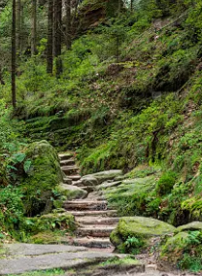
活用词汇
beyond /bɪˈjɒnd/ prep.在更远处;超出
1. 他穿着一件满是灰尘的红色背心，还有褪色得几乎无法辨认的牛仔裤。(续写)
He wore a red vest covered with dust and jeans faded beyond recognition.
2. 只有当一个人超越表面，他性格的真正本质才会显露出来。(续写)
It was only when one looked beyond the surface that the true essence of his character was revealed.
3. 那条路经过村子后又往上延伸到群山中。(续写)
The road continues beyond the village up into the hills.
4. 我们已无法控制这一局面。(应用文)
The situation is beyond our control.
5. 斯诺登山及其以远的山脉都被积雪覆盖着。(续写)
Snowdon and the mountains beyond were covered in snow.

Slide 46

活用词汇
solar /ˈsəʊlə(r)/ adj.太阳的;太阳能的
1. 此外，诸如天然气和太阳能这类清洁能源应当得到广泛利用，以取代化石燃料。(应用文)
Also, cleaner energies, such as natural gas and solar energy, should be universally utilized to replace fossil fuels.
2. 与传统能源相比，太阳能更加环保。(应用文)
Compared with traditional energy, solar energy is more environmentally friendly.

Slide 47
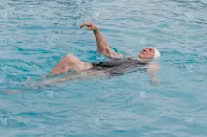
活用词汇
current /ˈkʌrənt/ adj.当前的;现在的 n.水流
1. 河流曾经温和的流动已经变成了急流，席卷了它路径上的一切。(续写)
The river's once gentle flow had turned into a rapid current, sweeping everything in its path.
2. 首先，在当今的数字化时代背景下，这一话题具有时效性且与我们的生活息息相关，而且也是学生们可能会展开激烈讨论的一个议题。(应用文)
For one thing, amid current digital age, it is timely and closely related to our life, a subject that students are likely to have strong arguments on.
3. 他逆着急流游向岸边。(续写)
He swam to the shore against a strong current.
4. 我感到一股凉气吹在脸上。(续写)
I felt a current of cool air blowing in my face.

Slide 48
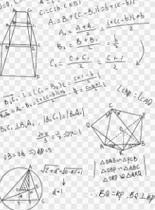
活用词汇
figure out /ˈfɪgə(r) aʊt/ 弄懂;弄清楚;弄明白
1. 经过数小时的思考，我终于想出了那道复杂数学题的解法，这让我充满了巨大的满足感。(续写)
After hours of pondering, I finally figured out the solution to the complex math problem, which filled me with immense satisfaction.
2. 正是他善意的话语，帮助我理解了友谊和支持的真谛。(续写)
It was his kind words that helped me figure out the true meaning of friendship and support.
3. 直到我们坐下来坦诚交流，才弄清了误会的根源。(续写)
Not until we sat down and communicated openly did we figure out the root of the misunderstanding.

Slide 49

活用词汇
sufficient /səˈfɪʃnt/ adj.足够的;充足的
1.只有当我们做好充分准备，才能自信面对高考的挑战。(应用文)
Only when we have sufficient preparation can we face the challenges of the college entrance examination with confidence.
2.正是足够的练习加上及时的反思，才能在英语写作中取得实质进步。(应用文)
It is sufficient practice, combined with timely reflection, that leads to substantial progress in English writing.
3. 第二天，她感觉好转，完全可以去上班了。(续写)
The following day she felt sufficiently well to go to work.

Slide 50
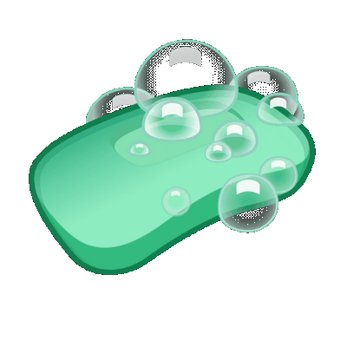
活用词汇
soap /səʊp/ n.肥皂
1. 她拿起一块薰衣草香皂，那淡淡的香气让她想起祖母的花园。(续写)
She picked up a bar of lavender soap, its gentle scent reminding her of her grandmother’s garden.
2.直到肥皂从手中滑落，她才意识到自己已发呆了好几分钟。(续写)
It was not until the soap slipped from her hand that she realized she had been lost in thought for minutes.
3. 最让我印象深刻的是她送我的那块手工香皂生日礼物。(续写)
What impressed me most was the handmade soap she gave me as a birthday gift.

Slide 51

活用词汇
towel /ˈtaʊəl/ n.毛巾;抹布
1.他用白毛巾擦了擦脸，篮球赛后既疲惫又满足。(续写)
He wiped his face with a white towel, feeling both exhausted and satisfied after the basketball match.
2. 那条毛巾虽已褪色变旧，却依然柔软吸水，就像他们的友谊一样。(续写)
The towel, though old and faded, was still soft and absorbent, just like their friendship.
3.他如此专注于比赛，连毛巾掉在湿地上都没察觉。(续写)
So absorbed was he in the game that he didn’t realize his towel had fallen onto the wet ground.

Slide 52
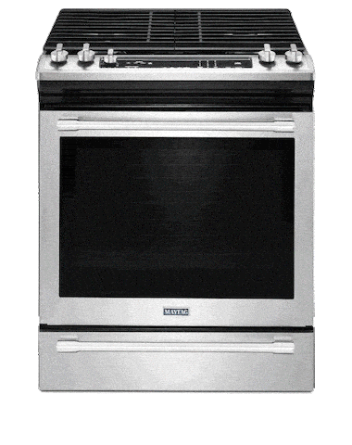
活用词汇
microwave /ˈmaɪkrəweɪv/ n.微波炉
1.微波炉“叮”了一声，提示牛奶热好了，但她太忙没注意到。(续写)
The microwave beeped, signaling that the milk was ready, but she was too busy to notice.
2. 那台微波炉是姑姑送的礼物，已为这个家服务了十多年。(续写)
The microwave, which was a gift from her aunt, had served the family for over a decade.
3. 令我惊讶的是，他居然能用微波炉烤蛋糕。(续写)
What surprised me was that he could even bake a cake in the microwave.

Slide 53

活用词汇
tissue /ˈtɪʃu:/ n.纸巾;(动植物细胞)组织
1. 她递给他一张纸巾，眼中充满同情与理解。(续写)
She handed him a tissue, her eyes full of sympathy and understanding.
2. 那张纸巾虽小虽普通，却承载着陌生人善意的温暖。(续写)
The tissue, though small and ordinary, carried the warmth of a stranger’s kindness.

Slide 54
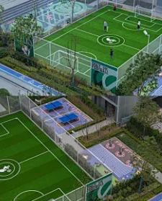

活用词汇
facility /fəˈsɪləti/ n.设施;设备
1. 我们学校最近升级了体育设施，极大激励了学生参与体育锻炼。(应用文)
Our school has recently upgraded its sports facilities, which greatly motivates students to participate in physical activities.
2. 她有语言天赋。(续写)
She has a facility for languages.

Slide 55

活用词汇
keen /ki:n/ adj.热衷的;渴望的
1. 她一直热衷于志愿服务，这不仅丰富了她的生活，也有益于社区。(续写)
She has always been keen on volunteering, which not only enriches her life but also benefits the community.
2. 让他成为优秀学生的，正是他对探索未知的浓厚兴趣。(续写)
What makes him an outstanding student is his keen interest in exploring the unknown.
3. 她不喜欢别人向她发号施令。(续写)
She's not keen on being told what to do.
4. 约翰很热心，愿意帮忙。(续写)
John was very keen to help.

Slide 56

活用词汇
globe /gləʊb/ n.地球;世界;地球仪
1. 有了互联网，我们现在可以联系来自世界各个角落的人，使世界变成一个真正的地球村。(应用文)
With the internet, we can now connect with people from every corner of the globe, making the world a truly global village.
2. 保护地球这个我们唯一的家园，是我们为子孙后代共同肩负的责任。(应用文)
It is our shared responsibility to protect the globe, our only home, for future generations.

Slide 57

活用词汇
argue /ˈɑ:gju:/ vt.&vi.论证;争辩;争论
argument /ˈɑ:gjumənt/ n.争论;争吵;论点
1. 我的兄弟们总是争论不休。(续写)
My brothers are always arguing.
2. 我们总是为钱吵嘴。(续写)
We're always arguing with each other about money.
3. 我们不应彼此争吵，而应坐下来寻找一个实际的解决方案。(续写)
Instead of arguing with each other, we should sit down and find a practical solution to the problem.
4. 毋庸置疑长城是中国的象征。(续写)
It is beyond argument that the Great Wall is the symbol of China.

Slide 58

活用词汇
fatal /ˈfeɪtl/ adj.致命的;灾难性的
1.最终实验中的那个致命错误导致我们整个项目失败，这给我们上了一课：细节至关重要。(应用文)
That one fatal mistake in the final experiment resulted in the failure of our entire project, teaching us a lesson about the importance of detail.
2.正是他的过度自信——他性格中的一个致命缺陷——最终导致了他在比赛中的失利。(续写)
It was his overconfidence, a fatal flaw in his character, that ultimately led to his downfall in the competition.
3.这个计划一开始就有致命的缺陷。(应用文)
The plan was fatally flawed from the start.

Slide 59

活用词汇
shallow /ˈʃæləʊ adj.肤浅的;浅的
1. 他呼吸短促。(续写)
He was breathing shallowly.
2. 他是个浅薄、不友好的人。(续写)
He's a shallow, disagreeable man.
3.我们不应满足于肤浅的知识，相反，需要深入挖掘以掌握事物的本质。(续写)
We should not be satisfied with shallow knowledge; instead, we need to dig deeper to grasp the essence of things.
4. 让我失望的不是他的失败，而是他对问题的肤浅理解以及不愿反思的态度。(续写)
What disappointed me was not his failure, but his shallow understanding of the problem and his unwillingness to reflect.

Slide 60
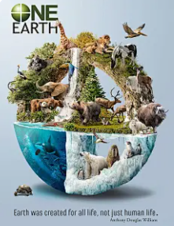
活用词汇
result in /rɪˈzʌlt ɪn/ 导致;造成
1. 缺乏有效沟通导致了这两位好朋友之间的一系列误会。(续写)
The lack of effective communication resulted in a series of misunderstandings between the two good friends.
2.正是持续的环境污染，对许多物种造成了严重的后果。(应用文)
It is the continuous environmental pollution that has resulted in severe consequences for many species.

Slide 61

活用词汇
pattern /ˈpætn/ n.模式;图案;模范
1.通过分析他的错误模式，他终于找到了根本原因并取得了显著进步。(续写)
By analyzing his mistake pattern, he finally figured out the root cause and made significant progress.
2. 正是这种固定的思维模式阻碍了我们想出创造性的解决方案。(应用文)
It is this fixed pattern of thinking that prevents us from coming up with creative solutions.

Slide 62

活用词汇
analysis /əˈnæləsɪs/ n.(对事物)分析;分析结果
1. 对他失败原因的透彻分析，而非失败本身，为他未来的改进提供了宝贵的见解。(续写)
A thorough analysis of the reasons behind his failure, rather than the failure itself, provided him with invaluable insights for future improvement.
2. 她对小说主题的分析如此深刻，以至于引导全班进入了一场深层次且有意义的讨论。(续写)
So profound was her analysis of the novel's themes that the entire class was led into a deep and meaningful discussion.

Slide 63
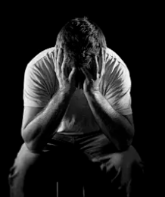
活用词汇
as a result /əz ə rɪˈzʌlt/ 所以;结果(是)
1. 文化节不仅使我们浸润在不同的文化中,也促进了彼此的理解和友谊。(应用文)
Not only did the festival immerse us in diverse cultures, but it also resulted in mutual understanding and friendship.
2. 结果他是对的,我们成了终生的朋友。(续写)
As a result, he was right, we have become friends for life.
3. 他从未认真听取那个建议。结果，他发现自己正在重复他父亲犯过的同样错误。(续写)
He had never taken the advice seriously. As a result, he found himself repeating the same mistakes his father had made.

Slide 64
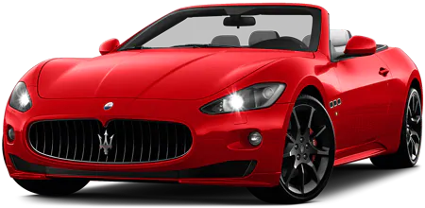
活用词汇
high-end /haɪ end/ adj.高端的
1.该品牌是高端奢侈的代名词，服务于那些重视独家性而非费用的客户群。(应用文)
The brand is synonymous with high-end luxury, catering to a clientele that values exclusivity over expense.
2.那款高端跑车的广告如此引人入胜，以至于它在根本买不起的观众心中也点燃了渴望。(续写)
So compelling was the advertisement for the high-end sports car that it ignited a sense of desire in viewers who couldn't possibly afford it.

Slide 65
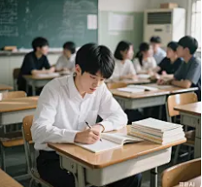
活用词汇
monitor /ˈmɒnɪtə(r)/ n.监视器;监测仪 vt.监视
1. 如果环保机构更频繁地监测水质，污染本可以更早被发现和控制的。(应用文)
Had the environmental agency monitored the water quality more frequently, the pollution could have been detected and contained much earlier.
2. 家长不仅应监测孩子上网的时间，还应引导他们如何建设性地使用网络。(续写)
Not only should parents monitor the time their children spend online, but they should also guide them on how to use the internet constructively.
3. 每一位同学的学习情况都受到密切的关注。(续写)
Each student's progress is closely monitored.

Slide 66

活用词汇
regularly /ˈregjələli/ adv.经常;定期地
1. 正是通过定期锻炼，一个人不仅能保持身体健康，还能保持思维清晰。(应用文)
It is by exercising regularly that one can maintain not only physical fitness but also mental clarity.
2. 他把定期反思每日经历定为一条规矩，他认为这个习惯是个人成长的关键。(续写)
He makes it a rule to reflect on his daily experiences regularly, a habit that he believes is key to personal growth.

Slide 67
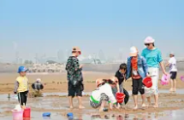
活用词汇
foam /fəʊm/ n.泡沫橡胶;泡沫
1. 浪花四溅，海滩上满是泡沫。(续写)
The breaking waves left the beach covered with foam.
2. 海浪撞击着岩石，化作我们脚下翻腾冒泡的白色泡沫。(续写)
The waves crashed against the rocks, dissolving into a white foam that frothed and bubbled at our feet.
3. 海滩上发现了如此多的泡沫塑料废物，志愿者们花了一整天时间进行清理。(续写)
So much foam plastic waste was found on the beach that volunteers spent the whole day collecting it.

Slide 68
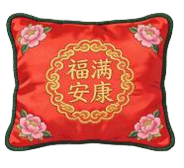
活用词汇
pillow /ˈpɪləʊ n.枕头
1. 她半躺半坐靠在枕头上。(续写)
She lay back against the pillows.
2. 她把脸埋进柔软的枕头，终于让压抑了一整天的泪水流了下来。(续写)
Burying her face in the soft pillow, she finally allowed the tears she had been holding back all day to fall.
3.那个绣着传统祝福语的枕头，是她祖母最珍爱的财产。(续写)
The pillow, embroidered with a traditional blessing, was her grandmother's most cherished possession.

Slide 69

活用词汇
smartphone /ˈsmɑːtfəʊn/ n.智能手机
1. 智能手机不仅彻底改变了我们的沟通方式，也从根本上改变了我们获取信息和感知世界的方式。(应用文)
Not only has the smartphone revolutionized the way we communicate, but it has also fundamentally altered how we access information and perceive the world.
2.正是无处不在的智能手机，让偏远乡村的人们得以与全球社区连接。(应用文)
It is the ubiquitous smartphone that has made it possible for people from remote villages to connect with the global community.
3.连续数小时盯着智能手机屏幕，许多青少年发现自己孤立在虚拟世界中，脱离了现实生活的交流。(应用文)
Staring at the smartphone screen for hours on end, many teenagers find themselves isolated in a virtual world, detached from real-life interactions.

Slide 70
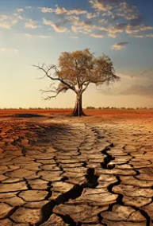
活用词汇
resource /rɪˈsɔ:s/ n.资源;财力;物力
1. 只有通过可持续地管理我们的自然资源，我们才能确保后代也能享受到我们今天所拥有的同样财富。(应用文)
Only by managing our natural resources sustainably can we ensure that future generations will have access to the same treasures we enjoy today.
2.这座图书馆拥有海量的书籍和数字资源，是终身学习者的无价宝库。(应用文)
The library, with its vast collection of books and digital resources, serves as an invaluable resource for lifelong learners.
3. 在受干旱侵袭的地区，淡水变得如此稀缺，每一滴水都被视作珍贵的资源。(应用文)
So scarce had fresh water become in the drought-stricken region that every drop was treated as a precious resource.

Slide 71

活用词汇
limited /ˈlɪmɪtɪd/ adj.有限的
1. 直到我们接受自己的时间和精力都是有限的，才能开始优先处理生命中真正重要的事情。(应用文)
Not until we accept that our time and energy are limited can we begin to prioritize what truly matters in our lives.
2.正是因为我们对于宇宙的理解仍然是有限的，探索的动力才如此强烈。(应用文)
It is precisely because our understanding of the universe is still limited that the drive for exploration remains so strong.
3. 面对有限的选择，她展现出非凡的创造力，将限制转化为创新的机遇。(续写)
Faced with limited options, she demonstrated remarkable ingenuity, turning constraints into opportunities for innovation.

Slide 72
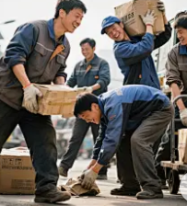
活用词汇
provide for sb. /prəˈvaɪd fə(r) ˈsʌmbədi/ 提供生活所需
1. 为孩子提供生活所需是父母的基本责任，这不仅包括物质上，还包括情感上和教育上。(应用文)
It is a fundamental responsibility of parents to provide for their children, not only materially but also emotionally and educationally.
2. 他如此致力于养家，以至于同时做三份工作，牺牲了自己的闲暇和舒适。(续写)
So dedicated was he to providing for his family that he worked three jobs simultaneously, sacrificing his own leisure and comfort.

Slide 73
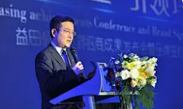
活用词汇
closing /ˈkləʊzɪŋ adj.结尾的;结束的 n.停业
in closing /ɪn ˈkləʊzɪŋ 最后
1. 主席的结束语既总结了成就，又勾勒了未来愿景，让听众感到鼓舞和充满动力。(应用文)
The chairman's closing remarks, both summarizing the achievements and outlining the future vision, left the audience feeling inspired and motivated.
2. 最后，我谨向所有从一开始就支持这项倡议的人们表示衷心的感谢。(应用文)
In closing, I would like to express my heartfelt gratitude to all those who have supported this initiative from its inception.

Slide 74

活用词汇
mystery /ˈmɪstri/ n.神秘事物;谜
1. 这些在神秘中笼罩了几个世纪的古代遗迹，终于开始向坚持不懈的考古学家透露它们的秘密。(应用文)
The ancient ruins, shrouded in mystery for centuries, finally began to reveal their secrets to the persistent archaeologists.
2. 她的失踪引起了重重疑团。(续写)
Mystery surrounds her disappearance.
3. 他来历不明。(续写)
His past is shrouded in mystery (= not much is known about it) .
4. 我真无法理解他们为什么会选他。(续写)
It's a complete mystery to me why they chose him.
5. 这墨镜使她显得有些神秘。(续写)
The dark glasses give her an air of mystery.

Slide 75

活用词汇
run out /rʌn aʊt/ 用完;耗尽
1.如果我们的自然资源在我们找到可行的替代品之前就耗尽了怎么办？这个问题困扰着许多环保人士。(应用文)
What if our natural resources run out before we find viable alternatives? This question haunts many environmentalists.
2. 他们已经想不出办法了。(续写)
They have run out of ideas.
3. 我对她已失去耐性。(续写)
I have run out of patience with her.
4.随着时间所剩无几，该队做了最后一次孤注一掷的尝试，以求得分制胜。(续写)
With their time running out, the team made a final, desperate attempt to score the winning goal.

Slide 76

活用词汇
attach /əˈtætʃ vt.系;绑;贴
1.桌子上发现了一个包装整洁的礼物，上面附着一张写着鼓励话语的小卡片。(续写)
Found on the desk was a neatly wrapped gift, with a small card attached bearing words of encouragement.
2. 她在那条旧项链上倾注了如此多的情感意义，以至于尽管搭扣坏了，她也拒绝与之分离。(续写)
So much emotional significance did she attach to the old necklace that she refused to part with it despite its broken clasp.
3. 她发现桌子上放着一个盒子,盒子上贴着一张卡片,上面写着“生日快乐”。(续写)
She found a box lying on the table with a card attached to it, saying “Happy birthday”.
4. 他们高度重视这个项目。(续写)
They attach great importance to the project.

Slide 77

活用词汇
oxygen /ˈɒksɪdʒən/ n.氧;氧气
1.正是氧气，不仅维持着我们体内的生命之火，也通过工业和创新维持着文明本身的火焰。(应用文)
It is oxygen that sustains not only the flame of life within us but also the very fires of civilization through industry and innovation.
2.深海潜水员最害怕的不是黑暗，而是他们的氧气供应在他们能浮出水面之前耗尽的可能性。(应用文)
What the deep-sea divers feared most was not the darkness, but the possibility of their oxygen supply running out before they could resurface.
3.森林常被描述为地球的肺，不知疲倦地生产着无数生命形式所依赖的氧气。(应用文)
Forests are often described as the lungs of the planet, tirelessly producing the oxygen on which countless life forms depend.

Slide 78




Thank You

