Slide 1


感恩遇见，相互成就，本课件资料仅供您个人参考、教学使用，严禁自行在网络传播，违者依知识产权法追究法律责任。
更多教学资源请关注
公众号：溯恩英语
知识产权声明

Slide 2



活用教材词汇，靶向高考写作
B3U5 单词拓展
The Value of Money

Slide 3

活用词汇
basis /ˈbeɪsɪs/ n.基础;根据;基点
on the basis of /ɒn ðə ˈbeɪsɪs əv/ 在某事的基础上;根据某事
1. 此外，在信息日新月异的当代社会，一个人要想在生活和工作中获得优势，就必须尽可能快速准确地获取信息。(应用文)
In addition, in the contemporary society where information explodes on a daily basis, one is required to access information as swiftly and accurately as possible if he is to gain an advantage in his life and work.
2. 他根本就是一天到晚坐在那儿无所事事。(续写)
He basically just sits there and does nothing all day.
3. 为实现全面健康，我们可以从定期锻炼开始。(应用文)
To achieve overall health, we can start by taking exercise on a regular basis.
4. 在相互尊重和信任的基础上，我们可以建立持久的友谊。
(应用文)
On the basis of mutual respect and trust, we can build a lasting friendship.

Slide 4


活用词汇
loan /ləʊn/ n.贷款;借款
为了让我能上大学，我的家庭不得不申请了一笔可观的银行贷款。(续写)
In order to pursue my university education, my family had to take out a substantial bank loan.
2. 我写信是想咨询关于申请贵校学生贷款的可能性。(应用文)
I am writing to inquire about the possibility of applying for a student loan at your university.
3. 图书馆允许学生借书，但这并非是一种可被视为理所当然的恩惠。(应用文)
The library allows students to borrow books, but it is not a loan to be taken for granted.

Slide 5
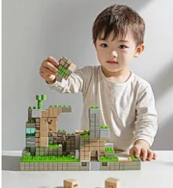
活用词汇
plastic /ˈplæstɪk/ n.塑料 adj.塑料制的
1. 我们应积极减少使用一次性塑料制品来保护环境。(应用文)
We should actively reduce the use of single-use plastics to protect our environment.
2. 海洋受到塑料垃圾的严重污染，这对海洋生物构成了巨大威胁。(应用文)
The ocean is severely polluted by plastic waste, which poses a great threat to marine life.
3. 孩子们正兴奋地用彩色塑料积木搭建一个模型。(续写
The children were excitedly building a model with colorful plastic bricks.

Slide 6

活用词汇
apologise /ə'pɒlədʒaɪz/ vi.道歉;谢罪
1. 本航班起飞延误，谨致歉意。(续写)
We apologize for the late departure of this flight.
2. 他感到内疚并表示歉意。(续写)
He felt suitably chastened and apologized.
3. 我没能按计划与你共度本周末,我写信向你致以诚挚的歉意。(应用文)
I’m writing to express my heartfelt apology to you for my failing to hang out with you this weekend as scheduled.
4. 她毅然走过来，要我向她道歉。(续写)
She marched over to me and demanded an apology.
5. 我鼓起勇气,真诚地为我的不当行为向他道歉。(续写)
I gathered my courage, and sincerely apologised to him for my misconduct.

Slide 7

活用词汇
ignore /ɪgˈnɔ:(r)/ vt.忽视;对…不予理会
1. 他身上有一种难以忽视的忧郁气质。(续写)
There was an air of melancholy about him that was hard to ignore.
2.他无视所有“禁止吸烟”的警示，点了香烟。(续写)
He ignored all the ‘No Smoking’ signs and lit up a cigarette.
3. 他自大、虚荣、而且无知。(续写)
He was self-important, vain and ignorant.
4. 她不愿意承认自己无知。(续写)
She was reluctant to confess her ignorance.

Slide 8

活用词汇
in return /ɪn rɪˈtɜ:n/ 作为回报;作为回应
1.我被他们无私的行为深深感动，意识到不求回报的给予带来的深刻喜悦。(续写)
I was deeply moved by their selfless act, realizing the profound joy that comes from giving without expecting anything in return.
2. 我非常感谢你的帮助,并且我希望有机会带你参观北京以报答你的好意。(应用文)
I deeply appreciate your help and I hope to have the opportunity to show you around Beijing in return for your kindness.
3. 她一回家,他们两人久别重逢悲喜交加。(续写)
On/Upon her return home, their reunion after a long separation brought mixed feelings of joy and sorrow to them both.

Slide 9
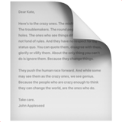

活用词汇
judge /dʒʌdʒ vt.&vi.评价;评判 n.法官
1. 从她上封信看，他们过得非常愉快。(续写)
Judging by her last letter, they are having a wonderful time.
2. 从他的话判断，他非常失望。(续写)
To judge from what he said, he was very disappointed.
3. 此次事故是飞行员判断失误所致。(续写)
The accident was caused by an error of judgement on the part of the pilot.
4. 永远不要凭一眼判断人,因为真正的美来自内在。(应用文)
Never judge people at first glance, for true beauty comes from the inside.

Slide 10

活用词汇
scene /si:n/ n.(戏剧或歌剧)场;现场
1. 为了让游客能身临其境地品尝到各国地道美食，如果能在现场展示一些我们特色菜肴的烹饪过程，并向游客介绍其文化及象征意义，那会是个不错的主意。(应用文)
In a bid to immerse visitors in authentic dishes from different countries, it would be a good idea if we could display how to cook some our special cuisine on the scene and introduce its cultural and symbolic significance to visitors.
2. 她睁开眼睛，看到这情景，高兴地叫出声来。(续写)
She opened her eyes and exclaimed in delight at the scene.
3. 在演那场重头戏之前，我非常紧张。(续写)
I got very nervous before my big scene (= the one where I have a very important part) .

Slide 11
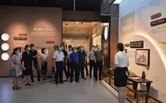
活用词汇
narrator /nəˈreɪtə(r)/ n.(书/戏剧)叙述者;讲述者
narration /nəˈreɪʃn/ n.叙述;讲述;解说
1. 她耐心地解释说，她需要一个旁白者，并且已经为这部剧写好了旁白者的部分，还让我换角色。(续写)
She explained patiently that she needed a narrator and had written a narrator’s part to the play, and asked me to switch roles.
2. 此外，专业的讲解使我能够深入理解中国画的内涵。(应用文)
Furthermore, the professional narration enabled me to have a deep understanding of the Chinese paintings.
3. 她在剧中的角色不是演员，而是连接各幕的场外叙述者。(续写)
Her role in the play was not an actor, but the off-stage narrator who connected the scenes.

Slide 12
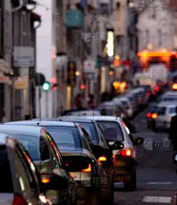
活用词汇
bet /bet/ n.打赌;赌注v.下赌注
make a bet /meɪk ə bet/ 打个赌
1. 我敢肯定，那个同学一直都在跟我开玩笑，直到他带我去了校园公告栏，我在那里看到了获奖名单。(续写)
I bet the classmate played a trick on me until he took me to the campus noticeboard, where I saw the winner list.
2. 我敢说他了解一切。(续写)
I'll bet you (that) he knows all about it.
3. 我估计他们是堵车了。(续写)
My bet is that they've been held up in traffic.

Slide 13
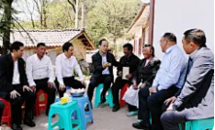
活用词汇
servant /ˈsɜ:vənt/ n.仆人;用人
1. 他有着公仆的作风，总是很耐心，愿意倾听人们的担忧。(应用文)
He had the manner of a public servant, always patient and willing to listen to people's concerns.

Slide 14
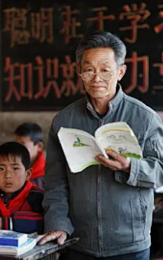
活用词汇
as a matter of fact /əz ə ˈmætə(r) əv fækt/ 事实上;其实;说真的
1. 我原以为这个任务很容易。事实上，它竟成了我面临过的最大的挑战之一。(续写)
I thought the task would be easy. As a matter of fact, it turned out to be one of the biggest challenges I've ever faced.
2. 事实上，许多伟大的发明都是无数次失败的结果。(应用文)
As a matter of fact, many great inventions were the result of countless failures.
3. 他在课堂上显得很严肃。事实上，他在私下里非常幽默。(应用文)
He appears very serious in class. As a matter of fact, he has a great sense of humor in private.

Slide 15
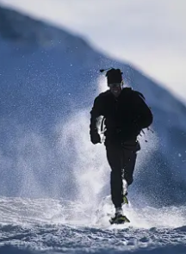
活用词汇
by accident /baɪ ˈæksɪdənt/ 偶然地;意外地
1. 几年后的一个下午，我的两个孩子偶然发现了它。(续写)
One afternoon several years later when my two children discovered it by accident.
2. 很偶然地，她偷听到一段对话，这彻底改变了她对情况的看法。(续写)
By accident, she overheard a conversation that completely changed her understanding of the situation.
3. 我们十年未见，竟在机场偶然相遇。(续写)
We met by accident at the airport after not seeing each other for ten years.
4. 他的成功绝非偶然，而是多年努力和奉献的结果。(应用文)
It was no accident that he succeeded; it was the result of years of hard work and dedication.

Slide 16
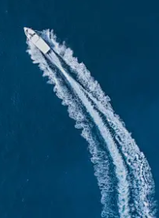
活用词汇
sail /seɪl/ v.(船)航行;(人)乘船航行
1. 在单调而又无声的餐厅里，那位水手怀着满心的善意，走向那位老妇人，她的花朵在令人恼火的日子里显得格外鲜艳。(续写)
In the dull and silent restaurant, the sailor, with a heart full of benevolence, approached the elderly woman, her flowers a vibrant burst of color amidst the annoying day.
2. 小艇平稳地驶过湖面。(续写)
The dinghy sailed smoothly across the lake.
3. 球从守门员头顶飞过。(续写)
The ball sailed over the goalie's head.
4. 她从我身边翩然走过，看都不看我一眼。(续写)
She sailed past me, ignoring me completely.

Slide 17

活用词汇
sail /seɪl/ v.(船)航行;(人)乘船航行
5. 船顺河而下，风逐渐胀满了帆。(续写)
As the boat moved down the river the wind began to fill the sails.
6. 她一阵风似的走了。(续写)
She moved away like a ship in full sail (= with all its sails spread out) .
7. 他们乘船驶向日落，心中充满了对未知的兴奋和发现的承诺。(续写)
They set sail into the sunset, their hearts filled with the thrill of the unknown and the promise of discovery.
8. 我们怀着激动的心情扬帆驶向那座未知的岛屿，心中充满了期待。(续写)
With great excitement, we set sail for the unknown island, our hearts full of anticipation.

Slide 18

活用词汇
spot /spɒt/ vt.看见;注意到 n.地点
1. 她穿着一条黑底白点的裙子。(续写)
She was wearing a black skirt with white spots.
2. 他的上衣满是泥点。(续写)
His jacket was covered with spots of mud.
3. 当时这孩子浑身布满小红疙瘩。(续写)
The baby's whole body was covered in small red spots.
4. 他把他当时向她求婚的确切地点指给我看。(续写)
He showed me the exact spot where he had asked her to marry him.
5. 看到北极熊向我们靠近, 我们吓得呆若木鸡。(续写)
Spotting the polar bear approaching us, we stood rooted to the spot with fear.

Slide 19

活用词汇
consulate /ˈkɒnsjələt/ n.领事馆
1. 领事馆将于下周举办一场文化交流活动以庆祝国庆。(应用文)
The consulate will host a cultural exchange event to celebrate the National Day next week.
2. 总领事馆在促进两城市间的经济文化合作方面起着至关重要的作用。(应用文)
The consulate general plays a vital role in promoting economic and cultural cooperation between the two cities.

Slide 20

活用词汇
dare /deə(r)/ vi.&modal v.胆敢;敢于
1. 随着演出的进行，我全神贯注，甚至不敢眨一下眼睛。(续写)
As the show went on, so concentrated was I that I hardly dared to even blink my eyes.
2. 她壮着胆子大声说了出来。(续写)
She said it as loudly as she dared.
3. 她不敢抱怨任何事情，显然，既然她的老师这么说，她就必须毫无怨言地跟着做。(续写)
She didn’t dare to complain about anything and it was apparent that since her teacher said so，she had to follow without any unhappiness.
4. 他不敢说出他的想法。(续写)
He didn't dare (to) say what he thought.

Slide 21

活用词汇
sort /sɔ:t/ n.种类;类别
1. 第二天，塔莉跑向安娜，滔滔不绝地向她讲述各种有关甲虫的知识，甚至还提议去公园抓活甲虫来展示。(续写)
The next day, Tali ran up to Anna and showered her with all sorts of information about beetles and even suggested that they catch live beetles in the park for display.
2. 我把文件纸张都归整好了。(续写)
I sorted through my paperwork.
3. 他是那种在危机中总能保持冷静和理性的人。(续写)
He's the sort of person who always stays calm and rational in a crisis.
4. 现在你该把自己的事好好安排一下了。(续写)
It's time you got yourself sorted .

Slide 22

活用词汇
mining /ˈmaɪnɪŋ n.采矿;采矿业
1. 那片废弃的矿区赫然矗立，警示着无序工业扩张的代价，曾经的茂密森林已被贫瘠的景观所取代。(应用文)
The abandoned mining site stood as a stark reminder of the price of uncontrolled industrial expansion, with barren landscapes replacing once lush forests.
2. 随着技术进步，“绿色采矿”的理念正日益受到关注，其目标是以最小的环境足迹开采矿产资源。(应用文)
With the advancement of technology, the concept of 'green mining' is gaining traction, aiming to extract mineral resources with minimal environmental footprint.

Slide 23

活用词汇
patience /ˈpeɪʃns/ n.耐心;忍耐力;毅力
1. 我要忍耐不住了。(续写)
My patience is wearing thin.
2. 我对她已失去耐性。(续写)
I have run out of patience with her.
3. 她可能认为我能容忍她的不耐烦，于是转了转眼珠，说：“是的。”(续写)
Possibly believing me to be tolerant of her impatience, she rolled her eyes and said, "Yeah."
4. 在他心里，没有什么比这个损坏的手表更具有教育意义的了，时刻提醒着他耐心的重要性。(续写)
Nothing was more educational than this broken watch, constantly reminding him of the significance of patience.

Slide 24
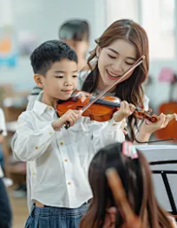
活用词汇
patience /ˈpeɪʃns/ n.耐心;忍耐力;毅力
5. 她对学生通常很有耐心,从来不让他们失望.(续写)
She was usually patient with her students and never made them disappointed.
6. 她给了我一个安慰的微笑,一边点头一边耐心地听着。(续写)
She gave me a comforting smile and nodded while listening patiently/with patience.
7. 学习一门乐器不仅需要天赋，还需要极大的耐心和持续的练习。(应用文)
Learning a musical instrument requires not only talent but also great patience and continuous practice.

Slide 25

活用词汇
to be honest /tə bi ˈɒnɪst/ 说实话;坦率地说
1. 实不相瞒，我申请这个职位的主要原因是源于我对社区服务的热情。(应用文)
To be honest, the main reason I'm applying for this position is my passion for community service.
2.实话告诉您，这段旅程远比我们想象的要更具挑战性。(续写)
To tell you the honest truth, the journey was far more challenging than we had ever imagined.
3. 回首那天,我确实吸取了一个教训:我们也应该学会诚实。(续写)
Looking back on that day, I did learn a lesson that we should also learn to be honest.

Slide 26
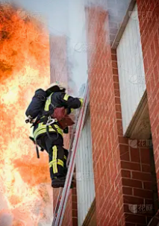
活用词汇
ought to /ɔ:t tə 应该;应当
1. 作为高中生，我们理应主动管理自己的学习计划。(应用文)
As senior high school students, we ought to take the initiative in managing our own study schedules.
2. 我们不应低估小小的善举可能对他人产生的影响。(应用文)
We ought not to underestimate the impact that small acts of kindness can have on others.
3. 他因从着火的大楼中救出孩子的勇敢行为理应受到表扬。(续写)
He ought to be praised for his bravery in rescuing the child from the burning building.

Slide 27

活用词汇
be about to do sth. /bi əˈbaʊt tə du ˈsʌmθɪŋ 即将或正要(做某事)
1. 随着暑假即将开始，我校决定组织一次志愿者活动。(应用文)
As the summer vacation is about to begin, our school has decided to organize a volunteering activity.
2. 他正准备放弃时，一个突然的想法闪过他的脑海，重新点燃了他的希望。(续写)
He was about to give up when a sudden idea flashed through his mind, reigniting his hope.
3. 就在她即将踏上舞台的那一刻，她的心像打鼓一样怦怦直跳，但她深吸一口气，自信地走了出去。(续写)
Just as she was about to step onto the stage, her heart pounded like a drum, but she took a deep breath and walked out confidently.

Slide 28

活用词汇
indicate /ˈɪndɪkeɪt/ vt.&vi.表明;显示 vt.象征
1. 他用双手比划着，示意他钓到的鱼的大小。(续写)
He gestured with his hands to indicate the size of the fish he had caught.
2. 夜空呈红色往往预兆第二天天气晴朗。(续写)
A red sky at night often indicates fine weather the next day.
3. 他在信中向我们透露他愿意合作。(续写)
In his letter he indicated to us (that) he was willing to cooperate.
4. 她拿出一张地图，给我们指出最快捷的路线。
She took out a map and indicated the quickest route to us.
5. 有明显的迹象显示经济已开始好转。(应用文)
There are clear indications that the economy is improving.

Slide 29

活用词汇
indicate /ˈɪndɪkeɪt/ vt.&vi.表明;显示 vt.象征
6. 从所有的迹象看，交易将按计划进行。(应用文)
All the indications are that the deal will go ahead as planned.
7. 他显然想接受这个职位。(续写)
He shows every indication (= clear signs) of wanting to accept the post.

Slide 30

活用词汇
beneath /bɪˈni:θ/ adv.&prep.在(或往)…下面
1. 在士兵粗糙的外表下，是一颗充满同情和爱的心。(续写)
Beneath the rough exterior of the soldier was a heart full of compassion and love.
2. 当我们脚下的地面移动，将我们困在紧密的岩石时，恐慌吞噬着我们。(续写)
When the ground beneath us shifted, trapping us within its rocky grip, panic consumed us.
3. 村民们在古老的石桥下发现了一条隐藏的溪流。(续写)
The villagers found a hidden stream running beneath the old stone bridge.
4. 她觉得这种闲言碎语有失她的身份，于是便走开了。(续写)
She felt that such petty gossip was beneath her, so she simply walked away.

Slide 31
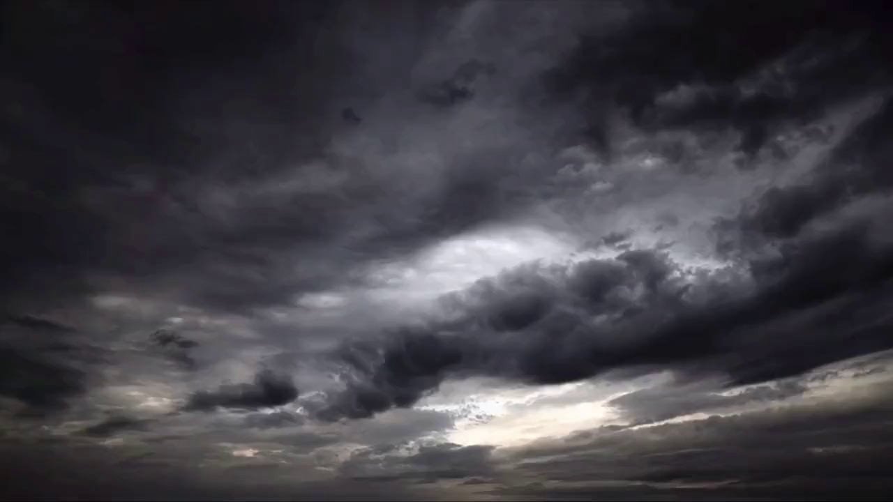
活用词汇
postpone /pəˈspəʊn/ vt.延迟;延期;延缓
1. 由于大雨，学校运动会已被推迟到下周五。(应用文)
Due to the heavy rain, the school sports meet has been postponed until next Friday.
2. 我写这封信是为了致歉，我们不得不推迟原定于明天的会议。(续写)
I am writing to apologize, but we have to postpone our meeting scheduled for tomorrow.
3. 永远不要推迟你的梦想，趁年轻要全力以赴去追求。(应用文)
Never postpone your dreams; pursue them with all your heart while you are young.
4. 看到乌云聚集，他们别无选择，只能推迟野餐。(续写)
Seeing the dark clouds gathering, they had no choice but to postpone their picnic.

Slide 32

活用词汇
odd /ɒd/ adj.奇怪的;怪异的;反常的
1. 他的反应令我诧异。(续写)
His reaction struck me as odd.
2. 他是个古怪但很有才华的艺术家，大部分时间都独来独往。(续写)
He's an odd but very talented artist who keeps to himself most of the time.
3. 我在抽屉里找到一只不成对的袜子，到处都找不到另一只。(续写)
I found an odd sock in the drawer; I can't find its pair anywhere.
4. 半夜从阁楼传来的奇怪声音让每个人都害怕得睡不着。(续写)
An odd noise coming from the attic at midnight made everyone too scared to sleep.

Slide 33

活用词汇
obligation /ˌɒblɪˈgeɪʃn/ n.义务;职责;责任
1. 你不必非买什么东西不可。(续写)
You are under no obligation to buy anything.
2. 她觉得没有义务告诉他实情。(续写)
She did not feel under any obligation to tell him the truth.
3. 我不想让别人迫于无奈来看我。(续写)
I don't want people coming to see me out of a sense of obligation .
4.老师不仅有传授知识的责任，更有育人的义务。(应用文)
Teachers have not only the obligation to teach knowledge but also to educate students.

Slide 34
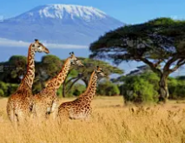
活用词汇
intention /ɪnˈtenʃn/ n.打算;计划;意图;目的
1. 我无意去参加婚礼。(续写)
I have no intention of going to the wedding.
2. 他已经宣布他打算退休。(续写)
He has announced his intention to retire.
3. 我没有要她吃苦头的意思。(续写)
It was not my intention that she should suffer.
4. 他离开英格兰，打算去非洲旅行。(续写)
He left England with the intention of travelling in Africa.
5. 我一心想把我欠她的还给她。(续写)
I have every intention of paying her back what I owe her.

Slide 35
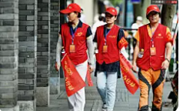
活用词汇
intention /ɪnˈtenʃn/ n.打算;计划;意图;目的
6. 我的初衷是想帮忙，但结果却让事情更糟了。(续写)
My original intention was to help, but I ended up making things worse.
7. 我写这封信的目的是申请志愿者职位。(应用文)
I am writing to you with the intention of applying for the volunteer position.
8. 无论多困难，他都不打算放弃自己的梦想。(续写)
He has no intention of giving up his dream, no matter how hard it gets.

Slide 36
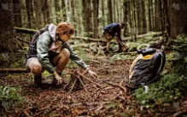
活用词汇
nowhere /ˈnəʊweə(r)/ adv.无处;哪里都不
1. 没有任何地方可藏，也没有任何地方可逃。(续写)
There was nowhere to hide and nowhere to run.
2. 我想和他谈谈，但哪儿也找不到他。(续写)
I wanted to talk to him but he was nowhere to be found.
3. 这种稀有植物只在这个山谷里有，世界其他地方都没有。(续写)
This kind of rare plant is nowhere else in the world but in this valley.
4. 小路把他们带到了一个死胡同，他们意识到自己在森林里完全迷路了。(续写)
The path led them nowhere, and they realized they were completely lost in the forest.

Slide 37

活用词汇
in case /ɪn keɪs/ 以防;以防万一
1. 你在这附近等着以防万一他来了，我继续往前走。(续写)
You hang around here in case he comes, and I'll go on ahead.
2. 请明天再提醒我一遍会议时间，免得我忘了。(应用文)
Please remind me of the meeting time again tomorrow in case I forget.
3. 他总是在车里放一个急救箱，以防紧急情况。(续写)
He always carries a first-aid kit in his car in case of an emergency.
4. 她低声说话，以防有人在门外偷听。(续写)
She spoke in a whisper in case someone was listening outside the door.

Slide 38

活用词汇
extent /ɪkˈstent/ n.程度;限度;大小;范围
to ... extent /tə ɪkˈstent/ 到…程度;在…程度上
1. 他变得我简直认不出了。(续写)
He had changed to such an extent (= so much) that I no longer recognized him.
2. 我对他知识的广博感到惊讶；他好像什么都知道。(续写)
I was amazed at the extent of his knowledge; he seemed to know everything.
3. 直到他崩溃大哭，没有人知道他有多悲伤。(续写)
No one knew the extent of his sadness until he broke down in tears.
4. 他的成就很大程度上得益于他父母的支持。(续写)
To a great extent, his parents' support contributed to his achievement.

Slide 39
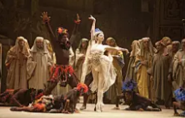
活用词汇
opera /ˈɒprə n.歌剧
1. 我奶奶是京剧迷，每周末都去剧院。(续写)
My grandmother is a big fan of Peking Opera and goes to the theater every weekend.
2. 那位歌剧演员的声音如此有力且动人，让我热泪盈眶。(应用文)
The opera singer's voice was so powerful and moving that it brought tears to my eyes.
3. 我们昨晚在国家大剧院看了一场精彩的歌剧表演。(应用文)
We went to see a wonderful opera performance at the National Grand Theatre last night.

Slide 40

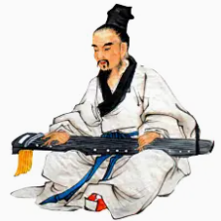
活用词汇
musical /ˈmju:zɪkl/ n.音乐剧 adj.音乐的
1. 学校戏剧社下个月将上演音乐剧版的《灰姑娘》。(应用文)
The school drama club is putting on a musical adaptation of "Cinderella" next month.
2. 他正在演奏的乐器叫古筝，是一种中国传统拨弦乐器。(应用文)
The musical instrument he is playing is called a guzheng, a traditional Chinese zither.
3. 那部电影是音乐剧，里面充满了朗朗上口的歌曲和壮观的舞蹈场面。(应用文)
The film was a musical, filled with catchy songs and spectacular dance numbers.

Slide 41

活用词汇
dinosaur /ˈdaɪnəsɔ:(r)/ n.恐龙
1. 我们在恐龙博物馆看到了一个巨大的霸王龙骨架。(应用文)
We saw a gigantic skeleton of a Tyrannosaurus Rex at the dinosaur museum.
2. 这次化石发现为食草恐龙的行为提供了新线索。(应用文)
This fossil discovery provides new clues about the behavior of herbivorous
dinosaurs.
3. 储藏室里的那台旧电脑真是个老古董；慢得惊人。(续写)
That old computer in the storage room is a real dinosaur;
it's incredibly slow.

Slide 42

活用词汇
hug /hʌg/ vt.&vi.拥抱;抱紧
1. 天阴沉沉的，乌云密布，整个世界仿佛都被笼罩在一张巨大的灰色被子里。(续写)
The sky was overcast, darkened with gloomy clouds, and the whole world seemed to be enveloped in a huge gray quilt.
2. 他拥抱了他的勇敢伙伴，眼中充满了释然的泪水，是他俩的联系救了他，他为此感激不尽 。(续写)
The man hugged his brave companion, tears of relief in his eyes, grateful for the bond that had saved him.
3. 她从后座上跳了出来，给了他一个拥抱。(续写)
She leapt out of the back seat, and gave him a hug.

Slide 43

活用词汇
pursue /pəˈsju:/ vt.追求;致力于
1. 她希望从事医学工作。(续写)
She wishes to pursue a medical career.
2. 警察高速追赶那辆汽车。(续写)
Police pursued the car at high speed.
3. 在亲身参与了所有的实践活动之后，这次节会激发了我的创造力，也增强了我投身这一领域、为人类作出积极贡献的新决心。(续写)
Having immersed myself in all the hands-on activities, the Festival has fueled my creativity, and boosted my newfound determination to pursue a career in
this field and make a positive impact on humanity.

Slide 44
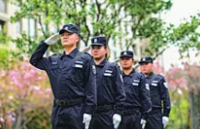
活用词汇
duty /ˈdju:ti/ n.责任;义务;职责;值班
1. 当她穿过森林时，她感到与地球有一种内在的联系。这提醒我们，人类是自然的一部分，我们有责任保护和维护它。(续写)
As she walked through the forest, she felt an innate connection to the earth. It was a reminder that humans are a part of nature, and it is our duty to protect and preserve it.
2. 如果你有任何问题，可以找值班的保安帮忙。(应用文)
You can ask the security guard on duty for help if you have any problems.
3. 随着责任而来的是一种责任感，一种他们带着骄傲和坚定承诺承担的重量。(续写)
With responsibility came a sense of duty, a weight that they bore with pride and unwavering commitment.

Slide 45

活用词汇
hesitate /ˈhezɪteɪt/ vi.犹豫;迟疑;顾虑
1. 她犹豫了一下才回答。(续写)
She hesitated before replying.
2. 她毫不犹豫地同意了。(续写)
She agreed without the slightest hesitation.
3. 我毫不犹豫地推荐她做这项工作。(续写)
I have no hesitation in recommending her for the job.
4. 我犹豫了一会儿,揣摩如何掩饰内心的尴尬。(续写)
I hesitated for a moment, wondering how to hide/disguise/mask my inner embarrassment.

Slide 46

活用词汇
sequence /ˈsi:kwəns/ vt.按顺序排列 n.顺序
1. 老师让学生们按正确顺序排列图片来讲述一个故事。(续写)
The teacher asked the students to arrange the pictures in the correct sequence to tell a story.
2. 他描述了抢劫案发生前的一系列有关情况。(续写)
He described the sequence of events leading up to the robbery.

Slide 47

活用词汇
eventually /ɪˈventʃuəli/ adv.最后;终于
1. 他的绯闻终于传到她耳朵里。(续写)
Our flight eventually left five hours late.
2. 每天练习钢琴三小时后，他最终在学校音乐比赛中获得了一等奖。(续写)
After practicing the piano for three hours every day, he eventually won first prize in the school music competition.
3. 她一直请求父母允许自己加入艺术俱乐部，父母看到她的热情后，最终同意了。(续写)
She kept asking her parents for permission to join the art club, and they eventually agreed after seeing her passion.
4. 这只走失的猫在小区里游荡了两天，最终主人在公园附近找到了它。(续写)
The lost cat wandered around the neighborhood for two days, and eventually, its owner found it near the park.

Slide 48

活用词汇
tailor /ˈteɪlə(r)/ n.(男装)裁缝 vt.专门制作
1. 非常兴奋地通知您，我们当地的电视台正在举办一项专为国际学生打造的精彩短视频活动，我强烈建议您参与一下。(应用文)
Exhilarated to inform you that our local TV station is currently hosting a captivating short video activity specifically tailored for international students, I strongly recommend that you give it a shot.
2.他穿着一套剪裁考究的西装，戴着一副金框眼镜。(续写)
He wears a perfectly-tailored suit and granny glasses.
3. 她决定根据职位要求修改简历，再发送给公司。(续写)
She decided to tailor her resume to the job requirements before sending it to the company.

Slide 49
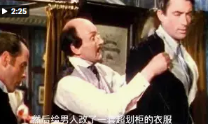
活用词汇
clerk /klɑ:k/ n.职员;文书;店员
1. 乍一看，店员认定亨利·亚当斯是个穷光蛋，买不起他店里的衣服，于是便把他领到一间屋子里，给了他一套不合身的廉价衣服。(续写)
At first sight, the clerk decided that Henry Adams was a poor man who can't afford the clothes m his store, so he led Henry Adams to a room and gave him a cheap suit that didn't fit.

Slide 50
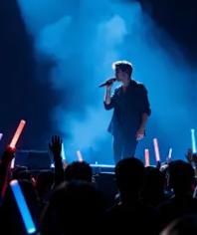
活用词汇
manner /ˈmænə(r)/ n.举止;行为方式;[pl.]礼貌
1. 而且，我每次采取的这种沉着而尊重的态度，都神奇地避免了争执的发生。(续写)
Moreover, the calm and respectful manner I am adopting has miraculously kept arguments at bay each time.
2. 令我感到宽慰的是，他只是在礼貌地对待那位主人而已。(续写)
To my relief, he was just being good-mannered to the host.
3. 歌手用温柔的方式演唱了这首歌，让观众感到平静放松。(续写)
The singer performed the song in a gentle manner, making the audience feel calm and relaxed.

Slide 51

活用词汇
downstairs /ˌdaʊnˈsteəz/ adv.顺楼梯而下;在楼下
stair /steə(r)/ n.楼梯;梯级
1. 他小心地把重箱子搬下楼，生怕掉下来摔坏里面的东西。(续写)
He carried the heavy box downstairs carefully, afraid that he would drop it and break the things inside.
2. 小女孩上楼梯时紧紧抓着妈妈的手，因为她怕摔倒。(续写)
The little girl held her mother’s hand tightly when walking up the stairs, as she was afraid of falling.
3. 楼下派对的声音太大，我根本无法专心写作业。(续写)
The noise from the party downstairs was so loud that I couldn’t focus on my homework.

Slide 52

活用词汇
aside /əˈsaɪd/ adv.到旁边;在旁边;留;存
1. 另外值得一提的是，每场工作坊都会预留一定时间用于互动交流。届时会有老师在场解答您的疑问或在必要时提供一些建议。(应用文)
Also of primary note is that a certain amount of time will be set aside in each workshop for interaction, when a teacher will be available to clarify your doubts or offer some suggestions if necessary.
2. 她把窗帘拉向一边。(续写)
She pulled the curtain aside.
3. 我把书丢在一边，站了起来。(续写)
I tossed the book aside and got up.
4. 警察们从他身边匆匆走过，用肩膀把他推到了一边。(续写)
The policemen rushed past him, shouldering him aside.

Slide 53
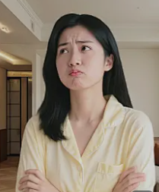
活用词汇
frown /fraʊn/ n.&vi.皱眉
1. 看到父亲脸上的皱眉，她知道她有麻烦了。(续写)
Seeing the frown on her father's face, she knew she was in trouble.
2. 她一皱眉，额头显出了皱纹。(续写)
A frown creased her forehead.
3. 她困惑地皱着眉抬头看。(续写)
She looked up with a puzzled frown.
4. 愁眉苦脸消失了，取而代之的是一种邪恶的满足。(续写)
The frown vanished away and gave place to an expression of evil satisfaction.

Slide 54

活用词汇
in that case /ɪn ðæt keɪs/ 既然那样;假使那样的话
1. 你说你不能按时完成报告？那样的话，我们需要找别人帮忙了。(应用文)
You say you cannot finish the report on time? In that case, we need to ask someone else for help.
2. 那样的话，我别无选择，只能接受你的决定。(续写)
In that case, I have no choice but to accept your decision.

Slide 55

活用词汇
option /ˈɒpʃn/ n.可选择的事物;选择
1. 你提到你有两门选修课程，其中一门是用中文进行的听力和口语训练，另一门是用中文进行的阅读和写作练习。(应用文)
You mentioned that you have two optional courses, one is listening and speaking in Chinese, the other is reading and writing in Chinese.
2. 我们别无选择，只有取消这项任务。(应用文)
We had no option but to abort the mission.
3. 此外，它还强调了自我认知的重要性，使学生们能够探索不同的职业选择并设定可实现的目标，这一举措受到了学生们的一致欢迎。(应用文)
Also, it emphasized the importance of self-awareness, enabling students to explore different career options and set achievable goals, which were warmly embraced by students.

Slide 56
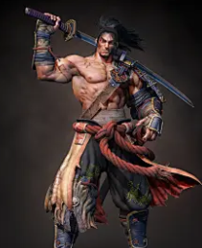
活用词汇
broad /brɔ:d/ adj.宽阔的;广阔的;广泛的
1. 当我拥抱他时，我的脸上渐渐浮现出灿烂的笑容。
A broad smile started to form on my face as I gave him a hug.
2. 通过阅读这些书籍，我们学生能够积极参与热烈的讨论，交流想法，并拓宽视野，从而全面提升我们的批判性思维能力。(应用文)
By discussing these books, we students can engage in lively debates, exchange ideas, and broaden our perspectives, all enhancing our critical thinking skills.
3. 他身高体宽，肌肉发达。
He is tall, broad and muscular.

Slide 57

活用词汇
indeed /ɪnˈdi:d/ adv.其实;实际上;当然
1. 在我最疯狂的幻想中，我从未想过自己竟然真的被分配了实习任务，要参与一档校园生活类节目的录制，而且我的首次电视公开亮相就在五天之后。(应用文)
Never in my wildest dream did I imagine that I was indeed assigned the intern job to act on a school life show and my first public appearance on TV was in five days.
2. 四股水流在此交汇，而且实际上，河水的流速明显加快了。(续写)
Four streams met here, and indeed, the water was flowing more quickly.

Slide 58
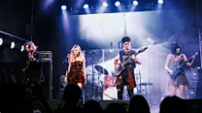
活用词汇
normal /ˈnɔ:ml/ adj.典型的;正常的 n.常态
1. 风暴过后，生活慢慢恢复了正常。(续写)
After the storm, life slowly returned to normal.
2. 在正常情况下，旅程大约需要两小时。(续写)
Under normal circumstances, the journey takes about two hours.
3. 她是个正常的青少年，喜欢音乐和和朋友一起玩。(续写)
She's a normal teenager who loves music and hanging out with friends.

Slide 59
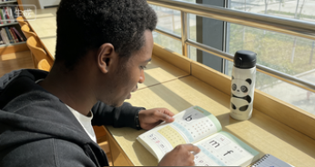
活用词汇
willing /ˈwɪlɪŋ adj.愿意;乐意
1. 尽管这么做让她非常痛苦，但她还是努力寻找可以收留她的人家，但愿意收留她的朋友都住在 180 英里之外的地方。(续写)
As much as it pained her to do it，she searched for someone to take her in，but the only friends willing to do so lived 180 miles away.
2. 总之，要放松心态。如果您在学习中文的过程中遇到任何问题，我随时愿意为您提供帮助。(续写)
In a word, be relaxed and if you have any problem in learning Chinese, I am willing to offer my help at any time.

Slide 60

活用词汇
element /ˈelɪmənt/ n.要素;基本部分
1. 正如她和她妈妈所说，如果我们勇敢地面对这些环境，我们就可以克服任何问题。(续写)
As she and her mom said, if we brave the elements, we can overcome any problems.
2. 你还记得那次文化沙龙吧？它展现了两国典型的文化元素，让我得以一窥这两种充满活力的文化的多样性和丰富性。(应用文)
Do you remember the culture salon, which featured the typical cultural elements of the two countries, helped me gain a glimpse into the diversity and richness of the two dynamic cultures.
3. 自然之美是一首交响乐，每个元素都是世界宏大乐章中的一个音符。(续写)
Nature's beauty was a symphony, each element a note in the grand composition of the world.

Slide 61
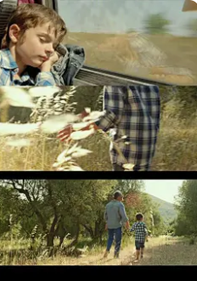
活用词汇
plot /plɒt/ n.故事情节;布局;阴谋
1. 其次，情节中加入了曲折的情节发展，同时人物形象也得到了合理且生动的塑造，这充分展现了我的创造力和独创性。(应用文)
Secondly, twists and turns are added to the plot and the characters well developed in a reasonable way, demonstrating my creativity and originality.
2. 这部电影情节很简单，但非常感人。(应用文)
The movie has a very simple plot but is deeply moving.
3. 有些观众觉得这部电视剧的情节太慢，但也有人认为它铺垫得很充分。(应用文)
Some viewers said the plot of the TV show was too slow, but others thought it was well - developed.

Slide 62

活用词汇
ambassador /æmˈbæsədə(r)/ n.大使;使节;代表
1. 这位年轻歌手表示，能成为儿童慈善机构的大使她很自豪，并会尽力帮助更多孩子。(续写)
The young singer said she was proud to be the ambassador of the children’s charity and would try her best to help more kids.
2. 她是我们学校的优秀代表，言行总是礼貌而聪慧。(续写)
She is a good ambassador for our school, always behaving politely and intelligently.
3. 熊猫被认为是中国与其他国家之间的友谊大使。(应用文)
The panda is considered an ambassador of friendship between China and other countries.

Slide 63
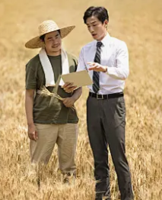
活用词汇
upper class /ˈʌpə(r) klɑ:s/ adj.上流社会的;上等阶层的
upper /ˈʌpə(r)/ adj.上面的;上层的
1. 突然，德文发现了一个直接射门的绝佳机会。他用力一击，屏住呼吸看着球飞向球门的上角。(续写)
Suddenly Devin saw a clear opening to the goal. He struck the ball hard and held his breath as it flew toward the upper corner of the net.
2. 她出身于上流社会家庭，但非常脚踏实地。(续写)
She comes from an upper-class family, but she is very down-to-earth.
3. 他出身于上层阶级，但毕生致力于帮助穷人。(续写)
He was born into the upper class but devoted his life to helping the poor.

Slide 64

活用词汇
maintain /meɪnˈteɪn/ vt.维持;保持;维修;保养
1. 她一言不发，以保持尊严。(续写)
She maintained a dignified silence.
2. 这几个男人坚持说案发时他们在国外。(续写)
The men maintained (that) they were out of the country when the crime was committed.
3. 她一直坚持说她是无辜的。(续写)
She has always maintained her innocence .

Slide 65
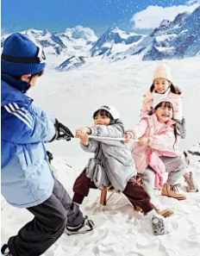
活用词汇
permission /pəˈmɪʃn/ n.准许;许可;批准;许可证
permit /pəˈmɪt/ vt.&vi.允许;准许;使可能
1. 她未经许可擅自使用了汽车。(续写)
She took the car without permission .
2. 他请求离开房间的许可。(续写)
He asked permission to leave the room.
3. 令我大为失望的是,门卫不允许我带相机。
Much to my disappointment, the door guards didn’t permit bringing my camera.
4. 天气允许的话,将举办冬日远足活动,让我们接近大自然并提高我们学生的健康意识。(应用文)
Weather permitting, a winter hike will be launched to get us close to nature and raise us students health awareness.

Slide 66

活用词汇
saying /ˈseɪɪŋ n.谚语;格言;警句
1. 常言道:“有志者，事竟成。”(应用文)
As the saying goes, "Where there is a will, there is a way."
2. 他喜欢在演讲中引用古语。(续写)
He likes to quote ancient sayings in his speeches.
3. 中国有句古话：“千里之行，始于足下。”(应用文)
There's a saying in China: "A journey of a thousand miles begins with a single step."

Slide 67
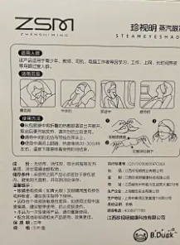
活用词汇
external /ɪkˈstɜ:nl/ adj.外部的;外面的;外来的
1. 尽管这所老房子外表平静，但我能感觉到里面有一种令人不安的气氛。(续写)
Despite the calm external appearance of the old house, I could feel an unsettling atmosphere inside.
2. 此药仅供外用；使用前请仔细阅读说明书。(应用文)
This medicine is for external use only; please read the instructions carefully before applying.
3. 他在外界的压力下保持冷静，这最终帮助他解决了那个复杂的问题。(续写)
He remained calm under external pressure, which eventually helped him solve the complex problem.

Slide 68
Thank You

