Slide 1


感恩遇见，相互成就，本课件资料仅供您个人参考、教学使用，严禁自行在网络传播，违者依知识产权法追究法律责任。
更多教学资源请关注
公众号：溯恩英语
知识产权声明

Slide 2
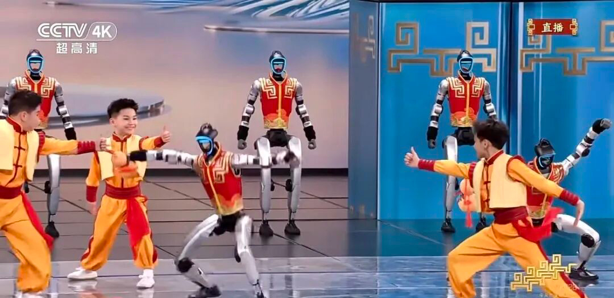
The First Lesson in 2026
Culture & Technology
——The Magic of 2026 CCTV Spring Festival Gala

Slide 3
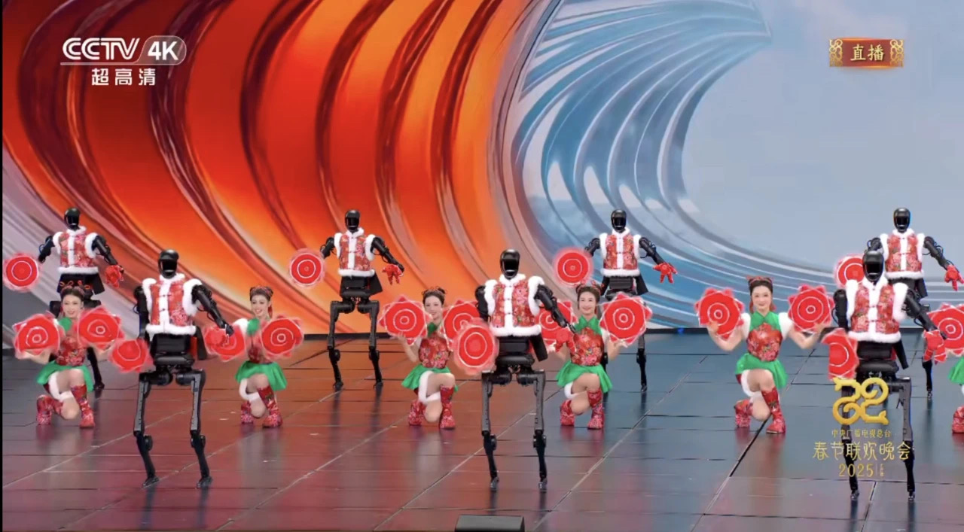
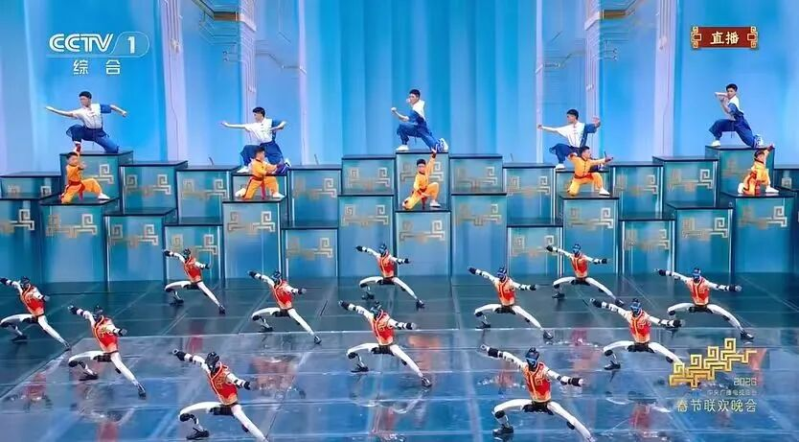
1.What can you see in the two pictures?
2025 The Spring Festival Gala
2026 The Spring Festival Gala
秧bot
武bot
2.What do these performances combine?
Traditional culture + Robots/ Technology

Slide 4
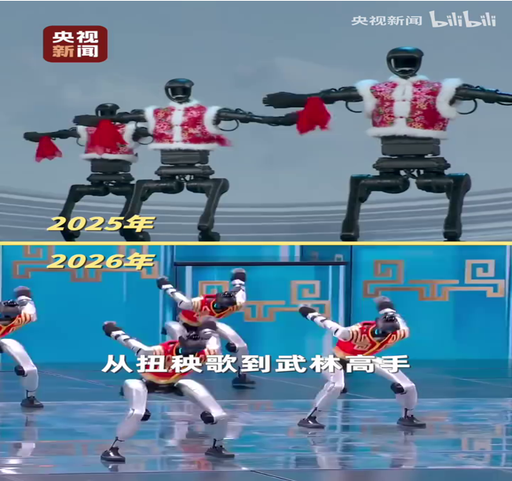
3.What impressed you most in the video?
Technology develops so fast
视频1

Slide 5

Listen & Think
4.What reaction did the performance cause?
Robots became one of the biggest talking points online after the 2026 CCTV Spring Festival Gala______ on Monday, with multiple robot-related topics trending on social media and driving a surge in_____________________ .
Several robotics companies, including Unitree Robotics, MagicLab, Galbot and Noetix Robotics, showcased their technologies __________________.Within __________ of the broadcast, e-commerce giant JD.com reported a 300 percent surge in _____________ "robots", a __________ spike in customer inquiries, and a 150 percent jump in __________ compared to the previous period, according to The Paper.
The buying frenzy spanned over 100 cities, from first-tier metropolises to smaller counties, signaling a nationwide appetite for_____________________ .
aired
consumer interest
on the national stage
two hours
searches for
460 percent
orders
intelligent machines
5.What do the underlined words mean?
From China Daily

Slide 6
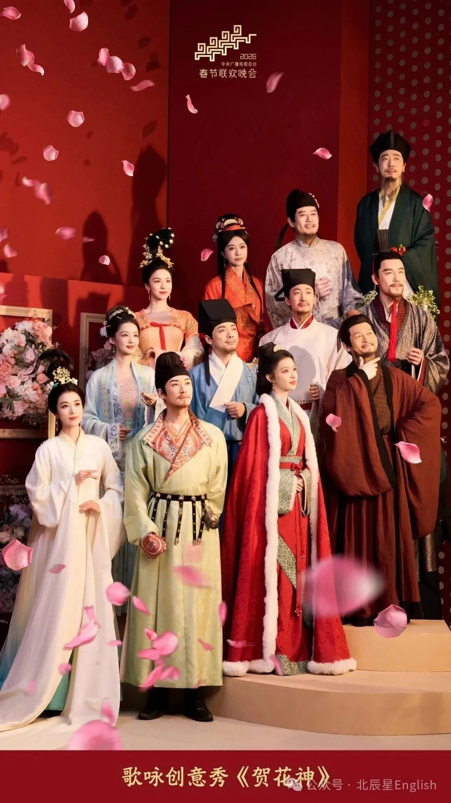
Guess& Learn
6.Can you think of another performance of Culture & Technology in 2026 Gala?
贺花神
Clue 1 : It’s a kind of flower.
Clue 2 : It carries people’s longing for purity and innocence and reflects the spirit of perseverance.
Clue 3 : It rises from the mud yet remains
unstained; Washed by clear ripples, it stands
pure,not ostentatious.
出淤泥而不染，濯清涟而不妖
Tribute to the Flower God
Lotus 荷花

Slide 7
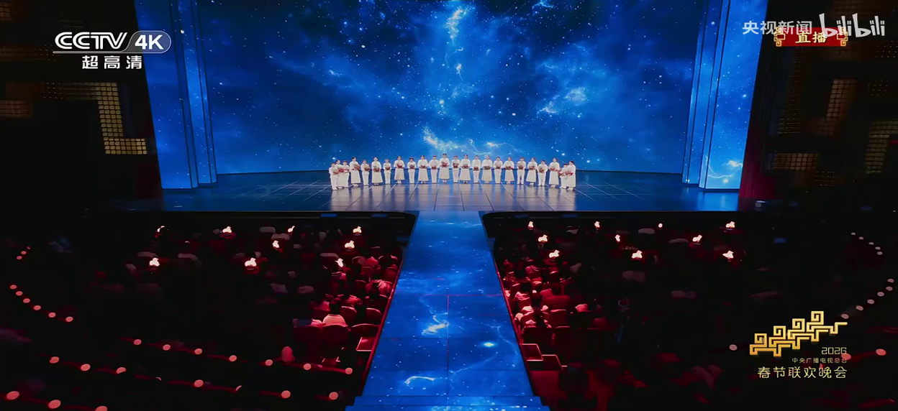
Watch& Learn
7.How many flower Gods are shown in the video? Who are they? What poems are mentioned in the performance?
视频3

Slide 8
Match &Learn
杏花 Apricot Blossom /ˈeɪ.prɪ.kɒt/
Sparse shadows slant across the shallow clear water;
Faint fragrance floats in the dusk moonlight.
小楼一夜听春雨，
深巷明朝卖杏花。
桃花 Peach Blossom /piːtʃ ˈblɒs.əm/
All night I listen to spring rain in my small chamber;
At dawn, apricot blossoms will be sold down the lane.
桃之夭夭，
灼灼其华。
梅花Plum Blossom /plʌm ˈblɒs.əm/
The peach tree is so lush and fair;
Its blossoms glow with a brilliant flare.
疏影横斜水清浅，
暗香浮动月黄昏。

Slide 9
Match &Learn
榴花Pomegranate /ˈpɒm.ɪˌɡræn.ɪt/
Clouds evoke the grace of your robes;flowers the beauty of your face.
五月榴花照眼明。
In the fifth moon, pomegranate blooms dazzle the eye.
芍药 Peony /ˈpiː.ə.ni/
云想衣裳花想容。
It rises from the mud yet remains unstained;
Washed by clear ripples, it stands pure, not ostentatious.
荷花 Lotus /ˈləʊ.təs/
出淤泥而不染，
濯清涟而不妖。

Slide 10
Match &Learn
蜀葵 Hollyhock /ˈhɒl.i.hɒk/
To whom shall I entrust this loyal heart?Only to the sun-facing branch within the painting.
丹心托向谁，
画里向阳枝。
Why need it be pale green or deep red?
It is simply the finest among all flowers.
桂花 Osmanthus/ɒzˈmæn.θəs/
何须浅碧深红色，自是花中第一流。
Picking chrysanthemums beneath the eastern fence,
I gaze at the southern mountains in peaceful ease.
菊花 Chrysanthemum/krɪˈsæn.θə.məm/
采菊东篱下，
悠然见南山。

Slide 11
Match &Learn
Her countenance is as fair as the blooming flower of dawn.
芙蓉 Hibiscus /hɪˈbɪs.kəs/
颜如舜华。
水仙Narcissus /nɑːˈsɪs.əs/
Only the camellia possesses such enduring vitality.
凌波微步，罗袜生尘。
She glides lightly over the waves;
Her silk stockings stir a faint dust in her wake.
山茶Camellia /kəˈmiː.li.ə/
惟有山茶偏耐久。

Slide 12
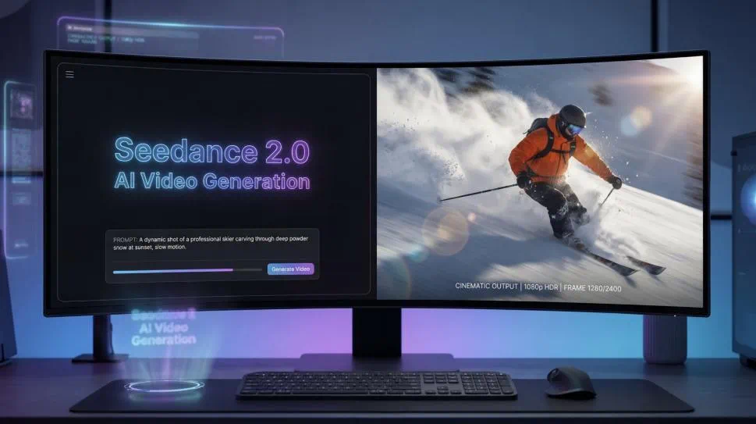
Think & Share
8.What specific technology makes this amazing performance possible?

Slide 13
Know more about Seedance 2.0
From China Daily
Chinese tech company ByteDance has launched the latest version of its artificial intelligence video-generation model, Seedance 2.0, ________ has quickly gone viral worldwide.
Seedance 2.0 markets __________（it) as a “true” multi-modal AI creator, allowing users___________ (combine) images, videos, audio and text to generate “cinematic content” with “precise reference capabilities, seamless video________ (extend) and natural language control”. The model is ________(current) available to select users of Jimeng AI, ByteDance’s AI video platform. The model can generate multi-shot videos______ about 60 seconds, significantly lowering production costs______ technical barriers.
Its advanced reference capabilities and multimodal integration______________ (spark) global interest so far. __________,several American directors and film professionals have expressed surprise after testing the tool, with some _________(call) it a potential troublemaker of traditional filmmaking.
which
itself
to combine
extension
currently
in
and
have sparked
However
calling

Slide 14
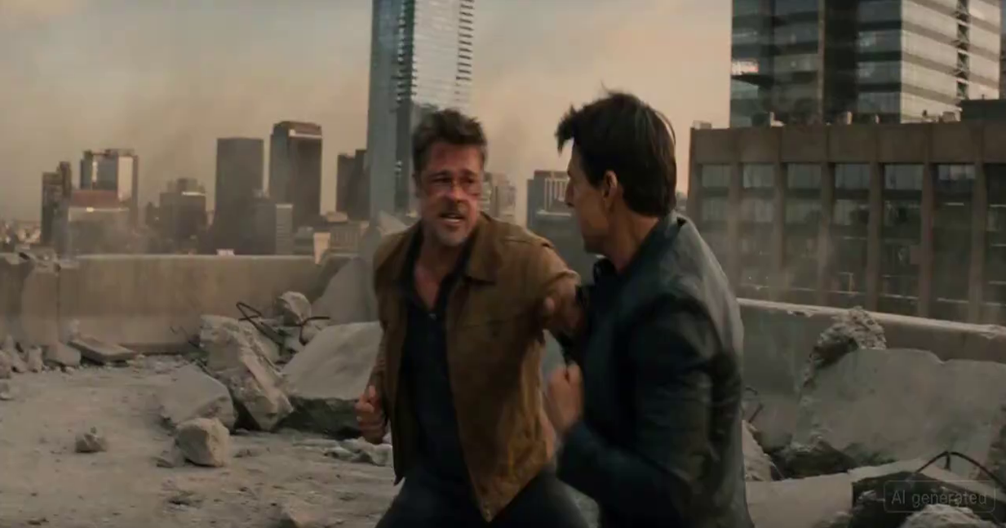
9.How do you feel after watching this video?
视频4

Slide 15

10.What do foreign media think of the AI video?
11.Do they fully support it?
视频5

Slide 16
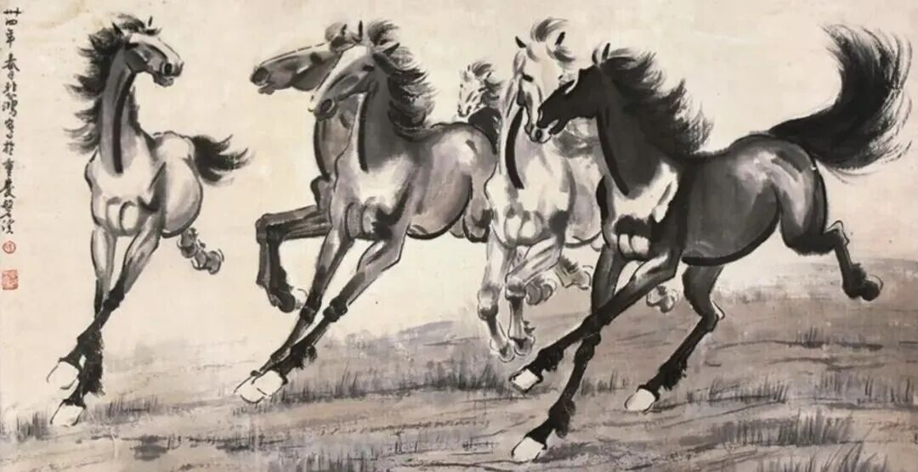
12. Can we make the traditional Chinese painting come to life?

Slide 17
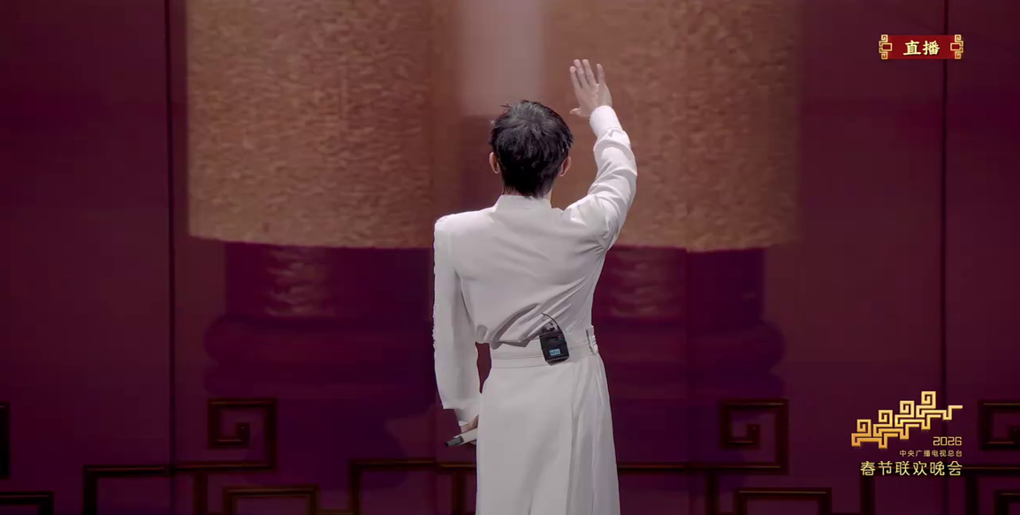
视频6

Slide 18
Think & Share
You are the director of the 2027 Spring Festival Gala.
The theme is: Culture & Technology.
You have all the tools — robots, AI, AR, Seedance 2.0, Unitree robots, whatever you need.
Your task: Design a 3-minute performance that uses technology to bring a piece of Chinese culture to life.”

Slide 19
Step 1: Choose Your Cultural Element (2 mins)
- A famous painting (like Six Steeds)
- A historical figure (like Confucius, a Tang dynasty poet)
- A traditional art form (Peking opera, calligraphy, tea ceremony)
- A festival tradition (lanterns, dragon boats)
- A classic story (Journey to the West, Mulan)
Step 2: Choose Your Technology (1 min)
- Unitree robots (for movement and performance)
- Seedance 2.0 (for AI-generated visuals)
- AR/VR (for blending real and virtual)
- Drones (for sky formations)
- AI-generated music/sound
- Bionic designs (mechanical animals)
Step 3: Describe Your Performance (2 mins writing)
My performance is called ______. It is inspired by ______. I will use ______ technology to bring it to life. The audience will see ______ and feel ______. This combination matters because ______.

Slide 20
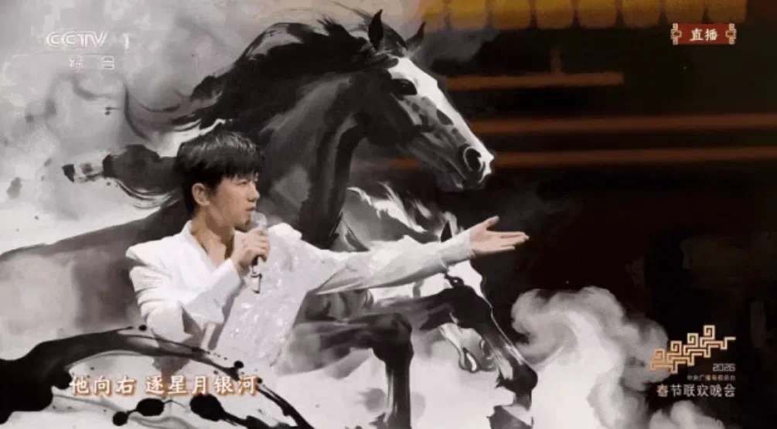
Culture gives technology a soul;
Technology gives culture a voice and a future.

Slide 21
Homework
假如你是2027春晚导演，请设计一个融合科技与文化的节目，写一篇短文介绍你的创意，内容包括：
1. 你选择的文化元素及原因；
2. 你使用的科技手段；
3. 你想传达的情感和观众的期待。
注意：
1. 词数80左右；
2. 可以适当增加细节，以使行文连贯。

Slide 22
One possibleSample
My Gala Performance: “Mulan: A Legend Reborn”
For the 2027 Gala, I would create “Mulan: A Legend Reborn.” I choose Mulan because she embodies courage and loyalty—values at the heart of Chinese culture. Her story deserves to be told to a new generation.
To bring her legend to life, I would integrate cutting-edge technology. Unitree robots, dressed in ancient armor, would perform alongside human dancers. Meanwhile, Seedance 2.0 would generate dynamic backdrops, transforming the stage from village to battlefield in seconds. AI-composed music would blend the pipa with modern orchestral sounds, bridging past and present.
What I want to convey is that heroism is timeless. I hope the audience leaves feeling that our cultural heritage is not a relic, but a living force guiding us forward. After watching, I want every young person to believe: they, too, can be heroes.

