Slide 1


感恩遇见，相互成就，本课件资料仅供您个人参考、教学使用，严禁自行在网络传播，违者依知识产权法追究法律责任。
更多教学资源请关注
公众号：溯恩英语
知识产权声明

Slide 2
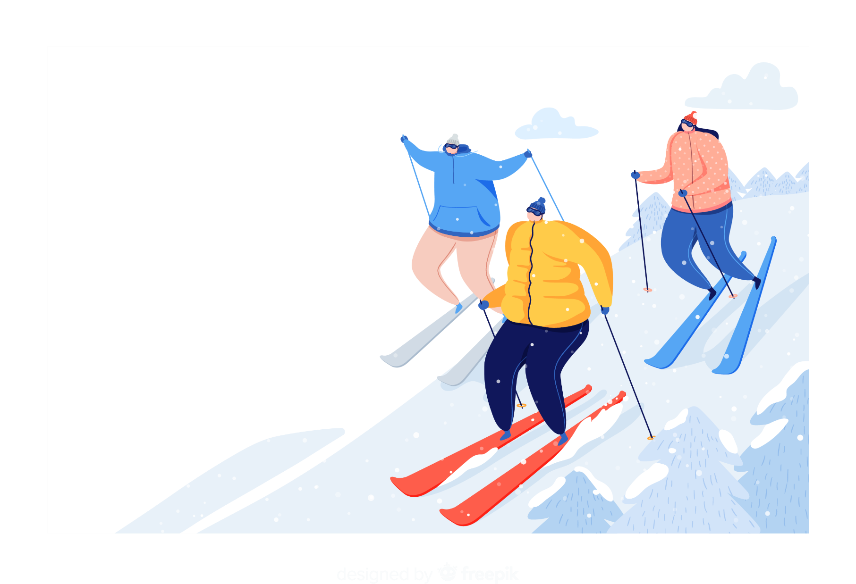
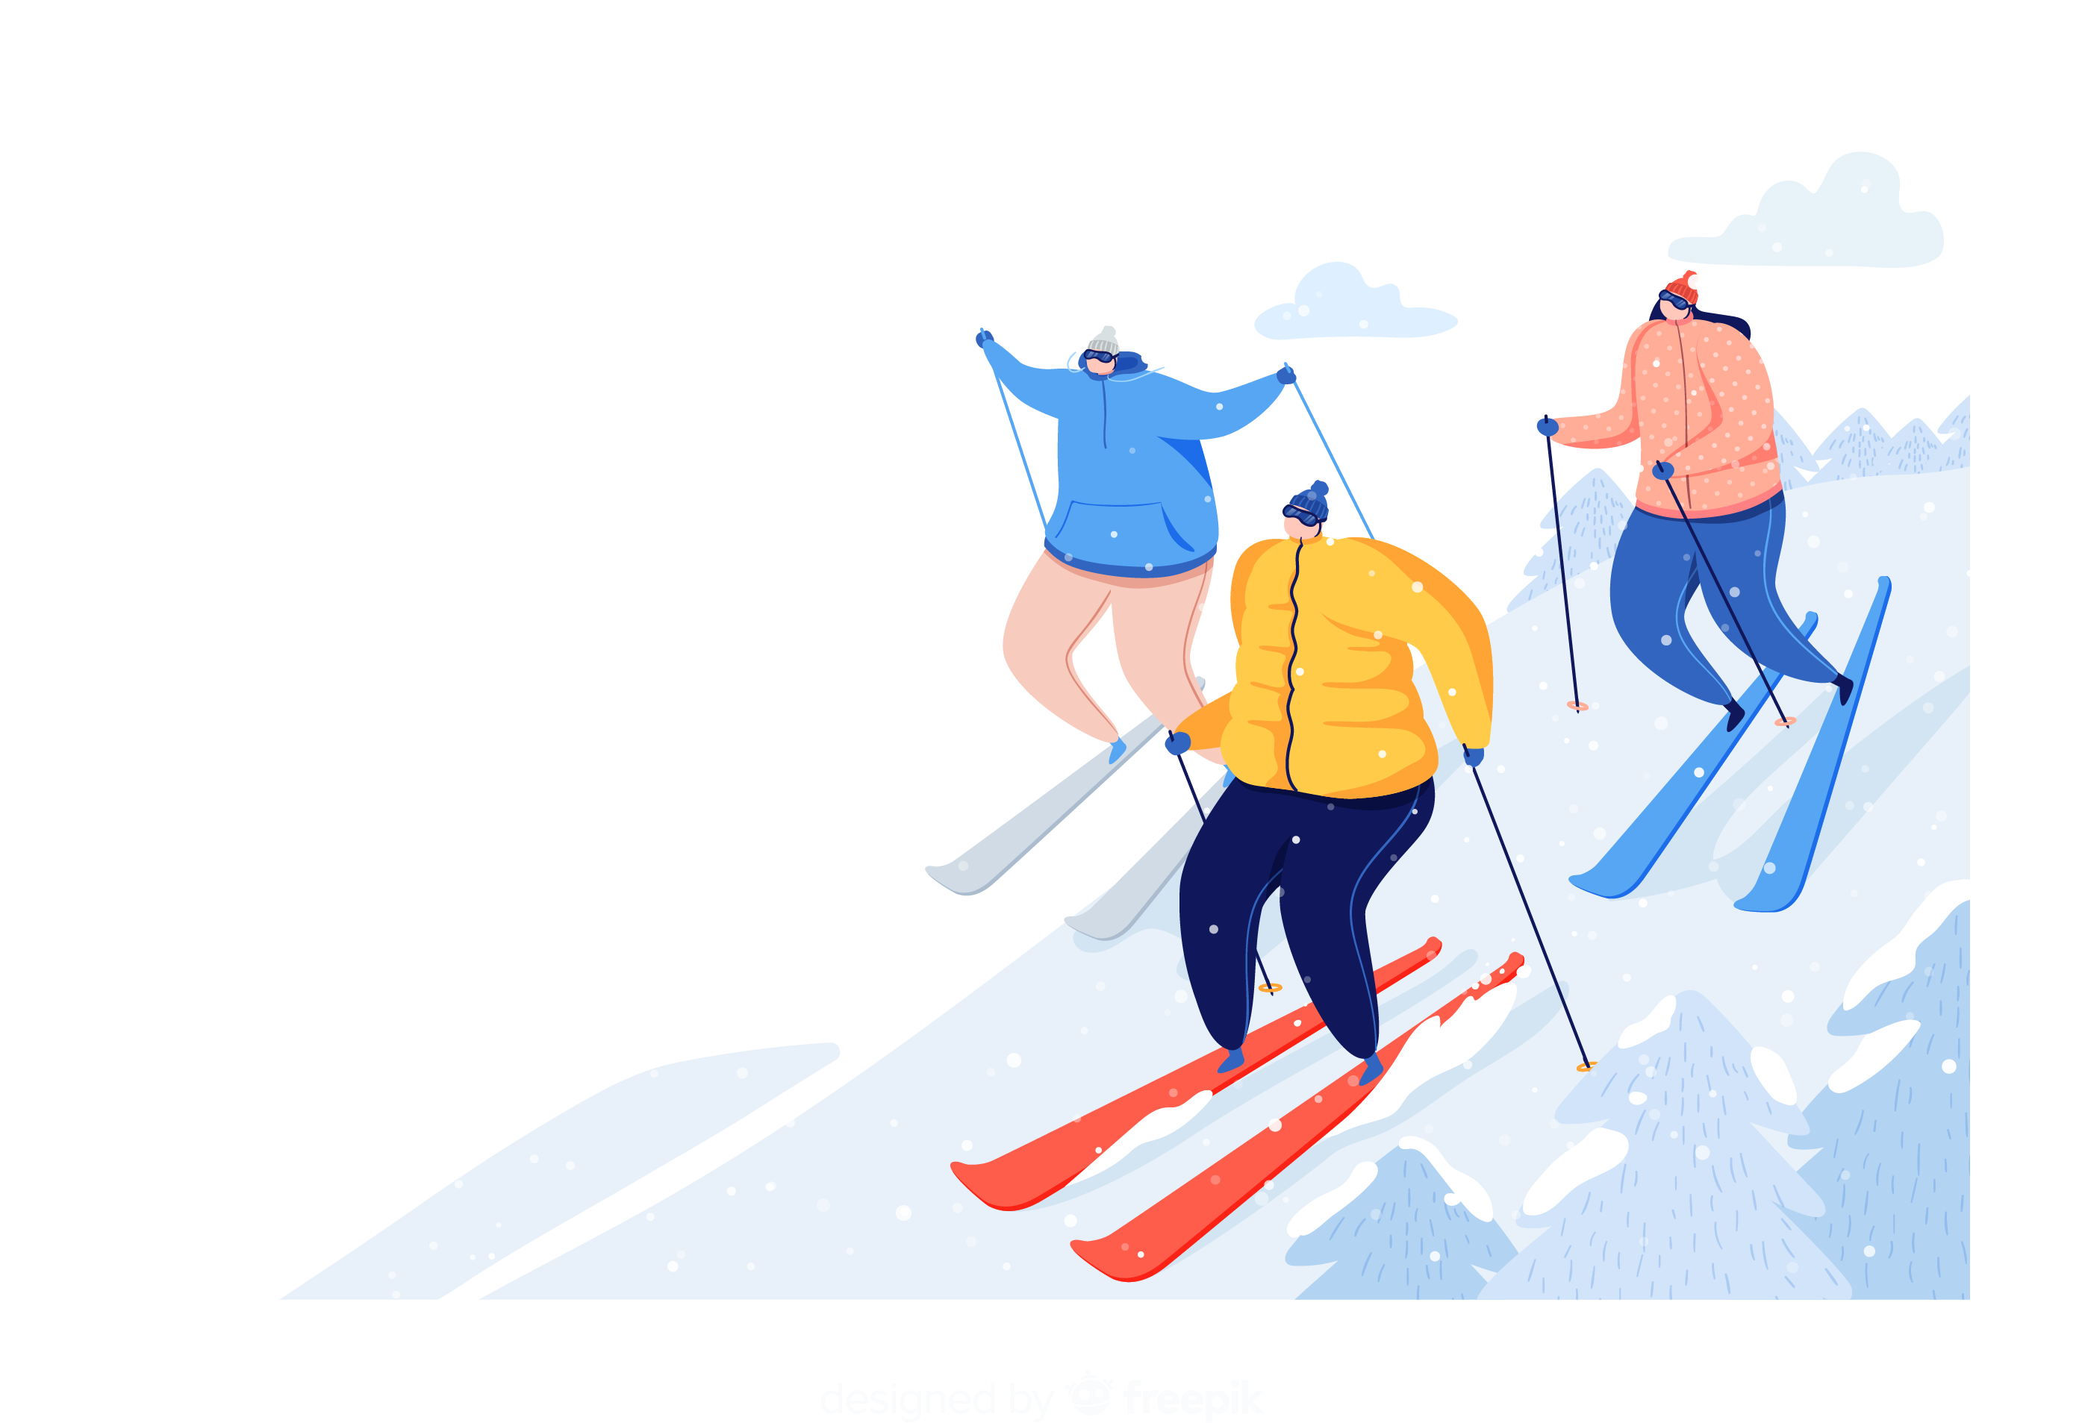
2026.02
What’s new during winter vacation?

Slide 3
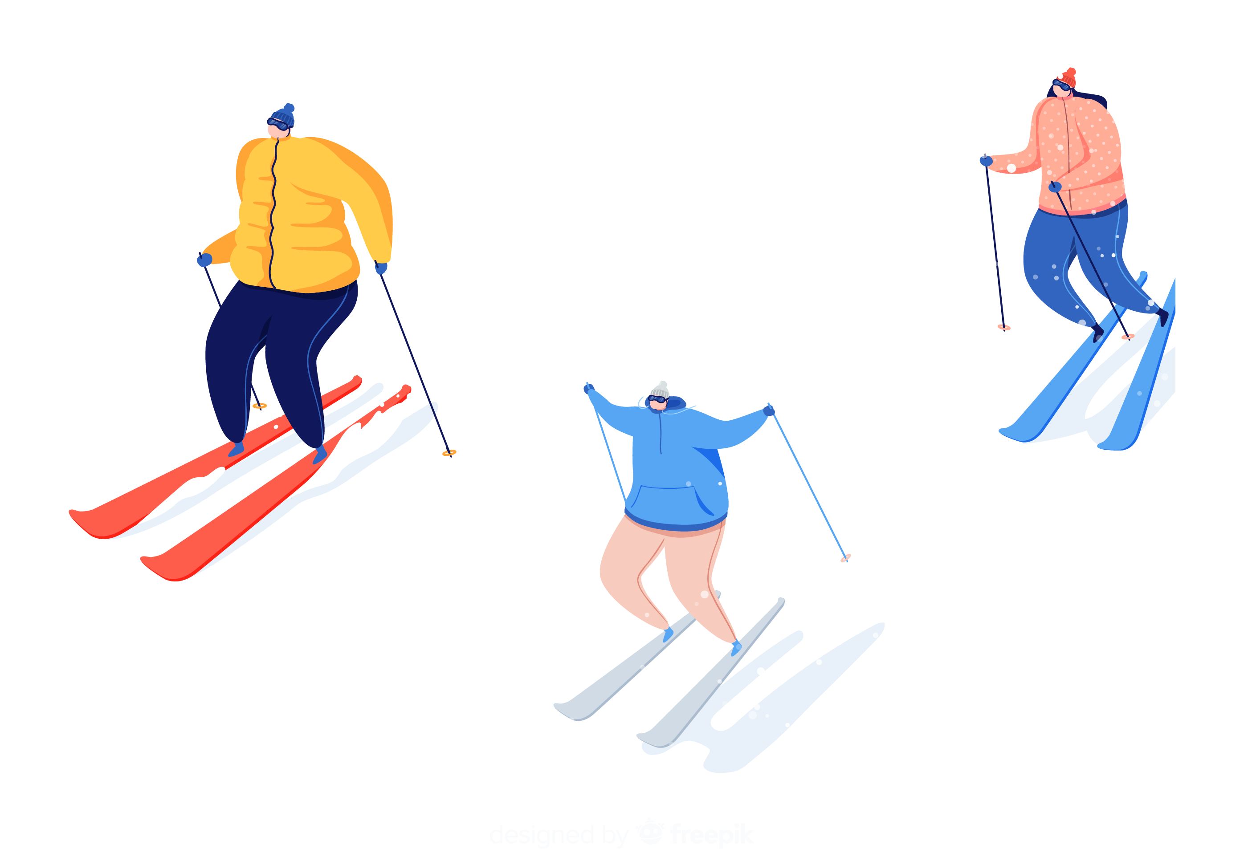

Part 01
第一部分
The Olympic Winter Games Milano Cortina 2026

Slide 4
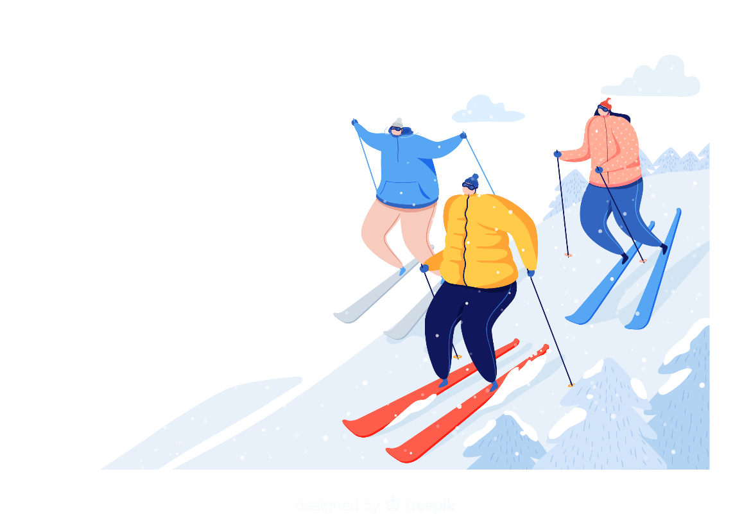

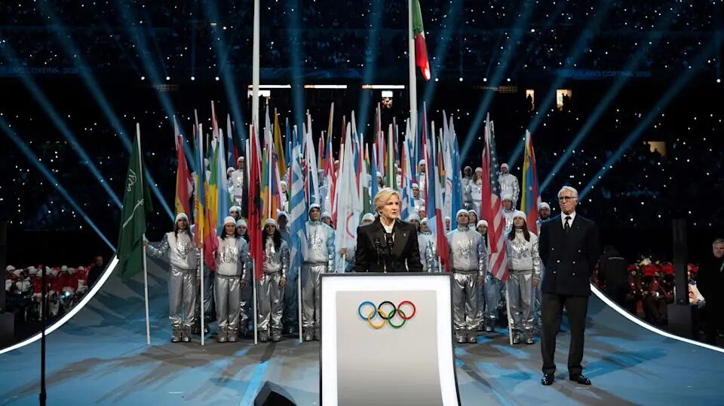
IOC President Kirsty Coventry delivered a speech at the opening ceremony of the 2026 Milan Cortina Winter Olympics.
Notes:
国际奥委会主席柯丝蒂·考文垂

Slide 5
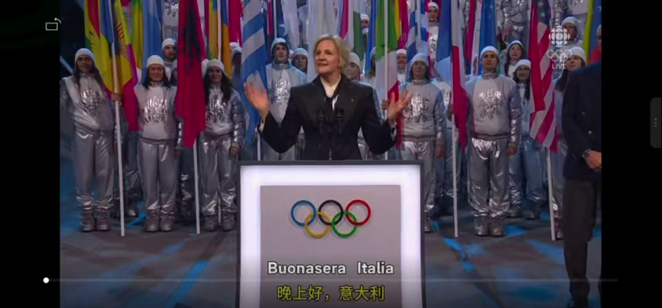

Slide 6
IOC President’s speech
Good evening, Italy!
Dear President of the Italian Republic, Your Excellency, Sergio Mattarella,
Dear President of the Milano Cortina 2026 Organising Committee, my dear colleague and friend, Giovanni Malagò,
Your Excellencies and distinguished guests,
Dear athletes,
To all of you and everyone who is watching: welcome to Milano Cortina 2026 Olympic Winter Games!
My fellow Olympians,
Whether you are here in Milano, in Cortina, Predazzo or Livigno: welcome to your Games.
This is your moment.
I know what it feels like – that mix of excitement and nerves. Your whole life of hard work, of early mornings, long days, sacrifices, setbacks – it all comes down to this. I know that feeling, when you realise – this is it. You’ve made it.
So first, be proud. Be proud of how far you’ve come. And now, take it all in. Enjoy it. Enjoy every second.
Over the next two weeks, you’re going to give us something truly special.

Slide 7
You’ll show us what it means to be human. To dream. To overcome. To respect one another. To care for each other.
You’ll show us that strength isn’t just about winning – it’s about courage, empathy and heart.
You will not only make incredible memories. You will reach your Olympic dreams – and you will show the world how to live.
This is why we all love the Olympic Games. Because through you, we see the very best of ourselves. You remind us that we can be brave. That we can be kind. And that we can get back up, no matter how hard we fall.
And to everyone watching, here in Italy and around the world – thank you for joining this moment. Thank you for believing in the magic of the Olympic Games.
When we see an athlete stumble and find the strength to rise, we are reminded that we can do the same.
When we see rivals embrace at the end of a finish line, we are reminded that we can choose respect.
When we see grace, courage and friendship – we remember the kind of people we all want to be.
The spirit of the Olympic Games is about so much more than sport. It is about us – and what makes us human.

Slide 8
剩余部分（可酌情使用）：
In Africa, where I’m from, we have a word: ubuntu. It means: I am because we are. That we can only rise by lifting others. That our strength comes from caring for each other.
No matter where you come from, we all know this spirit – it lives and breathes in every community.
I see this spirit most clearly at the Olympic Games. Here, athletes from every corner of our world compete fiercely – but also respect, support and inspire one another. They remind us that we are all connected, that our strength comes from how we treat each other, and that the best of humanity is found in courage, compassion and kindness.
So let these Games be a celebration of what unites us – of everything that makes us human.
This is the magic of the Olympic Games: inspiring us all to be the best that we can be – together.
Tonight, we are grateful to our gracious hosts, the Italian people, who set this spectacular Olympic stage with such passion and care.
To all the public authorities – and especially to the Italian government and its President – to the Organising Committee, and our Italian partners: your dedication, creativity and teamwork have brought us to the start line. And now together with our TOP Partners and Media Rights-Holders, we will spread the Olympic spirit around the world.

Slide 9
A very special shout-out to the wonderful volunteers! From the moment we arrived, you have made everyone feel so welcome. In the days ahead, your smiles and your energy will bring everything together – and bring the magic of the Games to life.
Thanks a million!
Since the Olympic flame was first lit, it has travelled across Italy – carried by thousands, celebrated by millions. Thank you to every torchbearer, and everyone who came out to cheer them on.
From north to south, east to west, the flame shines as a beacon of hope for all. Tonight, that flame will ignite the cauldron. Its light will shine for you, the athletes – and from you, it will spark inspiration across the world.
When I was an athlete, this was always my most favourite moment. Watching that flame light up in the night – that’s when I knew the Games were real. Now it’s your turn, my fellow Olympians. Now it’s your moment. It’s your Games.
We cannot wait to watch you, to cheer for you, to be inspired by you. To see your courage. Your strength. To see the best of humanity shine before the world.
Let your flame spark hope, let it ignite joy and light the way for all of us.
Grazie mille. Thank you.

Slide 10
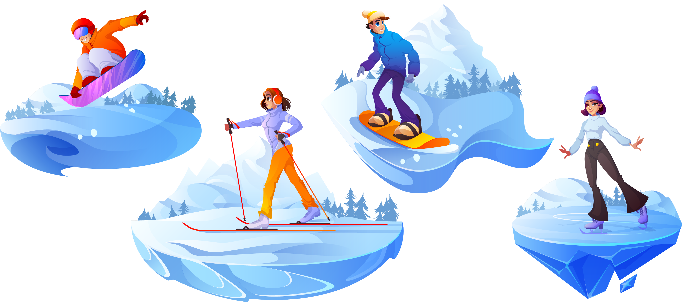

开幕词
Words
Milano /mɪˈlɑːnəʊ/ n. 米兰
Cortina /kɔːˈtiːnə/ n. 科尔蒂纳（意大利地名）
come down to 归根结底是、实质上是
get back up 重新振作
stumble v. 跌跌撞撞地走，蹒跚而行
a beacon of hope 希望的灯塔

Slide 11
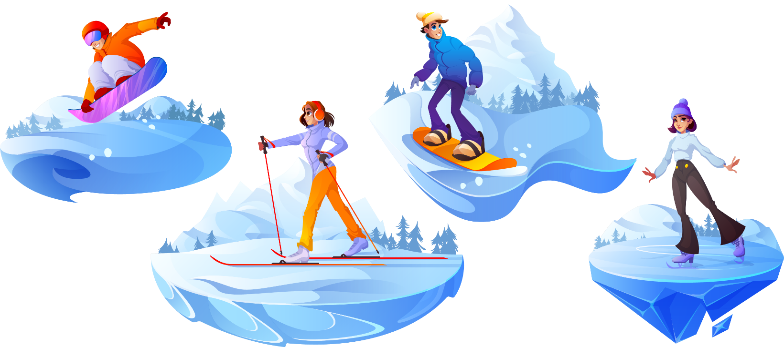
The Main Events 冰雪项目盘点
Ice Sports (冰上项目) 和 Snow Sports (雪上项目)
Figure Skating 花样滑冰 (花样滑冰不是运动，是流动的诗歌”)
Short Track Speed Skating 短道速滑
Speed Skating 大道速滑 (在超大的冰面“大道”上比拼绝对速度。)
Ice Hockey 冰球 (多变的滑冰技艺和敏捷娴熟的曲棍球技艺相结合)
Curling 冰壶 (被称为“冰上国际象棋 Chess on ice”)

Slide 12
The Main Events 冰雪项目大点兵
Alpine Skiing 高山滑雪(高山滑雪项目分为速度赛、技术赛和全能赛；速度赛包括滑降和超级大回转；技术赛包括回转和大回转；而全能赛则是速度与技术的综合比拼)
Freestyle Skiing 自由式滑雪(谷爱凌在女子U型场地技巧中大放异彩！)
Snowboarding 单板滑雪(苏翊鸣在本届冬奥会男子坡面障碍技巧赛获得金牌！)
Ski Jumping 跳台滑雪
Biathlon 冬季两项(越野滑雪 + 步枪射击，动静结合的极致考验。)
Notes:
/ˈæl.paɪn/高山的
/baɪˈæθ.lən/

Slide 13
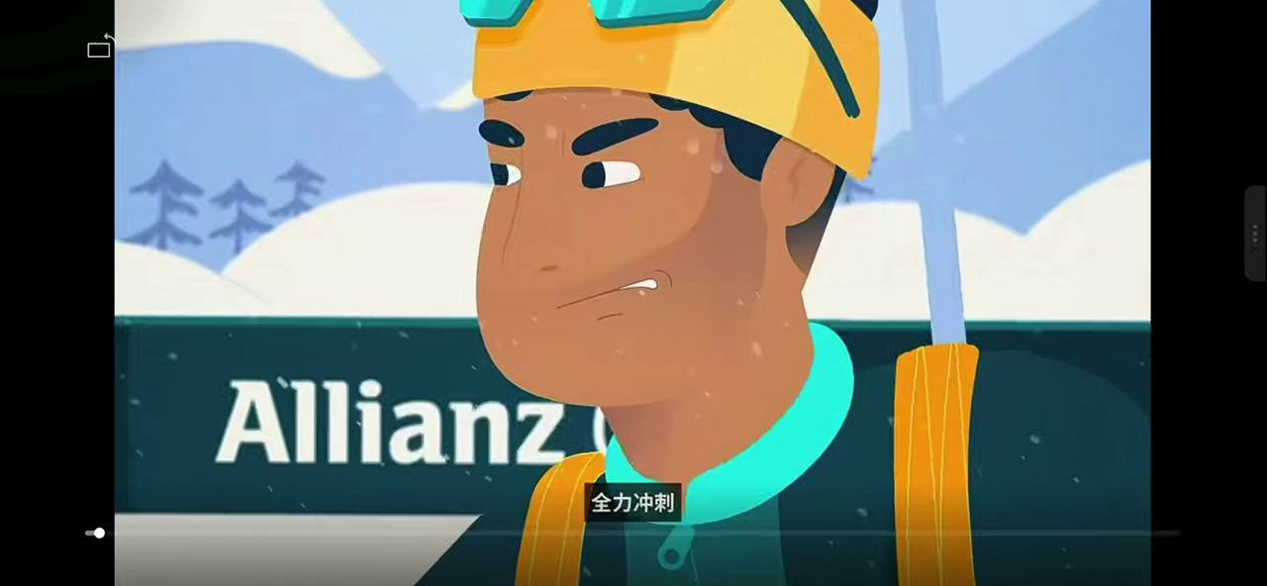
“冬季两项”（Biathlon）来源于拉丁语前缀“bi”和古希腊词“ἆθλον”（athlon），意为“竞赛”，指的是越野滑雪和步枪射击这两项运动的结合。在2026年米兰科尔蒂纳冬奥会上，冬季两项设置了11个项目的比赛。
Notes:
基本规则：冬季两项是越野滑雪和射击相结合的运动，比赛时运动员身背专用小口径步枪，脚穿滑雪板，手持滑雪杖，沿标记的滑道，按正确的方向和顺序滑完预定的全程。每滑行一段距离进行一次射击，如果射不中，将按不同小项规则受到增加时间或增加赛程的惩罚，最先到达终点者获胜。

Slide 14
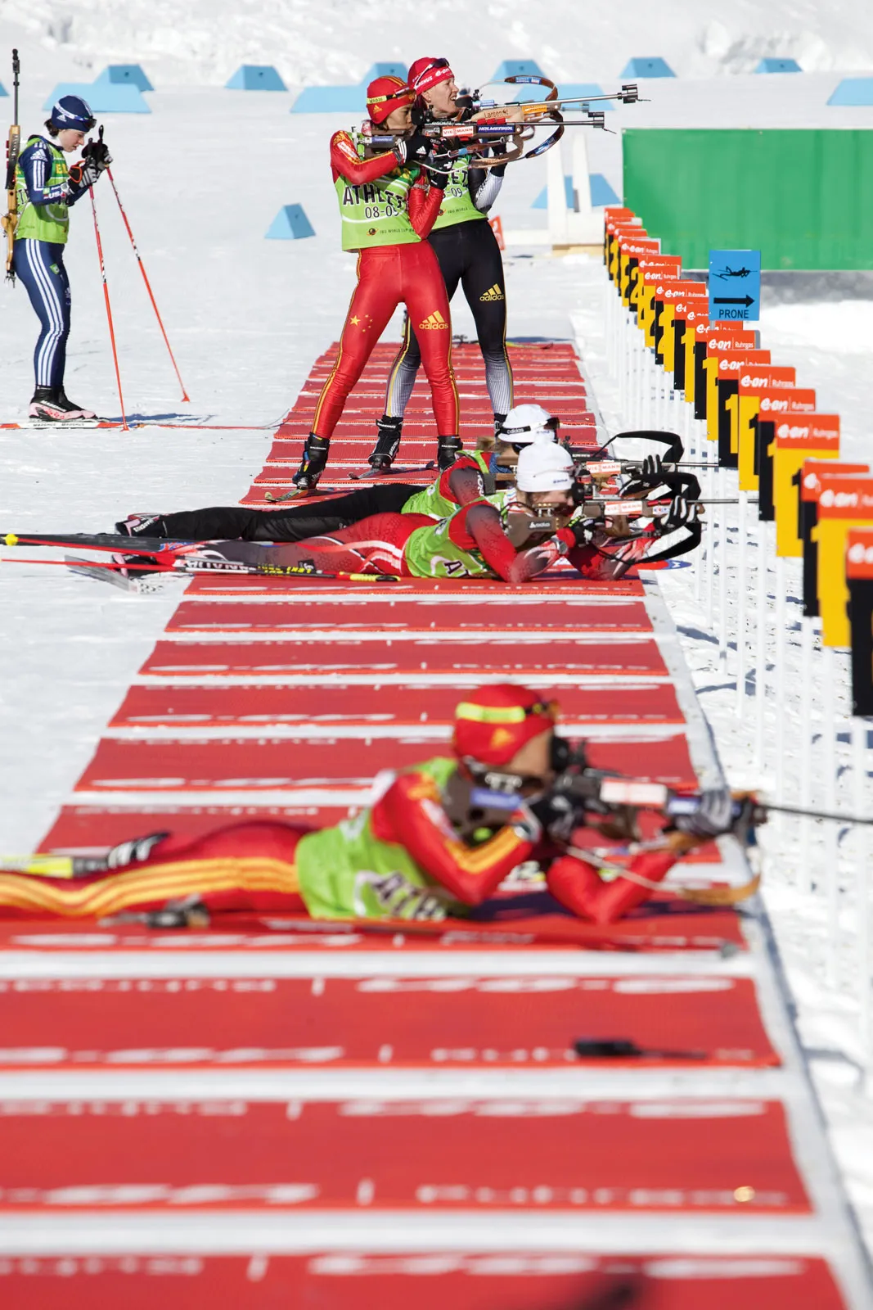
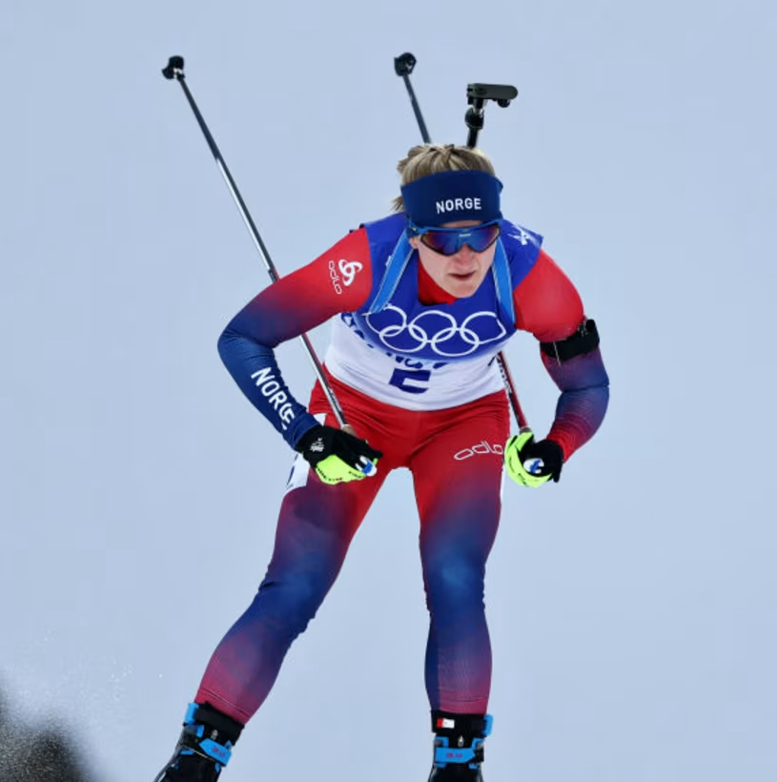

Slide 15
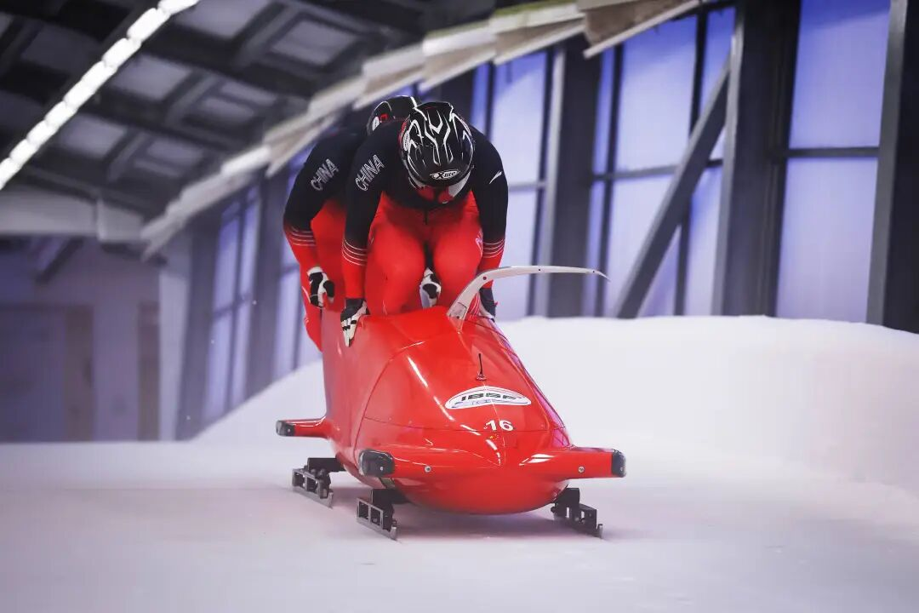
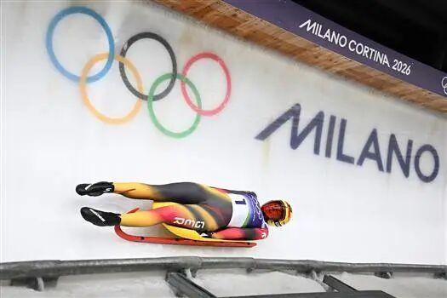
有舵雪橇（Bobsleigh）
无舵雪橇（Luge）
Notes:
/ˈbɒb.sleɪ/
/luːʒ/
运动员在赛道上快速滑行，看谁最先到达终点。到达终点时，运动员均须在座位上，否则成绩无效。但细节上有不少差别，有舵雪橇出发前距起点线15米，运动员需要在出发信号发出后手推雪橇奔跑起动，然后跃入座位，前座的人掌舵，最后座的人负责制动；无舵雪橇出发没有奔跑助推，运动员坐在雪橇上利用起点助栏发力起动，由于无舵，选手只能用身体姿势的改变来控制方向。

Slide 16
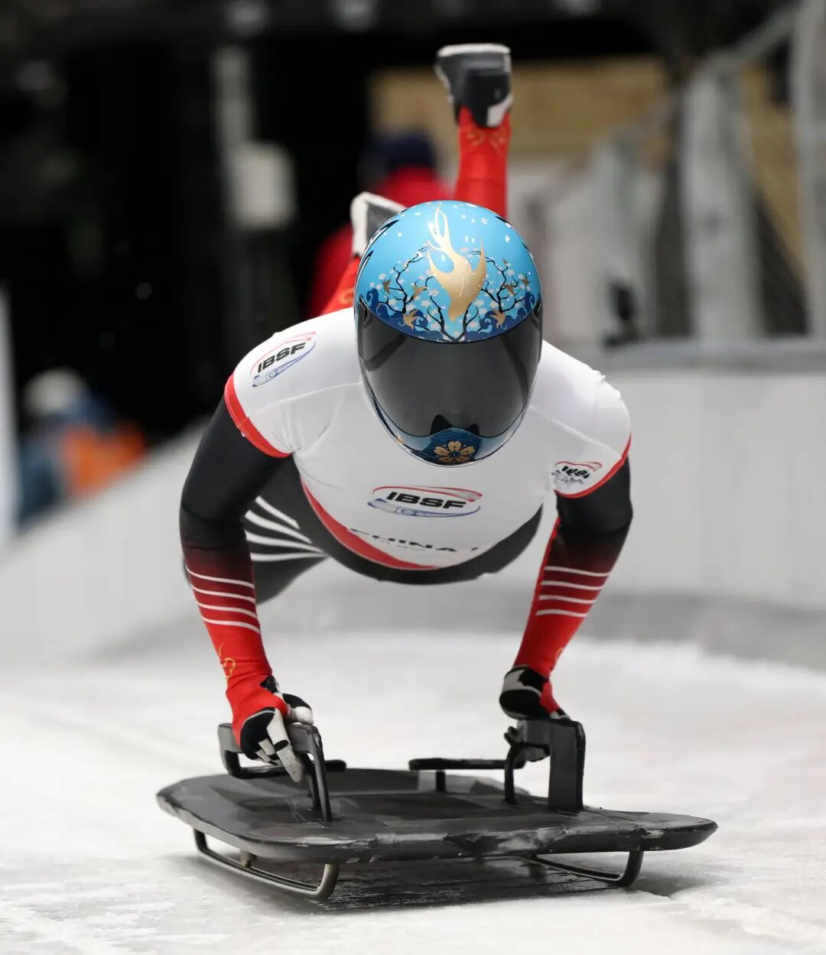
钢架雪车（Skeleton）
骨骼，骨架
We found an old sheep skeleton up on the cliffs.我们在悬崖上发现了一副老绵羊的骨架。
figurative Her long illness reduced her to a skeleton (= made her very thin).
长期的疾病使她瘦得只剩皮包骨头了。
skeleton in the/your closet
idiom
an embarrassing secret丑事，隐情
Most families have one or two skeletons in the closet.
大多数家庭都有一两件家丑。

Slide 17
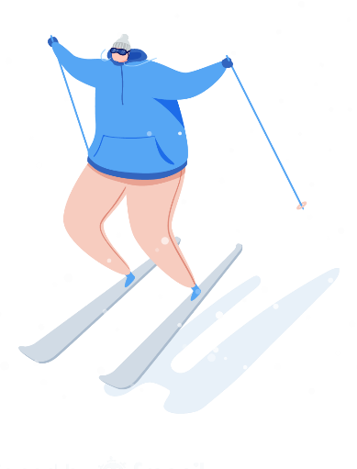
Commentary Buzzwords 解说员常挂嘴边的“行话”
Clean run / Clean skate
👉 完美表现，零失误
Example: "What a clean skate from the Japanese contender! Absolutely flawless."(日本选手的表现太完美了！毫无瑕疵。)
💡 在滑雪里叫 run，在滑冰里叫 skate。
Stick the landing
👉 （跳跃后）稳稳落地，站住了
Example: "He attempted a quad lutz and stuck the landing beautifully."(他尝试了一个四周跳，并且完美落地站稳了。)

Slide 18
Commentary Buzzwords 解说员常挂嘴边的“行话”
3. A Technical Masterpiece
👉 技术层面的杰作
Example: "His performance wasn't just artistic; it was a technical masterpiece."
4. The one to beat / Top contender (竞争者；争夺者）
👉 夺冠热门，最大的竞争对手Example: "Coming into Milano 2026, Team USA is definitely the one to beat in Ice Hockey."
5. Under Review
👉 （成绩/动作）正在回看审议中
Example: "The score is currently under review by the judges."(裁判们目前正在回看审议分数。)

Slide 19
Part 02
第二部分
iconic championship moments

Slide 20
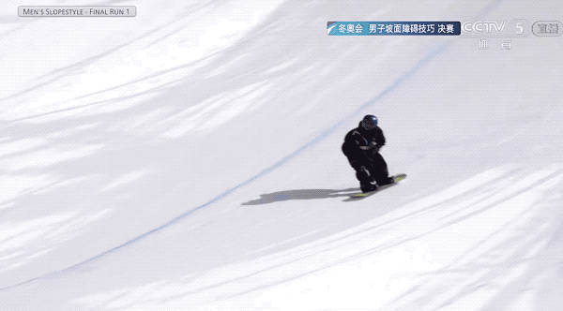

Slide 21
Birthday boy Su Yiming wins China's first gold of Winter Olympics
February 18, 2026 will forever be etched in the memory of Chinese snowboarder Su Yiming. On the day he turned 22, Su delivered a masterful performance in the men’s snowboard slopestyle final at the Milano-Cortina Winter Olympics, capturing the gold medal with a stunning first run score of 82.41 points. This victory not only marked his personal redemption (救赎) but also secured the first gold medal for the Chinese delegation at these Games.
Notes:
/ˌdel.ɪˈɡeɪ.ʃən/

Slide 22
Birthday boy Su Yiming wins China's first gold of Winter Olympics
The FIS President, Johannes Schenk, personally congratulated Su, calling him a “phenomenal athlete”. The organization celebrated the win as a milestone for Chinese skiing development.
国际雪联主席约翰·埃利亚施亲自祝贺苏，称他为“非凡的运动员”。该组织将这场胜利视为中国滑雪发展的一个里程碑。
非凡的，杰出的
Her rise to fame was quite phenomenal - in less than two years she was a household name.她的成名真是奇迹——不到两年的时间，她的大名已家喻户晓了。
Notes:
/fəˈnɒm.ɪ.nəl/ˈæθ.liːt/

Slide 23
Part 03
第三部分
Time for a little practice session!

Slide 24
China's 1. (celebrate) freestyle skiing aerials (aerial 空中的) team delivered fans a double delight by adding the delegation's second gold at Milano-Cortina 2026 after five-time Olympian Xu Mengtao successfully defended her women's title in Italy.
By landing a highly difficult trick to earn 112.90 points, Xu, the 2. (old) contender in the six-athlete final round at 35 years old, became the first skier in the Olympic history 3. (defend) a gold medal in the aerials event, 4. (edge) out Australia's Danielle Scott to second place on 102.17 points.
Three out of China's four qualifiers (入围者), also including Kong Fanyu and Chen Meiting, reached the final's first two rounds, 5. only the top six of all the 12 athletes advanced into the "super final" to decide the eventual medal winners.
"To others, it might seem simple to say, let's go another four years, let's do another Olympics. But to me, I had to go through countless 6. (jump) to just be able to stand here to compete. I'm proud of myself for being able to do that," Xu said before the super final.
China Daily
celebrated
oldest
having defended
edging
where
jumps
Notes:
https://www.chinadaily.com.cn/a/202602/18/WS6995bbcaa310d6866eb39922.html
celebrated /ˈeə.ri.əl/
oldest
have defended
edging
where
jumps

Slide 25
相关话题应用文：Pick one
1. 假定你是李华，你校英语报正围绕“冰雪运动热”举办征文比赛。请你写一篇短文投稿，内容包括：
1.你感兴趣的一项冰雪运动；
2.冰雪运动的好处。
2. 假定你是李华，寒假期间体验了滑雪。你的笔友Sam是一名运动爱好者，请你给他写一封信，分享这次经历，内容包括:
1.活动过程;
2.个人感受。
参考词汇：
Snowboarding单板滑雪
Skiing双板滑雪

Slide 26
参考范文一：
My Passion for Ice Skating
Among all the thrilling winter sports, ice skating is the one that fascinates me most. Gliding gracefully across the smooth and icy rink makes me feel as free as a bird. The cool wind on my face as I turn and spin is an amazing experience.
Taking part in ice skating offers great benefits. Firstly, it is a fantastic form of exercise. It strengthens my legs and improves my balance and coordination. Also, it helps me relax. After a long day of study, spending an hour on the ice washes away all my stress and leaves me feeling refreshed. It truly is a wonderful sport for both the body and the mind.

Slide 27
参考范文二：
Dear Sam,
How is everything going? I'm writing to share with you my exciting experience of trying skiing during the winter vacation.
When I first put on the heavy skis and boots, I could hardly walk! Standing at the top of the beginner's slope, my heart beat fast with both nervousness and excitement. Following the instructor's guidance, I leaned forward and pushed myself down. The cold wind rushed past my face as I glided down the slope. I fell many times, but each time I got up and tried again. Gradually, I began to control my speed and direction, and the feeling was simply amazing!
This experience taught me that skiing is not just about speed. It requires courage to take the first step and perseverance to get up after every fall. Most importantly, the sense of achievement when I finally made it to the bottom smoothly was beyond words.
Have you ever tried any winter sports? I'd love to hear about your experiences!
Best wishes,
Li Hua

Slide 28
相关话题读后续写（2025浙东北县域名校联盟）
I gazed down the frightening snow-covered slope, my heart beating wildly. The accident that took my leg two years ago replayed in my mind, a memory I couldn’t escape. But with my prosthetic leg (假肢) and persistent training, I was determined to return to the slopes.
It was my final training session before the competition. As I practiced the difficult jump, the world went black as I crashed headfirst into the densely packed snow. I rolled down the slope like a man trapped in a washing machine, unable to break free from the tossing and flipping. When I finally stopped, I found my prosthetic leg had been forced out of its place.
“I can’t do this!” I yelled, hammering my leg back into place. I freed myself from the snowboard and struggled to my feet. “Another round?” my coach asked with a soft laugh. He rested his arm on my shoulder as if to comfort me after his teasing. We both stared at the towering slope ahead. Failure loomed over me like a dark cloud — it had beaten me too many times before.
“I can’t handle the landing. This leg drags me down. How am I supposed to compete tomorrow?” I slammed my leg repeatedly with bitterness as tears welled up in my eyes. Every time I fell, I forced myself to get back on my feet so that I could snowboard again, but I had tricked myself into believing that I could return to being a professional snowboarder.
“Just remember: dig your heels in, bend your knees, and keep your arms up. Three steps to the gold medal.” My coach looked me straight in the eyes, his voice firm yet warm. “It’s not your leg holding you back. You’re using it as an excuse.” His words trailing off like droplets of water forming dotted indents in the snow — disappearing into the snow forever but leaving their marks behind.
Paragraph 1: The fateful day finally arrived.
Paragraph 2: The crowd erupted, cheers filling the air.

Slide 29
参考范文：
Para1. The fateful day finally arrived. The slope stretched before me, sharp and endless, the sunlight cutting across the snow like a blade. My heart thudded painfully against my ribs, and for a fleeting moment, I wished I could turn back time—to before the accident, before the fear. Then I heard my coach’s words echo in the cold air: “It’s not your leg holding you back.” I pressed my glove to the metal limb, feeling its chill merge with my own. “No excuses,” I whispered. I pushed off. The board sliced through the snow, the world rushing by in flashes of white and blue. As the ramp loomed closer, I bent my knees and jumped. For one suspended heartbeat, I wasn’t broken—I was flying. When I landed, the shock rippled through my body, but I didn’t fall. My leg held. My heart steadied.
Para2. The crowd erupted, cheers filling the air. My coach waved his arms wildly, snow swirling around him like confetti. I stood still for a moment, staring at the mountain I had feared for two long years. My prosthetic leg, half-buried in frost, glimmered like polished silver. For the first time, I didn’t see it as a weight—but as the proof that I had fought my way back. I raised my board, laughter breaking through the trembling in my chest. The wind roared past, carrying the sound of applause, and somewhere within it, I heard my own voice whisper, “You did it.”The medal could wait. The victory was already mine—the kind that shines quietly beneath the snow.

