Slide 1


感恩遇见，相互成就，本课件资料仅供您个人参考、教学使用，严禁自行在网络传播，违者依知识产权法追究法律责任。
更多教学资源请关注
公众号：溯恩英语
知识产权声明

Slide 2

2026年1月浙江省首考英语试卷
客观题部分讲评
姜建军

Slide 3
听力部分
1-5 CBCBA 6-10 ACACA
11-15 ABABC 16-20 BABCB

Slide 4
典型试题分析
Text 2. pack... with.... to fill sth. with a lot of people or things 塞进；挤进
be packed with...=be crowded/filled with...
Text 5
M: I’d like to summarize what it is we’re looking for.
W: Good.
M: Basically, we want the printing cost to come down by 15%.
W: Well, it’s really hard for us to offer such a price cut.
礼貌开场，用于正式谈判中提出总结需求。
=
Basically 用于软化语气，引出核心要求
A. negotiate v. /nɪˈɡəʊʃieɪt/ to try to reach an agreement by formal discussion谈判
deal n. an agreement, especially in business, on particular conditions for
buying or doing sth 协议；（尤指）交易
negotiate a deal 洽谈生意

Slide 5
Text 6
W: Happy New Year, Mike.
M: Happy New Year.
W: Have you made any resolutions?
M: I’d like to eat less and exercise more this year. Three hamburgers a day is probably not a good idea.
W: Yeah. Many people hope to be healthier in the New Year. You always see a lot of people start joining gyms. I heard some kind of statistic that gyms are always 50% more crowded in the month of January. And then usually by February, it’s back to normal. (7)
M: It’s so true. It’s always difficult to keep up the workout routine.
/ˌrezəˈluːʃn/ n. a definite decision to do or not to do something 决心；决定
enthusiasm is short-lived

Slide 6
Text 7
M: Fenny, if you’re up in London tomorrow, I’ve got two tickets for the American Ballet Theatre. Would you like to come?
W: Thanks, but I’ll be busy tomorrow.
M: No problem. Maybe another time. Do you have plans?
W: Yes. I’ll meet Katie at the Olympia Exhibition Centre. Remember her? We went to the same art school. Some of her designs are going to be exhibited there. She’s hoping one of the big clothes companies might buy them.
M: Setting her sights high, isn’t she?
W: Yeah, she is aiming high, but she has what it takes to get there.
她具备实现目标的能力 / 条件。
志向远大=ambitious

Slide 7
Text 8
W: People are increasingly concerned about online security, and many experts are now offering advice on how to use smartphones safely.
M: What advice?
W: Let me ask you first, how long have you kept your phone on so far?
M: For over a year now. It’s not that I’m addicted to it or have important calls, but I need the alarm to wake me up every morning.
W: Yeah, but that’s where the risk is. According to experts, we should switch our phones off and on once a day as a security measure. It helps close the applications running in the background and stop data collection processes we’re not aware of.
M: Sounds reasonable. Do we switch the phone off and switch it back on immediately?
W: Well, better wait for a few minutes.
M: When do you usually do that?
W: I do it every night before going to bed.
Data security

Slide 8
Text 9
W: Welcome to History of the English Language. Since the class is quite small, I plan to run this course as a discussion. I hope everyone will be fully engaged and volunteer to share your knowledge and opinions. I won’t take attendance, but since part of your grade depends on participation, I encourage you to come to class.
M: Professor Moore?
W: Yes.
M: Could you tell us more about the assessment of the course?
W: Certainly. In addition to your participation in class, which accounts for 10%, there will be a midterm test, 20%, a final exam, 30%, and a research paper, 40%. Any questions?
M: Do we have any reading assignments?
W: Yes, I believe you’ve all got your textbook. You have to finish reading assigned chapters before each class. Apart from that, there’s a list of books that you’re required to read. Now let’s have a close look at it.
14. expect students to take an active part in discussions
to check who is present and who is not present at a place and to mark this information on a list of names 点名
15. carry weight:
to have influence with sb.
重要性；影响力；实力
go through

Slide 9
Text 10
W: Hello everybody. Thanks for your consistent support for our weekly meeting, New Books Sharing. Today, we’ve invited Dr. Caspar Melville, (18) (19) (20) lecturer from the University of London. Dr. Melville started out as a music journalist for a black music magazine called Blues & Soul. In 1992, he moved to San Francisco and founded a jazz magazine named On the One with some friends. They did a really good job, though there was not a lot of money in it. In 1997, he moved back to London and started teaching, and made the decision to find another way to write about music. He grew up in London. He feels that the music in London clubs has formed him, but unfortunately, it has been seriously undervalued by the academic world. In black music studies, jazz has received great attention, but dance music has been largely ignored. His book, It’s a London Thing, is meant to change that situation. So, let’s welcome Dr. Melville to share with us his ideas in the book.
17. present v. to introduce somebody formally, especially to somebody of higher rank or status正式介绍；引见
20.promote the study of black dance music

Slide 10
阅读理解
21. D 22. B 23. A 24. B 25. D
26. C 27. A 28. A 29. D 30. B
31. D 32. A 33. B 34. C 35. C
36. B 37. E 38. C 39. F 40. G

Slide 11

A篇---艺术作品征集
21. What is the purpose of this text?
A. To raise money for local artists.
B. To release a collection of artworks.
C. To introduce a cultural festival.
D. To call for artworks for a project.
【分析】这是一则征稿启事，属于advertisment文体。广告类的文章旨在说服读者购买产品、服务或者参加某项活动。
本文的主要目的是为一个艺术项目征集作品。
Para 1 The city of Burlington public art program is presenting a series of temporary public art signs at the Beachway in conjunction with the Ontario Culture Days. This project will select 10 visual artists and 10 writers to create artworks that will be displayed on temporary signs along the multi-use path. This call is open to Burlington-based artists and is open to all art forms that can be presented in a sign format. This includes, but is no limited to: visual art, graphic art, photography, poetry, short story, non-fiction, etc. Submissions may be from existing or newly created work.
平面艺术

Slide 12
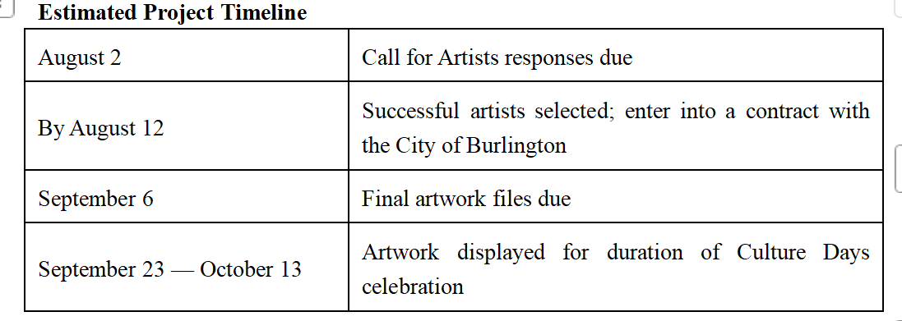
22. How long will the public art signs be on display?
A. Ten days. B. Three weeks.
C. One month. D. Two months.
到期

Slide 13
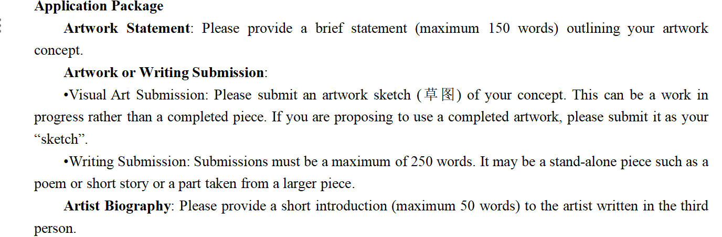
23. Which of the following meets the application requirements?
A. A 150-word poem. B. A 100-word self-introduction.
C. A 300-word story. D. A 200-word artwork statement.

Slide 14
B篇--教师以趣促学
24. What poses a challenge to teachers according to the author?
A. Students’ misunderstandings about teachers.
B. Students’ false assumptions about learning.
C. The irrelevance of textbooks to students’ life.
D. The gap between teachers’ and students’ hobbies.
v. to create a threat, problem, etc. that has to be dealt with
造成（威胁、问题等）；引起；产生
Para 1 When you’re a teacher, a big part of your job is battling student misconceptions. Often students come to the classroom believing that learning can’t be fun and that what they learn isn’t relevant to the real world — much less to their personal interests. I’ve discovered that if I show students how what they learn is relevant to my hobbies, they’re much more willing to make connections to their personal interests and develop their own hobbies.
misconception : n. a belief or an idea that is not based on correct information, or that is not understood by people 错误认识；误解

Slide 15
25. Why does the author bring tires into the classroom?
A. To teach an engineering skill.
B. To explain the strucutre of a car.
C. To share a real-life experience.
D. To illustrate a scientific concept.
/ˈfrɪkʃn/ n. 摩擦力
abstract
Para 2: No matter what subject I’m teaching, I find ways to bring my hobbies into the classroom. For example, I’m a car enthusiast , so when I teach physics, contextualize concepts with my knowledge about cars. If we’re covering friction, for example, I bring different tires into my classroom so that my students can conduct lab experients with them to see how friction works in real-life applications.
concrete

Slide 16
26. What was the unexpected outcome of the author’s teaching method?
A. A higher class attendance rate. B. Better examination results.
C. A closer teacher-student bond. D. More spare time for students.
Para 3: When I first brought my hobbies to my classroom, I was focused on how doing so would build engagement and help my students udnerstand concepts in science. But I quickly learned that the practice also helped me build stronger relationship with them. When I let them see an aspect of my life outside of school, some students who were also interested in cars connected with me more and became more engaged in my courses. Even those who didn’t share that interest with me seemed more engaged once I showed a different side of myself.

Slide 17
27. Which of the following best describes the author as a teacher?
A. Innovative. B. Humorous C. Decisive D. Sympathetic.
【分析】通过全文可知，作者通过带轮胎进教室实验等新颖的方式激发学生的兴趣，将抽象概念具体化的教学风格体现了作者是一位具有创新精神(innovative)的教师。
Para 1
Para 2
Para 3
Para 4
student misconception (错误认识)
My idea --relevant what they learn to my hobbies
/dɪˈsaɪsɪv/ adj. able to decide sth quickly and with confidence
坚决的；果断的
One example showing how I brought my hobbies into the classroom. -- I find ways...
I learned-- build stronger relationship with them
an experiment-- a philosophy;
the result: energizes my instruction, engages my students, demonstrate abstract concepts play out (happen) in the real world

Slide 18
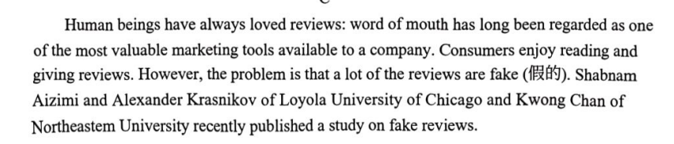
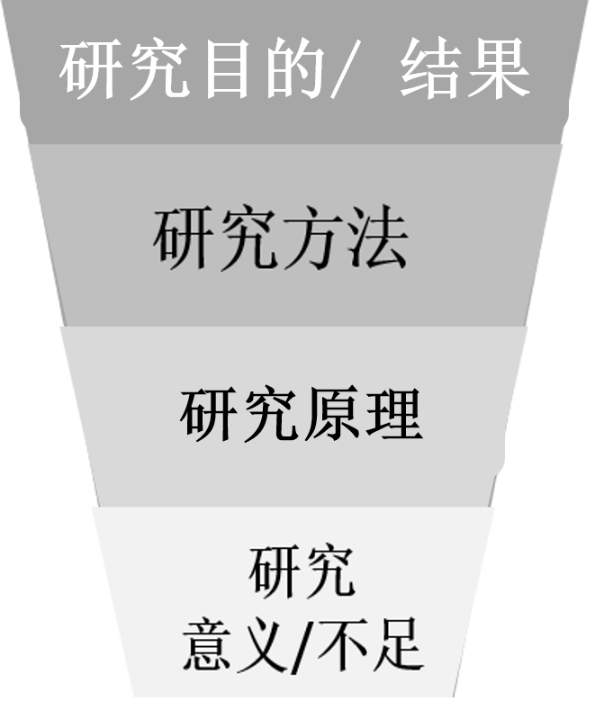
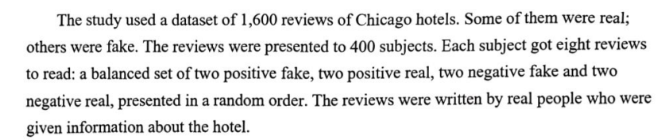
C篇--真伪消费评价
28. Which aspect of the study does paragraph 2 mainly talk about?
A. Its design. B. Its findings. C. Its purposes. D. Its significance.

Slide 19
29. What does the underlined word “glowing” in paragraph 4 mean?
A. Funny B. Abusive C. Insightful D. Praising
When it came to faking a review, length was important to believability, as was detail. A long, negative review of a hotel, complete with lots of information, tended to convince participants. A lengthy, positive review, on the other hand, was regarded as suspicious, and participants tended to trust writers that kept their glowing reviews short. Emotion was also important in convincing readers --or the lack of emotion, at least. Azimi says study perticipants tended not to trust reviews where the writers expressed thier feelings in a big way. the more dispassionate that negative write-up, the more likely it was to take the reader in.
key word
contrast
adj. giving enthusiastic praise
热烈赞扬的；热情洋溢的
adj. rude and offensive; criticizing rudely and unfairly 辱骂的；恶语的；毁谤的

Slide 20
30. What kind of review would readers most likely trust?
A. A long, positive one. B. An unemotional, negative one.
C. A short, negative one. D. An enthusiastic, positive one.
Para 4: When it came to faking a review, length was important to believability, as was detail. .... Emotion was also important in convincing readers --or the lack of emotion, at least. Azimi says study perticipants tended not to trust reviews where the writers expressed thier feelings in a big way. the more dispassionate that negative write-up, the more likely it was to take the reader in.
the more,... the more...越来越...
n. an article in a newspaper or magazine in which sb. writes what they think about a new book, play, product, etc.（报刊上的）评论，评述，评介
take sb in: to make somebody believe sth. that is not true
欺骗；蒙骗

Slide 21
31. What can be inferred from the last paragraph?
A. Many companies are producig fake reviews.
B. Writing fake reviews will be delcared illegal.
C. Machines can detect fake reviews accurately.
D. It will be harder to recognize fake reviews.
首段引出主题(吸引读者)/尾段总结全文
Last para: The fake reviews written for Azimi’s study were put together by humans, but increasingly, fake reviews are being written by AI, which makes them look more real. Though many companies use algorithms to weed out fake reviews, Azimi points out that the machines are programmed by humans, and given our limited ability to spot fake reviews, this isn’t a good sign.
Conclusion 结论
【分析】本段是文章的结论部分。given our limited ability to spot fake
reviews, this isn’t a good sign. 由于能力有限，对于如何辨识虚假
评论Azimi持消极态度。

Slide 22
D篇--植物碳封存
32. What do the scientists at Salk Institute hope to achieve?
A. Keeping more carbon in plants.
B. Optimize the use of energy.
C. Enhancing biological diversity.
D. Reducing carbon absorption.
/djuˈreɪʃn/ n.
the length of time that sth lasts or continues 持续时间；期间
Para 1 Carbon removal is crucial for fighting climate change. Scientists at Salk Institue are making use of the natural capacity of plants to absorb carbon dioxide by enhancing their root systems. This optimization aims to increase the amount of carbon stored and extend the duration of its storage.
【分析】文章围绕“如何去碳以应对气候变化”这一问题，介绍索尔克生物研究所“运用AI增加植物碳封存”的方案，首段介绍了本研究需要达成的结果： “aims to increase the amount of carbon stored “，A选项采用了换说的方式来表示这一研究目的。

Slide 23
33. Why did Pereira create SLEAP?
A. To generate plant images. B. To conduct research on animals.
C. To study climate patterns. D. To track features of root growth.
Para 2: To design these climate-saving plants, the scientists are using a research tool called SLEAP---an AI software that tracks multiple features of root growth. Created by Salk Fellow Talmo Pereira, SLEAP was initially designed to track animal movement in the lab. Now, Pereira has teamd up with plant scientist Professor Wolfgang Busch to apply SLEAP to plants.

Slide 24
34. What will SLEAP help the scientists do?
A. Pick out diseased plants in the forest.
B. Collect samples of plant root systems.
C. Identify genes for desirable plant roots.
D. Preserve the genes of endangered plants.
Para 4: The application of SLEAP to plants has already enabled researchers to establish the most extensive catalog (目录) of plant root phenotypes to date. What’s more, tracking these physical root system characteristics helps scientists find genes (基因) associated with those characteristics, as well as whether multiple root characteristics are determined by the same genes or independentity. This allows the Salk team to determine what genes are most beneficial to their plant designs.

Slide 25
/ˌɪntədɪsəˈplɪnəri/跨学科的 adj.
35. What can be inferred from Pereira’s words?
A. Academic discipline are of equal importance.
B. Computer programing is a must for scientists.
C. Interdisciplinary approach promotes creativity.
D. Cooperation outweighs competition in research.
The last para: Our cooperation is truly proof of what makes Salk science so special and impactful, says Pereira. “We’re not just ‘borrowing’ from different disciplines--- we’re really putting them on equal footing in order to create something greater than the sum of its parts. ”
Aristotle:
1) The whole is greater than the sum of its parts.
2) ...is greater/more/bigger than the sum of its parts.
整体大于部分之和
n. an area of knowledge; a subject that people study or are taught, especially in a university
知识领域；（尤指大学的）学科，科目

Slide 26
七选五--回读现象探究
A. Both are to blame.
B. Probably the latter is true.
C. Don’t just read the words, think
the idea.
D. Spend a few minutes reading the
material aloud.
E. Your eyes were engaged, but you
mind was not.
F. Then, start denying yourself the
right in order to break the habit.
G. Rereading because you did not
understand is a reasonable fix-up
strategy.
During your initial reading of material, do you ever go back and reread sentences or paragraphs? Is it because the material is too difficult to comprehend on the first reading or because you are asleep? 36 You are napping (打盹) or daydreaming. Halfway down the page you realize that you have no idea what you have read. ____37____ Thus, you go back and reread, not because you did not understand, but because you were not paying attention. This type of rereading is called regression.
过渡句

Slide 27
因果关系
During your initial reading of material, do you ever go back and reread sentences or paragraphs? Is it because the material is too difficult to comprehend on the first reaing or because you are asleep? 36 You are napping(打盹) or daydreaming. Halfway down the page you realize that you have no idea what you have read. 37 Thus, you go back and reread, not because you did not understand, but because you were not paying attention. This type of rereading is called regression.
A. Both are to blame.
B. Probably the latter is true.
C. Don’t just read the words, think
the idea.
D. Spend a few minutes reading the
material aloud.
E. Your eyes were engaged, but you
mind was not.
F. Then, start denying yourself the
right in order to break the habit.
G. Rereading because you did not
understand is a reasonable fix-up
strategy.
【分析】 Thus 说明前后文具有因果关系，根据后文的but because you were not paying attention.推断出前文内容是 “Your eyes were engaged, but your mind was not.”

Slide 28
先后关系
Regression is crutch (拐杖) that allows you to make up for wasted time. First of all, become aware of when and why you are regressing. 39 Say, “OK. I missed that paragraph because I was thinking of something else, but I’m going to keep on going and start paying close attention.”
A. Both are to blame.
B. Probably the latter is true.
C. Don’t just read the words, think
the idea.
D. Spend a few minutes reading the
material aloud.
E. Your eyes were engaged, but you
mind was not.
F. Then, start denying yourself the
right in order to break the habit.
G. Rereading because you did not
understand is a reasonable fix-up
strategy.
表示过程
v. to refuse to allow sb to have sth that they want or ask for
拒绝给予

Slide 29
对比关系
A. Both are to blame.
B. Probably the latter is true.
C. Don’t just read the words, think
the idea.
D. Spend a few minutes reading the
material aloud.
E. Your eyes were engaged, but you
mind was not.
F. Then, start denying yourself the
right in order to break the habit.
G. Rereading because you did not
understand is a reasonable fix-up
strategy.
40 Good readers who monitor their own comprehension use it in the reading process. However, regressing because your mind was asleep is a waste of time.
【分析】语篇标志词However，说明前后意义相反，后文的a waste of time 表示消极含义，前文就应该是积极含义的reasonable fix-up strategy.

Slide 30
完形填空--返乡发展农旅
41. D 42. A 43. C 44. C 45. B 46. B 47. A 48. B 49. D 50. B 51. D 52. A 53. B 54. C 55. D

Slide 31
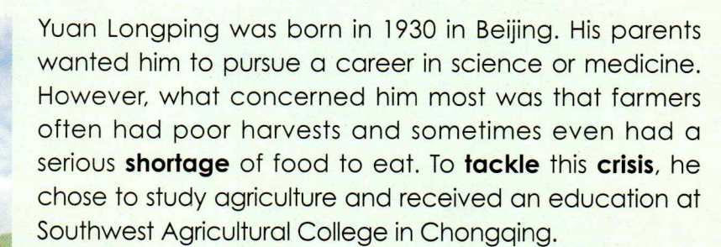
42. pursue a career 从事某项职业
B4U5 Reading and thinking
Pioneer For All People P 50
46. gain around: to become more powerful or successful
变得更强大（或更有成效、更成功）
take root: (of an idea思想) to become accepted widely 植根；深入人心
work wonders: to achieve very good results 创造奇迹,产生良好的效果
raise concers： 引起关注

Slide 32
50. Admittedly, I had little confidence in the beginning.
used, especially at the beginning of a sentence, when you are accepting that something is true
（尤用于句首）诚然，无可否认
supposedly adv. according to what is generally thought or believed but not known for certain据信；据传；据说
成名，名声大振
51. but the Sunflower Farm rose to fame and has become one of the most sought-after 51 in the province.”
adj. wanted by many people, because it is of very good quality or difficult to get or to find 争相获得的；广受欢迎的
destination n. 目的地
occupation n. a job or profession工作；职业
solution n. 解决办法；处理手段
institution n. 机构

Slide 33
While many visitors have never been to a farm at all, 52 a sunflower farm, the unique setting allows them to 53 the city for a while, breathe in the fresh air, gain a newfound 54 for agriculture, and maybe even 55 with their farming roots and what they may have taken for granted for too long.
appreciation
reconnect
52. let alone: used after a statement to emphasize that because the first thing is not true or possible, the next thing cannot be true or possible either 更不用说
注意本段（就一个长句）的展开方式：从外在的感受到内在的欣赏，再到精神回归与价值反思，层层递进。breathe in... gain a newfound appreciation... maybe even reconnect with their farming roots.
许多游客从未去过农场，更不用说向日葵农场了。这片独特的景致让他们得以暂时远离城市，呼吸新鲜空气，重新认识并欣赏农业，甚至或许能重拾自己的农耕根源，重新珍惜那些早已被他们视作理所当然的事物。

Slide 34
短文填空--童年趣事回忆
56. to finish 57. in 58. numbers 59. watching 60. excitement
61. that/which 62. being pushed 63. the 64. and 65. seemingly
She would dance us left and right around the kitchen, our eyes ____59____ (watch) the microwave like it was a space rocket countdown, 60 (excite) and tension (紧张) building to that final moment: BEEP!
watching
excitement
独立主格结构1，表示伴随, 修饰 dance
=with our eyes watching
独立主格结构2，表示伴随
修饰watching
build v. to become gradually stronger
逐渐增强

Slide 35
The microwave had a loud alarm, but we overshadowed that noise with our own performance, tipping our heads back and shouting into the air---a scream 61 always ended in laughter.
v. to make sb/sth seem less important, or successful
使显得逊色；使黯然失色
v.to move so that one end or side is higher than the other; （使）倾斜
62. I remember being pushed in a supermarket trolley over the unevenly park ground ...
记得曾经被妈妈装到超市的手推车推着
Para 1: I remember feeling so high up...
adj. in a way that is not level, smooth or flat
凹凸不平的；不平坦的

Slide 36
64. She would speed up, the wind blowing our hair back 64 my tiny voice singing out, “Weeee-eee-eee!”
and
两个独立主格结构，伴随状语， 修饰speed up
65. Life is full of so many seemingly uneventful moments, but we can turn any of them into a celebration.
adv. in a way that appears to be true but may in fact not be
看似；貌似；表面上
/ˌʌnɪˈventfl/ adj. in which nothing interesting, unusual or exciting happens平淡无奇的；平凡的；缺乏刺激的

