Slide 1


感恩遇见，相互成就，本课件资料仅供您个人参考、教学使用，严禁自行在网络传播，违者依知识产权法追究法律责任。
更多教学资源请关注
公众号：溯恩英语
知识产权声明

Slide 2
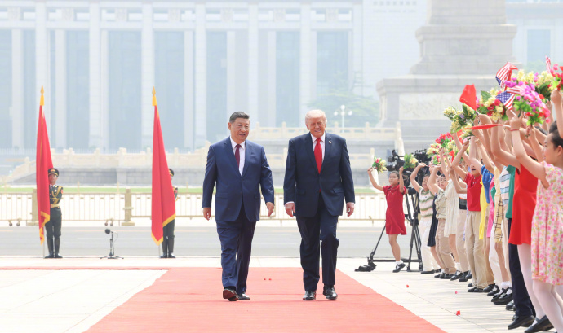
Trump Arrives in China for State Visit
特朗普抵达中国开启国事访问

Slide 3
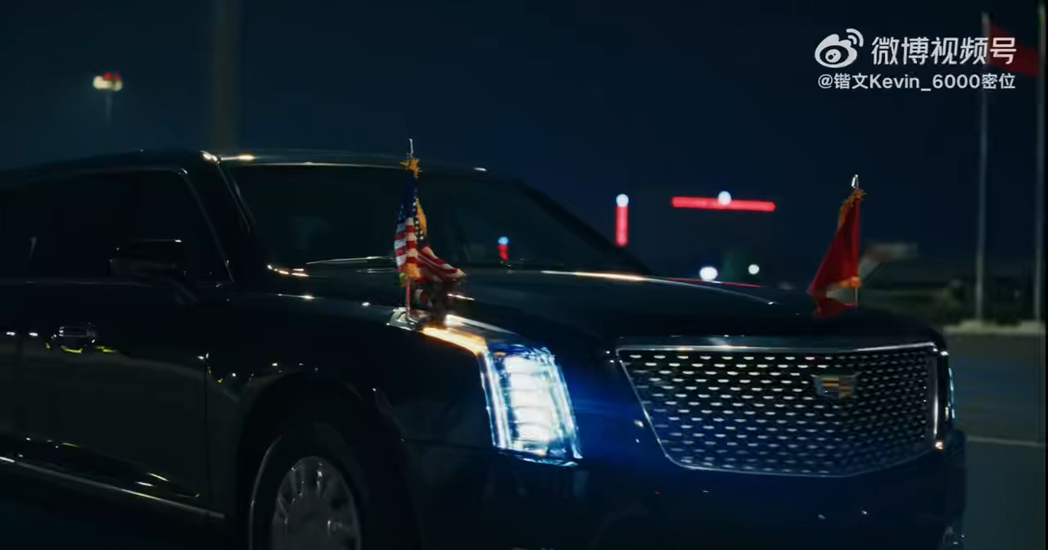
US President Donald Trump posted a message on his social media at around 3 a.m. after he arrived in China.

Slide 4
When US President Donald Trump arrived in China, he posted on social media at around 3 a.m. This shows his psychology:
1. Strong excitement and expectation
China is a great country he has long looked forward to visiting. Just like common people posting moments when arriving at a dream place, he couldn’t wait to share his feelings. It means he was very excited and hopeful.
2. Desire for attention and praise
Trump likes showing himself on social media. He wants the world to notice him and give him praise. Posting at midnight shows he wanted immediate attention and to be the center of focus.
3. A sense of achievement and pride
Visiting China as US president is important and honorable for him. Posting late at night was his way of sharing his success and showing his important position.

Slide 5
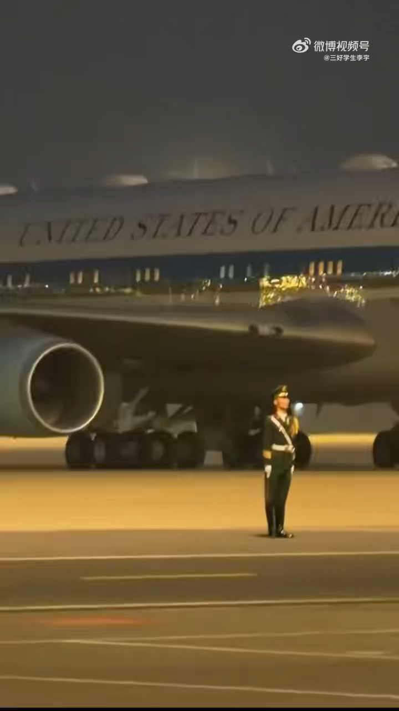
The special plane Air Force One carrying the US president roared /rɔː(r)/ past.美国总统乘坐的专机空军一号轰鸣而过。

Slide 6
Chinese soldiers stood there perfectly /ˈpɜːfɪktli/still.
中国军人伫立在此纹丝不动。
What does this calm manner show?
这般沉稳的姿态彰显了什么？
Standing on our own land, the firm will rooted deep in our bones weighs more than any weapon /ˈwepən/.
立足故土，刻入骨髓的铮铮骨气，胜过一切兵刃。
Besides, we treat others with equal respect.
同时我们秉持平等相待、彼此敬重的态度。
No matter how powerful you are, you can never bend /bend/ the backbone /ˈbækbəʊn/of the Chinese people.
纵使对方实力再强盛，也压不弯中国人的脊梁。
It fully shows that Chinese people are neither humble /ˈhʌmbl/ nor arrogant /ˈærəɡənt/.
这充分体现出中国人不卑不亢的民族风骨。

Slide 7
When US President Donald Trump arrived in China, he posted a message on social media at around 3 a.m. This shows his psychology: strong excitement and expectation. China is a great country he has long looked forward to 1 (visit). He couldn’t wait 2 (share) his feelings.
Trump likes 3 (show) himself on social media. He wants the world 4 (notice) him and give him praise. Posting at midnight shows he wanted immediate attention and to be 5 center of focus.
The special plane Air Force One 6 (roar) past. Chinese soldiers stood there perfectly still. Standing on our own land, the firm will rooted deep in our bones weighs more than any 7 (weapon). Besides, we treat others with equal 8 (respect). No matter how powerful you are, you can never bend the backbone 9 the Chinese people. It fully shows that Chinese people are neither humble 10 arrogant.

