Slide 1


感恩遇见，相互成就，本课件资料仅供您个人参考、教学使用，严禁自行在网络传播，违者依知识产权法追究法律责任。
更多教学资源请关注
公众号：溯恩英语
知识产权声明

Slide 2
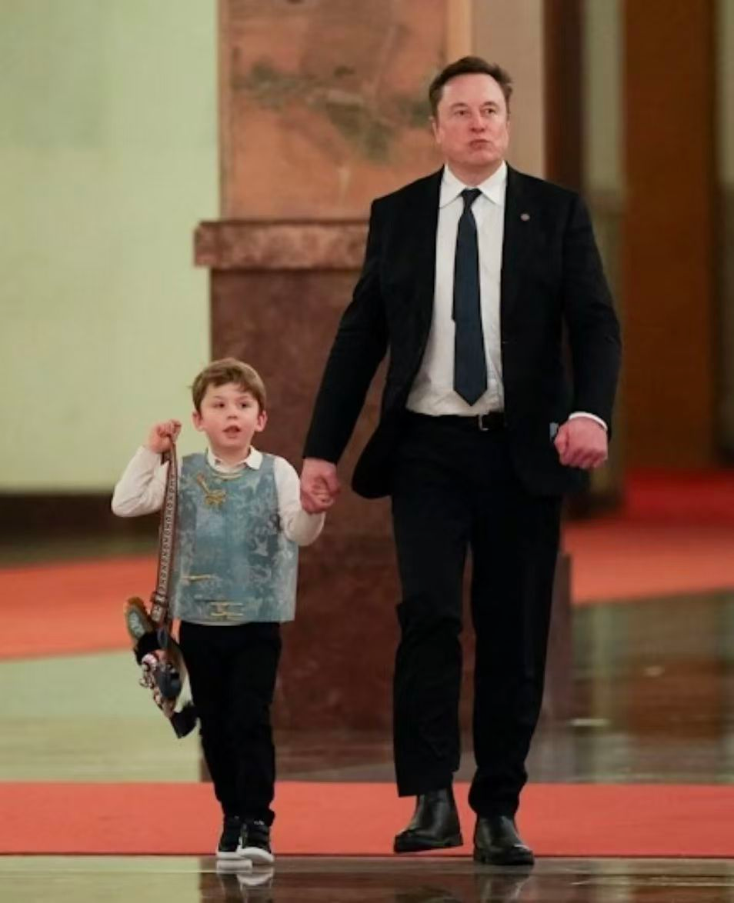
Tesla and SpaceX CEO Elon Musk
Neo- Chinese style

Slide 3
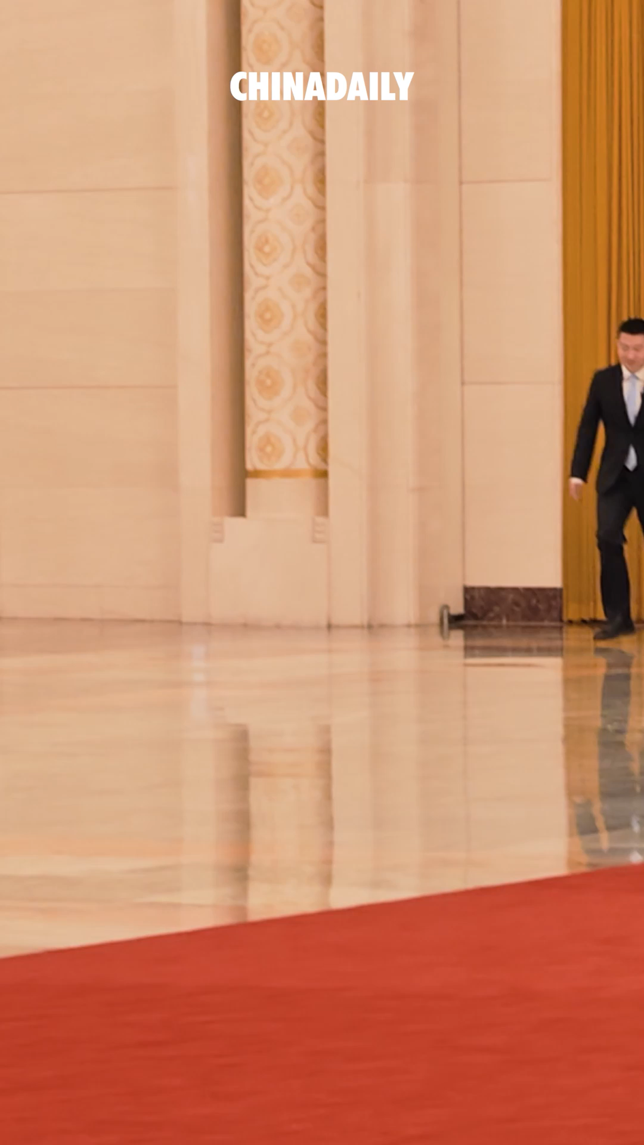
Tesla and SpaceX CEO Elon Musk 1 （spot） walking through the Great Hall of the People in Beijing with his son, X Æ A-Xii, on Thursday.
The little boy, 2 (dress) in a Chinese-style vest and 3 (carry) a tiger-head bag, 4 (win) hearts online with his outfit.
was spotted
dressed
carrying
won
谓语,非谓语辨析

Slide 4
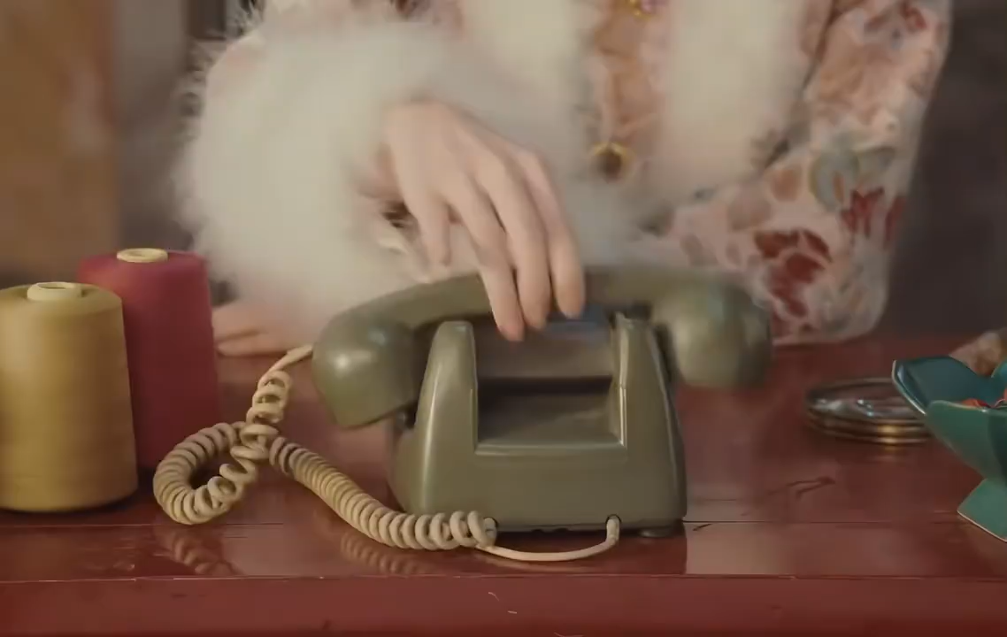
From this style, we can see many traditional Chinese culture elements and modern fashion trends. This kind of mixed -and -match esthetic/iːsˈθetɪk/ 审美；美学is called Neo- Chinese style.

Slide 5
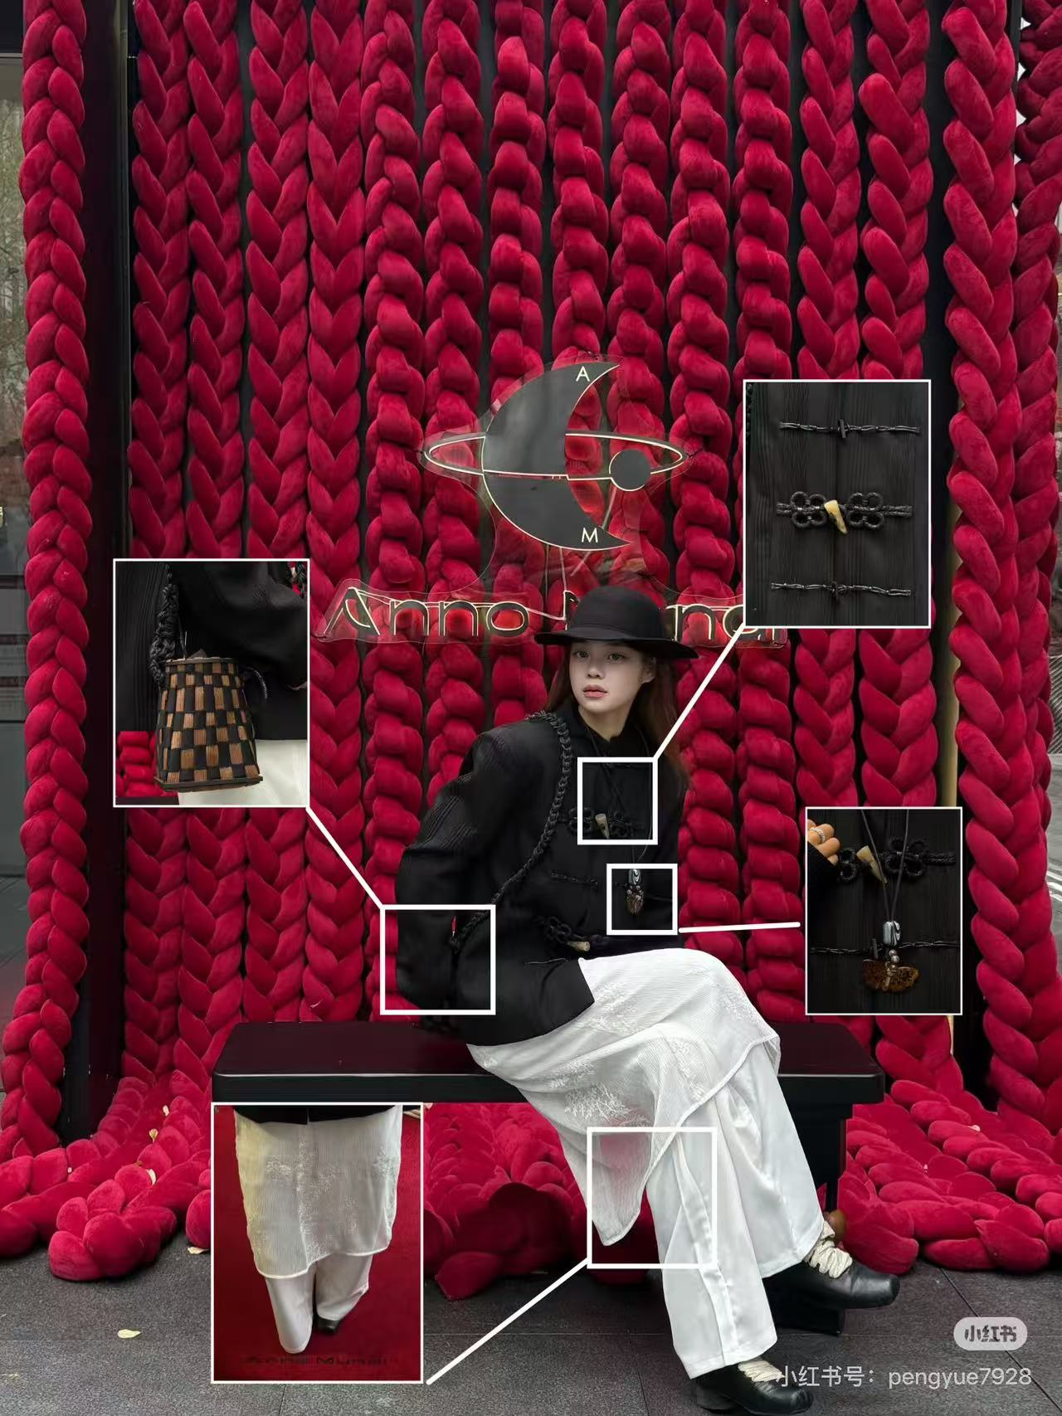
风格潮流类
new Chinese style 新中式
dressing style 穿搭风格
fashion trend 时尚潮流
emerging trend /ɪˈmɜːdʒɪŋ/ 新兴潮流
national pride 民族自豪感
aesthetic /iːsˈθetɪk/ 审美；美学
vibe /vaɪb/ 格调；氛围

Slide 6
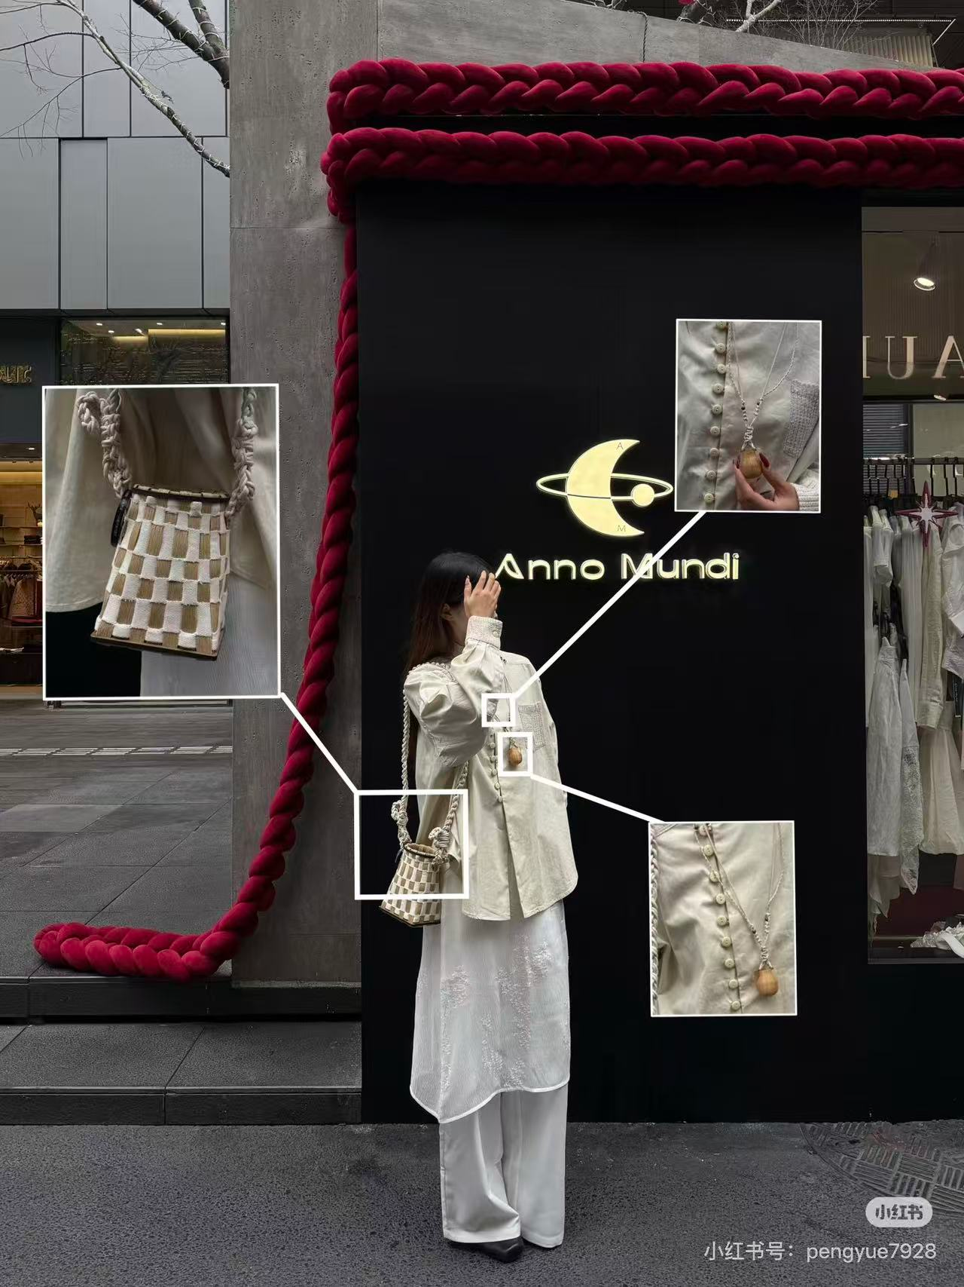
传统服饰文化元素
traditional Chinese culture elements 中国传统文化元素
antique /ænˈtiːk/ 复古的；古色古香的
frog buttons 盘扣
embroidery /ɪmˈbrɔɪdəri/ 刺绣
traditional clothing 传统服饰
Chinese calligraphy 中国书法

Slide 7
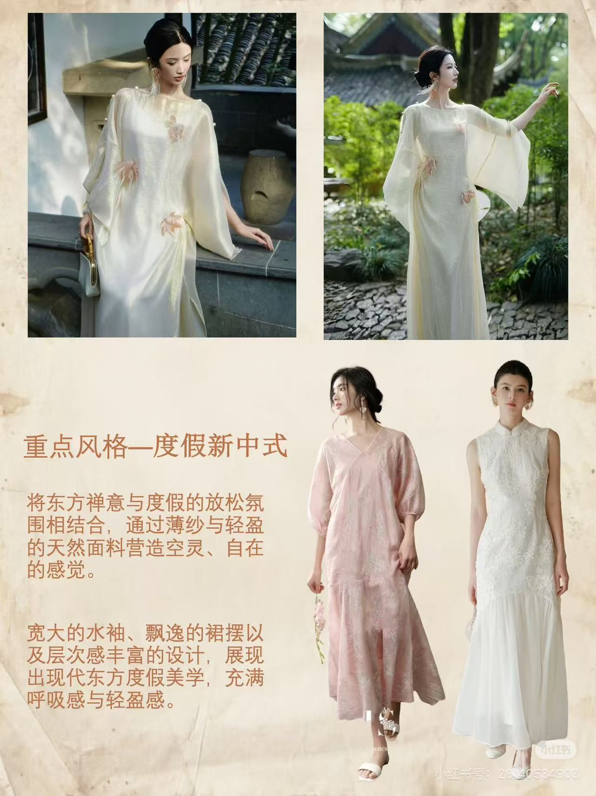
文化融合传承类
integrate /ˈɪntɪɡreɪt/ 融合
innovative /ˈɪnəveɪtɪv/ 创新的
interpret /ɪnˈtɜːprɪt/ 诠释；解读
draw inspirations from 从…… 汲取灵感
national characteristics 民族特色
cultural heritage /ˈherɪtɪdʒ/ 文化遗产
precious cultural heritage 珍贵文化遗产
inherit /ɪnˈherɪt/ 传承

Slide 8
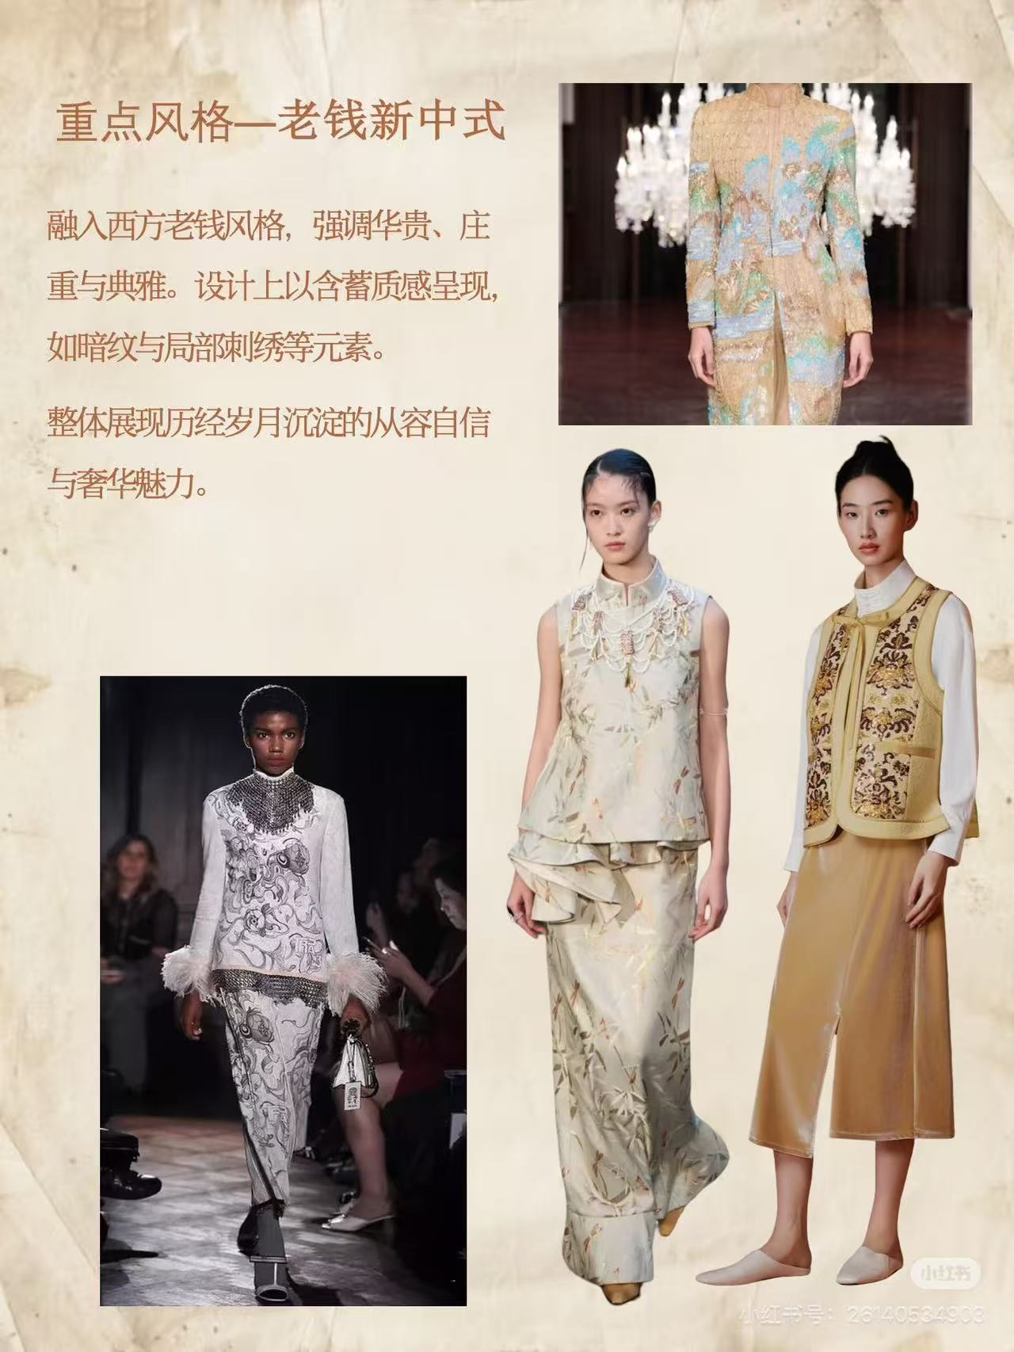
情感 & 影响力类
fascinate people 吸引众人
resonate /ˈrezəneɪt/ with consumers 引发消费者共鸣
spread traditional culture 传播传统文化
boost cultural confidence 增强文化自信

Slide 9
练习：假定你是李华，你的外国笔友Tom来信询问当下中国年轻人和名人中非常流行的新中式穿搭，他想了解这种风格的具体特点、背后的文化内涵以及它的影响力。请你给他写一封回信，详细介绍相关情况。
Dear Tom,
I’m really glad to receive your letter and it’s my pleasure to tell you about the popular ____1____（新中式风格） in China, which is popular among young people and ____2____（名人）.
As a new ____3____（时尚潮流）, it focuses on integrating classic antique elements with modern ____4____（审美） and urban casual vibe. You can easily find many ____5____（中国传统文化元素） in this style, such as frog buttons, beautiful ____6____（刺绣）, stand-up collars and Chinese calligraphy, which are interpreted in ____7____（创新的） ways.
This popular style is driven by our precious ____8____（文化遗产） and people’s growing sense of ____9____（民族自豪感）. More and more Chinese ____10____（设计师） are creating fashion collections with national characteristics, helping inherit our traditional culture and spread it to the world.
I believe this unique style will resonate with more people around the world soon.
Yours,
Li Hua

