Slide 1



感恩遇见，相互成就，本课件资料仅供您个人参考、教学使用，严禁自行在网络传播，违者依知识产权法追究法律责任。
更多教学资源请关注
公众号：溯恩英语
知识产权声明

Slide 2
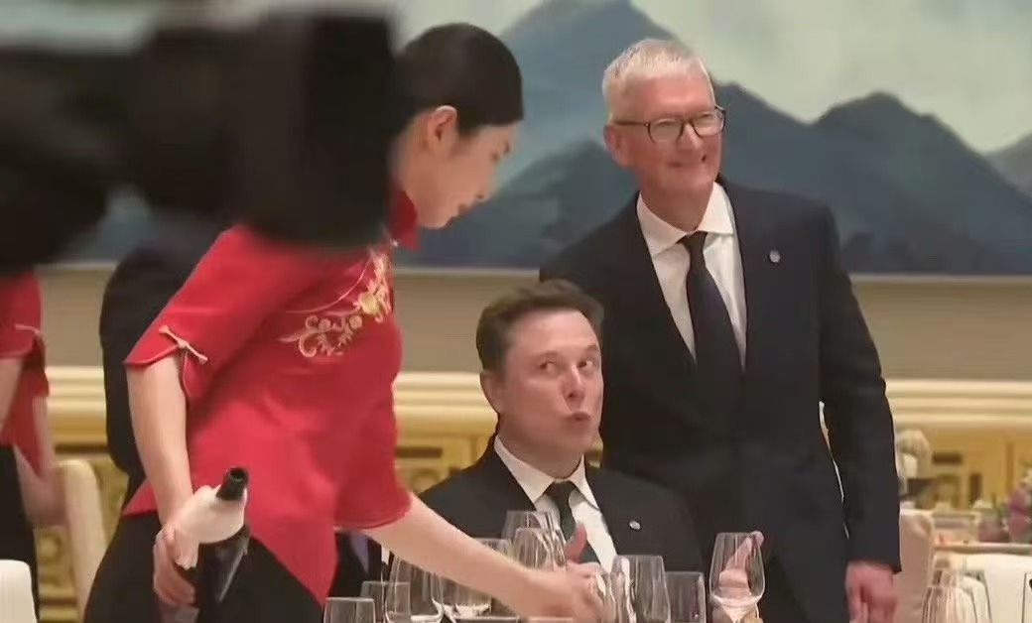
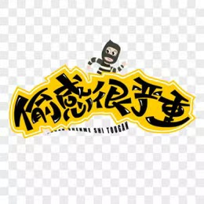
Chinese state banquet
中国国宴
sneaky vibe

Slide 3

Before the state dinner (国宴)started, Musk was deeply attracted by the delicious food 1 （prepare） for the feast. He secretly 2 （pick ） up a piece of food with his fingers and put it into his mouth， 3 tasted really good. Then he quietly ate another one again. He totally succeeded in this little sneaky act, 4 the whole scene was really fun.
prepared
picked
which
and
sneaky /ˈsniːki/ （adj.）核心义：偷偷摸摸的、悄咪咪的、心虚的
sneaky vibe = 偷感
vibe /vaɪb/ n.本义：氛围、气场、感觉

Slide 4
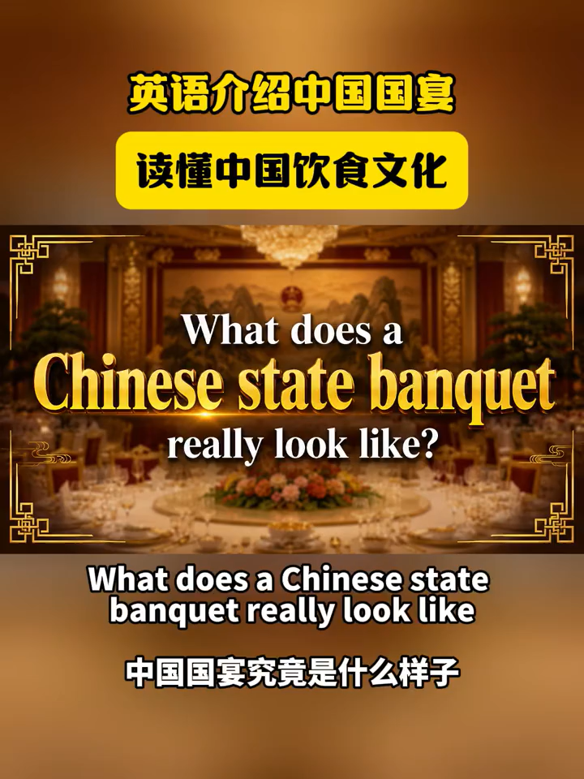

banquet /ˈbæŋkwɪt/n. 宴会；盛宴
diplomacy /dɪˈpləʊməsi/n. 外交
select /sɪˈlekt/v. 挑选；精选
delicate /ˈdelɪkət/adj. 精致的；清淡可口的
appetizer /ˈæpətaɪzə(r)/n. 开胃小菜；前菜
seasonal /ˈsiːzənl/adj. 应季的；季节性的
elegant /ˈelɪɡənt/adj. 精美的；雅致的
pastry /ˈpeɪstri/n. 糕点；点心
refined /rɪˈfaɪnd/adj. 精致的；考究的
hospitality /ˌhɒspɪˈtæləti/n. 热情好客；殷勤
plating /ˈpleɪtɪŋ/n. 菜品摆盘
harmony /ˈhɑːməni/n. 和谐；融洽
cuisine /kwɪˈziːn/n. 菜肴；烹饪风格

Slide 5
What does a Chinese state banquet really look like?
It is not just ①____ meal. It is a stage where food culture and diplomacy come together.
At a Chinese state banquet, every dish is carefully ②____ (select).
The menu usually begins with delicate cold appetizers, ③____ (follow) by clear soup, seafood, meat dishes, seasonal vegetables, and finally rice noodles or elegant desserts.
You may see famous dishes like Peking duck, steamed fish, braised beef ④____ beautifully shaped pastries.
The flavors are often refined and balanced, fresh, light and elegant, rather than overly rich or spicy, but ⑤____ makes it truly special is the meaning behind the food.
In Chinese culture, a banquet is a way ⑥___ _ (show) respect, friendship and hospitality.
The colors, the plating and even the order of the dishes are designed ⑦____ (create) harmony.
A state banquet may also bring together cooking styles from different parts of China, ⑧____ (show) the richness of the country's food culture in one single meal.
So when guests sit down at a Chinese state banquet, they are not only tasting Chinese cuisine, they are experiencing a tradition of welcome, beauty and cultural ⑨____ (connect).
Now more and more foreign guests ⑩____ (fall) in love with Chinese state banquet culture.
a
selected
followed
and
what
to show
to create
showing
connection
are falling

