Slide 1


感恩遇见，相互成就，本课件资料仅供您个人参考、教学使用，严禁自行在网络传播，违者依知识产权法追究法律责任。
更多教学资源请关注
公众号：溯恩英语
知识产权声明

Slide 2
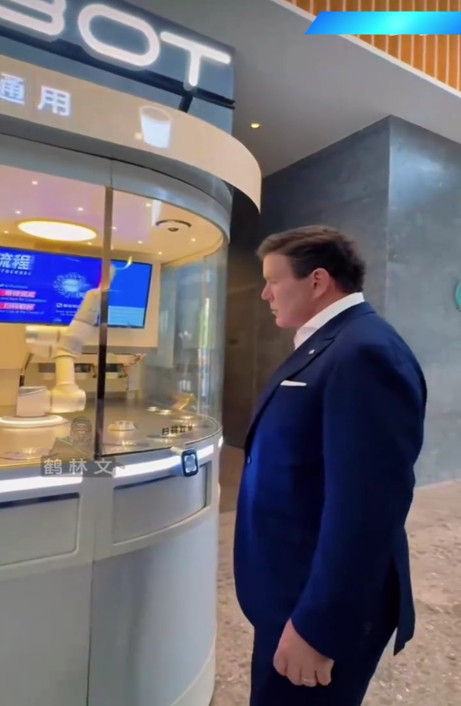
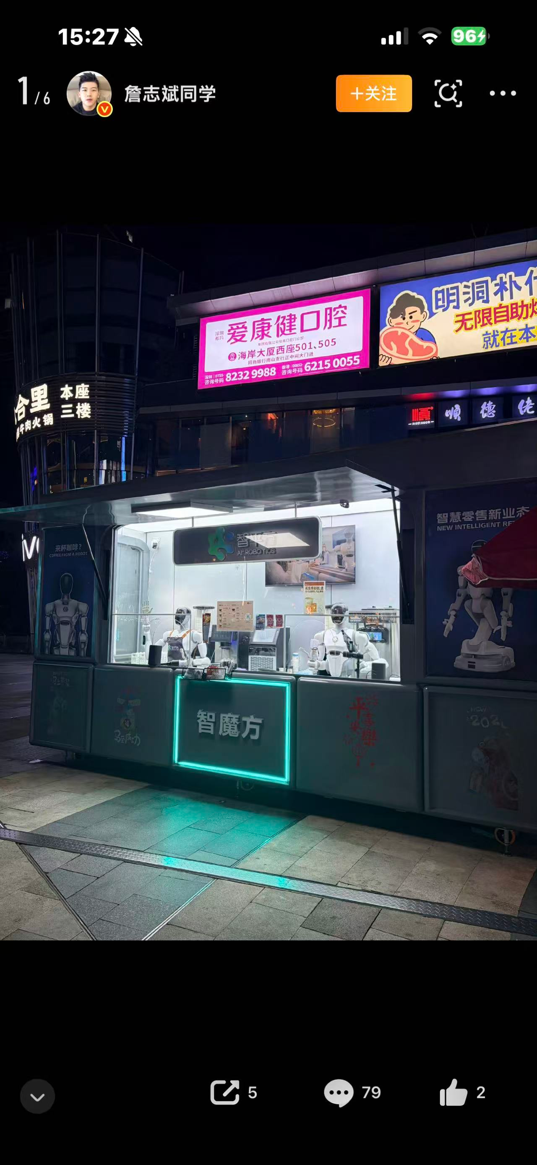
robotic coffee maker
机器人咖啡机

Slide 3
1 特朗普访华期间，一位知名的美国记者在北京街头买到了一杯机器人制作的咖啡。
句型提示：用定语从句
During Trump's visit to China, a famous American journalist bought a cup of coffee that was made by a robot on the streets of Beijing.
2 正是这件事在美国引发了民众极大的反响。
句型提示：用强调句（It was…that…）
It was this event that caused a great response among people in America.
3 美国人几乎无法想象中国的科技如今已经变得如此发达。
句型提示：用宾语从句
Americans can hardly imagine that China's science and technology has become so advanced now.

Slide 4
他们一直持有一种刻板印象stereotype /ˈsteriətaɪp/n. 刻板印象；固有偏见，那就是中国科技发展相对落后。
句型提示：用同位语从句
They have long held the stereotype that China's science and technology develops relatively slowly.
如此发达的现代科技让远道而来的外国游客倍感惊讶。
句型提示：用so…that… 结果状语从句，+ 倒装
So advanced is modern Chinese technology that foreign visitors from afar feel greatly surprised.

Slide 5
During Trump’s visit to China, a famous American journalist 1.____ (walk) along the streets of Beijing one day. He bought a cup of coffee 2.____ (make) by a smart robot. This simple experience left him greatly 3.____ (shock).
It was this small thing 4.____ caused heated discussions in America. Many ordinary Americans could not imagine 5.____ rapidly China’s science and technology had developed. They used to hold the stereotype 6.____ China was backward in high-tech fields.
Now more and more foreign visitors come to China, 7.____ (witness) various convenient smart services. They gradually change their old views and realize 8.____ China has made amazing progress. This is also 9.____ best way to show China’s power 10.____ the whole world.
walked 时态 一般过去时
made 非谓语 过去分词作后置定语
shocked 形容词化分词 人感到震惊
that 强调句 It was…that…
how 宾语从句连接词 多么
that 同位语从句 解释 stereotype
witnessing 非谓语 现在分词作伴随状语
that 宾语从句引导词
the 最高级前加定冠词
to 固定搭配 show sth. to sb.

Slide 6
假定你是李华，你的美国笔友 Tom 一直对中国存有科技落后的刻板印象，请你给他写一封邮件，结合 “街头机器人咖啡” 这件事，介绍如今中国的科技发展现状。
写作要点
提及美国记者在北京的有趣见闻
介绍中国日常智能便民科技
希望他放下偏见，亲身来中国看一看

Slide 7
Dear Tom,
How is everything going? I’m writing to tell you something about China’s rapid technological development.
Recently, a famous American journalist drank robot-made coffee on Beijing streets, which caused a big stir in your country. Many Americans are surprised to see such smart services in China.
In fact, high-tech products are everywhere in our daily life. We enjoy many convenient smart facilities. I hope you can drop your old stereotype that China is backward. Welcome to China and experience great changes in person.
Yours,
Li Hua

