Slide 1


感恩遇见，相互成就，本课件资料仅供您个人参考、教学使用，严禁自行在网络传播，违者依知识产权法追究法律责任。
更多教学资源请关注
公众号：溯恩英语
知识产权声明

Slide 2

考前冲刺
强化连贯与逻辑，高分拿下应用文
——以2026广东二模 “AI学伴”为例
Doris

Slide 3
题目呈现
(2026年广东二模) 你校英文报Youth Voices最近发起主题为“My Ideal AI Learning Partner”的征文活动，请你写一篇短文投稿，内容包括：
(1)它的样貌；(2)它的功能。
注意：
(1)写作词数应为80左右；
(2)请按如下格式在答题卡的相应位置作答。
My Ideal AI Learning Partner
________________________________________________________________________________________________________________________

Slide 4
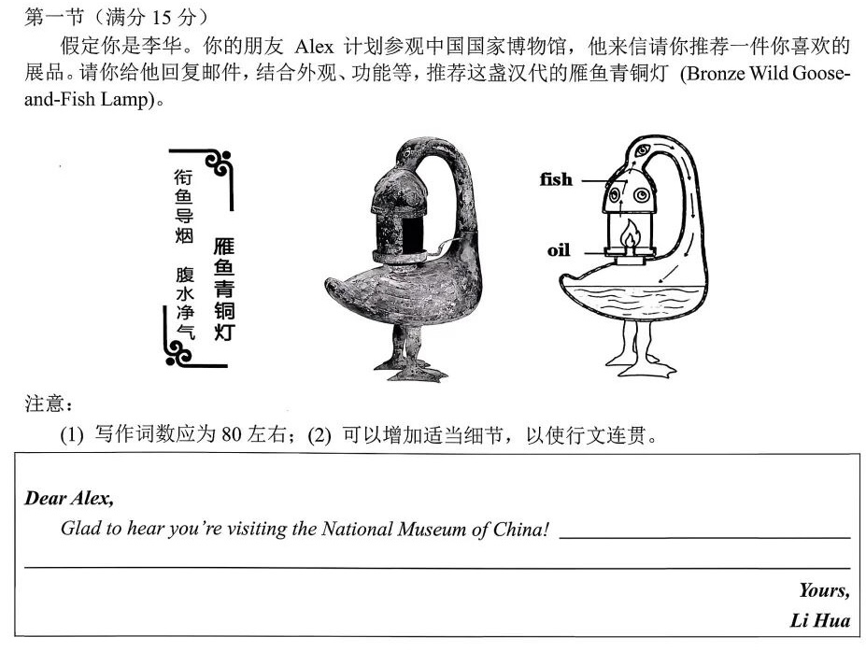
相似题目
(2026年广东二模) 你校英文报Youth Voices最近发起主题为“My Ideal AI Learning Partner”的征文活动，请你写一篇短文投稿，内容包括：(1)它的样貌；(2)它的功能。
2026年深圳一模

Slide 5
谋篇布局，必备语言，逻辑关系
Part 1 写作背景+写作目的
Glad to hear you’re visiting the National Museum of China (写作背景). Among the countless exhibits, I highly recommend the Bronze Wild Goose-and-Fish Lamp from Han Dynasty (写作目的).

Slide 6
谋篇布局，必备语言，逻辑关系
(2026年广东二模) 你校英文报Youth Voices最近发起主题为“My Ideal AI Learning Partner”的征文活动，请你写一篇短文投稿，内容包括：(1)它的样貌；(2)它的功能。
What should be included in Part 1?
×
×
×

Slide 7
谋篇布局，必备语言，逻辑关系
(2026年广东二模) 你校英文报Youth Voices最近发起主题为“My Ideal AI Learning Partner”的征文活动，请你写一篇短文投稿，内容包括：(1)它的样貌；(2)它的功能。
Part 1 引出介绍对象+描述AI学伴样貌
当谈到我理想中的AI学习伙伴时，我脑海中浮现出一幅清晰的画面。
When it comes to my ideal AI learning partner, I have a vivid picture in my mind.
2.如果我能拥有一个完美的AI学习伙伴，那将是一个有着柔软屏幕脸的可爱机器人。
If I could have a perfect AI learning partner, it would be a cute robot with a soft screen face.

Slide 8
谋篇布局，必备语言，逻辑关系
Part 1 引出介绍对象+ 描述AI学伴样貌
general description
This remarkable lamp is shaped like/is designed as/takes the form of a wild goose with its long neck curved gracefully backward and a fish held in its beak.
我理想的 AI 学习伙伴被设计成一个手掌大小的机器人，两只眼睛闪烁着温暖光，胸口还藏着一个微型扬声器。
My ideal AI learning partner is designed as a palm‑sized robot with its two eyes shining warmly and a tiny speaker hidden in its chest.
specific features
进行整体描述的表达
is shaped like/is designed as/takes the form of…
looks like/appears as …

Slide 9
谋篇布局，必备语言，逻辑关系
Part 1 引出介绍对象+ 描述AI学伴样貌
大小与尺寸
about the size of a smartphone / a tablet 大约智能手机 / 平板电脑大小
palm-sized / pocket-sized手掌大小 / 口袋大小
lightweight and portable 轻便便携
颜色、材质和发光
dressed in soft white and silver 有着柔和的白色与银色外观
dressed in a smooth metallic shell有着光滑的金属外壳
transparent / metallic finish 透明 / 金属质感 表面
soft blue / warm orange / silver-white glow 柔和的蓝光 / 温暖的橙光 / 银白色光

Slide 10
谋篇布局，必备语言，逻辑关系
Part 1 引出介绍对象+ 描述AI学伴样貌
我的 AI 学习伙伴有着光滑的金属外壳，散发出柔和的蓝光，并根据我的情绪或学习进度变换颜色。
Dressed in a smooth metallic shell, my AI learning partner gives off a soft blue glow that changes color according to my mood or progress.

Slide 11
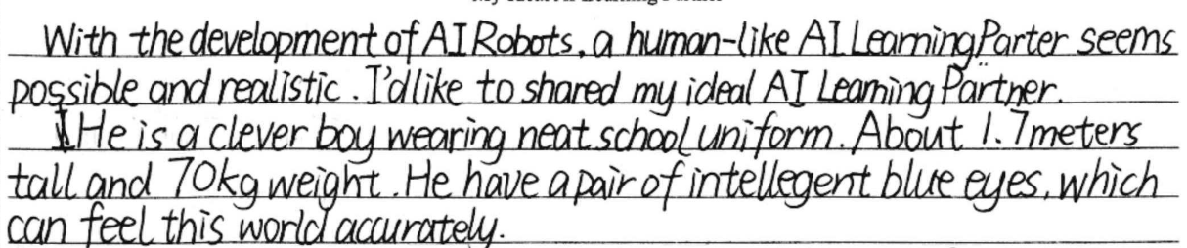
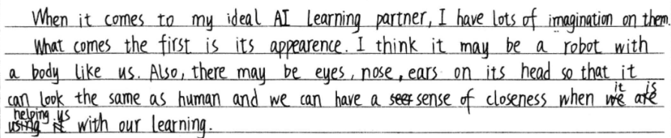
谋篇布局，必备语言，逻辑关系
Part 1 引出介绍对象+ 描述AI学伴样貌
Which one is better?
This one is more logical, although some expressions are not that natural.

Slide 12
谋篇布局，必备语言，逻辑关系
Part 1 引出介绍对象+ 描述AI学伴样貌
Refine the language
When it comes to my ideal AI learning partner, I have many ideas about it. What comes first is its appearance. I think it might be a robot with a human-like body. Also, it may have eyes, a nose, and ears on its head so that it looks like a human, making us feel close when it helps us with our studies.
逻辑链： 外观特征 → 设计意图 → 对使用者的好处

Slide 13
谋篇布局，必备语言，逻辑关系
Part 1 引出介绍对象+ 描述AI学伴样貌
让你的样貌设计更有理有据
1. This appearance makes it not just a tool but a friendly companion/warm partner (情感定位).
这样的外形让它不仅仅是一个工具，更是一个……
2. Its lovely look makes it more approachable and easier to get along with. 它可爱的样子让它更亲切，更容易相处。
My ideal AI learning partner is designed as a palm-sized robot, which makes it lightweight and portable, so that I can carry it anywhere with me. Dressed in soft white and silver, it has two eyes that give off a soft warm orange glow, making it not just a tool but a friendly companion.

Slide 14
谋篇布局，必备语言，逻辑关系
Part 2 介绍功能
外观&功能
This remarkable lamp is shaped like a graceful wild goose with its long neck curved gracefully backward and a fish held in its beak.
__________________________________________________________________________________________________________________
When it is lit, the smoke from burning oil flows through the goose’s hollow neck and into the goose’s belly, which is full of water. The water absorbs the smoke (事实), greatly reducing indoor air pollution (评价/结果).
外观
Beyond its attractive appearance, what makes this lamp impressive is its clever function.
过渡句
功能

Slide 15
谋篇布局，必备语言，逻辑关系
要点之间的衔接
The knowledge we gain during the process contributed to the creation of The Campus Bird Handbook, which features ten common bird species.
As weeks passed, our random notes became a structured record—The Campus Bird Handbook.
All the observations and research finally took shape as/ evolved into a handbook.
To make our discoveries accessible to everyone, we organized everything into a user-friendly handbook.
2026年深圳二模
要点1“研究过程”向“手册制作”过渡

Slide 16
谋篇布局，必备语言，逻辑关系
Part 2 介绍功能
1. 过渡句(与要点1“样貌”衔接)
Beyond its lovely appearance, this AI partner is equipped with powerful/ practical functions to help me with my study.
2. 功能
1. 学习辅助
2. 情感支持
Beyond its attractive appearance, what makes this lamp impressive is its clever function. (2026年深圳二模应用文)

Slide 17
谋篇布局，必备语言，逻辑关系
Part 2 介绍功能
2. 功能
1. 学习辅助
design a weekly plan based on my scores
explains difficult concepts with animations (动画)/ real-life examples
points out my mistake and corrects it promptly/timely
analyses my weak subjects and creates personalized exercises
create short quizzes from my wrong answers
2. 情感支持
send encouraging messages when I feel frustrated

Slide 18
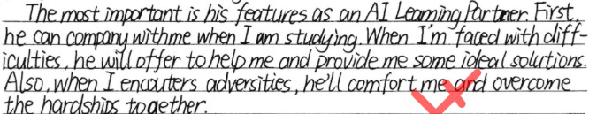
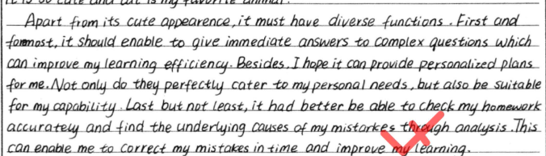
谋篇布局，必备语言，逻辑关系
Which one is better?
Part 2 介绍功能
more logical

Slide 19
谋篇布局，必备语言，逻辑关系
Part 2 介绍功能
Apart from its friendly appearance, it is equipped with practical functions. For one thing, it serves as a capable learning assistant. It can explain complex concepts with simple examples and point out my mistakes instantly, giving me prompt feedback. What makes it more advanced is that it creates personalized exercises based on my mistakes, which helps me consolidate what I have learned. For another, it is also a heart-warming companion because it comforts me whenever I need encouragement.
分类分层介绍功能，让你的介绍更有层次感和逻辑性

Slide 20
谋篇布局，必备语言，逻辑关系
Part 3
总结价值
The lamp is not only a light source, but also the wisdom of ancient Chinese people. Wish you enjoy your visit.
With it, I learn faster and feel less pressure.
With such a partner, learning would no longer feel lonely and I could make steady progress every day.
With such a partner, learning becomes an interactive and immersive journey.
2026年深圳二模
(评价+祝福)

Slide 21
范文学习
When it comes to my ideal AI learning partner, I have a vivid picture in my mind.
My ideal AI learning partner is designed as a palm-sized robot, which makes it lightweight and portable, so that I can carry it anywhere with me. Dressed in soft white and silver, it has two eyes that give off a soft warm orange glow, making it not just a tool but a friendly companion.
Apart from its approachable appearance, it is equipped with practical functions. For one thing, it serves as a capable learning assistant. It can explain complex concepts with simple examples and point out my mistakes instantly, giving me prompt feedback. What makes it more advanced is that it creates personalized exercises based on my mistakes, which helps me consolidate what I have learned. For another, it is also a heart-warming companion because it comforts me whenever I need encouragement.
With such a partner, learning becomes an interactive and immersive journey.

Slide 22
迁移练习
1. (2026年济南二模) 每年 5 月 8 日为世界微笑日。假定你是李华，你校英文报现征集相关庆祝活动的标识图案，请你投稿，内容包括：
(1) 图案描述；
(2) 设计解读。
整体描述+具体特征+设计意图
2. (2026年济南二模) 近日，一些学校开始尝试使用AI辅助心理咨询。你校英文报就此现象开展征文活动，请你写一篇短文投稿, 内容包括: (1) 你的观点; (2) 你的理由。
分层分类论述理由

Slide 23
迁移练习
1. (2026年济南二模) 每年 5 月 8 日为世界微笑日。假定你是李华，你校英文报现征集相关庆祝活动的标识图案，请你投稿，内容包括：
(1) 图案描述；
(2) 设计解读。
整体描述+具体特征+设计意图
My logo takes the form of a smiling face with a curved red mouth and two star‑like eyes. The smile represents joy, and the shining eyes stand for hope. I design it this way so that whenever people see it, they will feel encouraged to share a smile with others.

Slide 24
迁移练习
2. (2026年济南二模) 近日，一些学校开始尝试使用AI辅助心理咨询。你校英文报就此现象开展征文活动，请你写一篇短文投稿, 内容包括: (1) 你的观点; (2) 你的理由。
分层分类论述理由
For one thing, AI is available at any time. When students feel anxious late at night or before exams, they can turn to an AI tool for immediate support, which greatly lowers the barrier to seeking help.
For another, AI ensures privacy. Many students hesitate to talk about their problems face to face. An AI partner provides a safe, judgment‑free space where they can open up more easily.

Slide 25
Summary
How to help your essay score high?
The transition between the key points
The logic between the details

Slide 26
Homework
根据本课学习内容，修改你写的“My Ideal AI Learning Partner”

Slide 27

Thank You！

