Slide 1


感恩遇见，相互成就，本课件资料仅供您个人参考、教学使用，严禁自行在网络传播，违者依知识产权法追究法律责任。
更多教学资源请关注
公众号：溯恩英语
知识产权声明

Slide 2
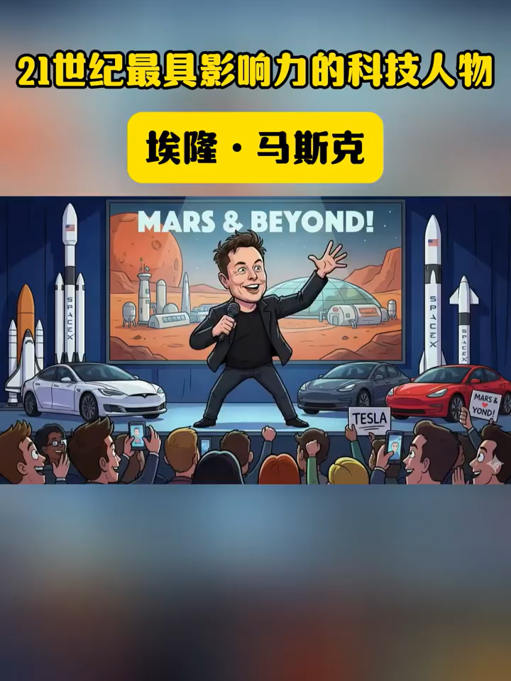
Elon Musk is one of the most influential technology figures of the 20 first century

Slide 3
Elon Musk is one of the most influential technology figures of __________1__________ 21st century. Born in South Africa and later __________2__________ (become) an American entrepreneur, Musk is best known for his work across several major industries, __________3__________ (include) electric vehicles, space exploration, artificial intelligence, and digital communication. As the CEO of Tesla, he helped push electric cars from a niche/niːʃ/ idea小众想法into the global mainstream. Through SpaceX, he led the development of reusable rockets, __________4__________ (significant) reducing the cost of space travel and reopening discussions about human missions __________5__________ Mars. Musk is also involved in projects related to AI, brain-computer interfaces and global Internet coverage, often focusing on long-term challenges __________6__________ (face) humanity. His leadership style and public statements are frequently debated. Supporters see him as a visionary /ˈvɪʒəneri/ willing有远见的人 __________7__________ (take) bold risks. Critics point to controversy, unpredictability, and ethical /ˈeθɪkl/伦理的. What is clear is __________8__________ Elon Musk has played a major role in shaping conversations about technology, innovation and the future. __________9__________ admired or questioned, his impact on modern science and industry is __________10__________ (deny).
the
becoming
including
significantly
to
facing
to take
that
Whether
. undeniable

Slide 4
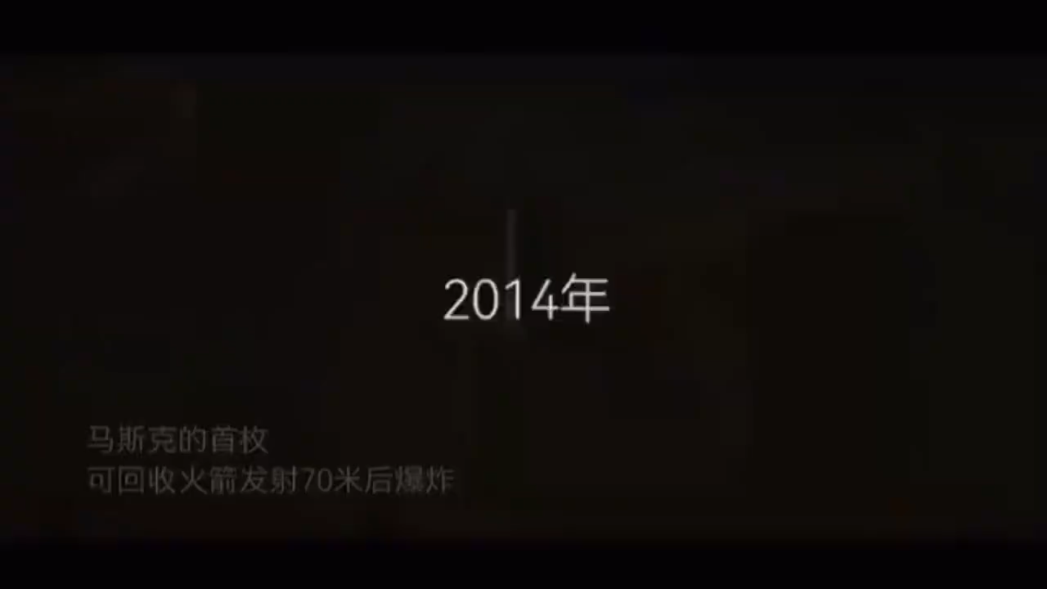

Slide 5
1 埃隆・马斯克经历了无数次火箭试验失败，这件事引来诸多批评。
语法要求：非限制性定语从句
Elon Musk experienced countless failures in rocket experiments, which drew plenty of criticism.
2 那位他年少时十分仰慕的童年偶像也曾批评过他。
语法要求：限制性定语从句
The childhood idol that he admired greatly in his childhood once criticized him.
3 尽管遭到偶像的批评内心十分难过，他却从未萌生放弃的念头。
语法要求：让步状语从句
Although he felt extremely sad after being criticized by his idol, he never thought of giving up.
4 正是坚定的信念让他坚持钻研火箭技术直至成功。
语法要求：It is…that… 强调句型
It is his firm belief that makes him keep researching rocket technology until he succeeds.

Slide 6
5只有正视每一次失败，他才能不断完善自己的研究。
语法要求：Only + 状语置于句首，用部分倒装
Only by facing every failure squarely can he keep perfecting his research.
6 倘若当初他选择放弃，他就无法实现火箭回收的伟大成就。
语法要求：与过去事实相反的虚拟语气
If he had chosen to give up back then, he would not have achieved great success in rocket recycling.
7 从失败中吸取经验教训是他走向成功的重要秘诀。
语法要求：动名词短语作主语
Learning lessons from failures is an important secret to his success.
8 他坚信自己终有一天会在航天领域实现远大梦想。
语法要求：宾语从句
He firmly believes that he will realize his great dream in the aerospace field one day.

Slide 7
人物描写手法：用具体事例刻画人物品质（事例凸显人物精神）
核心：不靠直白夸人，靠经历、遭遇、行为事件，侧面体现性格、品格、精神
林巧稚模式：人生抉择凸显品格通过一次次人生选择 → 体现善良、坚守、医者仁心、爱国情怀
马斯克模式：逆境失败凸显品格通过屡次受挫、遭受非议、屡败屡战 → 体现坚韧、执着、永不言弃、勇于探索
It is all the hardships and failures that shape his firm personality.
正是所有的艰难与失败，造就了他坚毅的性格。（强调句）
Only by overcoming numerous difficulties can he achieve final success.
唯有战胜重重困难，他方能取得最终成功。（倒装）
The hardships he has gone through serve as the best proof of his perseverance.
他所经历的磨难，是他坚持不懈最好的证明。（定语从句）
No matter how tough the situation was, he never lost heart or abandoned his goal.
无论处境多么艰难，他从未灰心、从未放弃目标。

