Slide 1


感恩遇见，相互成就，本课件资料仅供您个人参考、教学使用，严禁自行在网络传播，违者依知识产权法追究法律责任。
更多教学资源请关注
公众号：溯恩英语
知识产权声明

Slide 2
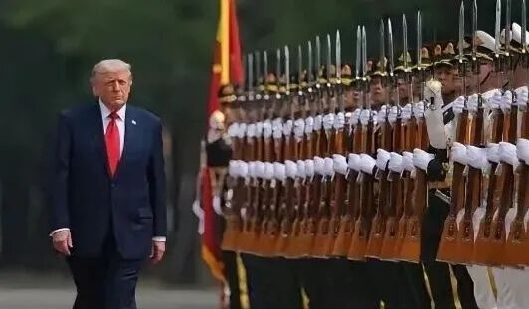
China's PLA Guard of Honor
中国人民解放军仪仗队。
An honor guard is a group of troops who formally greet or accompany someone special such as a visiting head of state.

Slide 3
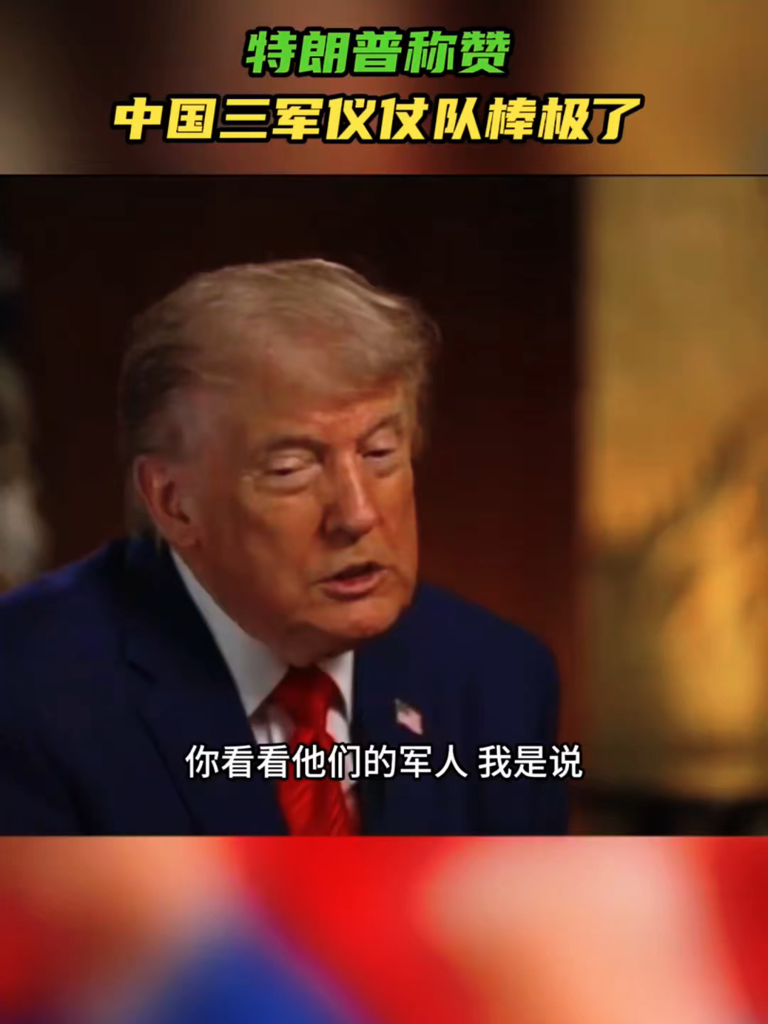
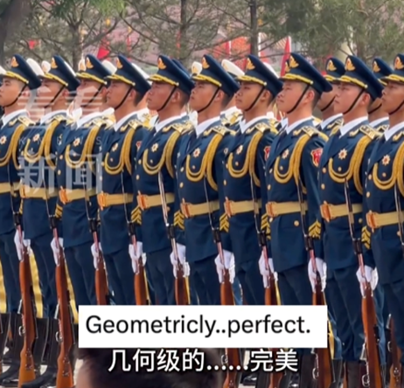
You look at the military. I mean, the military today was 1. That 2 was incredible.
incredible
marching

Slide 4
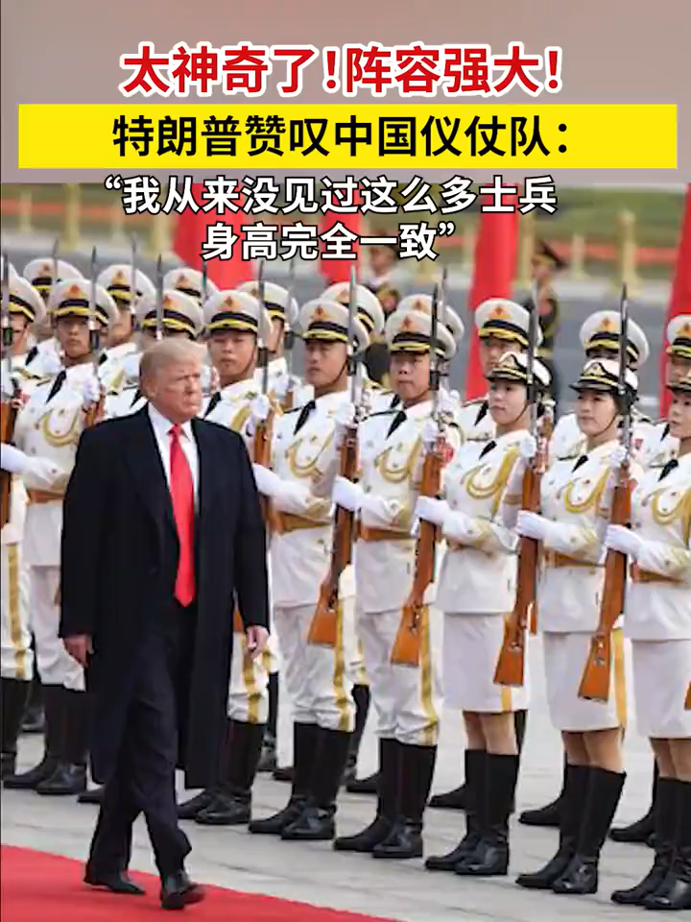
They gave me a 1. I never saw so many soldiers, all the same height, 2
the same height, within a quarter of an inch. You can do that when you have 3
billion people. It was pretty 5.
display
exactly
1.4
amazing

Slide 5
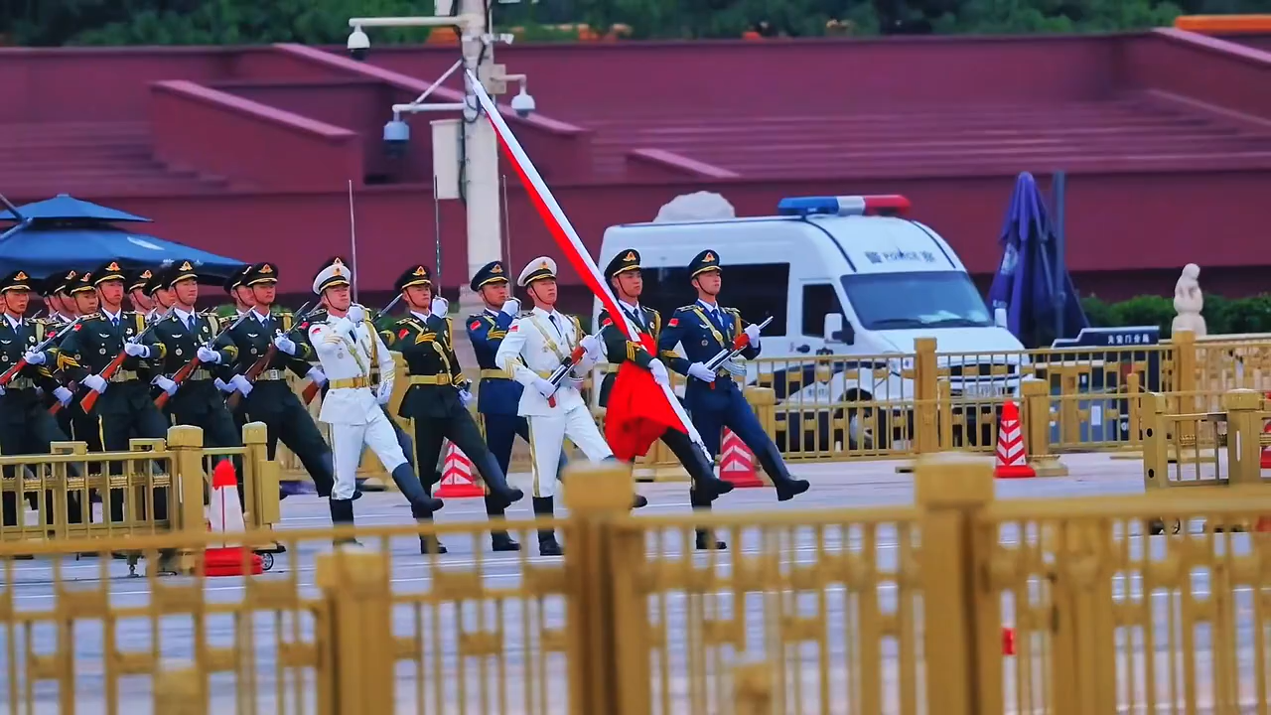

Slide 6
The flag-raising ceremony at Tiananmen Square in Beijing is a solemn /ˈsɒləm/adj. 庄严的；肃穆的 national ritual /ˈrɪtʃuəl/n. 仪式；惯例 1. (perform) daily by the PLA Honor Guard Flag Guard. The ceremony starts with flag guards 2. (march) from Tiananmen Gate, crossing the Golden Water Bridge and heading for the flagpole.
96 guards take part on the first day of every month, 3.______ 66 guards show up on ordinary days. The national flag 4. (raise) exactly at sunrise with the national anthem played once, and the whole process lasts 46 seconds.
According 5.______ the National Flag Law, all participants must stand solemnly 6. (face) the flag and show respect. Tourists need 7 (make) reservations 1 to 7 days ahead of time via the official Tiananmen Square reservation platform. This ceremony embody /ɪmˈbɒdi/v. 体现；使具体化 Chinese people’s traditional respect for 8.______ motherland and stands for the unity and 9 (patriot) of the Chinese nation. It is deeply rooted in 10. (tradition) Chinese culture.
performed
marching
while
is raised
to
to make
facing
the
patriotism
traditional

