Slide 1


感恩遇见，相互成就，本课件资料仅供您个人参考、教学使用，严禁自行在网络传播，违者依知识产权法追究法律责任。
更多教学资源请关注
公众号：溯恩英语
知识产权声明

Slide 2
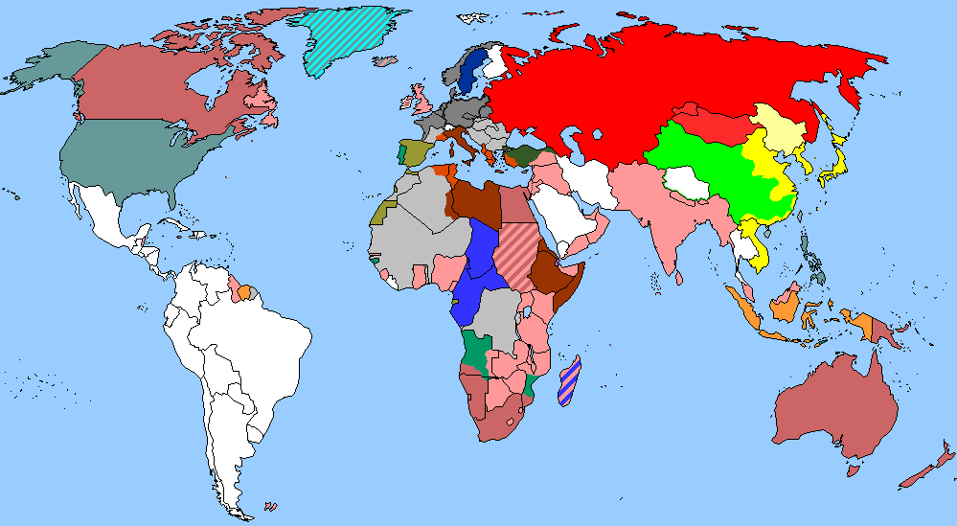
The World
May 1st-15th, 2026

Slide 3
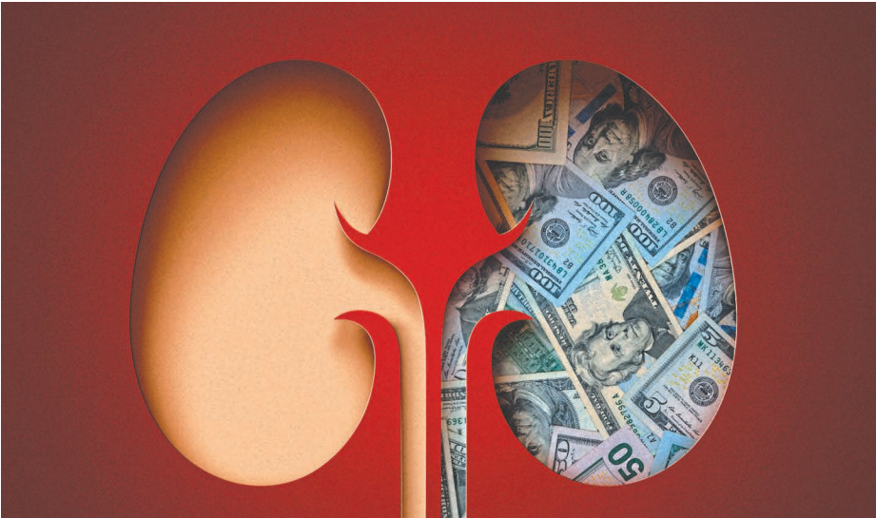
1. 90,000 people are waiting for an organ that can’t be bought
9万人在等待无法用金钱购买的器官

Slide 4
Text Completion
The Washington Post (May 10, 2026 A17)
The time has come to carefully but _________ (urgent) rethink payments to kidney donors.
There are approximately 130,000 new cases of kidney failure annually in the United States. It is disproportionately a disease of the poor, and is four times as likely ________ (affect) Black people as White people. Kidney failure costs Medicare alone more than $55 billion per year, mostly for dialysis. More than 500,000 people are presently on dialysis, about half of ______ will die within five years of beginning treatment. The best treatment for kidney failure is transplantation, but in 2025 fewer than 30,000 people in the United States received kidney transplants. So most people who could benefit from a lifesaving transplant will die _______ one.
About 90,000 people ____________ (register) on the national waiting list to receive a deceased-donor kidney, and many more would be, if there were enough transplants for all who need them. Thousands die each year while waiting, ____ thousands more are removed from the waiting list when they become too sick to undergo transplant surgery.
Nevertheless, kidneys for transplant remain in tragically short supply. So it is past time to consider amending the 1984 law that _________ (prohibit) giving “valuable consideration” for a kidney for transplant.
There is a long history of thoughtful _________ (argue) in favor of allowing kidney donors to be legally paid or compensated in some way, with carefully considered precautions.
To be clear, we should keep trying for big long-term goals, such as vastly ________ (reduce) the incidence of kidney disease by preventing or curing diabetes, hypertension and other causes. But we can save many lives now by being more generous ____ living donors, and it makes sense to start experimenting with ways to do this legally, ethically and equitably.
urgently
to affect
whom
without
are registered
and
prohibits
arguments
reducing
to

Slide 5

Reading Comprehension
1. What happens to many patients on the kidney waiting list?
A. They pay for kidneys privately.
B. They die before receiving one.
C. They switch to animal kidneys.
D. They recover without treatment.
DETAIL
2. What is the author’s main argument in the passage?
A. Dialysis is more effective than transplantation.
B. The 1984 law on kidney payment should be revised.
C. Kidney disease is mainly caused by poor diet.
D. Living donors should be banned permanently.
GIST

Slide 6
Vocabulary
1. amend: to change a law, document, statement, etc. slightly in order to correct a mistake or to improve it 修正，修订（法律文件、声明等）
The president agreed to amend the constitution and allow multi-party elections.
总统同意了修正宪法并且允许多党选举。
2. compensate: to provide sth good to balance or reduce the bad effects of damage, loss, etc. 补偿；弥补
The damages are designed to compensate victims for their direct losses.
该赔偿金是用来补偿受害人的直接损失的。
Translation
一名剧作家被要求修改剧本。
A dramatist was asked to amend the play.
Translation
失去心爱的人是无法补偿的。
Nothing can compensate for the loss of a loved one.

Slide 7
Translation
About 90,000 people are registered on the national waiting list to receive a deceased-donor kidney, and many more would be, if there were enough transplants for all who need them.
大约有 9 万人登记在全国等待名单上，希望获得已故捐献者的肾脏；如果有足够的移植手术满足所有需要的人，那么登记的人数还会多得多。
To be clear, we should keep trying for big long-term goals, such as vastly reducing the incidence of kidney disease by preventing or curing diabetes, hypertension and other causes.
需要明确的是，我们应当继续努力追求那些长期且重大的目标，比如通过预防或治愈糖尿病、高血压等疾病来大幅降低肾病的发病率。

Slide 8
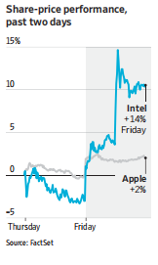
2. Apple, Intel Set Chip-Making Deal
苹果与英特尔达成芯片制造协议

Slide 9
Text Completion
The Wall Street Journal (May 9, 2026 A1&A6)
Apple and Intel have reached a preliminary agreement for Intel to manufacture some of the chips ___________ power Apple devices, according to people familiar with the matter.
Intensive _____ (talk) between the two companies have been going on for more than a year, and the two sides hammered out a formal deal in recent months, these people said. Bloomberg News __________ (previous) reported the talks. It is still unclear which Apple products Intel would make chips for, these people said. Apple ships more than 200 million iPhones a year as well as millions of iPads and Mac computers.
Representatives for Apple and Intel declined to comment.
Intel _____ (have) two main business lines: designing chips and manufacturing them—both its own designs and external customers’—in its Intel Foundry unit. Both businesses had been underperforming for years _______ Lip-Bu Tan took over as chief executive last spring vowing to revitalize them.
The Trump administration last summer struck a deal to convert nearly $9 billion in federal grants into Intel stock, _______ (give) the U.S. government a 10% stake in the chip maker. It played a key role in bringing Apple to the table.
Commerce Secretary Howard Lutnick _______ (meet) repeatedly over the past year with high-ranking Apple officials, including Chief Executive Tim Cook, as well as SpaceX chief Elon Musk and Nvidia Chief Executive Jensen Huang, to try to convince them ______ (get) into business with Intel, some of the people familiar _____ the matter said.
With____ Apple deal, Intel has now signed partnerships with all three.
that/which
talks
previously
has
before
giving
has met
to get
with
the

Slide 10
Reading Comprehension
1. What is known about the Apple-Intel agreement?
A. Intel will design chips for Apple.
B. The deal was reached last month.
C. Apple confirmed it publicly.
D. The products are not specified.
DETAIL
2.What is the main idea of the passage?
A. Intel’s chip business is improving.
B. Apple and Intel made a chip deal.
C. The U.S. government helped the deal.
D. Intel signed deals with three firms.
GIST

Slide 11
Vocabulary
1. ship: to be available to be bought; to make sth available to be bought 上市；把…推向市场
The company continues to ship more computer systems than its rivals.
这家公司继续比竞争对手推出更多的计算机系统。
2. revitalize: to make sth stronger, more active or more healthy 使更强壮；使恢复生机（或健康）
This hair conditioner is excellent for revitalizing dry, lifeless hair.
这种护发素对使干枯、无生气的头发重新焕发光彩非常有效。
Translation
这个软件定于下月上市。
The software is due to ship next month.
Translation
新计划试图给正在衰退的经济以新生。
The new plan tried to revitalize a flagging economy.

Slide 12
Translation
Intensive talks between the two companies have been going on for more than a year, and the two sides hammered out a formal deal in recent months, these people said.
这些人士称，这两家公司之间的深入谈判已经持续了一年多，而双方在最近几个月内终于敲定了正式协议。
Commerce Secretary Howard Lutnick has met repeatedly over the past year with high-ranking Apple officials, including Chief Executive Tim Cook, as well as SpaceX chief Elon Musk and Nvidia Chief Executive Jensen Huang, to try to convince them to get into business with Intel, some of the people familiar with the matter said.
据知情人士透露，美国商务部长霍华德·卢特尼克在过去一年中多次与苹果公司高层官员（包括首席执行官蒂姆·库克）、以及SpaceX首席执行官埃隆·马斯克、英伟达首席执行官黄仁勋会面，试图说服他们与英特尔开展业务合作。

Slide 13
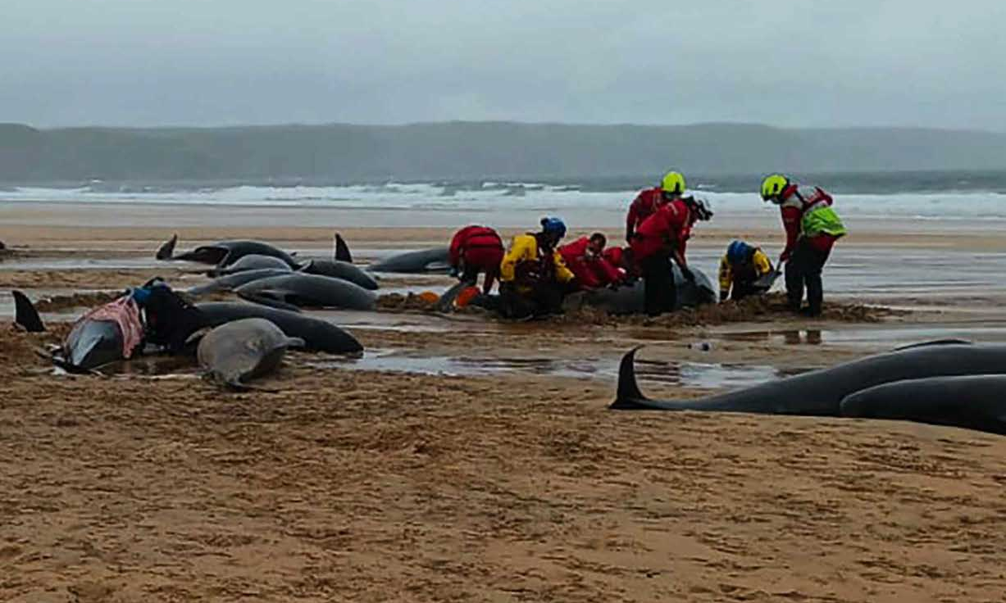
3. Scientists Discover Heartbreaking Reason For Mass Whale Stranding
科学家发现鲸鱼大规模搁浅的令人心碎的原因

Slide 14
Reading Comprehension
BBC Countryfile（May, 2026 P13)
The mass stranding of 55 long-finned pilot whales in Tolsta Bay on the Isle of Lewis in July 2023 seems to have been caused, at least in part, by the marine mammals’ loyalty to their pod, according to a new study involving scientists at the University of Glasgow.
The unusually large landing at Tràigh Mhòr, a sandy beach on the north-east coast of this island in the Outer Hebrides, could have been triggered by the pod’s social instincts. These may have led the whales to remain close to a female experiencing distress during a difficult birth, according to the report compiled by the Scottish Marine Animal Stranding Scheme.
Investigations on one of the female whales detected dystocia – difficulty during labour, which may have been caused by a large or poorly positioned calf. Pilot whales are known for their extremely strong social cohesion, often gathering together en masse when one of the pod is sick or injured in order to protect that individual from predators. In this case, the entire group may have followed the distressed female into shallow waters. One was successfully refloated by rescuers; the rest perished.
The report emphasises that multiple factors are often involved in such incidents. The topography of this beach could have played a role in the stranding of a species usually found in deeper offshore waters. The steep shelf of the shallow bay, potentially combined with onshore winds, may have hindered the pod’s ability to navigate. Once stranded, the whales were unable to refloat themselves, facing surf driven by onshore winds and difficulties caused by the soft sand floor of the bay. The whales were found to have good overall health, with no significant underlying diseases or infections.
An even larger stranding in July 2024 on Sunday, Orkney, resulted in the deaths of a 77-strong pod of long-finned pilot whales. A year later, 23 pilot whales were discovered dead on a different beach on Sunday, again having stranded. The causes of those incidents are being investigated.

Slide 15

Reading Comprehension
1. The word “triggered” in paragraph 2 most likely means ______.
A. caused B. prevented
C. discovered D. weakened
Vocabulary
2. What is the main idea of paragraph 4?
A. Investigation of the incidents.
B. Topographical features of the beach.
C. Many factors causing stranding.
D. Whales’ unability to navigate.
Details
3. What can be inferred from the passage?
A. Whales rarely help each other.
B. Social bonds may bring risks.
C. All strandings are caused by illness.
D. Rescuers saved all whales.
Gist

Slide 16
Vocabulary
1. compile: to produce a book, list, report, etc. by bringing together different items, articles, songs, etc.编写（书、列表、报告等）；编纂
The album was compiled from live recordings from last year’s tour. 这套唱片选辑由去年巡回演出的实况录音汇编而成。
2. hinder: to make it difficult for sb to do sth or sth to happen 阻碍；妨碍；阻挡
Some teachers felt hindered by a lack of resources.
有些教师因资源不足而感到困难重重。
Translation
我们在努力编制一份适合做这项工作的人员名单。
We are trying to compile a list of suitable people for the job.
Translation
一场伤病正使他无法发挥出最佳水平。
An injury was hindering him from playing his best.

Slide 17
Translation
The mass stranding of 55 long-finned pilot whales in Tolsta Bay on the Isle of Lewis in July 2023 seems to have been caused, at least in part, by the marine mammals’ loyalty to their pod, according to a new study involving scientists at the University of Glasgow.
2023年7月，苏格兰刘易斯岛托尔斯塔湾发生55头长鳍领航鲸集体搁浅事件，一项由格拉斯哥大学科学家参与的新研究指出，这一现象至少部分原因在于这些海洋哺乳动物对群体的忠诚。
The topography of this beach could have played a role in the stranding of a species usually found in deeper offshore waters. The steep shelf of the shallow bay, potentially combined with onshore winds, may have hindered the pod’s ability to navigate.
这片海滩的地形可能对这一物种的搁浅事件起到了一定作用。通常生活在较深海域的该物种，在这片浅海湾的陡峭海岸边可能会遇到困难，而强劲的陆上风力也可能对其航行能力造成阻碍。

Slide 18
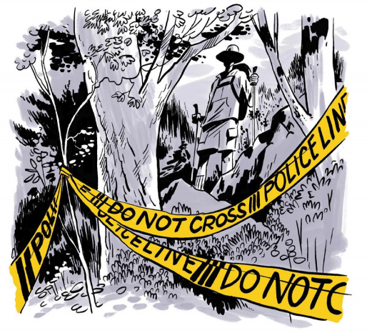
4. Earl Swift
厄尔·斯威夫特

Slide 19
Text Completion
Outside USA（Summer, 2026 P14)
Earl Swift, bestselling author of Chesapeake Requiem, wrote about one of the Appalachian Trail’s (AT) most haunting _________ (tragedy) in the pages of Outside. His new book, Up on Cove Mountain , is ____ extraordinary portrait of the AT, his two thru-hikes, and the murders that have haunted him for three decades.
In 1990, a youthful Swift backpacked the AT from Maine to Georgia, a _____________ (transform) experience ____________ colored every aspect of his later life. He emerged from his hike across the rugged, sky-high roof of 14 eastern states a ________ (sharp) and more organized thinker, a better problem solver, and a committed outdoorsman. But he also ____ (leave) the AT with baggage: early in his odyssey, he spent time with a couple of other southbounders who were friendly, capable, and doing everything right, but who were murdered weeks later at a mountaintop campsite in Pennsylvania—a fit of _________ (violent) that the killer never explained. Half a lifetime later, Swift returned to the trail to find out ________ he was still, in his sixties, equal to the AT’s roller-coaster terrain. ________ (drive) him, too, was a quest for answers that had nagged at him since that first hike.
Up on Cove Mountain is the arresting account of Swift’s 2024 trek through the AT’s enduring wonders and the ghosts of its past, a chronicle of swashbuckling adventure ________ (couple) with a meditation on the nature of risk and the risks of nature.
tragedies
an
transformative
which / that
sharper
left
violence
whether
Driving
coupled

Slide 20
Vocabulary
1. nag: to worry or irritate you continuously不断困扰；老使人烦恼
Doubts nagged me all evening. 我一晚上都没有摆脱心中的疑虑。
2. chronicle: a written record of events in the order in which they happened 编年史
Her latest novel is a chronicle of life in a Devon village.
她的最近一部小说是德文郡一个小村庄的生活记事。
Translation
一种不安的感觉一直困扰着她。
A feeling of unease nagged at her.
Translation
这份报告详细记录了该党自成立以来的历史。
The report is a chronicle of the history of the Party since its formation.

Slide 21
Translation
Earl Swift, bestselling author of Chesapeake Requiem, wrote about one of the Appalachian Trail’s (AT) most haunting tragedies in the pages of Outside. His new book, Up on Cove Mountain , is an extraordinary portrait of the AT, his two thru-hikes, and the murders that have haunted him for three decades.
厄尔·斯威夫特是畅销书《切萨皮克安魂曲》的作者，他在《户外》杂志中讲述了阿巴拉契亚小径上最令人难忘的悲剧之一。他的新书《科夫山之上》描绘了阿巴拉契亚小径的非凡图景，记录了他两次全程徒步的经历，以及那些困扰他三十年的谋杀案。
Up on Cove Mountain is the arresting account of Swift’s 2024 trek through the AT’s enduring wonders and the ghosts of its past, a chronicle of swashbuckling adventure coupled with a meditation on the nature of risk and the risks of nature.
《科夫山上的旅程》讲述了斯威夫特2024年徒步穿越阿巴拉契亚小径时所经历的壮丽奇景与历史幽灵，既是一段充满冒险精神的传奇记述，也是一次对风险本质以及自然之险的深刻沉思。

Slide 22

5. BBC News 05/14/2026

Slide 23

Dictation
Donald Trump is traveling to Beijing on the first trip to China by a US president since he last went there in 2017. The main focus of his talks with Xi Jinping will be the ______ trade relationship. Mr. Trump said he would ask Mr. Xi to _________ China’s economy. Before leaving Washington, Mr. Trump sounded ___________. “He’s been a friend of mine. He’s been somebody that we _______________. And I think you’re going to see that good things are going to happen. This is going to be a very exciting trip. A lot of good things are going to happen.” Mr. Trump said they would also discuss Iran.
Delegations from China and the United States have held ___________ in South Korea _________ President Trump’s arrival in Beijing. The U.S. Treasury Secretary Scott Bessent met the Chinese Vice Premier He Lifeng in Incheon International Airport in Seoul. There’s been ______________ yet from either side.
The British Prime Minister Keir Starmer is meeting his health minister Wes Streeting, a __________ leadership rival as he fights back against efforts to oust him. Ministers who support the Prime Minister _____________________ that the government is getting on with business, including today’s King’s speech, outlining its legislative program. Dozens of Labor MPs have _______ Sir Keir to quit.
tense
open up
optimistic
get along with
trade talks
ahead of
no comment
potential
have been stressing
urged

Slide 24
Vocabulary
1. oust: to force someone out of a position of power or job, especially in order to take their place 罢免，革职，驱逐
The rebels ousted him from power.
叛乱者推翻了他的统治。
2. legislative: relating to laws or the making of laws
与法律或立法相关的
The legislative branch of government is responsible for creating new laws. 政府的立法部门负责制定新法律。
Translation
他被罢免了董事会主席的职务。
He was ousted as chairman of the board.
Translation
该国正在进行重大的立法改革。
The country is undergoing a major legislative reform.

Slide 25
Translation
Delegations from China and the United States have held trade talks in South Korea ahead of President Trump’s arrival in Beijing. The U.S. Treasury Secretary Scott Bessent met the Chinese Vice Premier He Lifeng in Incheon International Airport in Seoul. There’s been no comment yet from either side.
中美代表团在特朗普总统抵达北京前，于韩国举行了贸易会谈。美国财政部长斯科特·贝森特与中国国务院副总理何立峰在首尔仁川国际机场会面。目前双方均未发表任何评论。
The British Prime Minister Keir Starmer is meeting his health minister Wes Streeting, a potential leadership rival as he fights back against efforts to oust him. Ministers who support the Prime Minister have been stressing that the government is getting on with business, including today’s King’s speech, outlining its legislative program.
英国首相基尔·斯塔默正在与卫生大臣韦斯·斯特里廷会面，后者可能是他在领导权上的竞争对手。与此同时，斯塔默正在反击试图罢免他的行动。支持首相的大臣们一直在强调政府正在处理各项事务，包括今天公布的国王演讲，其中概述了政府的立法计划。

