Slide 1


感恩遇见，相互成就，本课件资料仅供您个人参考、教学使用，严禁自行在网络传播，违者依知识产权法追究法律责任。
更多教学资源请关注
公众号：溯恩英语
知识产权声明

Slide 2
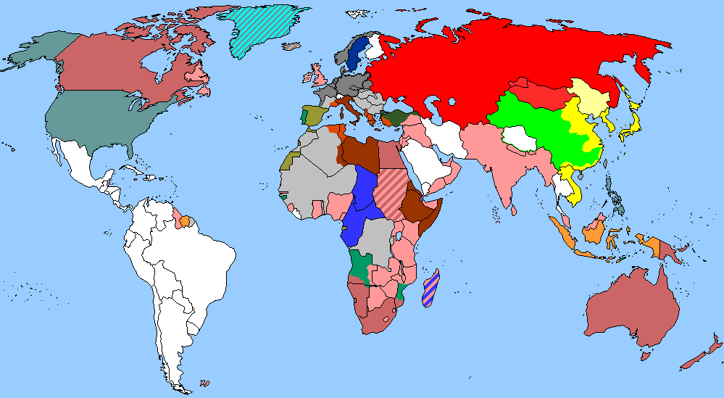
The World
May 16th-31st, 2026

Slide 3
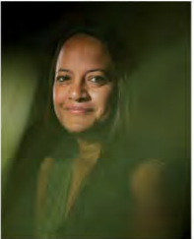
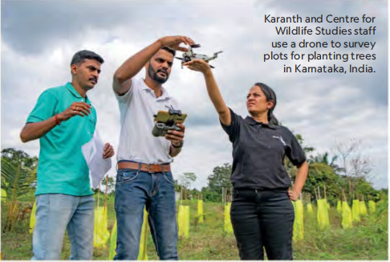
1. Meet the conservationist helping people live with wild animals
她帮助人类与野生动物和谐共处

Slide 4
Text Completion
National Geographic (June, 2026 P14)
In India, when an elephant tramples crops or a leopard attacks livestock—or worse, a person—the fallout can be devastating for families. It can also destroy the bonds ________ humans and nature that are crucial for protecting wildlife. That’s why conservation biologist Krithi Karanth has spent years developing novel strategies _______ (help) people live along_x0002_side some of the world’s most dangerous animals. For that work, she’s been named the 2026 Rolex National Geographic Explorer of the Year, ____ award recognizing significant contributions to research and conservation among National Geographic Explorers.
As CEO of the Bengaluru-based Centre for Wildlife Studies, Karanth _________ (confront) a paradox: that India, crowded with 1.4 billion people, is also a stronghold for wildlife, home to ______________ (approximate) half of Asia’s elephants and roughly three_x0002_quarters of the planet’s wild tigers. ___________ (conserve) those and other species,she says, requires not just habitat but also hearts and minds. To win them, she launched a platform for users to request government compensation _____ wildlife damages crops, livestock, or property. It__________ (help) earn remittance for some 17,000 families. She’s also created a curriculum for schoolkids living near wildlife reserves, now in 1,600 schools, designed to inspire curiosity about and respect for animals.
“Krithi has sparked a movement of hope across India,” says National Geographic Society CEO Jill Tiefenthaler.“By combining science, education, and community partnership, she is redefining _____ people coexist with nature.”
Next, Karanth wants to apply her ideas outside India, cultivating an international crop of environmental stewards—or even just empathetic neighbors. “Having a set of people who at
least tolerate the ___________ (occur) and presence of a large animal,” she says, “is a massive victory.”
between
to help
an
confronts
approximately
Conserving
when
has helped
how
occurrence

Slide 5

Reading Comprehension
1. What did Krithi Karanth do to help residents deal with wildlife-caused damage?
A. She taught kids to respect animals in nature reserves.
B. She created a digital system to apply for state payment.
C. She moved families away from dangerous animal habitats.
D. She persuaded the government to kill problematic animals.
DETAIL
2. What is the main idea of the passage?
A. India faces a human-wildlife conflict.
B. A scientist wins an award for coexistence work.
C. Wildlife attacks cause serious problems in India.
D. Education can reduce animal-related conflicts.
GIST

Slide 6
Vocabulary
1. trample: to step heavily on sb/sth so that you crush or harm them/it with your feet 踩碎；踩伤；践踏
People were trampled underfoot in the rush for the exit.
有人在拼命涌向出口时被踩在脚下。
2. devastating: causing a lot of damage and destruction 破坏性极大的；毁灭性的
Oil spills are having a devastating effect on coral reefs in the ocean.
海上溢油对海洋里的珊瑚礁有着毁灭性影响。
Translation
野营的人践踏了庄稼。
The campers had trampled the corn down.
Translation
他在这次事故中受到致命伤害。
He received devastating injuries in the accident.

Slide 7
Translation
As CEO of the Bengaluru-based Centre for Wildlife Studies, Karanth confronts a paradox: that India, crowded with 1.4 billion people, is also a stronghold for wildlife, home to approximately half of Asia’s elephants and roughly threequarters of the planet’s wild tigers.
作为总部位于班加罗尔的野生生物研究中心的首席执行官，卡拉思面临一个看似矛盾的局面：印度虽然拥挤着14亿人口，却同时也是野生动物的主要栖息地，拥有亚洲约一半的大象和全球近四分之三的野生老虎。
Next, Karanth wants to apply her ideas outside India, cultivating an international crop of environmental stewards—or even just empathetic neighbors. “Having a set of people who at least tolerate the occurrence and presence of a large animal,” she says, “is a massive victory.
接下来，卡拉思希望将她的理念推广到印度以外的地方，培养出一批具有环境责任感的国际公民——或者哪怕只是有同理心的邻居。她说：“如果能有一群人，至少能够容忍大型动物的出现和存在，那就是一个巨大的胜利。”

Slide 8
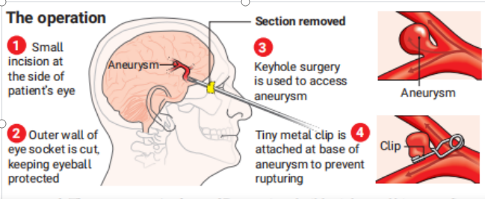
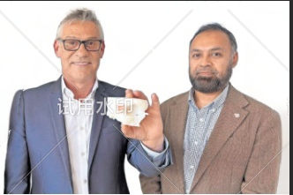
2. Brain aneurysm treated via eye socket in UK first
英国首次通过眼眶治疗脑动脉瘤

Slide 9
Text Completion
The Times (May 19, 2026 P14)
Doctors have performed brain surgery through a man’s eye socket, sparing the need to go through the skull, in a medical first for the UK.
Andrew Wood, 61, a grandfather from Leeds, had the operation in February after being diagnosed _____ a brain aneurysm.
He usually would have needed a craniotomy — in ______ surgeons cut off part of the skull using a drill and a surgical saw — to allow access to the swollen blood vessel.
Instead, a team at Leeds Teaching Hospitals NHS Trust performed keyhole surgery through his eye socket. It was the first time this sort of aneurysm operation ________________ (carry) out in the UK.
Asim Sheikh, ___ consultant neurosurgeon, said that the innovative process meant “we could directly access the aneurysm without even having to touch the brain”. The technique also _____________ (significant) reduced the risk of fatal complications.
The operation involved making a tiny incision at the side of Wood’s eye and cutting the outer wall of his eye socket while keeping his eyeball __________ (protect). The team practised on a 3D model of Wood’s skull.
The main treatment for an aneurysm is clipping. This involves _________ (place) a tiny metal clip across the base of the aneurysm to prevent it from rupturing, which can cause a stroke.
Patients would normally be in hospital for about a week, ____ Wood stayed for just one night. He returned to work in the building trade in May.
Sheikh said Wood got “the best of both worlds” in receiving “a durable cure for his aneurysm while cutting down on the __________ (drawback) of ... big cuts and scars”. He _______ (call) the operation a“significant step forward in minimally invasive brain surgery in the UK”.
with
which
had been carried
a
significantly
protected
placing
but
drawbacks
called

Slide 10
Reading Comprehension
1. How did the new surgery benefit Andrew Wood compared to the traditional one?
A. He stayed in hospital for a much shorter time.
B. He did not need any incision during the operation.
C. He avoided using metal clips to treat the aneurysm.
D. He received the surgery in a hospital near his home.
DETAIL
2.What is the main idea of the passage?
A. A new brain surgery technique avoids opening the skull.
B. A grandfather returned to work after a successful operation.
C. British doctors performed the first eye-socket brain surgery.
D. Keyhole surgery reduces the risk of fatal complications.
GIST

Slide 11
Vocabulary
1. clip: to fasten sth to sth else with a clip ; to be fastened with a clip 夹住；别住；被夹住
Clip the Three CARDS to the pencil.
然后把卡片夹在铅笔上。
2. invasive: involving cutting into the body 切入的；开刀的
Many people find the idea of any kind of invasive surgery unbearable.
许多人觉得任何一种开刀手术都是难以忍受的。
Translation
他把麦克风别在衣领上。
He clipped the microphone (on) to his collar.
Translation
结果是导致我们称为“侵袭式乳癌”的疾病。
The result is what we call invasive breast cancer.

Slide 12
Translation
Asim Sheikh, a consultant neurosurgeon, said that the innovative process meant “we could directly access the aneurysm without even having to touch the brain”. The technique also significantly reduced the risk of fatal complications.
神经外科顾问医师阿西姆·谢赫表示，这一创新手术意味着“我们无需触碰大脑就能直接到达动脉瘤”。该技术还显著降低了致命并发症的风险。
The main treatment for an aneurysm is clipping. This involves placing a tiny metal clip across the base of the aneurysm to prevent it from rupturing, which can cause a stroke.
动脉瘤的主要治疗方法是夹闭术。该手术是在动脉瘤的根部放置一个微小的金属夹，以防止其破裂，因为动脉瘤破裂可能导致中风。

Slide 13
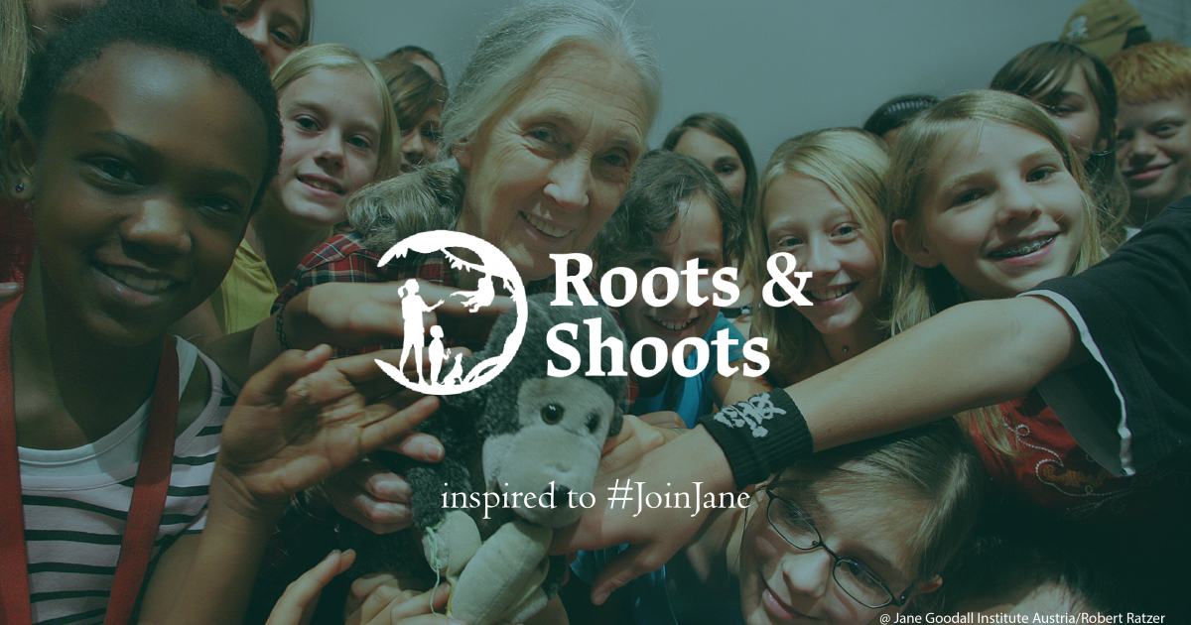
3. Leading young activists
杰出的年轻活动家

Slide 14
Reading Comprehension
The Week Junior USA（May, 29, 2026 P9)
Environmental educator Mary Ford has spent her career connecting people with the natural world. Today, she is the vice president of Roots & Shoots USA, a program founded by the renowned conservationist Jane Goodall. Roots & Shoots connects children with projects that help people, animals, and the environment.
Growing up in Minnesota, Ford loved animals and dreamed of becoming a scientist like Goodall. In high school, she worked at the Minnesota Zoo, where she cared for animals, including a slow loris. “I never in a million years thought that I would work with Jane Goodall or even meet her,” Ford told The Week Junior.
Ford went on to study environmental science at Harvard University and earned a master’s degree in environmental management from Yale University. After college, she traveled to Borneo, Indonesia, to study orangutans in the rainforest. She then shifted her focus from research to education. “I realized my favorite part of learning about animals was sharing that knowledge with other people,” she said.
Previously, Ford worked for other environmental groups, including the World Wildlife Fund. At Roots & Shoots, she leads programs across the US and in about 75 other countries. She meets regularly with students to assist them on their conservation and humanitarian efforts. Her work takes her around the world to provide support for projects ranging from tree planting in California to mangrove protection in Tanzania.
For young people who want to help the environment, Ford encourages small actions, such as picking up litter each time you go outside and throwing it away. “Jane would always talk about how little things made a big difference,” Ford said.

Slide 15

Reading Comprehension
1. What did Mary Ford do when she was in high school?
A. She studied orangutans in Borneo.
B. She worked at the Minnesota Zoo.
C. She met Jane Goodall for the first time.
D. She started the Roots & Shoots program.
Details
2. Why did Mary Ford switch from research to education?
A. She found scientific research too challenging.
B. She wanted to share what she learned about animals.
C. She was hired by the World Wildlife Fund.
D. She needed a master’s degree from Yale.
Details
3. What of the following best describes Mary Ford?
A. Ambitious and honest. B.Invovative and humorous.
C. Emotional and experienced. D.Responsible and committed.
Inference

Slide 16
Vocabulary
1. renowned: famous and respected有名的；闻名的；受尊敬的
It is renowned as one of the region's best restaurants. 这是本地区最好的饭店之一。
2. humanitarian: concerned with reducing suffering and improving the conditions that people live in 人道主义的；慈善的
They are calling for the release of the hostages on humanitarian grounds.
他们站在人道主义立场要求释放人质。
Translation
她的耐心是出了名的。
She is renowned for her patience.
Translation
人道主义工作对他们而言轻而易举。
Humanitarian work comes naturally to them.

Slide 17
Translation
Environmental educator Mary Ford has spent her career connecting people with the natural world. Today, she is the vice president of Roots & Shoots USA, a program founded by the renowned conservationist Jane Goodall. Roots & Shoots connects children with projects that help people, animals, and the environment.
环境教育家玛丽·福特一生致力于让人们与自然世界建立联系。如今，她是“根与芽”美国分会的副主席，该组织是由著名环保主义者简·古道尔创立的。“根与芽”旨在让孩子们参与到有助于人类、动物和环境的项目中来。
For young people who want to help the environment, Ford encourages small actions, such as picking up litter each time you go outside and throwing it away. “Jane would always talk about how little things made a big difference,” Ford said.
对于那些想要为保护环境出一份力的年轻人，福特鼓励他们采取一些简单的行动，比如每次外出时捡起垃圾并将其扔掉。福特说：“简总是会谈到，一些微小的事情竟能产生巨大的影响。”

Slide 18
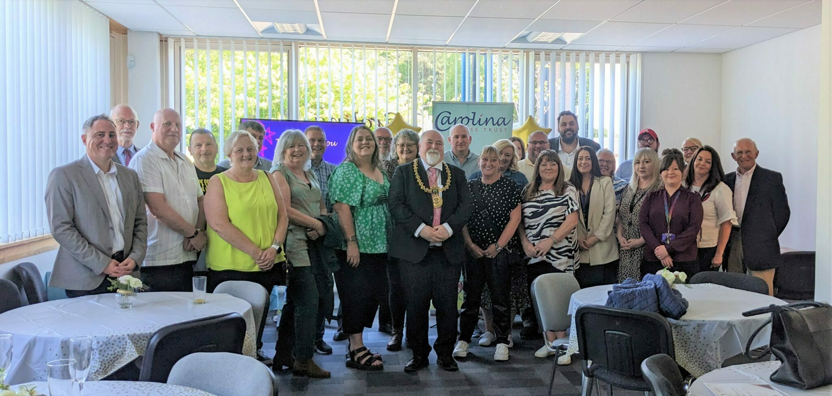
4. At the heart of fostering is compassion
培育的核心在于同情心

Slide 19
Text Completion
For more than 200 years, Carolina House Trust in Dundee has been providing vital services ____ children and young people looking for families. _________ (former) an orphanage, Carolina House Trust is now ___ modern provider of fostering services across east and central Scotland.
Sara Lovelock is chief operating officer there and says she is proud to be part of the trust.
“It’s more than a fostering service, it’s a community,” Sara _________ (explain). “Fostering is joyful, challenging and deeply __________ (reward)as you nurture a child, who may have experienced trauma, to grow, develop and reach their potential. “We have supported people from all walks of life into fostering. Many who have raised their own families have also joined us, ____________ (transform) an empty nest into a caring home.”
At Carolina House Trust, long-term training and support is available to foster carers, particularly those ______ look after vulnerable children. “At the heart of fostering is compassion,” Sara says. “Every carer ____________ (support) by a dedicated social worker, has access to twenty-four-hour support from a familiar on-call team, and can take part in regular training sessions and peer support groups.”
There are also ____________ (opportunity) for staff, carers, children and Board of Trustees to come together at events _______ (help) strengthen relationships and celebrate their shared purpose.
for
Formerly
a
explains
rewarding
transforming
who
is supported
opportunities
to help

Slide 20
Vocabulary
1. trauma: severe and lasting emotional shock and pain caused by an extremely upsetting experience, or a case of such shock happening 精神创伤，心理创伤
He had psychotherapy to help him deal with his childhood traumas. 他进行了心理治疗以医治童年时代受到的心理创伤。
2. compassion: a strong feeling of sympathy for people who are suffering and a desire to help them同情；怜悯
Elderly people need time and compassion from their physicians.
老年人需要医生的时间和同情心。
Translation
两人因共同的创伤而建立了深厚的情感联系。
The two men bonded over their shared traumas.
Translation
我当时想她或许会表现出一点点同情心。
I was hoping she might show a little compassion.

Slide 21
Translation
For more than 200 years, Carolina House Trust in Dundee has been providing vital services for children and young people looking for families. Formerly an orphanage, Carolina House Trust is now a modern provider of fostering services across east and central Scotland.
200 多年来，邓迪的卡罗琳娜之家信托一直为寻找家庭的儿童和青少年提供重要的服务。该机构前身为孤儿院，如今已成为苏格兰东部和中部地区现代化寄养服务的提供者。
“At the heart of fostering is compassion,” Sara says. “Every carer is supported by a dedicated social worker, has access to twenty-four-hour support from a familiar on-call team, and can take part in regular training sessions and peer support groups.”
“关爱的核心在于同情心，”萨拉说，“每位护工都由一名专职社会工作者提供支持，可随时获得熟悉值班团队的24小时帮助，并能参加定期的培训课程和同伴互助小组。

Slide 22

5. BBC News 05/20/2026

Slide 23

Dictation
The United States has issued fresh sanctions __________ Cuba’s intelligence agency, government officials and ministers. The move ____________ hours after the Cuban president insisted that Cuba pose no _______ to the U.S. will further increase pressure on the communist reined Island and its beleaguered __________. The U.S. Treasury announced the measures days after the head of the CIA held talks in Havana with Cuban officials.
Police in the U.S. city of San Diego say 3 people, including a security guard, have been killed in a shooting at an Islamic centre. The two ___________ teenage attackers were found dead in a car nearby with self-inflicted gunshot ________. Witnesses described hearing _________ gunshots from what sounded like a semi-automatic weapon coming from within the complex.
In football, the veteran Brazilian superstar Neymar has been called up for his country’s World Cup squad, returning to the national team after an almost 3-year _________. The 34-year-old Brazil’s all time leading scorer has been hit by a series of injuries that kept him out for much of their __________ campaign. Brazil, who were chasing a _______ 6th World Cup crown open their campaign against Morocco on June the 13th.
targeting
announced
threat
economy
suspected
wounds
multiple
absence
qualifying
record

Slide 24
Vocabulary
1. beleaguer: to cause difficulties for someone or something over a period of time 长期困扰，使陷入困境
The team was beleaguered by injuries throughout the season.
整个赛季球队都受到伤病的困扰。
2. inflict: to make someone or something suffer something unpleasant 使遭受(不愉快的事情)
The hurricane inflicted severe damage on the coastal town.
飓风给沿海城镇造成了严重破坏。
Translation
这个行业一直受到成本上升的困扰。
The industry has been beleaguered by rising costs.
Translation
新法律可能会给低收入家庭带来困难。
The new law may inflict hardship on low-income families.

Slide 25
Translation
Police in the U.S. city of San Diego say 3 people, including a security guard, have been killed in a shooting at an Islamic centre. The two suspected teenage attackers were found dead in a car nearby with self-inflicted gunshot wounds. Witnesses described hearing multiple gunshots from what sounded like a semi-automatic weapon coming from within the complex.
美国圣迭戈市警方表示，一处伊斯兰中心发生枪击事件，造成包括一名保安在内的3人死亡。两名疑似青少年袭击者在附近一辆车内被发现，身上有自残性枪伤，已当场死亡。目击者称，听到从建筑内传来多声枪响，声音类似半自动武器。
In football, the veteran Brazilian superstar Neymar has been called up for his country’s World Cup squad, returning to the national team after an almost 3-year absence.
在足球领域，巴西资深超级巨星内马尔入选了国家队的世界杯大名单，时隔近三年重返国家队。

