Slide 1



感恩遇见，相互成就，本课件资料仅供您个人参考、教学使用，严禁自行在网络传播，违者依知识产权法追究法律责任。
更多教学资源请关注
公众号：溯恩英语
知识产权声明

Slide 2

天马抒笔・
读后续写高分冲刺
春晖中学 龚金萍 2026.5.26

Slide 3

content
吃透考情与评分规则
1. 续写要求与评分标准
2. 浙江高考续写真题考情复盘
3. 续写12大高频失分痛点
二. 避坑指南+自查模板
1.巧理线（如何把握原文）
2.巧构思（如何避免离题）
3.巧点题（如何画龙点睛）
三．提分攻略+考前冲刺
1. 巧用词（如何精准抒情达意）
2. 巧用句（如何丝滑衔接/过渡）
3. 背多分（如何考前梳理/速刷）

Slide 4
01．吃透考情与评分规则

Slide 5

背景：明确要求+吃透标准
1 基本要求：
给出一篇350词以内的英文记叙文，考生依据原文内容、情节逻辑、情感基调，结合两段给定开头语，续写两段共150词左右的短文，实现情节完整、逻辑连贯、文风统一。

Slide 6
1.1.1各档具体要求:
档次 | 描述
第五档 （21—25） | —与所给短文融洽度高，与所提供各段落开头语衔接合理。 —内容丰富。 —所使用语法结构和词汇丰富、准确，可能有些许错误，但完全不影响意义表达。 —有效地使用了语句间的连接成分，使所续写短文结构紧凑。
第四档 （16—20） | —与所给短文融洽度较高，与所提供各段落开头语衔接较为合理。 —内容比较丰富。 —所使用语法结构和词汇较为丰富、准确，可能有些许错误，但不影响意义表达。 —比较有效地使用了语句间的连接成分，使所续写的短文结构紧凑。
第三档 （11—15） | —与所给短文关系较为密切，与所提供各段落开头语有一定程度的衔接。 —写出了若干有关内容。 —应用的语法结构和词汇能满足任务的要求，虽有一些错误，但不影响意义表达。 —应用简单的语句间连接成分，使全文内容连贯。
第二档 （6—10） | —与所给短文有一定的关系，与所提供各段落开头语有一定程度的衔接。 —写出了一些有关内容。 —语法结构单调，词汇项目有限，有些语法结构和词汇方面的错误，影响了意义的表达。 —较少使用语句间的连接成分，全文内容缺少连贯性。
第一档 （1—5） | —与所提供短文和开头语的衔接较差。 —产出内容较少。 —语法结构单调，词汇项目很有限，有较多语法结构和词汇方面的错误，严重影响了意义的表达。 —缺乏语句间的连接成分，全文内容不连贯。
0 | 白卷、内容太少无法评判或所写内容与所提供内容无关。
很不错
注意：
①控制词数：高考答题卡横线为两段各10行，含给定开头句，单段书写95-110词，全文190-220词为最优区间，既满足词数要求，又有足够空间加细节冲高分。
②重视衔接自然、内容丰富和语言准确。
还不错
算清楚
有点乱
胡言乱语

Slide 7
1.1.2 评分原则:
1. 本题总分为25分，按5个档次给分。
2. 评分时，先根据所续写短文的内容和语言初步确定其所属档次，然后以该档次的要求来衡量、确定或调整档次，最后给分。
3. 词数少于120个的，酌情扣分。
4. 评分时，应主要从以下四个方面考虑：
（1）与所给短文及段落开头语的衔接程度；
（2）内容的丰富性；
（3）应用语法结构和词汇的丰富性和准确性；
（4）上下文的连贯性。
5. 拼写与标点符号是语言准确性的一个重要方面，评分时，应视其对交际的影响程度予以考虑。
6. 如书写较差以致影响交际，可将分数降低一个档次。
注意：
①书写！！！
② 主题、情节/情感、人物、冲突、语言、道
具的协同。

Slide 8
1.2 浙江高考续写真题考情复盘
浙江高考续写
卷次 | 梗概 | 类别 | 主题语境 | 主题意义
2016.10 | 夫妻野营吵架，妻子出走后森林迷路 | 冒险脱险类 | 人与人（夫妻） | 人的感悟与成长
2017.6 | 森林骑行遇野狼 | 冒险脱险类 | 人与狼（脱险） | 互帮互助，和谐社会
2017.11 | 健忘母亲在旅行路上的趣事 | 家庭趣事类 | 人与人（家人） | 正确看待人物与困难
2018.6 | 爸爸带儿子农场骑马，森林迷路 | 冒险脱险类 | 人与人（父子） | 人的感悟与成长
2020.1 | 抚养小狗 | 温馨家庭类 | 人与狗（解困） | 关心动物，和谐共存
2020.6 | 拍摄北极熊遇险 | 冒险脱险类 | 人与熊（脱险） | 环境保护
2021.1 | 南瓜卡头 | 家庭趣事类 | 人与人（家人） | 积极看待挫折

Slide 9
浙江高考续写真题回顾
浙江高考续写
卷次 | 梗概 | 类别 | 主题语境 | 主题意义
2021.6 | 作者年幼时打工挣钱支持家庭 | 温馨家庭类 | 人与人（家人） | 家庭责任与自我成长
2022.1 | 学渣和学霸的合作 | 交友互助类 | 人与人（朋友） | 正确与人交往
2022.6 | 我的志愿者经历——施粥 | 社会服务类 | 人与人（他人） | 守望相助，自我成长
2023.1 | 作者解救蜂鸟后遇其报恩 | 交友互助类 | 人与鸟（解救） | 爱护动物，和谐共存
2023.6 | 我在老师鼓励+指导后参加写作比赛得奖 | 问题解决类 | 人与人/自我（成长） | 突破自我
2024.1 | 教学楼迷路与发现 | 问题解决类 | 人与自我（脱困） | 解决问题，突破自我

Slide 10
浙江高考续写真题回顾
浙江高考续写
卷次 | 梗概 | 类别 | 主题语境 | 主题意义
2024.6 | 我遇到善良的出租车司机 | 问题解决类 | 人与人（生人） | 互帮互助，和谐社会
2025.1 | 少年Kevin 发现陌生人闯入邻居家后报警并勇敢阻止 | 问题解决类 | 人与人（误解） | 解决疑问，知错就改
2025.6 | 家庭聚会时作者将兄弟家的狗拒之门外引发冲突。 | 家庭冲突类 | 人与人/狗（家人） | 亲情中的理解与沟通
2026.1 | 作者帮助警察驯服奶牛。 | 问题解决类 | 人与牛（解困） | 公民责任

Slide 11
1.3 续写难点与失分点：
① 人称时态混乱：原文第三人称误用第一人称，指代模糊，时态切换错乱
② 伏笔呼应不足：未回扣原文关键线索，前后情节衔接脱节
③ 情节逻辑违和：违背人物设定与客观常理，关键情节缺少铺垫
④ 语句衔接不畅：衔接词缺失或使用不当，行文零散生硬
⑤ 主题升华欠缺：立意偏离主旨，升华表达空洞牵强
⑥ 行文偏离题意：主线脱离核心冲突，冗余内容占比过多
⑦ 环境描写生硬：景物描写脱离情节，难以烘托心境氛围
⑧ 对话繁杂低效：对白篇幅冗长、用处不大，无法助推情节
⑨ 细节描写单薄：动作情绪刻画笼统，人物形象不够鲜活
⑩ 叙事节奏失衡：情节推进忽快忽慢，铺垫仓促或拖沓冗长
⑪ 基础错误频发：拼写、语法失误较多，降低语言准确度
⑫ 卷面书写欠佳：涂改杂乱，字母大小、疏密不均，观感不佳

Slide 12
02．避坑指南+自查模板

Slide 13
①.巧理线（如何把握原文）
三线把控法：
精准梳理原文情节发展线、人物情感线、人物人设线，三条主线
贯穿续写全文，保障续文与原文高度契合。
1.1 原文情节发展线提炼技巧：：精准梳理整合六大核心要素（人物、时间、地点、起因、经过、结果）
1.2 人物情感与人设提炼技巧：
Tip 1 锁定原文显性情感词汇，快速抓取人物核心情绪
Tip 2 研读人物对话/内心独白与动作细节，深挖隐性心理情感变化
Tip 3 结合原文环境描写，依托情景氛围感知人物心境

Slide 14
例：2024.1 走出教学楼迷宫
情节发展线：had a poor sense of direction→adopted a mind trick to finish one mile running→gained inspiration and applied the method to the teaching building
人物 | Eva
时间 | At the beginning of her high school life
地点 | the track---a six-story building
起因 | Eva刚入高中时面临困难，包括对庞大陌生的校园感到不知所措和在体育课上跑一英里的巨大挑战。
经过 | 她用心理策略发现自己克服了恐惧，成功完成了一英里的跑步。
结果 | 受到跑步成功的启发，Eva决定采用类似的策略来应对学校建筑的问题。
人物情感线：troubled→shocked&feared→confident
para.1隐性情感词:校园迷路，内心困扰 One of the major headaches for her was finding her way in the huge school building. para.3显性情感词+内心独白:得知一英里长跑任务，心生畏惧In her first PE class , Eva was shocked when Coach Pitt announced that everyone had to run one mile around the track outside. ..There was nothing she feared more than having to run a whole mile.and that always seemed like a long way, even in a car! para.5 显性情感词:长跑体力透支，陷入绝望Feeling desperate, Eva started using a mind trick on herself. 续文para.1显性情感词:意外获得教练表扬, 逐步建立自信When Coach Pitt said“Nice work!”to her at the finish line, Eva was surprised.
人物人设线：Poor sense of direction→good at adjusting mentality and solving problems→willing to learn and improve herself
para.2方向感差 Having a poor sense of direction, para.3 体能差 To Eva, “a mile” was used to describe long distances. para.5 善于思考Eva started using a mind trick on herself. para.2 懂得变通Eva decided to use the same trick to deal with the school building.

Slide 15
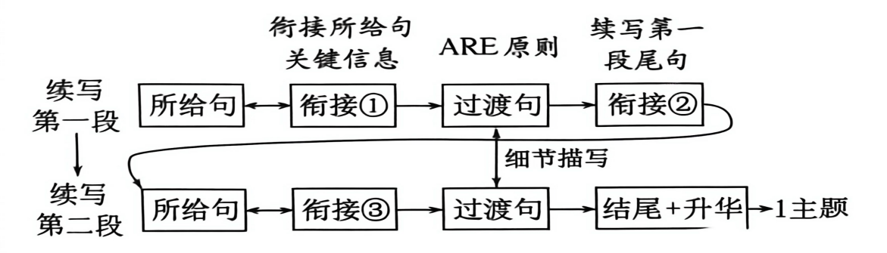
应对策略——②.巧构思（如何避免离题）
续文的情节设计必须严格依托原文语境、人物设定与原有叙事脉络展开。拓展情节、设计冲突与结局时，需精准抓取与呼应原文伏笔线索，遵循完整叙事逻辑，保证续文与前文协同与适配，从而避免偏题、跑题、逻辑断层等问题。
对策： 1. 321原则
3 点衔接：①第一段首句衔接第一段已给句的关键信息；②尾句衔接第二段已给句的关键信息；③第二段的首句衔接第二段已给句的关键信息。
2 个过渡：第一段和第二段首句与尾句之间的过渡情节，描写故事发展过程。
1 个主题：续写部分的主题与原文主题一致。

Slide 16
2.ARE原则
续写时可遵循「行为→反应→情感」的递进链条：
Action（行为/动作）：聚焦故事中人/物的具体动作细节，推动情节发展；
Response（反应/互动）：描写另一人/物的对应动作回应，构建互动场景；
Emotion（情感/情绪）：通过神态、肢体语言或环境烘托，展现角色的情感变化，深化人物塑造。
如(2024.1 走出教学楼迷宫)：
Puffing and panting (A), she was even more delighted when she wheeled around to see (A) a group of her classmates falling far behind (R). A wave of achievement mingled with excitement flooded over her (E).

Slide 17
3.伏笔锚定法
伏笔(Foreshadowing) 是叙事类文本创作中的一种写作手法，指作者对将要在作品中出现的人物或事件预先作提示或暗示，以求前后呼应，从而帮助全文达到结构严谨、情节合理、主题深化及内部联系贯通的效果（莫美玉，2025）。精妙的伏笔与照应可凸显主旨、理顺行文，让续写内容贴合原作逻辑，形成完整叙事闭环。续写常见伏笔可划分为物品伏笔、话语伏笔、细节伏笔三类。
①物品伏笔
例：2026届浙江省县域教研联盟高三模拟考读后续写：狗狗眼中的世界
Para 1.Yet all it took to turn this little rebel into a perfect gentleman was a spoonful of peanut butter (花生酱) or his old tennis ball.
续文可作的伏笔照应：Mrs. Carter entered the yard, passing her a jar of peanut butter,"I think you need this."

Slide 18
②话语伏笔：
例：2016年10月续写：夫妻野营吵架
Para.1 By the time they reached the lake, Jane was so angry that she said to Tom, “I’m going to find a better spot for us to camp” and walked away.
续文可作的伏笔照应：Amid the delight of reunion, she swore inwards she would never leave him again.
③细节伏笔：
例：2017年1月续写人狼大战
Para.1 As Mac pedaled (骑行) along alone, he thought fondly of his wife and two young daughters at home. He hoped to show them this beautiful place someday.
结尾可作的伏笔照应：Aware that gorgeous scenery hid unseen hazards, Mac would never bring his beloved wife and young daughters here.

Slide 19
(3).巧点题（如何画龙点睛）
•点题技巧：灵活运用励志金句、原文核心词句，搭配自然景物或温情场景收尾，回扣故事主线，烘托情感内核，层层拔高文章主旨，让立意更深刻隽永。
(1). 巧用契合主旨的金句，凝练立意，升华主旨。
例1善良. But that was not going to happen — one good turn deserves another(好人有好报) — the firefighters arrived just in time to put the fire out and the tunnel was reopened for use a week later.
例2不放弃Yes grandma was right：quitters never win and winners never quit.半途而废者永无成功，成功者永不放弃。
例3骄兵必败 I learned a valuable lesson that day—pride comes before a fall, and being humble is essential for success.我那天学到了宝贵的一课—— 骄兵必败，谦逊是成功的关键。

Slide 20
续写加分金句
坚持积累・挫折成长类 Constant dropping wears the stone. 滴水穿石。 Rome was not built in a day. 罗马不是一天建成的 / 冰冻三尺，非一日之寒。 No cross, no crown. 不经历风雨怎么见彩虹。 After the storm, the rainbow appears; after attempts, magic happens. 风雨过后，彩虹出现；经过尝试，奇迹就会发生。 Mistakes are the stepping stones to success. 错误是成功的垫脚石。 Every cloud has a silver lining. 黑暗中总有一线光明。 Life is not a bed of roses. 生活并不总是称心如意。 No rose without a thorn. 没有不带刺的玫瑰。 善良包容・待人处世类 Roses given, fragrance in hand. 赠人玫瑰，手留余香。 Kindness begets kindness. 善生善。 One good turn deserves another. 善有善报。 Give without remembering and always receive without forgetting. 施恩勿记，受恩勿忘。 Never judge a book by its cover. 不要以貌取人。

Slide 21
续写加分金句
品格坚守・实干奋进类 A good medicine tastes bitter. 良药苦口。 Honesty is the best policy. 诚实为上策。 Fortune favors the bold. 命运眷顾勇者。 Action speaks louder than words. 事实胜于雄辩。 A man can be destroyed but not defeated. 一个人可以被毁灭，但不能被打败。 阅历成长・合作交友类 Experience is the best teacher. 经验是最好的老师。 A friend in need is a friend indeed. 患难见真情。 Many hands make light work. 众人拾柴火焰高。

Slide 22
(2). 巧用原文核心词汇(包括原文主题词和线索词)、首尾呼应，拔高主旨。
首尾呼应之 A. 复现主题词进行呼应：
例： 2018年6月浙江高考
头：It was summer, and my dad wanted to treat me to a vacation like
never before. He decided to take me on a trip to the Wild West.
尾：Before long, we caught sight of the lights in the distance. We knew
we were safe.What a thrilling vacation, like never before, we had!

Slide 23
B.复现/重新诠释线索词呼应：
1. 2021年6月浙江高考
头：My dad, George, only had an eighth grade education. A quiet man, he didn’t understand my world of school activities. From age 14, he worked. And his dad, Albert, took the money my dad earned and used it to pay family expenses. （认为爸爸不理解我和我的世界）
I didn’t really understand his world either： He was a livestock trucker, and I thought that I would surpass（超越） anything he had accomplished by the time I walked across the stage at high school graduation. （认为可以超越爸爸的所有成就）
尾：At exactly that moment, I realized why my father let me have the money-it was his expectation for my future, his encouragement and quiet love. And that was something I might never surpass.

Slide 24
2.2021年1月浙江省新高考读后续写
头：Pumpkin(南瓜）carving at Halloween is a family tradition.
尾：Thanks to Mom,the video turned out to be a reminder, a captured memorable moment, a recollection (回忆） of festive happiness,colored by hearty/harti/(真挚的）human interactions. But for me, though a little embarrassed, I soon totally forgot the" unforgettable" incident and set out for the trick-or-treat. I would like to take it as a treat(乐事) to add joy and fun to this festive atmosphere.(句中的treat巧妙地与万圣节主题trick-or-treat联系起来。）
3.2021年6月全国新高考I卷读后续写
头：How pleased and proud Mother would be when they brought her breakfast in bed.
尾：The whole room was bathed in a happy Mother's Day atmosphere.

Slide 25
4.2017年11月浙江省高考读后续写
头： I had an interesting childhood. It was filled with surprises and amusements, all because of my mother-loving, sweet, yet absent-minded and forgetful. One strange family trip we took when I was eleven tells a lot about her.
尾：Despite Mom’s being absent-minded and forgetful, she was still a kind and nice mom.
5.2022年1月浙江省高考读后续写
头： As fate would have it, Dr. Henderson very deliberately matched everyone in class and announced that I would be working with the person in class I wanted to avoid.（作者不想和此人合作）
尾： But for my partner, nothing like this could have happened. So when he thumbed up with a rare big grin, it suddenly dawned on me that we were to become kind of lifelong friends. Even better, I received a precious gift-the approval of a person who later became my friend for life.（成为朋友）

Slide 26
(3). 借助日月风雨、花鸟星月等自然景物烘托氛围，以景衬情、借景表意，含蓄升华情感与主旨。
1. 月份：以特定月份定格故事，赋予时光纪念意义，沉淀人物成长感悟。
The golden September witnessed how a boy’s kindness healed his best friend as well as a lonely soul. 金色的九月见证了一个男孩的善良如何治愈了他最好的朋友和孤独的灵魂。
2.动物：用鸟兽动静映射人物心境，烘托喜悦/慰藉等情绪, 烘托圆满结局氛围。
Outside the bakery, the birds chirped happily, as if celebrating their achievement.
在面包店外面，鸟儿欢快地叫着，好像在庆祝它们的成就。

Slide 27
3.景色：以雨、星星、阳光、月色等景色渲染温馨氛围，暗示冲突解决，凸显温情主题。
雨The rain that came that day was a miracle, saving our farm, just like my boy saved a life.那天下的雨是个奇迹，它拯救了我们的农场，就像我儿子拯救了一条生命一样。
/Cold as the rain was, great warmth filled his heart like never before.纵使雨水寒凉，他心底却涌上前所未有的暖意。
星星Vibrant stars twinkled in the sky, waves of hearty laughter ran out of the camp site and delicious smell filled the air. My forgetful mother gave us an unforgettable experience!明亮的星星在天空中闪烁，营地里 传出阵阵爽朗的笑声，空气中弥漫着香味。健忘的妈妈给了我们一次难忘的经历!
阳光The sunlight flooded in through the window, warming the whole room and melting the tension. 阳光透过窗户照进来，温暖了整个房间，融化了紧张的气氛。

Slide 28
(4). 依托动静相融的具象场景，借相拥、畅谈、沉思、欢笑等画面流露心绪，凝练人生感悟，升华文章主旨。
1. 拥抱感动场景Never had Dora received such a gift. Speechless and moved, she held her son tightly into her arms, with tears welling up in her eyes.多拉从未收到过这样的礼物。她激动得说不出话，紧紧地把儿子搂在怀里，眼里涌出了泪水。
2. 内心独白场景Tears of joy and gratitude welling up in her eyes, she threw her arms around her brother, thinking what a blissful world it was and how lucky she was to have Tony as her brother.喜悦与感激的泪水在她眼中涌动，她张开双臂抱住哥哥，心想：这是多么幸福的世界啊，能有托尼做她的哥哥，她是多么幸运。

Slide 29
3. 欢笑温情场景Tingling with ineffable joy and excitement, they chatted and laughed with love and warmth brimming in their hearts, which bonded the family forever. 心中涌动着难以言喻的喜悦与激动，他们有说有笑，爱意与温情充盈心间，这份情感将这个家庭紧紧维系在一起，直至永远。
4. 人物对话场景The mother suddenly gathered the boy to her chest and spoke gently to him, " My little sweetheart, honesty values more than any antique."母亲突然把男孩抱在胸前，温柔地对他说:“我的小宝贝，诚实比任何古董都珍贵。”
5. 人物静立释怀场景Down at the port, the line between sea and sky softened (柔和), the two, hand in hand, folding into(融入) the same wide blue, and into the quiet comfort(慰藉) of each other.The ocean had taken much, but not everything.伫立码头，海天交界的轮廓渐渐温柔，海天相融，化入一片无垠的蔚蓝，二人并肩相依，彼此温柔慰藉、默然相守。大海曾带走诸多美好，却终究留不下世间所有温柔与相伴。

Slide 30

03．提分攻略+考前冲刺

Slide 31
高分作文的核心优势不在于华丽辞藻的堆砌，而在于词汇精准适配、句式灵活多变、衔接自然丝滑、行文逻辑闭环、细节细腻有质感。
1.巧用词（如何精准抒情达意）
高分用词的核心原则：替换笼统词、细化场景词、分层情感词、适配语境词，不用生僻字，用高级适配词，精准贴合行文场景与情感。

Slide 32
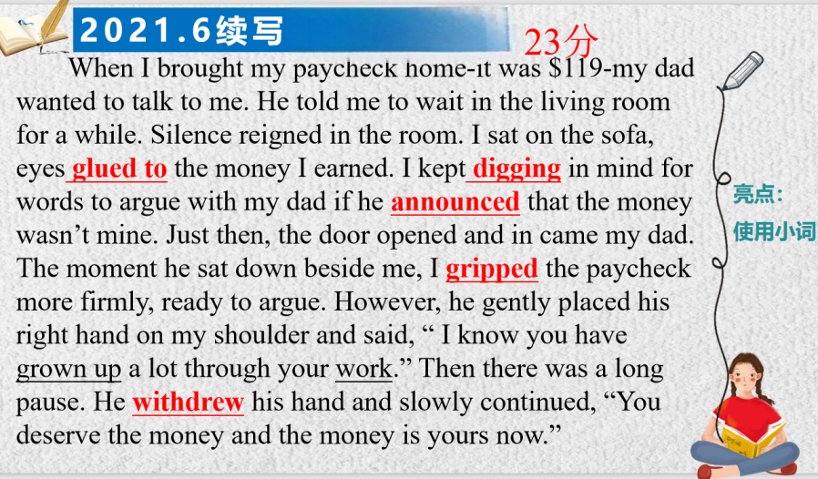
①．用具体小词替换笼统词（Show, don’t tell 核心技巧）
该生用grip(紧握)代替hold完美传递了 “焦虑、抗拒、守护自己工资” 的情绪，让人物形象跃然纸上；;用digging deep in mind 代替think把抽象的 “绞尽脑汁想” 转化为具象的 “在脑海里翻找、挖掘” 的动作，更有表现力;用announce （宣告）代替say，自带 “严肃、不容置疑、带有权威性” 的语气，完美贴合父亲作为家长，在孩子面前说话时的身份感。

Slide 33
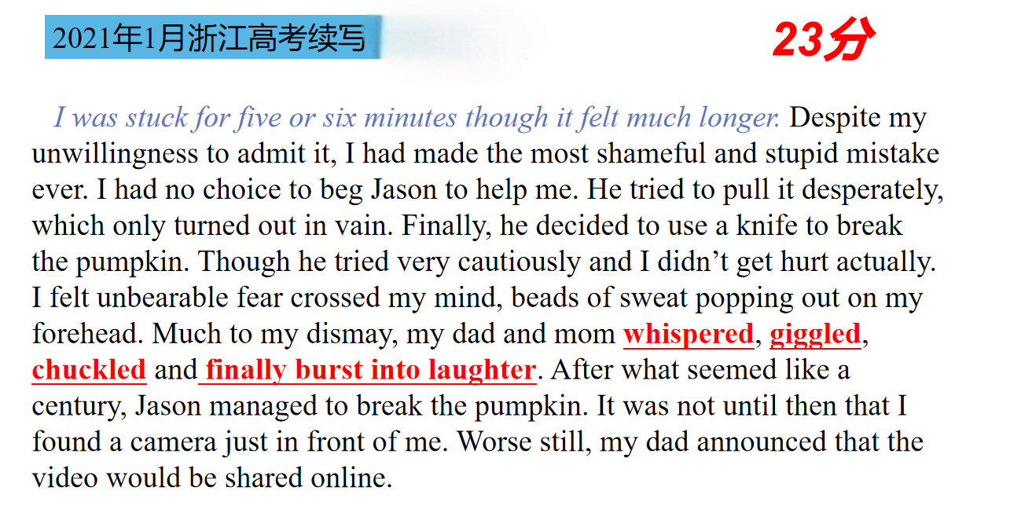
②．用分层词汇凸显程度（情绪/状态递进，避免平铺直叙）
分层词汇，就是针对同一类情绪 / 状态，按照「弱→中→强」的程度梯度，使用不同精准词汇描绘人物情绪变化过程，避免用单一笼统词（如happy/sad/laughed）平铺直叙，让情感表达有层次、更真实。
该生用whisper (耳语)---giggle(咯咯笑)---chuckle (轻声笑)---finally burst into laughter (突然大笑)不同词汇 描写了父母一开始强忍着笑到情绪开始破防，笑意逐渐藏不住到爆发式的大笑，情绪逻辑层层递进，既写出了父母的反应变化，又侧面烘托出“我” 被困在南瓜里的窘迫和尴尬，让场景瞬间有了画面感和戏剧张力；

Slide 34
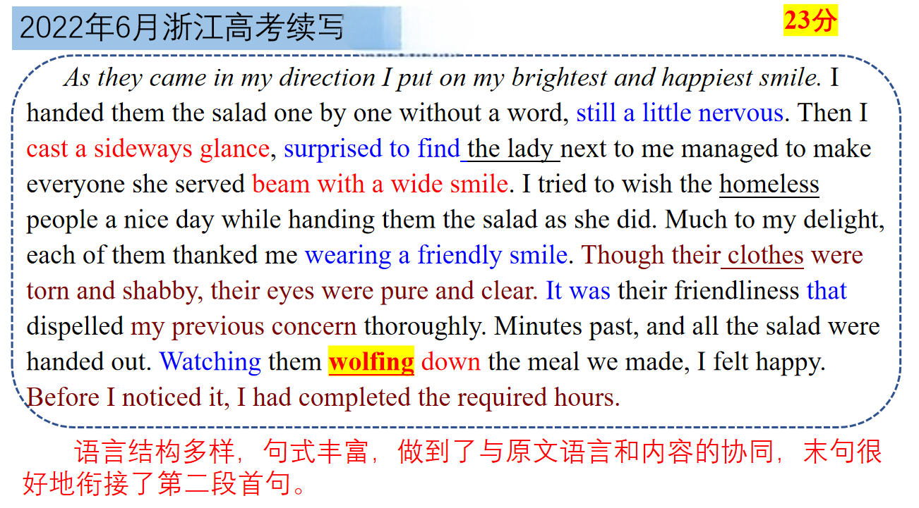
③．活用词汇丰富表达
灵活转换词汇词性、挖掘熟词多元含义，也可同时巧妙结合双关、象征等手法，一词兼具表层表意与深层内涵，可以使表达灵动新颖，同步提升文字质感。
例1：词性活用
该生用短语wolf down 活用名词本义作动词表意，跳出常规 eat 的平淡表述，生动刻画狼吞虎咽的进食模样，动作刻画鲜活立体。

Slide 35
续写加分小词
1.rocket v. 猛冲
My words caught in my throat and melted into screams as the roller coaster suddenly
rocketed forward.过山车突然向前飞驰，我的话语哽在喉咙里，化为尖叫。
2.edge v. 徐徐移动（=inch）
She edged nervously towards the door, unsure of what she would find inside.
她紧张地慢慢挪向门口，不确定里面会有什么。
3. surface v. 露面/浮现 A vivid memory surfaced.一段生动的记忆浮现了。
4. share n.一份
She collected from a life that has had its share of both joy and pain. 她从一段既有欢乐也有痛苦的生活中汲取感悟/ 力量等
5.blossom: v变得更加健康（或自信、成功）
Juan blossomed in my advanced chemistry class.胡安在我的高级化学课上表现得非常出色。
6.demonstrate v. 展示
He demonstrated the incredible role of an uncle.他诠释了好叔叔的角色。
7.lift 心情/情绪高兴起来/使更愉快 I felt decades of anger lift.我感到几十年的愤怒烟消云散了。
8. squeeze v.挤出
In the chaos, King squeezed her way through the crowd, grabbed the terrified baby and carried her to her mother.在一片混乱中，金从人群中挤了出来，抓住了这个吓坏了的婴儿，把她抱到了她妈妈身边。

Slide 36
续写加分小词
9.secure v1. 成功获得 2. 固定
After months of efforts, she finally secured the scholarship she had long dreamed of.
经过几个月的努力，她终于获得了梦寐以求的奖学金。
They gather twigs and leaves to secure a nest for their young.它们衔来枝叶，为幼鸟搭建巢穴。
10.wheel / spin (spun, spun) around v1.转身 2. 推
Grant wheeled around.格兰特转过身来。
An elderly man wheeling a bicycle paused beside me, unfolded his umbrella and held it silently over my phone for three minutes. 一位推着自行车的老人在我身旁停下，撑开伞默默地为我的手机遮了三分钟的雨。
11.stumble over/through sth （不顺畅地）说，读，演奏
I confidently told the kids that a mysterious creature lived there — but stumbled when they asked me follow-up questions. 我自信地告诉孩子们，那里住着一种神秘的生物——但当他们问我后续问题时，我却结结巴巴地说不出话来。
12.swim v.眩晕；晃动
Her vision (视线) swam before focusing on two faces leaning close — Hill’s and Smith’s. 她的目光游走在两张靠近她的脸上——希尔和史密斯。
13.silence v. 使不说话；使不再发表（反对意见）
She was going to silence all those doubts. No more eye-rolling from her big brother. No more “You’re too young, Anna” from her parents.她要消除所有的疑虑。她的哥哥不再翻白眼了。再也不会听到父母说“你还太小，安娜”。

Slide 37
续写加分小词
14.snake v. 蜿蜒前行 snaking 蜿蜒的
The line behind me continued to snake its way into an aisle.我身后的队伍继续像蛇一样蜿蜒进入过道。
Her bike stayed level, but mine was snaking all over the place.她的自行车保持水平，而我的自行车却弯弯曲曲地乱转
15.bond v.建立联系
My willingness to be more open allowed me to bond with another student I met on my course.我愿意更加开放，这让我和我在课程上遇到的另一个学生建立了联系。
16.escape v. 被忘掉；被忽视；未被注意
He has shown an exceptional talent for noticing details that escape others. 他在注意别人没有注意到的细节方面表现出了非凡的才能。
17.weave v.（weaved 或 move woven）1. 蜿蜒行进 2. 交织
The man weaved his way through the crowded market, searching for the perfect gift for his mother.这个男人穿过拥挤的市场，为他的母亲寻找最完美的礼物。
The sun began to weave its golden threads through the trees.太阳开始在树林间编织金色的丝线。
18.anchor v.固定
Fear anchored his feet to the ground.恐惧使他的双脚僵在地上。
Amidst the chaos of the storm, his father’s calm voice anchored him. 让他心安

Slide 38
续写加分小词
19.hover v. 盘旋、萦绕、徘徊
A sense of fear hovered in his heart.一种恐惧感在他心中盘旋。
His gaze hovered on the broken vase, filled with regret.他的目光停留在破碎的花瓶上，心中满是悔恨。
tiptoe v.蹑手蹑脚地走（=sneaked/crept）
He tiptoed past the door, holding his breath.他屏住呼吸，蹑手蹑脚地从门边走过。
21.floor v.使惊呆、使不知所措
The news that she had won the first prize in the international competition floored her family.
她在国际比赛中获得一等奖的消息让她的家人惊呆了。
22.storm v.怒气冲冲地走
She stormed out of the room after arguing with her friend.和朋友争吵后，她怒气冲冲地冲出了房间。
23.flood v.大量涌入
Memories/donations flooded in.回忆 / 捐款大量涌来。
24.course v.快速流动
Tears coursed down her cheeks when she heard the news.听到这个消息，泪水顺着她的脸颊流下。
25.bank v.堆积
Snow banked up against the window.雪在窗户边堆积起来。

Slide 39
续写加分小词
26.jog (-gg-)v.唤起（记忆）
The old photo jogged her memory of the summer she spent with her grandma.
这张旧照片唤起了她和奶奶一起度过的那个夏天的回忆。
27. blanket v. 覆盖；笼罩Mist blanketed the valley at dawn.黎明时薄雾笼罩着山谷。
28. nudge v. 用肘轻推；促使某人做某事
Her friend’s encouragement nudged her to finally sign up for the singing competition.在她朋友的鼓励下，她终于报名参加了歌唱比赛。
29.freeze (froze, frozen) v. 突然停住；僵住
She froze in her tracks when she spotted a dark figure approaching.当她看到一个黑影朝她走来时，她停住了脚步。
The music froze suddenly, and the whole hall fell into silence.音乐突然停了下来，整个大厅鸦雀无声。
30.wind (wound, wound) v. 蜿蜒穿行
The path winds through the forest to the mountain top.这条小路蜿蜒穿过森林到达山顶。
31.shower v. 大量地给
I showered them with zillions of thanks.我对他们表示了无数的感谢。
32.land v. ①陷入困境 ②获得（工作 / 合同等）
Her efforts paid off. Finally she landed the job.她的努力得到了回报。她终于得到了那份工作。
His carelessness landed him in trouble.他的粗心使他陷入困境。

Slide 40
续写加分小词
33.distance v. 与… 保持距离
She tried to distance herself from the controversial issue.她试图与有争议的问题保持距离。
34.carry v. 承载（情感 / 信息）
The old letter carried the warmth of her grandma’s love.这封旧信充满了她祖母温暖的爱。
35.buffet v. 艰难度过
She buffeted through hard times with her family’s support.她在家人的支持下度过了困难时期。
36. cushion v. 减轻（压力、伤害）；缓和（冲击、影响）
Her parents’ support cushioned the blow of her failed exam, making her feel better.父母的支持减轻了她考试不及格的打击，使她感觉好多了。
37.stuff v. 塞
Before we began hiking, he had a sleeping bag stuffed into my pack.在我们开始徒步旅行之前，他在我的背包里塞了一个睡袋。
comb v.梳理；仔细搜寻
He combed through his memories, struggling to recall the exact details.他仔细回忆，努力回忆起确切的细节。
39.scoop v.抱起、搂起
Seeing the puppy fall into the grass, I quickly scooped it up.看到小狗跌进草丛，我连忙把它抱了起来。
40.cup v.-pp-手捧
I cupped my hands to catch the falling raindrops.我伸手捧起落下的雨滴。

Slide 41
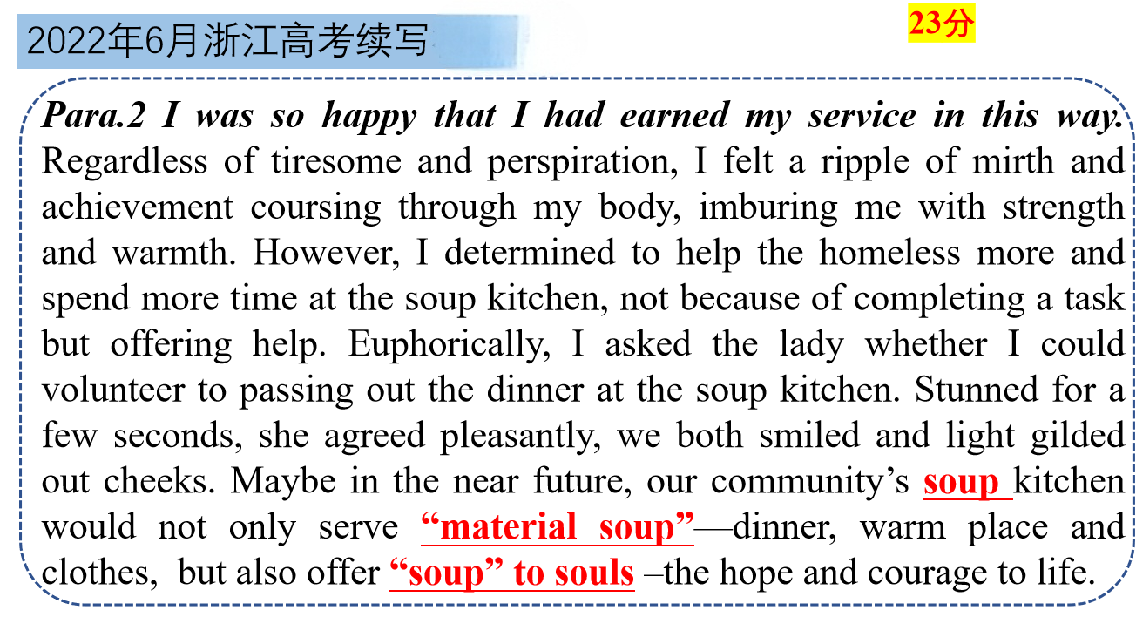
例2. 词义双关运用
该生巧用soup一词的双关含义，以表层的 “餐食汤羹” 呼应 soup kitchen（施粥所）的实景，又以 “soup to souls” 赋予其 “精神慰藉与生活希望” 的深层象征意义，一词双关串联起物质帮助与心灵关怀，既贴合情节语境，又升华了志愿服务的主题，让文字意蕴更显深刻动人。

Slide 42
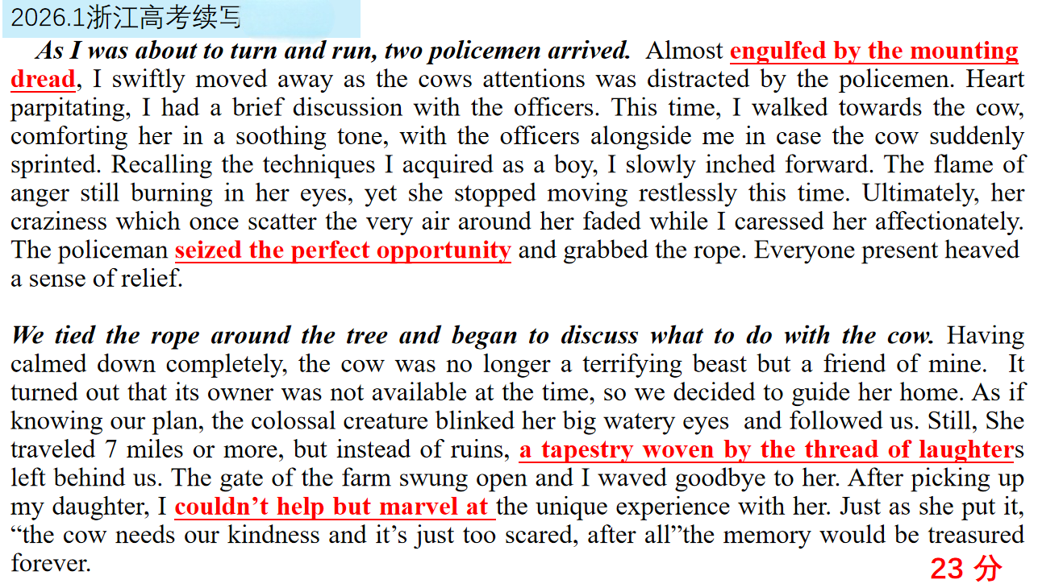
2.巧用句（如何丝滑衔接/过渡）
①．巧用俚语、习语与俗语，让语言地道出彩
在续写中合理使用高频习语、固定搭配，既能跳出“中式英语” 的平淡表达，又能快速提升语言的地道感与文采，同时不增加理解难度。
例：2026.1 浙江高考
很多同学写“我很害怕” 只会用 I was very scared，写 “抓住机会” 只会用 take the chance，而该生用 engulfed by dread、seize the opportunity等这类惯用习语搭配，跳出了中式英语的平淡表达，语言质感直接提升一个档次。

Slide 43
续写加分俚语俗语习语
rain or shine 不管发生什么; 风雨无阻
Eg. She practised rain or shine.她风雨无阻地练习。
be over the moon欣喜若狂
Eg. I felt like walking on air as eventually I gained an A for my paper.当我最终为我的论文拿到A 等成绩时，我欣喜若狂。
rain cats and dogs下倾盆大雨
Eg. It rained cats and dogs when we finished the exam, so we had to wait in the classroom for the rain to stop.我们考完试时下起了倾盆大雨，只好在教室等雨停。
out of the blue突然；出乎意料
Eg.The good news that he won the scholarship came out of the blue and made him excited.他获得奖学金的好消息来得很突然，让他激动不已。
have butterflies in one’s stomach感到紧张；心里发慌
Eg. I had butterflies in my stomach before the college entrance examination started.高考开始前我心里十分紧张。
sb be blown away某人感到震惊；被深深打动
Eg. We were blown away by his excellent performance in the English speech contest.他在英语演讲比赛中的出色表现让我们大为震惊。
chicken out临阵退缩；因害怕而放弃
Eg. He was going to participate in the English debate contest but chickened out at the last minute due to nervousness.他本打算参加英语辩论赛却因紧张在最后一刻临阵退缩了。

Slide 44
续写加分俚语俗语习语
make one’s day让某人开心一整天；使某人非常高兴
Eg. Receiving a handwritten encouragement note from my teacher made my day during the stressful review period.复习压力大的时候，收到老师手写的鼓励便条，让我开心了一整天。
ups and downs 有成功有失败
Eg. Life is full of ups and downs. 生活总是有起有伏的。
a lucky dog 幸运儿
Eg. He scored high in TOEFL without much preparation. He is really a lucky dog.
他没怎么准备托福就考了高分，他可真是个幸运儿。
one in a million 凤毛麟角，百里挑一，佼佼者
Eg. Li Ming is one in a million—his kindness and sense of responsibility set a great example for his peers.
Sb be chilled to the bone 全身都冻僵了
Eg.After waiting for the delayed bus in the pouring rain for nearly an hour, I was chilled to the bone, my fingers numb and teeth chattering uncontrollably.在倾盆大雨中等待晚点的公交车近一个小时后，我全身都冻僵了，手指发麻，牙齿不由自主地打颤。

Slide 45
续写加分俚语俗语习语
green with envy 特别羡慕，羡慕死了
Eg.When she learned that her sister is going abroad again, she is green with envy.当她听说她姐姐又要出国时，她羡慕死了。
hold dear珍视、非常在乎
Eg.Honesty is something most of us hold dear.诚实是我们大多数人所珍视的东西。
One’s heart missed a beat 心里一惊
Eg. His heart missed a beat when he saw what happened.当他看到所发生的一切时，他的心都停止了跳动。
Heart in mouth/throat 心都提到了嗓子眼
Eg. Her heart was in her mouth as she stepped onto the stage.走上舞台时，她心都提到了嗓子眼。
hold water站得住脚
Eg. Realizing that Missy's story didn't hold water and couldn't escape his acute eye, I blushed with embarrassment.意识到米西的故事站不住脚，逃不过他敏锐的目光，我尴尬地脸红了。

Slide 46
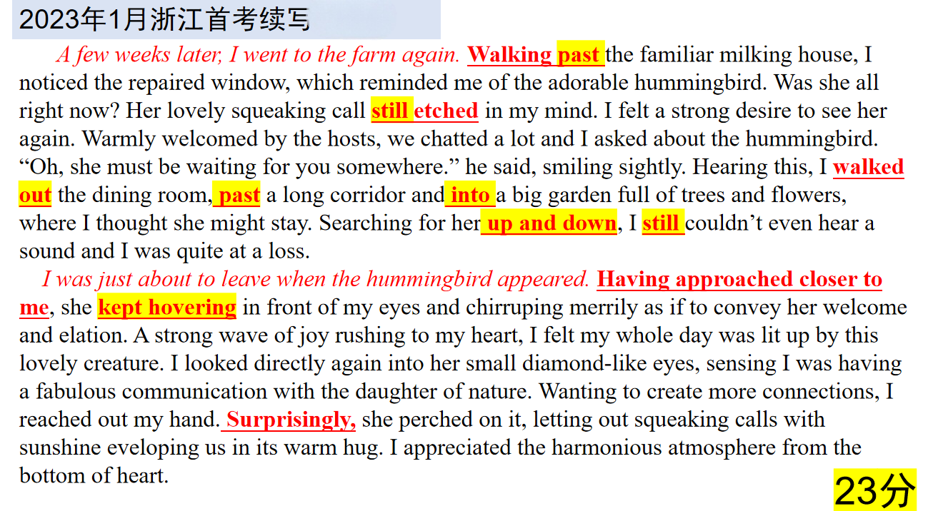
②．妙用衔接过渡，让行文逻辑闭环丝滑
通过逻辑衔接词、过渡句、场景转换词串联情节与情绪，避免段落生硬断裂，实现“起承转合” 的自然流畅。
这篇作文能拿到 23 分，过渡的 “丝滑感” 是关键加分项 —— 它的每一个衔接都服务于情节和情绪，没有多余的套路词，完全实现了 “起承转合” 的自然闭环。空间位移链walk out → past → into实现场景转换、行动推进；Walking past... / Having approached...用分词短语过渡实现开篇引入与动作衔接；Surprisingly / Still情绪转折词促进反转情节、情绪递进；up and down / kept hovering动作具象化又强化细节、推动情绪。

Slide 47
续写衔接手段与策略：
① 情节推进类衔接：用时间/顺序词串联事件发展，让叙事节奏清晰：
就在那一刹那At that split moment/In that breath, I realized small acts could cast light for others.v就在那一刻，我意识到小小的举动也能照亮他人。
过了很久After what seemed a century, the long-awaited train finally arrived at the station.
一眨眼的功夫 In the blink of an eye, the girl came back breathlessly, a paper bag held tightly in her hand.
没过多久It wasn’t long before the sun started to set, casting a beautiful orange glow over the horizon.
一… 就… Hardly had I stepped out when I was greeted by a flawlessly cleaned driveway, shimmering in the twilight.
正要做… 突然… Tom was about to close the window when his attention was caught by a bird.
还没来得及… 就… Before Father could utter a single word of blame, Jane threw herself at him, pouring out the whole tale.
直到… 才… Not until I picked the taco（玉米卷） up did I spot a $20 bill along with a note, reading “Kindness is free. Take care.”

Slide 48
续写衔接手段与策略：
① 情节推进类衔接：用时间/顺序词串联事件发展，让叙事节奏清晰：
就在此时我才… It was then that he really realized the true significance of granny’s wisdom.
几乎在同时Almost at the same time, I heard a chorus of “Happy Birthday”
然后轮到他了 Then came his turn
只剩下最后五英里了 Here came the last five miles!
接下来两个小时我在马不停蹄地清扫The following two hours witnessed me cleaning the house without a single halt.
一天天的 with each passing day
就在那时，一个想法闪过脑海Just then, a thought struck me.
我还没来得及反应Before I could react, everything got out of hand.
突然Out of the blue, someone grabbed my hand.
接下来的事情超出想象What happened next was beyond my imagination.

Slide 49
② 情绪转折类衔接：用转折词体现心理变化，让情感过渡不突兀：
Ø尽管身心俱疲Despite physical and mental exhaustion
Ø最初的震惊平复之后Recovering from the initial shock, …
Ø不再沉溺在绝望中Rather than abandoning myself to despair
Ø尽管外面很冷心变暖 Freezing cold as it was outside, my heart was brimming over with satisfaction and happiness.
Ø忐忑不安地Having butterflies in my stomach, I, …
Ø不管我的抗议despite my protest…
Ø认识到自己天真I used to think everything was under control—how naive I was.
Ø信心被彻底摧毁My confidence was shattered in a matter of seconds.
Ø看起来正常事实却不是Everything seemed normal—until it wasn’t.
Ø以为会生气结果却笑了I expected him to be angry, but instead, he smiled.
续写衔接手段与策略：

Slide 50
② 情绪转折类衔接：用转折词体现心理变化，让情感过渡不突兀：
Ø一直不理不睬但这次却温柔地说话She had always ignored me, but this time, she spoke gently.
Ø看起来很强硬却透露出脆弱He appeared tough, but his eyes betrayed his vulnerability.
Ø没有责骂反而给拥抱Instead of scolding me, my mother gave me a warm hug.
Ø没有惩罚反而表扬To my astonishment, the teacher praised me instead of punishing me.
Ø说不在乎但能看出担忧Although he said he didn’t care, I could see the concern in his eyes.
Ø以为会离开但却留下I thought she would leave, but she stayed by my side.
Ø很幸运的是/很不幸的是As luck would have it, the train was late.不巧火车晚点了。
续写衔接手段与策略：

Slide 51
③ 场景/视角转换类衔接：用环境/感官描写过渡场景，避免直白跳转：
Ø事情变得更糟了However, things took a turn for the worse.
Ø奇迹般出现 As if by magic, he suddenly appeared
Ø察觉出异常 Detecting something unusual, I…
Ø突然安静下来Total silence descending for a moment,
Ø如释重负With a heavy load taken off his mind, …
Ø想到此At the thought of this…
Ø在一种莫名的力量的驱使之下Driven by a force from nowhere
Ø在他父亲的坚持下At her father’s insistence, …
Ø突然，身后一个声音让我驻足。Suddenly, a voice behind me stopped me in my tracks.
Ø出乎意料的是Unexpectedly/Out of my expectation, the door creaked open on its own.
Ø正当我要离开时But just as I was about to leave, something caught my eye.
Ø他的目光一落到……The moment his gaze fell on…
Ø映入眼帘的是……What came into view was…
续写衔接手段与策略：

Slide 52
放大版见word
3.背多分（如何考前梳理/速刷）
话题分类 | 续写主题 | 语料
1.校园生活类 | Ø突破自我，从不自信到自信 Ø适应新学校 Ø应对挑战或偏见 | 一起打扫寝室He immediately bent down to gather the pizza boxes and empty snack bags, and folded the messy clothes on his chair neatly. Andy, meanwhile, busied himself tidying up the overflowing bin and mopped the floor inch by inch meticulously, wiping every crumb away. Many hands make light work. Soon, the dorm was clean.他立刻弯腰收拾披萨盒与空零食袋，把椅子上凌乱的衣物叠放整齐。安迪则忙着清理堆满杂物的垃圾桶，一丝不苟地逐寸拖地，擦净每一处碎屑。众人齐心效率倍增，宿舍很快就焕然一新。 用心术应对挑战It seemed that her mind trick worked! Breaking down the challenging task into smaller ones did make it easier. 看来她的心术奏效了！将具有挑战性的任务分解成更小的任务确实会让它变得更容易。 医院探望+交心The once stern expressions now all dissolved away, replaced by a pale and stiff grin. I felt seized by a sudden gush of grief as he uttered, “Don’t mind me. Finish the project alone.” Fist clenched tightly, I nodded unwaveringly. It was weird that I was on the verge of tears, to the guy once I hated most.曾经冷酷的神情此刻全都消散，取而代之的是一抹苍白而僵硬的笑容。他轻声说道：“别管我，你一个人把项目做完吧。”我紧握拳头，坚定地点了点头。奇怪的是，我竟快要落泪，而对象却是曾经最恨的人。 结尾感悟： 1.友谊不是一味妥协Together, they worked out the rules and taped(用胶带粘贴)/pinned(用图钉钉在墙上) the paper on the wall. With this, the messy days were gone for good(永远) and it also reminded them that true friendship was not one-sided compromise, but mutual growth and shared responsibility.他们一同制定规则，将纸张粘贴钉上墙。自此杂乱的日子彻底远去，这也让他们明白，真挚的友谊并非单方面迁就，而是彼此成长、共担责任。 2.策略+行动=成功Reflecting on the series of accomplishments, she was fully aware: with a willing heart, a workable strategy, as well as immediate action, nothing is impossible!回顾这一系列的成就，她深有感触：只要怀着一颗积极的心，制定出可行的策略，并迅速付诸行动，那么没有什么是不可能实现的！ 3. 关系改进We got a straight A by Dr. Henderson and he hugged me tightly when I told him. My seemingly single-minded and cold teammate and I together, achieved something satisfying, and had fun but more than fun.我们在亨德森医生的考试中得了a，当我告诉他时，他紧紧地拥抱了我。我和看似一心一意、冷酷无情的队友一起取得了一些令人满意的成就，我们玩得很开心，但不仅仅是开心。

Slide 53
话题分类 | 续写主题 | 语料
2.优秀品行类 | 走出道德困境/抉择，坚守诚实品质 | 不说实话，保持沉默Realizing that Missy's story didn't hold water and couldn't escape his acute eye, I blushed with embarrassment yet once again, I chose to remain silent. 意识到米西的故事站不住脚，逃不过他敏锐的目光，我又一次尴尬地脸红了，我选择保持沉默。 承认错误 Tina, blushing with embarrassment, started to stammer out the truth. 蒂娜尴尬得满脸通红，开始结结巴巴地说出真相。 主旨升华：: 1. 诚实乃上策Honesty is the best policy. The mother suddenly gathered the boy to her chest and spoke gently to him," 2. 诚实比古董珍贵My little sweetheart, honesty values more than any antique."妈妈突然把小男孩抱在胸前，温柔地对他说：“我的小甜心，诚实比任何古董都珍贵。” 3.车可修复信任不可"My dear children," his voice softened,"honesty holds greater value than anything else. A damaged car can be repaired but trust can’t." With our heads lowered in shame, we learned a thought-provoking lesson.“我亲爱的孩子们，”他的声音变得柔和了，“诚实比什么都重要。损坏的汽车可以修复，但信任无法修复。”羞愧地低着头，我们学到了发人深省的一课。

Slide 54
话题分类 | 续写主题 | 语料
3.善行互助类 | Ø赠人玫瑰手留香 Ø对慈善事业的认同 Ø善行链条（善生善） | 相助 行动答谢I showered them with zillions of thanks.我对他们表示了无数的感谢。 喉咙哽咽I had a lump in my throat, too moved to speak. 我喉咙哽咽，感动得说不出话来 救人“Everyone, come here” Olav shouted, waving his arms in the air, signaling people to run towards his van. ..Under the influence of the strong wind, smoke spread even faster. It’s just like a life versus对抗 smoke match. As a former volunteer firefighter, Olav knew well what would happen if they didn’t leave as soon as possible. Hardly had the tourists piled into the van and he zoomed to the cab when he accelerated the speed. “大家到这里来。”奥拉夫喊道，他在空中挥舞着手臂，示意人们向他的货车跑去……在强风的影响下，烟雾蔓延得更快了。这就像一场生命大战。作为一名前志愿消防员，奥拉夫非常清楚如果他们不尽快离开会发生什么。游客们还没来得及挤进车里，他就加快了速度，飞快地跑向驾驶室。 结尾感悟： 善良治愈灵魂+恢复对人性的信心That day witnessed how a Mexican family’s kindness healed a helpless soul, and restored my faith in humanity.那一天见证了一个墨西哥家庭的善良如何治愈了一个无助的灵魂，并恢复了我对人性的信心。 善良是把社会联系在一起的金链It suddenly hit me that kindness is the golden chain by which society is bonded together. 我突然意识到，善良是把社会联系在一起的金链。 赠人玫瑰，手留余香。Roses given, fragrance in hand. 善举温暖了冷天The bus stop had witnessed how kindness was shared between absolute strangers, which added warmth to that cold and wet evening.：他向我微微一笑便驾车离去。那个公交站见证了陌生人之间善意的传递，这给那个寒冷潮湿的夜晚增添了温暖。

Slide 55
话题分类 | 续写主题 | 语料
4.亲情 | Ø家人间消除隔阂、增进理解 Ø家人的陪伴 / 鼓励带来勇气、自信、成长 Ø感恩家人的付出 | 冲突： 摔门She slammed the door behind her, the noise echoing her fury.她摔上身后的门，响声呼应着她的怒火。 怒火中烧Anger boiled inside her, and she couldn’t hold it back. 结尾感悟： 1.学会爱just on that day both Lena and her mom learned how to define safety and control,privacy and openness, love and to beloved.就在那一天，莉娜和她的妈妈都学会了如何定义安全与控制、隐私与开放、爱与被爱。 2.家人的爱一直在身边Richard’s love had never left—it had just turned into the warmest part of my new life, wrapped in the boundless love of my family who held me dear.理查德的爱从来没有离开过，它刚刚变成了我新生活中最温暖的部分，包裹在我亲爱的家人无限的爱中。 3.定义家庭的不是完美In that moment surrounded by the warmth she had thought was lost, the ice around Sara’s heart began to melt. She finally understood that family isn’t defined by perfection, but by the courage to mend what’s broken.在那一刻，被她以为已经失去的温暖包围着的萨拉的心开始融化。她终于明白，定义家庭的不是完美，而是修补破碎的勇气。

Slide 56
话题分类 | 续写主题 | 语料
5.友情 | Ø消除误解、重拾友情 Ø真正的友情是 Ø友情助力困难解决，帮助对方变得更好 | 怀疑I studied him from head to toe in suspicion, the thought of Rogers would be laughed at by everyone making me feel furious.我很怀疑地上下打量他， 一想到罗杰斯会被众人嘲笑我就非常生气。 意识到误会With a jolt, I realized that I might have made a mistake. 我心里咯噔一下, 想到自己可能错怪他了。 误会消除Tears welling up in my eyes, I hugged her tightly, with all the awkwardness between us melting away. 隐藏的好I felt a mixture of embarrassment and satisfaction striking into my heart. Maybe I had misunderstood him and maybe he's even kind of sweet...in a hidden sort of way.我感到一种既尴尬又满意的感觉涌上心头。也许我误解了他，也许他甚至有点好……以一种隐蔽的方式。 不要以貌取人Never judge a person by his appearance.

Slide 57
话题分类 | 续写主题 | 语料
6.跨文化沟通 | Ø解决跨文化冲突 Ø建立跨文化友谊 Ø文化认同与尊重 | 用功夫突破文化隔阂Encouraged by their enthusiasm, Li Ming overcame his shyness and began to open up.He even taught them some basic moves, and the group had a great time learning together. 在他们热情的鼓励下，李明克服了羞怯，开始敞开心扉。他甚至教了他们一些基本的动作，这群人在一起学习得很开心。 折纸融入A wave of relief and excitement washed over May. When the first club meeting arrived, a handful of students showed up. As May helped a shy member fold a paper crane, she saw Olivia giving her a thumbs-up from across the room. A warm sense of accomplishment filled her. Mom was right—being her crafty self had not only found her a friend but had helped her create a place where she belonged.一阵宽慰和兴奋的情绪席卷了梅。第一次俱乐部会议开始时，来了几个学生。当梅帮助一个害羞的成员折纸鹤时，她看到奥利维亚在房间的另一边对她竖起大拇指。一种温暖的成就感充满了她。妈妈是对的——她灵巧/巧妙的自我不仅给她找到了一个朋友，而且帮助她创造了一个属于她的地方。 结尾感悟 He realized that by sharing something he loved, he had eventually defeated his fears and entered a whole new world of friendship and cultural exchange.他意识到，通过分享自己热爱的事物，他最终战胜了内心的恐惧，踏入了一个充满友谊与文化交流的全新世界。 His mom was right—he didn’t need to speak Spanish to connect. 他妈妈说得没错 —— 人与人之间的联结，不需要靠西班牙语来搭建。 Seeing the room enveloped in an ocean of warmth, Amanda was moved and proud that this diverse group of students finally found a sense of belonging. 看着整间屋子被浓浓的暖意笼罩，阿曼达既感动又自豪 —— 这群背景各异的学生终于找到了归属感。

Slide 58
话题分类 | 续写主题 | 语料
6.跨文化沟通 | Ø解决跨文化冲突 Ø建立跨文化友谊 Ø文化认同与尊重 | 用功夫突破文化隔阂Encouraged by their enthusiasm, Li Ming overcame his shyness and began to open up.He even taught them some basic moves, and the group had a great time learning together. 在他们热情的鼓励下，李明克服了羞怯，开始敞开心扉。他甚至教了他们一些基本的动作，这群人在一起学习得很开心。 折纸融入A wave of relief and excitement washed over May. When the first club meeting arrived, a handful of students showed up. As May helped a shy member fold a paper crane, she saw Olivia giving her a thumbs-up from across the room. A warm sense of accomplishment filled her. Mom was right—being her crafty self had not only found her a friend but had helped her create a place where she belonged.一阵宽慰和兴奋的情绪席卷了梅。第一次俱乐部会议开始时，来了几个学生。当梅帮助一个害羞的成员折纸鹤时，她看到奥利维亚在房间的另一边对她竖起大拇指。一种温暖的成就感充满了她。妈妈是对的——她灵巧/巧妙的自我不仅给她找到了一个朋友，而且帮助她创造了一个属于她的地方。 结尾感悟 He realized that by sharing something he loved, he had eventually defeated his fears and entered a whole new world of friendship and cultural exchange.他意识到，通过分享自己热爱的事物，他最终战胜了内心的恐惧，踏入了一个充满友谊与文化交流的全新世界。 His mom was right—he didn’t need to speak Spanish to connect. 他妈妈说得没错 —— 人与人之间的联结，不需要靠西班牙语来搭建。 Seeing the room enveloped in an ocean of warmth, Amanda was moved and proud that this diverse group of students finally found a sense of belonging. 看着整间屋子被浓浓的暖意笼罩，阿曼达既感动又自豪 —— 这群背景各异的学生终于找到了归属感。

Slide 59
话题分类 | 续写主题 | 语料
7.文化传承 | Ø坚守传统 Ø尝试创新 | 坚守传统+创新形式 拍视频传网上+解读 This time, her camera swept across the leather album's sketches of Timmy's curved spoon and lingered on a yellowed newspaper featuring his distinctive stairs. As Grandfather narrated their story, she zoomed in on his hands — weathered yet steady — shaping a piece of wood into art. The video ended with his voice,"Hands remember stories machines forget. " 拍视频+翻译 Hesitant as they were, elders sang into the phone—harvest chants, whispered star myths. Miguel cataloged each file, adding English translations.老人们迟疑地对着手机哼唱起来 —— 丰收歌谣，低吟的星辰传说。米格尔将每一份音频文件分类归档，还附上了英文翻译。 结尾感悟/变化 1.订单增加Wood shavings danced in the sunlight as the workshop came back to life, the order book's empty February page now filled with March's mounting demands.木屑在阳光下纷飞，工坊重焕生机。订单簿二月的空白页，已然被三月不断增加的订单填满。 2. 贡献力量David and his classmates cheered, feeling a sense of accomplishment. They knew that their hard work had made a difference and that they had played a part in saving a piece of history.大卫和同学们欢呼起来，心中满是成就感。他们深知，自己的付出已然带来了改变，更在守护一段历史的过程中，贡献了自己的一份力量。

Slide 60
话题分类 | 续写主题 | 语料
8.节日风俗 | Ø节日意义 Ø节日传承 | 节日分享It was indeed a traditional jack-o'-lantern, and it captured the essence of the holiday. As the light cast shadows around the room, I began to tell them about the origins of Halloween, the legends of spirits and the custom of carving pumpkins to drive off evil spirits. 这确实是一盏经典的南瓜灯，尽显万圣节日韵味。光影在屋内摇曳错落，我顺势向大家讲述万圣节的由来、鬼怪传说，以及雕刻南瓜驱邪避凶的传统习俗。 节日真谛That night taught us the true essence of Thanksgiving—it lies not just in giving, but in sharing hand in hand, even in the face of hardship. 那个夜晚让我们领悟到感恩节的真谛：它不只在于馈赠，纵使身处困境，携手相伴、彼此分享才是核心所在。

Slide 61
话题分类 | 续写主题 | 语料
9.表演比赛类 | Ø正确面对失败 Ø友谊第一比赛第二 Ø克服恐惧 Ø尊重对手 | 比赛前紧张A feeling of panic seized him. 她惊慌失措。 Anxiety tore him into pieces. 焦虑不安。 比赛中动力与坚持His parents were screaming at their top voice, which gave Mike an extra burst of energy. 迸发出额外的能量 Mike gritted his teeth and pushed on.咬紧牙关 比赛后群众反应The audience burst into thunderous/deafening applause.爆发出掌声 /His teammates gathered around him, offering their congratulations to him, throwing him in midair. 抛至半空 结尾感悟 比赛精神与态度：自律是王道！ 回想起来，迈克清楚地意识到，冰淇淋从来都不是，将来也不会是他的幸运符，他的获胜意志才是！Reflecting, Mike was well aware that ice cream was never, and would never be, his lucky charm, his will to win was, instead! 比赛态度：虽败犹荣 As dad carried me around, I felt a different kind of victory, one that came from knowing I had given it my best though I didn’t win.

Slide 62
话题分类 | 续写主题 | 语料
10.自然探索类 | Ø尊重自然 Ø必备求生技能很重要 Ø救人勇气与美德 | 自救 Tom felt a surge of fear welling up; he tried to call for help at the top of his voice, but his cries were drowned out by the deafening thunder crashing overhead. With no other choice, he struggled toward it, slipping and falling several times on the slippery ground. 汤姆感到一股恐惧之情油然而生；他竭尽全力大声呼救，但他的喊声被头顶上震耳欲聋的雷声所掩盖。别无选择，他艰难地朝那个方向爬去，在湿滑的地面上几次滑倒跌倒。 救人 Approximately fifty yards offshore, he discovered a terrifying scene: a teenage girl was struggling in the deep water, desperately holding onto the foot of another girl who was completely submerged and unconscious. Acting quickly, Bell managed to pull the lifeless girl into his boat. Her face had turned blue, and she showed no signs of breathing. Fortunately, Bell had completed a CPR training course just months earlier for his truck driving job. Remembering his training, he immediately began chest compressions. After several tense moments, the girl finally coughed up water and began breathing again. She was later identified as 15-year-old Genesis Delgado and made a full recovery.在离岸约 50 码的地方，他发现了一幕令人惊恐的场景：一名少女在深水中挣扎，拼命抓着另一名已完全溺水、失去意识的女孩的脚。贝尔反应迅速，成功将这名奄奄一息的女孩拖上了自己的船。女孩的脸已经憋成青紫色，毫无呼吸迹象。幸运的是，贝尔几个月前因货车司机的工作需求，刚完成了心肺复苏（CPR）培训课程。他回忆起所学的内容，立刻开始为女孩进行胸外按压。在数分钟的紧张抢救后，女孩终于咳出积水，恢复了呼吸。这名女孩随后被确认是 15 岁的吉妮西丝・德尔加多（Genesis Delgado），且最终完全康复。 主题升华： 这段经历让我懂得，绝不能忽视安全事项的重要性，而且要永远心怀希望。This experience taught me never to ignore how important safety things are and to always keep hoping. 这场危及生命的经历给了她一次深刻的教训，让她深刻认识到敬畏大自然的力量和珍惜生命的重要性。This life-threatening experience served as a tough lesson, impressing on her the significance of honoring nature’s strength and cherishing life. 知难而退亦是英雄 A true hero knows to respect nature, to accept limits, and to retreat gracefully-that was a lesson the mountains taught me.一个真正的英雄懂得尊重自然，接受极限，优雅地后退——这是群山教会我的。

Slide 63
话题分类 | 续写主题 | 语料
11.人与动物类 | Ø陪伴、珍爱动物 Ø难忘经历 Ø陪伴 Ø尊重大自然 Ø获得教训 | 动物救助： I bandaged 用绷带包扎him...Immediately I scooped him up and cautiously placed him in a cardboard box with towels, mimicking a nest, and stayed up all night researching how to care for him.I fed him some food,chirped(chirp =chirrup v. 鸟叫,这里指学鸟叫) at him, sang him to sleep…tenderly stroking his feathers.我用绷带给他包扎……我立刻把他抱起来，小心翼翼地把他放进一个装有毛巾的纸板箱里，就像一个鸟巢一样，并整夜守在旁边研究如何照顾他。我给他喂了些食物，对着他学鸟叫，给他唱歌哄他入睡……温柔地抚摸着他的羽毛。 2.After breaking the ice using the man’s rock, Arens jumped into the icy water. He surfaced in time to see the dog going under. Arens swam about five feet toward the dog, grabbed hold of her collar, and pulled her out of the water and onto the ice. He then put the dog into the boat and slid it back to the bank, where anxious bystanders carried the dog to the home of the rowboat’s owner, a retired vet.阿伦斯用那块石头破冰后，跳进了冰冷的水中。他浮出水面时，正好看到狗沉下去了。阿伦斯游了大约五英尺向狗游去，抓住了它的项圈，把它从水里拉出来放到冰面上。然后他把狗放进船里，滑回岸边，焦急的旁观者把狗抬到了船主人的家里，船主人是一位退休的兽医。 结尾感悟： 那天的雨是一个奇迹，拯救了我们的农场，就像我的儿子拯救了一条生命一样，这是对同情力量的珍贵提醒。(主题升华；同位语； 回应原文的miracle) The rain that day was a miracle, saving our farm, just like my boy saved a life, a precious reminder of the power of compassion. 那个圣诞节，他们都学到了宝贵的一课：圣诞节的真正精神不是礼物或盛宴，而是团结起来关心那些无法照顾自己的人。(主题升华用借代 回应原文的受困的马) That Christmas, they all learned a precious lesson: the true spirit of Christmas isn’t about gifts or feasts, but about coming together to care for those who cannot care for themselves. 在那一刻，他突然明白了：他不需要通过赢得这场战斗来证明自己——真正的坚韧在于放手并继续前进。瑞德拍了拍他的肩膀，“孩子，你的父母会为你感到骄傲的。”约翰笑了，一种平静的平静笼罩着他，准备迎接新的生活。(哲理感悟式升华) In that moment, it suddenly clicked: he didn’t need to prove himself by winning this fight—true resilience lay in letting go and moving forward. Red clapped his shoulder, “Your parents would be proud, son.” John smiled, a quiet peace settling over him, ready to embrace a new life.

Slide 64

the end

