Slide 1


感恩遇见，相互成就，本课件资料仅供您个人参考、教学使用，严禁自行在网络传播，违者依知识产权法追究法律责任。
更多教学资源请关注
公众号：溯恩英语
知识产权声明

Slide 2





2026年6月高考冲刺系列
良驹破局・
AB篇阅读满分冲刺
—— 浙江省常山县第一中学 吴俊峰

Slide 3

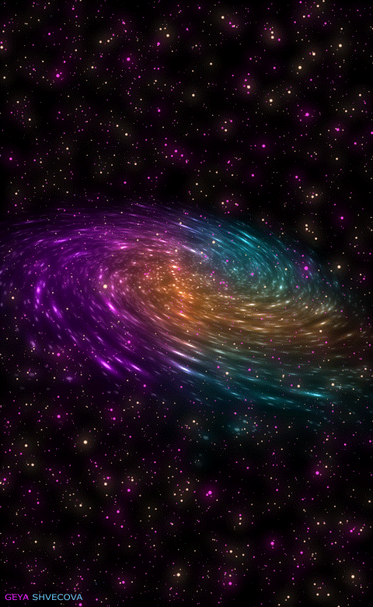

新高考思维优化——精通词义延伸方式和过程
①主题句本身会包含核心话题和决定语篇发展方向的控制性信息，主要陈述部分则需要将控制性信息进行语义延展，为支撑主题句服务。
②利用关键词重复来突出并强化主旨。核心关键词存在复现的关系，围绕同一主题前后呼应，形成词汇链和语义链，建构逻辑链，使文本语际间实现语义上的衔接和连贯。
③利用语义场保证主题和语义传递取得统一（信息流flow的桥梁通道）。 阅读过程中要善于扫描同词/同话题词，建构语义链→逻辑链，搭建信息流flow的通道。尤其注意paraphrase(释文，改述，换说)的地方往往是题眼。
“哒哒哒--达达”信息搭桥法
Notes:
联系 系统 真实挑战
应用 迁移
大概念不是法则，从左到右，先算个位后算十位，从低位到高位。 乘除法规则运算：先分后合
最核心的是什么？
基于知识技能 高于知识技能 的思想 理念 认识 准则
自主学习能力
选择不同的工具进行测量，能够准确表示。高楼 大树 不能测量可以选择参照物估测。
真实的 挑战性
教室的高 楼房的高
大概念可以是各种形式的体现：一个词、一个短语、一个句子或者一个问题
站位很高，长远的目标，指向学生核心素养，抓住大概念，抓住基本问题，实现预期结果和目标

Slide 4

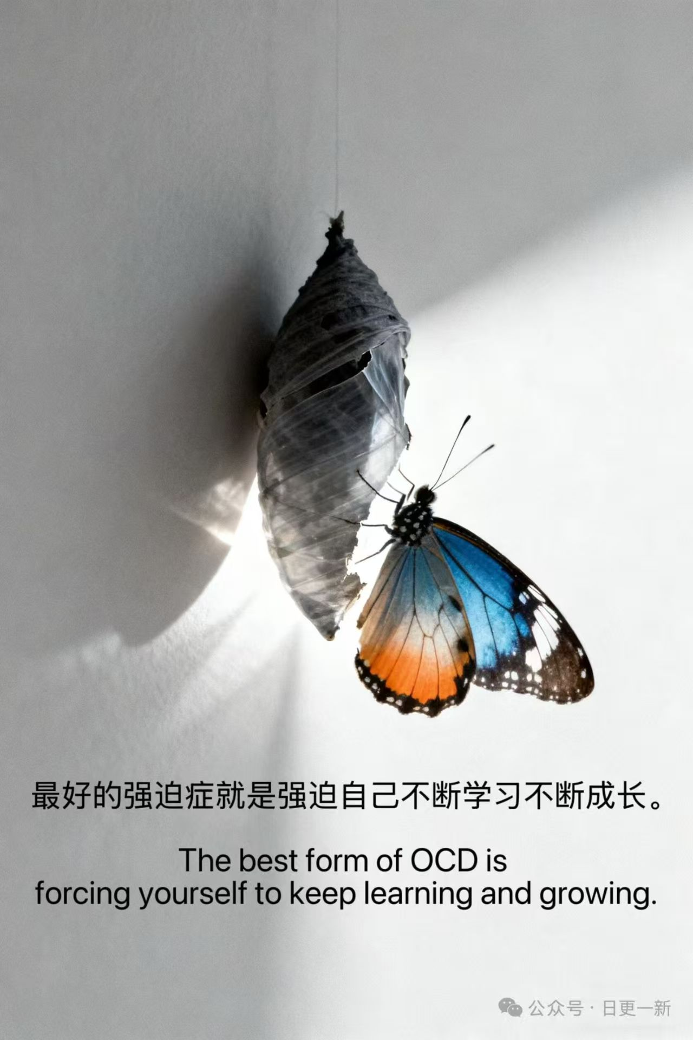
一分钟精准秒杀A篇阅读理解
—— 先主题框架，再题干关键词，
后原文快速定位信息源

Slide 5

2026年1月浙江高考A篇 阅读理解满分突破思维策略
——语篇解构
21. What is the purpose of this text?
A. To raise money for local artists.
B. To release a collection of artwork.
C. To introduce a cultural festival.
D. To call for artworks for a project.
22. How long will the public art signs be on display?
A. Ten days. B. Three weeks.
C. One month. D. Two months.
23. Which of the following meets the application requirements?
A. A 150-word poem.
B. A 100-word self-introduction.
C. A 300-word story.
D. A 200-word artwork statement.
The City of Burlington public art program is presenting a series of temporary public art signs at the Beachway in conjunction with the Ontario Culture Days. This project will select 10 visual artists and 10 writers to create artwork that will be displayed on temporary signs along the multi-use path. This call is open to Burlington-based artists and is open to all art forms that can be presented in a sign format. This includes, but is not limited to: visual art, graphic art, photography, poetry, short story, non-fiction, etc. Submissions may be from existing or newly created work.
The artist fee for this project is $400. The City of Burlington will pay for all costs related to the production, installation (安装) and maintenance of the signs.
Estimated Project Timeline
August 2 | Call for Artists responses due
By August 12 | Successful artists selected; enter into a contract with the City of Burlington
September 6 | Final artwork files due
September 23~October 13 | Artwork displayed for duration of Culture Days celebration
Application Package
Artwork Statement: Please provide a brief statement (maximum 150 words) outlining your artwork concept.
Artwork or Writing Submission:
● Visual Art Submission: Please submit an artwork sketch (草图) of your concept. This can be a work in progress rather than a completed piece. If you are proposing to use a completed artwork, please submit it as your “sketch”.
● Writing Submission: Submissions must be a maximum of 250 words. It may be a stand-alone piece such as a poem or short story or a part taken from a larger piece.
Artist Biography: Please provide a short introduction (maximum 50 words) to the artist written in the third person.
语篇结构快定位，信息采集巧加工
1.快速读标题，获取文章主旨大意: Part1 项目概况→ Part2 时间节点→ Part3 申请要求。
2.题干关键词快速回到原文定位信息源：
① 题目=阅读提纲；题文同序有规律
② 题目→形成问题链：项目目的 → 展示时长 → 符合要求的申请材料。

Slide 6

2026年1月浙江高考A篇 阅读理解满分突破思维策略
——语义链和逻辑链的建构
21. What is the purpose of this text?
A. To raise money for local artists.
B. To release a collection of artwork.
C. To introduce a cultural festival.
D. To call for artworks for a project.
22. How long will the public art signs be on display?
A. Ten days.B. Three weeks.
C. One month.D. Two months.
23. Which of the following meets the application requirements?
A. A 150-word poem.
B. A 100-word self-introduction.
C. A 300-word story.
D. A 200-word artwork statement.
The City of Burlington public art program is presenting a series of temporary public art signs at the Beachway in conjunction with the Ontario Culture Days. This project will select 10 visual artists and 10 writers to create artwork that will be displayed on temporary signs along the multi-use path. This call is open to Burlington-based artists and is open to all art forms that can be presented in a sign format. This includes, but is not limited to: visual art, graphic art, photography, poetry, short story, non-fiction, etc. Submissions may be from existing or newly created work.
The artist fee for this project is $400. The City of Burlington will pay for all costs related to the production, installation (安装) and maintenance of the signs.
Estimated Project Timeline
August 2 | Call for Artists responses due
By August 12 | Successful artists selected; enter into a contract with the City of Burlington
September 6 | Final artwork files due
September 23~October 13 | Artwork displayed for duration of Culture Days celebration
强化建构关键信息链的意识与能力
敏锐捕捉核心信息的同义复现：public art program=This project=This call ，建构语义链→逻辑链，搭建信息流flow的通道。
精准领悟This call 的内涵“号召，呼吁”在具体语境的外延为“项目征集公告”，建构D选项“call for”的高阶思维信息桥梁。
快速回到第一段寻读跳读，整合信息链，补位补全D选项“ artworks”和“ for a project”的对等信息匹配。
Application Package
Artwork Statement: Please provide a brief statement (maximum 150 words) outlining your artwork concept.
Artwork or Writing Submission:
● Visual Art Submission: Please submit an artwork sketch (草图) of your concept. This can be a work in progress rather than a completed piece. If you are proposing to use a completed artwork, please submit it as your “sketch”.
● Writing Submission: Submissions must be a maximum of 250 words. It may be a stand-alone piece such as a poem or short story or a part taken from a larger piece.
Artist Biography: Please provide a short introduction (maximum 50 words) to the artist written in the third person.

Slide 7
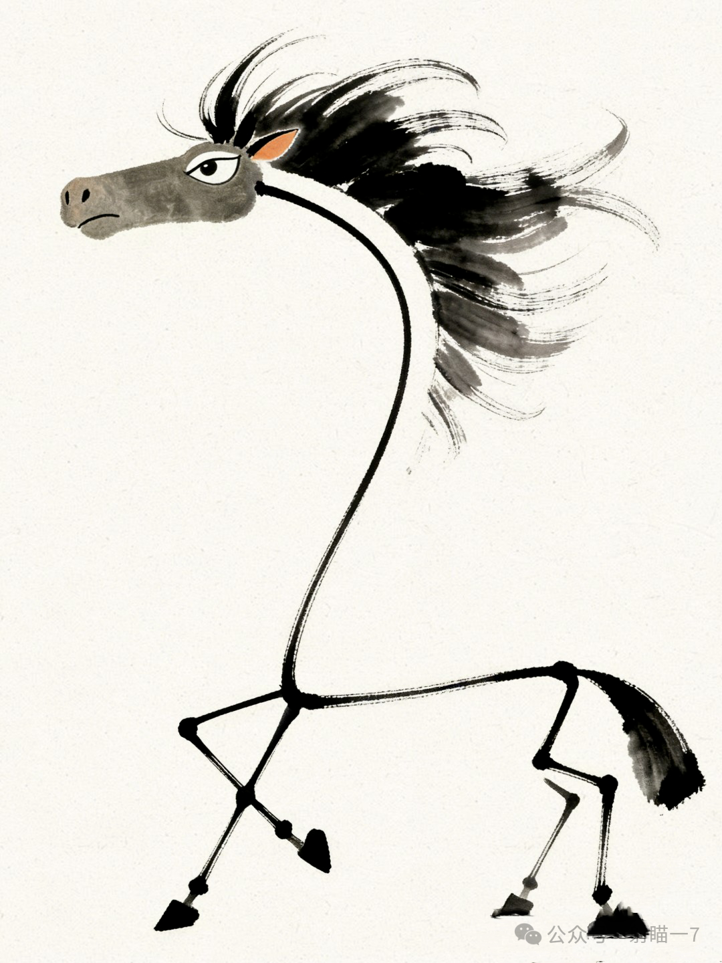
2026年1月浙江高考A篇 阅读理解满分突破思维策略
——语义链和逻辑链的建构
22. How long will the public art signs be on display?
A. Ten days. B. Three weeks.
C. One month. D. Two months.
23. Which of the following meets the application requirements?
A. A 150-word poem.
B. A 100-word self-introduction.
C. A 300-word story.
D. A 200-word artwork statement.
Estimated Project Timeline
August 2 | Call for Artists responses due
By August 12 | Successful artists selected; enter into a contract with the City of Burlington
September 6 | Final artwork files due
September 23~October 13 | Artwork displayed for duration of Culture Days celebration
Application Package
Artwork Statement: Please provide a brief statement (maximum 150 words) outlining your artwork concept.
Artwork or Writing Submission:
● Visual Art Submission: Please submit an artwork sketch (草图) of your concept. This can be a work in progress rather than a completed piece. If you are proposing to use a completed artwork, please submit it as your “sketch”.
● Writing Submission: Submissions must be a maximum of 250 words. It may be a stand-alone piece such as a poem or short story or a part taken from a larger piece.
Artist Biography: Please provide a short introduction (maximum 50 words) to the artist written in the third person.
D. A 200-word artwork statement.
敏锐捕捉关键信息，快速整合加工信息
22题解题关键在于抓题干关键词 on display，寻读原文对等语义display，定位信息源September 23~October 13，数字换算为“展出时间为21天”，B选项“Three weeks”
23题单点直接信息题（①带问题 meets the application requirements，寻读跳读---②获取文本信息--③选项对号入座--④排除干扰项）
C. A 300-word story.
B. A 100-word self-introduction.

Slide 8

两分钟精准秒杀B篇阅读理解
—— 快速从尾段获取人物、情节、情感到位，
建构语义场，秒杀正确答案

Slide 9
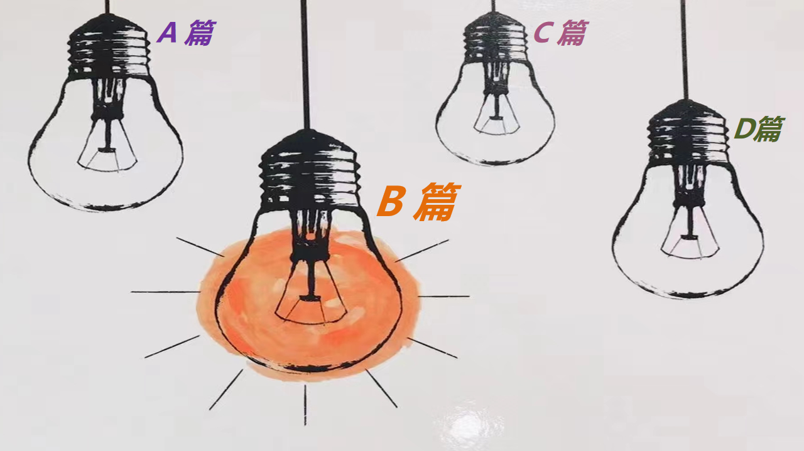

B篇阅读理解满分秒杀策略
1.B篇阅读要强化“作者意识”：
B篇阅读，多为体现立德树人，语言表现力强的记叙文，常常以细腻的语言呈现一个暖心或是励志的故事，考生需强化“作者意识_{含命题者}”，体验不同情感，感受正确的人生观和价值观。
作为阅读者，唯有站在作者的立场上，试着从作者的角度_{（命题人的角度多半也是作者的角度）}出发，去揣测、想象、推敲作者要表达的真实意图，把握人物特征，才能秒懂语言组织之道，才能洞悉文本内涵之妙，并快速精准答题。
Notes:
词汇与结构知识
正式语篇结构知识
内容/世界背景知识
自动识别技能
综合与评价策略
元认知知识与技能监控

Slide 10
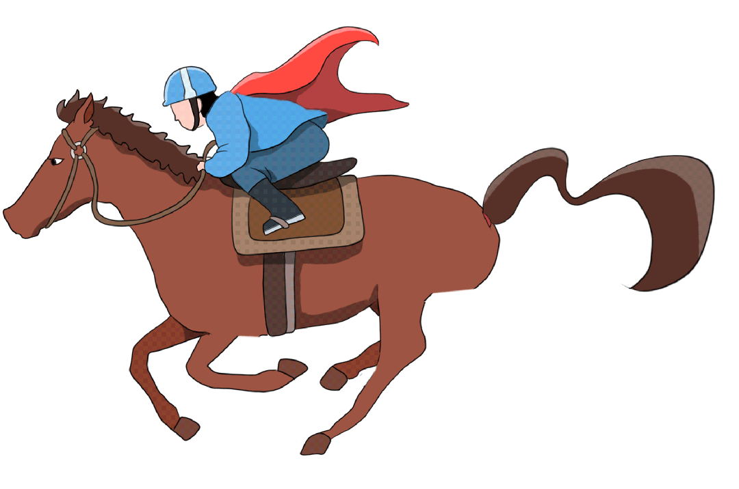
B篇阅读理解满分秒杀策略
2.快速从尾段获取评议，精准读懂文章：
快速从尾段获取人物、情节、情感的主题信息到位。
根据拉波夫叙事模式， B篇记叙文的尾段通常包括评议、结局、回应。 评议是叙事者或故事中人物对事件的看法和态度；结局是故事的完结；回应是故事与现实生活的纽带，用来点明主旨，升华主题。
直接从尾段阅读能快速激发直觉的情感体验，把握文脉走向，预测全文大意，找准文本的情感契合点。情感体验是一种全方位、全历程、全情境的整体性体验，通过后文尾段初步体验（基本可以解决 第27题），再依据试题题干指引，构建语义场，深化文本主题的感悟，分析作者所表达的思想情感，领悟作者的立意。
Notes:
词汇与结构知识
正式语篇结构知识
内容/世界背景知识
自动识别技能
综合与评价策略
元认知知识与技能监控

Slide 11



2026年1月浙江高考B篇 阅读理解满分突破思维策略
——语篇解构
When you’ re a teacher, a big part of your job is battling student misconceptions. Often students come to the classroom believing that learning can’t be fun and that what they learn isn’t relevant to the real world — much less to their personal interests. I’ve discovered that if I show students how what they learn is relevant to my hobbies, they’re much more willing to make connections to their personal interests and develop their own hobbies.
No matter what subject I’m teaching, I find ways to bring my hobbies into the classroom. For example, I’m a car enthusiast, so when I teach physics, I contextualize concepts with my knowledge about cars. If we’re covering friction, for example, I bring different tires (轮胎) into my classroom so that my students can conduct lab experiments with them to see how friction works in real-life applications.
When I first brought my hobbies to my classroom, I was focused on how doing so would build engagement and help my students understand concepts in science. But I quickly learned that the practice also helped me build stronger relationships with them. When I let them see an aspect of my life outside of school, some students who were also interested in cars connected with me more and became more engaged in my courses. Even those who didn’t share that interest with me seemed more engaged once I showed a different side of myself.
What started as an experiment is now more of a philosophy. Even when I’m planning classes, I tend to think about how I can bring in my hobbies. I find that doing so energizes my instruction, engages my students, and demonstrates to them how abstract concepts play out in the real world. Best of all, my passion for my hobbies seems to inspire them to be passionate about finding their own.
24. What poses a challenge to teachers according to the author?
25. Why does the author bring tires into the classroom?
26. What was the unexpected outcome of the author’s teaching method?
A. A higher class attendance rate.
B. Better examination results.
C. A closer teacher-student bond.
D. More spare time for students.
27. Which of the following best describes the author as a teacher?
A. Innovative. B. Humorous.
C. Decisive. D. Sympathetic.
构建语义场，深化文本主题的感悟: 快速从尾段锁定27题A选项“Innovative”符合第3段“outside of school”，“a different side ”和第4段“inspire ...finding their own激励...寻找自己的爱好” 的语义场中的核心词汇和相关词汇，精准把握语篇的主题和人物特征：“有创新精神的”老师。
paraphrase(释义，改述，换说)的地方往往是秒杀正确答案的突破点：build stronger relationships with them= A closer teacher-student bond，找到正确选项C.
快速从尾段获取人物、情节、情感到位
直接从尾段阅读能快速激发直觉的情感体验，把握文脉走向，了解全文大意，找准文本的情感契合点。
本篇以“问题导向 — 方法探索 — 实践结果 — 教学理念” 的闭环叙事结构 ，理清两条叙事主线：我的付出和学生的转变。

Slide 12
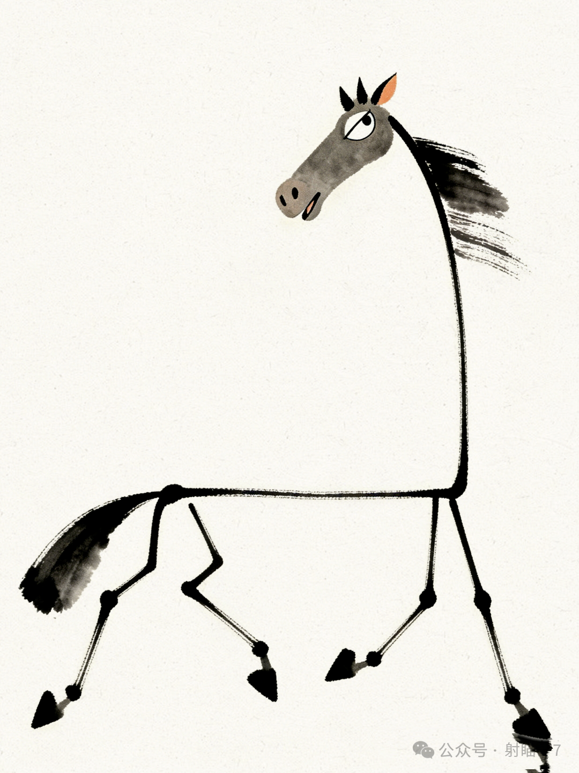
2026年1月浙江高考B篇 阅读理解满分突破思维策略
——语义链和逻辑链的建构
When you’ re a teacher, a big part of your job is battling student misconceptions. Often students come to the classroom believing that learning can’t be fun and that what they learn isn’t relevant to the real world — much less to their personal interests. I’ve discovered that if I show students how what they learn is relevant to my hobbies, they’re much more willing to make connections to their personal interests and develop their own hobbies.
No matter what subject I’m teaching, I find ways to bring my hobbies into the classroom. For example, I’m a car enthusiast, so when I teach physics, I contextualize concepts with my knowledge about cars. If we’re covering friction, for example, I bring different tires (轮胎) into my classroom so that my students can conduct lab experiments with them to see how friction works in real-life applications.
When I first brought my hobbies to my classroom, I was focused on how doing so would build engagement and help my students understand concepts in science. But I quickly learned that the practice also helped me build stronger relationships with them. When I let them see an aspect of my life outside of school, some students who were also interested in cars connected with me more and became more engaged in my courses. Even those who didn’t share that interest with me seemed more engaged once I showed a different side of myself.
What started as an experiment is now more of a philosophy. Even when I’m planning classes, I tend to think about how I can bring in my hobbies. I find that doing so energizes my instruction, engages my students, and demonstrates to them how abstract concepts play out in the real world. Best of all, my passion for my hobbies seems to inspire them to be passionate about finding their own.
24. What poses a challenge to teachers according to the author?
A. Students’ misunderstandings about teachers.
B. Students’ false assumptions about learning.
C. The irrelevance of textbooks to students’ life.
D. The gap between teachers’ and students’ hobbies.
24题考查归纳和迁移的高阶思维
学生关于learning的believing：can’t be fun -- isn’t relevant to the real world -- much less to their personal interests 是a big part of your job is battling...= a challenge to teachers, 结合上下文语境，可归纳为misconceptions = false assumptions，迁移到后文作者打破学习learning常规，将具象爱好融入relavant课堂，解释抽象概念，激发学生兴趣interests，并意外收获unexpected outcome更紧密的师生关系。 考生需充分调动发散思维，围绕主题前后呼应(见绿色标底)， 形成语义链，实现语篇内部语义贯通、逻辑严密。

Slide 13


2026年1月浙江高考B篇 阅读理解满分突破思维策略
——语义链和逻辑链的建构
When you’ re a teacher, a big part of your job is battling student misconceptions. Often students come to the classroom believing that learning can’t be fun and that what they learn isn’t relevant to the real world — much less to their personal interests. I’ve discovered that if I show students how what they learn is relevant to my hobbies, they’re much more willing to make connections to their personal interests and develop their own hobbies.
No matter what subject I’m teaching, I find ways to bring my hobbies into the classroom. For example, I’m a car enthusiast, so when I teach physics, I contextualize concepts with my knowledge about cars. If we’re covering friction, for example, I bring different tires (轮胎) into my classroom so that my students can conduct lab experiments with them to see how friction works in real-life applications.
When I first brought my hobbies to my classroom, I was focused on how doing so would build engagement and help my students understand concepts in science. But I quickly learned that the practice also helped me build stronger relationships with them. When I let them see an aspect of my life outside of school, some students who were also interested in cars connected with me more and became more engaged in my courses. Even those who didn’t share that interest with me seemed more engaged once I showed a different side of myself.
What started as an experiment is now more of a philosophy. Even when I’m planning classes, I tend to think about how I can bring in my hobbies. I find that doing so energizes my instruction, engages my students, and demonstrates to them how abstract concepts play out in the real world. Best of all, my passion for my hobbies seems to inspire them to be passionate about finding their own.
25. Why does the author bring tires into the classroom?
A. To teach an engineering skill.
B. To explain the structure of a car.
C. To share a real-life experience.
D. To illustrate a scientific concept.
精通词义延伸方式和过程
考生要深谙词义延伸方式和过程：本文核心词是concept，并贯穿全文，围绕“解释抽象概念”核心话题展开叙事→作者把具象的爱好融入课堂→提高学生参与度→增强师生关系→创新教学模式→激发了学生培养自身爱好的热情。
第二三段两次出现的bring my hobbies into the classroom与后句形成一般-具体的小句关系，contextualize -- demonstrate = illustrate；teach physics -- conduct lab experiments -- in science
= scientific存在同义复现和释义的语义关系。
考生要区分本文中学生“错误认知misconceptions”和“抽象概念abstract concepts”的区别。

Slide 14

AB篇阅读理解王炸技巧
—— 快狠准的“高阶思维可视化标识法”；
依托题干关键定位词，实现精准拆解 ；
图表服务观点，快速梳理观点语义链；
列举数字定能提炼观点；
警惕逻辑陷阱

Slide 15


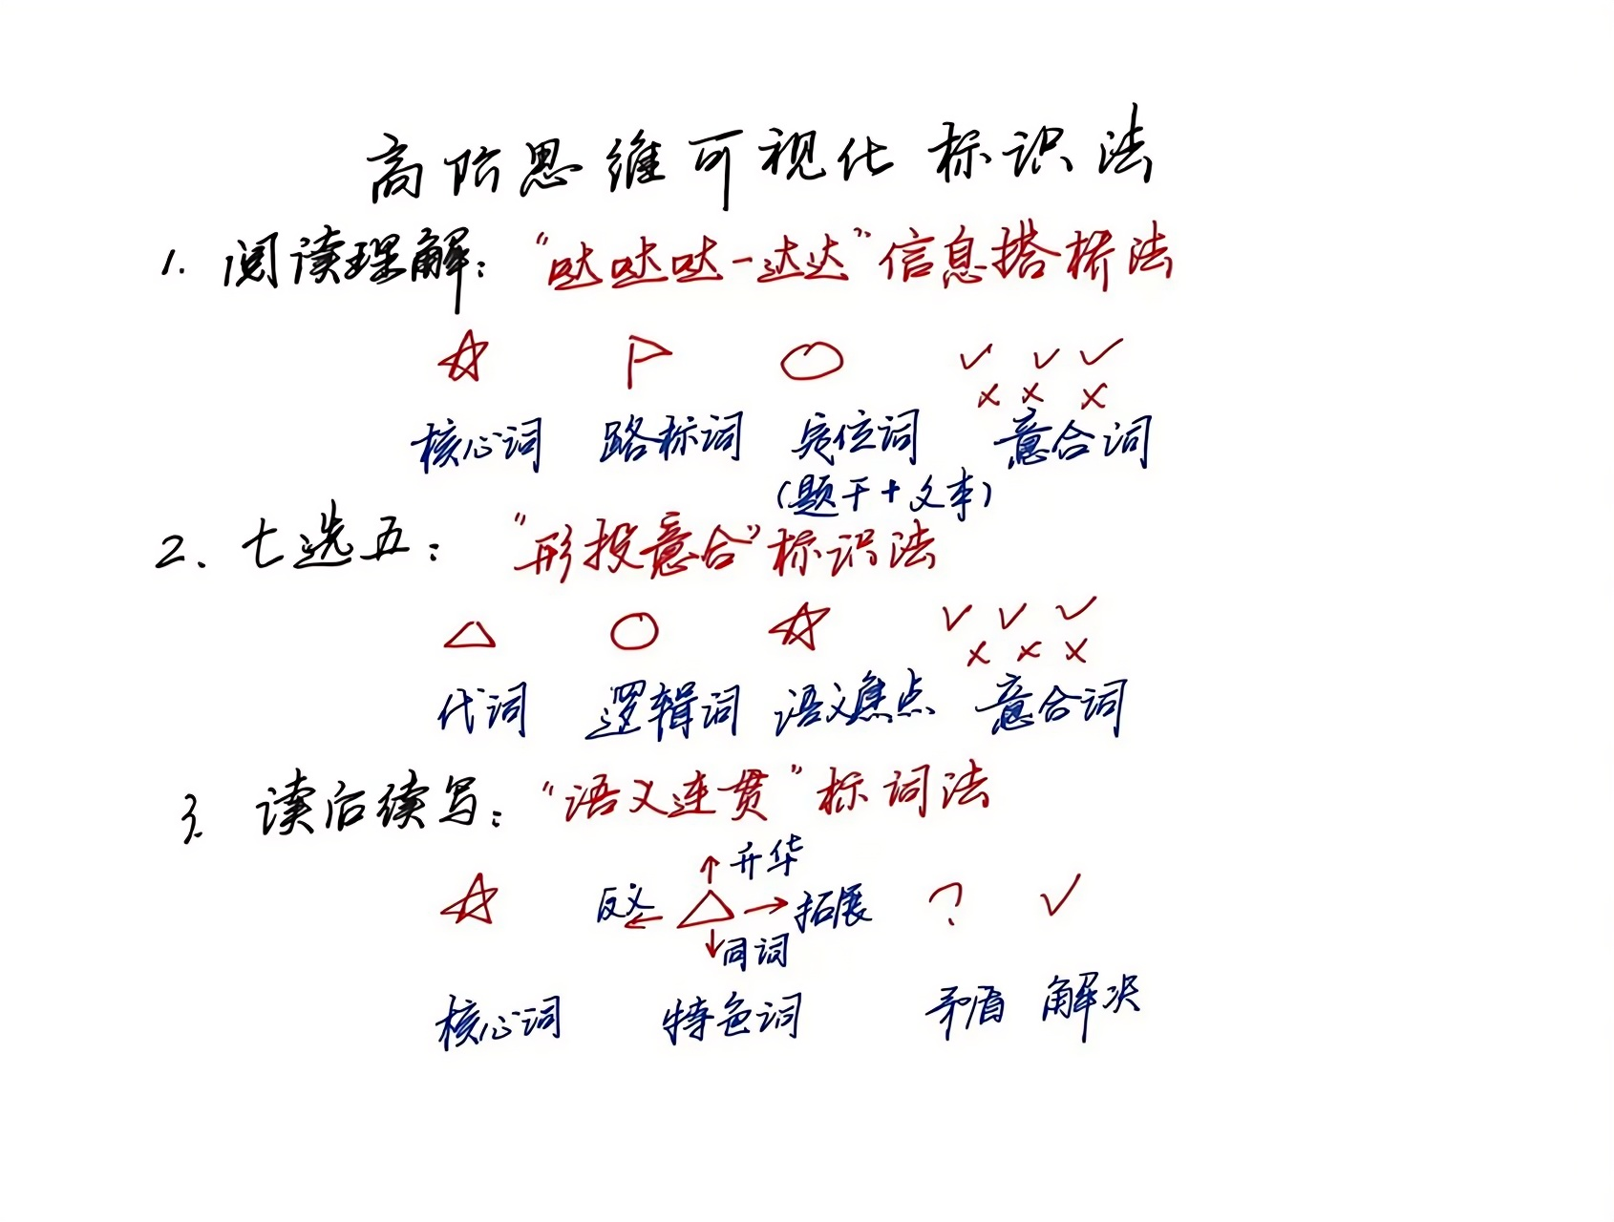























AB篇王炸技巧1：快狠准的“高阶思维可视化标识法”
When John Todd was a child, he loved to explore the woods around his house, observing how nature solved problems. A ditry stream, for example, often became clear after flowing through plants and along rocks where tiny creatures lived. When he got older, John started to wonder if this process could be used to clean up the messes people were making.
After studying agriculture, medicine, and fisheries in college, John went back to observing nature and asking questions. Why can certain plants trap harmful bacteria (细菌)? Which kinds of fish can eat cancer-causing chemicals? With the right combination of animals and plants, he figured, maybe he could clean up waste the way nature did. He decided to build what he would later call an eco-machine.
The task John set for himself was to remove harmful substances from some sludge (污泥). First, he constructed a series of clear fiberglass tanks connected to each other. Then he went around to local ponds and streams and brought back some plants and animals. He placed them in the tanks and waited. Little by little, these different kinds of life got used to one another and formed their own ecosystem. After a few weeks, John added the sludge.
He was amazed at the results. The plants and animals in the eco-machine took the sludge as food and began to eat it! Within weeks, it had all been digested, and all that was left was pure water.
_{2023年6月全国新课标I卷B篇}
24. What can we learn about John from the first two paragraphs?
A. He was fond of traveling. B. He enjoyed being alone.
C. He had an inquiring mind. D. He longed to be a doctor.
25. Why did John put the sludge into the tanks?
A. To feed the animals. B. To build an ecosystem.
C. To protect the plants. D. To test the eco-machine.
24题善于从词汇特性角度概括情感性格特征，“哒哒哒--达达”信息搭桥法扫描有关描述人或事特征的相关词汇，建构语义场。如“loved to explore”“observing”与“ studying”和“ asking questions”，高度抽象整合对等信息“an inquiring mind”，从而秒杀正确答案C选项。
25题解题阅读过程中要善于扫描同词/同话题词，搭建信息流flow的通道：First---Then---Little by little---After a few weeks---He was amazed at the results说明实验测试test过程。再通过eco-machine的同词复现，秒杀正确答案D选项。

Slide 16








































AB篇王炸技巧1：快狠准的“高阶思维可视化标识法”
“I am not crazy,” says Dr. William Farber, shortly after performing acupuncture (针灸) on a rabbit. “I am ahead of my time.” If he seems a little defensive, it might be because even some of his coworkers occasionally laugh at his unusual methods. But Farber is certain he’ll have the last laugh. He’s one of a small but growing number of American veterinarians (兽医) now practicing “holistic” medicine—combining traditional Western treatments with acupuncture, chiropractic (按摩疗法) and herbal medicine.
Farber, a graduate of Colorado State University, started out as a more conventional veterinarian. He became interested in alternative treatments 20 years ago when he suffered from terrible back pain. He tried muscle-relaxing drugs but found little relief. Then he tried acupuncture, an ancient Chinese practice, and was amazed that he improved after two or three treatments. What worked on a veterinarian seemed likely to work on his patients. So, after studying the techniques for a couple of years, he began offering them to pets.
Leigh Tindale’s dog Charlie had a serious heart condition. After Charlie had a heart attack, Tindale says, she was prepared to put him to sleep, but Farber’s treatments eased her dog’s suffering so much that she was able to keep him alive for an additional five months. And Priscilla Dewing reports that her horse, Nappy, “moves more easily and rides more comfortably” after a chiropractic adjustment.
Farber is certain that the holistic approach will grow more popular with time, and if the past is any indication, he may be right: Since 1982, membership in the American Holistic Veterinary Medical Association has grown from 30 to over 700. “Sometimes it surprises me that it works so well,” he says. “I will do anything to help an animal. That’s my job.”
24. What do some of Farber’s coworkers think of him?
A. He’s odd. B. He’s strict.
C. He’s brave. D. He’s rude
25. Why did Farber decide to try acupuncture on pets?
A. He was trained in it at university.
B. He was inspired by another veterinarian.
C. He benefited from it as a patient.
D. He wanted to save money for pet owners.
26. What does paragraph 3 mainly talk about?
A. Steps of a chiropractic treatment.
B. The complexity of veterinarians’ work.
C. Examples of rare animal diseases.
D. The effectiveness of holistic medicine.
27. Why does the author mention the American Holistic Veterinary Medical Association?
A. To prove Farber’s point.
B. To emphasize its importance.
C. To praise veterinarians.
D. To advocate animal protection.
_{2024年6月全国I卷B篇}
——语篇解构，语义建构，逻辑建构
Notes:
词汇与结构知识
正式语篇结构知识
内容/世界背景知识
自动识别技能
综合与评价策略
元认知知识与技能监控

Slide 17
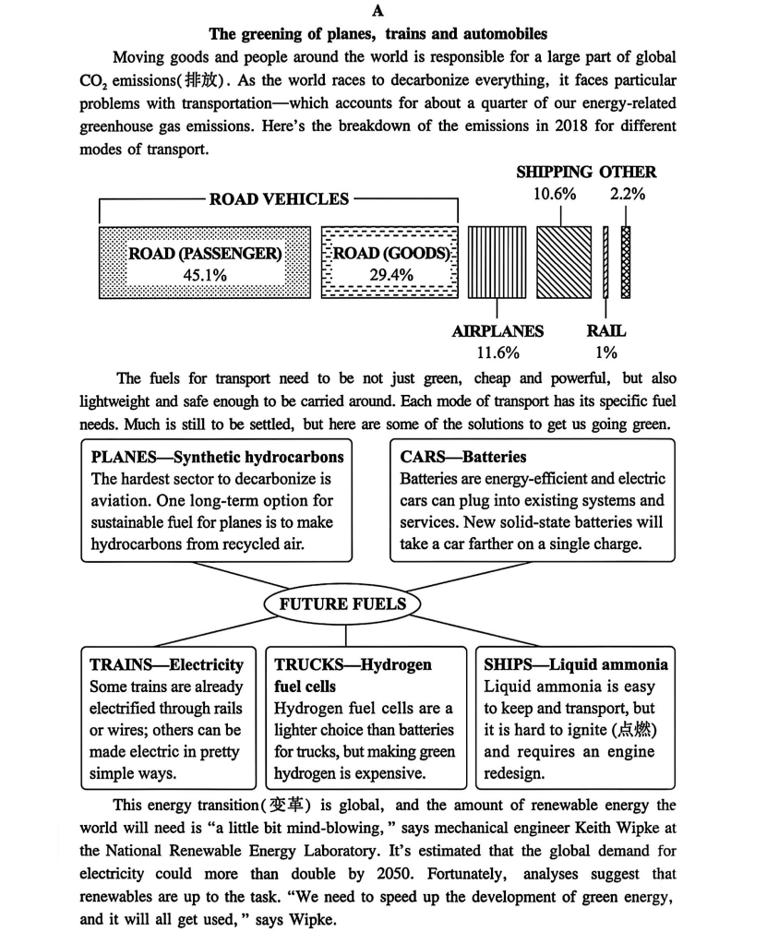
































AB篇王炸技巧2：依托题干关键定位词，实现庖丁解牛式精准拆解
The greening of planes, trains and automobiles Moving goods and people around the world is responsible for a large part of global CO₂ emissions (排放). As the world races to decarbonize everything, it faces particular problems with transportation — which accounts for about a quarter of our energy-related greenhouse gas emissions. Here's the breakdown of the emissions in 2018 for different modes of transport.
The fuels for transport need to be not just green, cheap and powerful, but also lightweight and safe enough to be carried around. Each mode of transport has its specific fuel needs. Much is still to be settled, but here are some of the solutions to get us going green.
This energy transition (变革) is global, and the amount of renewable energy the world will need is “a little bit mind-blowing,” says mechanical engineer Keith Wipke at the National Renewable Energy Laboratory. It's estimated that the global demand for electricity could more than double by 2050. Fortunately, analyses suggest that renewables are up to the task. “We need to speed up the development of green energy, and it will all get used,"says Wipke.
21.What percentage of global transport emissions did road vehicles account for in 2018? A.11.6%. B.45.1%.
C.74.5%. D.86.1%.
22.Which mode of transport can go green comparatively easily? A.Planes. B.Trucks.
C.Trains. D.Ships.
23.What does Wipke suggest regarding energy transition? A.Limiting fuel consumption.
B.Putting more effort into renewables. C.Improving energy efficiency.
D.Making electricity more affordable.
微观结构的逻辑分析
段际的逻辑连贯
阅读理解黄金定位法
1.顶级定位词（优先选用）
①专有名词：大写字母（人名、地名）
②数字/时间类词汇
2.次级定位词
具体名词短语，形副词：提升唯一性
3.定位时结合题文同序原则
_{2025年6月全国高考Ⅰ卷A篇}

Slide 18

AB篇王炸技巧3：图表服务观点，快速梳理观点语义链
The fuels for transport need to be not just green, cheap and powerful, but also lightweight and safe enough to be carried around. Each mode of transport has its specific fuel needs. Much is still to be settled, but here are some of the solutions to get us going green.
22.Which mode of transport can go green comparatively easily? A.Planes. B.Trucks.
C.Trains. D.Ships.
微观结构的逻辑分析
22图表题是为表达“ go green comparatively easily”的主题观点服务，抓住这一牛鼻子，就能快速捕捉与easily意义相同、相似、相反的词，形成语义链，建构逻辑链：
反义表达hardest sector，expensive，it is hard to ignite，快速排除ABD选项，再建构语义链already electrified--pretty simple ways，秒杀正确答案C选项。
2025年6月全国高考Ⅰ卷A篇

Slide 19
AB篇王炸技巧4：列举数字定能提炼观点，研判数据论证意义
Over the years John has taken on many big jobs. He developed a greenhouse-like facility that treated sewage (污水) from 1,600 homes in South Burlington. He also designed an eco-machine to clean canal water in Fuzhou, a city in southeast China.
2023年6月全国新课标I卷B篇
26. What is the author’s purpose in mentioning Fuzhou?
A. To review John’s research plans.
B. To show an application of John’s idea.
C. To compare John’s different jobs.
D. To erase doubts about John’s invention.
“ many big jobs”与“1,600 homes in South Burlington”和“ also ... in Fuzhou, ... China”形成语义场，列举数字，世界各地的地名，综合说明其环保发明及理念的推广应用“application”，从而秒杀正确答案B选项。
Farber is certain that the holistic approach will grow more popular with time, and if the past is any indication, he may be right: Since 1982, membership in the American Holistic Veterinary Medical Association has grown from 30 to over 700. “Sometimes it surprises me that it works so well,” he says. “I will do anything to help an animal. That’s my job.”
2024年6月全国I卷B篇
27. Why does the author mention the American Holistic Veterinary Medical Association?
A. To prove Farber’s point.
B. To emphasize its importance.
C. To praise veterinarians.
D. To advocate animal protection.
法伯认为综合疗法会越来越受欢迎，随后作者列举了美国综合兽医协会的会员已经从30个增加到700多个的例子，因此推断美国整体兽医协会是为证明法伯的观点Farber is certain that ....grow more popular with time，从而秒杀正确答案A选项。

Slide 20
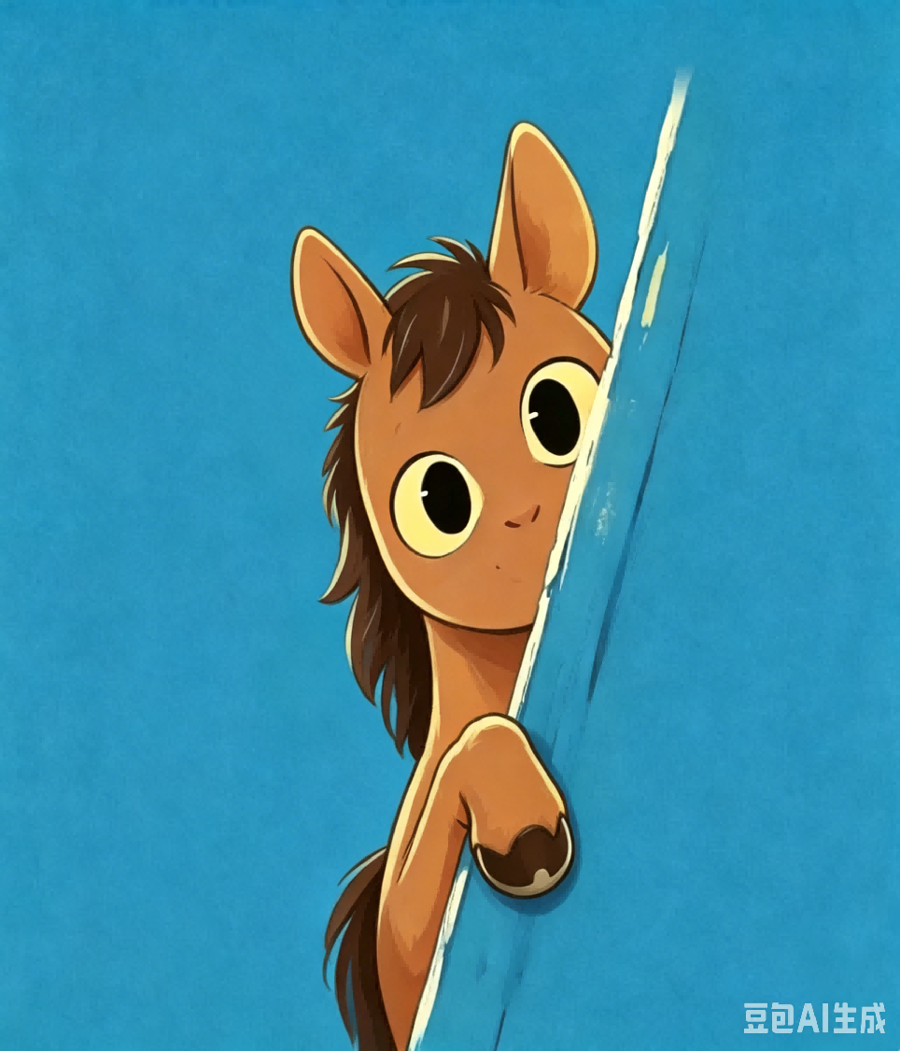





AB篇王炸技巧5：警惕逻辑陷阱 ：范围（概念）不清
The greening of planes, trains and automobiles ...
The fuels for transport need to be not just green, cheap and powerful, but also lightweight and safe enough to be carried around. Each mode of transport has its specific fuel needs. Much is still to be settled, but here are some of the solutions to get us going green.
This energy transition (变革) is global, and the amount of renewable energy the world will need is “a little bit mind-blowing,” says mechanical engineer Keith Wipke at the National Renewable Energy Laboratory. It's estimated that the global demand for electricity could more than double by 2050. Fortunately, analyses suggest that renewables are up to the task. “We need to speed up the development of green energy, and it will all get used,"says Wipke.
23.What does Wipke suggest regarding energy transition? A.Limiting fuel consumption.
B.Putting more effort into renewables. C.Improving energy efficiency.
D.Making electricity more affordable.
微观结构的逻辑分析
段际的逻辑连贯
_{2025年6月全国高考Ⅰ卷A篇}
警惕“范围（概念）不清”的逻辑错误
D选项干扰性极强，以局部代替整体，即Electricity来混淆renewable energy 的概念，本篇中Synthetic hydrocarbons，Batteries，Electricity，Hydrogen fuel cells，Liquid ammonia只是renewable energy 的一种。 所以阅读过程中，要特别注意关键名词的概念内涵与外延。

Slide 21

AB篇王炸技巧5：警惕逻辑陷阱 ：张冠李戴/ 偷梁换柱
But things were different for their first essay, which was about the question: “Why is writing important?” Most of the essays filled less than one page, and few contained a sentence that could be interpreted as a thesis (论点) statement. I was shocked. Then I realized that the problem was the question itself. They could have written pages on the necessity of computers, but writing, in and of itself, simply didn’t strike them as important. This would have to change.
As a new unit started, I asked everyone to write a persuasive piece on a health-related topic of their choice. This time they found the exercise much more interesting. For the next two assignments, a personal-narrative unit followed by a creative-writing workshop, I only required that the piece meet the specifications of its genre (体裁) and that it contain a thesis. The results were staggering. The students took on diverse topics and turned in stories, 10 to 20 pages each, with characters that broadened my view and touched my heart.
I walked into class believing that writing is important as a means of communication. However, my students demonstrated something more important to me. When the final bell rang in June, I walked away with a yearbook full of messages about writing’s most powerful significance — the ability to connect people, to put us in another’s skin, to teach us what it means to be human.
25.Why did the students perform poorly in writing their first essay?
A.They were not given enough time.
B.They had a very limited vocabulary.
C.They misunderstood the question.
D.They had little interest in the topic.
微观结构的逻辑分析
段际的逻辑连贯
25题：警惕“张冠李戴/ 偷梁换柱”的逻辑错误
依据统一语境_{(如本题中的the question)，}寻找词义
延伸方式和过程，善于扫描同义词/同话题词：
本文就“写作的重要性和意义？”建构
语义链, 形成逻辑链，writing simply
didn't strikethem as important→change→much
more interesting，D选项吻合语义。
C选项极具干扰性，与原文高度相似，一半是一半非，似是而非。命题者用核心词“the question”挖坑布陷阱；与此同时，命题者会在不易引人注意的地方换了一两个词汇造成句意的改变；或者把一个事物的特征说成是另一个事物的特征；或者把他人的观点说成是作者的观点。如本题C选项的 misunderstood是对文本的曲解。
正确答案通常是对原文信息的同义改写，其全部信息一定都能从文中找到依据和逻辑关联。D选项的They had little interest = writing simply didn't strike them as important； the topic = the question: “Why is writing important?”
_{2025年6月全国高考Ⅰ卷B篇}

Slide 22




