Slide 1


感恩遇见，相互成就，本课件资料仅供您个人参考、教学使用，严禁自行在网络传播，违者依知识产权法追究法律责任。
更多教学资源请关注
公众号：溯恩英语
知识产权声明

Slide 2
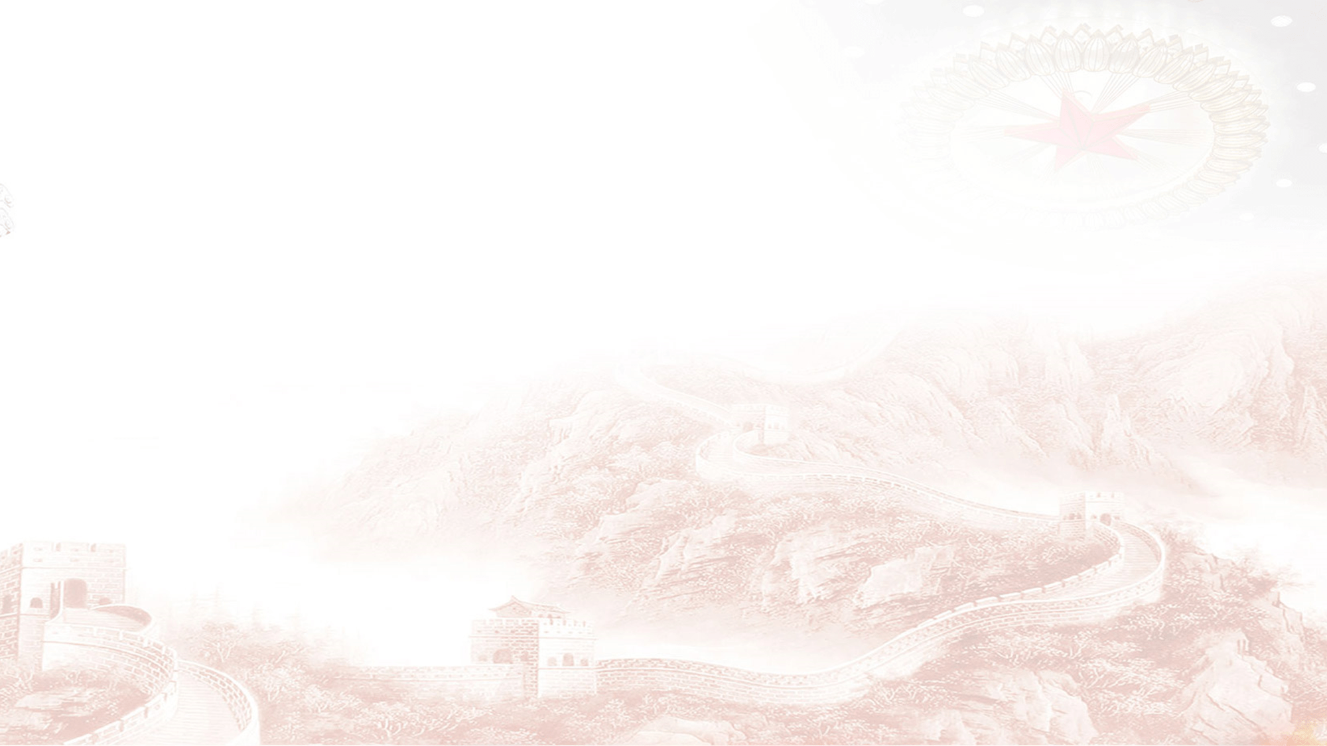
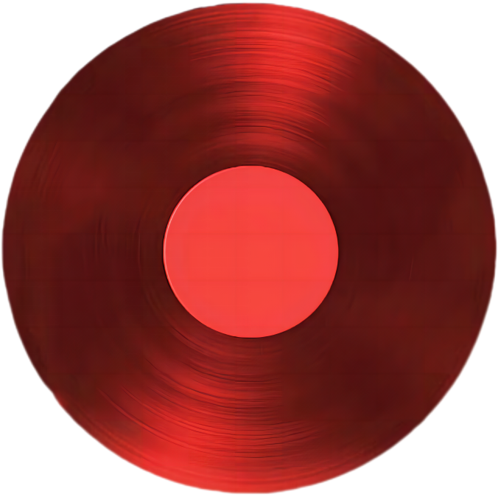


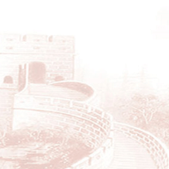

2026年6月高考冲刺系列
马踏飞燕・
英语考前必备王炸技巧
—— 浙江省常山县第一中学 吴俊峰

Slide 3


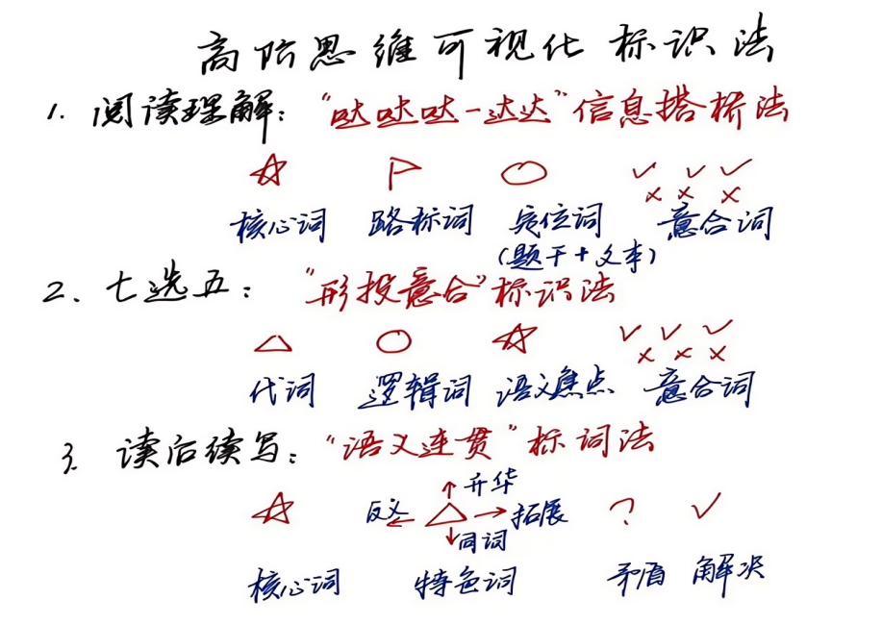
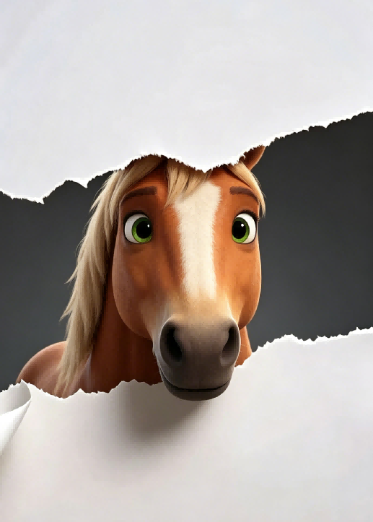
^{高分王炸技巧-1：}
快狠准的“高阶思维可视化标识法”+“秒杀口诀”
嗯嗯，
这俩方法相辅相成，
超级高效实用！
哇，
这个字也超级帅！
口诀也好有个性！
“秒杀口诀”：根植于原文，弃逐字翻译；扫描语义场，抓复现强调（马蹄哒哒哒）；关联信息桥，建构逻辑链；选项贴语义（语义达达达），即为正确项。

Slide 4


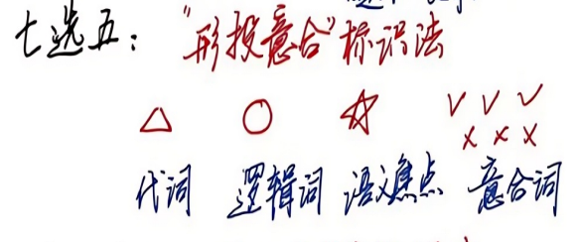


































^{高分王炸技巧-1：}
快狠准的“高阶思维可视化标识法”+“秒杀口诀”
During your initial reading of material, do you ever go back and reread sentences or paragraphs? Is it because the material is too difficult to comprehend on the first reading or because you are asleep? 36 You are napping (打盹) or daydreaming. Halfway down the page you realize that you have no idea what you have read. 37 Thus, you go back and reread, not because you did not understand, but because you were not paying attention. This type of rereading is called regression.
Napping and daydreaming are habits caused by lack of involvement with the material. Be demanding on yourself and expect 100 percent attention to the task. Engage your mind. Visualize the incoming ideas, and relate the new material to what you already know. 38 If your mind is truly occupied with the text, you will not be able to think about Friday night or where to go on Saturday.
Regression is a crutch (拐杖) that allows you to make up for wasted time. First of all, become aware of when and why you are regressing. 39 Say, “OK. I missed that paragraph because I was thinking of something else, but I’m going to keep on going and start paying close attention.”
。 40 Good readers who monitor their own comprehension use it in the reading process. However, regressing because your mind was asleep is a waste of time.
微观结构的逻辑分析
A. Both are to blame.
B. Probably the latter is true.
C. Don’t just read the words; think the ideas.
D. Spend a few minutes reading the material aloud.
E. Your eyes were engaged, but your mind was not.
F. Then, start denying yourself the right in order to break the habit.
G. Rereading because you did not understand is a reasonable fix-up strategy.
2026年1月浙江高考卷七选五

Slide 5
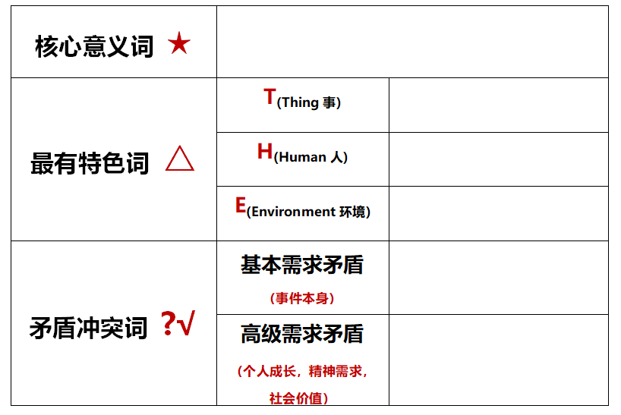

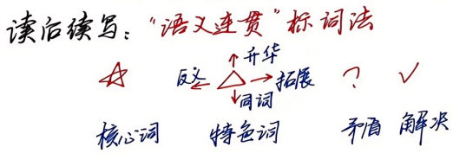
^{高分王炸技巧-1：}
快狠准的“高阶思维可视化标识法”
My wife and I wanted to share our new home with family and friends by hosting a. small gathering in the early summer. She had prepared lots of snacks, while my job was to have the backyard in order. There was plenty of space for the kids to run and play. There was just one thing I hadn’t counted on: My brother chose to bring his dog Toby, a 50-pound ball of fire. Though friendly, he could easily knock over my niece’s small boys and my six-month-old granddaughter. So, when my brother showed up, I asked him to watch Toby and keep him outside. My plan was working out just fine. Toby was using up his energy by running back and forth in the backyard and giving the kids plenty of room. Unexpectedly, after supper, the weather changed. It started to rain and everyone went indoors. It was an awkward moment. I didn’t want Toby to be running around in the house, and my brother wasn’t happy with driving home with a wet dog. Eventually, my brother decided to leave rather than force the issue. A few days passed, and I hadn’t heard anything from my brother. I texted him and expressed wishes for him to come out again. His reply came as a surprise—a shock, actually: “Not a chance.” Clearly, he was unhappy over the way we had parted. After all, I had left him little choice. Well, he’ll get over it, I reasoned. Two months passed. My wife suggested I get in touch with my brother, but I resisted, thinking he should call first. However, my conscience (良心) kept bothering me. I tried to put myself in my brother’s shoes. He was facing health issues and his wife of thirty-five years had passed away a few months earlier. Toby was his constant companion, the one who kept him going.
I realized it was me who was at fault. With the biscuits my wife had made, I arrived at my brother’s door.
E
T
H
T
E
T
T
H
H
H
2025年6月全国新高考 I 卷 读后续写

Slide 6

基于语义连贯标词扩展法的读后续写准确读题和可视化快速构思：
语义连贯方式 | 原文标词 | 续文协同
同词复现↓ | conscience | Gradually conscience grabbing me like an invisible claw, I got my phone, dialed my brother and waited with anxiety.
 | surprise; a 50-pound ball of fire | It seemed like eternity before the door was open and I was greeted with my brother’s somewhat surprised look and Toby, a 50-pound ball of fire, beside his feet.
同义复现→ | surprise | The door cracked open, and my brother, with Toby nestled in his arms, came out, his eyes gleamed with disbelief and surprise toward my unexpected visit.
 | put myself in my brother’s shoes; friendly | Putting myself in brother’s skin, Toby was a friendly ball and was supposed to be viewed as one of our family members because of the unique place it held in my brother’s heart.
反义复现← | I realized it was me who was at fault. | “Oh, it’s also my fault.” Admitted my brother, exchanging a playful wink with me.
2025年6月全国新高考 I 卷
Notes:
词汇与结构知识
正式语篇结构知识
内容/世界背景知识
自动识别技能
综合与评价策略
元认知知识与技能监控

Slide 7
基于语义连贯标词扩展法的读后续写准确读题和可视化快速构思：
语义连贯 | 原文标词 | 续文协同
语义扩展 →→ | the summer ；Toby | The rosy glow of summer sunshine witnessed our warm hug with a cheerful rhythm of bark rising form our feet.
 | the biscuits | Sharing some biscuits over warm cups of tea, my brother and I had an earnest conversation.
 | the biscuits； health condition； Toby | For fear that he refused to see me, I hastened to extend my sincere apology for my selfishness and show him the fragrant biscuits. His face softened, and was nearly reduced to tears as I asked about his health condition and invited him and Toby to come out again.
2025年6月全国新高考 I 卷
Notes:
词汇与结构知识
正式语篇结构知识
内容/世界背景知识
自动识别技能
综合与评价策略
元认知知识与技能监控

Slide 8

基于语义连贯标词扩展法的读后续写准确读题和可视化快速构思：
语义连贯 | 原文标词 | 续文协同
意义升华↑ | biscuit | “Toby, come and get your treat!” I passed a biscuit to the puppy, and helped myself with another --- sweet as it was, the true taste of brotherhood and LOVE.
 | the summer ； the rain | It was the rain that led to our conflict and now our relationship cheered up just like the summer sky.
 | he was unhappy over the way we had parted; little choice | We gave each other a heartfelt hug. “From now on, Toby will always be welcome wherever our family is, because he is part of the family, a perfect choice”.
2025年6月全国新高考 I 卷
Notes:
词汇与结构知识
正式语篇结构知识
内容/世界背景知识
自动识别技能
综合与评价策略
元认知知识与技能监控

Slide 9
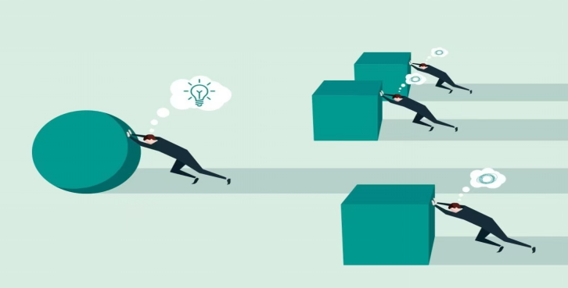

^{高分王炸技巧-2：}
阅读理解要快速语篇解构，语义建构，逻辑建构
语义流通连贯，
信息关联搭桥：
1✅ 结构决定命题位置
2✅ 主题决定命题方向
3✅ 主线决定正确答案
剖析长难句子
高考试题是通过情境化设计，将价值引领渗透于关键能力、学科素养和思维品质的考查。
语义连贯，信息搭桥
纠结生词
孤立片面理解句子和段落
语言是活的，流动的。语言不是像盖房子似的，一块砖一块砖叠出来的。语言是树，是长出来的。树有树根、树干、树枝、树叶，但是是一个有机的整体。树的内部的汁液是流通的。一枝动，百枝摇。
——作家汪曾祺《思想·语言·结构》
高考英语阅读不必逐句吃透、不必深究专业内容，而是重在明晰文脉逻辑_{（关联到知识技能）}、感知时代资讯（_{关联到创新思维）}、体会情感价值_{（关联到立德树人）}。 ——吴俊峰
目察文脉，心织语义

Slide 10


2025年6月全国高考Ⅰ卷C篇 阅读理解满分突破思维策略
——语篇解构+逻辑建构
What phenomenon
While safety improvements might have been made to our streets in recent years, transport studies also show declines in pedestrian (行人) mobility, especially among young children. Many parents say there’s too much traffic on the roads for their children to walk safely to school, so they pack them into the car instead.
Dutch authors Thalia Verkade and Marco te Br mmelstroet are bothered by facts like these. In their new book Movement: How to Take Back Our Streets and Transform Our Lives, they call for a rethink of our streets and the role they play in our lives.
Life on city streets started to change decades ago. Whole neighbourhoods were destroyed to make way for new road networks and kids had to play elsewhere. Some communities fought back. Most famously, a Canadian journalist who had moved her family to Manhattan in the early 1950s led a campaign to stop the destruction of her local park. Describing her alarm at its proposed replacement with an expressway, Jane Jacobs called on her mayor (市长) to champion “New York as a decent place to live, and not just rush through.” Similar campaigns occurred in Australia in the late 1960s and 1970s as well.
Although these campaigns were widespread, the reality is that the majority of the western cities were completely redesigned around the needs of the motor car. The number of cars on roads has been increasing rapidly. In Australia we now have over twenty million cars for just over twenty-six million people, among the highest rate of car ownership in the world.
We invest a lot in roads that help us rush through, but we fail to account for the true costs. Do we really recognise what it costs us as a society when children can’t move safely around our communities? The authors of Movement have it right: it’s time to think differently about that street outside your front door.
28. What phenomenon does the author point out in paragraph 1?
29. What were the Canadian journalist and other campaigners trying to do?
30. What can be inferred about the campaigns in Australia in the late 1960s and 1970s?
31. What can be a suitable title for the text?
路标词
微观结构的逻辑分析
How+ rethink
How
利用路标词厘清语篇框架结构：
有助于快速解构语篇宏观模式，有效彰显作者的写作思路，带出作者真正写作意图： studies show...，the reality is that...，but...。
抓住关键词复现，确定篇章结构:
运用语篇分析手段，从语境、信息、结构等层面分析文本，理清文本内在的错综复杂的关系。在快速浏览中抓住关键词复现与呼应 rethink →think differently，本篇区分于传统的单一的“问题解决”模式，属于“问题+解决+失败反思”模式，What phenomenon---How---What reality---Why fail + think differently。聚焦主题 streets and the role they play in our lives，“反思街道功能，重视城市宜居性”。考查学生批判性思维。
段际的逻辑连贯
路标词
What reality
路标词
Why fail + think differently

Slide 11
2025年6月全国高考Ⅰ卷D篇 阅读理解满分突破思维策略
——语篇解构+逻辑建构
★
Microplastics have become a common source of pollution across the Earth — they have settled in the deep sea and on the Himalayas, stuck inside volcanic rocks, filled the stomachs of seabirds and even fallen in fresh Antarctic snow. They are even appearing inside humans.
Now, new research suggests that a simple, cheap measure may significantly reduce the level of microplastics in water from your tap (水龙头): boiling and filtering (过滤) it. In a study published Wednesday in Environmental Science & Technology Letters, researchers from China found that boiling tap water for just five minutes — then filtering it after it cools — could remove at least 80 percent of its microplastics.
Crucially, this process relies on the water containing enough calcium carbonate (碳酸钙) to trap the plastics. In the study, boiling hard water containing 300 milligrams of calcium carbonate led to an almost 90 percent drop in plastics. But in samples with less than 60 milligrams of calcium carbonate, boiling reduced the level of plastics by just 25 percent. Additionally, the research didn’t include all types of plastics. The team focused only on three common types — polystyrene, polyethylene and polypropylene — and they didn’t study other chemicals previously found in water such as vinyl chloride.
Still, the findings show a potential path forward for reducing microplastic exposure — a task that’s becoming increasingly difficult. Even bottled water, scientists found earlier this year, contains 10 to 1,000 times more microplastics than originally thought.
Scientists are still trying to determine how harmful microplastics are — but what they do know has raised concerns. The new study suggests boiling tap water could be a tool to limit intake. “The way they demonstrated how microplastics were trapped through the boiling process was nice,” Caroline Gauchotte-Lindsay, an environmental engineer of the University of Glasgow in Scotland who was not involved in the research, tells New Scientist. “We should be looking into upgrading drinking water treatment plants so they remove microplastics.”
32. How does the author present the issue in the first paragraph?
33. What determines the effectiveness of trapping microplastics in water?
34. What does the author try to illustrate by mentioning bottled water in paragraph 4?
35. What is Gauchotte-Lindsay’s suggestion about?
Present the issue：_{Microplastics}
微观结构的逻辑分析
路标词
★
★
Propose a solution: _{boiling and filtering}
路标词
厘清语篇框架结构
Crucial factor: _{calcium carbonate}
快速了解本文的框架结构是解题关键：第一段呈现问题：微塑料污染普遍性，捕捉核心词Microplastic；第二段提出方法，煮沸和过滤自来水；第三段关键因素，碳酸钙含量；第四段实际挑战，日益困难；第五段未来前景，升级饮用水处理厂，符合“问题-解决” _{(Problem-solution pattern)} 的篇章模式，搭建了信息流flow的通道。
定位宏观信息，提炼主旨与篇章结构，有利于对信息理解的全面性和思维的深刻性。
路标词
Actual challenge: _{increasingly difficult}
Future prospect: _{upgrading plants}
★

Slide 12
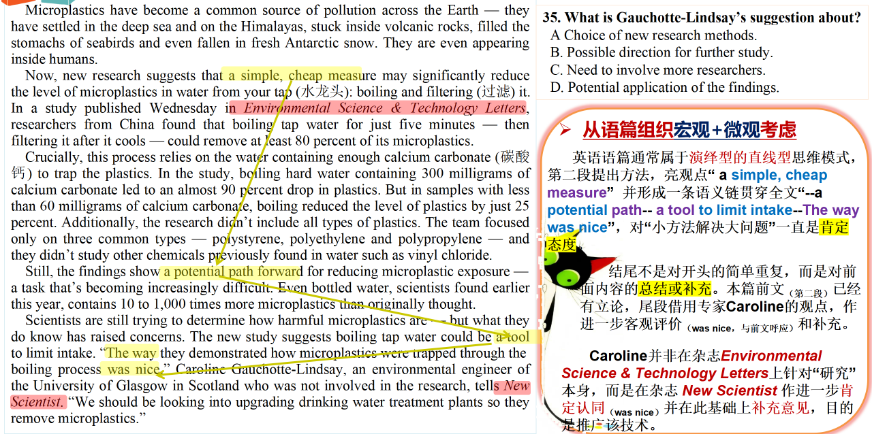


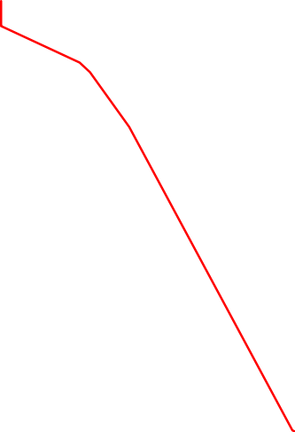
^{高分王炸技巧-3：}
CD篇不是考查专业论文的深入理解，而是运用语篇知识去了解
史上最有争议性的答案：35题B or D?
不是专业深入理解，
而是前沿动态了解！
目察文脉，心织语义
2025年6月全国高考Ⅰ卷D篇 阅读理解

Slide 13
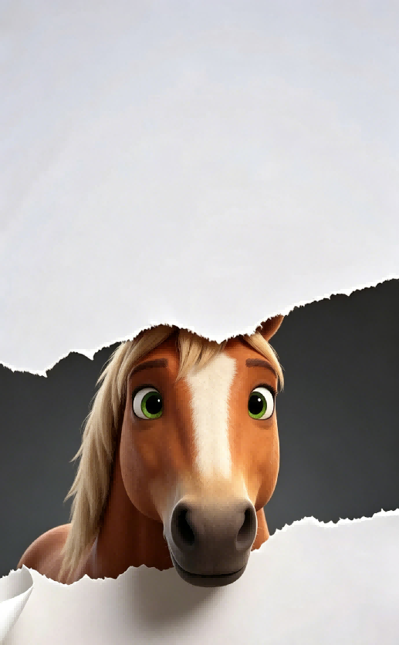
^{高分王炸技巧-4：}
CD篇阅读理解考查考生严谨科学，求真务实的思维品质
Researchers say they have translated the meaning of gestures that wild chimpanzees (黑猩猩) use to communicate. They say wild chimps communicate 19 specific messages to one another with a “vocabulary” of 66 gestures. The scientists discovered this by following and filming groups of chimps in Uganda, and examining more than 5,000 incidents of these meaningful exchanges. 2021年1月浙江卷C篇
严谨科学，
不偏不倚，
依照原文；
不夸大其词，
不妄下结论，
不主观臆断。
30. Which of the following is the best title for the text?
A. Chimpanzee behaviour study achieved a breakthrough
B. Chimpanzees developed specific communication skills
C. Chimpanzees: the smartest species in the animal kingdom
D. Chimpanzee language: communication gestures translated
夸大其词，吸引眼球
“However, this study does not show cause and effect between cardiovascular fitness and dementia, it only shows an association,” said Horder. “More research is needed to see if improved fitness could have a positive effect on the risk of dementia and also to look at when during a lifetime a high fitness level is most important.” She also admitted that a relatively small number of women were studied, all of whom were from Sweden, so the results might not be applicable to other groups. 2022年1月浙江卷C篇
29. What do we know about Dr Horder's study?
A. It aimed to find a cure for dementia. B. Data collection was a lengthy process.
C. Some participants withdrew from it. D. The results were far from satisfactory.
妄下结论，主观臆断

Slide 14

^{高分王炸技巧-5：}
标题或主旨统领全文，没有抓住主旨就不能形成有效阅读/写作
1.主题句（含标题）和主旨语境（含核心词）是决定语篇发展方向的控制性信息：
找准主题句和主旨语境（含核心词）是任何阅读和写作的起点和抓手，是英语阅读解构、写作语义建构的切入点与落脚点。
2.正确答案特征:
基于主旨语境或忠实原文的合理信息加工和转换释义。
有道理：
主旨统摄全文，
抓主旨是读写首要抓手！
基本点①：篇章逻辑
转折、因果、递进等逻辑纽带串联文脉
基本点②：论据细节
数据、实例、事实等细节服务中心
一个中心、两个基本点
一个中心
主旨语境 + 核心词统领语篇脉络

Slide 15

^{高分王炸技巧-5：}
标题或主旨统领全文，没有抓住主旨就不能形成有效阅读/写作
2025年6月全国高考Ⅰ卷C篇
While safety improvements might have been made to our streets in recent years, transport studies also show declines in pedestrian (行人) mobility, especially among young children. Many parents say there’s too much traffic on the roads for their children to walk safely to school, so they pack them into the car instead.
Dutch authors Thalia Verkade and Marco te Br mmelstroet are bothered by facts like these. In their new book Movement: How to Take Back Our Streets and Transform Our Lives, they call for a rethink of our streets and the role they play in our lives.
找准主旨核心词（语义场主干）：rethink streets、take back our streets、transform our lives、 the streets’ role in our lives，围绕“拿回我们的街道”和“街道对生活的作用”进行有效预测和有序梳理：
28. What phenomenon does the author point out in paragraph 1?
29. What were the Canadian journalist and other campaigners trying to do?
30. What can be inferred about the campaigns in Australia in the late 1960s and 1970s?
31. What can be a suitable title for the text?
★
路标词
★
2025年6月全国高考Ⅰ卷D篇
Microplastics have become a common source of pollution across the Earth — they have settled in the deep sea and on the Himalayas, stuck inside volcanic rocks, filled the stomachs of seabirds and even fallen in fresh Antarctic snow. They are even appearing inside humans.
Now, new research suggests that a simple, cheap measure may significantly reduce the level of microplastics in water from your tap (水龙头): boiling and filtering (过滤) it. In a study published Wednesday in Environmental Science & Technology Letters, researchers from China found that boiling tap water for just five minutes — then filtering it after it cools — could remove at least 80 percent of its microplastics.
找准主旨核心词（语义场主干）：a simple cheap measure、boiling、filtering tap water、significantly reduce microplastics，围绕“简单易行的显著减低微塑料的方法”进行有效预测和有序梳理：
32. How does the author present the issue in the first paragraph?
33. What determines the effectiveness of trapping microplastics in water?
34. What does the author try to illustrate by mentioning bottled water in paragraph 4?
35. What is Gauchotte-Lindsay’s suggestion about?
路标词
★
★

Slide 16


^{高分王炸技巧-5：}
标题或主旨统领全文，没有抓住主旨就不能形成有效写作
2024年1月浙江首考应用文真题
试题呈现 Unique presentation | 观点有理有据 Clear levels | 语言准确丰富 Complete points | 语篇合理建构 Logic bridges | 交际真实得体 Authentic emotions
请你写一篇短文向校英文报“Sports and Health”栏目投稿，向同学们推荐一项适合课间开展的运动，内容包括: 1.介绍这项运动; 2.说明推荐理由。 | Stand Up and Exercise, Everybody! Nowadays,we students are pressed with mounting academic demands.As a result, we experience prolonged sedentary periods and less exercise time, I hereby encourage everyone who is reading this passage stand up and start jogging. Jogging, an aerobic exercise that trains all parts of your body, is both inexpensive to do and very flexible.You can easily fit jogging sessions into your tight study schedule, and all you need are some comfortable clothes and a pair of trainers of your preference. Besides, jogging has several scientifically proved mental benefits, such as boosting your cognition and mental clarity. With all those physical and mental benefits, jogging is such an excellent exercise for us students. So,let's stand up and hit the trail today.
带标题类的应用文写作，首尾段一定要回扣标题。首段复现，开门见山，引入核心话题；结尾复现，呼应前文，逻辑闭环。

Slide 17

^{高分王炸技巧-5：}
标题或主旨统领全文，没有抓住主旨就不能形成有效写作
A MOTHER'S DAY SURPRISE
The twins were filled with excitement as they thought of the surprise they were planning for Mother's Day. How pleased and proud Mother would be when they brought her breakfast in bed. They planned to make French toast and chicken porridge. They had watched their mother in the kitchen. There was nothing to it. Jenna and Jeff knew exactly what to do.
2021年6月全国新高考Ⅰ卷
续写结尾： Before that day, Jeff and Jenna thought what Mom did for them was just nothing to it, and they could do that well too. But actually the result surprised them. Not until this Mother's Day did they realize that Mom gave them not only lives but also unconditional love and care, and what they should surprise her was to make her feel that she was the happiest mom in the world.
反思感悟式结尾：通过给妈妈母亲节惊喜，结果让人意外发现“我们平时认为妈妈无条件的爱和支持是理所当然，没什么大不了的。等到自己回报母爱时，却发现并不轻松”， 反映内心触动和成长历程。
浅层惊喜是外在礼物，深层惊喜是人物思想、心智的成长变化，用人物内心感悟回扣标题，是续写高分万能思路。
标题是全文主旨锚点，续写全程双线扣题：表层具象事件 + 深层情感升华，首尾闭环回扣标题关键词。一词双关是标题续写高分密码。

Slide 18
^{高分王炸技巧-6-1：}
命题暗藏玄机，正确选项多含词缀派生词汇
路标词
Although these campaigns were widespread, the reality is that the majority of the western cities were completely redesigned around the needs of the motor car. The number of cars on roads has been increasing rapidly. In Australia we now have over twenty million cars for just over twenty-six million people, among the highest rate of car ownership in the world. 2025年6月全国高考Ⅰ卷C篇
呵呵，ineffective， unemotional
这个秘密被我发现了！
30. What can be inferred about the campaigns in Australia in the late 1960s and 1970s?
A. They boosted the sales of cars. B. They turned out largely ineffective.
C. They won government support. D. They advocated building new parks.
The results show that consumers generally trust negative reviews more than positive ones. Moreover, we humans tend to assume that positive reviews might be fake. “Overall, negative reviews are less common. So, we pay more attention to them. When a negative review is fake, we get tricked,” Azimi says.
When it came to faking a review, length was important to believability, as was detail. .... Emotion was also important in convincing readers --or the lack of emotion, at least. Azimi says study perticipants tended not to trust reviews where the writers expressed thier feelings in a big way. the more dispassionate that negative write-up, the more likely it was to take the reader in. 2026年1月浙江卷C篇
不过，
正确答案必须忠实于原文，根植于原文哟。
30. What kind of review would readers most likely trust?
A. A long, positive one. B. An unemotional, negative one.
C. A short, negative one. D. An enthusiastic, positive one.

Slide 19
^{高分王炸技巧-6-2：}
列举数字或事实，定能提炼观点，形成正确秒杀选项
Microplastics have become a common source of pollution across the Earth — they have settled in the deep sea and on the Himalayas, stuck inside volcanic rocks, filled the stomachs of seabirds and even fallen in fresh Antarctic snow. They are even appearing inside humans.
列举数字或事实的地方，
定能提炼正确观点，
必能秒杀正确选项！
32. How does the author present the issue in the first paragraph?
C. By giving examples. 通过列举微塑料存在于......等具体例子，属于举例说明（giving examples）说明其污染的普遍性（opion），秒杀正确选项。另外关注破折号，起进一步解释说明的作用。
Crucially, this process relies on the water containing enough calcium carbonate (碳酸钙) to trap the plastics. In the study, boiling hard water containing 300 milligrams of calcium carbonate led to an almost 90 percent drop in plastics. But in samples with less than 60 milligrams of calcium carbonate, boiling reduced the level of plastics by just 25 percent.
33. What determines the effectiveness of trapping microplastics in water?
A. The hardness of water. 关注数字之间的联系，碳酸钙含量直接决定去除微塑料的有效性（特别留意enough, almost, just修饰语）。根据hard water containing 300 milligrams 可以建立“hard water硬水” 即 “碳酸钙含量高”的概念成分上的照应性。
Still, the findings show a potential path forward for reducing microplastic exposure — a task that’s becoming increasingly difficult. Even bottled water, scientists found earlier this year, contains 10 to 1,000 times more microplastics than originally thought.
科技说明文中，
对数字或事实要敏感和善于关联，
数字→观点或事实→观点的关联是最科学严谨的推导结论！
34. What does the author try to illustrate by mentioning bottled water in paragraph 4?
B. The severity of the microplastic problem. 提及事实，就是论证观点，秒杀！

Slide 20
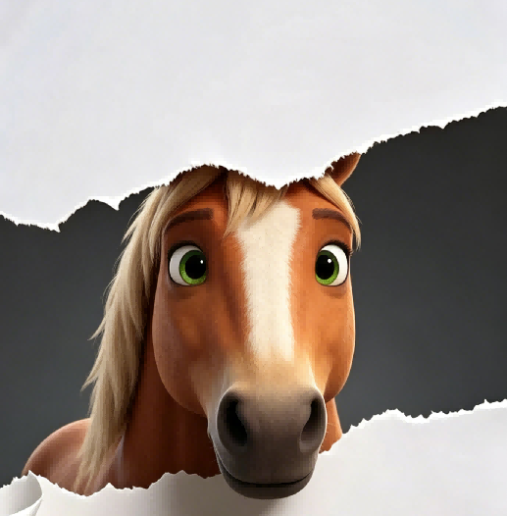


^{高分王炸技巧-7：}
警惕逻辑陷阱 ：偷换概念
Microplastics have become a common source of pollution across the Earth — they have settled in the deep sea and on the Himalayas, stuck inside volcanic rocks, filled the stomachs of seabirds and even fallen in fresh Antarctic snow. They are even appearing inside humans.
Now, new research suggests that a simple, cheap measure may significantly reduce the level of microplastics in water from your tap (水龙头): boiling and filtering (过滤) it. In a study published Wednesday in Environmental Science & Technology Letters, researchers from China found that boiling tap water for just five minutes — then filtering it after it cools — could remove at least 80 percent of its microplastics.
Crucially, this process relies on the water containing enough calcium carbonate (碳酸钙) to trap the plastics. In the study, boiling hard water containing 300 milligrams of calcium carbonate led to an almost 90 percent drop in plastics. But in samples with less than 60 milligrams of calcium carbonate, boiling reduced the level of plastics by just 25 percent. Additionally, the research didn’t include all types of plastics. The team focused only on three common types — polystyrene, polyethylene and polypropylene — and they didn’t study other chemicals previously found in water such as vinyl chloride.
Still, the findings show a potential path forward for reducing microplastic exposure — a task that’s becoming increasingly difficult. Even bottled water, scientists found earlier this year, contains 10 to 1,000 times more microplastics than originally thought.
Scientists are still trying to determine how harmful microplastics are — but what they do know has raised concerns. The new study suggests boiling tap water could be a tool to limit intake. “The way they demonstrated how microplastics were trapped through the boiling process was nice,” Caroline Gauchotte-Lindsay, an environmental engineer of the University of Glasgow in Scotland who was not involved in the research, tells New Scientist. “We should be looking into upgrading drinking water treatment plants so they remove microplastics.”
34. What does the author try to illustrate by mentioning bottled water in paragraph 4?
A. The importance of plastic recycling.
B. The severity of the microplastic problem.
C. The danger in overusing pure water.
D. The difficulty in treating polluted water.
警惕“偷换概念”逻辑错误：
微观结构的逻辑分析
D选项有干扰性，difficulty与原文意义相符。但命题人利用treating polluted water偷换了microplastic problem的概念。从逻辑推理角度犯了“偷换概念，偷梁换柱”的错误，偷换概念包含：
1.表述范围过泛、过偏、过窄或与过远：treating polluted water范围太大，本文及本段的中心词是microplastic problem。
2.偷换中心词，中心词不全：有的干扰选项中虽然涉及文章里反复出现的信息，包含其中一个中心词，但其他的信息却是命题人编造出来的，并未涵盖另一个中心词，此类选项无法充当文章主旨。
解题技巧提示：阅读中我们要从整体上感知，准确寻找出原文中与选项对应的语句，找出语句含有的意义，提取与答案相关的信息。
切不可轻信感觉或仅凭常理或按自己主观意愿判断!
路标词
2025年6月全国高考Ⅰ卷阅读理解D篇

Slide 21


^{高分王炸技巧-7：}
警惕逻辑陷阱 ：推理过度，主观臆断
While safety improvements might have been made to our streets in recent years, transport studies also show declines in pedestrian (行人) mobility, especially among young children. Many parents say there’s too much traffic on the roads for their children to walk safely to school, so they pack them into the car instead.
Dutch authors Thalia Verkade and Marco te Br mmelstroet are bothered by facts like these. In their new book Movement: How to Take Back Our Streets and Transform Our Lives, they call for a rethink of our streets and the role they play in our lives.
Life on city streets started to change decades ago. Whole neighbourhoods were destroyed to make way for new road networks and kids had to play elsewhere. Some communities fought back. Most famously, a Canadian journalist who had moved her family to Manhattan in the early 1950s led a campaign to stop the destruction of her local park. Describing her alarm at its proposed replacement with an expressway, Jane Jacobs called on her mayor (市长) to champion “New York as a decent place to live, and not just rush through.” Similar campaigns occurred in Australia in the late 1960s and 1970s as well.
Although these campaigns were widespread, the reality is that the majority of the western cities were completely redesigned around the needs of the motor car. The number of cars on roads has been increasing rapidly. In Australia we now have over twenty million cars for just over twenty-six million people, among the highest rate of car ownership in the world.
We invest a lot in roads that help us rush through, but we fail to account for the true costs. Do we really recognise what it costs us as a society when children can’t move safely around our communities? The authors of Movement have it right: it’s time to think differently about that street outside your front door.
31. What can be a suitable title for the text?
A. Why the Rush? B. What’s Next?
C. Where to Stay? D. Who to Blame?
微观结构的逻辑分析
标题蕴含文章要义和内核，
凝练语篇价值和特色:
★
★
标题是主题语境的浓缩，根据文章中核心
词汇streets and the role以及它的下义词a decent place to live和rush through，列举大量事实说明“过度的公路和汽车 = the Rush _{快速通行}”，其代价是“街道功能和城市宜居性的丢失”，呼吁重新思考_{think differently} 问题根源和街道功能。(见思维导图)
★
警惕“推理过度，主观臆断”逻辑错误：
D选项有干扰性，命题人根据原文信息“大量的街道功能和城市宜居性的丢失的事实”，做了一种貌似合理的推理，让考生掉入陷阱“Blame”，是没有基于事实与逻辑的推理过度，文章里没有问责，而是呼吁重新思考根源the Rush，并提出质疑Why?
务必确保所选答案确有出处，必然能在原文中找到依据的，符合原意（原文出现了两次rush），切不可轻信感觉或仅凭常理或按自己主观意愿判断 。
★

Slide 22
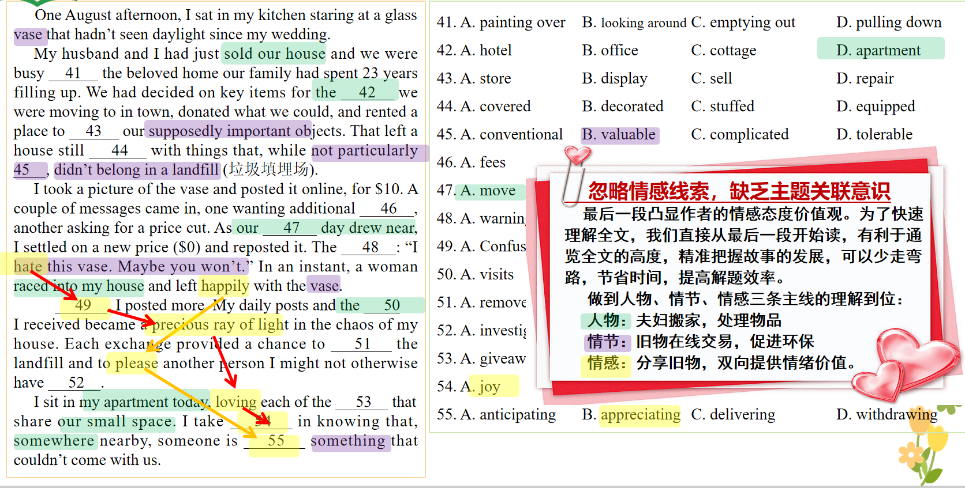
^{高分王炸技巧-8：}
完形填空把握人物、情节、情感三位一体的整体理解到位
41.C
42.D
43.A
44.C
45.B
46.B
47.A
48.C
49.D
50.A
51.B
52.C
53.D
54.A
55.B
先读尾段，通览全文，快速答题

Slide 23
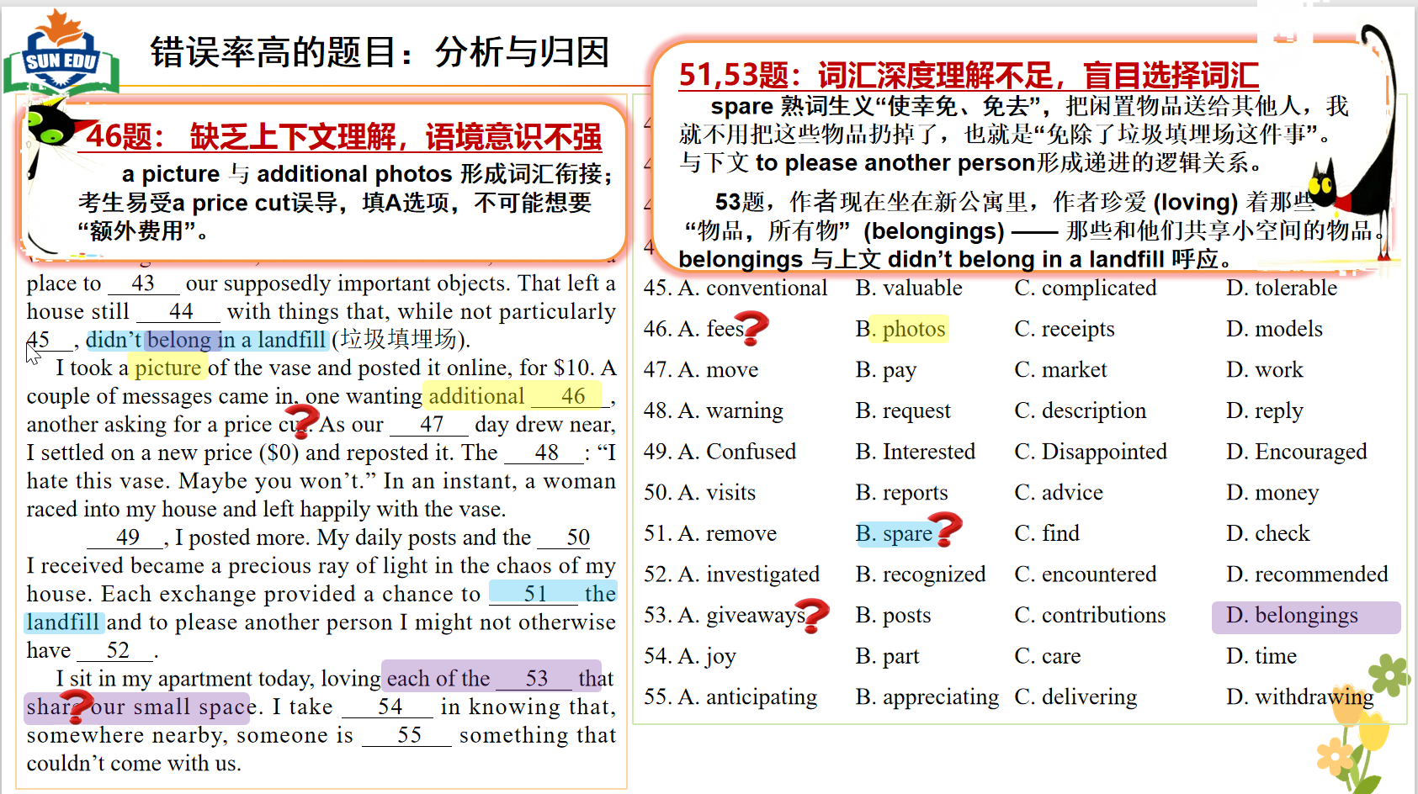

Slide 24
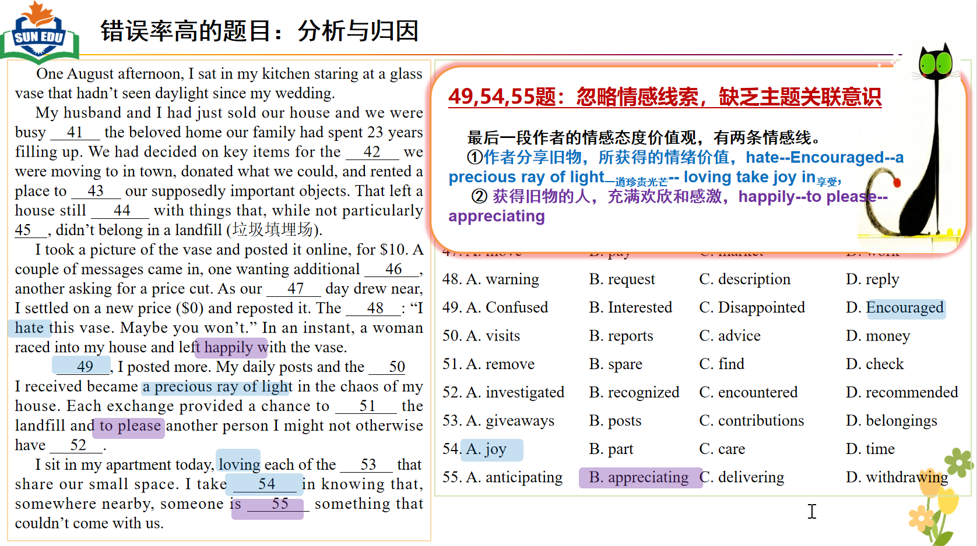

Slide 25
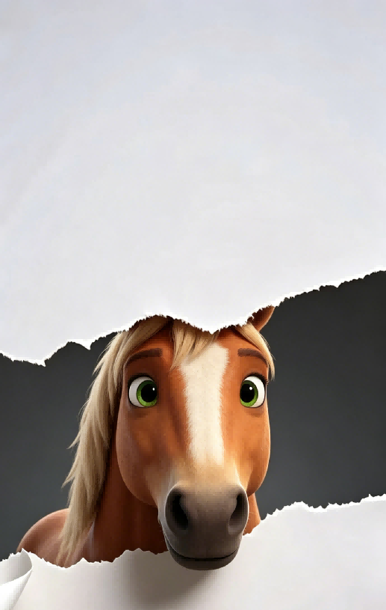
^{高分王炸技巧-9：}
语法填空注重上下文语境照应和内在逻辑
The design features ten steel “sepals (萼片)”made of glass and aluminium (铝). These sepals open on warm days 58 (give) the inside plants sunshine and fresh air. In cold weather, the structure stays 59 (close) to protect the plants. 2024年6月 新课标全国卷 Ⅰ 语法填空题
词性-语块-句子-语义，步步为营；
从语法到语境语篇，运用所学的语法知识，理解所学语篇的基本意义和深层意义。
两句之间语境照应和内在逻辑非常强：on warm days→In cold weather, open→ stays 59 (closed) ， 58 ( to give目的状语) →to protect the plants. 考后有很多老师问“63题为什么不填giving做伴随状语”，是因为没有关注两个句子之间的上下文语境照应和内在逻辑。
Tu says that the balance between the black and white pieces, the beauty in the 63 (strategy) placement of the pieces, 64 the energy flow following each move inspired artists to create oil paintings, sculptures, 65 (digital) generated pictures and silk-screen prints for the exhibition.
2025年6月 新课标全国卷 Ⅰ 语法填空题
尽管本句要长难句分析，但理解句内逻辑，建构语义场：围棋棋子排布→美学→气韵，同属围棋艺术语义群。64题A, B, and C → 平衡、布局之美以及落子带来的气韵，三者启发艺术家创作。

Slide 26
^{高分王炸技巧-9：}
语法填空注重上下文语境照应和内在逻辑
2026年1月浙江高考的语法填空的选材非常注重上下文语境照应和内在逻辑统一，堪称完美范本。所有空格不孤立考语法，依托上下文情感、句式逻辑、前后照应解题，正是高考语法填空核心命题特点。
三个would(过去常常)，表达熟悉的特定的场景 the kitchen，the microwave，63.______ uneven ，不难解释为什么63题填the。 而本题恰恰是全网老师们最困惑的答案，如果从上下文语境照应的角度，就可以得到完美的豁然开朗的解释，高考题实在是高！
另外59题高难度考查的独立主格结构watching，也有3处独立主格结构building，blowing...and singing ...在语境照应！
There are few people who could find joy in waiting for a microwave (微波炉) 56.______ (finish) heating, but my mum did it. One of my earliest memories is being held 57.______ her arms, counting down the flashing green 58.______ (number) together. Mum is small, but I remember feeling so high up there. She would dance us left and right around the kitchen, our eyes 59.______ (watch) the microwave like it was a space rocket countdown, 60.______ (excite) and tension building to that final moment: BEEP! The microwave had a loud alarm, but we overshadowed that noise with our own performance, tipping our heads back and shouting into the air — a scream 61.______ always ended in laughter.
My mum would find fun even when completing the most boring of tasks. I remember 62.______ (push) in a supermarket trolley (手推车) over 63.______ uneven car park ground like riding a rollercoaster. She would speed up, the wind blowing our hair back 64.______ my tiny voice singing out, “Weeee-eee-eee!”
I realise now that Mum didn’t find the joy in these tasks: she created it. Who cares if neighbours can hear you singing along to a microwave? Life is full of so many 65.______ (seeming) uneventful moments, but we can turn any of them into a celebration.
2026年1月浙江高考 语法填空

Slide 27
^{高分王炸技巧-10：}
应用文的开头和结尾一定要情感饱满，体现交际情感策略
假定你是李华，你们班上周五在公园上了一节美术课，请给英国好友Chris写一封邮件分享你的经历，内容包括：1. 你的作品内容 2. 你的感想 。 2024年6月全国新课标I卷
首段：拉近情感（求共情）
尾段：祝愿鼓励（画大饼）
Dear Chris，
I'm writing to share with you an art class in a park last Friday. Guess what? I drew an oil painting! I think I’ve done myself proud.
...
So how do you think of it? Tell me as soon as possible.
1. 开头：事件引入 + 情绪植入 + 口语破冰，拒绝冰冷通知体；
2. 结尾：互动提问 + 真诚期待，实现真实交际闭环；
首尾情感饱满、身份贴合、语境真实，这就是高考应用文的“王炸质感”。
我情商是不是很高呀！

Slide 28
^{高分王炸技巧-10：}
应用文的开头和结尾一定要情感饱满，体现交际情感策略
假定你是李华，外教Ryan准备将学生随机分为两人一组，让大家课后练习口语，你认为这样分组存在问题。请你给外教写一封邮件，内容包括： 1. 说明问题； 2. 提出建议。2023年6月全国高考新课标 I &Ⅱ卷
Dear Ryan,
I’ Li Hua from Class 3. I don’t intend to offend, but I suppose there lies a problem in the English speaking practice you organized.
It’s a truly brilliant idea that you chose the form of group practice, but I’m afraid you’ve neglected the fact that two students divided at random won’t have much to say.
...
So, I wonder if you could allow us to pair up freely and you could make adjustments if necessary. It’ll increase our motivation to speak and learn.
交际策略拆解，打造高考应用文的“王炸质感”：
开头：礼貌铺垫 ，情感克制得体，符合师生交际礼仪。+ 先行赞美 ，先褒后贬（欲抑先扬），交际满分技巧+ 委婉提疑（保全对方颜面），用词委婉弱化对立：I suppose / I’m afraid
结尾：委婉请求 ，I wonder if you could…请求句式软化，语气恳切，情感温和饱满+ 灵活让步 ，预留老师调控空间，体现体谅教师管理工作+ 说明益处（提高采纳概率），站在课堂效果角度提建议，不是单纯利己诉求。

Slide 29
^{高分王炸技巧-11：}
应用文的修辞使用让文章更出彩，脱颖而出
假定你是李华，你班的英语报要增设一个栏目。外教Jenny提出“Fun at my school"和"Guess who I am"两个选项供大家选择。请给Jenny写一封邮件，内容包括：（1）你的选择；（2）说明理由。 2025年6月全国高考I卷应用文
啊？
应用文卷到用修辞？！
Dear Jenny,
I really like the idea of adding a new column to our English newspaper. Between the two options, I support “Guess who I am” without hesitation. Here are the reasons for my preference.
First of all, the “Guess who I am” column will undoubtedly be a fun-packed part, where everyone showcases their uniqueness, awaiting “Holmes” to reveal their identities. Moreover, it not only reaps us a deeper understanding of each other but also fosters an affectionate bond among classmates, creating a more harmonious class atmosphere.
In a word, I hope to see “Guess who I am” column. But whatever column is finally chosen, I hope the English newspaper will become a hit and leave an indelible mark on youthful imprint!
1.比喻修辞（awaiting “Holmes” to reveal their identities），贴合栏目「猜猜我是谁」解谜游戏属性，生动形象；体现词汇积淀，阅卷老师一眼升格档次。
2.结尾夸张 + 隐喻：① a hit：口语隐喻，比喻报刊大受欢迎、成为热门；② leave an indelible mark：隐喻，把报刊内容比作刻印在青春里的印记；收尾升华立意，跳出常规 平淡套话，情感真挚、文采出彩，拔高书信格局。
修辞加持

Slide 30


2026年1月浙江高考 应用文 高分突破思维策略—— 修辞的合理加持
假定你是李华，你发现你校图书馆藏书存在被勾画涂改的现象。为此，请你向校英文报投稿，写一篇文章，内容包括：
1.说明具体情况；2.呼吁爱护书籍。
Many of us are book worms and resort to the school library for books to read. However, recently I have been disappointed to find that some of them carry unpleasant marks.
“Jane Eyre” was filled with sketches and “Macbeth” was “decorated” with meaningless circles and lines ... scribbles and doodles stained the once-white pages and even covered some of the content, making it hard to scrutinize the original lines.
Maybe some put down their notes to inspire others and some just for fun. But we should remember: these books are our school library's property, not our personal belongings. So I hereby appeal to all of you: let's relish the collection of our library with heart and soul instead of with pens and pencils. If you spot others scribbling on library books, please remind him or her with polite manners.
Library books are not merely a shared treasure, but they also embody a collective responsibility--only with joint efforts can we preserve them better!
1.比喻修辞：book worms生动比喻 “爱读书的人”，形象亲切，有文学感。
2. 反语 / 讽刺修辞：“decorated”加引号使用，讽刺乱涂乱画，含蓄有力，更有文采和张力。
3. 排比 / 列举修辞：Jane Eyre was... and Macbeth was ...用两本经典名著举例，形成对称结构，画面感极强，让 “涂画现象” 具体可感，极具说服力。
4.拟人：carry, embody让书有生命、有灵魂
5.对比：once-white pages 对比 stained（被玷污），突出破坏之严重。public property 对比 personal belongings，强化公共意识。with heart and soul instead of with pens and pencils强烈呼吁。

Slide 31
2026年1月浙江高考 应用文 高分突破思维策略—— 修辞的合理加持
假定你是李华，你发现你校图书馆藏书存在被勾画涂改的现象。为此，请你向校英文报投稿，写一篇文章，内容包括：
1.说明具体情况；2.呼吁爱护书籍。
Recently, I’ve noticed a disturbing phenomenon that books are being scribbled by borrowers, completely ignoring the guidelines of our library. The “artistic creations” on the illustrations, personal comments and colorful highlights made by markers stand out starkly against the once neat and clean book pages, influencing other readers’ reading experience.
I hereby appeal to every reader of our school library: please treasure our library books! These books are not your personal possessions, but the public property shared by every reader. It’s our shared responsibility to keep the book pages clean and kindly remind others if they scribble on the books.
Together, let’s be the “guardians” of our library books and treat our delicate “companions” with caution and care, RIGHT NOW!
1.反语 / 讽刺修辞：artistic creations（加引号），表面 “艺术创作”，实则乱涂乱画，讽刺效果强烈。
2.比喻 (Metaphor)：把 “读者” 比作 “guardians（守护者）”，赋予读者保护书籍的使命感和责任感；② 把 “图书馆书籍” 比作 “companions（伙伴）”，将书籍拟人化、情感化，体现对书籍的珍视。
3.对比 (Contrast)：...stand out starkly against the once neat and clean book pages用 “被涂画的杂乱痕迹” 与 “曾经整洁干净的书页” 形成今昔对比，“stand out starkly against” 进一步强化这种反差，直观展现书籍被破坏的程度。

Slide 32
^{高分王炸技巧-12：}
续写结尾的出彩要收住“矛盾解决+核心词升华”的逻辑闭环和情感价值
^{2025年6月全国新高考 I 卷}We gave each other a heartfelt hug. “From now on, Toby will always be welcome wherever our family is, because he is part of the family, a perfect choice”.I passed a biscuit to the puppy, and helped myself with another --- sweet as it was, the true taste of brotherhood and LOVE.
我最爱看有逻辑闭环和情感价值拉满的续写！
^{2026年1月浙江卷}Knowing the result, she looked at me with admiration and said, “I knew you could do it! Papa is my super star — ALWAYS competent to tackle any tricky crisis in an active and surefire way!” I told her I hadn’t handled the cow by myself—it was all down to teamwork with the policemen, and dealing with dangerous animals, although a little fear, requires patience and understanding, not blind courage.
^{2023年6月全国新高考 I 卷}Just Like my story's subject - Revere's horse, I kept going, checking, correcting, and writing again and again, then finally succeed. Only then did I realize that nothing is impossible when we give it a try and learn to enjoy it!
收放自如，长袖善舞

Slide 33




