Slide 1


感恩遇见，相互成就，本课件资料仅供您个人参考、教学使用，严禁自行在网络传播，违者依知识产权法追究法律责任。
更多教学资源请关注
公众号：溯恩英语
知识产权声明

Slide 2
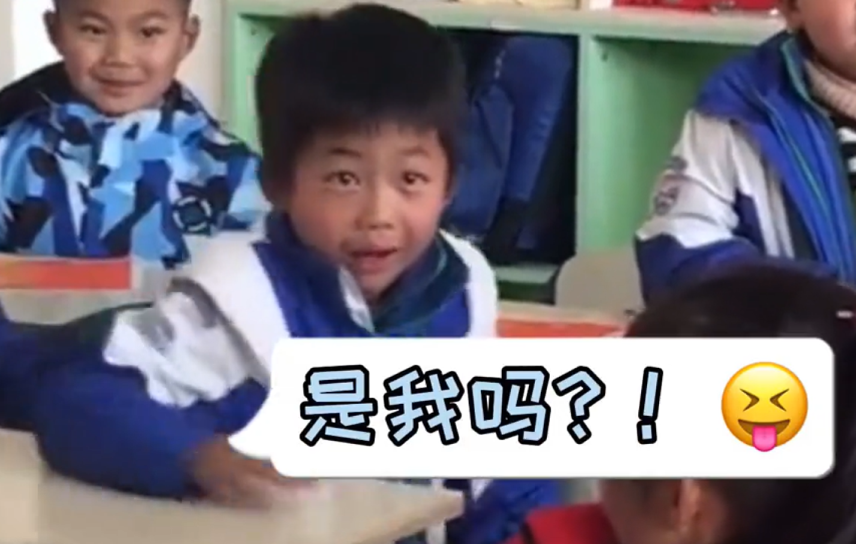
动作链：
1 写好主语
2 分清谓语非谓语
高一期末读后续写微技能训练：多模态 《领奖状的小男孩》
刘艳

Slide 3
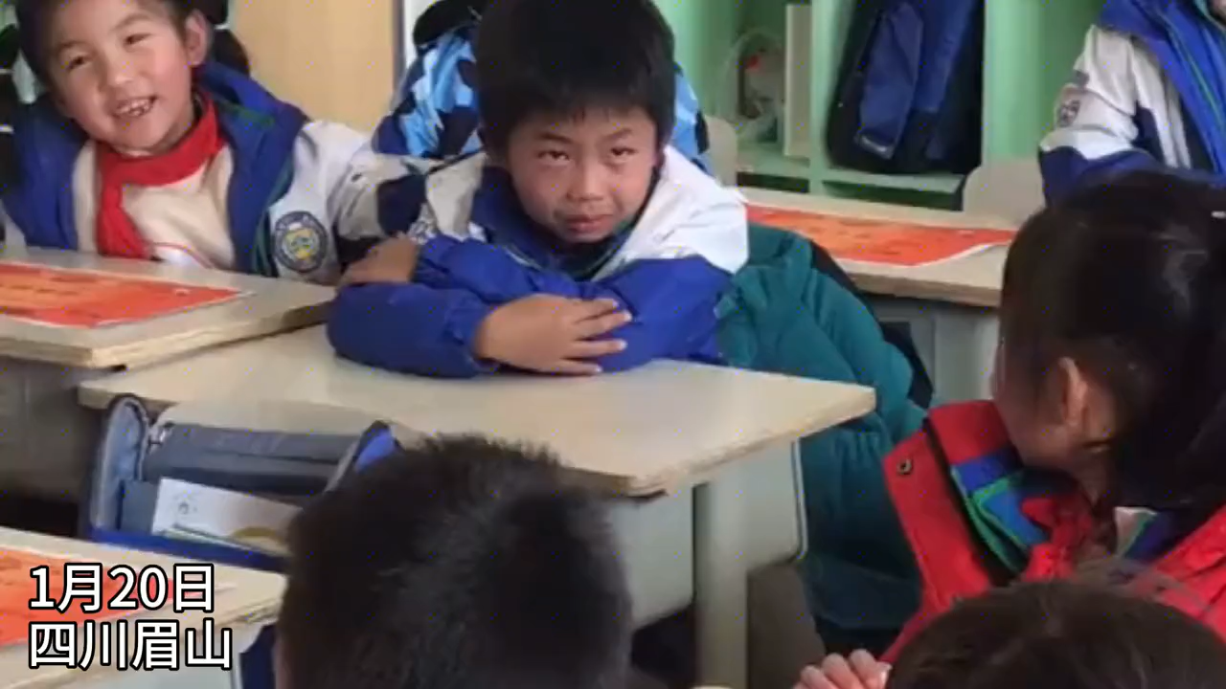

Slide 4
Step1：改错练习
句子要有主和谓，主干动词变时态；伴随动作 doing/done，永远不当谓语用；主动就用 doing，被动要用 done。
1 Waiting quietly in the classroom.
2 Holding the shirt, staring at the certificate.
3 Holding his breath, almost stand up.
4 Not his name.
5 Hit by disappointment, Peter slumping back.
6 Feeling sad, forced a smile and clapping.
7 Hearing his name called, eyes lighting up.
8 Jumped to feet, high-fiving classmates.
9 Seeing Peter crying, the teacher patting his head.

Slide 5
1 原错句：Waiting quietly in the classroom.
改正句：The classroom was quiet，and Peter waited.
错误解析：整句只有非谓语 waiting，无主语、无谓语，不是完整句子。
2 原错句：Holding the shirt, staring at the certificate.
改正句：Holding the corner of his shirt and staring at the certificate, Peter waited nervously.
错误解析：全为非谓语动词，缺少主干主语和谓语，句子成分残缺。

Slide 6
3 原错句：Holding his breath, almost stand up.
改正句：Holding his breath and leaning forward, Peter almost stood up.
错误解析：缺少主语；故事为过去时态，动词 stand 时态错误。
4 原错句：Not his name.
改正句：But the name called was not his.
错误解析：只是短语，无主语、无谓语，无法构成完整句子。

Slide 7
5 原错句：Hit by disappointment, Peter slumping back.
改正句：Hit by disappointment, Peter slumped back into his chair.
错误解析：slumping 是非谓语，不能作谓语，需改为过去式谓语动词 slumped。
6 原错句：Feeling sad, forced a smile and clapping.
改正句：Feeling disappointed, he forced a weak smile and clapped politely.
错误解析：缺少主语；clapping 为非谓语，需改为过去式谓语 clapped。

Slide 8
7 原错句：Hearing his name called, eyes lighting up.
改正句：When he heard his name called, Peter’s eyes lit up.
错误解析：lighting 是非谓语，无谓语动词，需改为过去式谓语 lit。
8 原错句：Jumped to feet, high-fiving classmates.
改正句：He jumped to his feet and high-fived his classmates crazily.
错误解析：前半部分缺主语；high-fiving 是非谓语，需改为谓语动词 high-fived。

Slide 9
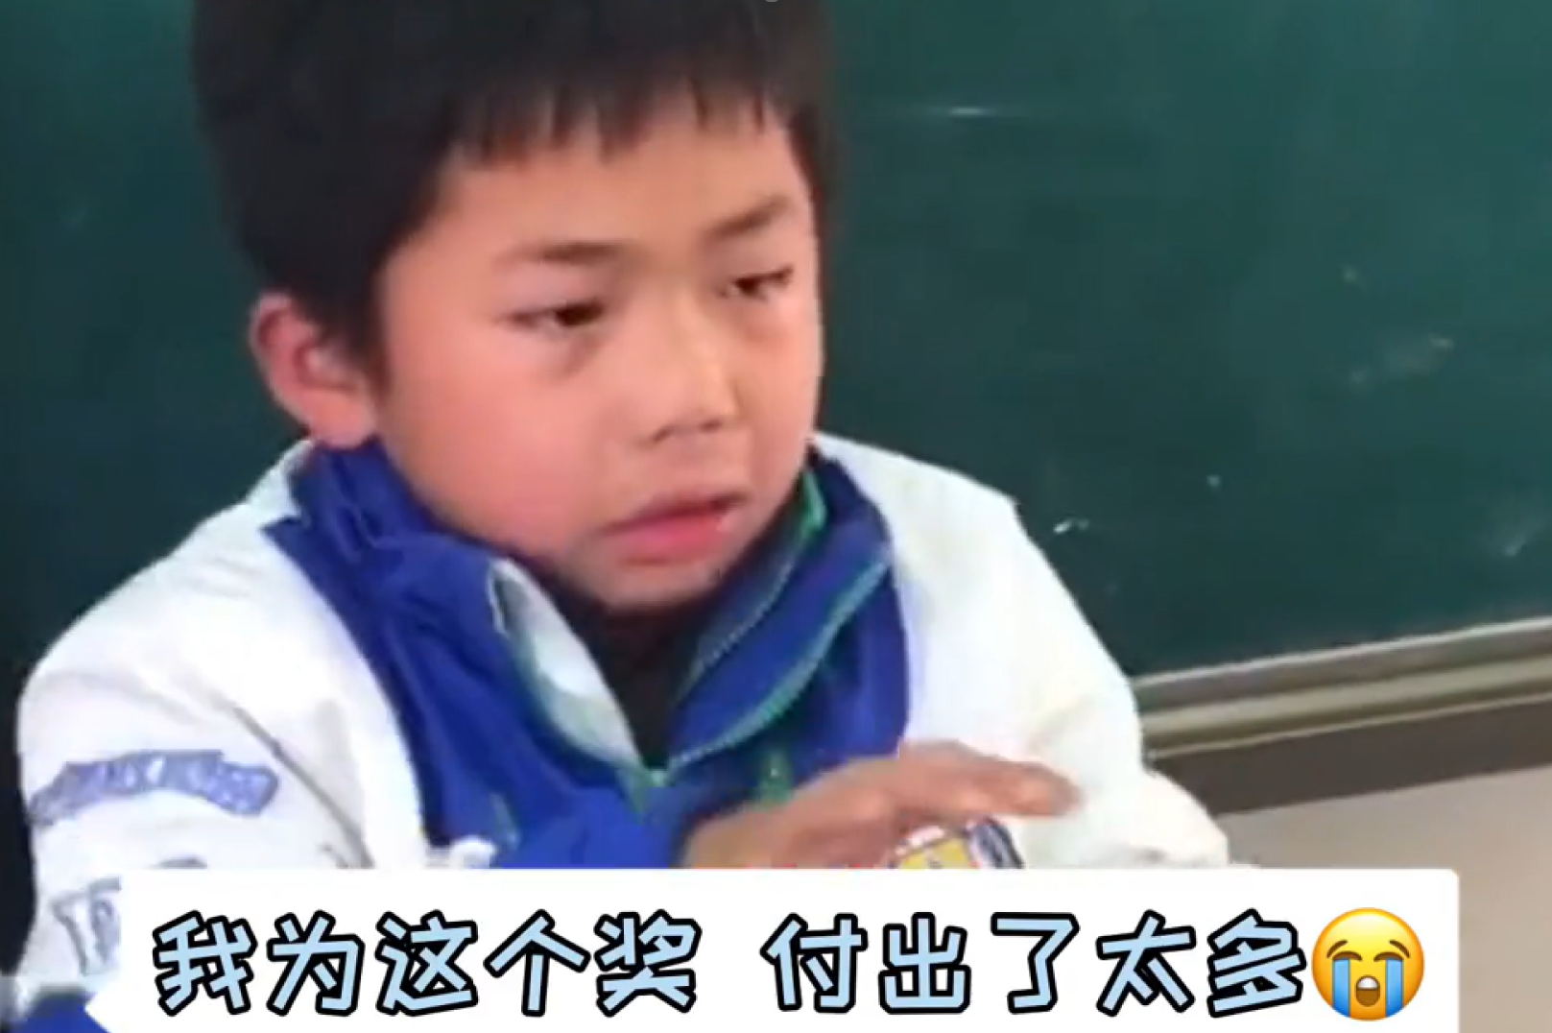
9 原错句：Seeing Peter crying, the teacher patting his head.
改正句：Seeing Peter’s lovely look of laughing and crying, the teacher patted him gently on the head.
错误解析：patting 是非谓语，不能作谓语，需改为过去式谓语动词 patted。

Slide 10
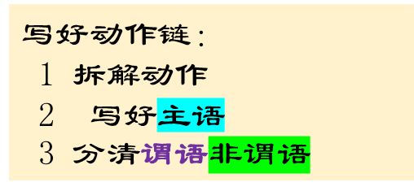
场景1：等待时的紧张与期待
（主动伴随链 Doing B+C, 主语 + 谓语动词 A + D…）
动作拆解：攥着衣角，盯着老师手里的奖状，Peter紧张地等待着。
Holding the corner of his shirt and staring at the certificate in the teacher’s hand, Peter waited nervously.
场景2：以为要念到自己的激动
（主动伴随链 Doing B+C, 主语 + 谓语动词 A + D…）
动作拆解：屏住呼吸，身体前倾，Peter激动得差点站起来。
Holding his breath and leaning forward, Peter almost stood up in excitement.
Step1：改错练习

Slide 11
场景3：听到不是自己的失望
（被动完成链 Done C, 主语 + 谓语动词 A + B…）
动作拆解：被失望击中，Peter瘫坐回椅子上，肩膀垮了下去。
Hit by disappointment, Peter slumped back into his chair, his shoulders drooping.
场景4：礼貌鼓掌的强撑
（主动伴随链 Doing B+C, 主语 + 谓语动词 A + D…）
动作拆解：尽管很失望，Peter还是挤出微笑，礼貌地鼓掌。
Feeling disappointed, Peter still forced a weak smile and clapped politely for the winner.

Slide 12
场景5：听到自己名字的狂喜
（主动伴随链 Doing B+C, 主语 + 谓语动词 A + D…）
动作拆解：听到自己的名字，Peter眼睛一亮，立刻露出了灿烂的笑容。
When he heard his name called, Peter’s eyes lit up and he immediately showed a bright smile.
场景6：疯狂击掌→眼泪掉落→边走边擦
（主动伴随链 Doing B+C, 主语 + 谓语动词 A + D…）
动作拆解：脸上挂着笑容，Peter猛地站起来，转身和周围的同学疯狂击掌，然后在走向讲台的路上，激动的眼泪掉了下来，他一边快步走，一边用手背擦去眼角的泪水。
With a smile on his face, Peter jumped to his feet, turned around and high-fived his classmates crazily. Then, as he walked toward the platform, excited tears fell down, and he wiped the tears from the corner of his eyes with the back of his hand while walking quickly.

Slide 13
场景7：老师的反应和领奖瞬间
（被动完成链 Done C, 主语 + 谓语动词 A + B… + 主动伴随链）
动作拆解：看到Peter又笑又哭的可爱模样，老师心里满是温柔，主动走上前，轻轻拍了拍他的头，还温柔地帮他擦了擦脸颊上的泪痕。Peter不好意思地笑了笑，双手接过奖状，眼含泪水、一脸严肃又自豪地把奖状紧紧举在胸前，腰板挺得笔直，接受同学们的掌声。
Seeing Peter’s lovely look of laughing and crying, the teacher felt full of warmth. She stepped forward actively, patted him gently on the head, and also wiped the remaining tears on his cheeks softly. Peter smiled embarrassedly, took the certificate with both hands, held it tightly against his chest seriously and proudly with tears in his eyes, straightened his back, and accepted the applause from his classmates.

Slide 14
The classroom was quiet as students waited anxiously for the award ceremony. Holding the corner of his shirt and staring at the certificate in the teacher’s hand, Peter waited nervously, his heart beating fast. When the teacher paused, holding his breath and leaning forward, Peter almost stood up in excitement. But the name called was not his. Hit by disappointment, Peter slumped back into his chair, his shoulders drooping. Still, feeling disappointed as he was, Peter forced a weak smile and clapped politely for the winner.
Finally, “Peter!” the teacher called. When he heard his name called, Peter’s eyes lit up and he immediately showed a bright smile. With a smile on his face, Peter jumped to his feet, turned around and high-fived his classmates crazily. Then, as he walked toward the platform, excited tears fell down, and he wiped the tears from the corner of his eyes with the back of his hand while walking quickly. Seeing Peter’s lovely look of laughing and crying, the teacher felt full of warmth. She stepped forward actively, patted him gently on the head, and also wiped the remaining tears on his cheeks softly. Peter smiled embarrassedly, took the certificate with both hands, held it tightly against his chest seriously and proudly with tears in his eyes, straightened his back, and accepted the warm applause from his classmates.
时间过渡+逻辑连词
动作面

Slide 15
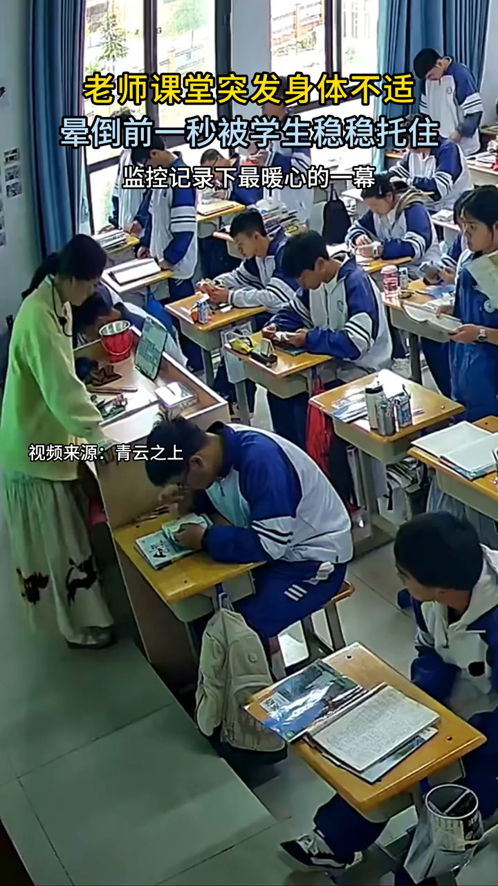
实战演练1

Slide 16
场景分类 | 动作描述 | 基础词汇 | 进阶词汇
老师・不适 | 感到头晕 | feel dizzy | feel light-headed; a wave of dizziness hits sb.
 | 撑住身体 | lean on; prop up | hold oneself up with one’s elbow
 | 撑不住 / 坚持不住 | can’t hold on; can’t keep going | struggle to stay upright
 | 摇摇晃晃地走 | walk unsteadily | stumble; sway; stagger
老师・离开 | 走出教室 | walk out of the classroom | head out of the classroom slowly
 | 找地方休息 | want to find a place to rest | seek a quiet spot to catch one’s breath
 | 快要晕倒 | be about to faint; fall to the ground | be on the verge of collapsing

Slide 17
场景分类 | 动作描述 | 基础词汇 | 进阶词汇
事后 感动 | 看到监控视频 | watch the video | look back at the security footage
 | 深受感动 | feel deeply moved | be touched to the heart; filled with warmth
 | 感到幸福 | feel happy; feel lucky | feel fulfilled as a teacher
发现 异常 | 察觉到不对劲 | notice; find out | sense something is wrong
 | 瞪大了眼睛 | open one’s eyes wide | stare with wide eyes
 | 观察 | watch; observe | keep an eye on sb.
 | 窃窃私语 | whisper to each other | murmur quietly; talk in low voices
救助老师 | 快步冲出去 | run out quickly | rush out; hurry out of the classroom
 | 接住 / 扶住 | catch; hold | steady sb.; hold sb. up firmly
 | 稳稳地接住 | catch sb. steadily | support sb. just in time

Slide 18
Hit by a sudden dizziness during class, the teacher propped herself up with her arm, but still couldn’t hold on. Swaying and gathering her last strength, she walked out of the classroom, hoping to find a place to rest.
Noticing something was wrong, the students opened their eyes wide and then began to whisper to each other. Worried about their teacher, several students rushed out quickly and caught her steadily just as she was about to fall to the ground.
Watching the video footage later, the teacher was deeply moved. She felt so lucky and happy to be a teacher with such caring students.

Slide 19
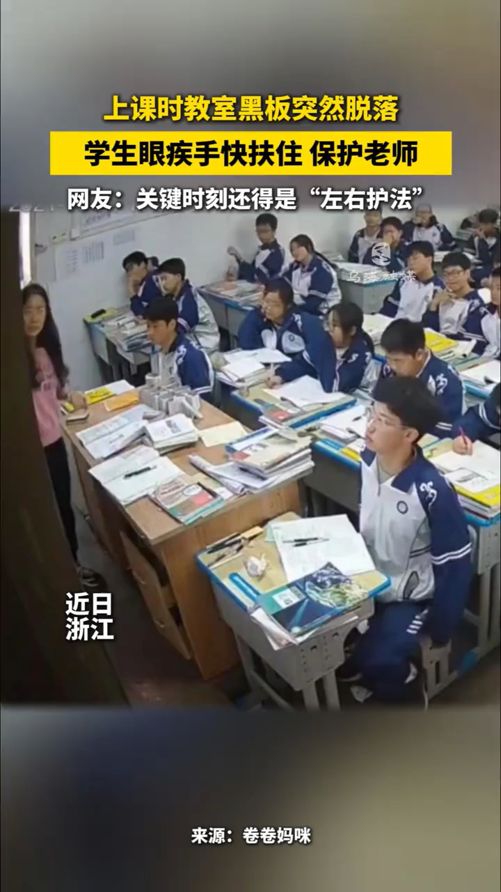
实战演练2

Slide 20
动作链：done C , 主语（人）谓语动词 A +B …
序号 | 动作 / 神态 | 英文表达（高一词汇）
1 | 看到黑板要掉下来 | See the blackboard begin to fall
2 | 迅速站起来 | stood up quickly / stood up at once
3 | 伸出手 | put out their hands
4 | 扶住黑板框架 | held the blackboard’s frame
5 | 稳住、撑住 | kept it steady / held it up
6 | 靠在墙边 | leaned it against the wall
7 | 松了一口气 | took a deep breath of relief / let out a sigh of relief
8 | 安然无恙 | stayed safe / was not broken
动作链：Doing B +C , 主语（人）谓语动词 A +D …

Slide 21
Seeing the blackboard start to fall, the two boys sitting near the teacher’s desk jumped up quickly and reached out their hands to grab it. Holding the blackboard’s frame tightly, they pulled it back and leaned it safely against the wall.
Meanwhile, shocked by the sudden scene, the teacher froze for a second and stared at them in surprise. Once the blackboard was steady, the teacher let out a long sigh of relief and smiled softly at the class. Finally, feeling the danger had passed, the whole class sighed with relief and then laughed quietly.

