Slide 1


感恩遇见，相互成就，本课件资料仅供您个人参考、教学使用，严禁自行在网络传播，违者依知识产权法追究法律责任。
更多教学资源请关注
公众号：溯恩英语
知识产权声明

Slide 2
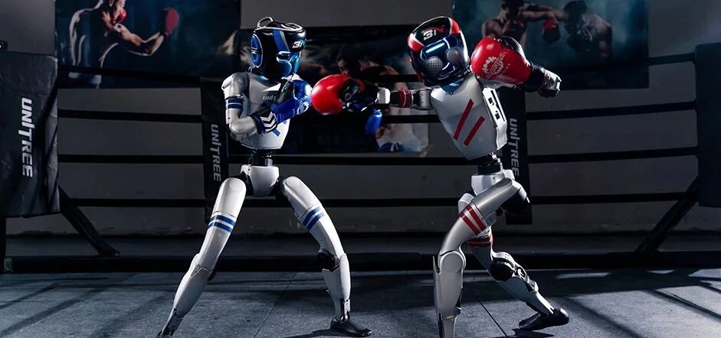
全球首场人形机器人格斗擂台赛
First Commercial Robot Fighting League Opens in Shenzhen
刘艳

Slide 3
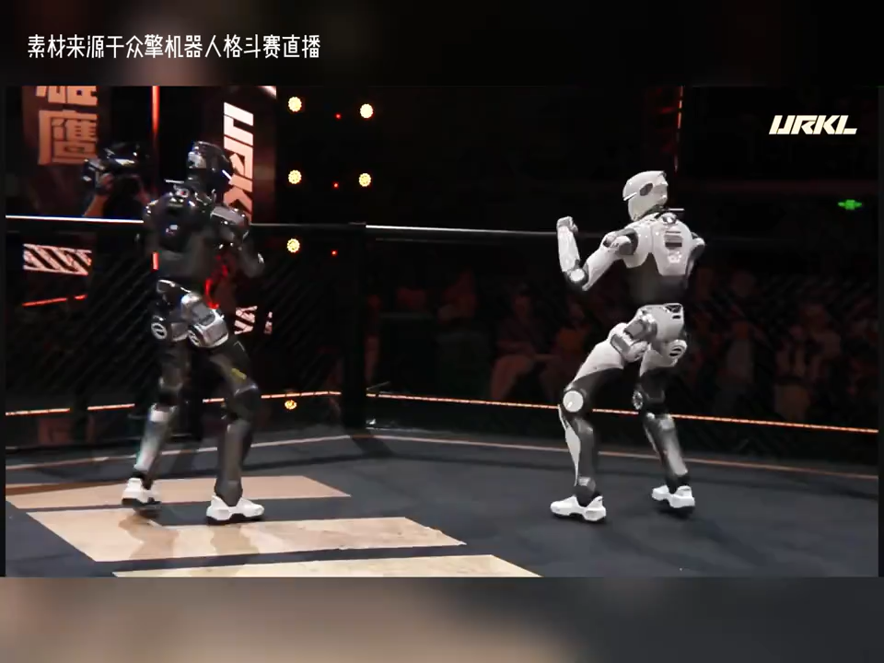

Slide 4
International authoritative media reported on July 16th that the opening match of URKL, the world's first commercial humanoid robot fighting league, officially 1.______ (kick) off in Shenzhen, China.
A total of 32 top teams 2.______ (select) from more than 200 global teams took part in the event, including research groups from Tsinghua University and Stanford University.
All competitors use the same self-developed T800 full-size humanoid robots. Different from remote-controlled toys, the robots rely entirely on built-in AI algorithms 3.______ (finish) punches, kicks, and dodging movements during matches.
A strict rule states that any robot knocked down must stand up within 10s, 4.______ it will lose the round directly. Judges score robots based on effective strikes, balance ability and stable operation instead of powerful 5.______ (hit) alone.
This competition is not just an entertaining show. It tests core technologies such as motion control, balance calculation and impact resistance（抗冲击） of humanoid robots.
These technologies can be applied to real-life scenes 6.______ disaster rescue and security patrol.
In the future, the champion team 7.______ (give) a pure gold championship belt weighing ten kilograms.
Lots of tech lovers and students in China 8.______ (follow) the live broadcast back then.
Experts say this competition marks a new 9.______ (develop) for the global humanoid robot industry, and China's robot R&D 10.______ (strong) has drawn wide attention throughout the whole world.
kicked
selected
to finish
or
hits
like
will be given
followed
development
strength

Slide 5
模块四：七选五（新闻结构题型，新闻 “导语 - 正文 - 细节 - 意义 - 结尾” 框架）
International authoritative media reported on July 16th that the opening match of URKL was held in Shenzhen. 1
Over 200 teams worldwide applied for the competition, yet only 32 were qualified to compete. 2 All robots are the same model named T800 and run on built-in AI instead of human remote control.
3 Once knocked down, a robot has only 10 seconds to get up, otherwise it loses the round. Judges judge matches from three aspects: valid hits, balance and stable operation.
This competition is not merely a show for fun. 4 These technical breakthroughs can serve real-world fields including emergency rescue and security patrol.
After watching the live stream, many tech fans spoke highly of the game. 5 It proves China has gained global recognition in humanoid robot research.
A. Strict competition rules are carried out during each match.
B. It aims to examine the core technology of humanoid robots.
C. It marks the start of the first commercial robot fighting league.
D. Famous university teams from China and the US are included.
E. Experts believe the event pushes forward the whole industry.
F. The champion will be rewarded with a huge pure gold belt.
G. Robots are able to win points by delivering heavy punches.
1.C 2.D 3.A 4.B 5.E

Slide 6
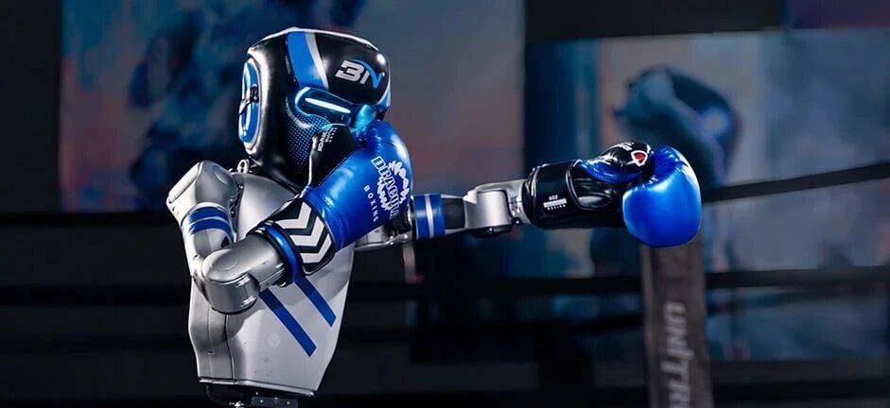
假定你是校英文报记者李华，请根据本篇素材，写一篇英文新闻报道刊登在校英文报上。
内容要点：
时间地点：7 月 16 日，深圳，URKL 全球首届商用仿生人机器人大赛揭幕
参赛规模：200 余支队伍筛选出 32 支，包含清华、斯坦福研究团队
比赛形式：机器人依靠 AI 自主格斗，有严格判分与倒地时限规则
赛事意义：测试机器人核心技术，可应用于救援、安防；业内评价

Slide 7
First Commercial Robot Fighting League Opens in Shenzhen
It is reported that the opening match of URKL, the world’s first commercial humanoid robot fighting league, took place in Shenzhen on July 16.
Thirty-two teams picked from more than 200 global teams joined the competition, including research groups from Tsinghua and Stanford University. Equipped with AI systems, robots finish fights automatically without remote control. They must stand up within 10 seconds after being knocked down.
More than entertainment, the contest tests key robotic technology for disaster rescue and security work. Experts think it promotes the robot industry and shows China’s strong research strength worldwide.

Slide 8
一、手部击打（拳击核心）
throw a punch 出一拳
land a punch 一拳打中对手
punch sb. in the face 一拳打在某人脸上
punch sb. in the stomach 击打某人腹部
swing at sb. 挥拳朝某人打去
block a punch 格挡拳头、挡拳
dodge a hit 躲闪攻击
hook punch 勾拳
straight punch 直拳

Slide 9
二、腿部踢击（正面 / 近身脚攻）
kick sb. forward 正面踢向对方
kick sb. in the chest 踹胸口正面攻击
deliver a kick 踢出一脚
step forward to kick 上前抬脚踢击
sweep sb.’s leg 扫腿勾脚
三、击倒、摔倒对手
knock sb. down 把某人打倒在地
knock sb. to the ground 将对方击倒在地
push sb. down 把人推倒
take sb. down 放倒对手
send sb. falling 打得对方踉跄倒地

Slide 10
四、倒地后起身动作
get up from the ground 从地上爬起来
struggle to one’s feet 挣扎着站起身
rise to one’s feet 缓缓站起身
pick oneself up （摔倒后）自己爬起来
五、缠斗 & 防守补充短句
hold back the opponent 牵制对手
back away 向后退开拉开距离
grab the opponent 抓住对方
break free 挣脱束缚

Slide 11
读后续写
He threw a punch and knocked his rival down to the ground.
他挥出一拳，将对手打倒在地。
The boy struggled to his feet and prepared to fight again.
男孩挣扎着从地上爬起来，准备再次迎战。
She stepped forward and kicked the man right in the stomach.
她上前一步，正面一脚踹在那人肚子上。

