Slide 1


感恩遇见，相互成就，本课件资料仅供您个人参考、教学使用，严禁自行在网络传播，违者依知识产权法追究法律责任。
更多教学资源请关注
公众号：溯恩英语
知识产权声明

Slide 2

Shirley Tong

Slide 3
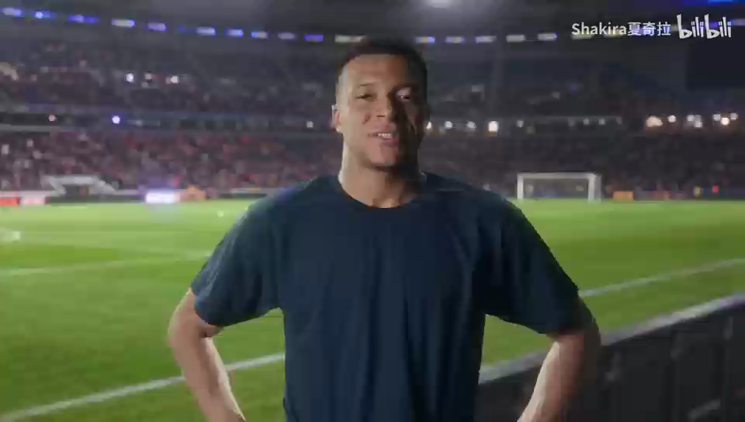

Slide 4
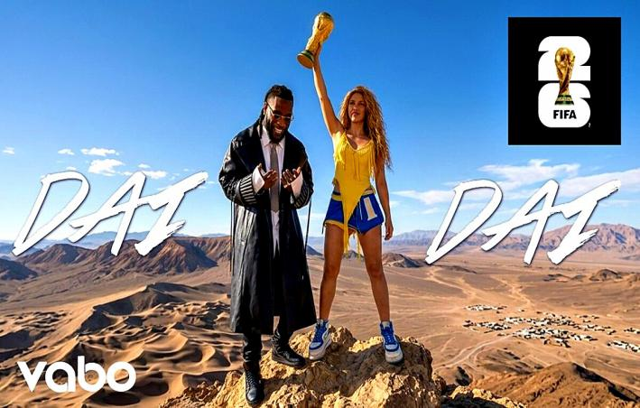
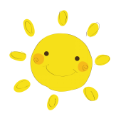
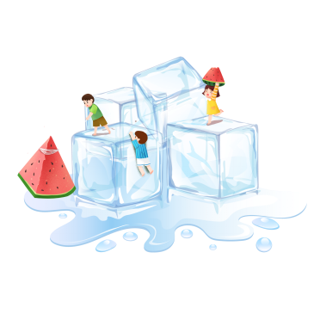
Passion Begins
How does the song make you feel?
The rhythm makes me feel __________
rhythm a strong regular repeated pattern of sounds or movements 节奏；韵律；律动
What does it remind you of ? （make someone remember or think of someone/something）
The 2026 World Cup has released a new energetic theme song Dai Dai,performed by Colombian superstar Shakira.
release to make sth available to the public 公开；公布；发布
Notes:
World Cup!
Football!
Spain!
Shakira!

Slide 5
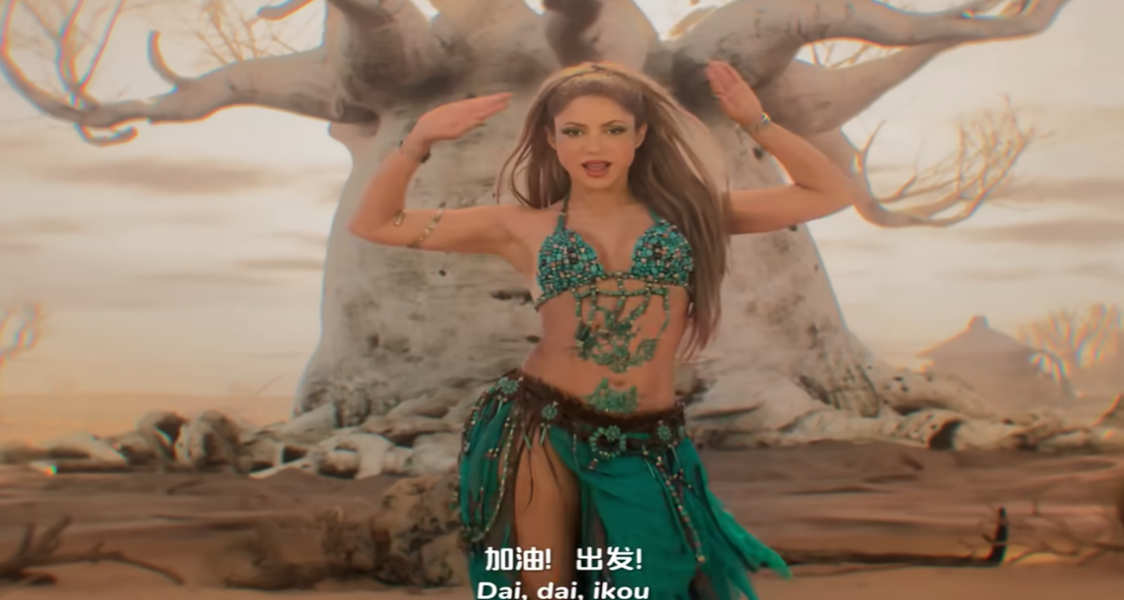
Passion Begins
You knew from the day you were born
That here in this place, you belong
You've been this brave all along
What broke you once, made you strong
Dai, dai, ikou, dale, allez, let's go
Dai, dai, ikou, dale, allez, let's go
いこう
DAH-leh ah-LAY
What do you think “Dai Dai” means?
Meaning “come on” in Italian, the song features inspiring multilingual lyrics （Italian + Japanese + Spanish + French + English）to cheer for football fans. When you repeat it as "Dai dai," it's like the Chinese "go go go!" or "Just go for it / get it done!”

Slide 6
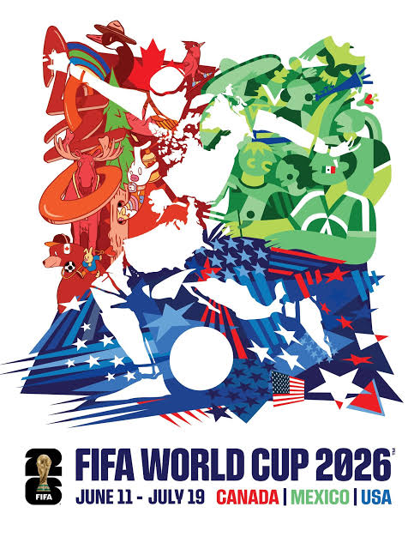
World Cup Word Challenge

Slide 7

2. 32 teams are divided into several groups.
Each team plays several matches against the other teams in its group.
The best teams move on to the next round.
This part of the World Cup is called the group stage.
小组赛
3. Now the group stage is over.
From this point on, if a team loses one match, it is out of the tournament.
The winners continue to the next round until only one team becomes champion.
This is the knockout stage.
淘汰赛
东道主

Slide 8
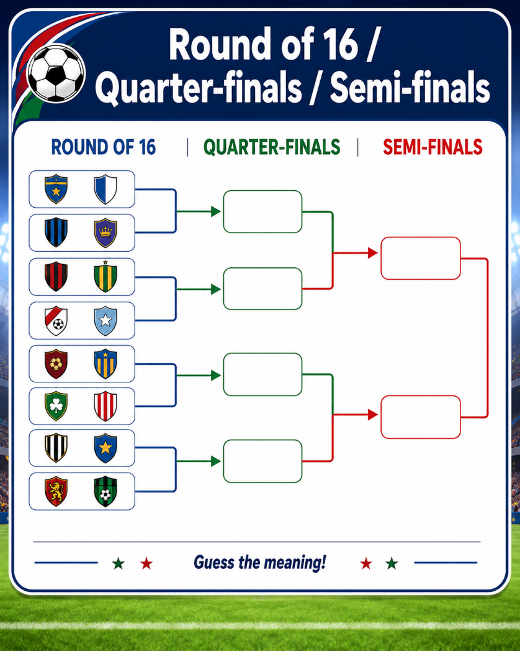
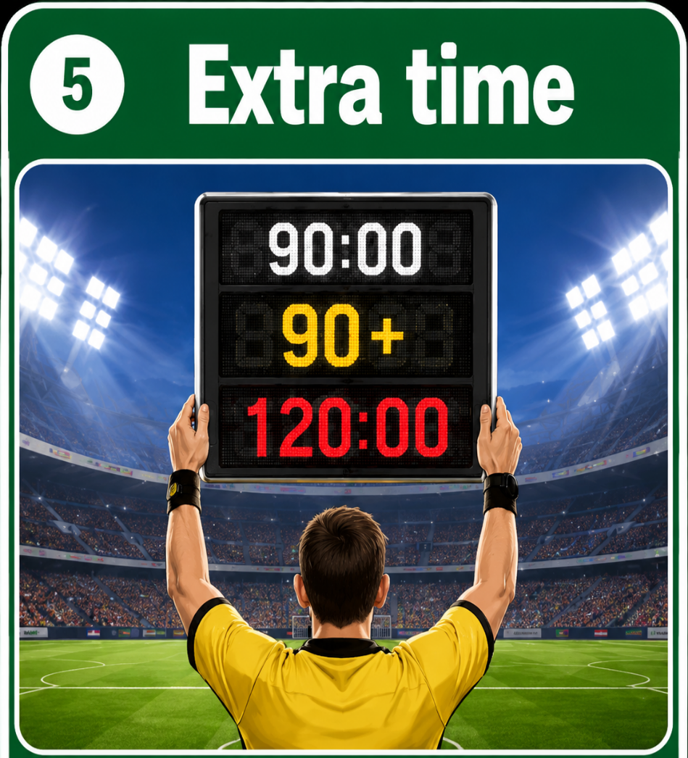
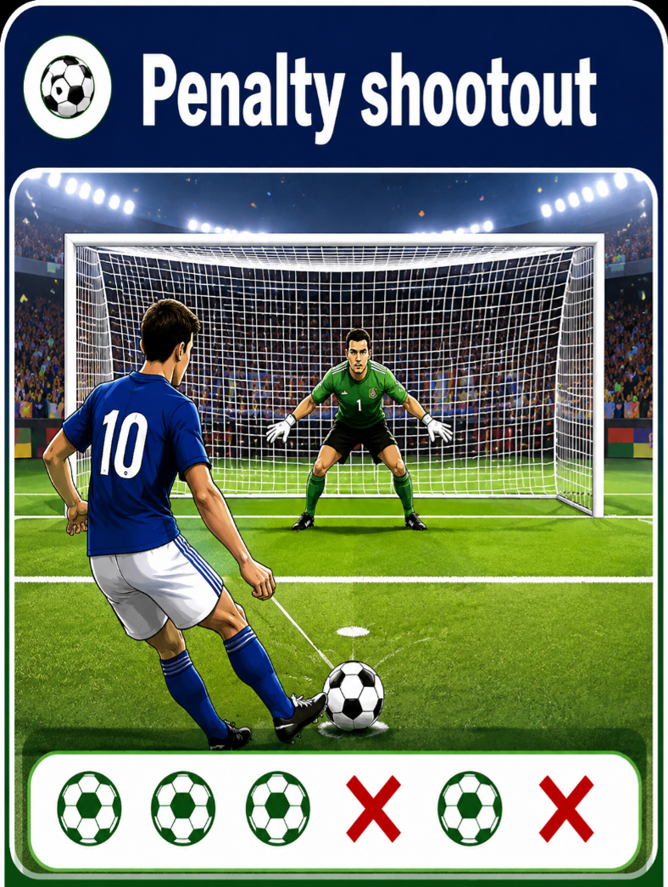
16 强 / 8 强 / 4 强
final [ C ] the last of a series of games or competitions in which the winner is decided 决赛
加时赛
点球大战
penalty /ˈpenəlti/ a punishment for breaking a law, rule or contract 惩罚；处罚；刑罚

Slide 9
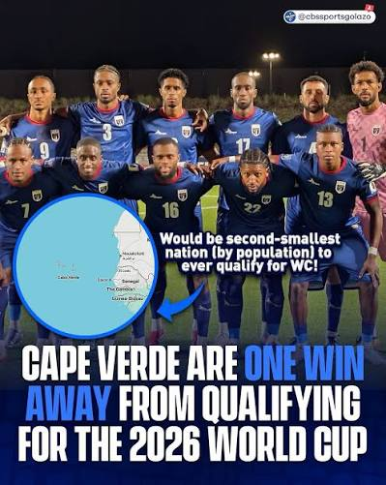
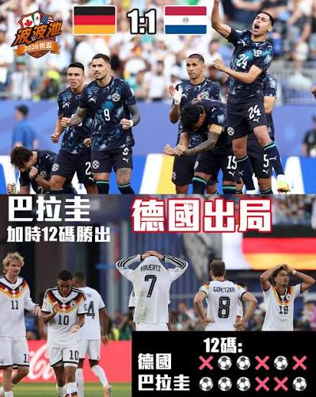
Cape Verde（佛得角） had never played in a World Cup before 2026.
It is a small country with few internationally famous football stars.
Before playing Spain, most people expected Spain to win.
But Cape Verde surprised everyone and drew 0–0 with Spain.
Cape Verde was the underdog.
黑马
Paraguay（巴拉圭） knocked Germany out of the 2026 World Cup after a dramatic penalty shootout. Paraguay were the underdogs.
Beating Germany was a giant-killing.
爆冷

Slide 10
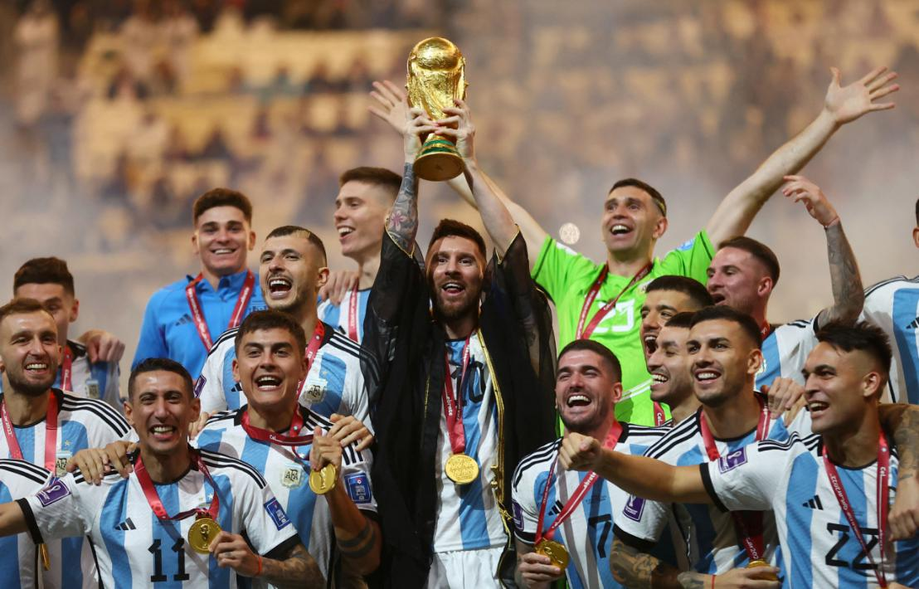


Argentina won the World Cup in 2022.
In 2026, they came to the World Cup as the defending champions.They hoped to win the trophy again and keep their title.This was their title defense.
hat-trick
A hat trick means achieving something three times in a row, especially scoring three goals in a game.
The expression originated in cricket in the 1850s. When a bowler took three wickets with three consecutive balls, fans would collect money to buy him a hat as a special reward.
She achieved a hat-trick of promotions in three years.
她三年内连续三次升职。
What does “title defense” probably mean?
A. Trying to win the championship again
B. Winning the championship for the first time
C. Playing a friendly match
Notes:
帽子戏法这个说法起源于1850年代的板球运动。当一名投手连续三球淘汰三名打者时，观众会募款送他一顶帽子作为奖励，因此有了这个名称。现在英语中的hat trick 泛指连续三次成功达成同一件事，尤其常指球员在一场比赛中攻入三球。

Slide 11
Passion Begins
Follow your passion. Explore a bigger world.
The World Cup brings teams from different countries together. They start from the group stage and move into the knockout stage. Some matches need extra time or even a penalty shootout.Sometimes, an underdog defeats a strong team — a real giant-killing. A player may complete a hat-trick, while the champion fights for title defense.
So, what makes football so exciting?
Behind every goal, every challenge and every victory, there is one thing — passion.
What is your PASSION?
⚽ Sports 🎵 Music 📖 Reading 🎨 Art
🎮 Games ✈️ Travel 🔬 Science 🎬 Movies...
I'm passionate about ______ because ______.
Notes:
We may have different passions, but passion gives us energy to move forward.
Follow your passion. Explore a bigger world.

Slide 12
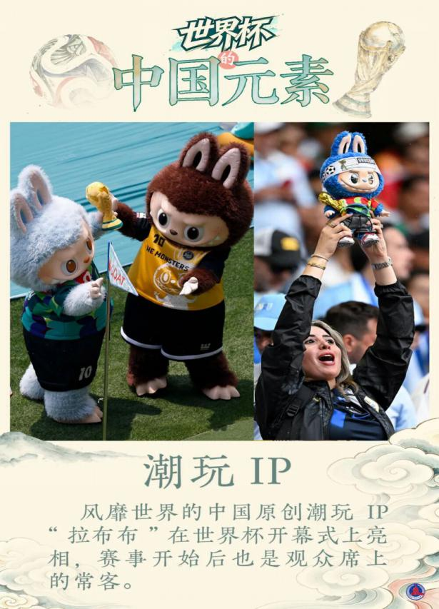
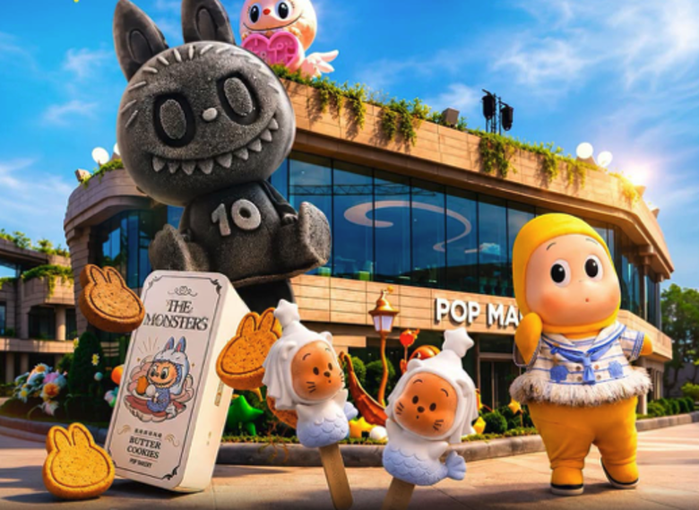
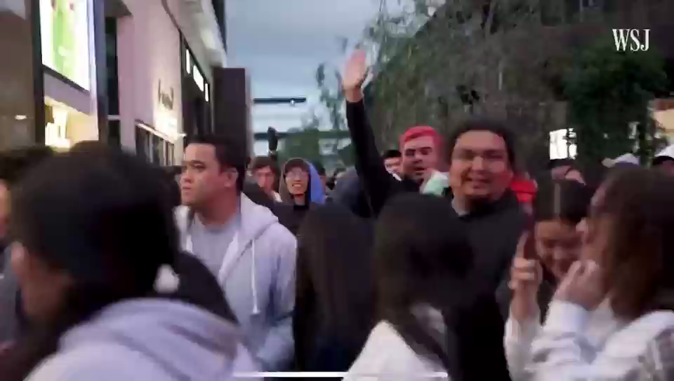
Why can Labubu become popular around the world?
Can culture travel without language?
Vision Expands
Pop Mart brings Labubu to the dessert table in global bakery push
It is not only a toy, but also a symbol of Chinese creativity.
English can help our ideas ，stories and creativity travel further.
Notes:
English helps ideas, stories and creativity travel further.

Slide 13
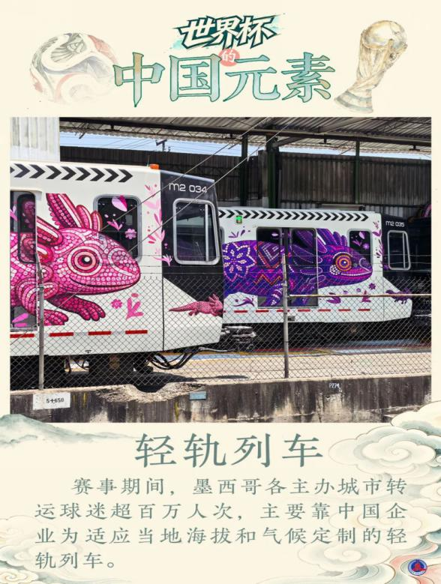
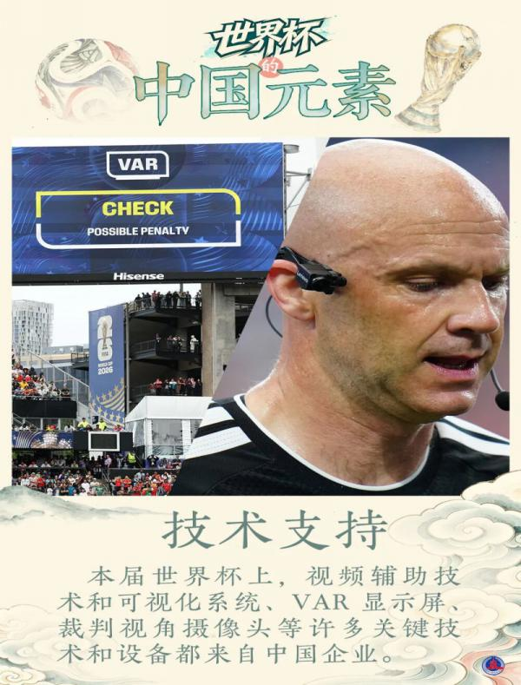
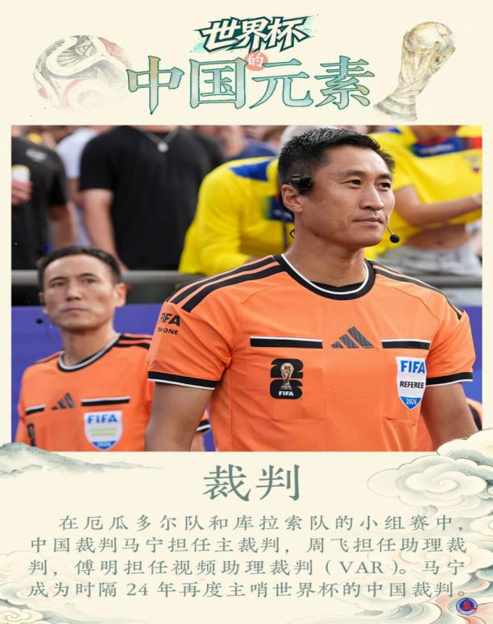
Voice Matters
China on the World Stage
What other Chinese elements can you find?
English helps us see the world.
English helps the world see China.
Chinese trains Chinese technology Chinese referees
Which one surprises you most? Why？
How do you feel?

Slide 14
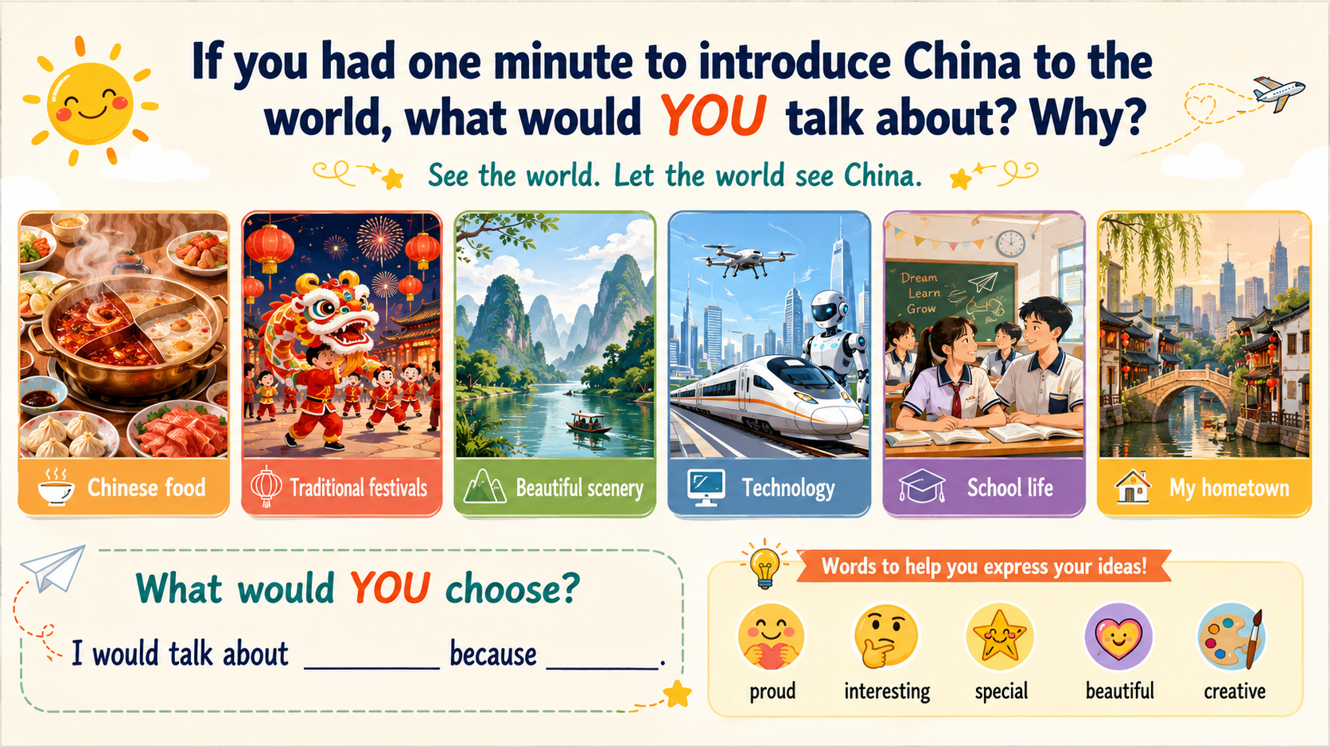
Notes:
Yes. China is being seen by the world.
这时进入最关键的一步——把问题落到学生自己身上：
But imagine this: a foreign teenager sees these Chinese elements and asks you...
屏幕依次出现几个非常简单的问题：
Why are Chinese trains special?
What is Labubu?
What technology does China bring to the World Cup?
Can you tell me more about China?

Slide 15
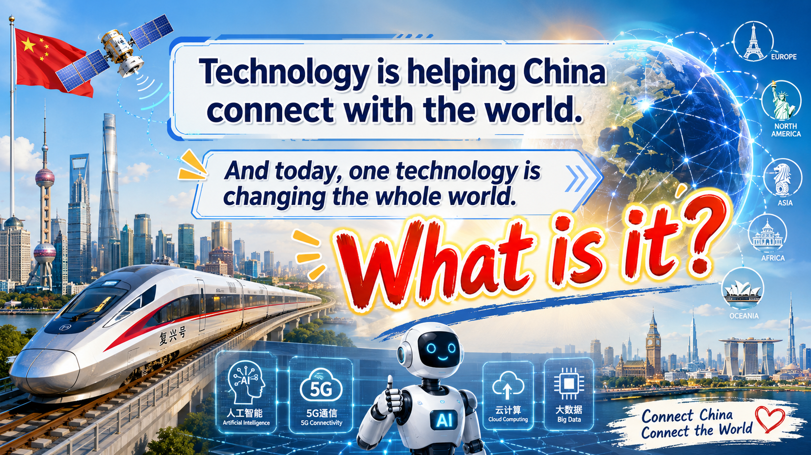

Slide 16
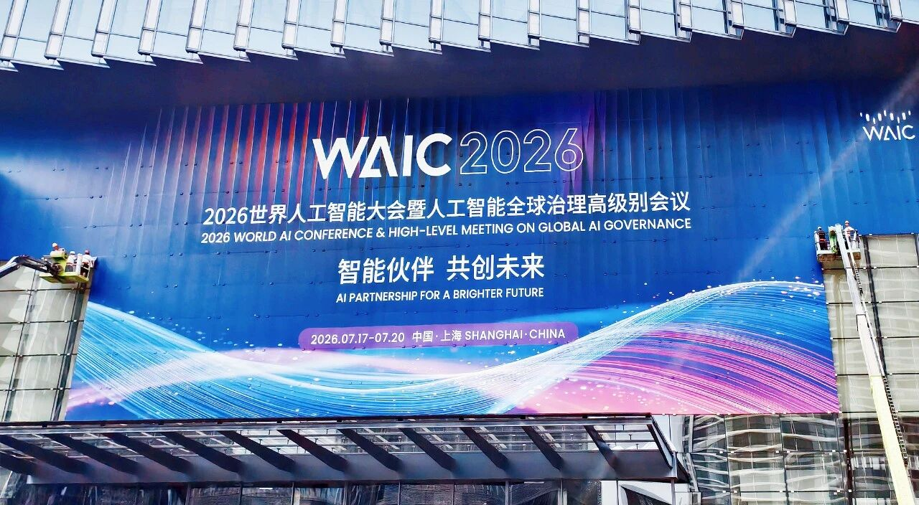
The 2026 World AI Conference kicks off in Shanghai on July 17 and will run through July 20. As one of China’s most high-profile international events dedicated to artificial intelligence, the conference serves as a core platform for global AI exchange, cooperation, collaborative governance, and shared benefits.
What can you see in this picture?
AI is global.
China is working with the world.

Slide 17
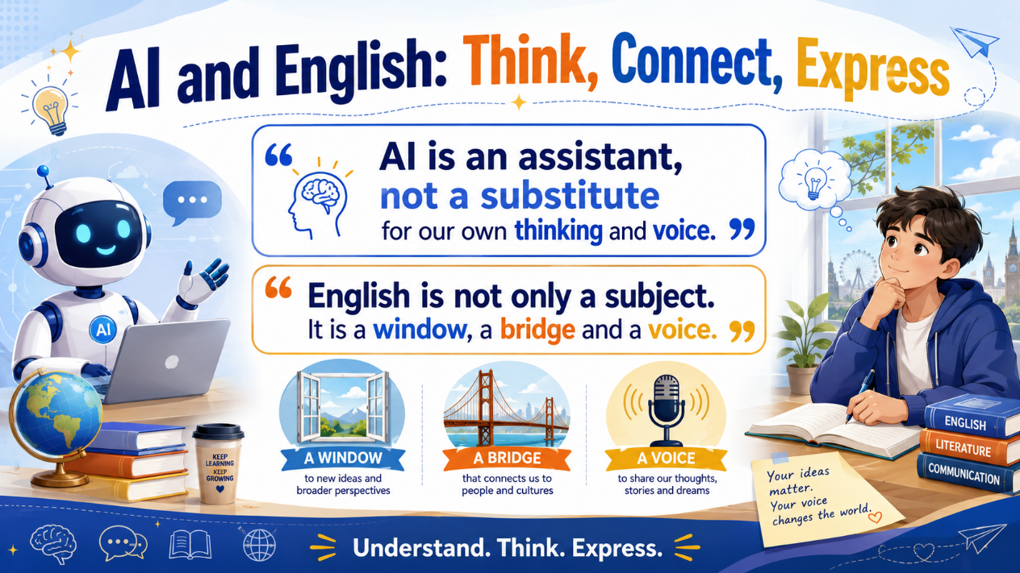
Action Starts
Do you use AI？
What do you use it for?
AI can translate for us.
AI can write for us.
AI can even speak English for us.
So why do WE still need to learn English in the AI era?
AI is an assistant, not a substitute for our own thinking and voice.
English is not only a subject.
It is a window, a bridge and a voice.

Slide 18
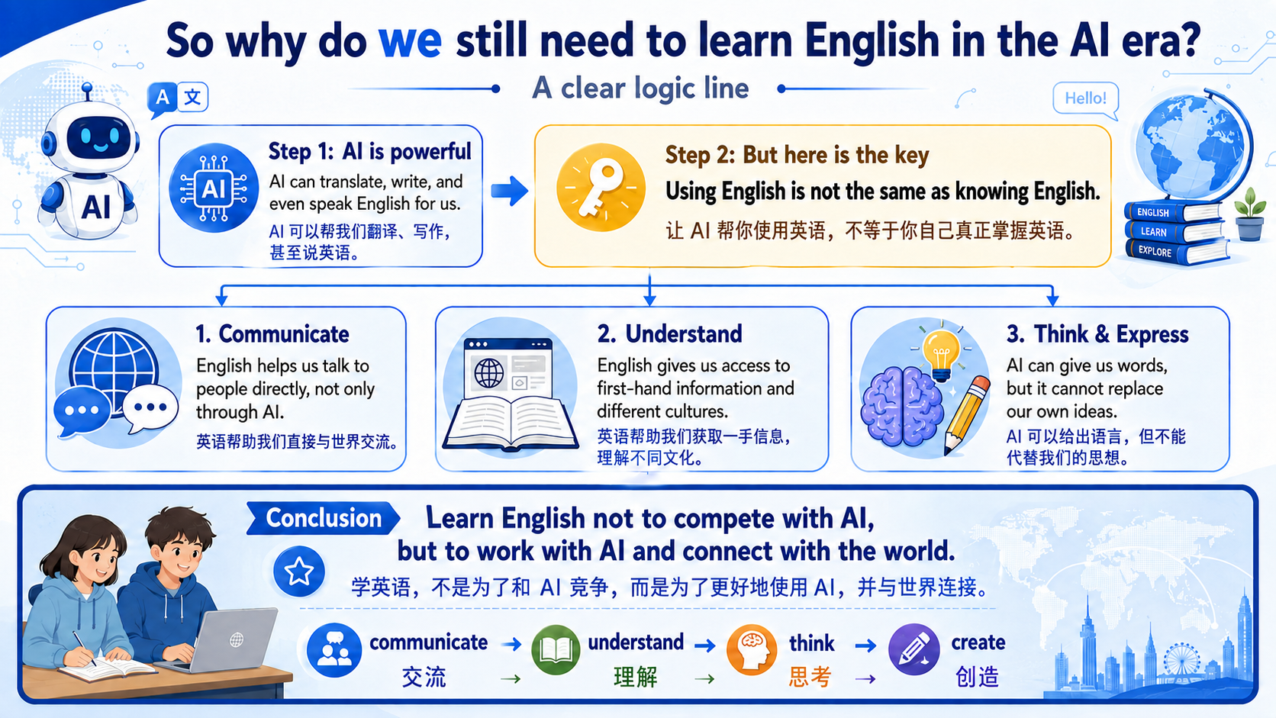
Notes:
English is not only a subject.
It is a window, a bridge and a voice.

Slide 19
Action Starts
 | 听力 | 阅读理解 | 完形填空 | 词汇运用 | 语法填空 | 写作
中考 （120分） | 共15题/20分 | 20题/40分 ①4篇阅读；15题/30分 ②任务型阅读；一道问答题，5题/10分 | 15题/15分 | 15分 | 10题/10分 | 书面表达20分
高考 （150分） | 共20题/30分 | 20题/50分 ① 4篇阅读；15题/37.5分 ②1篇七选五；5题/12.5分 | 15题/15分 |  | 10题/15分 | 写作40分 ①应用文写作/15分 ②读后续写（阅读材料，按要求完成写作）25分
Input → Understand → Think → Express
Listen more, and listen regularly.
Meet English every day.
Don't just memorize words. Use them in context.
Read more & think deeper
What does it say?
Why does the writer say it?
What does the writer really mean?
Use English to share your ideas.

Slide 20
Build your routine
READY
提前三分钟准备好文具（0.5mm/0.7mm的黑色水笔、高考作文纸）、书本、笔记、牛津高阶双解字典和相关资料
积极思维，举手提问，积极参加小组讨论。不怕犯错，贵在积极参与。
认真记笔记，在课本上标记重点内容，随时抽查。
限时作业及时上交，不拖延。
ACTIVE
CONSISTENT
当天内容及时消化（自习课或自抽时间）
作业认真独立完成，阅读理解答案要有标记，标记处在哪里找到的答案。

Slide 21
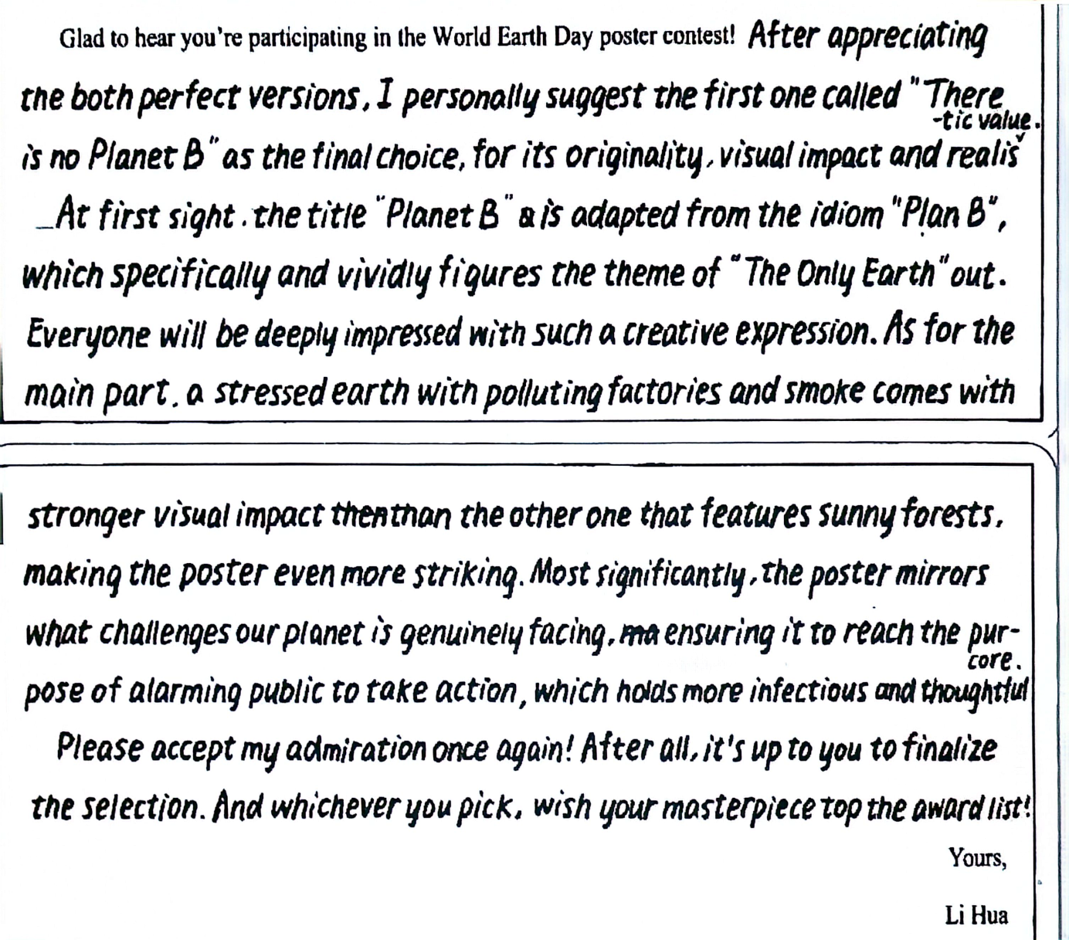
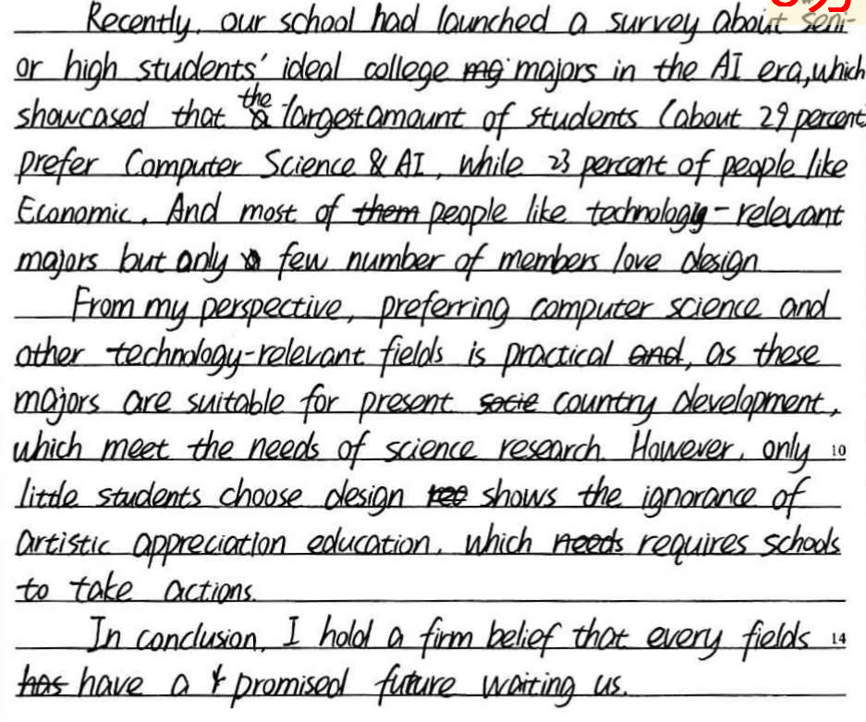
If you were the reader, which one would you prefer to read? Why？
Make Your Ideas Visible
Good handwriting doesn't make a weak idea strong.
But clear handwriting helps your good ideas be seen.
Clear · Neat · Consistent
Clear
字母能够认清。
Neat
页面整洁，不乱涂。
Consistent
大小、间距、倾斜尽量一致。

Slide 22

A Letter to My Future Self
Write to the person you will be three years from now.（80–100 words）
Dear Future Me,
Today marks the beginning of my senior high school journey.What I am truly passionate about is ______ because ______.
Three years from now, I hope to become someone who can ______.I hope English will not only help me ______, but also enable me to ______.One thing I would like the world to know about China / my hometown is ______.
To turn my goal into reality, I will start by ______.I hope that when you read this letter three years later, you will be ______.
Best wishes,
_____________

Slide 23


