Slide 1


感恩遇见，相互成就，本课件资料仅供您个人参考、教学使用，严禁自行在网络传播，违者依知识产权法追究法律责任。
更多教学资源请关注
公众号：溯恩英语
知识产权声明

Slide 2
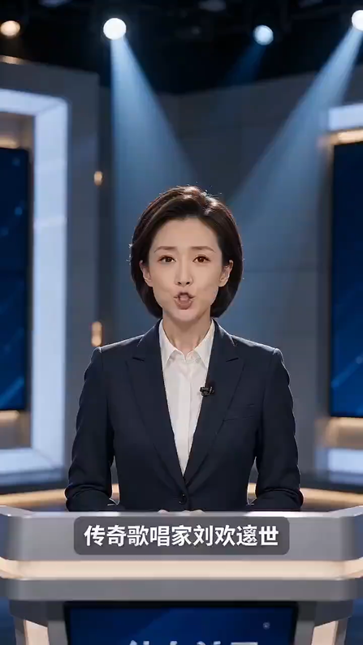
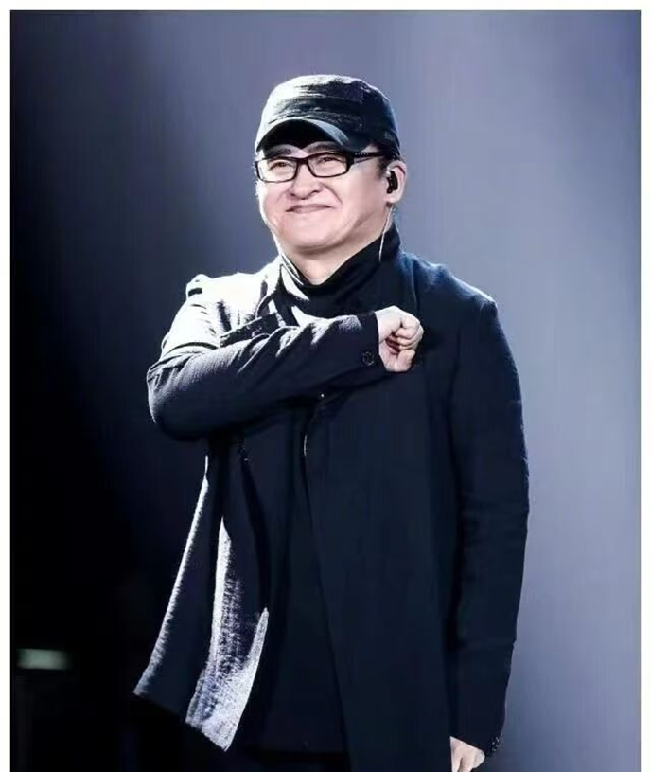
Liu Huan,
a Great Chinese Musician
Farewell to Liu Huan:
A Voice of an Era, and Thirty Years Behind the Lectern

Slide 3
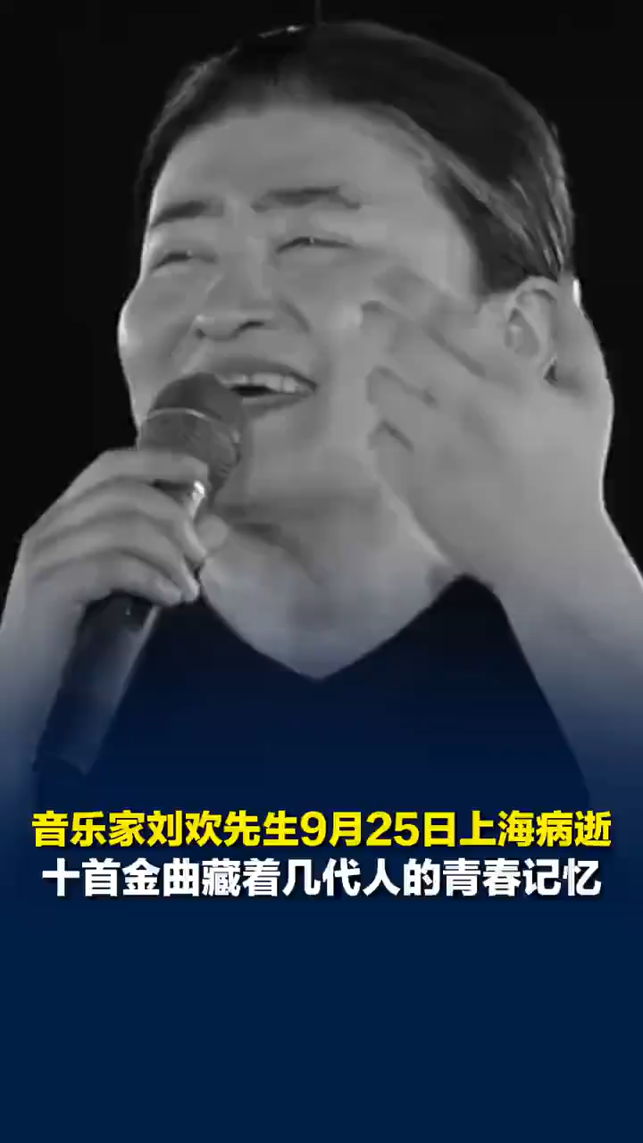
Liu Huan,
a Great Chinese Musician
Fortunately, the songs remain: the great river still flows east, the crescent moon still hangs in that distant night sky, and our hearts remain connected to his, above this land. Rest in peace.
所幸那些歌还留着：大河依旧向东流，弯弯的月亮还挂在遥远的夜空，而我们与他的心，仍在这片土地的上空连着。先生一路走好。

Slide 4
Liu Huan, a Great Chinese Musician
Chinese musician Liu Huan died in Shanghai on September 25, 2026. He was 63 years old. According to the obituaries（讣告）, he passed away at 9:52 a.m., 1. ________​ (surround) by his family members.
Liu Huan 2. ________​ (bear) in Tianjin in August 1963. He studied French literature at the University of International Relations in Beijing. In 1985, he 3. ________​ (stand) out in singing competitions in English and French among university students.
He later became a famous singer, composer and music educator. His songs, such as 《少年壮志不言愁》《弯弯的月亮》 and 《好汉歌》, became 4. ________​ (wide) known in China. In 2008, he and British singer Sarah Brightman sang 《我和你》at the Beijing Olympic Games opening ceremony. This made him 5. ________​ (famous) around the world.
Liu Huan also loved teaching. He 6. ________​ (join) the University of International Business and Economics in 1991 and taught there for more than thirty years. His course on Western music history was very popular 7. ________​ students. He retired in September 2023.
In 2019, he gave 20 million yuan to start a fund to help young Chinese-language musicians. He asked people 8. ________​ (keep) his funeral arrangements simple. So there will be no funeral committee, no farewell ceremony 9. ________​ no memorial service.
Liu Huan’s death is a big loss to China’s music world. His beautiful voice and love for music will always 10. ________​ (remember) by people.
surrounded
was born
stood
widely
more famous
joined
with / among
to keep
and
be remembered

Slide 5
高考英语应用文写作
选择性必修二爱因斯坦
假定你是校英文报记者李华。为致敬杰出人物，你校英文专栏 Great Figures in China 拟刊登人物报道。请你结合所学人物传记写法，介绍我国著名音乐家刘欢，内容包括：
基本生平与职业经历；
音乐成就与社会贡献；
大众评价与精神影响

Slide 6
Great Chinese Musician — Liu Huan
Liu Huan, a distinguished Chinese musician and educator, passed away recently, leaving deep sorrow among the public. He is widely regarded as one of the most influential artists in the history of Chinese modern music.
Born in Tianjin in 1963, Liu Huan showed great talent in music from an early age. After finishing his studies, he began to work as a music teacher at a famous university. For more than 30 years, he devoted himself to education and cultivated many young talents for the music industry.
Apart from teaching, he achieved huge success in music creation and performance. He wrote and sang a large number of classic songs, which have accompanied generations of Chinese people. His works are simple, powerful and full of positive energy. Besides, he always actively took part in public welfare activities to help people in need.
Liu Huan has made extraordinary contributions to Chinese music and education. Though he has left us, his sincere love for art and spirit of devotion will always inspire us. He will forever live in people’s hearts.
总起人物身份 + 核心事件
出生背景 + 职业经历（人生履历）
事业成就 + 额外善行（核心功绩）
历史评价 + 精神传承（升华结尾）

