Slide 1


感恩遇见，相互成就，本课件资料仅供您个人参考、教学使用，严禁自行在网络传播，违者依知识产权法追究法律责任。
更多教学资源请关注
公众号：溯恩英语
知识产权声明

Slide 2
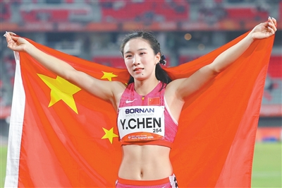

ENGLISH READING · CURRENT AFFAIRS
少年中国
名古屋亚运会上的青春力量
外刊阅读课 · 高一 ｜ 两篇时事语篇 + 看视频 + 语法填空 + 词汇聚焦
素材来源：China Daily / Xinhua / People's Daily (2026-09-19~09-26，第20届亚运会 爱知·名古屋）

Slide 3
本课学习目标
学习目标 · Learning Objectives
① 语言知识 掌握核心词汇（音标/词性/中文）；在语境中运用过去时、过去完成时、被动语态与非谓语动词。
② 阅读技能 借助语法填空以填促读，把握新闻叙事逻辑；用「抓主干、析修饰」拆解长难句；提升 200 词外刊速读。
③ 思维品质 对比「天赋」与「毅力」，分析少年冠军背后的「困境—解决」路径，形成有依据的观点。
④ 情感态度 从同龄人拼搏中汲取力量，理解「青春与中国」，中国青年在亚运会的突破，激发民族自豪感与体育精神，增强文化自信与奋斗意识。

Slide 4
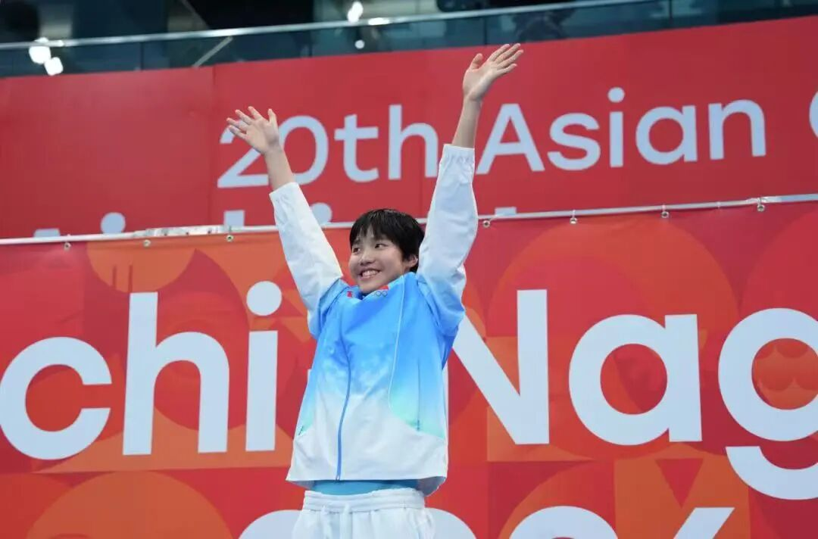

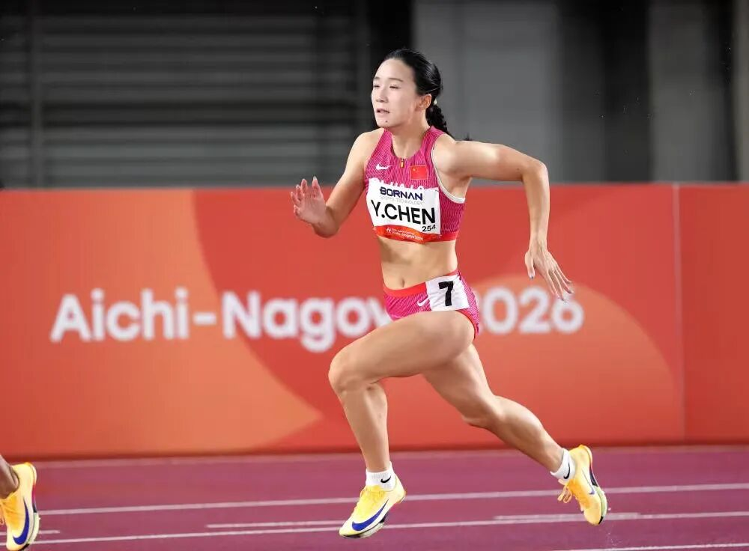
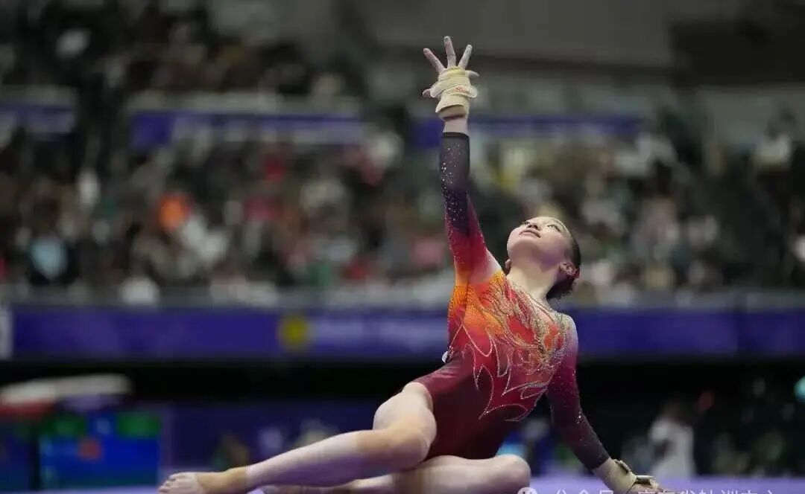
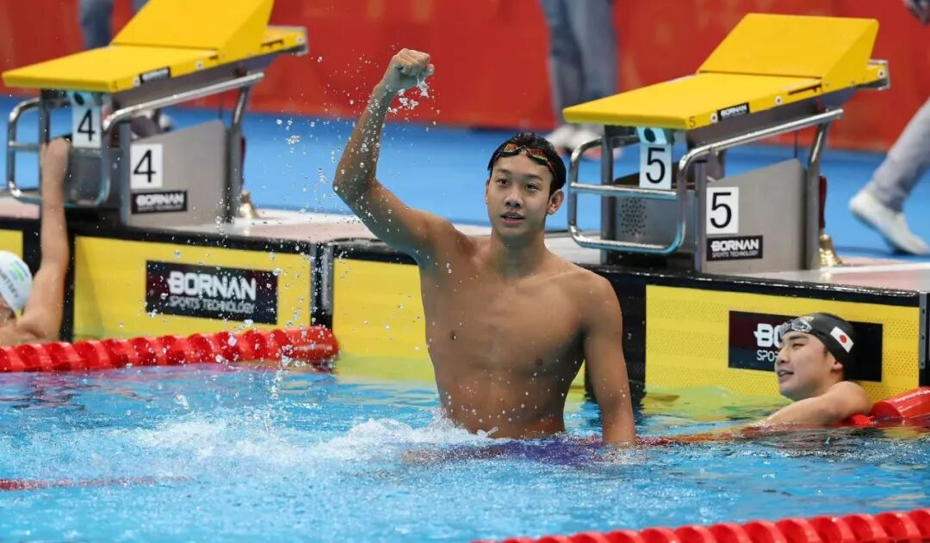
1 lead-in
Ages 12, 13, 16, 19…
What does it feel like to take part in the Asian Games for the first time?
At this Asian Games, a group of post-2005 young athletes make their Asian Games debut.
Their performances are truly impressive.
/ˈdeɪbjuː/n. 首次亮相
13岁于子迪 亚洲纪录到手
17岁陈妤颉 亚洲百米“新王”
16岁柯沁沁 经历夺金成长课
19岁张展硕 亚运“七金王”

Slide 5
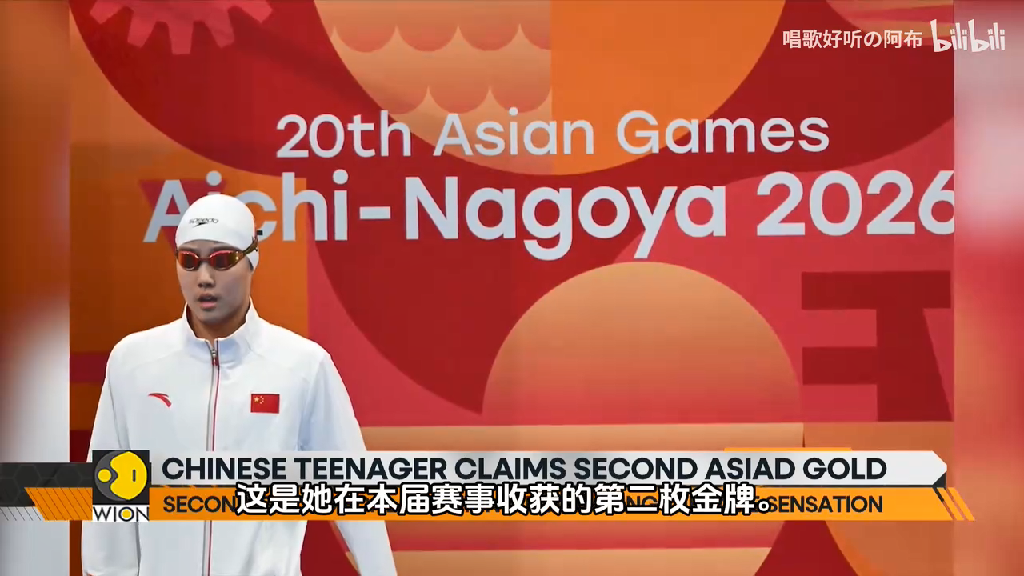
1
Reading 1 · A Teenage Star in the Pool

Slide 6
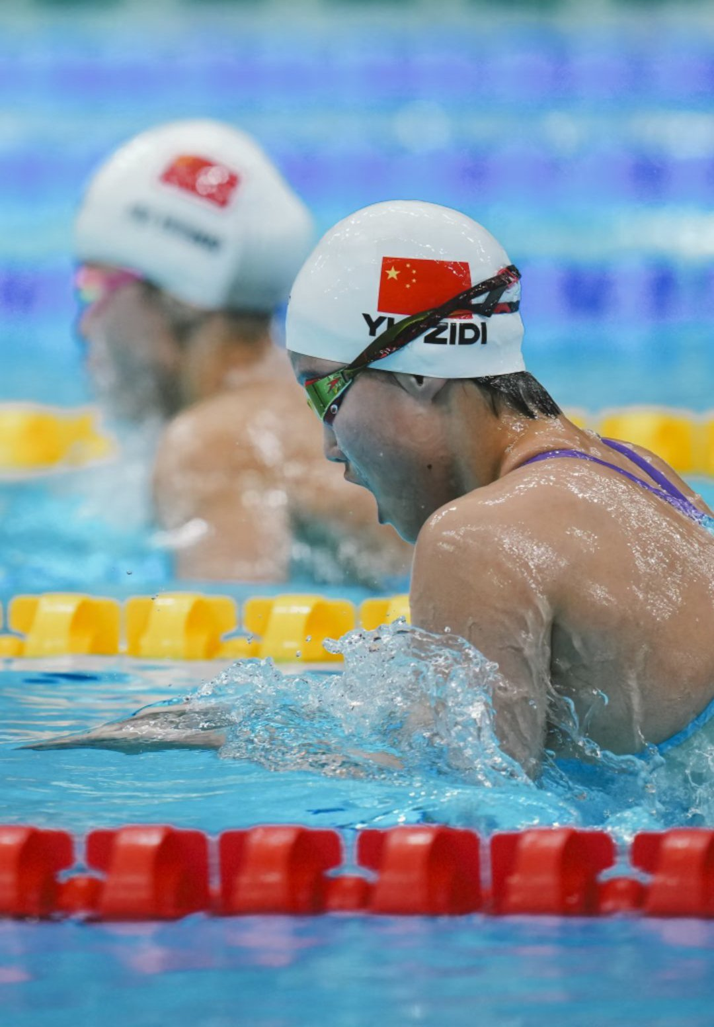
straight /streɪt/
adj.连续的、不间断的
title /ˈtaɪtl/
n.赛事冠军头衔
1
Reading 1 · A Teenage Star in the Pool
On September 20, 2026, at the Tokyo Aquatics[ə'kwætɪks]水上运动 Centre, something amazing (1)______(happen). A 13-year-old Chinese girl (2)______(step) onto the starting block出发台. Her name is Yu Zidi. When the race ended, the crowd cheered wildly — Yu (3)______(win) the women's 200m butterfly in 2:05.08, breaking the Asian Games record. She (4)______(become) the youngest swimming champion in Asian Games history, and won China's first swimming gold of the Games. It was also the team's (5)______(five) straight title连胜 in this event.
The next day, Yu (6)______(return) for the 200m individual medley混合泳. She (7)______(fall) behind at first, then (8)______(power) past her rivals in the final laps. She touched the wall first in 2:06.10 — another Asian record! Her time (9)______(be) just 0.40 seconds off the world record.
"I feel even happier winning this second gold than the first," Yu said with a smile.
These two golds are more than medals. They show the world the (10)________(rise) power of China's young generation. From a small pool in Baoding to the Asian Games stage, Yu's story is only just beginning.
1. happened
2. stepped
3. won
4. became
5. fifth
6. returned
7. fell
8. powered
9. was
power vi.驱动，推动；猛力前进
10. rising

Slide 7

2
Reading 2 · The Girl Behind the Medals
Behind the two gold medals is a teenager who still goes to school. Yu Zidi (1)______(bear) in 2012 in Baoding, Hebei Province. She started swimming at the age of six. By nine, she (2)______(join) the provincial team; by eleven, she was already a national champion. Last year, at only twelve, she stood on the World Championships podium.
Like many teenagers, Yu lives two lives at once. (3)______(train) hard in the pool for hours each day, she must also keep up with her schoolwork. Her school made a special plan so that she (4)______(not fall) behind. "I want to be a good student as well as a good swimmer," she says.
After her big wins, Yu stayed calm and humble. She did not show off. "I still have room to improve," she told reporters. "I believe I can swim even faster next time."
Yu's story inspires millions of young people in China. She proves that with talent, hard work and a peaceful heart, a dream can come true at any age. The future is wide open — and she is only just getting started.
1. was born
2. had joined
3. training
4. would not fall

Slide 8
🔤
词汇聚焦 · Reading 1+2 核心词
单词 | 音标 | 词性 | 中文释义
step |  | v./n. | 走上；步伐
race |  | v./n. | 跑步；比赛
butterfly | /ˈbʌtəflaɪ/ | n. | 蝶泳；蝴蝶
champion | /ˈtʃæmpiən/ | n. | 冠军（= winner 同义）
straight | /streɪt/ | adj./adv. | 连续的（地）；笔直的
balance | /ˈbæləns/ | v./n. | 平衡；兼顾（一词多义）
humble | /ˈhʌmbl/ | adj. | 谦逊的（反义 proud）
prove | /pruːv/ | v. | 证明；证实
talent | /ˈtælənt/ | n. | 天赋；才能
ordinary | /ˈɔːdnri/ | adj. | 普通的；平常的

Slide 9
🤔
深度思考 · Think Deeper
R1 · 硬实力
13 岁打破亚运纪录、登顶领奖台——她用成绩惊艳世界。
R2 · 软实力
仍坐课堂、谦逊平和、说「我还能更快」——金牌之外，更动人的是人格。
真正的冠军，是金牌，还是金牌背后那个不断变好的人？
于子迪说："I believe I can swim even faster next time." 这种态度，对我们意味着什么？

Slide 10
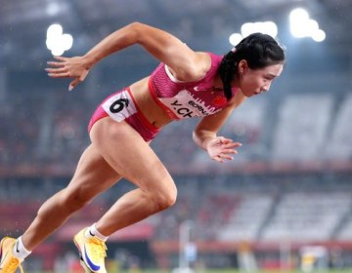
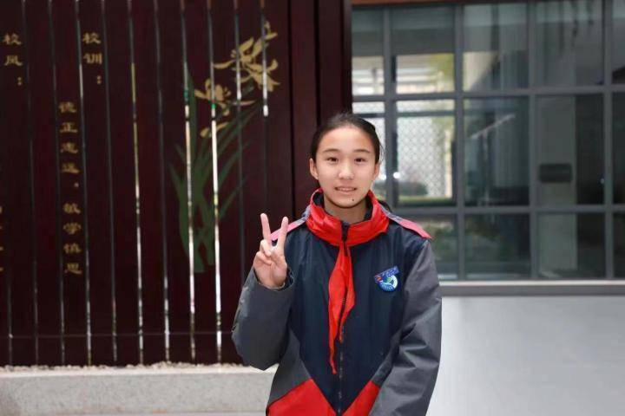
3
Reading3 · 百米飞人陈妤颉
On the night of September 25, 2026, the athletics stadium in Aichi-Nagoya lit up. In the women's 100-meter final of the 20th Asian Games, 17-year-old Chinese sprinter Chen Yujie ①______(break) out of the blocks and crossed the line in 11.06 seconds. With that single run, she set the Asian Games record, making her the youngest-ever champion in the event.
Yet the road to gold was far ②____ easy. The defending champion卫冕冠军（葛曼棋） ③_________(withdraw) from the final with a thigh ④______(injure), leaving Chen as the only Chinese runner. The weight of a nation's hope ⑤_______(rest) on her young shoulders. Before the gun, she was so nervous that her legs ⑥______(tremble). "I was afraid of making a mistake," she admitted.
Instead of ⑦_________(panic), Chen chose to focus on herself. "I just want to be myself," she said. When the pistol手枪 fired, she ⑧_____________(transform) her fear into speed.
Still a student, she trains by day and studies by night — proving teenage dreams, backed by grit /ɡrɪt/ 毅力, can outrun the world.
broke
from
withdrew
injury
rested
trembled
panicking
transformed
一词多义
back v.支持
词块
=explode out of the blocks
起跑爆发

Slide 11
3
词汇聚焦
单词 | 音标 | 词性 | 中文释义
light up | 1. 点亮、照亮；2. （脸上）流露出喜悦、兴奋等情绪；
sprint | /sprɪnt/ | v./n. | vi.冲刺； n.全速短跑
explode | /ɪkˈspləʊd/ | v. | （枪响后）冲出，爆发
defending champion | /dɪˈfendɪŋ/ | n. | 卫冕冠军
withdraw from | /wɪðˈdrɔː/ | v. | 退出，撤出（比赛）
tremble | /ˈtrembl/ | v. | 颤抖，发抖
panic | /ˈpænɪk/ | v./n. | 惊慌，恐慌
fire |  |  | v.开火，射击
transform | /trænsˈfɔːm/ | v. | 使转变，转化
outrun | /ˌaʊtˈrʌn/ | v. | 跑赢，超越
back |  | v. | 支持
grit | /ɡrɪt/ | n. | 毅力，坚韧

Slide 12
？
深度思考 · Think Deeper
是什么，让少年成为冠军？
陈妤颉说："I just want to be myself." 但镜头拉远，我们看到的不只是她一个人——
是一支平均年龄 24 岁、548 人首次出战的「少年军团」。天赋，真的是唯一的答案吗？
👉 带着这个问题，进入Reading4：中国亚运的「少年浪潮」。

Slide 13
4
Reading4 · 少年浪潮
Behind Chen's gold lies a bigger story: the rise of China's "teenage wave" at the Nagoya Asian Games. Of 815 athletes, 27% ①__________(bear) in 2005 or later, 548 ②________(make) their debut. Youth is the engine of the team. At the last Hangzhou Asian Games, China topped the medal table with 201 golds; this young generation now carries that pride into a new era.
Take 13-year-old Yu Zidi: she won the 200m butterfly in 2:05.08, breaking the record and ③__________(become) the youngest swimming champion. Zhang Zhanshuo, 19, ④_________(collect) seven golds; shooter Sheng Lihao, 19, set two world records. These teenagers are not produced by talent alone. Behind every bright smile on the podium is a story of early mornings and quiet sacrifice.
What turns a teenager into a champion? Not just gift, but grit — the same quality ⑤_______(need) in our studies. When young people dream big yet stay humble, train hard yet keep balance, they show the world a new face of China.
Greatness ⑥_______(begin) with a single brave step. From the pool to the track, ⑦_______the shooting range to the gym, ⑧_______wave of youth is rewriting what is possible.
were born
making
becoming
collected
needed
begins
from
a
单元·外刊阅读课 ｜ 第 7 / 12 页

Slide 14
4
词汇聚焦
词汇聚焦 R2 · Vocabulary Focus
单词 | 音标 | 词性 | 中文释义
rise | /raɪz/ | n. | 崛起，兴起
debut | /ˈdeɪbjuː/ | n. | 首次亮相，首秀
engine | /ˈendʒɪn/ | n. | 引擎；动力，核心
champion | /ˈtʃæmpiən/ | n. | 冠军；捍卫者
collect | /kəˈlekt/ | v. | 收获（奖牌），收集
produce | /prəˈdjuːs/ | v. | 造就，生产
humble | /ˈhʌmbl/ | adj. | 谦逊的
balance | /ˈbæləns/ | n. | 平衡
greatness | /ˈɡreɪtnəs/ | n. | 伟大
grit | /ɡrɪt/ | n. | 毅力，坚韧
单元·外刊阅读课 ｜ 第 8 / 12 页

Slide 15
5
两篇金句重现 · Golden Lines
"Behind every medal are years of early mornings, repeated failures, and the courage to face pressure."
每一枚奖牌背后，是无数清晨的苦练、一次次失败的累积，以及直面压力的勇气。荣耀来自「困境中的坚持」。
Still with childlike innocence, they have shown extraordinary talent. Some soar into the air, pushing limits at the skate park; some cut through waves, setting new records in the swimming pool. Some fight with all they have. Even with regrets, their eyes still shine with passion.
A gold medal is not the only answer. This first Asian Games appearance marks the meeting of youth and major competitions, the collision of sweat and dreams.
When youth steps onto the arena, the future holds great promise. They prove with hard work: youth itself is power.
Young yet fearless of strong rivals in the bloom of youth.

Slide 16
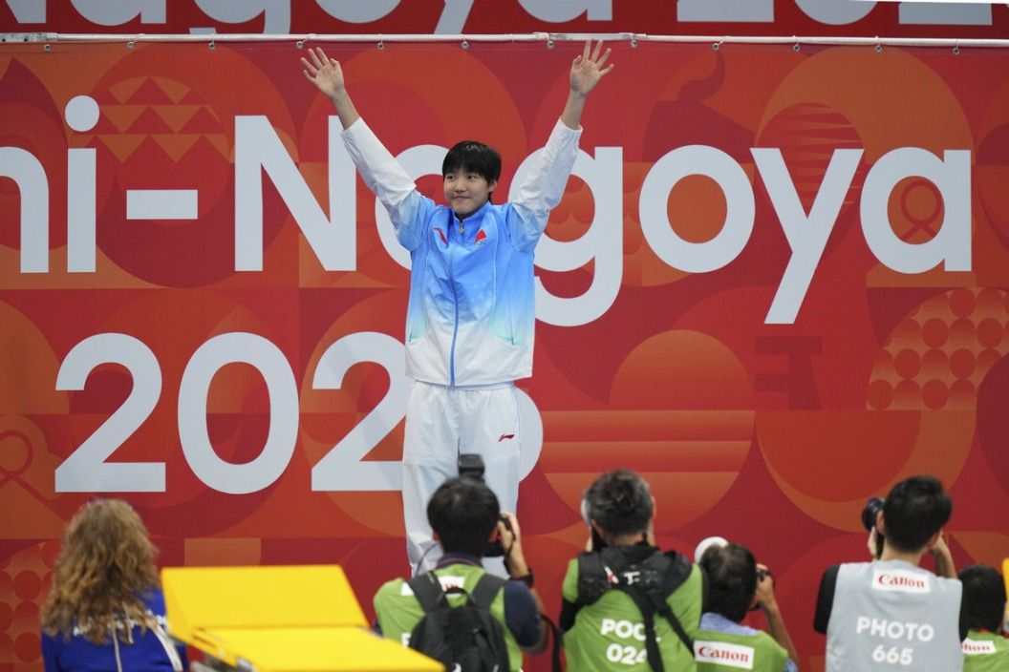
5
总结 · Takeaway
"Greatness begins with a single brave step."
伟大，始于一次勇敢的起步。 —— 少年中国，未来可期。
17 岁的陈妤颉、13 岁的于子迪、19 岁的张展硕与盛李豪……他们用成绩告诉世界：青春不只有天赋，更有毅力、谦逊与平衡。愿你在自己的赛道上，也跑出「无极限」。

Slide 17
语法聚焦（三大考点）
6
语法聚焦 · Grammar Focus
① 叙事时态一致（一般过去时）
新闻事件用过去时：broke / withdrew / trembled / won / collected。人物原话用现在时。
② 过去完成时 had stood
表示「过去的过去」：纪录在被打破之前已保持 24 年 → ...the record that had stood for 24 years.
③ 非谓语动词
介词后接动名词 instead of panicking；现在分词作结果状语 breaking...becoming...；过去分词作定语/被动 the quality needed / are not produced。
单元·外刊阅读课 ｜ 第 10 / 12 页

